Slide 1
AZ-103T00A Microsoft Azure Administrator

Slide 2

Welcome
Thank you for joining us today.
We’ve worked together with the Microsoft Partner Network and Microsoft IT Academies to bring you a world-class learning experience.
Microsoft Certified Trainers + Instructors. Your instructor is a premier technical and instructional expert who meets ongoing certification requirements.
Customer Satisfaction Guarantee. Our partners offer a satisfaction guarantee and we hold them accountable for it. At the end of class, please complete an evaluation of today’s experience. We value your feedback!
Certification Exam Benefits. After training, consider pursuing a Microsoft Certification to help distinguish your technical expertise and experience. Ask your instructor about available exam promotions and discounts.
We wish you a great learning experience and ongoing career success!

Slide 3


Facilities
Class hours
Building hours
Parking
Restrooms
Meals
Phones
Messages
Smoking
Internet access
Recycling
Emergency procedures

Slide 4
Cloud Administrator Role
Cloud Administrators manage the cloud services that span storage, networking and compute cloud capabilities, with a deep understanding of each service across the full IT lifecycle.
They take end-user requests for new cloud applications and make recommendations on services to use for optimal performance and scale, as well as provision, capacity, monitor and adjust as appropriate. This role requires communicating and coordinating with vendors.
Cloud Administrators use the Azure Portal and as they become more proficient, they use PowerShell and the Command Line Interface.
Successful Cloud Administrators start this role with experience on operating systems, virtualization, cloud infrastructure, storage structures, and networking.

Slide 5
About this Course: Prerequisites
Successful Azure Administrators start this role with experience on operating systems, virtualization, cloud infrastructure, storage structures, and networking
Understanding of on-premises virtualization technologies, including: VMs, virtual networking, and virtual hard disks
Understanding of network configuration, including TCP/IP, Domain Name System (DNS), virtual private networks (VPNs), firewalls, and encryption technologies
Understanding of Active Directory concepts, including domains, forests, domain controllers, replication, Kerberos protocol, and Lightweight Directory Access Protocol (LDAP)
Understanding of resilience and disaster recovery, including backup and restore operations

Slide 6
About this Course: Course Outline
M01: Azure Administration
M02: Azure Virtual Machines
M03: Azure Storage
M04: Virtual Networking
M05: Intersite Connectivity
M06: Monitoring
M07: Data Protection
M08: Network Traffic Management
M09: Azure Active Directory
M10: Securing Identities
M11: Governance and Compliance
M12: Data Services

Slide 7
Certification Areas (AZ-103)
Study Areas | Weights
Manage Azure subscriptions and resources | 15-20%
Implement and manage storage | 15-20%
Deploy and manage virtual machines | 15-20%
Configure and manage virtual networks | 30-35%
Manage identities | 15-20%
Percentages indicate the relative weight of each area on the exam
The higher the percentage, the more questions you are likely to see in that area
Notes:
AZ-103 Certification Areas - https://www.microsoft.com/en-us/learning/exam-AZ-103.aspx

Slide 8
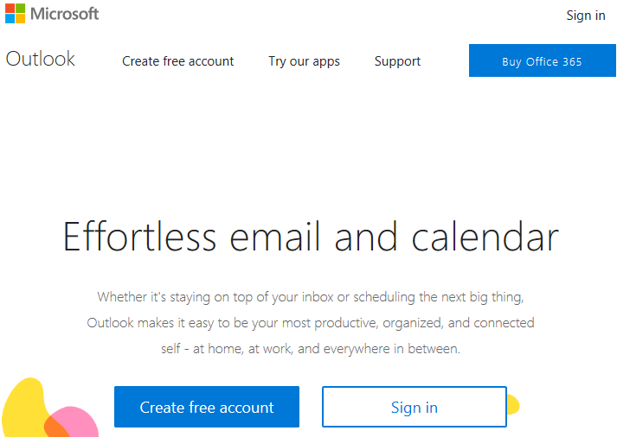
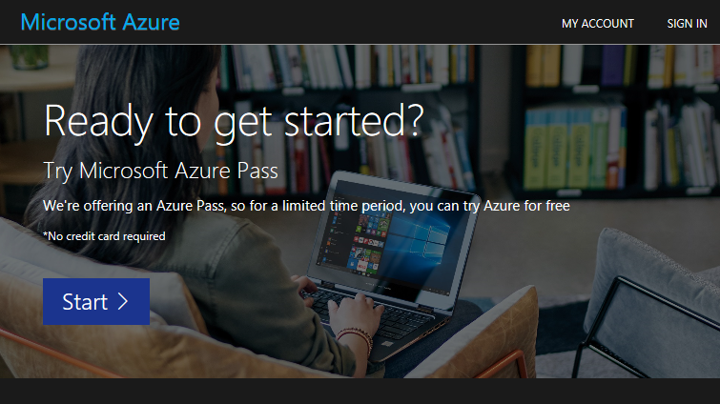
Create your account
https://www.live.com
https://www.microsoftazurepass.com

Slide 9

Hello! Student Introductions
Let’s get acquainted:
Your name
Company affiliation
Title/function
Cloud/Microsoft Azure experience
Your expectations for the course

