Slide 1
AZ-101 Microsoft Azure Integration and Security

Slide 2


Facilities
Class hours
Building hours
Parking
Restrooms
Meals
Phones
Messages
Smoking
Internet access
Emergency procedures

Slide 3
Course Agenda (1/2)
Part 1: Migrate servers to Azure
M01: Azure Migrate
M02: Azure Site Recovery
M03: Disaster Recovery
M04: Migrating Data
Part 2: Application Services
M01: Introducing the Azure App Service Platform
M02: Managing and Securing Web Apps
M03: Scaling and Performance
M04: Deploying Serverless Computing Solutions

Slide 4
Course Agenda (2/2)
Part 3: Advanced Virtual Networking
M01: Distributing Network Traffic
M02: Site Connectivity
M03: Monitoring and Troubleshooting Network Connections
Part 4: Secure Identities
M01: Introduction to Identity Protection in Azure
M02: Using Multi-Factor Authentication (MFA) for Secure Access
M03: Azure AD Privileged Identity Management

Slide 5
Cloud Administrator Role
Cloud Administrators manage the cloud services that span storage, networking and compute cloud capabilities, with a deep understanding of each service across the full IT lifecycle.
They take end-user requests for new cloud applications and make recommendations on services to use for optimal performance and scale, as well as provision, capacity, monitor and adjust as appropriate. This role requires communicating and coordinating with vendors.
Cloud Administrators use the Azure Portal and as they become more proficient, they use PowerShell and the Command Line Interface.
Successful Cloud Administrators start this role with experience on operating systems, virtualization, cloud infrastructure, storage structures, and networking.

Slide 6
Certification Areas (AZ-101)
Study Areas | Percentage
Evaluate and perform server migration to Azure | 15-20%
Implement and manage application services | 20-25%
Implement advanced virtual networking | 30-35%
Secure identities | 20-25%
Percentages indicate the relative weight of each area on the exam
The higher the percentage, the more questions you are likely to see in that area
Notes:
AZ-101 Certification Areas - https://www.microsoft.com/en-us/learning/exam-az-101.aspx

Slide 7

Let’s get acquainted !
Name
Company affiliation
Business role
Cloud / Microsoft Azure experience
Expectations for the course

Slide 8
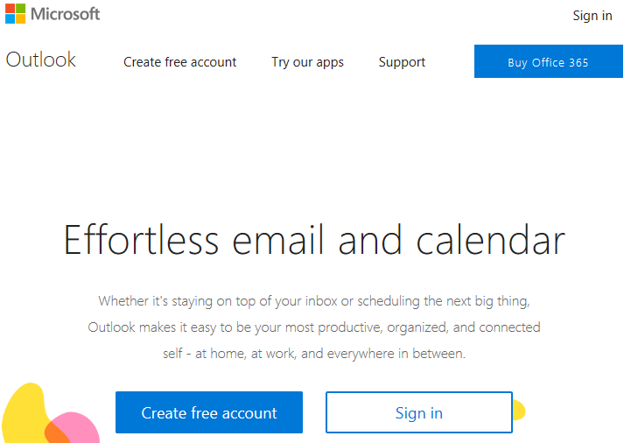
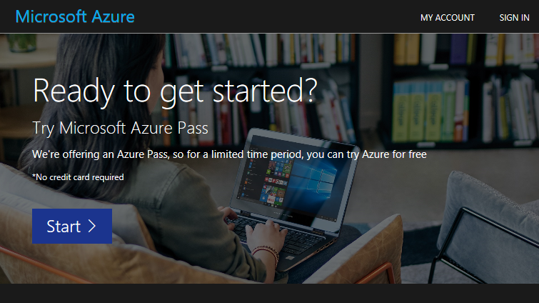
Create your account
https://www.live.com
https://www.microsoftazurepass.com

