Slide 1
AZ-100 Microsoft Azure Infrastructure and Deployment

Slide 2


Facilities
Class hours
Building hours
Parking
Restrooms
Meals
Phones
Messages
Smoking
Internet access
Emergency procedures

Slide 3
Course Agenda (1/3)
Part 1 – Subscriptions and Resources
M01: Managing Azure Subscriptions
M02: Access Management for Cloud Resources
M03: Monitoring and Diagnostics
M04: Log Analytics
M05: Azure Resource Manager
M06: Azure Tips, Tricks, and Tools
Part 2 – Storage
M01: Overview of Azure Storage
M02: Storage Services
M03: Securing and Managing Storage
M04: Storing and Accessing Data
M05: Monitoring Storage

Slide 4
Course Agenda (2/3)
Part 3 – Virtual Machines
M01: Introduction to Virtual Machines
M02: Creating Virtual Machines
M03: Deploying Virtual Machine Images
M04: Configuring Virtual Machines
M05: Configuring Availability and Extensibility
M06: Managing and Monitoring Virtual Machines
Part 4 – Virtual Networks
M01: Azure Virtual Networks
M02: Azure DNS
M03: Securing Virtual Network Resources
M04: Connecting Virtual Networks

Slide 5
Course Agenda (3/3)
Part 5 – Identities
M01: Managing Azure Active Directory
M02: Managing Azure Active Directory Objects
M03: Implementing and Managing Hybrid Identities

Slide 6
Cloud Administrator Role
Cloud Administrators manage the cloud services that span storage, networking and compute cloud capabilities, with a deep understanding of each service across the full IT lifecycle.
They take end-user requests for new cloud applications and make recommendations on services to use for optimal performance and scale, as well as provision, capacity, monitor and adjust as appropriate. This role requires communicating and coordinating with vendors.
Cloud Administrators use the Azure Portal and as they become more proficient they use PowerShell and the Command Line Interface.
Successful Cloud Administrators start this role with experience on operating systems, virtualization, cloud infrastructure, storage structures, and networking.

Slide 7
Certification Areas (AZ-100)
Study Areas | Weights
Manage Azure subscriptions and resources | 15-20%
Implement and manage storage | 20-25%
Deploy and manage virtual machines | 20-25%
Configure and manage virtual networks | 20-25%
Manage identities | 15-20%
Percentages indicate the relative weight of each area on the exam
The higher the percentage, the more questions you are likely to see in that area
Notes:
AZ-100 Certification Areas - https://www.microsoft.com/en-us/learning/exam-az-100.aspx

Slide 8

Let’s get acquainted !
Name
Company affiliation
Business role
Cloud / Microsoft Azure experience
Expectations for the course

Slide 9
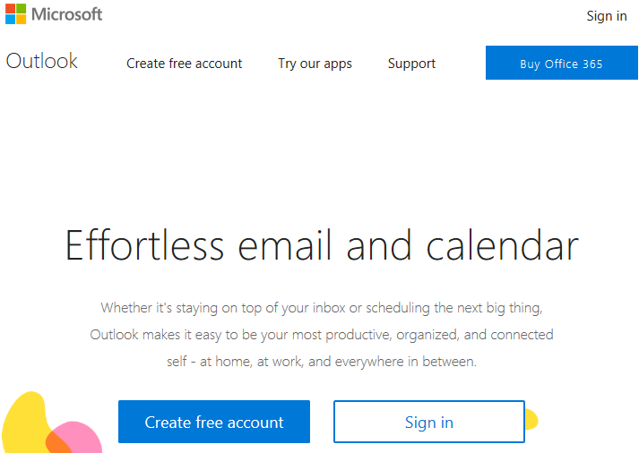
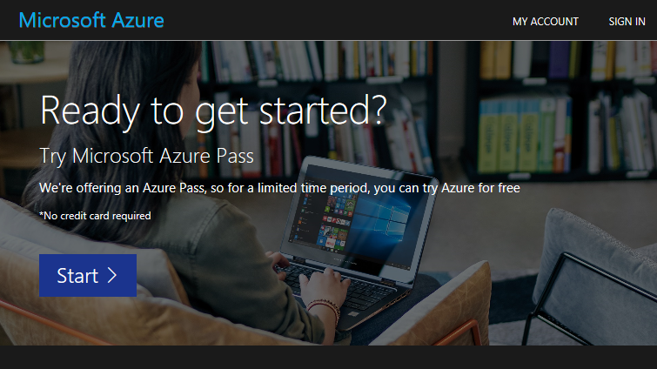
Create your account
https://www.live.com
https://www.microsoftazurepass.com

