Slide 1
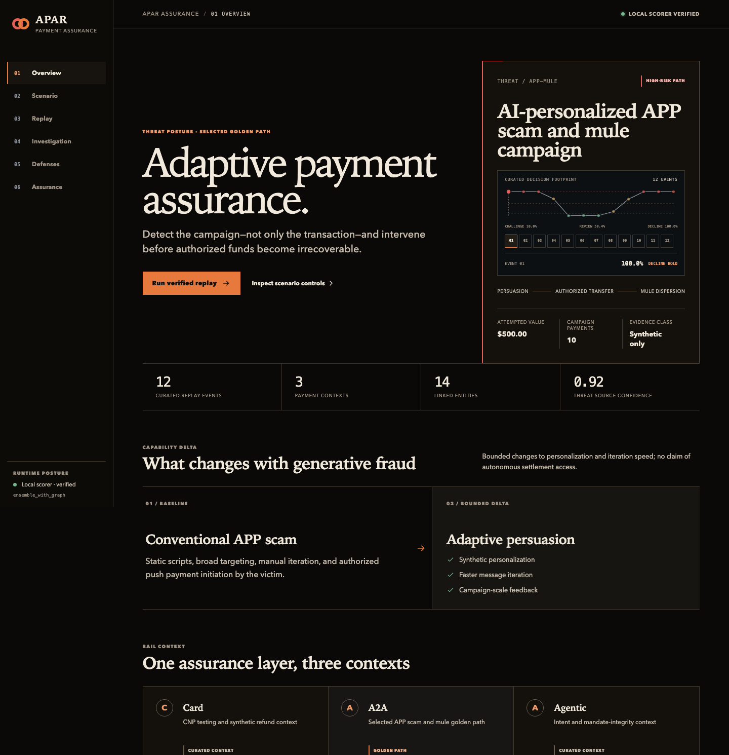
MASTERCARD INNOVATION CHALLENGE 2026
Assure the campaign,
not just the transaction.
APAR turns emerging GenAI payment threats into rail-correct synthetic campaigns, tests layered defenses, and preserves a human promotion boundary.
SYNTHETIC • OFFLINE • REPLAYABLE
Team: LedgerPe Labs • Competition submission
Notes:
Open with the problem shift: AI changes attacker capability, so the unit of assurance becomes the campaign.
[Sources]
- docs/demo/screenshots/apar-console-overview-desktop.png
- SOLUTION_SPEC.md
[/Sources]

Slide 2
ADAPTIVE PAYMENT ASSURANCE RANGE
02
GenAI changes the operating model of fraud
01
02
03
04
PERSONALIZE
ITERATE
COORDINATE
DELEGATE
→
→
→
Victim-specific
content at scale
Faster adaptation
to feedback
Many entities, rails,
and time windows
Agents can act
on user intent
Transaction classifier
→
Campaign-aware assurance system
Behavior + lifecycle + economics + authority + governance
Notes:
Most entries stop at a fraud classifier. APAR models the operating capability GenAI adds and tests the downstream control system.
[Sources]
- SOLUTION_SPEC.md
- https://www.bis.org/speeches/20260608-strengthening-security-european-payments
[/Sources]

Slide 3
ADAPTIVE PAYMENT ASSURANCE RANGE
03
One assurance loop connects five control planes
IDENTIFY
GENERATE
DEFEND
VERIFY
GOVERN
Evidence + sources
threat registry
→
Rail + ledger-correct
campaigns
→
Rules + calibrated
graph ensemble
→
Identity + intent
integrity
→
Controls + human
promotion
Bounded feedback returns failed controls to the research backlog—never directly to deployment.
Notes:
Walk left to right. Emphasize that verification and promotion are separate from probabilistic scoring.
[Sources]
- docs/02-system-architecture.md
- docs/08-security-and-governance.md
[/Sources]

Slide 4
ADAPTIVE PAYMENT ASSURANCE RANGE
04
Failed experiments shaped the winning architecture
V1
V5a
V5c
Workload cap failed
Perfect score rejected
Graph arm selected
1.7857% review floor
vs 1% cap
Future graph leakage
removed and recorded
Best frontier;
full hybrid rejected
V4
V5b
Missing metrics failed closed
Real rail evidence
Calibration + alert time
were not invented
Generator → simulator →
rail → ledger → row
Novelty: not a single algorithm—an evidence-governed loop that learns from its own failure modes.
Notes:
Tell the story of intellectual honesty: the architecture improved because infeasible, incomplete, and leaky results were rejected.
[Sources]
- docs/submission/RESEARCH_AND_EXPERIMENT_JOURNEY.md
- docs/experiments/defense-v5-rejected-7410a64-record.json
- docs/experiments/defense-v5-rejected-7f3b78d-record.json
[/Sources]

Slide 5
ADAPTIVE PAYMENT ASSURANCE RANGE
05
Graph context wins the operational frontier
Verified recovered diagnostics — synthetic and non-authoritative
ARM
RECALL %
PRECISION %
F1 %
FALSE-DECLINE %
P95 MS
Rules only
85.95
14.88
25.37
87.44
4.06
Ensemble • no graph
99.74
94.76
97.19
0.000
3.38
Ensemble • graph
99.87
95.88
97.83
0.0037
3.54
Full hybrid
99.93
16.85
28.83
87.44
19.74
Precision +1.12 pts
Challenge −0.23 pts
Latency +0.16 ms p95
Notes:
The graph arm improves the no-graph frontier at a small latency cost. The full hybrid proves why recall alone is unsafe.
[Sources]
- evidence/sentinel-v5-recovered-metrics/verified-report.json
- docs/submission/EVALUATION_AND_LIMITATIONS.md
[/Sources]

Slide 6
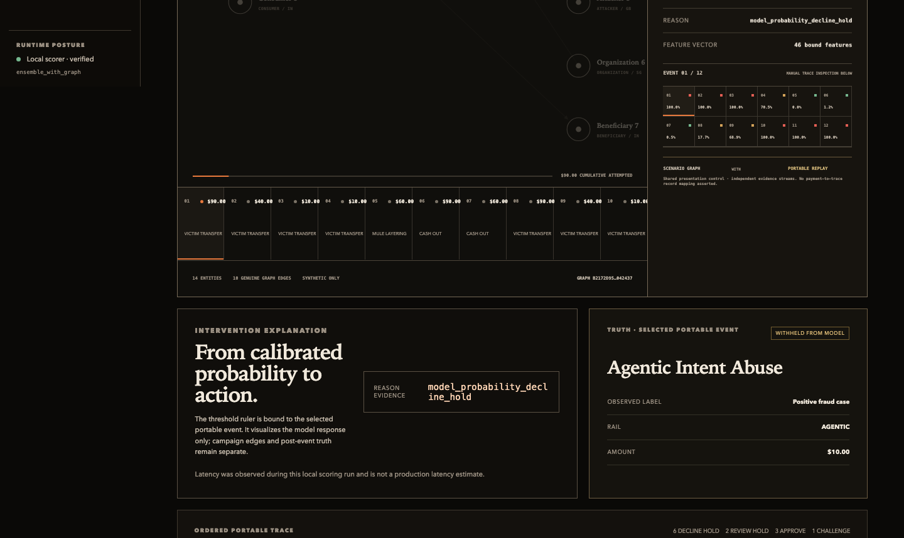
ADAPTIVE PAYMENT ASSURANCE RANGE
06
A small, portable model powers the live demo
3 ×
CatBoost members
46
frozen causal features
12
hash-bound scenarios
0.0
max replay error
Approve • Challenge • Review hold • Decline hold
Notes:
This is the accepted Stage 30 ensemble_with_graph bundle. The scorer is real; the scenarios are curated replay checks.
[Sources]
- demo/sentinel-v5/manifest.json
- demo/sentinel-v5/spec.json
- docs/demo/screenshots/apar-console-replay-desktop.png
[/Sources]

Slide 7
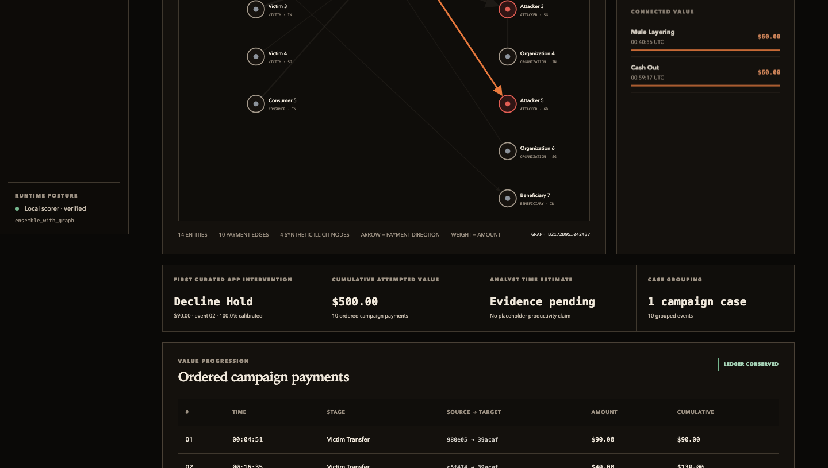
ADAPTIVE PAYMENT ASSURANCE RANGE
07
Investigators see one campaign—not twelve alerts
CASE-CENTRIC
14
entities
10
payment edges
$500
conserved synthetic ledger
Analyst-time benefit: evidence pending
Notes:
Point to the linked mule node and genuine deterministic payment edges. Do not invent an analyst productivity number.
[Sources]
- docs/demo/screenshots/apar-console-investigation-desktop.png
- web/public/data/console-evidence.json
[/Sources]

Slide 8
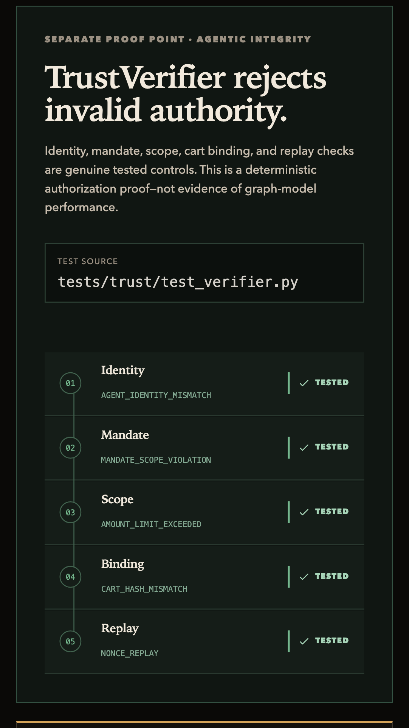
ADAPTIVE PAYMENT ASSURANCE RANGE
08
Agentic commerce needs proof before probability
✓
Agent identity
✓
Merchant + cart
✓
User mandate
✓
Expiry + nonce
✓
Scope + amount
✓
Replay rejection
DEFINITIVE FAILURE
DECLINE_HOLD before statistical risk
Notes:
TrustVerifier is a separate authorization-integrity claim—not graph model performance. A probabilistic score cannot repair invalid authority.
[Sources]
- src/apar/trust/verifier.py
- tests/trust/test_verifier.py
- https://www.mastercard.com/us/en/news-and-trends/stories/2026/mastercard-agentic-commerce-vision.html
- https://www.nccoe.nist.gov/sites/default/files/2026-02/accelerating-the-adoption-of-software-and-ai-agent-identity-and-authorization-concept-paper.pdf
[/Sources]

Slide 9
ADAPTIVE PAYMENT ASSURANCE RANGE
09
Evidence governance is part of the product
01
02
Causal features
03
Executed controls
04
Immutable evidence
05
Future append + equal-time isolation
Independent replay
Shuffle, rename, leakage, single-class
Human promotion
Models, traces, metrics, manifests hashed
Fresh environment re-scores all 12 cases
The model cannot approve itself
Portable bundle
Promotion boundary
NO SELF-PROMOTION
52ed4c31…dbc900
Human approval required
Notes:
Show that every evidence step stays auditable and that promotion remains a human decision; recovered metrics remain diagnostics.
[Sources]
- demo/sentinel-v5/manifest.json
- evidence/sentinel-v5-recovered-metrics/verified-report.json
- docs/submission/RELEASE_CHECKLIST.md
[/Sources]

Slide 10
ADAPTIVE PAYMENT ASSURANCE RANGE
10
A sharp claim boundary makes the demo credible
WHAT WE PROVE
WHAT WE DO NOT CLAIM
✓
Portable model loads and replays exactly
×
Production or real-cardholder performance
✓
Four rail-backed synthetic families
×
Production-readiness or scale evidence
✓
Graph/no-graph architecture comparison
×
External or multi-institution validation
✓
Deterministic TrustVerifier integrity
×
Autonomous model promotion
✓
Offline console + hash-bound fallback
×
Claims beyond the demonstrated model
Synthetic evidence before assertion.
Notes:
This slide is the trust moment. Be explicit about what remains future work and why that does not diminish the working prototype.
[Sources]
- docs/submission/EVALUATION_AND_LIMITATIONS.md
- docs/submission/MODEL_CARD.md
[/Sources]

Slide 11
ADAPTIVE PAYMENT ASSURANCE RANGE
11
From competition prototype to governed payment assurance
1
2
3
4
5
OFFLINE REPLAY
SHADOW MODE
ASSISTED OPS
CHALLENGER
GOVERNED SCALE
→
→
→
→
Authorized historical samples
Live features; no authority
Human-controlled friction
Limited traffic + rollback
Continuous adversarial regression
APAR
Assure the campaign. Verify the intent.
Promote only the evidence.
DEMO READY
Adaptive Payment Assurance Range • Team: LedgerPe Labs
Notes:
Close on the product promise and transition into the live console walkthrough.
[Sources]
- docs/submission/COMMERCIAL_AND_DEPLOYMENT_PLAN.md
- docs/submission/FIVE_MINUTE_WALKTHROUGH.md
[/Sources]

