Slide 1


GrooveGen
Physiologically-driven closed-loop music generation
Daniel Llamas Maldonado
Daniel Llamas Maldonado
CU Boulder | August 2026

Slide 2
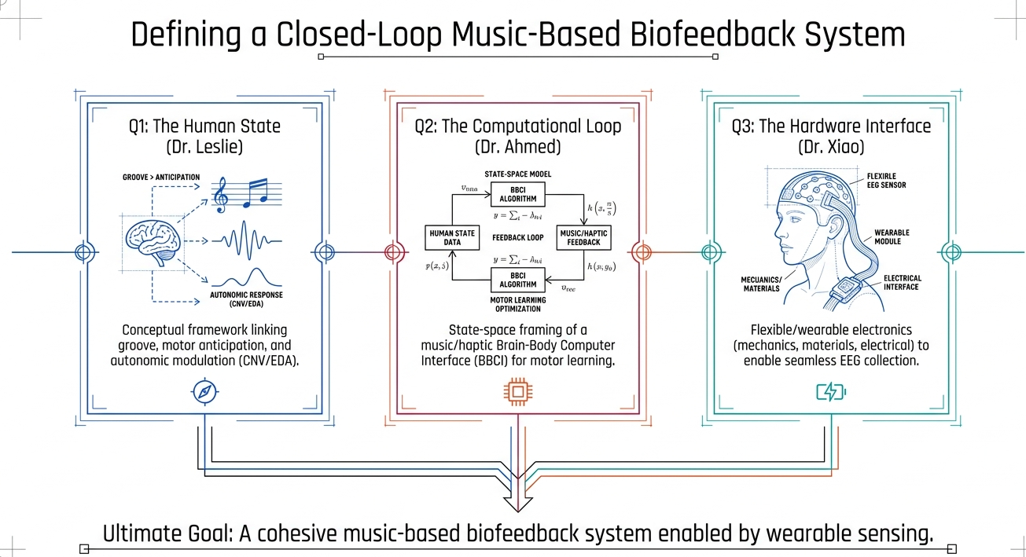
Background
Music Stimulation
Control Systems
Bioinstrumentation

Slide 3
The question
Can music be steered by physiology, in a way we can measure?
The premise
Music affects arousal.
Arousal affects heart rate.
Heart rate is measurable at ~1 Hz with a chest strap.
If we can pick the right music at the right moment, we can steer arousal toward a chosen target — with the loop closed by physiology, not by self-report.
What we've built.
A closed-loop simulator that renders real audio, models a two-plant physiological cascade, and lets us test control policies before we touch a human.

Slide 4
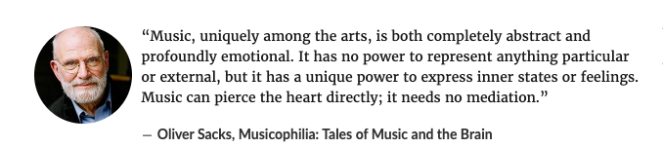

Slide 5
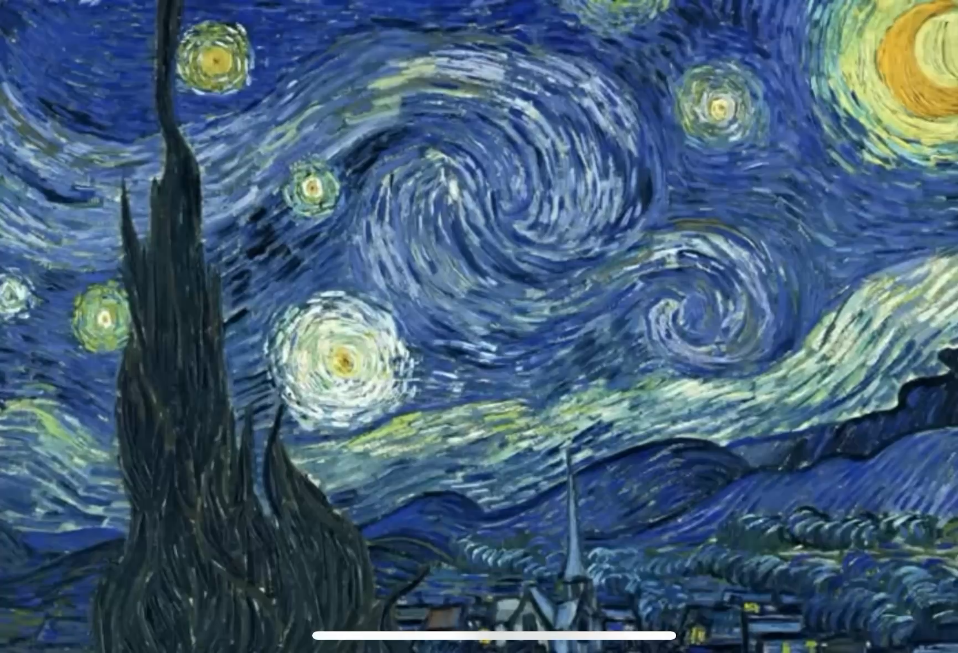

Slide 6
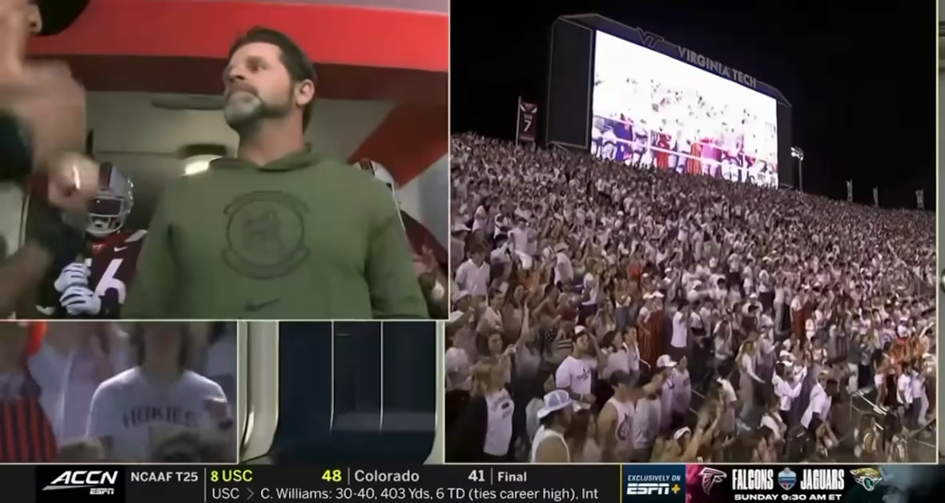

Slide 7
The closed loop
Controller
Composer
Renderer
Physiology
Ladder MPC + RLS gain ID
Rule-based, MIDI, per-genre
fluidsynth + SoundFont
Music → arousal → HR
feedback loop: HR sample every 20 s → controller updates rung selection
Ladder – 25 discrete music "cells" ordered by expected arousal.
MPC – picks next cell to minimize predicted arousal error, with churn cost.
RLS – online estimate of subject-specific arousal→HR gain.
Physiology plant – measured MIR features → arousal (Sophia regression) → first-order HR dynamics.

Slide 8
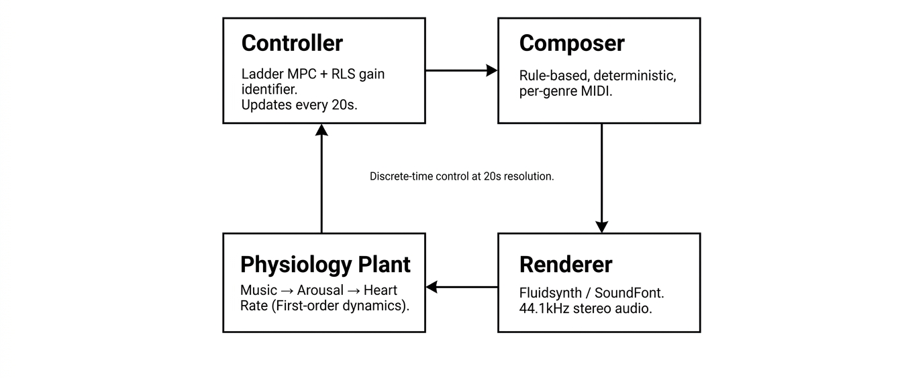
The closed loop
.
3 / 14

Slide 9
Design lineage: Sophia + literature
Why the composer has the knobs it has, and where each knob came from.
From Sophia's regression
From the broader literature
Tempo band 110–130 BPM. +9.3 danceability pts in-band, p<.001. Default 120 BPM.
Percussive weight + bass. Standardized β +4.66 and +2.97 — the only robust positive predictors. Every mix is drum + bass forward.
Beat consistency. β +1.35. Composer stays metronomic; humanization is bounded.
Syncopation null in commercial audio. Witek inverted-U did not recover. So syncopation is built by construction, not measured out.
Genre menu locked. Pop, R&B, hip-hop, latin, calm — high-danceability families with adequate n. Not a taste choice.
Loudness > tempo for arousal drive. Bernardi 2009. Loudness handled continuously at mix stage.
Onset density drives arousal. Chen 2025 EMBC. Density knob (0.3–1.0) is the ladder's energy dial.
Tempo ramp rate matters. Watanabe 2017: 2%/min → +6% HR; fast ramps null. Controller rate-limited.
Silence lowers HR. Bernardi 2006, Sleight 2006. Calm rungs can drop to near-silent density.
No trait screening. Sophia: eBMRQ Sensory-Motor did not moderate the SM–SR gap. One stimulus path for all listeners.
6 / 15

Slide 10
Personalization: the listener-side layer
Sophia gave us the structural knobs. Senn tells us why we still need a personal fit.
Why a listener-side layer exists
What GrooveGen adds
Sophia found acoustic structure explains R² ≈ 0.18 of danceability. 82% of variance is listener-side, not in the audio.
Senn 2018 (n=665, 248 drum patterns). Style fit + familiarity: R² ≈ 0.15. Syncopation and event density each: R² ≈ 0.01. Style + familiarity ≈ 15× the structural knobs.
van den Bosch 2013. Familiarity mediates the arousal-pleasure link even when acoustics are held fixed.
Design implication. Hold the structural knobs (Sophia). Personalize the frame around them (Senn).
Intake. 12 songs at session start. Uploaded files or URLs.
Analysis. Whole-track librosa MIR (no source separation). ≈5 sec/song, ≈1 min total.
Descriptor. 6 floats — median predicted arousal + 5-way genre-affinity vector.
Where it plugs in. Sets the controller's default arousal target before any poll; weakly tiebreaks MPC candidates within one dead-zone-width. Composer internals unchanged.
7 / 16

Slide 11
The composer
Rule-based, deterministic, per-genre. No neural sampling.
Design decisions
Why rule-based
Deterministic seed.
5 genres: calm, lofi, rnb, pop, latin — chosen to span Sophia's danceability range.
Each genre: tempo default, key, instrument palette, drum pattern, density knob (0.3-1.0).
Signature: generate_segment(genre, tempo, density, bars, seed) → MIDI.
Reproducible.
Every cell renders identically on every run — essential for a preregistered study.
Auditable.
The reason cell (pop, tier 3) sounds like it does is a set of rules I can point at.
Fast enough for closed-loop.
~200 ms to compose + render an 8-bar segment on M5.
5 / 14

Slide 12
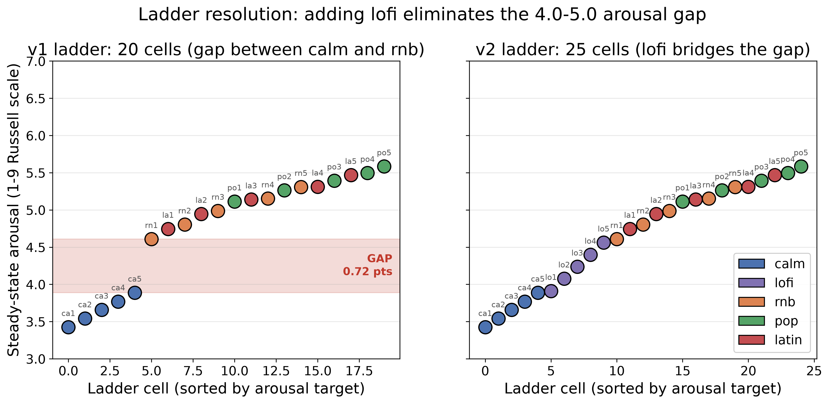
The ladder
A discrete action space for the controller. 25 cells, ordered by predicted arousal.
v1 had a 0.72-point gap between calm-5 and rnb-1. Adding a lofi family (5 cells at ~78 BPM, warm Rhodes + soft drums) closes it. Now the maximum inter-cell arousal step is 0.28 points — tight enough for a subject with typical K to have controller options at their target.
4 / 14

Slide 13
The physiology model
Two plants in series. Both grounded in prior data.
Plant 1: Music → Arousal
Plant 2: Arousal → HR
a = 1 + 8 · σ(βᵀ x)
τ dHR/dt + HR = HR₀ + K · (a - 5)
β = Sophia's danceability regression coefficients (7 MIR features). Squashed to 1-9 Russell scale. Adds ε_a ∼ N(0, 0.15).
First-order LTI. HR₀ ∈ [58, 90] bpm baseline. K bpm/pt = per-subject arousal responsiveness. τ ≈ 60 s. Delay d = 1 segment.
Subject population (N = 400 simulated)
non-responder
typical
strong
paradoxical
n = 115
n = 192
n = 68
n = 25
K < 2
2 ≤ K < 4
K ≥ 4
K < 0 (HR drops)
7 / 14

Slide 14
The preregistered study
Three conditions per subject. Three hypotheses. Thresholds locked before analysis.
Conditions (within-subject)
Hypotheses (preregistered thresholds)
Closed-loop.
MPC picks rung every 20 s from live HR.
Yoked-reversed.
Another subject's CL trace, played in reverse. Same music, wrong time.
Reactive.
Simple threshold controller (no model).
H1_A.
Closed-loop MAE(arousal) < yoked by at least 0.10 pts.
H1_HR.
Closed-loop MAE(HR) < yoked by at least 1.0 bpm.
H3.
≥ 60% of subjects have |g_hat_final - true K/2| < 1.5.
8 / 14

Slide 15
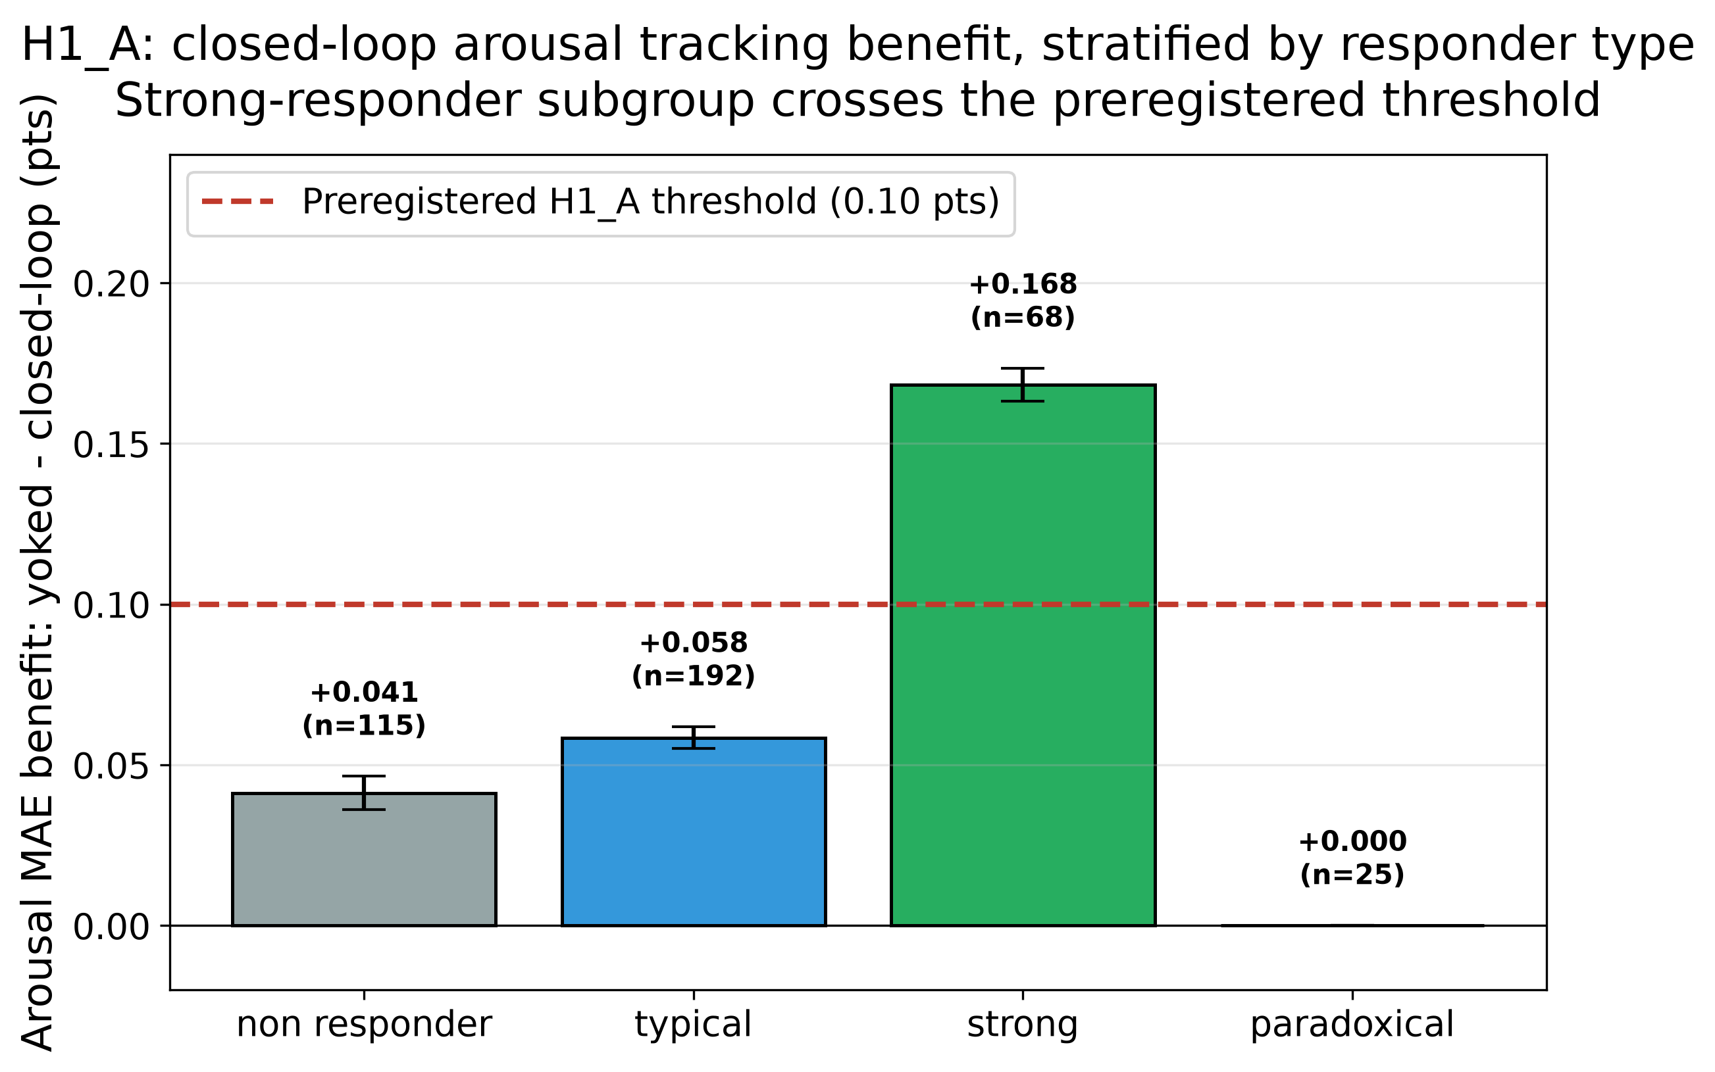
H1_A: closed-loop vs yoked, by responder type
Aggregate below threshold; strong-responder subgroup clearly above. d_z = 1.02 across all.
What this means
Aggregate mean diff +0.069 pts
below the 0.10-pt threshold, but the mean masks the responder structure.
Strong subgroup +0.168 pts
cleanly above threshold. This is where the loop should work.
Effect size d_z = 1.02
very large by Cohen benchmarks. p < 0.0001.
10 / 14

Slide 16
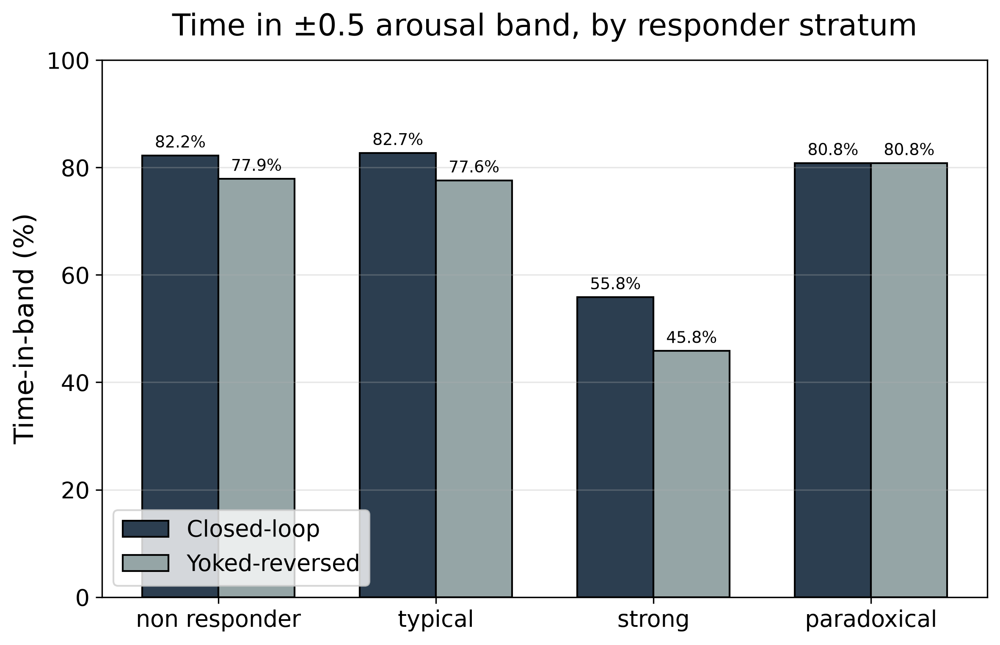
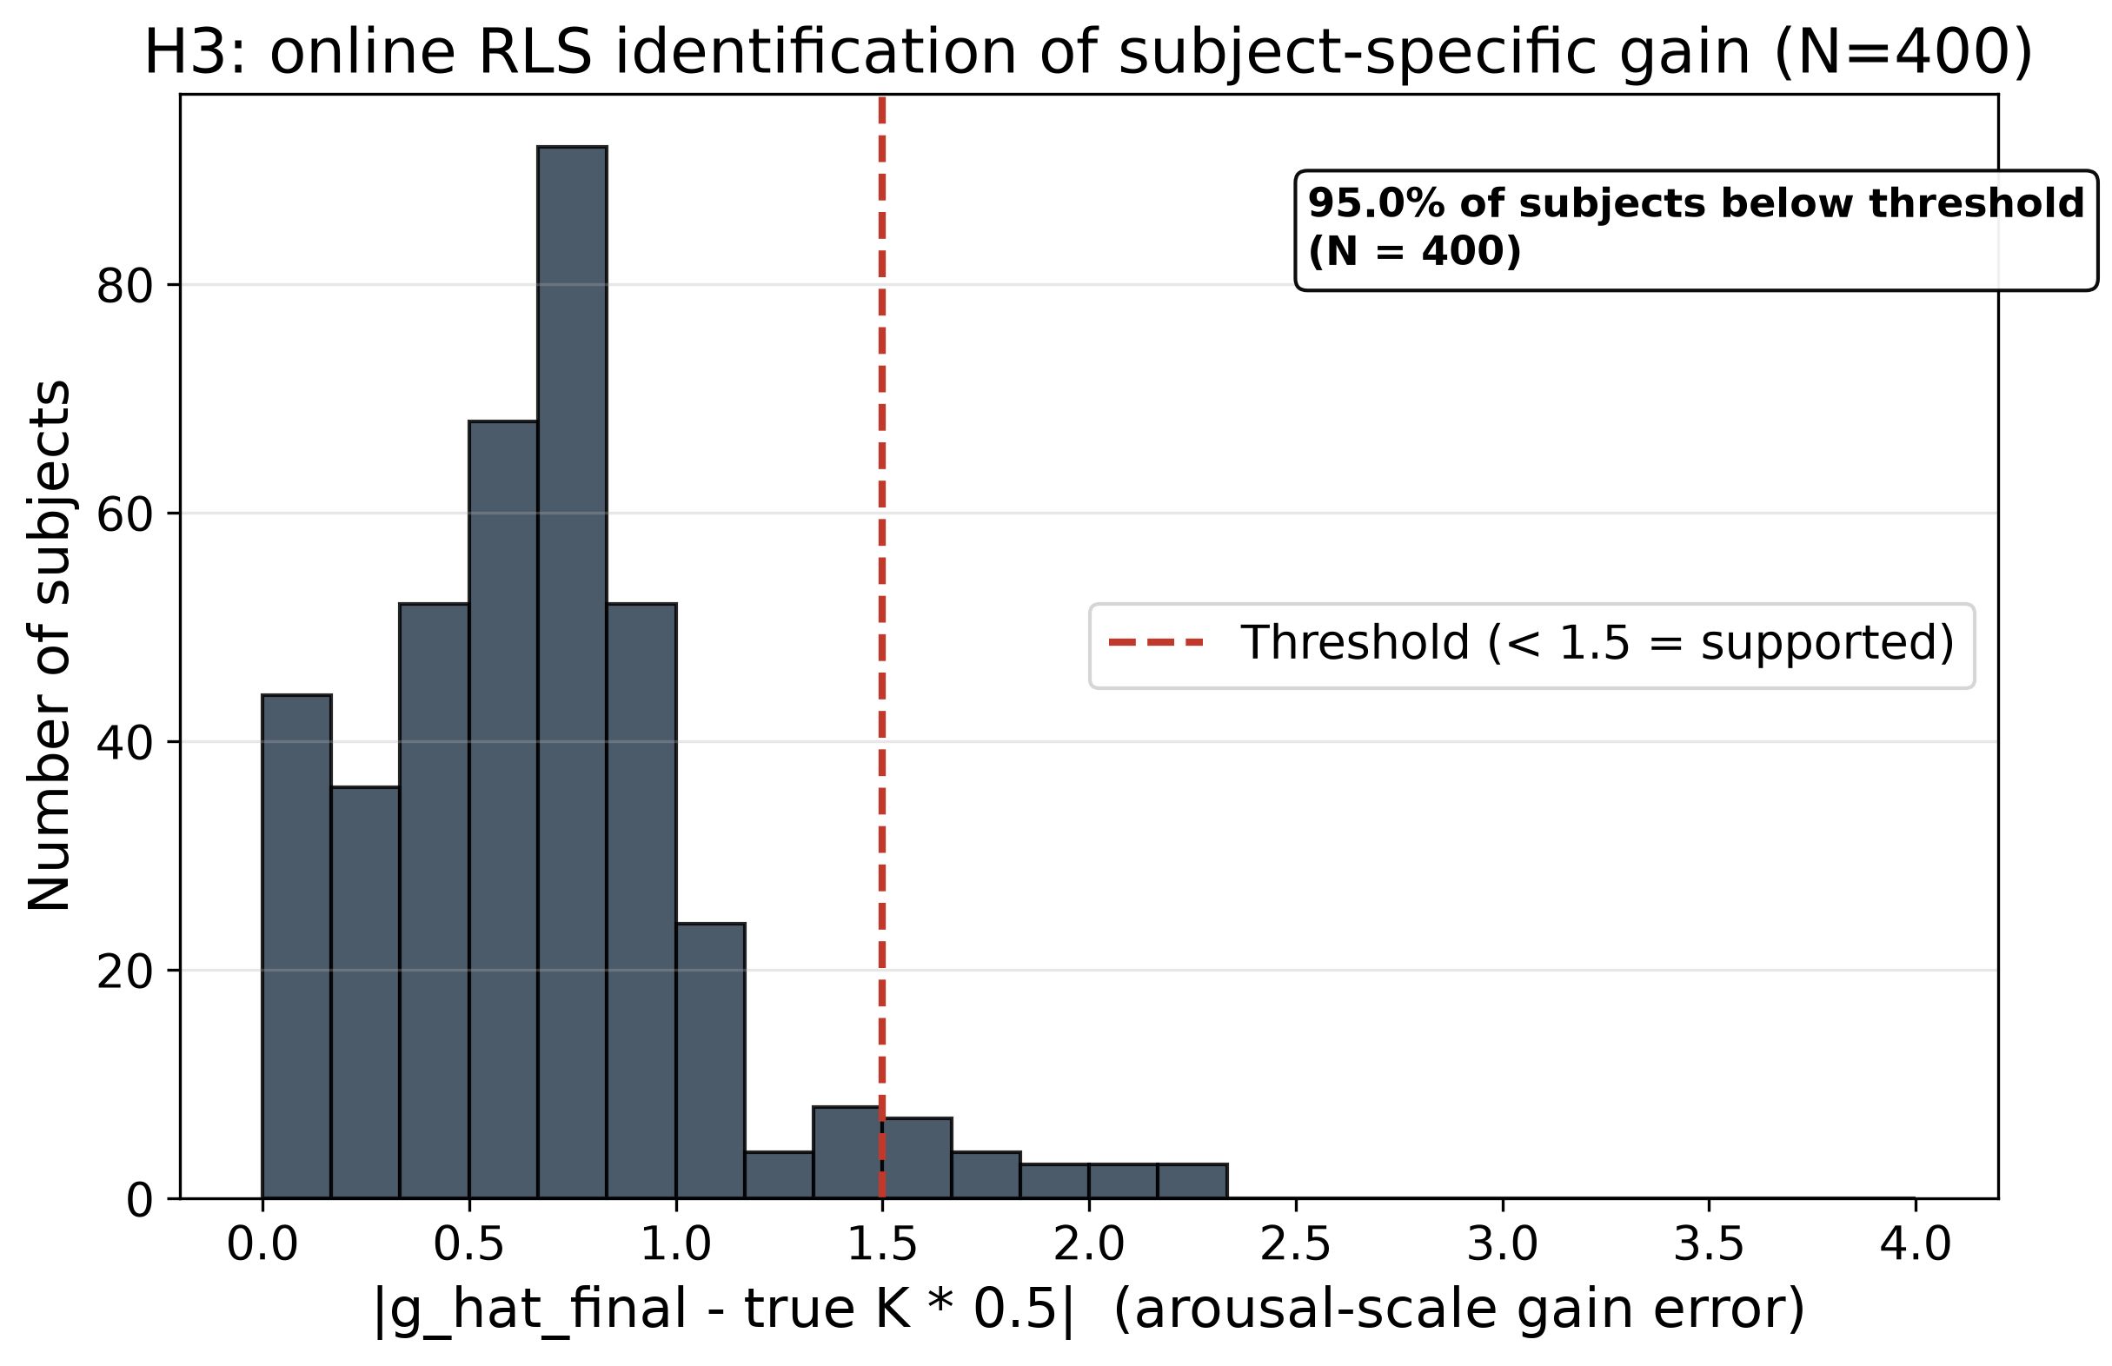
Two more checks pass
Time-in-band across all strata (left), online gain identification across N=400 (right).
CL keeps arousal in the target band ~78% of segments. H3: 95% below threshold, well above the 60% target.
11 / 14

Slide 17
Honest caveats
What I want to flag before you ask me about it.
Aggregate H1_A is under threshold.
Priors were refit mid-study.
Mean diff +0.069 pts vs 0.10-pt bar. The strong-subgroup analysis crosses it; the d_z = 1.02 effect size is large. But the primary aggregate hypothesis is technically not supported. Preregistered, reported, not hidden.
Measured MIR features didn't match commercial-corpus priors in absolute value (rank order was fine). Refit priors to composer-rendered means. Logged in DEVIATIONS.md v2.2 with rationale.
Simulator, not humans.
HR-side H1_HR did not clear.
Every number here is in silico. The point of this work is to justify a preregistered human pilot with sensible design decisions already tested. Nothing here replaces the pilot.
The HR benefit is real but small (< 1 bpm) because our arousal-mode controller optimizes arousal error, not HR error. Expected. HR-primary mode is a separate path.
12 / 14

