Slide 2
Kube-hunter is an open-source tool that is designed to help identify security weaknesses within Kubernetes clusters. It is a penetration testing tool that focuses specifically on Kubernetes, allowing you to identify vulnerabilities that might not be detectable using traditional security scanning tools.
Kube-hunter can scan your Kubernetes cluster for common vulnerabilities and misconfigurations, such as unsecured API servers, insecure service accounts, and unencrypted secrets. It can also identify potential attack vectors, such as exposed ports and weak authentication mechanisms.
Kube-hunter works by deploying a small container into your Kubernetes cluster that scans for vulnerabilities and reports its findings back to the user. The tool is easy to use and can be run against both local and remote Kubernetes clusters.
Overall, Kube-hunter is a useful tool for Kubernetes security testing and can help identify potential vulnerabilities that may otherwise go undetected.

Slide 3
Kubernetes is a popular and powerful container orchestration tool that is used by many organizations to deploy and manage their applications. However, as with any technology, there are potential security risks associated with using Kubernetes. These risks can include misconfigurations, vulnerabilities, and other weaknesses that can be exploited by attackers.
Kube-hunter was developed to help organizations identify and mitigate these risks by providing a simple, yet powerful, tool for scanning Kubernetes clusters for vulnerabilities. By running Kube-hunter, organizations can proactively identify potential security weaknesses in their Kubernetes environments, and take action to address them before they can be exploited by attackers.
Kube-hunter is especially useful because it is designed specifically for Kubernetes. This means that it can identify vulnerabilities and weaknesses that may not be detected by traditional security tools. Additionally, Kube-hunter is open-source and easy to use, making it accessible to organizations of all sizes and skill levels.
Overall, Kube-hunter is a valuable tool for anyone using Kubernetes who wants to ensure the security and integrity of their deployments.

Slide 4
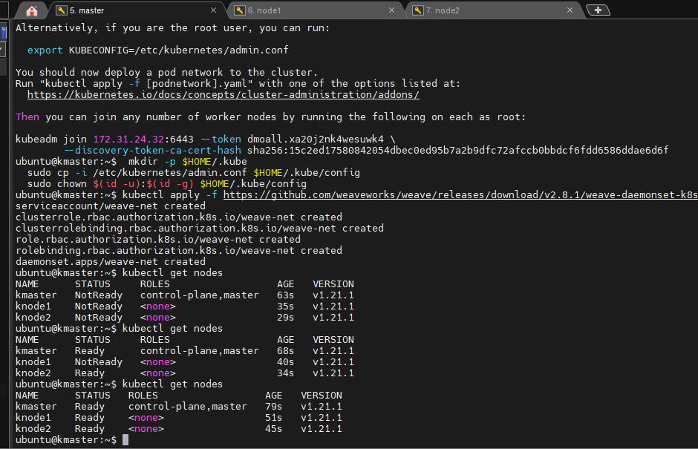

Slide 5
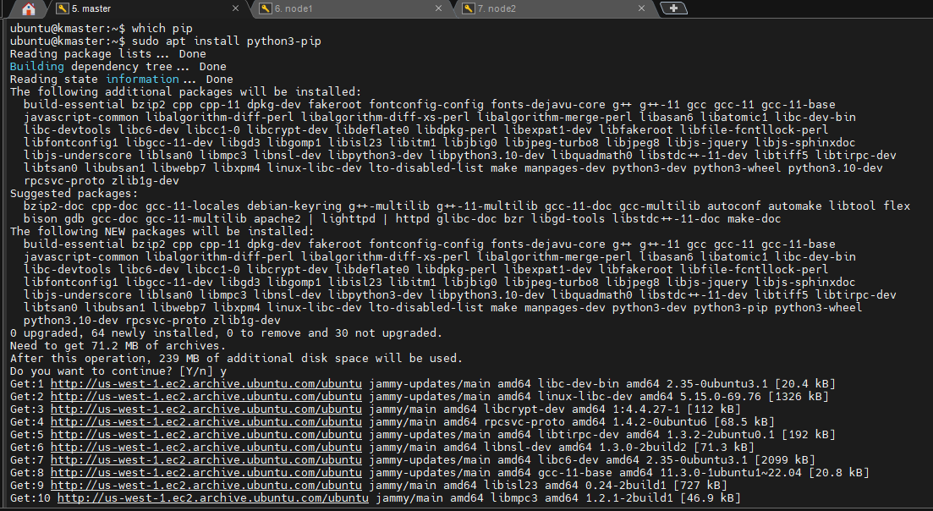

Slide 6
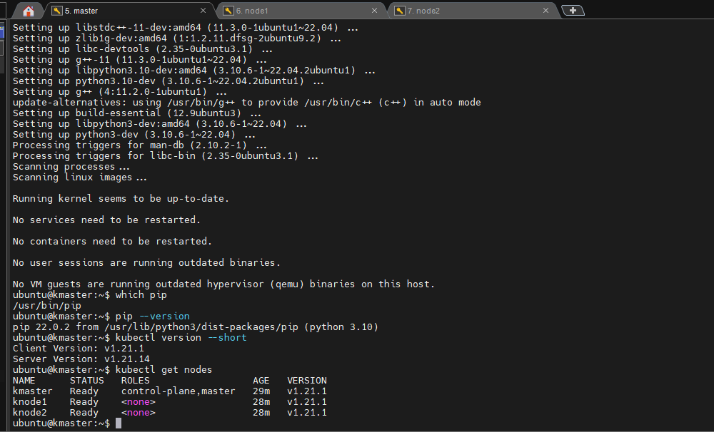

Slide 7
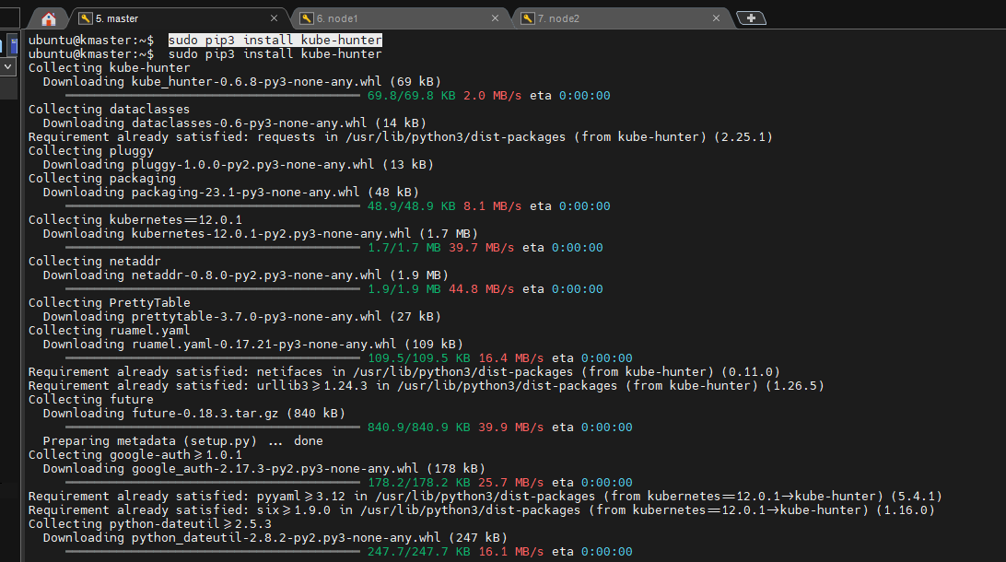

Slide 8
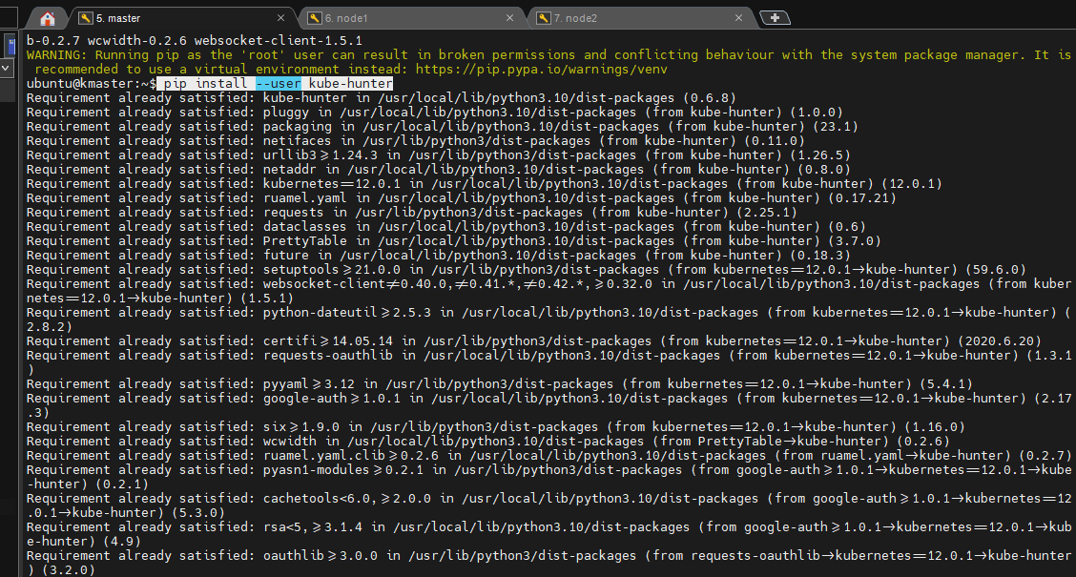

Slide 9
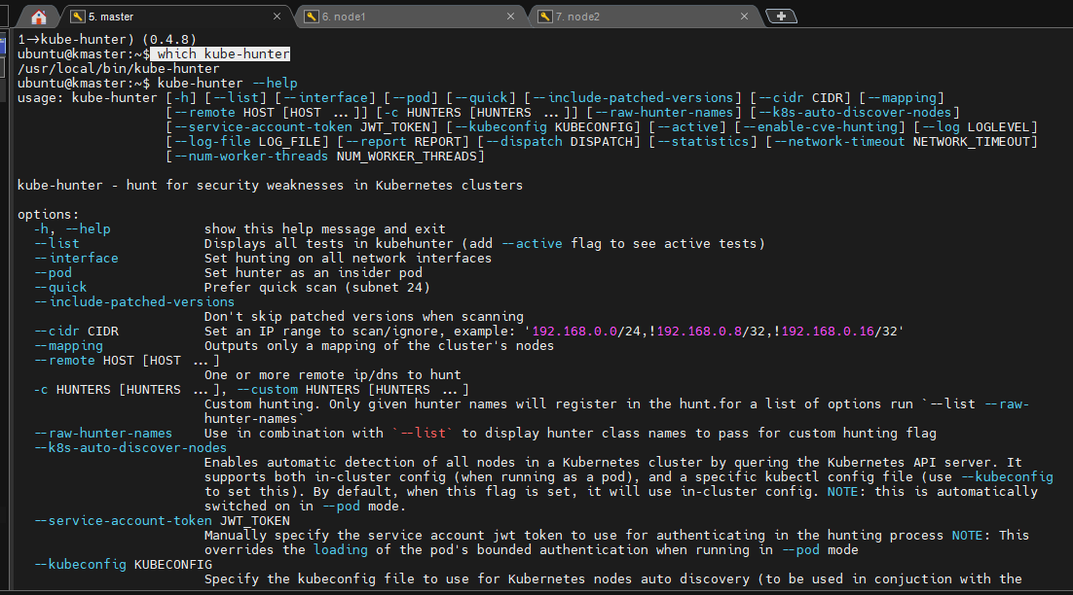

Slide 10
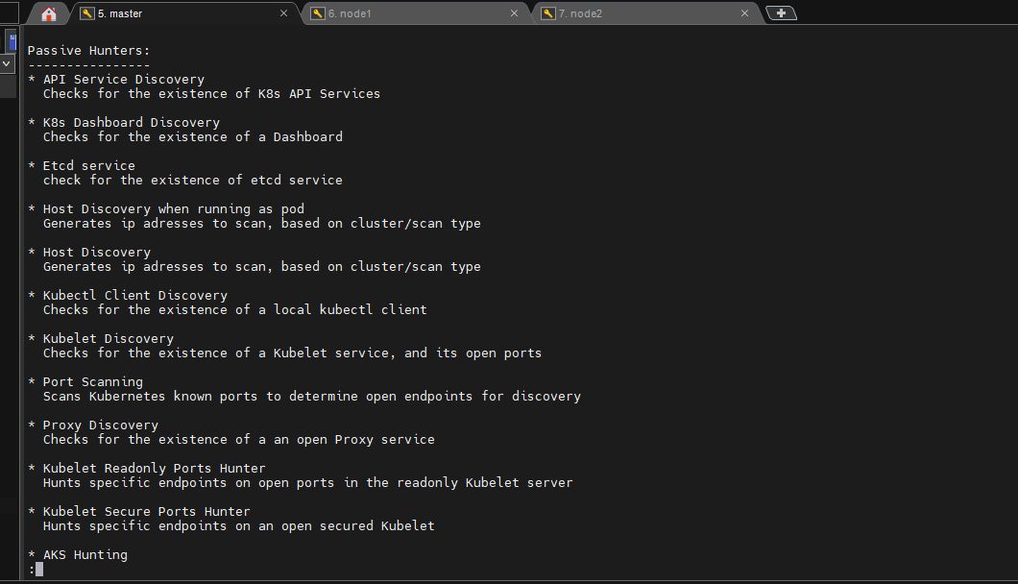

Slide 11
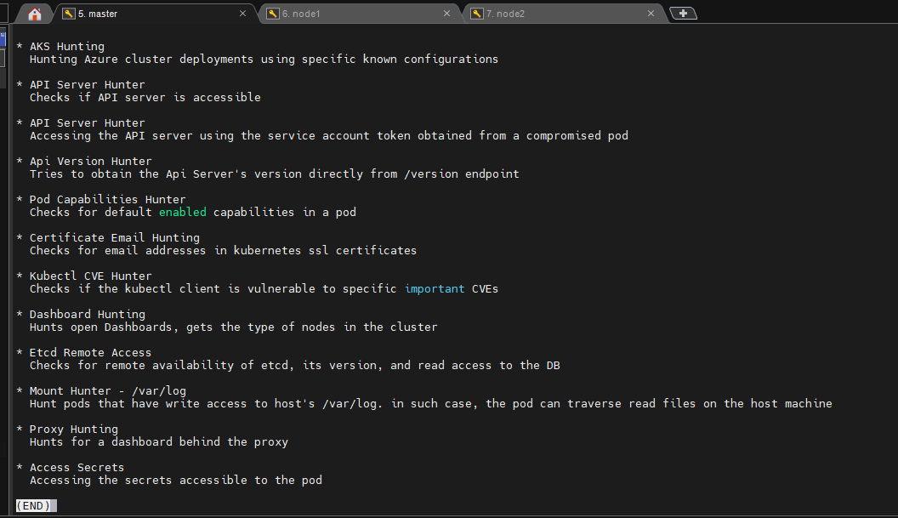

Slide 12
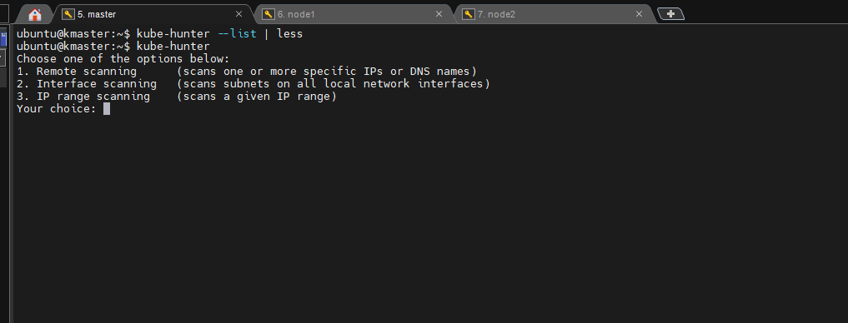

Slide 13
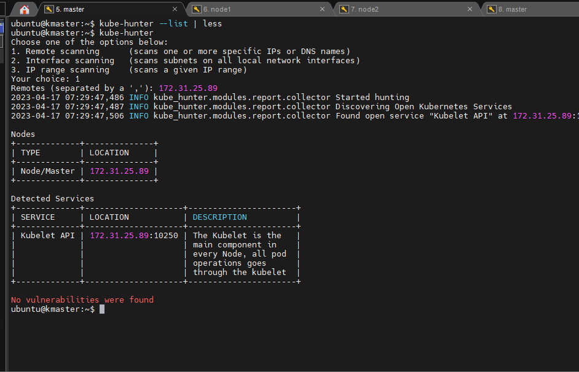

Slide 14
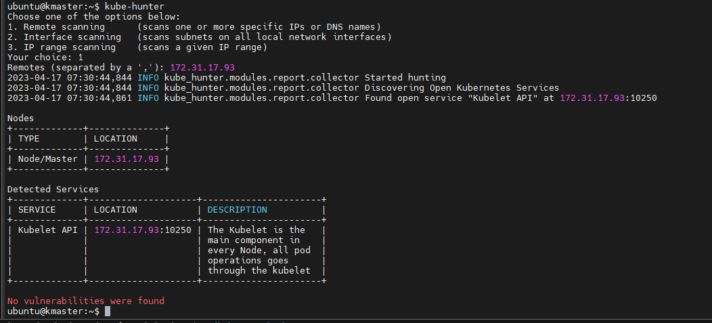

Slide 15
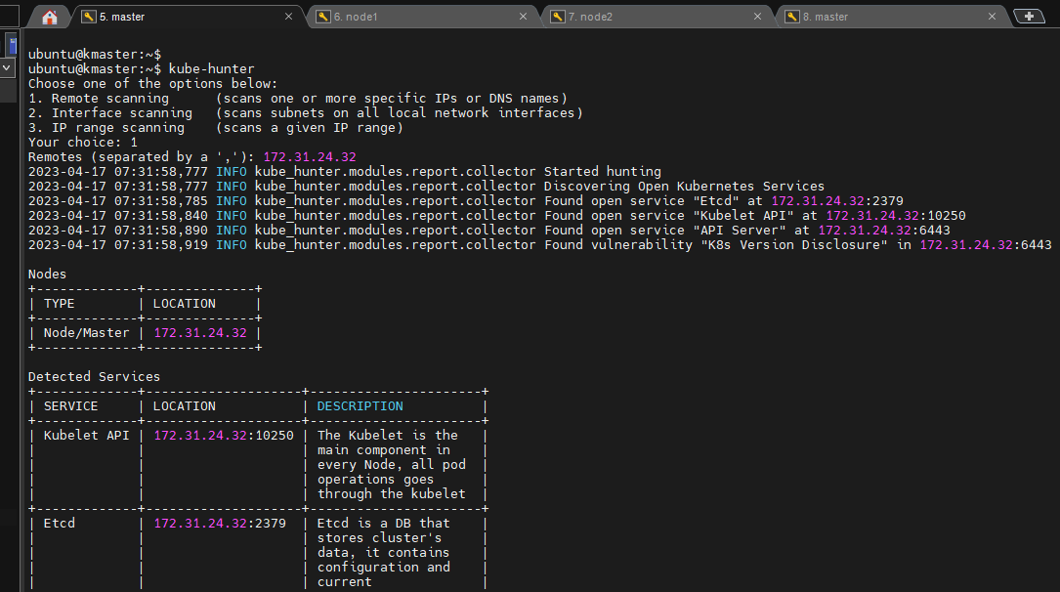

Slide 16
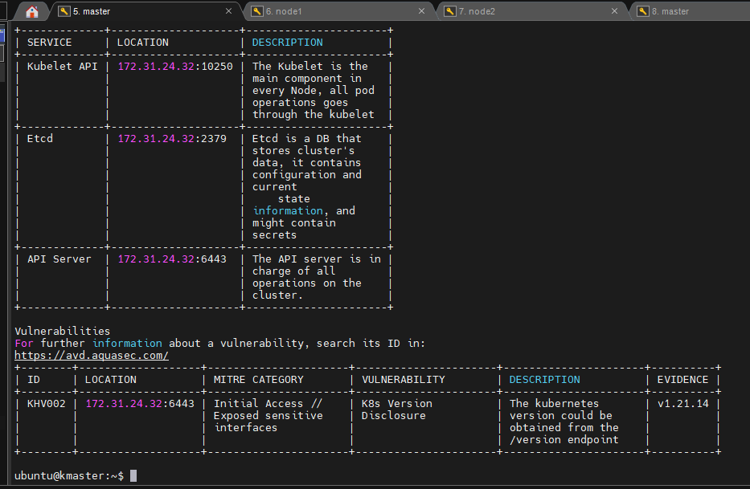

Slide 17
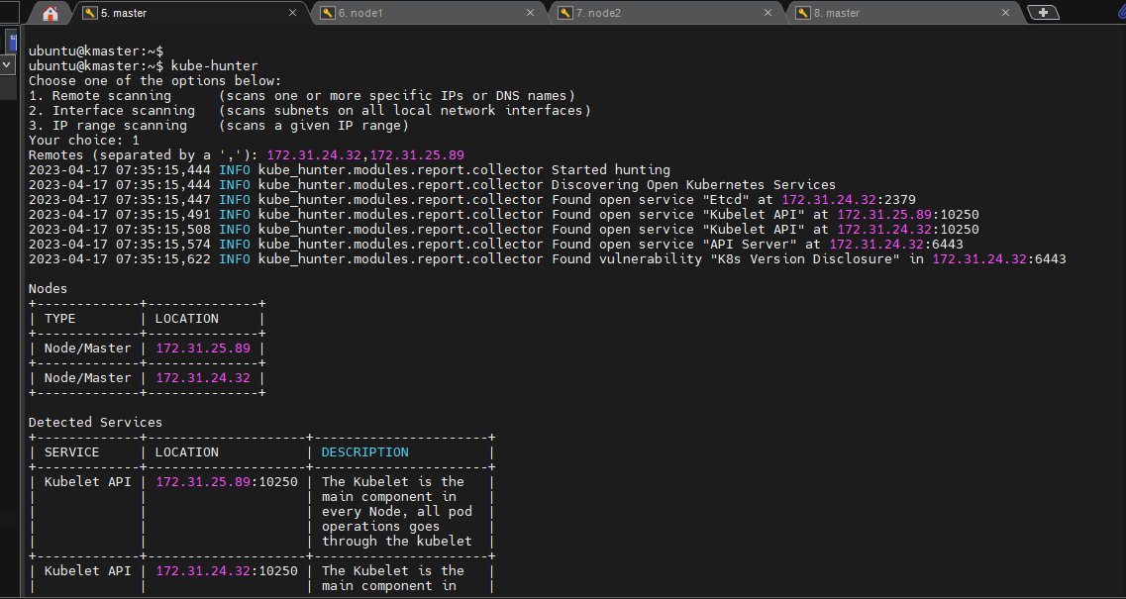

Slide 18
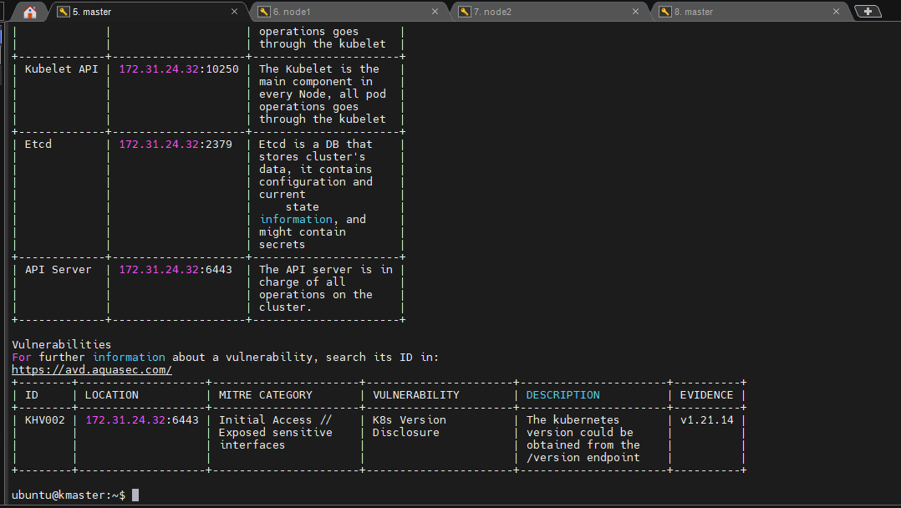

Slide 19
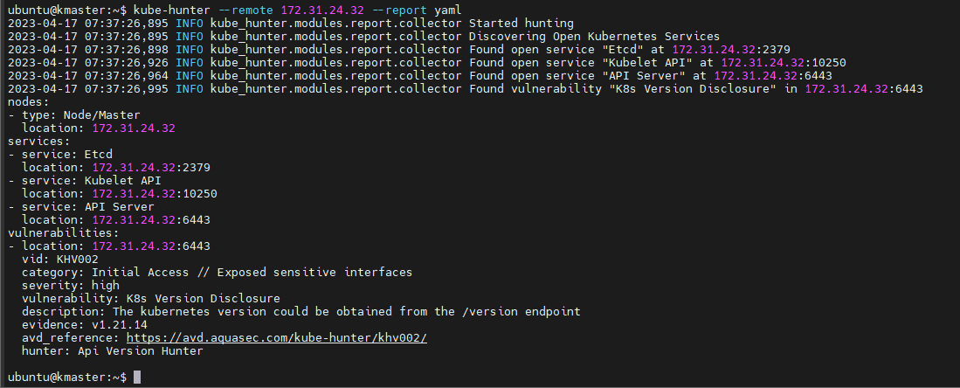

Slide 20
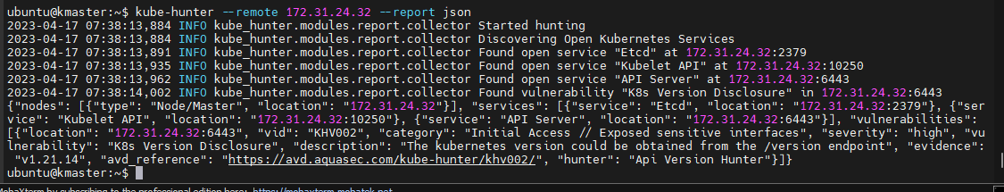

Slide 21
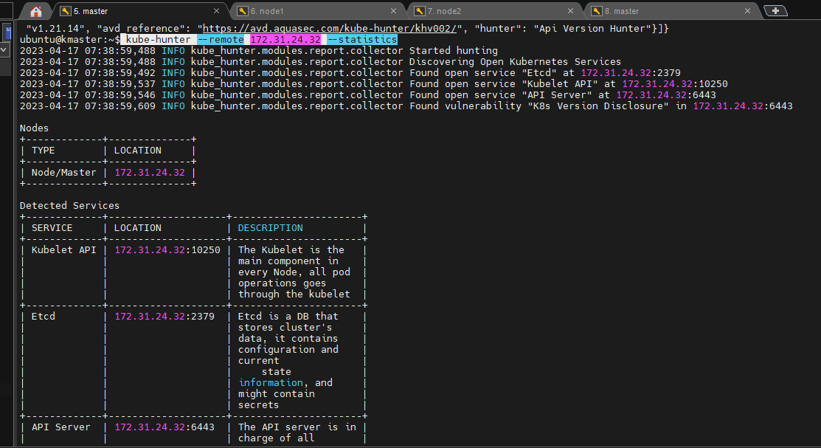

Slide 22
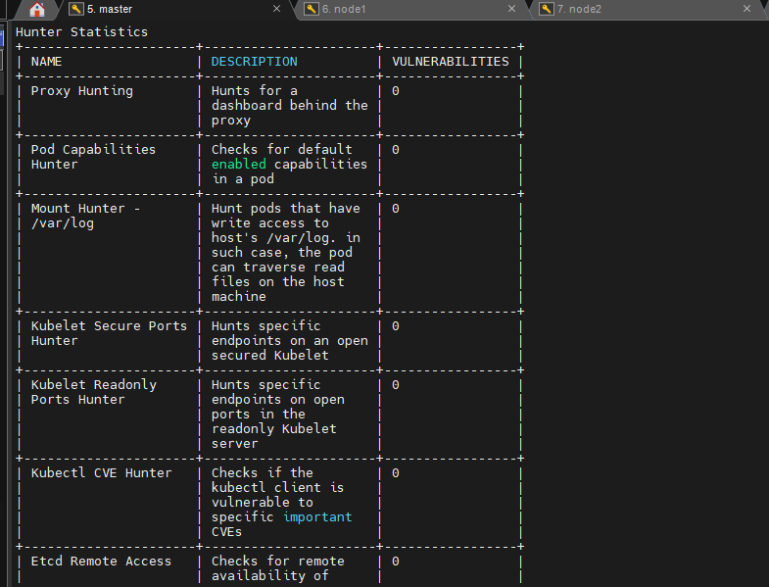

Slide 23
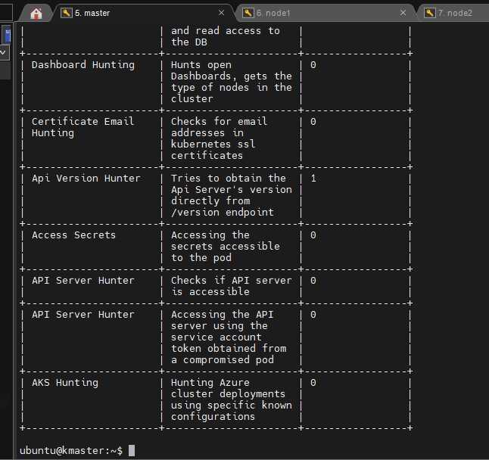

Slide 24
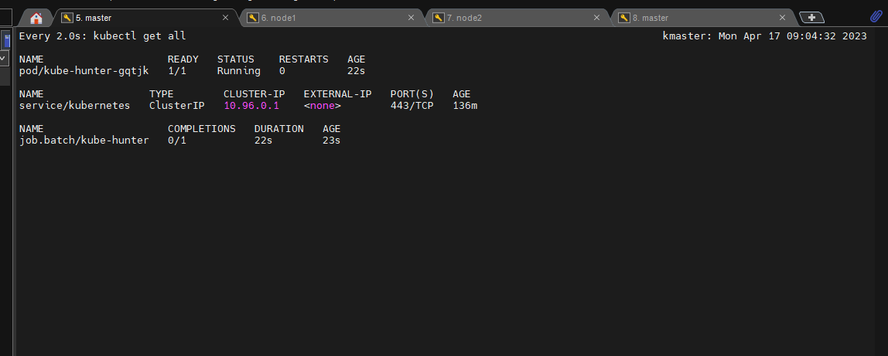
Deploying this kube hunter as a pod inside our kubernetes cluster

Slide 25
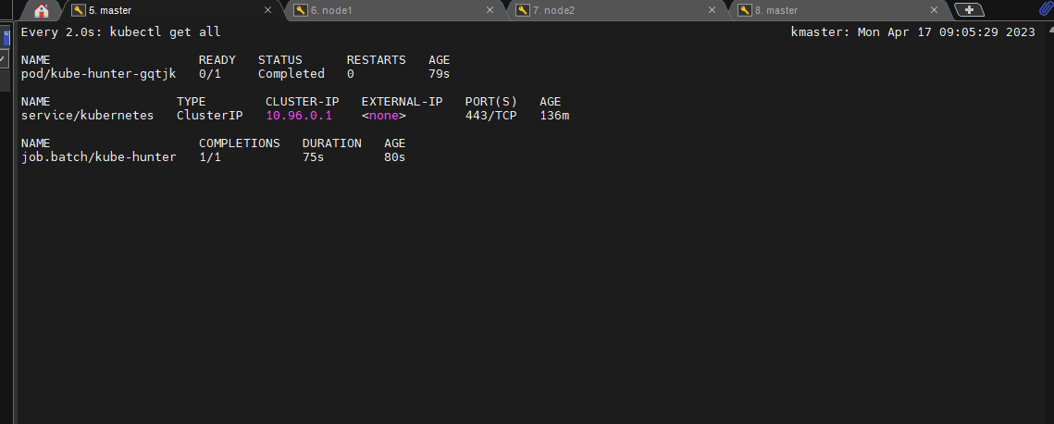

Slide 26
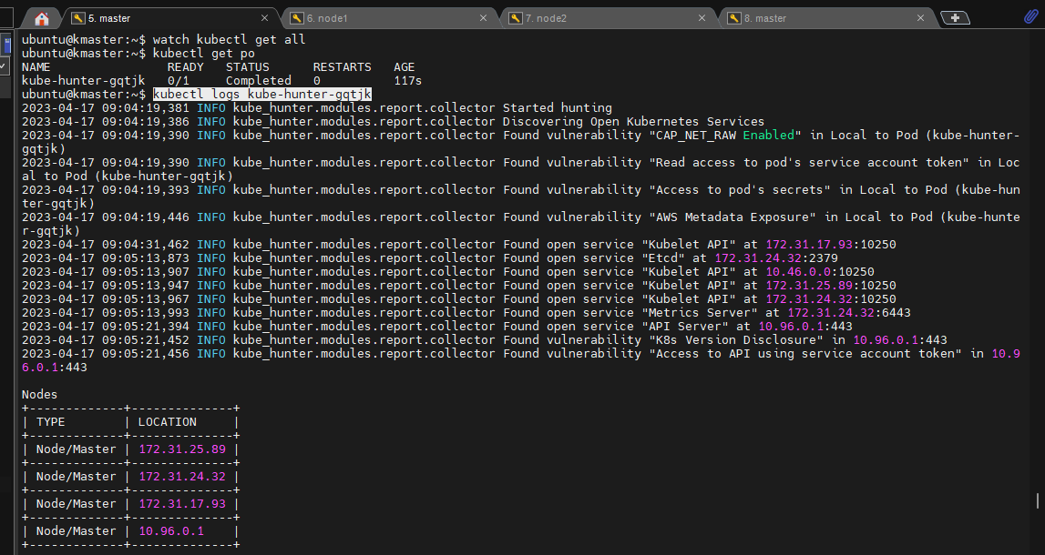

Slide 27
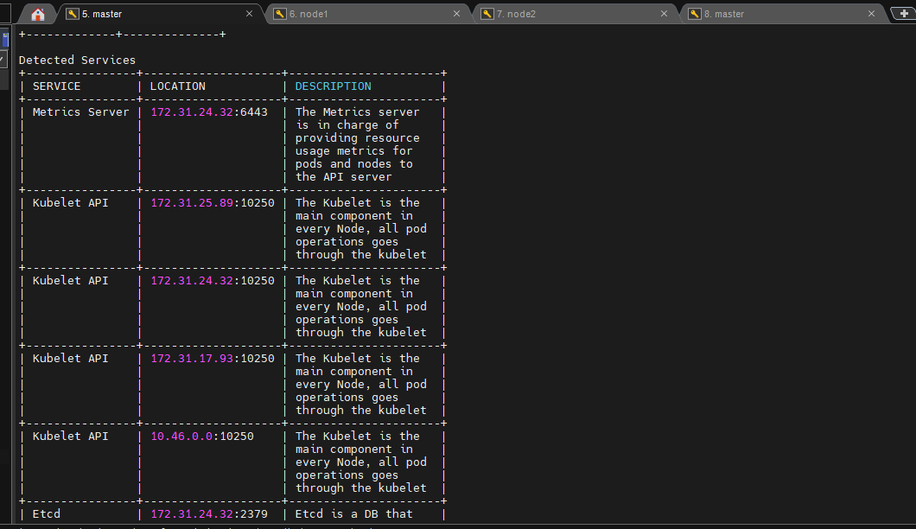

Slide 28
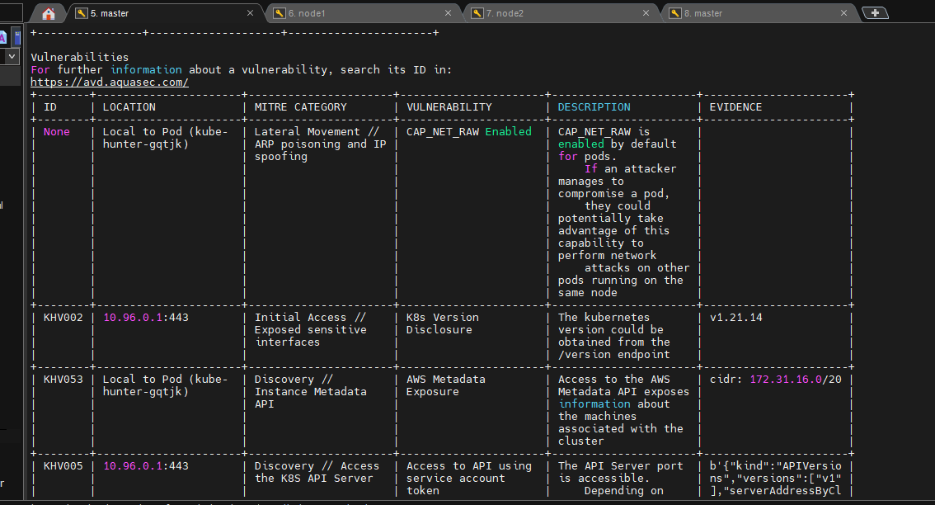

Slide 29
