Slide 1
Naming Schemes for Machine Learning Runs
Quang Le

Slide 2
Objective
Naming schemes for machine learning results.
Why:
Organize every machine learning run in a consistent and systematic manner for our high-throughput workflow
Find and identify documents even if they are no longer in their original folder
Store documents in a single folder without losing their context
Give the user knowledge about the content without opening the file.
Help us query our graph database. The simpler the name, the better

Slide 3
Criteria for success
It must be concise and easy to read
No obvious bad practices such as whitespace or special characters (besides – and _)
Must provide a unique name for every single machine learning run
It must give the user some information about the content without opening it
If there are rules, they must be simple, easy to follow and remember.

Slide 4
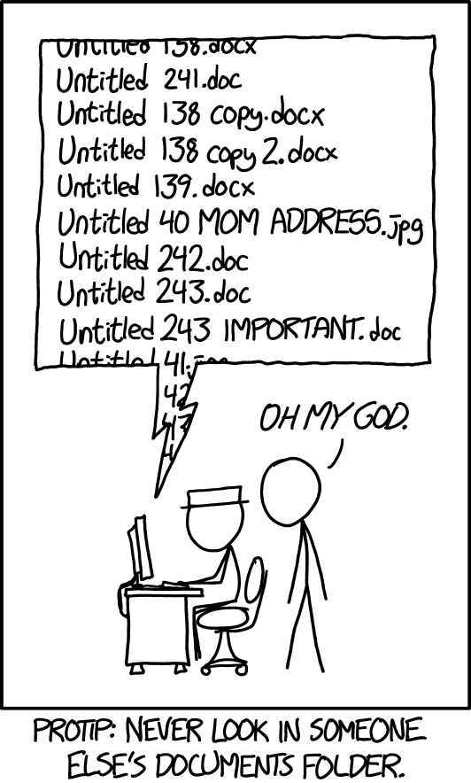
Copy of Copy of Copy of
Copy of Copy of Copy of
Copy of Copy of Copy of
Untiled.doc

Slide 5
Words and numbers (What we have right now)
Example: ESOL-rf-0-tuned
Pros:
Generates a unique name for every single run
Most intuitive and informative
Cons:
Unnecessarily long
While the name is perfect for storage and organization purposes, there must be more concise ways to represent it.
However, if we end up going against our criteria for success for the sake of a shorter name, it defeats the entire purpose of this exercise.

Slide 6
Numbers only
There are two ways we can go about using numbers and apply it to our current naming scheme:
Using lexicographic rule to number each component of our current naming scheme

Slide 7
Lexicographic rule
Rule: Every component in algorithm-dataset-feature-tune will be represented by their lexicographic order with respect to their own set.
* In lexicographic order, uppercases comes before lowercases (https://chortle.ccsu.edu/java5/Notes/chap92/ch92_2.html)
Lexicographic Order | Number
ESOL | 0
jak2_pic50 | 1
Lipophilicity* | 2
logP14k | 3
water-energy | 4

Slide 8
Lexicographic rule (Continue)
Applying the same rule to the rest of the components:
rf-ESOL-0-tuned, will become 4_0_5_0 (I chose 5 for feature arbitrarily since it depends on the set of feature combination we want to use. rdkit2d starts with an r so it is unlikely to be a small number since we also have other features that starts with characters that is earlier alphabetically like morgancount or atomcount).
Without the underscore in the middle, it will be impossible to tell which number belong to which component when the components in algorithm_dataset_ feature_tune have more than 9 things in them.

Slide 9
Lexicographic rule (continue)
As of right now, it seems like only dataset and feature have the potential to surpass 9 so let’s try and remove the underscores that are separating each number.
Let’s say the run number is 311180. Following the algorithm _dataset_ feature_tune scheme, since we know algorithm and tune will never surpass 9, we can deduce that the two numbers 3 and 0 at each end must be algorithm and tune, so the run uses the 11th dataset and the 18th feature combination in their respective list.
However, it is impossible to apply the rule without the underscore once when one of set surpasses 2 digits.

Slide 10
Pros and Cons
Pros:
Most efficient in terms of speed and memory since integers are mutable.
The rule is simple enough to easily apply and automate.
Cons:
We need to decide whether we need to add a separator or not depending on how big this project gets.
The number themselves don’t contain any information at face value which goes against our criteria for success -> Might as well be a random number generator

Slide 11
Letters and Numbers
Rule: We use some of the letters in the file name to represent the elements in algorithm and dataset while using a numbering system for feature and tune.
Example:
rf-ESOL-0-tuned will become RE51 where: R is the first letter in Random Forest Regressor (r for classifier), E is the first letter in ESOL, 5 is for rdkit2d (Again, I chose 5 for feature arbitrarily since it depends on the set of features and the combinations we want to use. rdkit2d starts with an r so it is unlikely to be a small number since we also have other features like morgancount or atomcount that are earlier alphatically), and 1 is for tuned.

Slide 12
Letters and Numbers (continues)
When two elements have the same first letter with the same case, there are several ways to go deal with this problem. (Read naming_schemes_idea.docx in the naming branch in our Git repo for more details)
The best way to deal with this is to use the first and last character of each element. Let’s say we have Lipophilicity-ID (1) and Lipophilicity14k (2) as two of the datasets that have similar names. (1) will be represented as LD and (2) will be represented as Lk.
If we have elements that contain the same first and last letter with the same cases, the algorithm will move to the next to last character and so on until all created names are unique.

Slide 13
Letters and Numbers (continues)
If the first letter to an element is a digit – 18k-logP - for example, it will include all the number that comes after and stops after the first letter is found. Therefore, the algorithm will represent 18k-logP as 18k.
If the element name is – 18k-logP2 – it will still be represented as 18k.
If both 18k-logP (1) and 18k-logP2 (2) exist our set, the code will either send an error message, or represent (1) as 18k and represent (2) as 18k2.

Slide 14
Pros and Cons
Pros:
Fast and memory efficient
It can be quite intuitive depending on the situation
It RE51 sounds cooler than 4_0_5_0 (Most important pros)
Cons:
Lots of ways to go about it. There maybe even better options that I have not thought of.
There are more situations that the code needs to account for.

Slide 15
Examples
Firstly, I change the dataset-algorithm-feature-tune scheme that we currently have to algorithm-dataset-feature-tune and then apply the letters and numbers rule.
water-energy-ada-0-tuned -> aw01
water-energy-rf-0-notune -> rw00
ESOL-gdb-2-tuned -> gE21
jak2_pic50-gdb-0-4-tuned -> gj041
Lipophilicity-ID-rf-0-4-notune -> rL040

