Slide 1

Technical Feasibility of a Wheelchair Securement Concept for Airline Travel: A Preliminary Assessment

Slide 2
Study Origin
Congress called on the U.S. Access Board to:
• study the feasibility of in-cabin wheelchair restraint systems; and if feasible, the ways in which individuals with significant disabilities using wheelchairs, including power wheelchairs, can be accommodated with the systems
• consult with the Secretary of Transportation, airplane manufacturers, air carriers, and disability advocates during the study.
Section 432, Federal Aviation Administration Reauthorization Act of 2018 (Public Law 115-254)

Slide 3
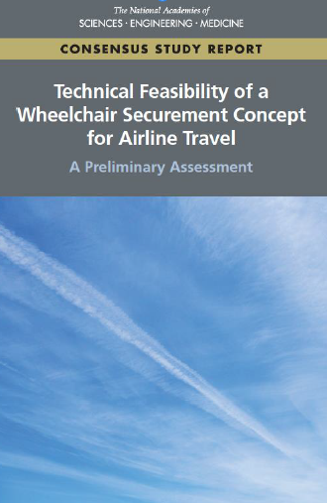
Committee Members
ALAN M. JETTE (Chair), Boston University
NAOMI ARMENTA, Nelson\Nygaard
PETER W. AXELSON, Beneficial Designs, Inc.
RORY A. COOPER, University of Pittsburgh
KAREN J. ERAZO, Sun Country Airlines (retired)
FRANCIS S. HEMING JR., Goodrich Interiors (retired)
KEVIN L. HIATT, Safety Practitioner, Alexandria, Virginia
KATHARINE M. HUNTER- ZAWORSKI, Oregon State University
GEORGE A. LESIEUTRE, The Pennsylvania State University
MIRIAM A. MANARY, University of Michigan Transportation Research Institute
CLINTON V. OSTER, Jr., Indiana University
GARY M. WEISSEL, Tronos Aviation Consulting

Slide 4
Statement of Task
Assess and evaluate the conditions under which it may be technically feasible to equip passenger aircraft with in-cabin restraint systems for motorized and nonmotorized wheelchairs (WCs), including assessments of:

Slide 5
Statement of Task (continued): Issues to be Addressed
design, engineering, and safety requirements for installation and use of these restraint systems and for the WCs that would be used as seats in aircraft, including aircraft structural requirements, WC occupant restraint and passenger emergency evacuation requirements;
injury criteria limits for both wheelchair users and occupants of seats behind and adjacent to the WC users; and
Implications on FAA regulations and policies for airworthiness, crashworthiness, and other safety requirements.

Slide 6
Statement of Task (continued): Accommodation of Passengers
If the committee finds reasonable circumstances for equipping airplanes, then consider how to accommodate effectively the passengers who use the WC securement systems and provide a level of service equal to other passengers.
The committee may advise on further actions warranted for making public policy choices, including needed research, information gathering, and technical analyses.

Slide 7
Terms Used in the Report
• power wheelchairs (motorized wheelchairs)
• manual wheelchairs (non-motorized wheelchairs)
• personal wheelchair - either a power or manual wheelchair owned by the user
• wheelchair securement system (instead of wheelchair restraint system)
- securement device used to “tie down” or otherwise attach the wheelchair to a vehicle
- occupant restraints, such as belts and straps, which secure the wheelchair user to the wheelchair
- a compatible personal wheelchair

Slide 8
Committee’s Approach
What are the most significant technical issues that would need to be addressed for WC securement systems to progress from concept to design and implementation, giving particular attention to any technical challenges that are so formidable that they could hinder or thwart this progress?

Slide 9
Committee’s Approach (continued)
Focus on potential challenges to the development and implementation of an in-cabin WC securement system that could:
• be installed on enough airplanes to provide nonambulatory people with flight offerings in enough markets for meaningful (not niche) service, and
• accommodate passengers’ personal wheelchairs (as opposed to wheelchairs designed and optimized specifically for airplane travel).

Slide 10
Technical Considerations
• Whether airplanes common to airline service have enough doorway and interior space for entering, exiting, and performing necessary maneuvers;
• Whether an airplane floor and its structure can accommodate the loadings; and
• Whether a secured personal WC can meet the crashworthiness, occupant injury protection, and other relevant air transportation safety requirements of the FAA.

Slide 11
Report Organization
Chapter 1 Introduction
Burdens People Who Are Nonambulatory Face When Flying
Study Origins, Charge, Scope, Approach
Chapter 2 Background
Wheelchair Characteristics and Use as Seats in Transportation
Overview of Passenger Airplanes, Their Seats and Interiors, and the Airline Industry
Chapter 3 Crashworthiness and Other Safety Considerations
FAA Cabin Interior Crashworthiness Requirements
Wheelchair Transportation Safety Standards
Comparison of FAA and RESNA Crashworthiness Criteria
Chapter 4 Airplane Space Considerations
Chapter 5 Assessment of Findings and Recommended Next Steps

Slide 12
Background: Airplanes
• More than 6,000 active airplanes in the U.S. passenger airline fleet
• Fewer than 10 major airplane families; different models
• Interior layouts differ widely
• But certain dimensions (doorway, cabin interior widths) are uniform for airplanes in a given family
• Boeing 737 and Airbus A320 families are predominant(most domestic enplanements and departures)

Slide 13
Background: Wheelchairs
• Hundreds of WC models - differing sizes, performance levels, and configurations.
• The vast majority can maneuver within the clearance and clear space parameters specified in the Americans with Disabilities Act (ADA) access guidelines.
• ADA parameters are widely used and influence WC dimensions.
• With comprehensive WC data available and ADA access guidelines, can estimate min cabin space and clearance requirements.

Slide 14
Key Findings: Airplane Boarding Doors
A large majority of airplanes have a main boarding door with sufficient width to enable a large majority of personal WCs to pass through.
(Based on clearance and clear space parameters in the Americans with Disabilities Act (ADA) access guidelines.)

Slide 15
Key Findings: Interior Modifications
The two most common families of airplanes, the Boeing 737 and Airbus A320, should require only modest interior modifications to create a WC securement area located at the front of the cabin near the turn from the main boarding door.
(Based on clearance and clear space parameters in the Americans with Disabilities Act (ADA) access guidelines.)

Slide 16
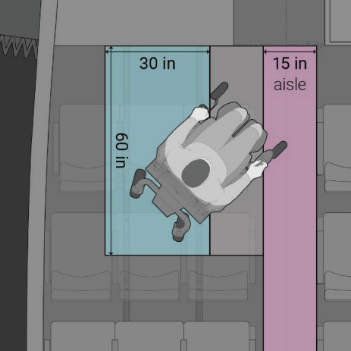
Key Findings: Removal of Airplane Seats
The removal of two successive rows of seats should provide sufficient room for:
• a 30- × 60-in. space for the securement location with space to maneuver and use essential WC position functions, and
• for the WC to maneuver laterally between the aisle and the securement space without requiring changes to other seating or to aisle widths.

Slide 17
Key Findings: Removal of Airplane Seats (continued)
Removal of two successive rows of seats near the boarding door should:
provide clear space to satisfy FAA injury criteria for both the wheelchair occupant and nearby passengers
free up enough airplane floor structure to accommodate the imparted load of the heaviest of occupied power WCs using commonly employed load distribution systems (e.g., pallets)

Slide 18
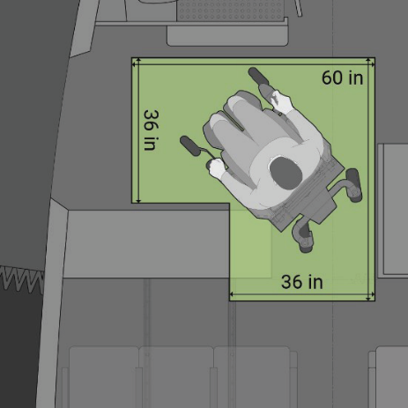
Key Findings: Maneuvering Inside the Cabin
Maneuvering the WC between the entryway and cabin aisle entails the execution of a 90-degree turn.
Airplane interior features that intrude on these clear spaces would need to be resized or relocated to provide the needed space.

Slide 19

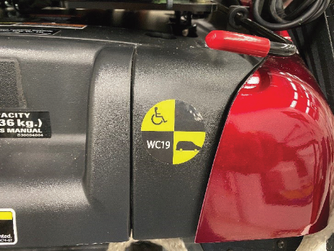
Key Findings: WC19 Standards
Many personal wheelchairs comply with motor vehicle transportation safety and crash performance standards (WC19) for wheelchairs established by the Rehabilitation Engineering and Assistive Technology Society of North America (RESNA).

Slide 20
Key Findings: WC19-compliant Wheelchairs
WC19-compliant personal wheelchairs are designed to:
• Retain their form, stay upright with the restrained occupant remaining in a seated posture, and retain their battery when subject to 20-g impact forces characteristic of a 30-mph frontal motor vehicle crash when the WC is secured to the vehicle by a system that performs under this dynamic loading
• Accommodate a WC-anchored pelvic safety belt that will stay in place and restrain the occupant during a frontal crash

Slide 21
Key Findings: WC19-compliant Wheelchairs (continued)
WC19-compliant personal wheelchairs also are designed to provide four standardized points with slot-type geometries (e.g., brackets) for attaching tiedown straps for in-vehicle securement.

Slide 22
Key Findings: FAA Safety Criteria
More work is needed to understand how secured personal wheelchairs are likely to perform relative to certain FAA safety criteria in restraining and protecting occupants during a survivable airplane crash or emergency landing.

Slide 23
Key Findings: WC-19 Standards and FAA Standards
• RESNA’s crash performance test for WC19 wheelchairs has some similarities with FAA dynamic crash tests for airplane seats in which the predominant impact vector is horizontal.
• However, RESNA’s WC19 standard does not include a test condition comparable to FAA’s second dynamic crash test in which the predominant impact vector is vertical.
• RESNA’s flammability testing standards for wheelchairs also differ from FAA’s standards for airline seats.
RESNA standards establish a baseline minimum level of crash and safety performance that many WCs comply with today, which can facilitate further evaluation of WCs for compliance with FAA criteria.

Slide 24
Key Findings: Operational and Passenger Accommodation Issues
Operational and passenger accommodation issues that would warrant further careful consideration include:
• provision of needed passenger assistance and service,
• fare reservation system capabilities,
• procedures for validating WC boarding eligibility, and,
• protocols and power management for controlling WC seating functions in flight.

Slide 25
Conclusions
The committee did not identify any issues from the information available that seem likely to present design and engineering challenges so formidable that they call into question the technical feasibility of an in-cabin WC securement system and the value of exploring the concept further.
The extent to which the assurance of reliable and sufficiently available securement systems on airplanes could create operational and accommodation challenges will depend in part on the level of passenger demand for in-cabin wheelchair service and the nature of this demand.

Slide 26
Recommendation 1: Program of Research
To fill the identified information gaps:
The U.S. Department of Transportation and Federal Aviation Administration (FAA) establish a program of research,
(in collaboration with the Rehabilitation Engineering and Assistive Technology Society of North America (RESNA) and the assistive technology industry,)
…to test and evaluate an appropriate selection of WC19-compliant wheelchairs in accordance with applicable FAA crashworthiness and safety performance criteria.

Slide 27
Recommendation 1 (continued): Issues to be Addressed
The research program should address, but not be limited to:
• assessing, the performance of WC19 wheelchairs secured in an airplane cabin during a survivable crash, an emergency landing, and severe turbulence by maintaining their form, restraining their occupants and protecting them from injury,
• retaining batteries and other items of mass, and
• providing adequate fire resistance.

Slide 28
Recommendation 1 (continued): Future Decision Making
The research should be conducted to inform decisions that may need to be made by:
– U.S. DOT and FAA in response to petitions and other requests
– RESNA and the assistive technology industry to identify opportunities to align existing WC transportation safety standards with performance criteria required for airplanes
– airline and aircraft industries to more fully understand the implications of and opportunities for providing travelers the ability to remain seated in their personal WCs

Slide 29
Recommendation 2
The U.S. Access Board should sponsor studies that assess the likely demand for air travel by people who are nonambulatory if they could remain seated in their personal WCs.
Studies should:
• better define the space needed in the airplane cabin for WC maneuvering and securement,
• provide insight into passenger support and service assistance requirements, and
• inform airline decisions about needed levels of fleet coverage and flight availability.

Slide 30
Next Steps: Development of a Roadmap
Future research, testing, and evaluation would be informed by the recommended research and planned and programmed in accordance with a high-level “roadmap” that defines and prioritizes the technical and numerous other decisions to be made and the follow-on work.

Slide 31
Next Steps (continued): Issues to be Addressed in a Roadmap
Example issues to address in a roadmap:
• Identifying priorities for furthering WC engineering and design activities, wheelchair standards
• Identifying areas for regulation development
• Ensuring that wheelchairs brought on board an airplane cabin are kept crashworthy
• Understanding the training requirements for airline personnel
• Understanding likely travel experience of passengers using the systems
• Testing and simulations to confirm the actual amount of cabin space required
• Understanding the implications of wheelchair securements for airplanes on airline operations and economics

Slide 32
Next Steps (continued): Department of Transportation
U.S. DOT would be the logical lead for development of a strategic roadmap:
– in collaboration with agencies and entities identified in the recommendations, and
– with consultation and input from a wide range of interests and experts, including airlines and their passenger service personnel, airframe manufacturers and interior component suppliers, people with disabilities and their advocates, and the assistive technology industry.

