Slide 1
AviationData.csv Risk Analysis
AviationData.csv Insights
Presented by,
David Muriithi.
April,29th 2025.

Slide 2
Introduction:
The purpose of this analysis is to help make informed investment decision based on the historical data.
Objective:
To determine the aircraft with lowest risk by studying the Aviation data patterns and trends
Data overview
The dataset is from National Transportation Safety Board that includes aviation accident data from 1962 to 2023 about civil aviation accidents and selected incidents in the United States and international waters.
The data contains 88,889 rows and 31 columns.
There are 6 critical columns in the dataset namely:
Total.Serious.Injuries
Total.Minor.Injuries
Total.Uninjured
Event.Date
Weather.Condition
Total.Fatal.Injuries

Slide 3
Data Cleaning
For there to be a thorough and informative analysis the following steps were undertaken
Identifying the missing data and filling the values apart from the critical columns
Identifying the duplicates and dropping them
Standardizing the date format
Visualization
Creating an interactive dashboard

Slide 4
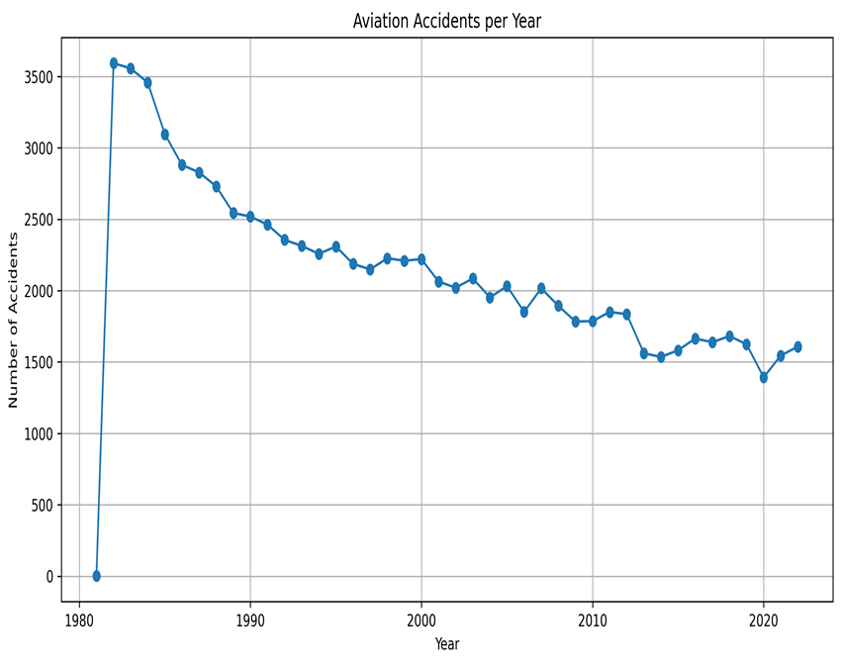
Accident counts
The accident have gone done in the recent years as shown by the line graph.
This could be attributed to the fact that probably the companies have been able to mitigate the causes of the accidents therefore this are good times to invest in the aviation industry

Slide 5
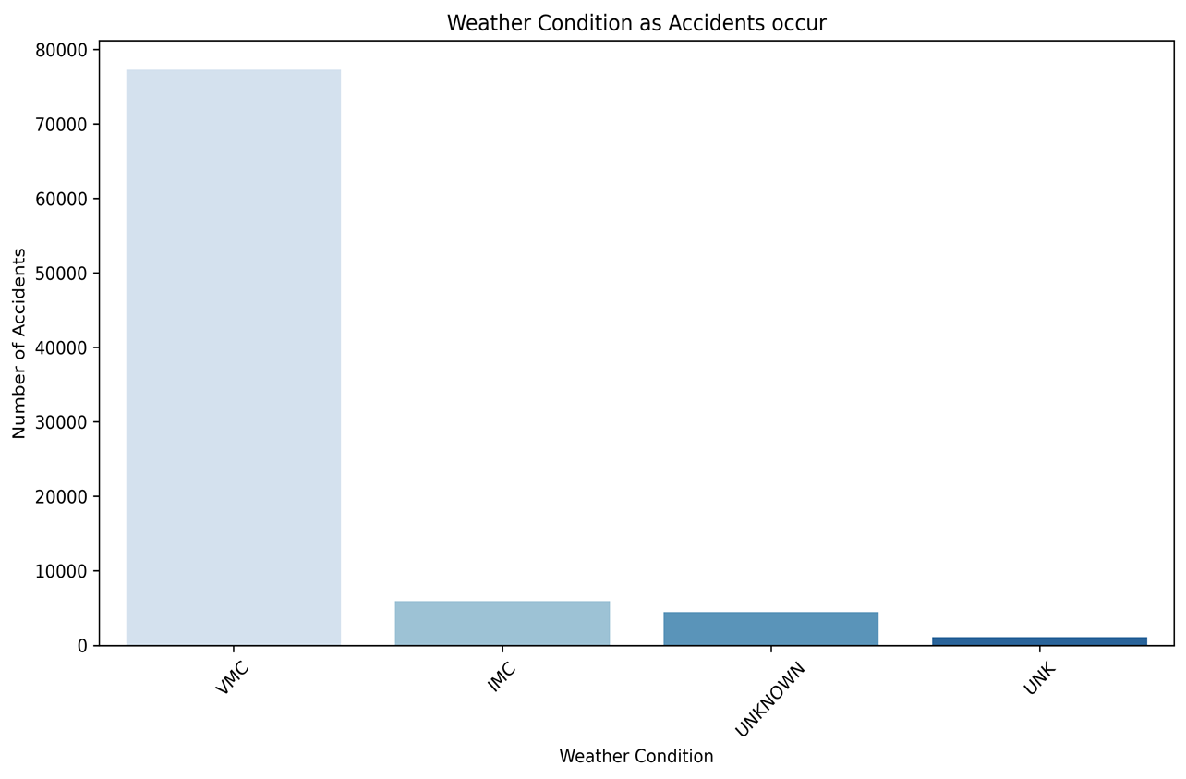
Weather condition vs Accident
Most of the accidents occur when the weather is vmc, therefore the aircraft should be operating during the other weather condition to mitigate the losses
This indicates operations should be minimal during the Vmc condition.

Slide 6
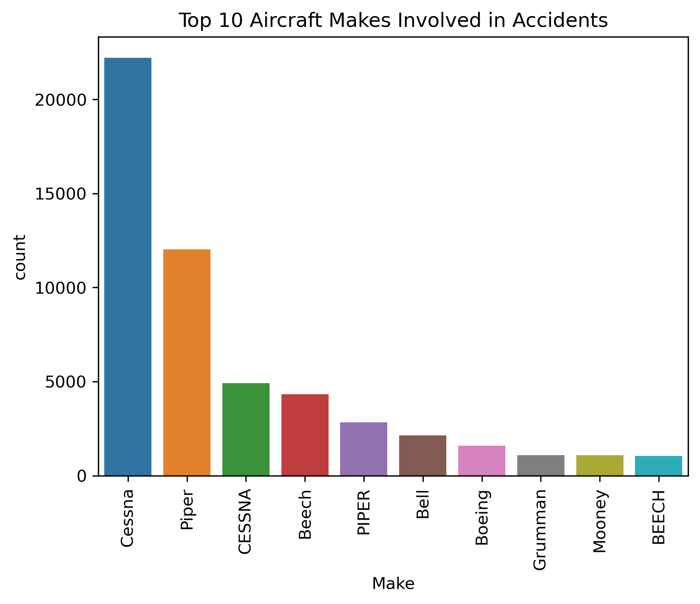
Makes mostly involved in accidents
This bar graph sorts the 10 most makes involved in accidents by the number of times they are involved in the accident.
Cessna,piper ,Beech are high risk and the company should invest in the other makes

Slide 7
Recommendation and findings
The following are the recommendation occurring from the analysis
The accidents are the going down over the number of years and it’s a good time for the company to venture into the aviation industry
The company aircraft operations should be lowest during the VMC condition and therefore operate highly during the other weather condition
The cessen,piper and Beech are likely to cause accidents and the company should invest in the other makes
As the number of engines increases the injury severity increases and the Boeing has the lowest fatality at category one and therefore the company should invest in Boeing.
Boeing also has the highest total of uninjured at 89,051 and the company should invest in Boeing.

Slide 8
Conclusion
The company should invest in Boeing because as the number of engines increases the injury severity increases and the Boeing has the lowest fatality at category one. Boeing also has the highest total of uninjured at 89,051
The company operation should be lowest during the VMC condition

