Slide 1
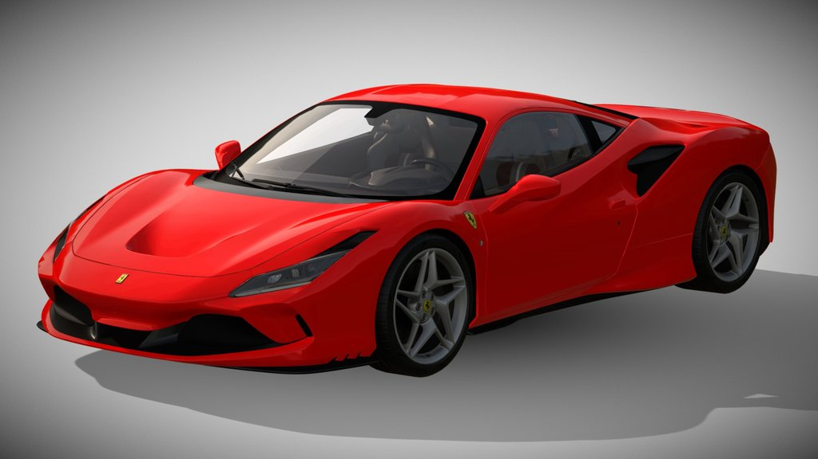
Limitless Deal Hub
Interactive 3D car showroom
Durim Memishi
Computer Graphics project
Ferrari F8 Tributo source model preview
01
Notes:
Timing 0:00–0:30
My project is Limitless Deal Hub, an interactive car showroom built for Computer Graphics. A visitor can inspect a vehicle in 3D, customize its appearance and take that design into a controllable city scene. I will explain the graphics, the account system and the database, then show a short demonstration.
Implementation sources:
https://github.com/Dm31650/comp-graph-project/blob/14b42a9/src/App.jsx
https://github.com/Dm31650/comp-graph-project/blob/14b42a9/src/data/cars.js
Image: Ferrari F8 Tributo source model preview. Artist: Ddiaz Design. Creative Commons Attribution 4.0. Source, license and adaptations: https://comp-graph-project.vercel.app/models/MODEL-CREDITS.md

Slide 2
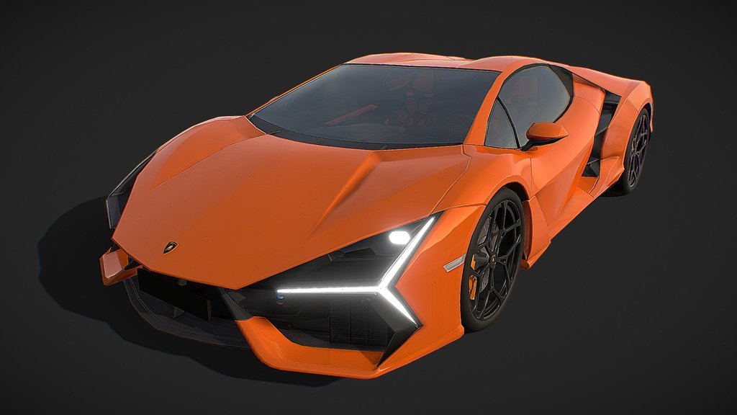
Project aim and scope
12 vehicles across 9 brands
Interactive inspection and material editing
A controllable city for the selected design
Educational prices and arcade driving
Lamborghini Revuelto source model preview
02
Notes:
Timing 0:30–1:10
The aim is to make vehicle exploration interactive. Instead of relying only on prepared photographs, users can rotate a model and observe changes to its materials and lighting. The current collection contains 12 vehicles from nine brands. The application is an educational prototype, so prices and checkout are demonstrations, and driving uses arcade physics.
Implementation sources:
https://github.com/Dm31650/comp-graph-project/blob/14b42a9/src/data/cars.js
https://github.com/Dm31650/comp-graph-project/blob/14b42a9/src/pages/TestDrive.jsx
Image: Lamborghini Revuelto source model preview. Artist: ALIEEEN. Creative Commons Attribution 4.0. Source, license and adaptations: https://comp-graph-project.vercel.app/models/MODEL-CREDITS.md

Slide 3
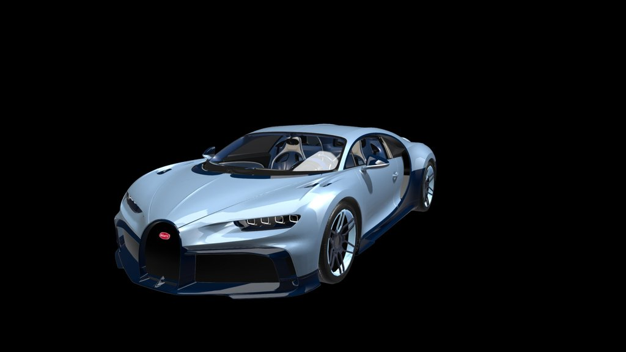
Website walkthrough
01 Browse brands and filter the collection
02 Shortlist cars on this device
03 Compare up to three vehicles
04 Open the studio or personal garage
Bugatti Chiron Profilée source model preview
03
Notes:
Timing 1:10–1:55
The home page introduces the 3D model and the brand carousel. Users can filter the catalog by brand or powertrain, search for a car and change the sort order. A heart control saves a shortlist on this device. They can compare up to three cars before opening the customization page. Accounts add a profile, named saved designs and a persistent cart. A device shortlist and a named account design are different types of saved information.
Implementation sources:
https://github.com/Dm31650/comp-graph-project/blob/14b42a9/src/components/BrandCarousel.jsx
https://github.com/Dm31650/comp-graph-project/blob/14b42a9/src/components/CarCollection.jsx
https://github.com/Dm31650/comp-graph-project/blob/14b42a9/src/pages/VehicleCompare.jsx
Image: Bugatti Chiron Profilée source model preview. Artist: DisneyCars. Creative Commons Attribution 4.0. Source, license and adaptations: https://comp-graph-project.vercel.app/models/MODEL-CREDITS.md

Slide 4
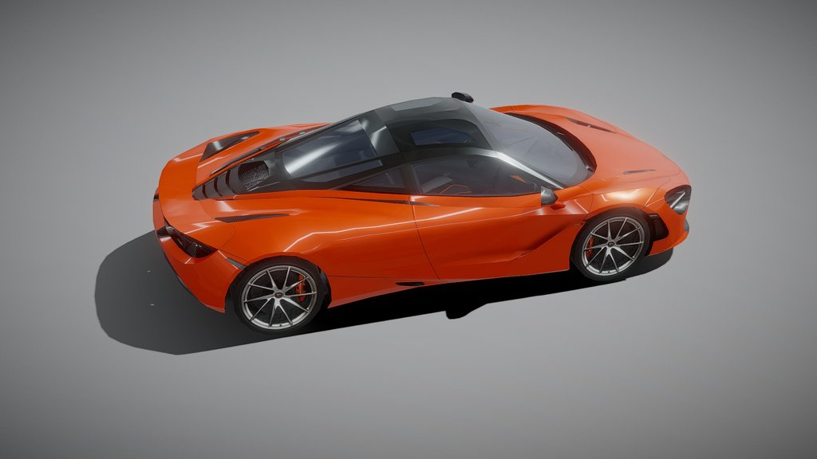
Three.js implementation
GLB assets load into a Three.js scene
Transforms prepare the assembly reveal
Materials respond to light and user input
Wheel pivots animate rotation and steering
McLaren 720S source model preview
04
Notes:
Timing 1:55–2:50
Three.js renders the scene. React Three Fiber connects it to React, and Drei supplies controls and scene utilities. Each catalog ID maps to a local GLB model. The application prepares its geometry, then applies lighting, camera controls and an assembly animation. Model materials are mapped to body, wheel and glass roles. The wheel rig creates four axle-centered pivots. Compressed models can contain integer attributes, so the preparation step converts positions and recomputed normals to floating-point data before transforming the geometry. Meshes contain geometry and materials. Transformations place them in the scene. Lights, cameras and frame updates determine what the user sees.
Implementation sources:
https://github.com/Dm31650/comp-graph-project/blob/14b42a9/src/components/CarModel.jsx
https://github.com/Dm31650/comp-graph-project/blob/14b42a9/src/components/carAssembly.js
https://github.com/Dm31650/comp-graph-project/blob/14b42a9/src/components/carCustomization.js
https://github.com/Dm31650/comp-graph-project/blob/14b42a9/src/components/wheelRig.js
Image: McLaren 720S source model preview. Artist: _shobh19. Creative Commons Attribution 4.0. Source, license and adaptations: https://comp-graph-project.vercel.app/models/MODEL-CREDITS.md

Slide 5
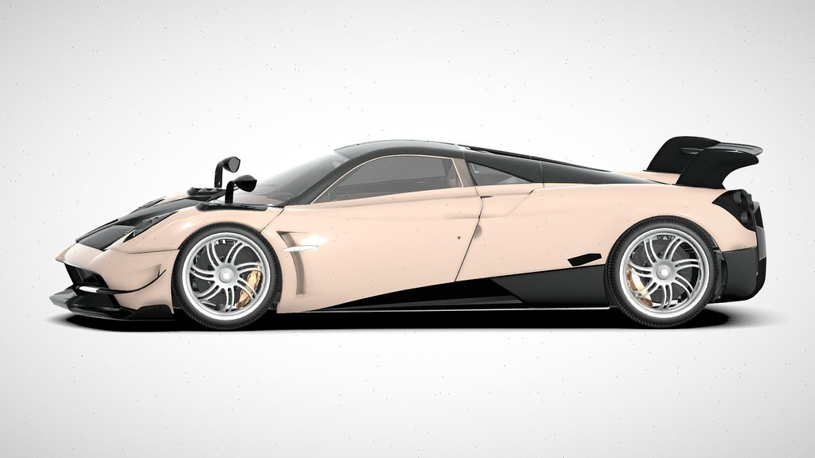
Customization and saving
Body paint and wheel finish stay independent
Lighting changes the surface appearance
Browser drafts save the current vehicle build
Named designs and carts belong to an account
Pagani Huayra source model preview
05
Notes:
Timing 2:50–3:50
The design state keeps paint, finish, graphics, wheels, tint and studio lighting as separate fields. Changing wheels therefore preserves the body paint. The browser automatically saves a draft for each vehicle. A signed-in user can also name a design and save it through the API. That account record can later reopen the model or launch a drive. The cart stores a snapshot of the configuration, so two different designs of the same car remain separate items. Use Test drive my design to pass the selected studio configuration into the game.
Implementation sources:
https://github.com/Dm31650/comp-graph-project/blob/14b42a9/src/components/CarCustomizer.jsx
https://github.com/Dm31650/comp-graph-project/blob/14b42a9/src/cart/cart.js
https://github.com/Dm31650/comp-graph-project/blob/14b42a9/src/components/SavedDesigns.jsx
Image: Pagani Huayra source model preview. Artist: Black Snow. Creative Commons Attribution 4.0. Source, license and adaptations: https://comp-graph-project.vercel.app/models/MODEL-CREDITS.md

Slide 6
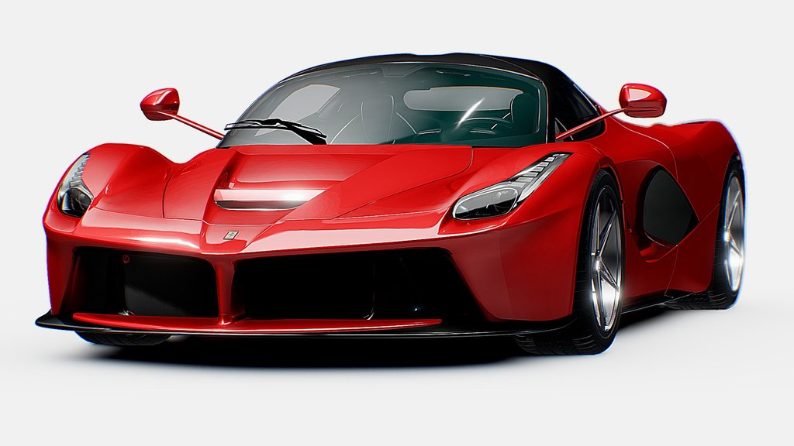
City driving
W / S accelerate and reverse A / D steer
Space brakes C changes camera Esc pauses
Animated wheels, traffic and pedestrians
Day and night lighting with a moving sun and moon
Ferrari LaFerrari source model preview
06
Notes:
Timing 3:50–4:50
The city uses keyboard or touch input to update a vehicle simulation. Small time steps make movement more consistent across frame rates and support collision checks. W and S control acceleration and reverse, A and D steer, and Space brakes. The wheel pivots rotate with speed and the front wheels steer. Traffic, pedestrians and signals animate the environment. Day and Night interpolate the sky and lighting while moving the sun and moon. Camera presets and a free view let the user inspect the car while driving. Speed values are arcade settings rather than a complete driving simulator. Touch controls and Lite graphics are available.
Implementation sources:
https://github.com/Dm31650/comp-graph-project/blob/14b42a9/src/pages/TestDrive.jsx
https://github.com/Dm31650/comp-graph-project/blob/14b42a9/src/pages/drivingPhysics.js
https://github.com/Dm31650/comp-graph-project/blob/14b42a9/src/pages/CityLife.jsx
https://github.com/Dm31650/comp-graph-project/blob/14b42a9/src/pages/DriveSky.jsx
Image: Ferrari LaFerrari source model preview. Artist: vecarz. Creative Commons Attribution 4.0. Source, license and adaptations: https://comp-graph-project.vercel.app/models/MODEL-CREDITS.md

Slide 7
Backend and database
Local development
Deployed website
React and Vite
Node HTTP API
SQLite file created automatically
React build on Vercel
Vercel API function
Neon PostgreSQL
Users, sessions, carts and designs
Owner checks and session cookies protect account records
07
Notes:
Timing 4:50–5:45
The frontend calls same-origin API routes for accounts, profiles, carts and saved designs. On my PC, a Node server creates a SQLite database automatically. In deployment, a Vercel function connects to Neon PostgreSQL. The main records are users, sessions, carts and designs. The backend derives password hashes with scrypt and identifies signed-in users through a session cookie. Queries restrict saved records to their owner. Local accounts and cloud accounts are separate, and signing out does not delete an account’s saved cart or designs.
Implementation sources:
https://github.com/Dm31650/comp-graph-project/blob/14b42a9/server/index.mjs
https://github.com/Dm31650/comp-graph-project/blob/14b42a9/server/cloud-handler.mjs
https://github.com/Dm31650/comp-graph-project/blob/14b42a9/server/postgres.mjs
https://github.com/Dm31650/comp-graph-project/blob/14b42a9/src/auth/AuthContext.jsx

Slide 8
Live demonstration
01 Browse and compare Ferrari, Bugatti and Pagani
02 Change body paint, then wheel finish
03 Save a named design to the profile
04 Drive that design, brake and switch to Night
05 Show the saved entry if time permits
comp-graph-project.vercel.app
08
Notes:
Timing 5:45–7:25
Preparation: use a signed-in demonstration account and preload the Ferrari model. Do not display passwords or personal records. About 15 seconds: show the collection and /compare?cars=7,9,11. About 25 seconds: open /cars/7#customize-car, change body paint, select Gold wheels and switch one lighting preset. About 15 seconds: name the design Presentation Ferrari and choose Save to my profile. Wait for the success message. About 35 seconds: choose Test drive my design. Wait until Start / resume drive is enabled, start, accelerate briefly, steer and brake. Choose Left or Right camera and Night. Pause before returning. About 10 seconds: show the saved profile entry if loading allowed enough time. If the network fails, use a prepared local copy and local account, or continue explaining the workflow. Never claim a failed save succeeded.
Implementation sources:
https://github.com/Dm31650/comp-graph-project/blob/14b42a9/src/components/CarCustomizer.jsx
https://github.com/Dm31650/comp-graph-project/blob/14b42a9/src/components/SavedDesigns.jsx
https://github.com/Dm31650/comp-graph-project/blob/14b42a9/src/pages/TestDrive.jsx

Slide 9
Evaluation and next steps
13 automated regression checks passed at the baseline
6 new models passed integration checks
Next: device measurements, API tests and account recovery
Third-party assets retain their sources and licenses
comp-graph-project.vercel.app
github.com/Dm31650/comp-graph-project
09
Notes:
Timing 7:25–8:00
The baseline passed 13 automated regression checks covering the cart, catalog, material state, driving updates and wheel geometry. All six new models also passed integration checks. The next priorities are broader device performance measurements, API integration tests and account recovery. Third-party models retain their attribution, and the prototype explains its demo limits. The main result is a working connection between web interaction, 3D graphics and persistent user designs. Invite questions. Test success is evidence of selected behaviors rather than complete correctness. The tutorial provides likely questions and a five minute alternative.
Implementation sources:
https://github.com/Dm31650/comp-graph-project/tree/14b42a9/tests/
https://github.com/Dm31650/comp-graph-project/blob/14b42a9/public/models/MODEL-CREDITS.md
https://github.com/Dm31650/comp-graph-project/blob/14b42a9/public/images/brands/CREDITS.md

