Slide 1
Angular 2
Component basics
and templates

Slide 2
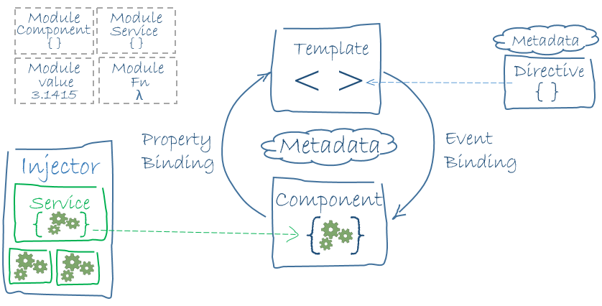
Big picture

Slide 3
Angular module
Angular apps are modular and Angular has its own modularity system called Angular modules or NgModules.
Every Angular app has at least one module, the root module, conventionally named AppModule.
An Angular module, whether a root or feature, is a class with an @NgModule decorator.
import { NgModule } from '@angular/core'; import { BrowserModule } from '@angular/platform-browser'; @NgModule({ imports: [ BrowserModule ], providers: [ Logger ], declarations: [ AppComponent ], exports: [ AppComponent ], bootstrap: [ AppComponent ] }) export class AppModule { }
app/app.module.ts

Slide 4
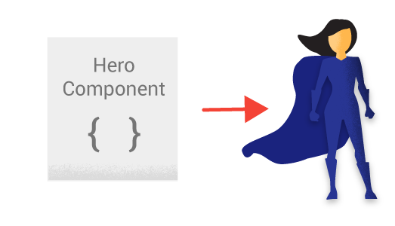
Component
app/hero-list.component.ts
export class HeroListComponent implements OnInit { heroes: Hero[]; selectedHero: Hero; constructor(private service: HeroService) { } ngOnInit() { this.heroes = this.service.getHeroes(); } selectHero(hero: Hero) { this.selectedHero = hero; } }

Slide 5
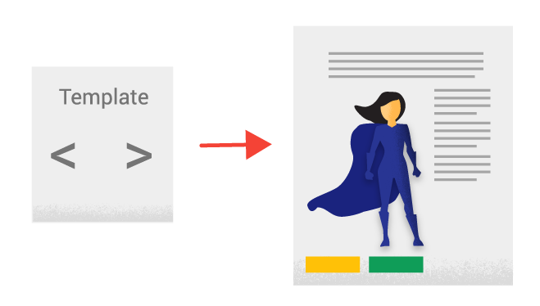
Template
app/hero-list.component.html
<h2>Hero List</h2>
<p><i>Pick a hero from the list</i></p>
<div *ngFor="let hero of heroes" (click)="selectHero(hero)”>
{{hero.name}}
</div>
<hero-detail *ngIf="selectedHero" [hero]="selectedHero”>
</hero-detail>

Slide 6

@Component decorator
@Component({ selector: 'hero-list', templateUrl: 'app/hero-list.component.html'
})
export class HeroesComponent { ... }
selector - a css selector that tells Angular to create and insert an instance of this component where it finds a <hero-list> tag in parent HTML: <hero-list></hero-list>
Angular inserts an instance of the HeroListComponent view between tags.
templateUrl - the address of this component's template

Slide 7
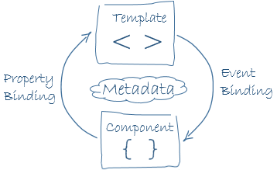
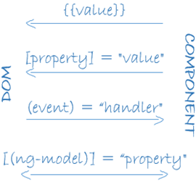
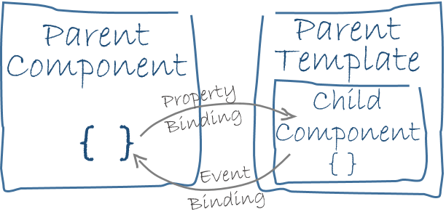
Data binding
template and its component communication
parent and child components communication
app/hero-list.component
<div>{{hero.name}}</div> <hero-detail
[hero]="selectedHero”></hero-detail> <div (click)="selectHero(hero)></div>

Slide 8
Example: component
import {Component} from ’@angular/core';
@Component({ selector: 'my-app', template: ` <h1>{{title}}</h1> <h2>My favorite hero is: {{myHero}}</h2> ` }) export class AppComponent { title = 'Tour of Heroes'; myHero = 'Windstorm'; }
<body> <my-app>Loading...</my-app> </body>
index.html:

Slide 9
Example: create class for data and fill it
hero.ts:
export class Hero { constructor(public id:number, public name:string) { } }
app.component.ts:
export class AppComponent { title = 'Tour of Heroes'; heroes = [ new Hero(1, 'Windstorm'), new Hero(13, 'Bombasto'), new Hero(15, 'Magneta'), new Hero(20, 'Tornado') ]; myHero = this.heroes[0]; }

Slide 10
Example: show the list of heroes
@Component({ selector: 'my-app’, templateUrl: 'app.component.html' }) export class AppComponent { title = 'Tour of Heroes'; heroes = ['Windstorm', 'Bombasto', 'Magneta', 'Tornado']; myHero = this.heroes[0]; }
Template app.component.html:
<h1>{{title}}</h1> <h2>My favorite hero is: {{myHero.name}}</h2> <p>Heroes:</p> <ul> <li *ngFor="let hero of heroes"> {{ hero.name }} </li> </ul> <p *ngIf="heroes.length > 3">There are many heroes!</p>

Slide 11
Example: work with the events
@Component({ selector: 'click-me', template: ` <button (click)="onClickMe()">Click me!</button> {{clickMessage}}` }) export class ClickMeComponent { clickMessage = ''; onClickMe() { this.clickMessage ='You are my hero!'; } }

Slide 12
Example: adding hero form
@Component({ selector: 'little-tour', template: ` <input #newHero (keyup.enter)="addHero(newHero.value)" (blur)="addHero(newHero.value); newHero.value='' "> <button (click)=addHero(newHero.value)>Add</button> <ul> <li *ngFor="let hero of heroes">{{hero}}</li> </ul>
`}) export class LittleTourComponent { heroes=['Windstorm', 'Bombasto', 'Magneta', 'Tornado']; addHero(newHero:string) { if (newHero) { this.heroes.push(newHero); } } }
Notes:
https://angular.io/docs/ts/latest/guide/user-input.html

Slide 13
Example: execute
boot.ts
import {bootstrap} from 'angular2/platform/browser' import {AppComponent} from './app.component' bootstrap(AppComponent);
package.json
name, version
dependencies (SystemJS is used as module system)
devDependencies
tsconfig.json
TypeScript configuration
npm start

Slide 14
Templates

Slide 15
ngIf
The ngIf directive is used when you want to display or hide an element based on a condition. The condition is determined by the result of the expression that you pass in to the directive.
<div *ngIf="false"></div> <!-- never displayed --> <div *ngIf="a > b"></div> <!-- displayed if a is more than b --> <div *ngIf="str == 'yes'"></div> <!-- displayed if str holds the string "yes" →
Angular 2 offers no built-in alternative for ng-show. So, if your goal is to just change the CSS visibility of an element, you should look into either the ngStyle or the class directives.
<!-- isSpecial is true --> <div [class.hidden]="!isSpecial">Show with class</div> <div [class.hidden]="isSpecial">Hide with class</div> <div [style.display]="isSpecial ? 'block' : 'none'">Show with style</div> <div [style.display]="isSpecial ? 'none' : 'block'">Hide with style</div>
When NgIf is false, Angular physically removes the element subtree from the DOM.

Slide 16
ngSwitch
Sometimes you need to render different elements depending on a given condition.
<div class="container" [ngSwitch]="myVar"> <div *ngSwitchWhen="'A'">Var is A</div> <div *ngSwitchWhen="'B'">Var is B</div> <div *ngSwitchDefault>Var is something else</div> </div>
ngSwitchDefault element is optional

Slide 17
ngStyle
With the ngStyle directive, you can set a given DOM element CSS properties from Angular expressions.
The simplest way to use this directive is by doing [style.<cssproperty>]="value":
<div [style.background-color]="'yellow'"> Uses fixed yellow background </div>
Another way to set fixed values is by using the ngStyle attribute:
<div [ngStyle]="{color: 'white', 'background-color': 'blue'}"> Uses fixed white text on blue background </div>

Slide 18
ngStyle: dynamic values
The real power of the NgStyle directive comes with using dynamic values.
<div class="ui input"> <input type="text" name="color" value="{{color}}" #colorinput> </div> <div class="ui input"> <input type="text" name="fontSize" value="{{fontSize}}" #fontinput> </div>
We’re setting the font size based on the input value:
<span [ngStyle]="{color: 'red'}" [style.font-size.px]="fontSize"> red text </span>
<span [ngStyle]="{color: colorinput.value}"> {{ colorinput.value }} text </span>
Otherwise we can use this:
<div [style.background-color]="colorinput.value" style="color: white;"> {{ colorinput.value }} background </div>

Slide 19
ngClass
ngClass directive, represented by a ngClass attribute in your HTML template, allows you to dynamically set and change the CSS classes for a given DOM element.
.bordered { border: 1px dashed black; background-color: #eee; } <div [ngClass]="{bordered: false}">This is never bordered</div> <div [ngClass]="{bordered: true}">This is always bordered</div> <div [ngClass]="{bordered: isBordered}"> Using object literal. Border {{ isBordered ? "ON" : "OFF" }} </div>
List of classes:
<div class="base" [ngClass]="['blue', 'round']"> This will always have a blue background and round corners </div>

Slide 20
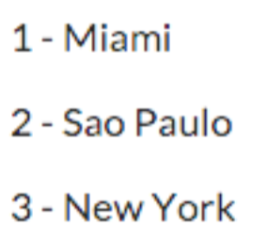
ngFor
The role of this directive is to repeat a given DOM element (or a collection of DOM elements), each time passing it a different value from an array.
The syntax is *ngFor="let item of items".
this.cities = ['Miami', 'Sao Paulo', 'New York'];
<div class="ui list" *ngFor="let c of cities">
<div class="item">{{ c }}</div>
</div>
ngFor with index:
<div class="ui list" *ngFor="let c of cities; let num = index">
<div class="item">{{ num+1 }} - {{ c }}</div>
</div>

Slide 21
* and <template>
When we reviewed the NgFor, NgIf, and NgSwitch built-in directives, we used asterisk (*) that appears before the directive names.
We can do what Angular does ourselves and expand the * prefix syntax to template syntax:
<hero-detail *ngIf="currentHero" [hero]="currentHero">
</hero-detail>
Is the same as
<template [ngIf]="currentHero"> <hero-detail [hero]="currentHero"></hero-detail> </template>

Slide 22
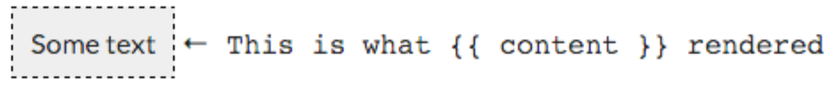
ngNonBindable
We use ngNonBindable when we want tell Angular not to compile or bind a particular section of our page.
Let’s say we want to render the literal text {{ content }} in our template. Normally that text will be bound to the value of the content variable because we’re using the {{ }} template syntax.
<div> <span class="bordered">{{ content }}</span>
<span class="pre" ngNonBindable>
&larr; This is what {{ content }} rendered
</span>
</div>

Slide 23
Property binding
We write a template property binding when we want to set a property of a view element to the value of a template expression.
binding the src property of an image element to a component’s heroImageUrl property:
<img [src]="heroImageUrl">
disabling a button when the component says that it isUnchanged:
<button [disabled]="isUnchanged">Cancel is disabled</button>
setting a property of a directive:
<div [ngClass]="classes">[ngClass] binding to the classes property</div>
setting the model property of a custom component:
<hero-detail [hero]="currentHero"></hero-detail>
Property binding as one-way data binding because it flows a value in one direction, from a component’s data property into a target element property.

Slide 24
Attribute binding
We must use attribute binding when there is no element property to bind.
If we try this:
<tr><td colspan="{{1 + 1}}">Three-Four</td></tr>
We’ll get the error:
Template parse errors:
Can't bind to 'colspan' since it isn't a known native property
<td> element does not have a colspan property. It has the "colspan" attribute, but interpolation and property binding can set only properties, not attributes.
We need attribute bindings to create and bind to such attributes.
<tr><td [attr.colspan]="1 + 1">One-Two</td></tr>

Slide 25
Class binding
We can add and remove CSS class names from an element’s class attribute with a class binding.
Replacement binding:
<!-- reset/override all class names with a binding --> <div class="bad curly special" [class]="badCurly">Bad curly</div>
Angular adds the class when the template expression evaluates to truthy. It removes the class when the expression is falsey.
<!-- toggle the "special" class on/off with a property --> <div [class.special]="isSpecial">The class binding is special</div> <!-- binding to `class.special` trumps the class attribute --> <div class="special" [class.special]="!isSpecial">This one is not so special</div>
For managing multiple class names it’s preferred to use ngClass

Slide 26
Style binding
We can set inline styles with a style binding.
<button [style.color] = "isSpecial ? 'red': 'green'”>Red</button> <button [style.background-color]="canSave ? 'cyan': 'grey'" >Save</button>
Some style binding styles have unit extension. Here we conditionally set the font size in “em” and “%” units:
<button [style.font-size.em]="isSpecial ? 3 : 1" >Big</button> <button [style.font-size.%]="!isSpecial ? 150 : 50" >Small</button>
When setting several inline styles at the same time ngStyle directive is preferrable

Slide 27
Event binding
User actions may result in a flow of data in the opposite direction: from an element to a component. They are described with event bindings:
<button (click)="onSave()">Save</button>
The binding conveys information about the event, including data values, through an event object named $event.
Event object is determined by the target event. If the target event is a native DOM element event, then $event is a DOM event object, with properties such as target and target.value:
<input [value]="currentHero.firstName" (input)="currentHero.firstName=$event.target.value" >

Slide 28
Two-way binding with ngModel
We often want to both display a data property and update that property when the user makes changes.
[( )] = BANANA IN A BOX
Two-way data binding with the NgModel directive makes that easy. Here's an example:
<input [(ngModel)]="currentHero.firstName">
Note: to make [(ngModel)] available we have to import FormsModule in NgModule.
For <input> it’s the same as
<input [value]="currentHero.firstName" (input)="currentHero.firstName=$event.target.value" >
That ngModel directive hides these onerous details behind its own ngModel input and ngModelChange output properties:
<input [ngModel]="currentHero.firstName" (ngModelChange)="currentHero.firstName=$event">

Slide 29
Template reference variables
A template reference variable is a reference to a DOM element or directive within a template.
Note: Do not define the same variable name more than once in the same template. The runtime value will be unpredictable.
<!-- phone refers to the input element; pass its `value` to an event handler --> <input #phone placeholder="phone number"> <button (click)="callPhone(phone.value)">Call</button>

Slide 30
Binding in templates
Data Direction | Syntax | Binding Type
One way from data source to view target | {{expression}} [target] = "expression" | Interpolation Property Attribute Class Style
One way from view target to data source | (target) = "expression" | Event
Two way | [(target)] = "expr” | Two-way

Slide 31
Binding targets
Binding Type | Target | Examples
Property | Element Property | <img [src] = "heroImageUrl">
 | Component Property | <hero-detail [hero]="currentHero"> </hero-detail>
 | Directive property | <div [ngClass] = "{selected: isSelected}"> </div>
Event | Element Event | <button (click) = "onSave()"> Save </button>
 | Component Event | <hero-detail (deleted)="onHeroDeleted()"> </hero-detail>
 | Directive Event | <div myClick (myClick)="clicked=$event">click me</div>
Two-way | Directive Event Property | <input [(ngModel)]="heroName">

Slide 32
Binding targets
Binding Type | Target | Examples
Attribute | Attribute (the exception) | <button [attr.aria-label]="help"> help </button>
Class | class Property | <div [class.special]="isSpecial"> Special </div>
Style | style Property | <button [style.color] = "isSpecial ? 'red' : 'green'">

Slide 33

Thank you and have a great Angular 2 experience!

