Slide 1
Non-destructive testing of gears
Date: 5th June 2025
Subject: Artificial Intelligence in Material Diagnostics
Lecturers: Prof. Dr.-Ing. Constanze Tschöpe, Dr. Ivan Kraljevski
Group Members: Talib Gasanov, Dmitriy Kozyrev, Eric Sprunk, Volodymyr Telesh

Slide 2
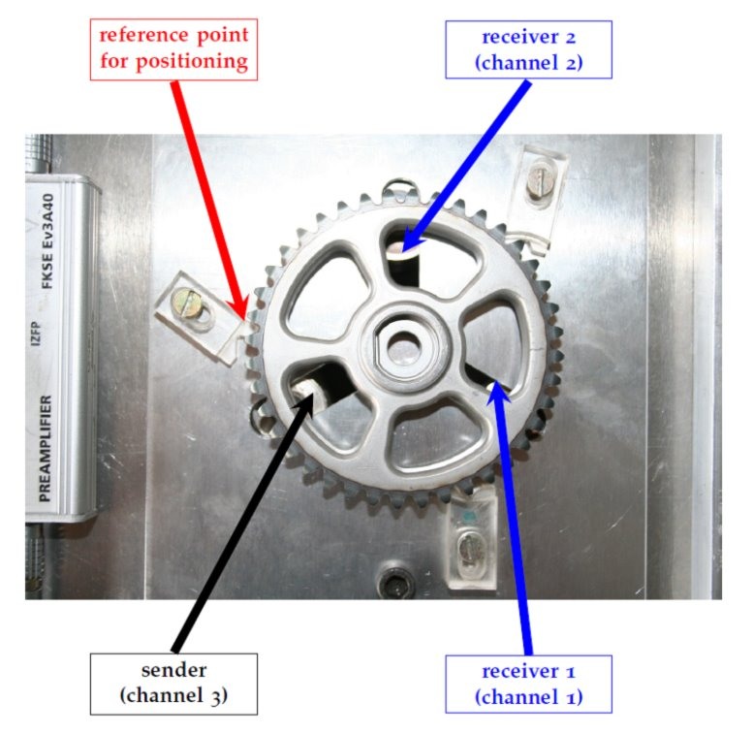
Outline
Introduction and task
Data
Preprocessing
STFT-Calculation
Results of the STFT-Analysis
Comparison
Conclusion

Slide 3
Introduction and task
Material diagnostics is important to detect broken parts of a system like metal or glass
--> ensuring quality control and safety
--> non-destructive testing, so tested actually working materials stay intact
Task:
Distinguish between good and bad gears using acoustic measurement signals
Load the given signals into a dataframe, calculate STFT and plot spectrograms
Compare results and detect the broken gear

Slide 4
2. Data
one dataset of two gears
For each gear four ultrasonic signals taken from two channels
Gears are named Z01 and Z05
One gear is broken and the other one is alright

Slide 5

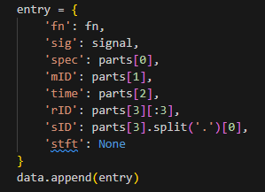
3. PrEpRocessing
We use os.path.join for reading the data
We get all the data with .wav at the end
In 'entry' we put the keys, according to the task
After that we add it to our data list

Slide 6
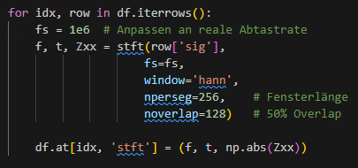
4. STFT-Calculation
Set sampling rate
f: Array with frequencies (in Hz) for the STFT.
t: Array with times we used for calculating STFT
Zxx: Array with STFT-Coefficients (Amplitude and Phase).
Set window-options, for example length and overlap
Save the result of the STFT as a triple (frequency, time, spectrum)

Slide 7
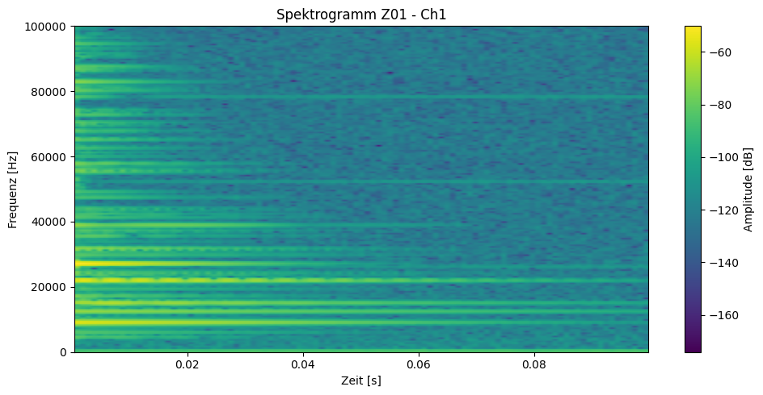
5. Results of the STFT-Analysis Z01 CH1

Slide 8
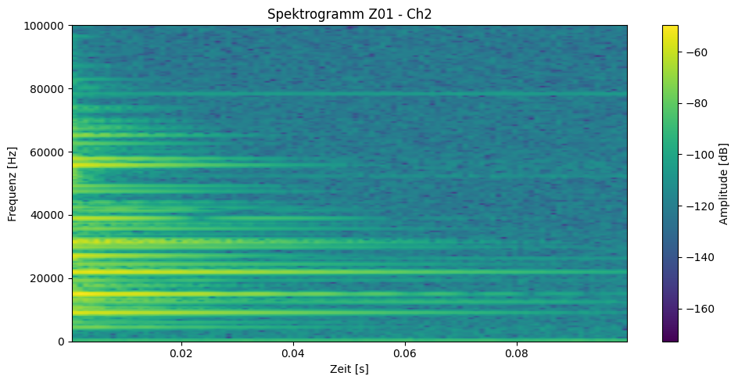
5. Results of the STFT-Analysis Z01 Ch2

Slide 9
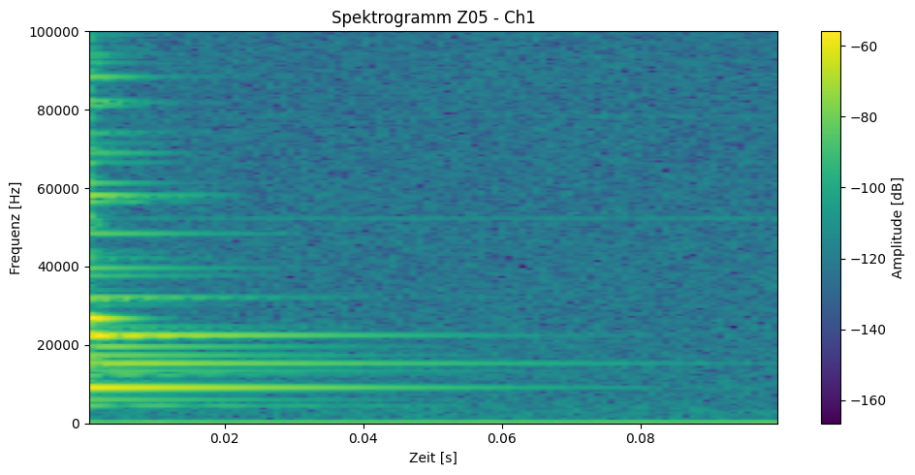
5. Results of the STFT-Analysis Z05 Ch1

Slide 10
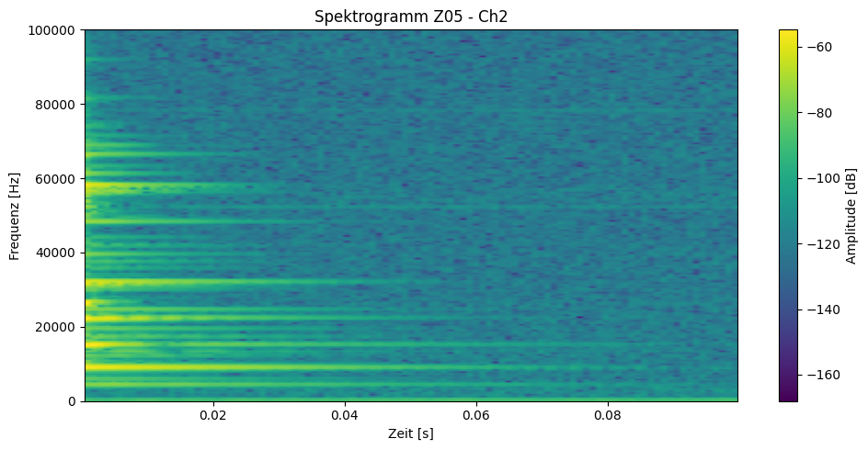
5. Results of the STFT-Analysis z05 Ch2

Slide 11
6. Comparison
Frequencies in Z01 could be heard for a relatively long time
In Z01 there are many noticeable measurements over 20 kHz
Frequencies in Z05 are mostly shorter than in Z01
In Z05 there are barely any good hearable (visible) frequencies above 20 kHz

Slide 12
7. Conclusion
Z01 has higher and longer frequencies than Z05
Those differences are hearable und visible
We compared that situation with wine glasses:
intact glass: longer and higher sounds
broken glass: shorter and mostly deeper sounds

Slide 13
7. Conclusion
That case transmitted to the gears we think that:
Z01 is the intact gear
Z05 is the broken gear

Slide 14
Thank you for your attention

