Slide 1
Strategic Market Analytics for Fracking
AKASH BOSE | ABHINAV CHANDEL | LINHUI FUI | Xing zhang | DMITry chudnosvik
Course : MSBA – PRACTICUM
COMPANY ： DELLOITE

Slide 2
Problem Statement
An off shore gas company wants to expand it’s operations in the States of America. They have limited funding options and are seeking advisory to prioritize fracking sites based on a few predetermined options.
The Procedure followed:
How was it broken down ?
Prioritize based on following factors:
Create a template for selection of oil drills
Apply it to the state of colorado
Research
Collect Data
Ecological
Economical
Sentiments
Create Model

Slide 3
The Prioritization stairs
Ecological
0.6955 (9X)
Sentimental
0.2290 (3X)
Economical
0.0754
Notes:
Sentimental is 4 times important than Economical,
Ecological is 4 times important than Sentimental
Ecological is 7 times important than Economical
This is when the objective is more ecological than environmental.

Slide 4
The Research Framework
During the initial research we contacted multiple fracking consultancies and shortlisted the criteria and sub-criteria which need to be taken into consideration while selecting oil wells.
Ecological
Economical
Sentiments
  Faults
  Groundwater Reserves
  Park conservation Areas
  Urban Areas
  Highway Proximity
  Media Reaction

Slide 5
The Methodology
Once we knew our criteria’s we went ahead to look for the data required, but the search for structured data was futile and instead we went ahead with Geographical Information Systems, in the form of Shapefiles.
Load Shapefile into QGIS
Load Data from QGIS to GRASS GIS
SentimentAnalysis
AHP Analysis
Set the CRS
Use Differencing Algorithm to remove conservation areas
Use Geospatial Analysis to find the distance of each site from the faults,Highways and Urban Areas.
Select sites farthest from faults and Urban Areas ( cutoff can be varied depending on the number of sites required in the last step)
Using python to create a tool to automate scraping of media articles of different dilling locations
Using AFINN-111 to do sentiment analysis on these articles and give them scores
Determine the payload matrix depending on the distance and Sentiment ratio’s
Get the final prioritization using Analytic Hierarchy Process
Notes:
World Azimuthal Distance
The most common CRS for geospatial analysis
Python _ Selenium & Beautiful Soup
AFIN-111 to do the sentiment.
AFINN is a list of English words rated for valence with an integer
between minus five (negative) and plus five (positive). The words have
been manually labeled by Finn Årup Nielsen in 2009-2011. The file
is tab-separated. There are two versions:
AFINN-111: Newest version with 2477 words and phrases.

Slide 6
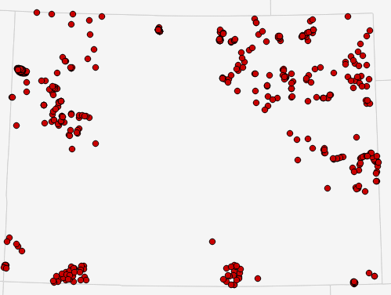
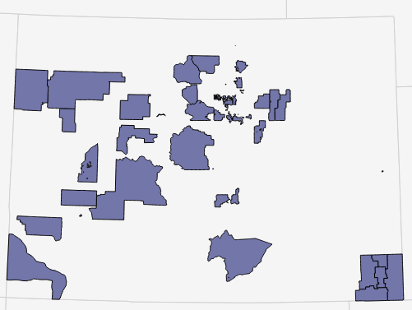
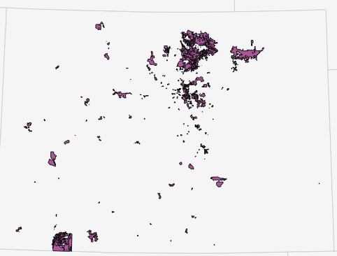
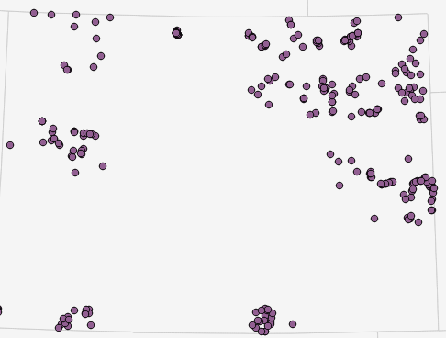
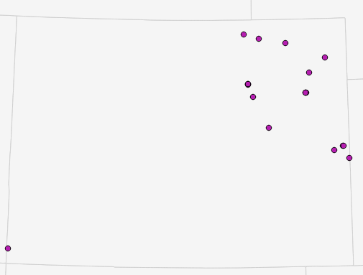
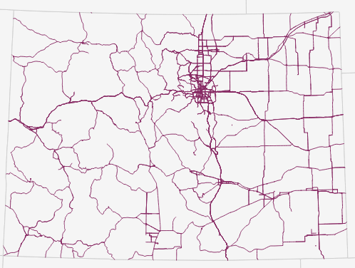
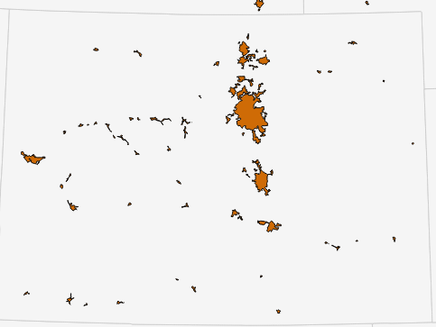
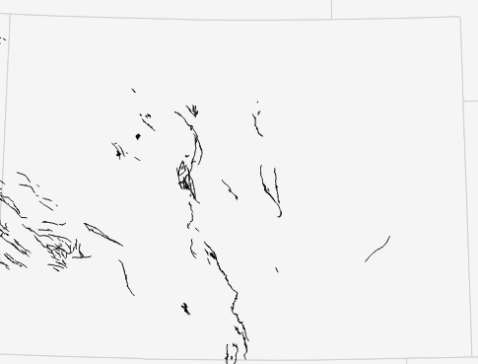
Geo-Spatial Analysis ( QGIS and Grass GIS)
All sites in the state of Colorado(641)
Park Conservation Areas
Water Conservation Areas
After Differencing Algorithm (399)
Nearest Neighbor Analysis
Main roads
Urban Areas
Earthquake Faults

Slide 7
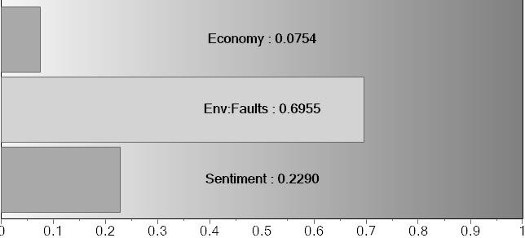
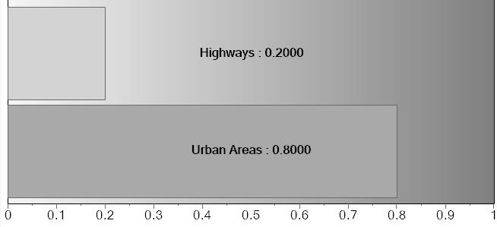
AHP diagram
Analytic Hierarchy Process is a judgement and sentiment based hierarchal system. Using pairwise comparison we try to figure the weights of each criteria and create a priority matrix so that the CR remains less than 10%.
Goals
Select fracking Sites
Objectives/Criteria
Economical
Ecological
Sentiment
Sub Criteria
Urban Areas
Highways
Faults
Alternatives
Alt 18
Alt 1
Alt 2
Alt 3
Alt 4
Alt 5
Alt 6
Alt 7
Alt 8
Alt 9
Alt 10
Alt 11
Alt 12
Alt 13
Alt 14
Alt 15
Alt 16
Alt 17

Slide 8
The Priority Pyramid.
Drill 1 (0.0718)
Drill 6 (0.0684)
Drill 4 (0.0627)
Drill 2 (0.0694)
Drill 5 (0.0621)
Drill 17(0.0517)
Drill 14(0.0509)
Drill 12(0.0503)
Drill 13(0.0492)
Drill 15(0.0317)
Drill 18(0.0385)
Drill 11(0.0634)
Drill 3 (0.0633)
Drill 9 (0.0560)
Drill 7 (0.0538)
Drill 8 (0.0530)
Drill 10(0.0608)
Drill 16(0.0427)

Slide 9
Learning Issues
Data Conversion
Factor Prioritization
Data Collection

Slide 10
Implications
Flexible Model for changing objectives
Zero Cost Visual Deployment Alternative
Remove deadlock by weighted mathematical factors
Notes:
Notes :
Based on the client’s focus i.e. PR/ ESR/ Cost the the alternatives can change while selection during the Geospatial data, also the priority vector will assign different priorities to the factors depending on the goals of the company
No need of expensive geospatial visualization software‘s as the output can be in form of KML file and can be presented in Google earth or in forms of heat maps/locations on QGIS
Similar placed oil wells can be separated by priority vectors backed by data. often location can be extremely close to each other and it becomes difficult to select one of the two just be normal qualitative inspection. Because of the weights small changes such as distances can have larger impacts in the priority value.

Slide 11
Implications
Reduction of time in collecting quantitative data
PR Team can focus on the lower weighted factors
Precaution against negative public sentiment
Notes:
4. A lot of time goes in collecting structured quantitative data, which can be reduced as our model takes qualitative data and converts them into quantitative data. This qualitative data is easily available on state and federal websites.
5.Fracking a lot of times attract negative attention from all corners and it is impossible to track and solve all of them, the prioritized factor tells us which factors are giving least importance and the team can move bottom – up on lookout of such negative attention.
6. We are also aware of the sentiment’s in the area where drilling needs to be done, which can help the client take precautionary steps to protect public image

Slide 12
Thank you.
Questions?

Slide 13
Appendix
A. SHAPEFILES
B. DISTANCE ALGORITHM
C. NEAREST NEIGHBOUR ANALYSIS
D. AHP MODELLING
  D.1 PAIRWISE COMPARISON SCORE
  D2. PRIORITY VECTOR GRAPH AND CR
D. GOOGLE MAPS LINK

Slide 14
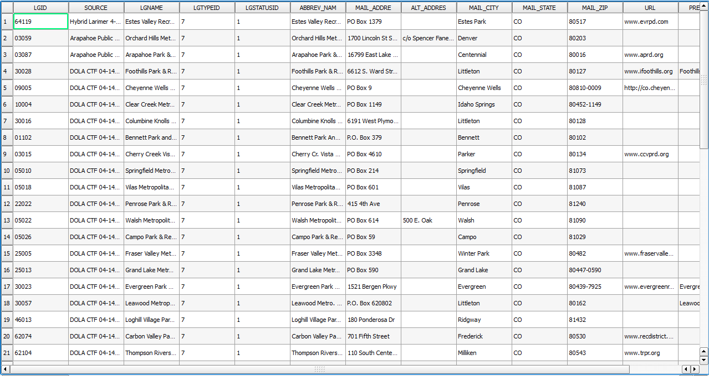
A.Shapefiles
Shapefiles are location based data which lead to mapping on a GIS software

Slide 15
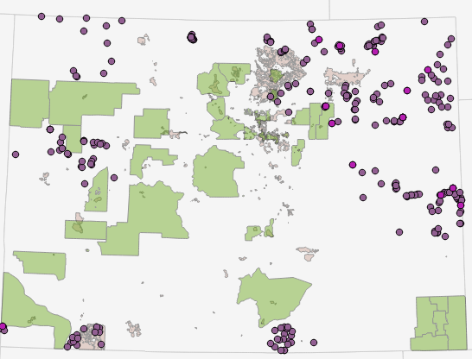
B. DIFFERENCE ALGORITHM

Slide 16
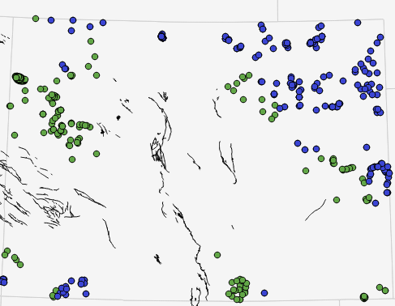
C. NEAREST NEIGHBOUR ANALYSIS
Choosing the farthest from the faults.
Green – Before
Blue – After

Slide 17
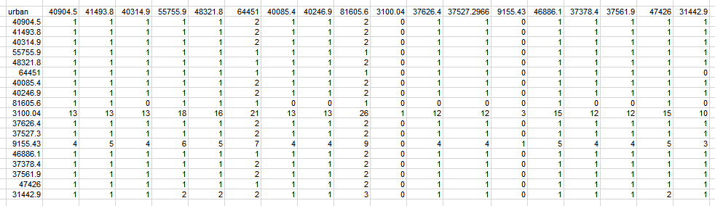
D. AHP
D.1 PAIRWISE COMPARISON SCORE

Slide 18
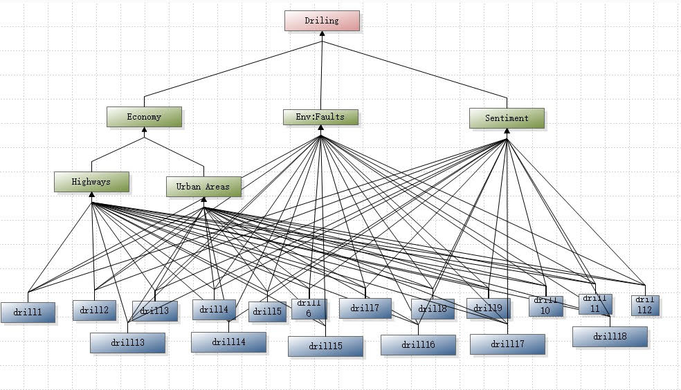
D.AHP
D.2. MODEL GRAPH

Slide 19
E.GOOGLE MAPS
https://www.google.com/maps/d/u/0/edit?mid=1vqRY-jNgrV6909_K5656Woy9lZ8&ll=38.930756991467554%2C-105.5405015&z=7

