Slide 1
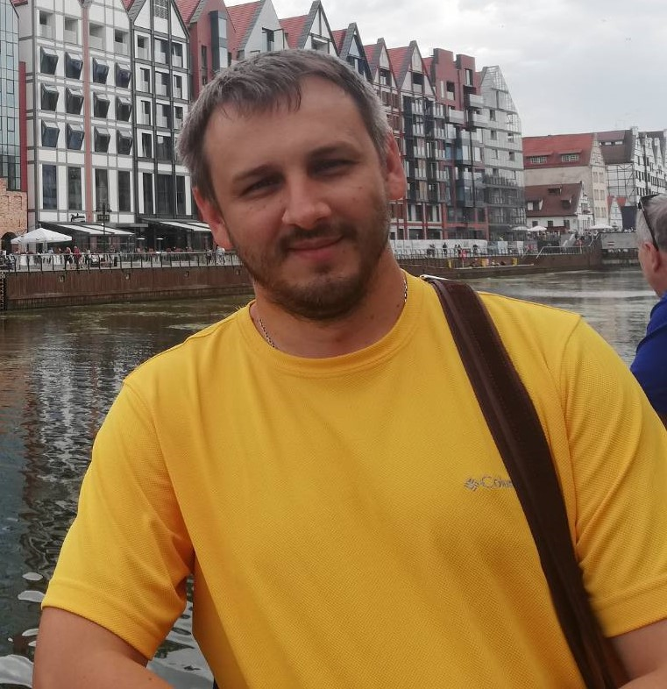
Make your own bot
Dzmitry Lapunou
Senior Software Engineer in MSTD BY
https://github.com/SychevIgor/pronet_docker Content link. Replace

Slide 2
Agenda:
Bots are coming
A bot is a web service
Language Understanding Service
Two types of queries
Virtual Assistant Template

Slide 3
Bots are coming
Gartner
Chatbots will power 85% of all customer service interactions by the year 2020
By 2022, 70% of white-collar workers will interact with conversational platforms on a daily basis.
Source: https://www.gartner.com/smarterwithgartner/chatbots-will-appeal-to-modern-workers/

Slide 4

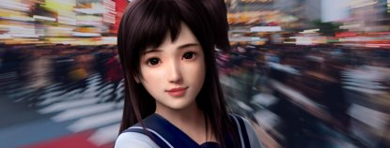
Xiaoice

Slide 5


A bot is a web service
Web service

Slide 6
A bot is a web service
Web service
POST
DELETE
GET

Slide 7
A bot is a web service
BOT

Slide 8
A bot is a web service
BOT
One end point
POST

Slide 9
A bot is a web service
BOT
One end point
FREE TEXT
POST

Slide 10

A bot is a web service
BOT
One end point
FREE TEXT
POST

Slide 11

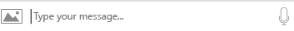
Language Understanding Service
One end point
POST
What time in London?
What time in London?

Slide 12

Language Understanding Service
One end point
POST
What time in London?
{
"query": "What time in London?",
"topScoringIntent": {
"intent": "KnowTime",
"score": 0.9887482
},
"entities": [ {
"entity": "london",
"type": "Location",
"score": 0.956781447
"startIndex": 13,
"endIndex": 16,
}]
}
What time in London?

Slide 13
Language Understanding Service
One end point
POST
What time in London?
200
What time in London?
{
"query": "What time in London?",
"topScoringIntent": {
"intent": "KnowTime",
"score": 0.9887482
},
"entities": [ {
"entity": "london",
"type": "Location",
"score": 0.956781447
"startIndex": 13,
"endIndex": 16,
}]
}
London time is 5:32 p.m.

Slide 14
Language Understanding Service
{
"query": "What time in London?",
"topScoringIntent": {
"intent": "KnowTime",
"score": 0.9887482
},
"entities": [ {
"entity": "london",
"type": "Location",
"score": 0.956781447
"startIndex": 13,
"endIndex": 16,
}]
}
What time in London?

Slide 15
Classification

Slide 16
Classification
k nearest neighbors
Color
Size

Slide 17
Classification
k nearest neighbors
Color
Size

Slide 18
Classification
k nearest neighbors
Color
Size

Slide 19
Classification
k nearest neighbors
Color
Size

Slide 20
Classification
k nearest neighbors
Color
Size

Slide 21
Classification
k nearest neighbors
Color
Size

Slide 22
Two types of queries
Getting information

Slide 23
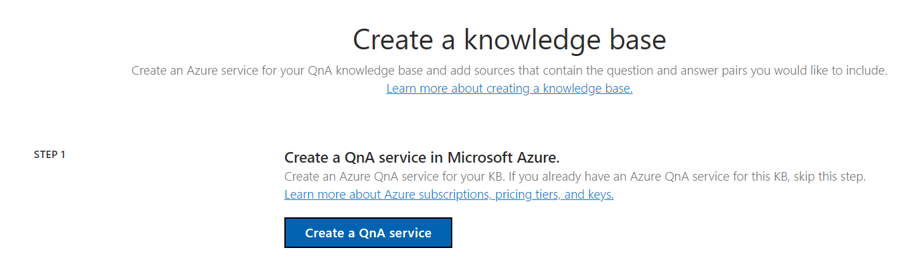
QnA Maker (https://www.qnamaker.ai/) - Step 1

Slide 24
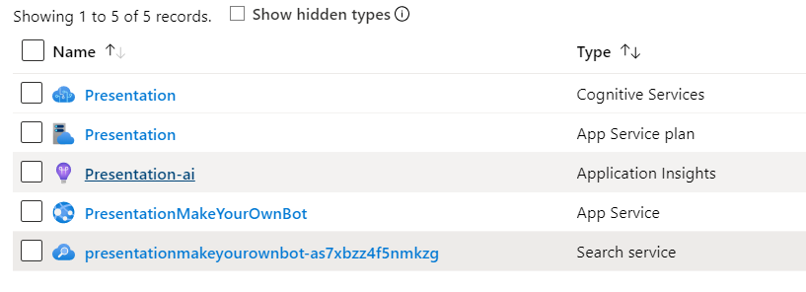
QnA Maker – Azure side

Slide 25
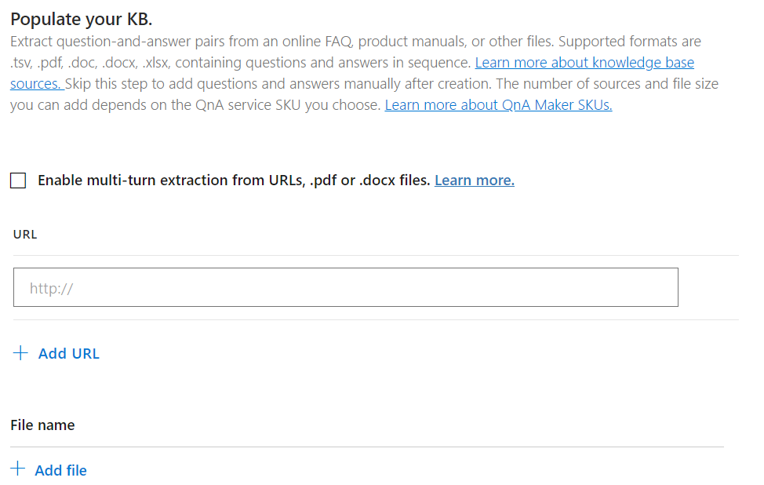
QnA Maker - Step 4

Slide 26
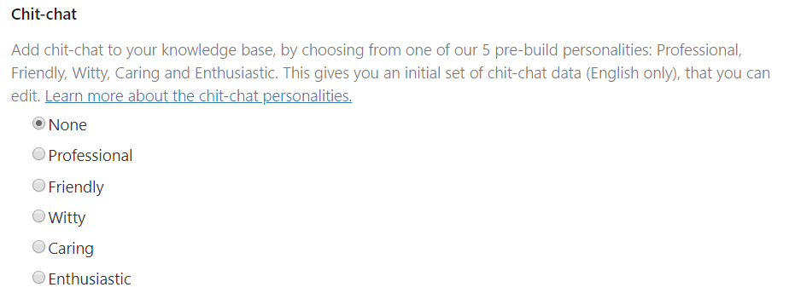
QnA Maker - Step 4

Slide 27
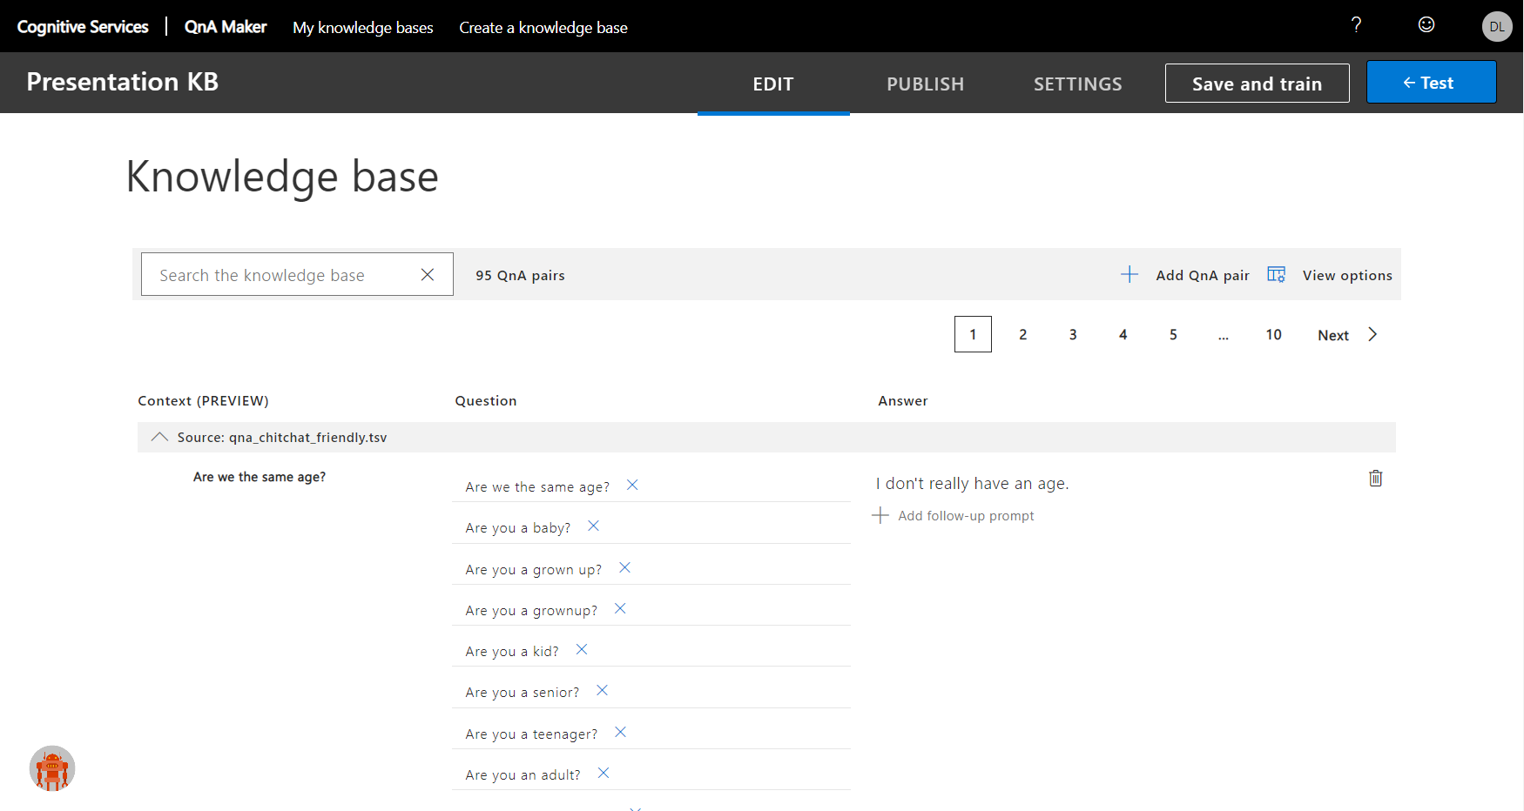
QnA Maker - KB

Slide 28

Bot with 1 KB
One end point
Chit-chat KB
POST
Hi!
200
Hi!
Hi there!

Slide 29
Bot with 2 KBs
One end point
POST
Hi!
Chit-chat KB
FAQ

Slide 30
Bot with 2 KBs
One end point
POST
Hi!
Chit-chat KB
FAQ

Slide 31
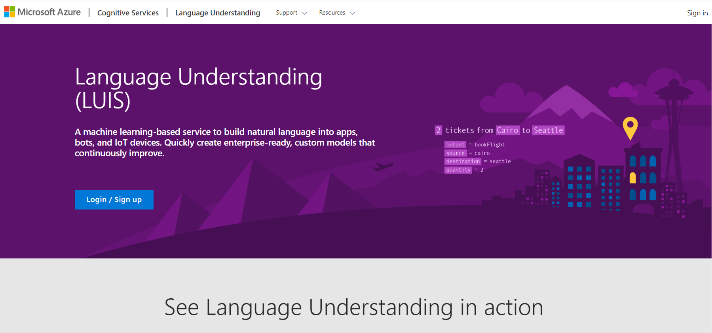
LUIS (https://www.luis.ai)

Slide 32
Dispatch Command Line tool
https://github.com/microsoft/botbuilder-tools/tree/master/packages/Dispatch
Node.js version 8.5 or higher
dispatch init
dispatch add -t qna -i 3bcd1eb7-1354-4f0c-99d2-34f24910adee -n ChitChat -k e6e125c
Cfc2640a0a64a2fbd4c09db6f
dispatch add -t qna -i 0ded18ea-58fc-453c-ad94-5cd7654ad627 -n MicrosoftFAQ -k e6e
125ccfc2640a0a64a2fbd4c09db6f

Slide 33
Dispatch Command Line tool – {MyName}.dispatch
"services": [
{
"kbId": "3bcd1eb7-1354-4f0c-99d2-34f24910adee",
"subscriptionKey": "e6e125ccfc2640a0a64a2fbd4c09db6f",
"type": "qna",
"name": "ChitChat",
"id": "1"
},
{
"kbId": "0ded18ea-58fc-453c-ad94-5cd7654ad627",
"subscriptionKey": "e6e125ccfc2640a0a64a2fbd4c09db6f",
"type": "qna",
"name": "MicrosoftFAQ",
"id": "2"
}
],
{
"authoringRegion": "westeurope",
"hierarchical": true,
"useAllTrainingData": false,
"dontReviseUtterance": false,
"copyLuisData": true,
"services": ...
"authoringKey": "e6e125ccfc2640a0a64a2fbd4c09db6f",
"version": "Dispatch",
"region": "westeurope",
"type": "dispatch",
"name": "PresentationDispatch"
}

Slide 34
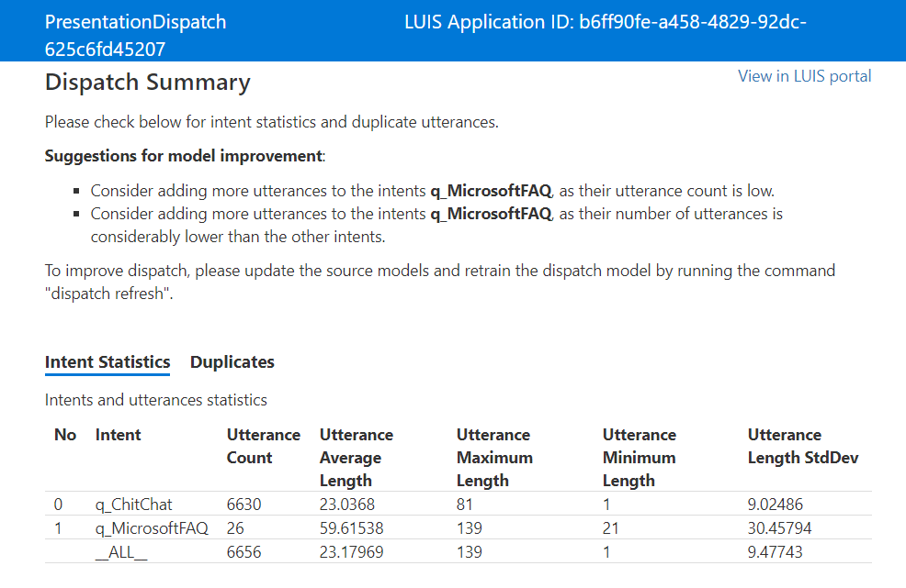
Dispatch Command Line tool – Summary.html (dispatch create)

Slide 35
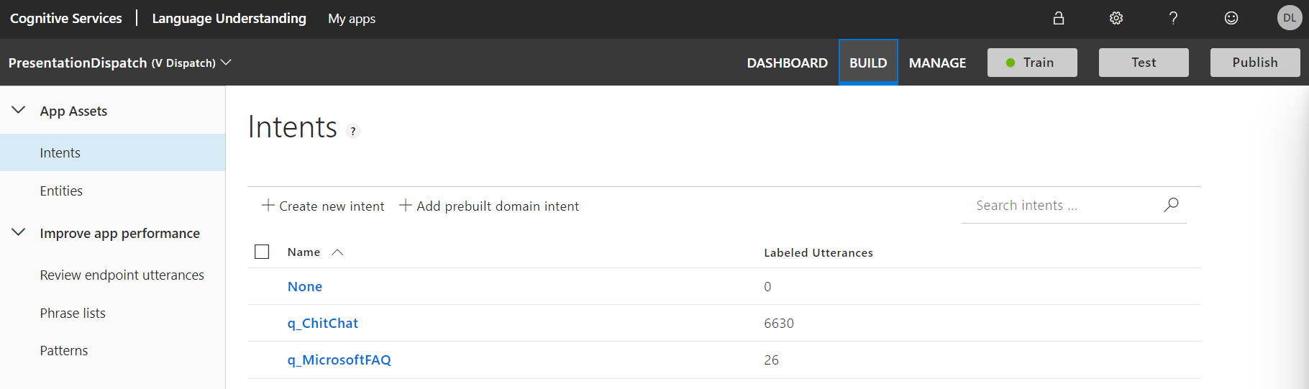
Luis.ai

Slide 36
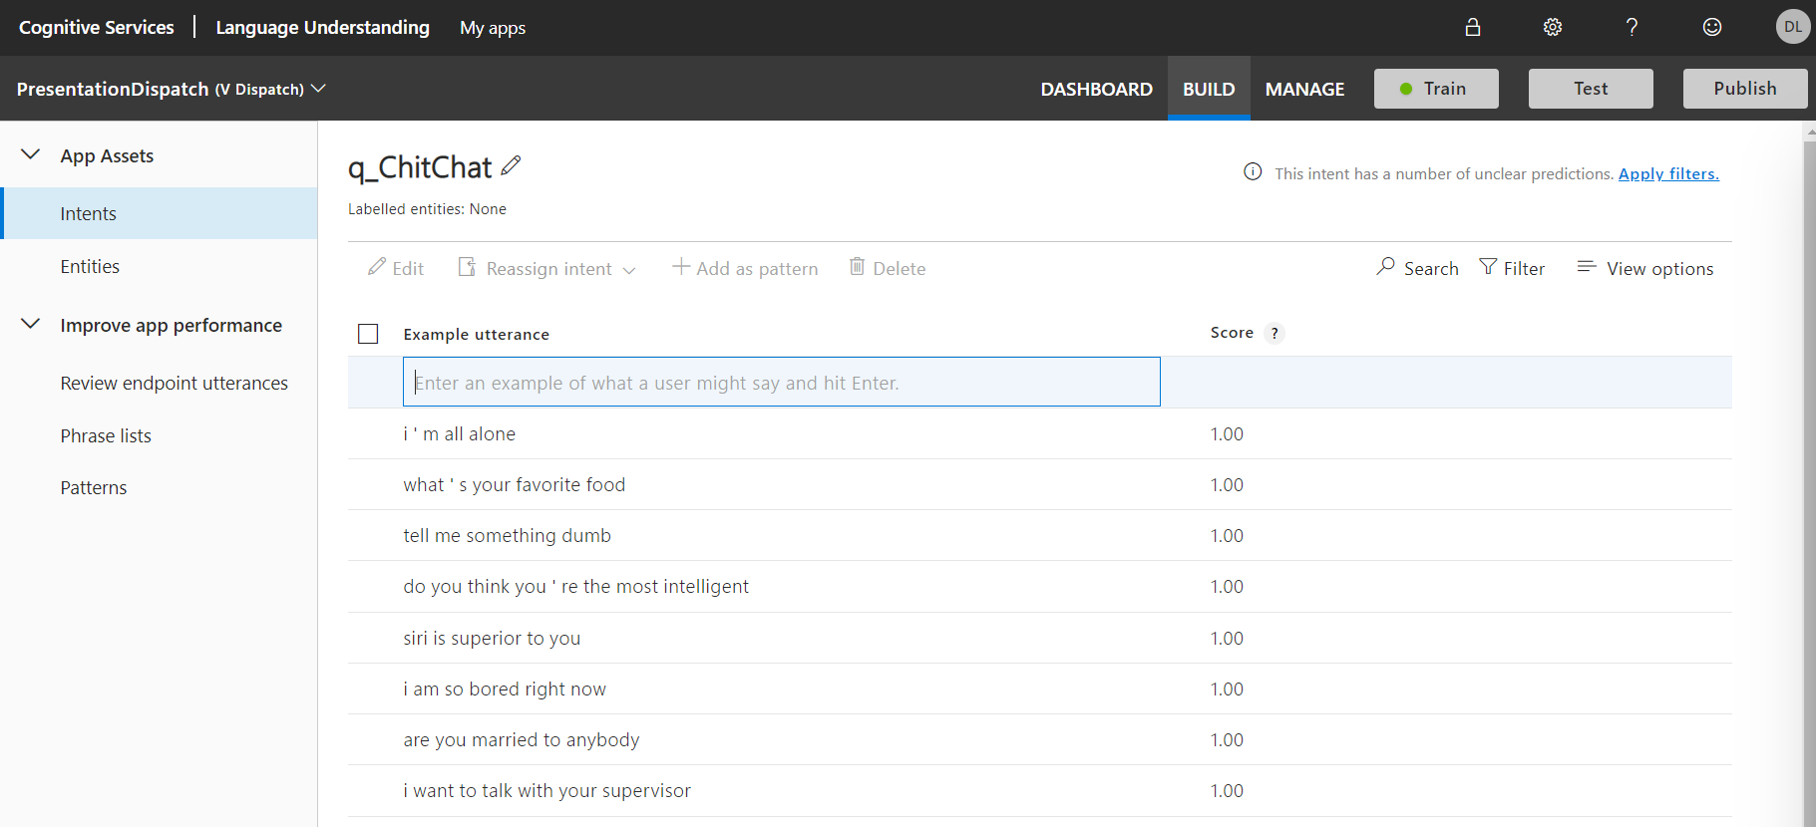
Luis.ai

Slide 37
Bot with 2 KBs
One end point
POST
Hi!
Hi!
Chit-Chat
Chit-chat KB
FAQ

Slide 38
Bot with 2 KBs
One end point
POST
Hi!
Hi!
Chit-Chat
Hi!
Hi there!
Chit-chat KB
FAQ

Slide 39
Bot with 2 KBs
One end point
POST
Hi!
200
Hi!
Hi there!
Chit-Chat
Hi!
Hi there!
Chit-chat KB
FAQ

Slide 40
Bot with N KBs
One end point
POST
Hi!
200
Hi!
Hi there!
Chit-Chat
Hi!
Hi there!
KB N
KB 1
Chit-chat KB
FAQ

Slide 41
Two types of queries
Getting information
Doing something

Slide 42
Doing something
Order taxi
Where from?
My current location
Where to?
Airport
Your taxi will arrive in 5 mins

Slide 43
Doing something
Dialogs:
Bot framework
Class
Inherit form base dialog (Component)
Steps
A dialog can call another dialog
Stack
Activity (do not go to luis every time)
Add to LUIS a new app with your Intents
Order taxi
Where from?
My current location
Where to?
Airport
Your taxi will arrive in 5 mins

Slide 44
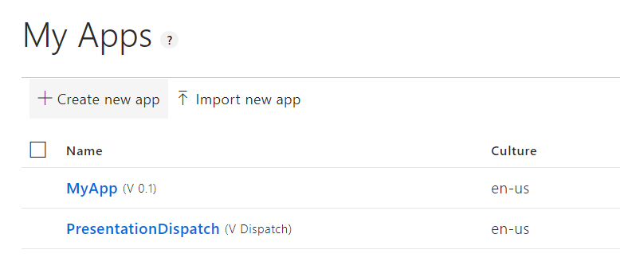
Doing something - MyApp

Slide 45
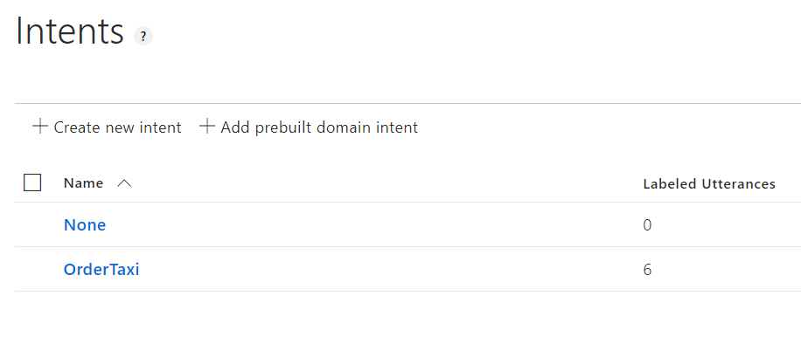
Doing something - MyApp
Add utterances

Slide 46
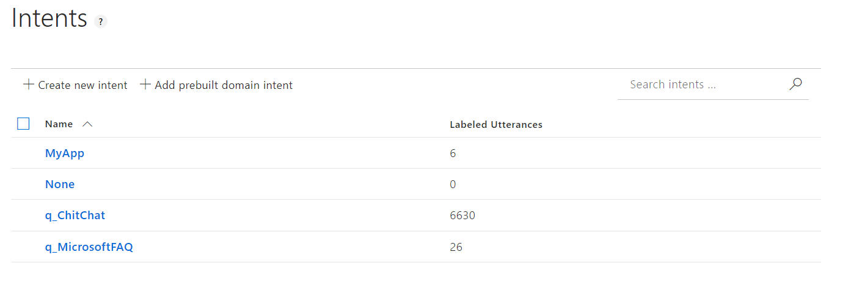
Doing something – Dispatch (after 'dispatch refresh')

Slide 47
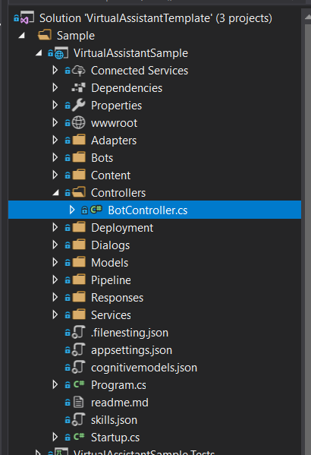
Virtual Assistant Template - Code

Slide 48
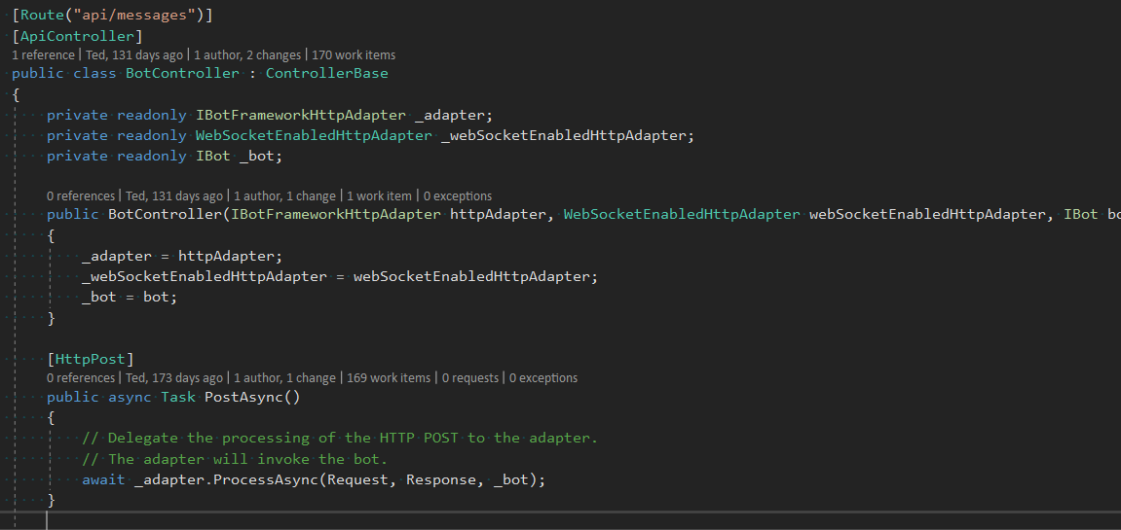
Virtual Assistant Template - Code

Slide 49
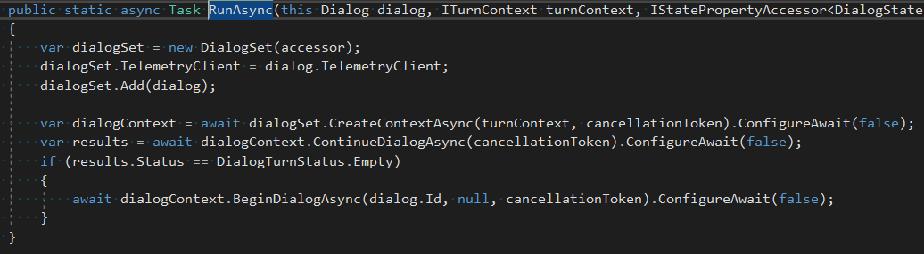
Virtual Assistant Template - Code
namespace Microsoft.Bot.Builder.Dialogs

Slide 50
Virtual Assistant Template - Code
Main - routing
https://github.com/microsoft/botbuilder-tools/blob/master/packages/LUISGen/src/npm/readme.md
JSON -> CS

Slide 51
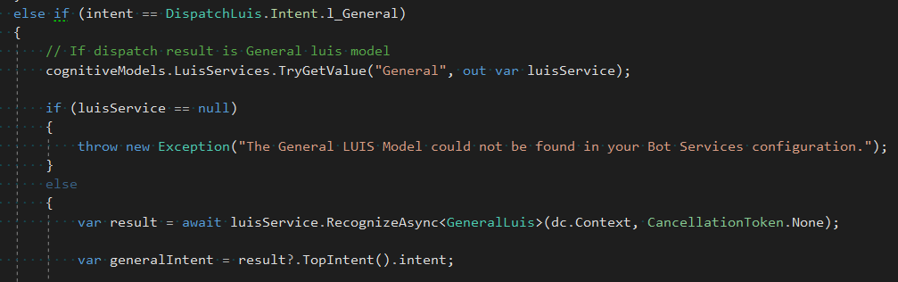
Virtual Assistant Template - Code

Slide 52
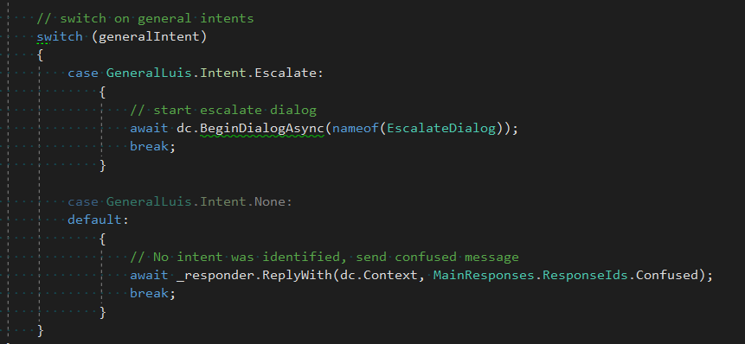
Virtual Assistant Template - Code

Slide 53
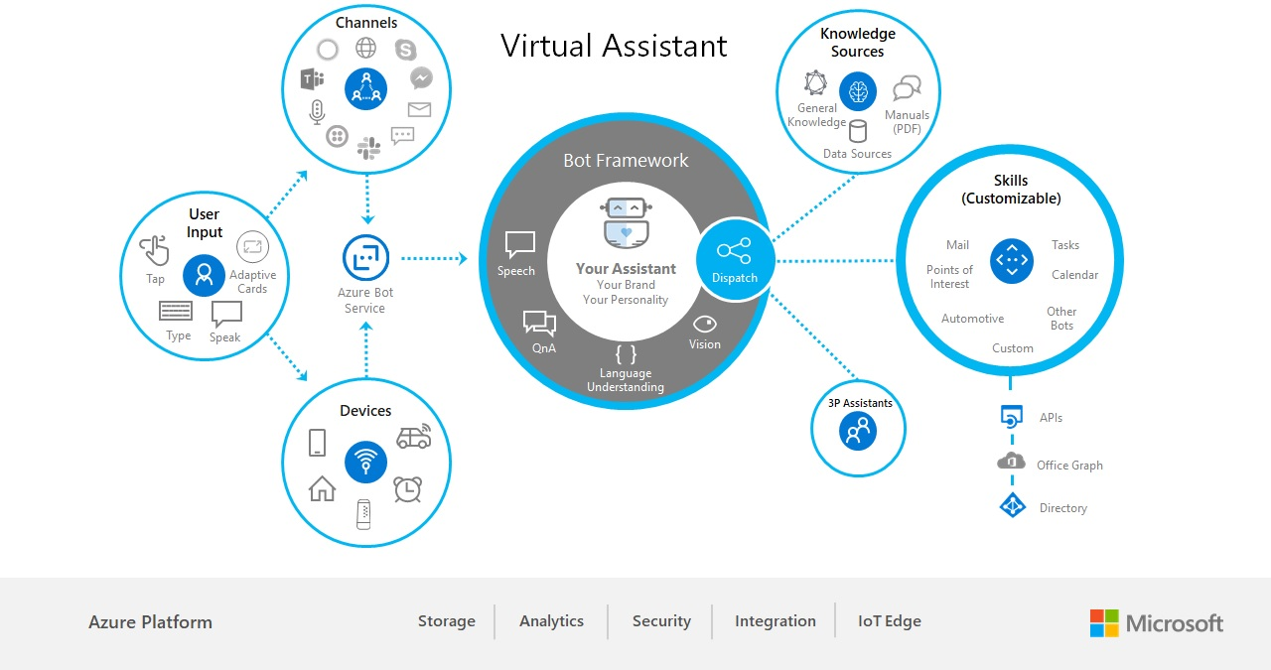
Virtual Assistant template
Notes:
Рассказать про шаблон.
Рассказать про проблемы, которые у нас были (нельзя локально тестить в тимз, при изменении что-нибудь в Luis или qna - регрессия, qna должны быть сбалансированы)
Рассказать про концепцию диалогов (???)
Показать Main Dialog (где идет запрос на дистпатчер). Показать диалоги, promts, actions

Slide 54
Useful links
https://microsoft.github.io/botframework-solutions/tutorials/csharp/create-assistant/3_create_project/
https://github.com/microsoft/BotBuilder-Samples
https://github.com/microsoft/botframework-solutions

Slide 55
Thank you! Questions!
https://github.com/SychevIgor/pronet_docker Content link. Replace

