Slide 1
Quantum programming environments
Cojocari Dmitri, IS11Z

Slide 2
Table of contents
Introduction
IBM Quantum Experience
IBM Quantum Services
Circuit Composer
Quantum Processor
Circuit Simulator
Quantum Assembly Language
OpenQASM
Quantum Experience Standard Header
OpenQASM in IBM Quantum Experience
Quantum Adder
Qiskit SDK
Conclusions

Slide 3
Introduction
Computers
Classical computing
Quantum computing

Slide 4
IBM Quantum Experience
IBM Quantum Services
Circuit Composer
Quantum Processor
Circuit Simulator

Slide 5
IBM Quantum Services
IBM was the first to make their quantum processors available over the internet (over the “cloud”), and their online platform is called IBM Quantum Experience.

Slide 6
Circuit Composer
The Circuit Composer provides a drag-and-drop interface for programming quantum circuits.

Slide 7
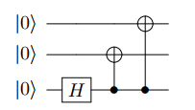
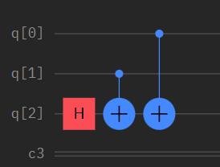
Circuit Composer

Slide 8
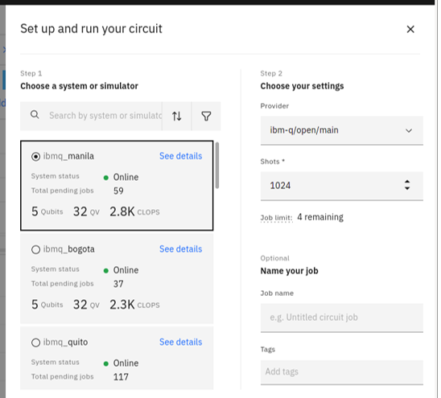
Quantum Processor
It is possible to run the quantum circuit on one of IBM’s actual quantum processors.

Slide 9
Circuit Simulator
Sometimes, it can take a long time for a job to make it through the queue for an actual quantum processor. Or, the available quantum processors have too few qubits. In these cases, using a simulator rather than an actual quantum processor may be favorable.

Slide 10
Quantum Assembly Language
Open QASM
Quantum Experience Standard Header
OpenQASM in IBM Quantum Experience
Quantum Adder

Slide 11
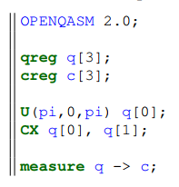
Open QASM
Rather than dragging and dropping quantum gates to create a circuit, they can also be written using programming languages. It is possible to describe quantum circuits using OpenQASM.

Slide 12
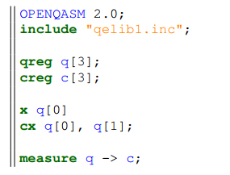
Quantum Experience Standard Header
It would be convenient if commonly used quantum gates like X, Y , Z, H, and others were predefined. Thankfully, these and many of the gates used by IBM Quantum Experience are defined in the library qelib1.inc, called the IBM Quantum Experience standard header.

Slide 13
OpenQASM in IBM Quantum Experience
Besides dragging and dropping quantum gates, IBM Quantum Experience also supports programming using OpenQASM.

Slide 14
Quantum Adder
Another possibility might be to try to write some OpenQASM code to add 1110 + 1011 = 11001 and simulate it in IBM Quantum Experience.

Slide 15
Qiskit SDK
Qiskit is the most powerful way to program IBM’s quantum computers because it provides more functionality than the other approaches, and it also allows users to use Python’s vast network of packages and libraries.

Slide 16
Conclusions
Quantum computing is progressing from an academic research interest to a nascent industry.
Quantum Computing is here to stay for a long time. Even though it is still at its origins, it has the potential to revolutionize the world and to attain such heights that no one ever thought was possible.

Slide 17


