Slide 1
Quantum computing
By: Cojocari Dmitri

Slide 2
Contents
Introduction
Key concepts and principles of quantum mechanics
Why do we need quantum computing?
Quantum computers
Practical applications
Quantum programming languages
Advantages
Disadvantages
Conclusions

Slide 3
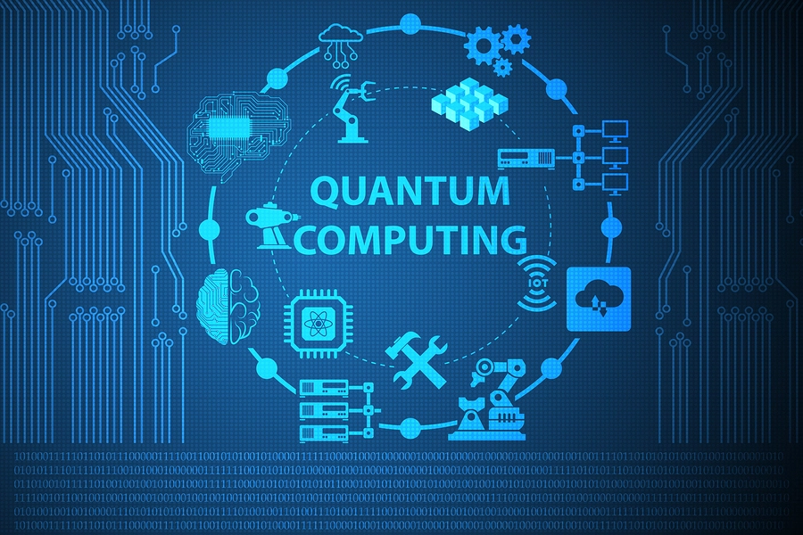
Introduction
Quantum computing represents a new paradigm that utilizes the fundamental principles of quantum mechanics to perform calculations.

Slide 4
Key concepts
Qubit – basic unit of information in quantum computing;
Entanglement – the ability of quantum particles to correlate their measurements results with each other;
Superposition – the ability of a quantum system to be in multiple states at the same time (until it is measured).

Slide 5
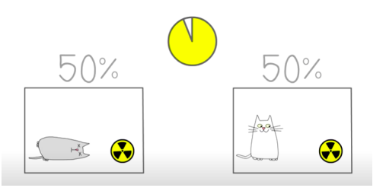
Experiment: Schrödinger's cat

Slide 6

Schrödinger's cat (continuation)
As long as the cat stays in the box, we can say that it is in a superposition of states.

Slide 7
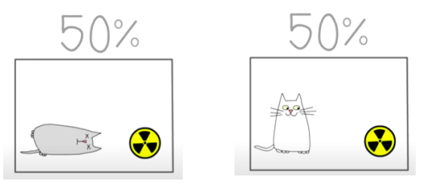
Schrödinger's cat (continuation)
If we open the box and try to observe the cat’s state (we measure it), then the state of superposition will collapse. Therefore, we will have only one of the states (it is alive or it is dead).

Slide 8
Principles of quantum mechanics
A quantum system can have multiple states at the same time;
A quantum state is continuously evolving;
If we measure a quantum superposition state, it can change and become a classical state.
Neither the position nor the impulse can be known precisely.

Slide 9
Why do we need quantum computing?
Solve problems that can’t be solved with classic computers;
Faster calculation speed;
Quantum computers are getting smaller and smaller.

Slide 10
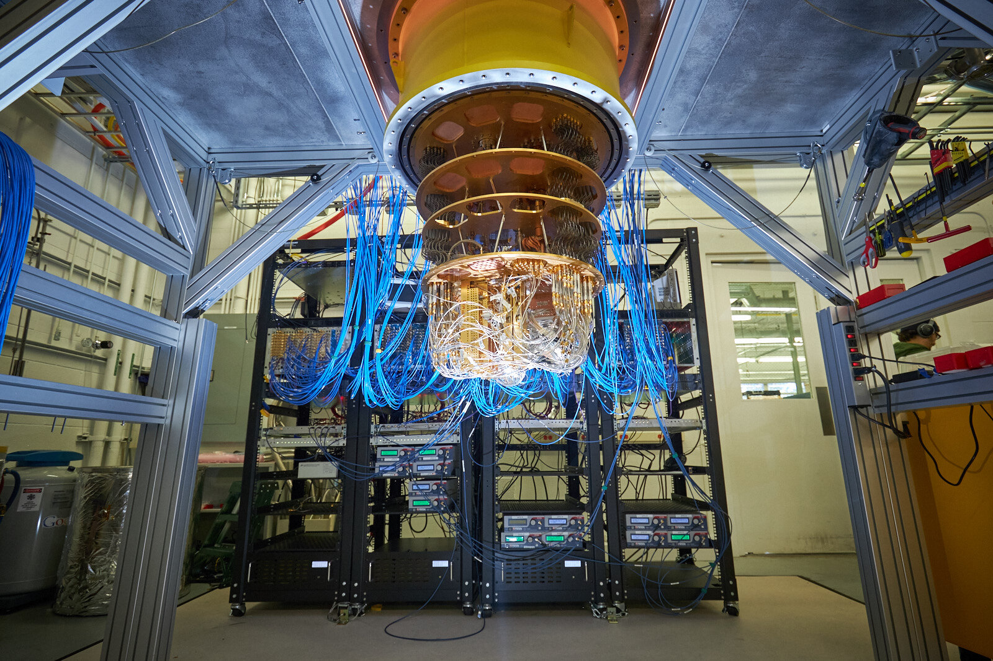
Quantum computers
Use qubits;
Use quantum logic gates to perform the calculations.

Slide 11
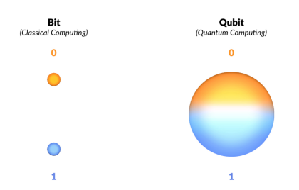
Bit vs Qubit

Slide 12
QC applications
Cryptography (safer protocols);
Faster search in big sets of data;
Machine Learning;
Medicine.

Slide 13
Quantum programming languages
Quantum Computation Language (QCL);
Q# - used to simulate quantum algorithms, created by Microsoftș
Qiskit – open source SDK. The circuits are created and manipulated in Python;
Quipper – Haskell library;
MatLab QLib.

Slide 14
Advantages of QC
Can solve difficult problems;
The power of quantum computers grows exponentially with more qubits;
Big sets of data can be evaluated faster (parallel calculations);
Quantum-safe Cryptography.

Slide 15
Disadvantages of QC
We need new algorithms in order to perform difficult calculations;
It’s a new area, which is constantly evolving;
Requires both programming and quantum mechanics knowledge;
Fragile – vibrations lead to errors;
Quantum computers operate in extremely cold environments (about -273°C)
Expensive.

Slide 16
Conclusions
QC is a relatively new paradigm, that emerged about 25-30 years ago. There’s still a lot to learn about Quantum Computers and, even though they are expensive to keep and run, they will have a significant impact on our future.

Slide 17


