Slide 1
OS Performance Tool Introduction
Speaker name: Ted Nowak
Email: tonowak@us.ibm.com

Slide 2
Performance Issues
Performance issues are a result limited resources
  Multiple resources may be the limiting factor
  The resource itself may not be the problem
There are many types of resources
  Hardware / OS
    CPU
    Disk
    Network
    Memory
  Application
    Serialization tools such as locks / latches
    Internal memory divisions
Notes:
Performance issues are truly a result of a resource limitation. Something has be come a bottleneck and is reducing how much throughput the system is capable of performing.
Not every bottleneck is the fault of the resource. Many times something starts misbehaving and instead of acting in a good manner, it starts overloading something that is not designed for that much activity. For instance, access plan change starts performing Sargable Index access (reads whole index instead of start / stop key access of the index) and so disk activity increases and the additional contention causes other things to wait for their reads to complete.
Underlying all resources are hardware resources. Those are managed by the os and hardware controllers. The os tries to share the resources as best it can. Normally, it does a good job; however, it has limits to what it can do.
Sitting above the os and hardware is the application. Within the application will be resources that are created to support the work of the application. It’s address space will be divided for different purposes. Locking and latching controls will serialize multiple threads / processes as they access different resources.
If the application drives and os / hardware resource too heavily, many of the os monitors can be used to see what the limiting factor is. This can be used to direct the search back into the application to see what the application is doing and perhaps identify another way for the application to behave that does not drive that resource so much.
When the limiting resource is something defined in the application, sometimes there may not be any noticeable os / hardware bottlenecks.

Slide 3
Unix OS Monitors -- CPU
There are numerous os tools to monitor the hardware and os resources. Each has its own advantages and disadvantages.
  CPU
    vmstat
    uptime
    ps
    iostat
    top
    nmon
    sar
    tprof / oprofile (also vtune / caliper / workshop)
Notes:
Not all of these tools will be documented here in this presentation.
Here is more info Oprofile: http://www.ibm.com/developerworks/linux/library/l-oprof.html

Slide 4
Unix OS Monitors -- Disk
There are numerous os tools to monitor the hardware and os resources. Each has its own advantages and disadvantages.
  Disk
    iostat
    vmstat
    nmon
    filemon
    sar

Slide 5
Unix OS Monitors -- Memory
There are numerous os tools to monitor the hardware and os resources. Each has its own advantages and disadvantages.
  Disk
    svmon
    ps
    nmon
    sar

Slide 6
Unix OS Monitors -- Network
There are numerous os tools to monitor the hardware and os resources. Each has its own advantages and disadvantages.
  Disk
    nmon
    netstat
    ping

Slide 7
vmstat
Light weight monitor, can leave running all day
Provides information on
  Number of active threads
  Number of blocked threads
  Memory in use
  Memory cleaning activity
  Paging space activity
  Context switching
  CPU usage breakdown
Recommended options on aix:
  vmstat -It 10
  vmstat -t 10
  vmstat -v
Notes:
Vmstat does not use many resources. It can be left running all day and will not fill up a file system with output nor will it overwhelm the CPU while running.
Lots of very good information about the system.
Get the timestamp information

Slide 8
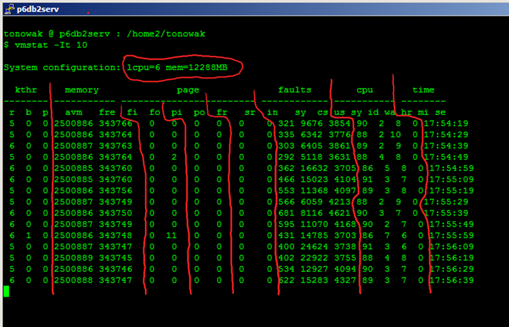
vmstat -It 10
Notes:
The top of the vmstat gives you information on the number of logical cpus as well as the memory the system has available.
The kthr, or kernel threads, show which the average number of threads in either the run (r) or blocked (b) queues. The -I option causes vmstat to show an io oriented version of the output and includes how many threads per second are waiting on raw devices under the (p) heading.
A thread on the runable queue means it is not sleeping or waiting for i/o, but that it has instructions to perform.
A thread on the blocked queue is waiting for some i/o activity to be performed. When that i/o is done, the thread will move off the blocked queue and likely into the run queue.
When the –I is included in the command, you can also see how many threads are waiting on raw devices.
If there are a lot of threads on the run queue, more threads then the number of cpus, then even when there are threads blocked, you may see no i/o wait. This is because the i/o wait column only gets time when there are cpus that have nothing to do and there is a blocked process. Otherwise the time is recorded as idle. However, if the cpu has other action it can take, there may be many threads waiting on i/o and the wa column may have little to no time recorded against it.
Memory columns provide information on how much memory is in use.
avm – active virtual pages
fre – the size of the free list.
Most people miss-understand the avm and fre columns. Avm is not how much is available, but how much memory is active. This value can change as processes change their memory allocations. The fre column is not how much memory is free on the server, but of the of the active memory, how many pages are in the free list. When the is file system cache in use, the free list can remain small. However, this memory can be stolen from the client / perm pages and used for computational memory.
When the fre list goes to zero or gets very small, the lru daemon will probably be very busy processing memory to try to free pages. So this can be a problem.
With the –I option for io focused information, we get the fi and fo columns. These columns represent the number of file page ins and page outs of memory. This represents the loading in and out of file data, but not paging space. If these numbers are high, then there is a lot of i/o going on to transfer mmaped data.
The pi and po columns represent paging space activity. When these columns have values, that mean not only was memory over committed at some point, but the os is either moving things back into memory that was previously paged out or is forcing things currently in memory out to disk so there is room for pages that currently need to active. Seeing activity in the pi / po columns is not good. This will definitely be a performance impact.
The fr and sr columns deal with the memory daemon releasing pages of memory to increase and maintain an adequately sized free list and how many pages were scanned to do this. If these values become high, that means the os is needing to spend CPU time trying to manage memory due to memory limitations and so there may be less cpu available for user processes.
The faults columns reflect device interrupts (in), system calls (sy), and kernel thread context switches (cs).
Hardware interrupts are how the hardware tells the os there is something to do / something needs attention.
Threads in user mode are unable to directly access files, disk, or any other parts of the system. They are limited in scope to protect the system. When they need to read a file, write to the screen, … they invoke a system call, which triggers a software interrupt to let the kernel know something needs to be done. The system call takes care of performing the requested action.
When a privileged action needs to take place, the thread moves out of user mode into system mode. This change (and the one back to user mode) is called a context switch. Performing context switches requires cpu time and a high number of context switches could resent a problem. A context switch also occurs when a thread that was running on a cpu expires its time slice and is moved off the cpu and another thread is moved on to the cpu. If there are many more runable threads than there are cpus, the number of context switches can grow.
The CPU information contains the percent of time spent in user mode, kernel / system mode, idle with nothing else to do, and idle with nothing else to do while a thread was waiting for io.
It is important to note that wait time only accumulates when there is no other need for the cpu. You may still have a system that has i/o problems even when wait time is low. So you should also make note of the run queues to see how many processes are in the run / blocked queues, as well, check data from things like iostat.
In this case, there are 6 CPUs on the server. Any single thread can only use at most 1/6 of the time (or 16.667%). So if 1 thread was stuck using 100% of 1 cpu, the vmstat would only show at most 17% used.

Slide 9
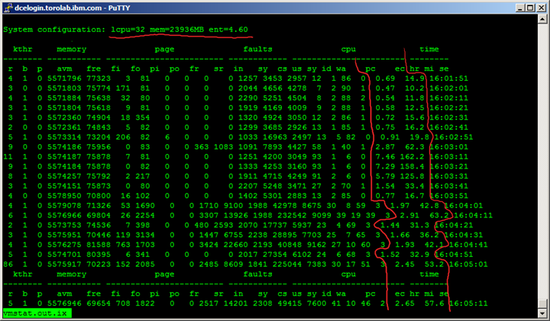
vmstat – Micro-Partitioned Environment
Notes:
At the top of the vmstat, you can see the number of entitled CPUs.
pc -- Number of physical processors consumed. Displayed only if the partition is running with shared processor.
ec -- The percentage of entitled capacity consumed. Displayed only if the partition is running with shared processor. Because the time base over which this data is computed can vary, the entitled capacity percentage can sometimes exceed 100%. This excess is noticeable only with small sampling intervals.
In a Micro partitioned environment, the cpu times need to be reviewed with the pc and ec columns. Even though the first few entries showed a high percentage of wait, at the time the server was using less that 1 processor. So a single thread in wait with a few threads running can exaggerate the amount of wait percentage. If all 32 of the logical cpus were active (not partitioned away), a single thread in the wait queue when the cpu had nothing to do would use 1/32 of the cpu time on the server (or 3.125%). So while you see high 80 and low 90% wait time, this need to be taken into consideration with the number of cpus present at the time.

Slide 10
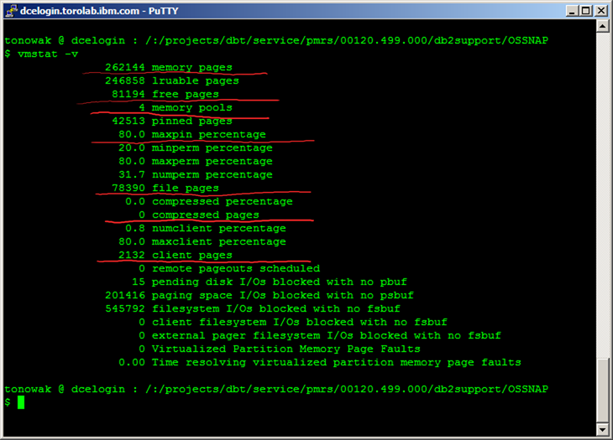
vmstat -v
Notes:
This is aix only.
The vmstat –v command provides a great deal of information about how the memory is currently utilized. If memory appears to be over committed / the lru daemon appears to be busy freeing pages, checking the amount of memory used by the file system cache is useful.
The memory pages are the number of 4k pages of RAM
The lruable pages are the number of pages controlled by the VMM and can be repaged. The virtual memory manager needs some memory for its only control structures that cannot be used for user processes.
The free memory is how much is on the free list. AIX is always going to try to keep a certain percentage free.
The minperm / maxperm are set through the vmo command. The numperm is the current % of lruable pages used for jfs file system cache
The client pages are similar to the perm pages. These represent jfs2 file system cache

Slide 11
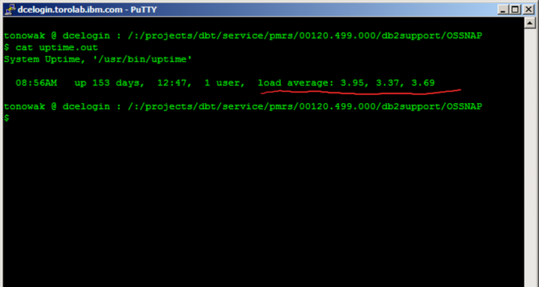
uptime
Notes:
Uptime prints the load average, which is the number of runable processed over the last 1, 5, and 15 minute intervals.
This can give you an idea of just how busy the system is now and in the very recent past. This can let you know if the number of runable processes is increasing or decreasing at the time the uptime is run
This is collected as part of a db2support and a db2service.perf1
uptime
This comand is available on Linux, Solaris and HP-UX with slight different syntax.
Reference:
http://www.howtogeek.com/howto/solaris/get-system-uptime-information-on-solaris/
http://www.informatik.uni-frankfurt.de/doc/man/hpux/uptime.1.html

Slide 12
ps
Snapshot of the current state
Needs to read the /etc/passwd or other security files to translate user information from the numeric id to the text string
The ps command has many options and even the capability to customize the output
Some of the most common ones are:
  ps -elf
  ps -elkf
  ps -elkfm
  ps aux
The -k includes kernel processes so you can see things like aioserver
The -m includes kernel threads
Example of customized command
  ps -e -opid,sched,class,args
Notes:
The ps command may take a little to return if the system is i/o bound, due to the need to open security files to translate uid / gid values into the text labels.
This command allows for numerous options to get great details about the processes running
Getting thread information becomes more important with v9.5
This comand is available on Linux, Solaris and HP-UX with slight different syntax.
Solaris have some other process monitors, such as pstree which presents the hierar
Reference: http://developers.sun.com/solaris/articles/solaris_processor.html

Slide 13
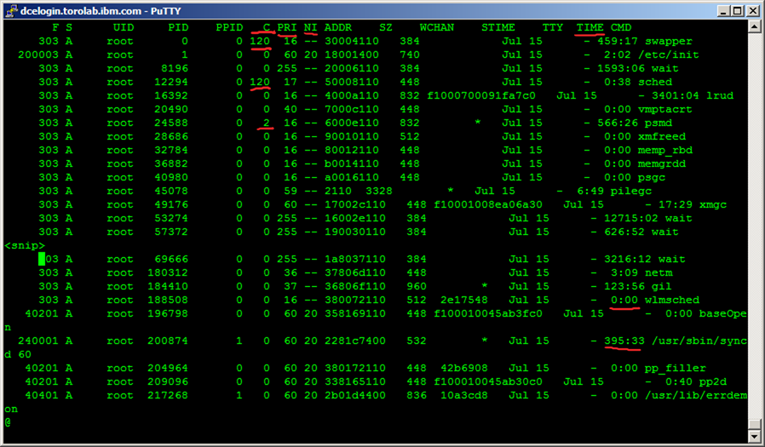
ps -elkf
Notes:
The ps output can show you which processes have recently used CPU time as well as which processes have used a lot of CPU over time.
ps –elf is collected with db2support and db2service.perf1
The C column is a penalty column. CPU utilization of process or thread, incremented each time the system clock ticks and the process or thread is found to be running. The value is decayed by the scheduler by dividing it by 2 once per second. For the sched_other policy, CPU utilization is used in determining process scheduling priority. Large values indicate a CPU intensive process and result in lower process priority whereas small values indicate an I/O intensive process and result in a more favorable priority. The decay is fairly quick, so it really only shows things that recently used CPU.
The PRI column is the priority of the process or kernel thread; higher numbers mean lower priority.
The NI column is the nice value; used in calculating priority for the sched other policy.
The TIME column is the cumulative amount of CPU time the process has used.
Processes bound by i/o will generally have a C value of 0 and may not show much TIME used. However, when looking at TIME, it is also good to look at the STIME, which is when the process started. If it has been active for a long time, having accumulated TIME may not mean much at the present moment.

Slide 14
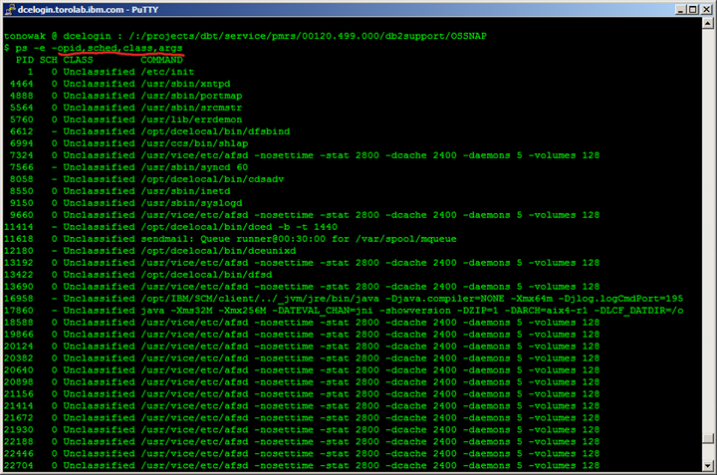
ps -e -opid,sched,class,args
Notes:
In this case, the ps command was instructed to print out the pid, the schedule class, the AIX WLM class, and the command with arguments
The schedule class, when set, is 0,1, or 2 (sched_other, sched_fifo, or sched_rr).
The sched_other is the standard and is designed for sharing time.
The sched_fifo and sched_rr are real time scheduling models that allow a process to continue to get CPU time. Normally, these are reserved only for kernel processes / daemons.
The WLM class could impact the performance of a process depending on how the class was configured.

Slide 15
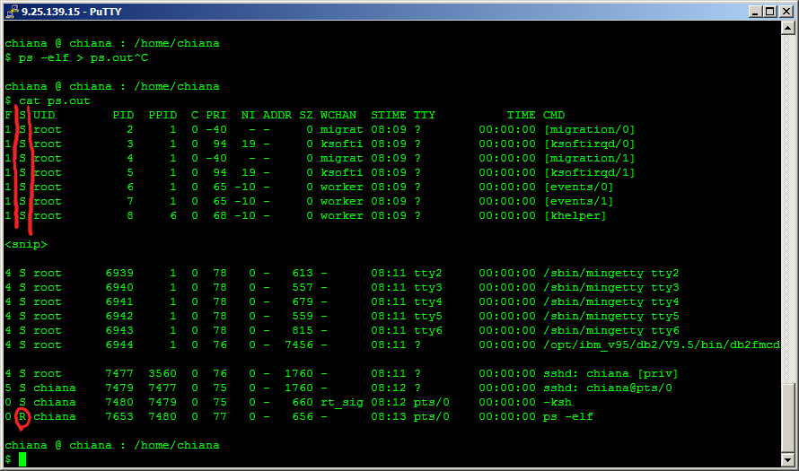
ps – from Linux
Notes:
On Linux, there are some additional columns that can give you an indication of which queue the process / thread is actually in at the time the ps is collected.
In this output the S column reflects the process state:
D Uninterruptible sleep (usually IO)
R Running or runnable (on run queue)
S Interruptible sleep (waiting for an event to complete)
T Stopped, either by a job control signal or because it is being traced.
W paging (not valid since the 2.6.xx kernel)
X dead (should never be seen)
Z Defunct ("zombie") process, terminated but not reaped by its parent.

Slide 16
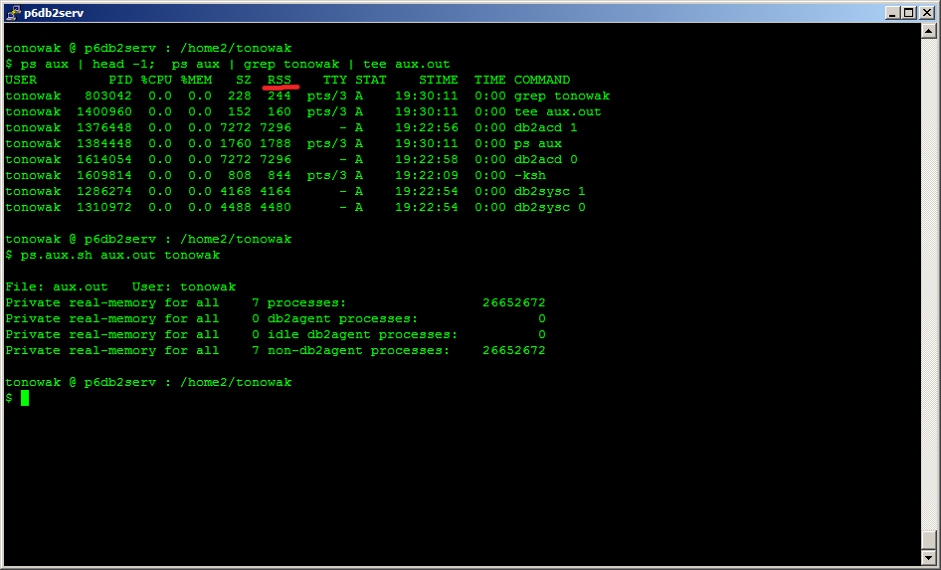
ps – aux
Notes:
The ps aux command on aix can allow you to examine how much real memory is in uses by processes under the RSS column. Linux and other platforms combine private and shared, preventing this from being accurate.
ps aux is collected with db2service.perf1
Here is a script that can be used to quickly analyze the output:
$ cat ps.aux.sh
#!/bin/ksh
Input=$1
Id=$2
TMPFILE=/tmp/$(basename $0).$$
if (( $# != 2 ))
then
print "\nsyntax -- $(basename $0) <input file> <id>\n"
exit 1
fi
grep $Id $Input > $TMPFILE
print -n "\nPrivate real-memory for all $Id processes ===> "
grep $Id $TMPFILE | grep -v grep | awk '{ sum += $6 } END { printf "%d", sum * 1024 }'
print -n "\nPrivate real-memory for all $Id db2agent processes ===> "
grep $Id $TMPFILE | egrep 'db2agent|db2agntp' | grep -v grep | awk '{ sum += $6 } END { printf "%d", sum * 1024 }'
print -n "\nPrivate real-memory for all $Id idle db2agent processes ===> "
grep $Id $TMPFILE | egrep 'db2agent|db2agntp' | grep idle | grep -v grep | awk '{ sum += $6 } END { printf "%d", sum * 1024 }'
print -n "\nPrivate real-memory for all $Id non-db2agent processes ===> "
grep $Id $TMPFILE | grep -v db2agent |grep -v db2agntp| grep -v grep | awk '{ sum += $6 } END { printf "%d", sum * 1024 }'
rm $TMPFILE

Slide 17
iostat
Light weight monitor, can leave running all day
Provides information on
  CPU Activity
  Terminal i/o activity
  Read activity
  Write activity
  Queue activity
The basic iostat gives the Percent Time Active; however, this can be misleading. Better to look at Queue information.
Recommended options on aix:
  iostat -DlT 10
Notes:
Iostat does not use many resources. It can be left running all day, but will take up more file system space then vmstat
Lots of very good information about the system.
Get the timestamp information
Have to install separately on many Linux distros.
Basic iostat is collected in db2support / db2service on platforms that have iostat/

Slide 18
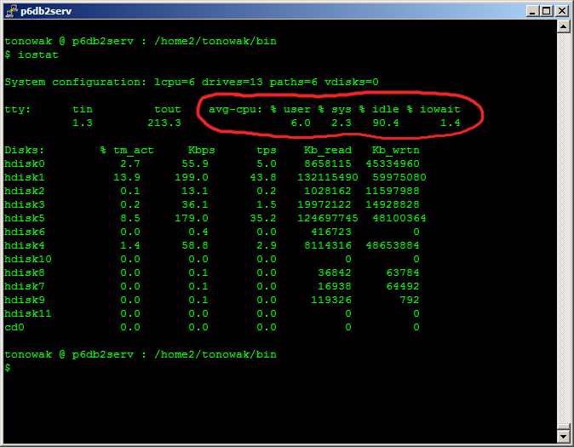
iostat
iostat can be used to see some cpu information. However, the primary purpose of the tool is to provide io statistics.
Notes:
These can help as it will show what the CPU stats were during the time the io information was collected. However, vmstat is better for looking at cpu data.
The tty is the terminal i/o.

Slide 19
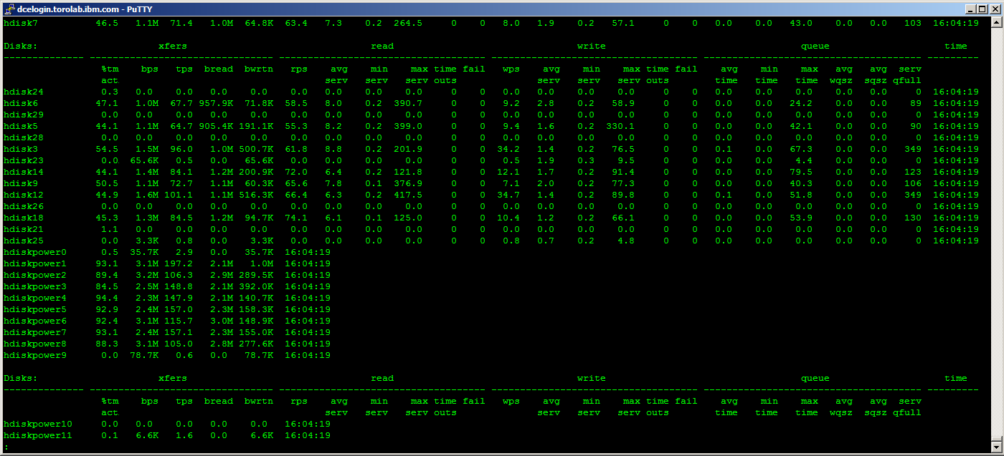
iostat -DlT
Notes:
The detailed iostat information is so much more useful than basic version. Not all platforms have iostat information to this detail. When it is missing, you have to make due with what you have.
Not all disk types / abstractions will have data at all levels.
The first set of data is transfer data, how much data was transferred to and from the disk. If you have high %tm act (% time active) and low throughput, this could mean the disk is thrashing and the data is not very clustered on the disk. This lack of cluster, causes the heads to have to see a lot, resulting in lower throughput.
The second set of data is the read data. When there is prefetching taking place and the disk read ahead logic is working well, the read times should be very low, since they are “cheap” reads. If the read times jump around, then their could be bottlenecks in the access (other contending activity) or the data may be scattered.
The third set of data is the write data. Very similar to the read data. Write times tend to be higher than read times.
The last set of data is the queue data. The queue is a fixed size buffer defined to the os to track and handle all of the io requests. This can be configured and different types of disk can support different queue sizes.
Looking at qfull is a far better indicator of the amount of time the disk is busy as compared to %tm act. When the queue is full, that means processes wanting to read or write (any i/o request) must wait to even submit the i/o request. The amount of qfulls will ideally be low, as this can be a significant impediment to throughput.
In looking at iostat data, some speculation can be made as to what the bottleneck might be. If you see a lot of qfulls, it may mean the queue depth is not large enough. It may also mean that there needs to be a greater amount of parallelization. Regardless of how many disks are in the SAN under the aix “disk” definition, there is only 1 queue for each disk. It maybe that the configuration of disks exposed to the os needs to be modified to increase parallelization.
Another factor could be a lot of slow read/write times and backing up the queue because the requests are not getting completed fast enough.

Slide 20
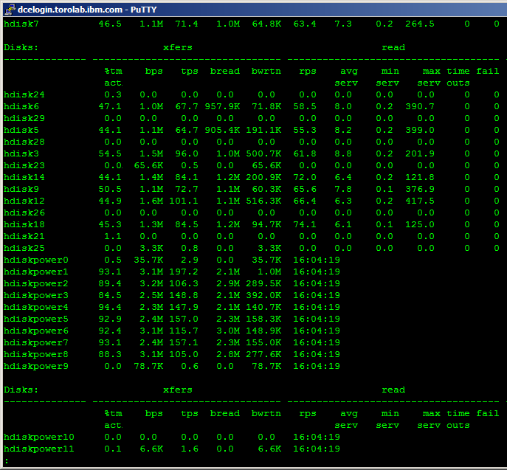
iostat –DlT -- read

Slide 21
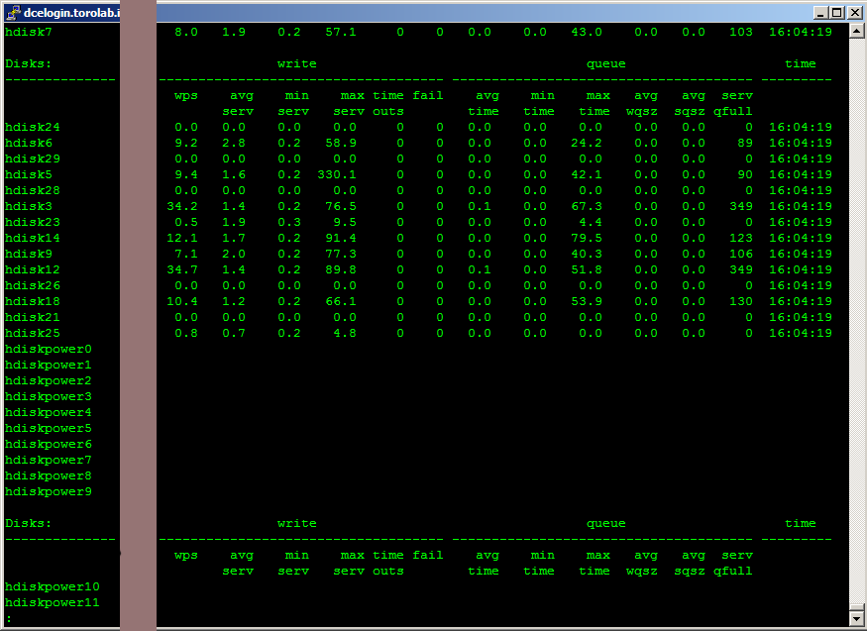
iostat – DlT -- write / queue

Slide 22
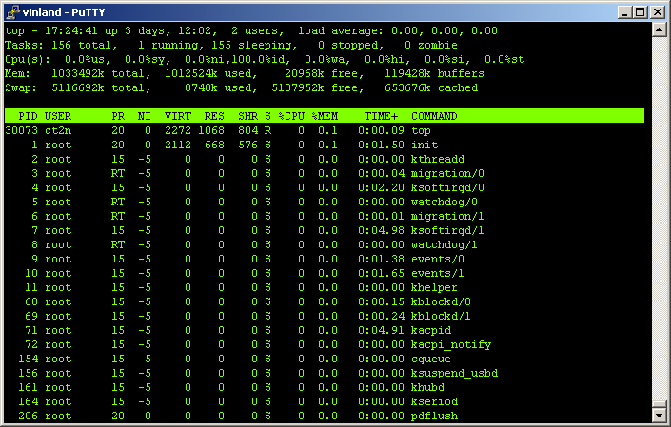
top
Notes:
Top is an interactive tool. It can provide a lot of real time data and the data can be sorted in different ways.
Top will also give you load average information that uptime can provide.
The limitation is that you have to either take screen shots or be watching the system to see what is currently the “top” consumer at the time. Therefore, not very useful for remote performance debugging, but a customer might be watching the output and can report changes in the system behavior if you are on the phone with them
This comand is available on Linux, Solaris and HP-UX with slight different syntax.
In Solaris you can use the command prstat.
Reference: http://developers.sun.com/solaris/articles/prstat.html
In HP-UX you can use the command glance.
Reference: http://www.informatik.uni-frankfurt.de/doc/man/hpux/glance.1.html

Slide 23
nmon
A heavier weight monitor; however, very powerful when left running over time
Capable of interactive and data capture modes
Provides information on many areas
  CPU Activity
  i/o activity
  network
  Memory
Can be data overload
Notes:
nmon is a tool that is very powerful and can run on both aix and Linux.
Not everyone has it installed, but more people are installing it. When it is available, it can help understand overall system performance over the course of time. The graphs that it creates makes looking at the data a visual exercise and that can help more quickly spot problem periods.
The tool is now shipped with the most recent versions of aix (5.3 TL 9 / 6.1 TL 2).
There are even tools to covert nmon output into web pages.
This tool is available only AIX and Linux.
Reference: Question 29 of http://www.ibm.com/developerworks/wikis/display/WikiPtype/nmon+FAQ
To HP-UX the Glance tool have almost the same capacity. Reference: http://www.informatik.uni-frankfurt.de/doc/man/hpux/glance.1.html
To SE Toolkit the Glance tool have almost the same capacity. Reference: http://sourceforge.net/projects/setoolkit/

Slide 24
nmon
The more powerful part of nmon is the data capture mode where the performance data can be saved and reviewed at a later time.
  Run nmon with the -f flag. See nmon -h for the details. But as an example, try to run nmon for an hour capturing data snapshots every 30 seconds by using:
    nmon -f -s 30 -c 120
    nmon -fT -s 30 -c 120
  The second line also captures the top processes. Both of these create the output file in the current directory called:
    <hostname>_date_time.nmon
  This file is in a comma-separated values (CVS) format and can be imported into a spreadsheet directly. If you are using Lotus® 1-2-3, the file needs to be sorted. (This is not required for the Excel version of the nmon analyzer.) On AIX, follow this example:
    sort -A mymachine_311201_1030.nmon > xxx.csv
Exercise, download a copy nmon to your unix server, collect data to a file, then format it with the spread sheet formatter
http://www.ibm.com/developerworks/aix/library/au-analyze_aix/

Slide 25
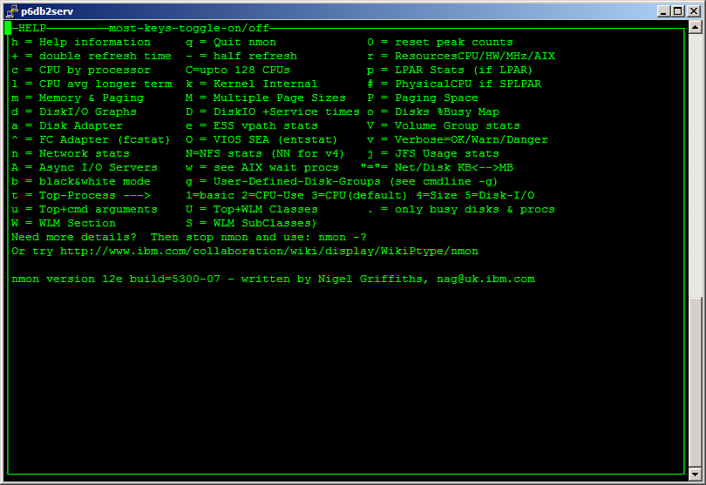
nmon – help

Slide 26
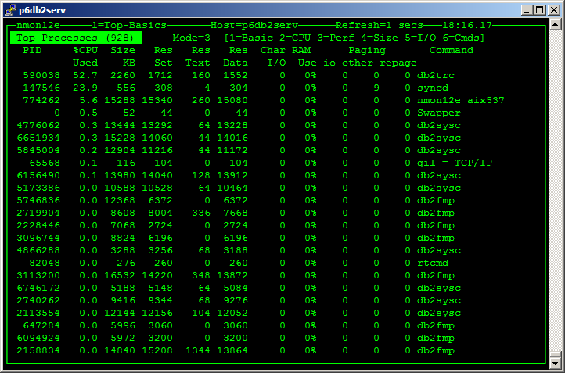
nmon
Notes:
The nmon tool is extremely powerful. In some cases, nmon may replace top.
The tool has two primary modes of interface. The first is an interactive display, much like top. This is display can be customized to display a wide variety of information. However, like top, it is limited in that you have to be watching the screen.
The nmon tool also has another mode of use, where it will capture the output to a file, where it can then be analyzed into a spread sheet at a later time. This gives a wealth of information about the system that can be very useful for remote / delayed problem diagnostics.

Slide 27
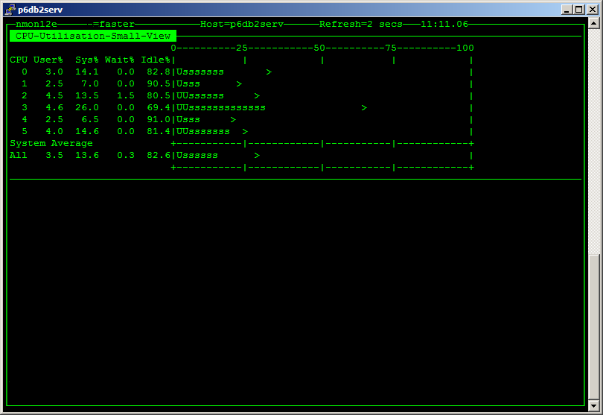
nmon – cpu

Slide 28
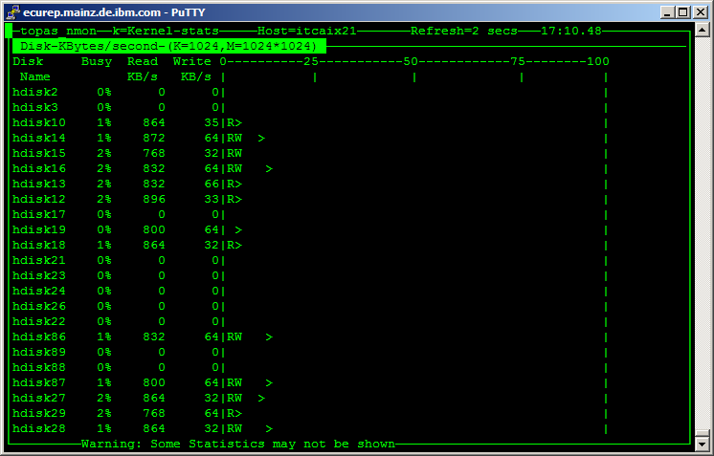
nmon – disk

Slide 29
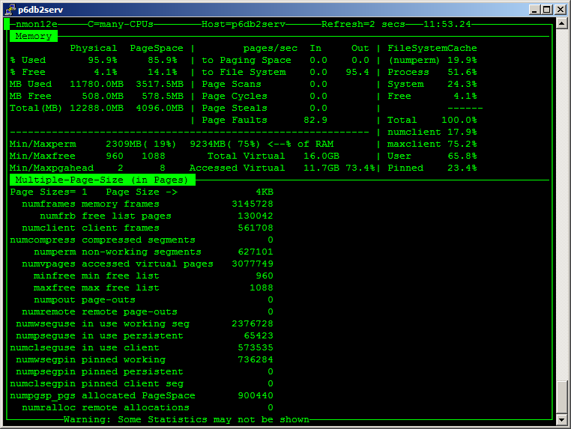
nmon – memory

Slide 30
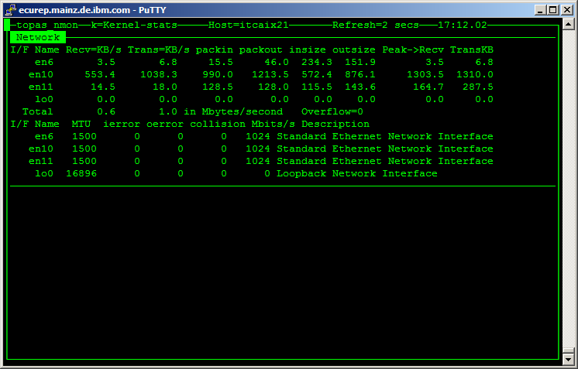
nmon – network

Slide 31
sar
System Activity Report: Collects, saves, and reports system activity
Can be very powerful
  CPU usage
  Number exec/s fork/s as well as different system calls
  IO information of various types
The sar tool will provide summaries of data that was previously collected.
Unless previously activated, the tool cannot provide any data.
On Aix, the data is saved under: /var/adm/sa/sadd file, where the dd parameter indicates the current day
Data collection can also be done with /usr/lib/sa/sa1, often put into crontab
Notes:
-A Without the -P flag, using the -A flag is equivalent to specifying -abcdkmqruvwy. When used with the -P flag, the -A is equivalent to specifying -acmuw. Without the -M flag, headers are only printed once in multiple lines grouped together before the data for the first interval. When this flag is used with the -M flag, each line of data at each iteration is preceded by the appropriate header.-a Reports use of file access system routines specifying how many times per second several of the system file access routines have been called. When used with the -P flag, the information is provided for each specified processor; otherwise, it is provided only system-wide. The following values are displayed:
dirblk/s
Number of 512-byte blocks read by the directory search routine to locate a directory entry for a specific file.
iget/s
Calls to any of several i-node lookup routines that support multiple file system types. The iget routines return a pointer to the i-node structure of a file or device.
lookuppn/s
Calls to the directory search routine that finds the address of a v-node given a path name.
-bReports buffer activity for transfers, accesses, and cache (kernel block buffer cache) hit ratios per second. Access to most files in Version 3 bypasses kernel block buffering and therefore does not generate these statistics. However, if a program opens a block device or a raw character device for I/O, traditional access mechanisms are used making the generated statistics meaningful. The following values are displayed:
bread/s, bwrit/s
Reports the number of block I/O operations. These I/Os are generally performed by the kernel to manage the block buffer cache area, as discussed in the description of the lread/s value.
lread/s, lwrit/s
Reports the number of logical I/O requests. When a logical read or write to a block device is performed, a logical transfer size of less than a full block size may be requested. The system accesses the physical device units of complete blocks and buffers these blocks in the kernel buffers that have been set aside for this purpose (the block I/O cache area). This cache area is managed by the kernel, so that multiple logical reads and writes to the block device can access previously buffered data from the cache and require no real I/O to the device. Application read and write requests to the block device are reported statistically as logical reads and writes. The block I/O performed by the kernel to the block device in management of the cache area is reported as block reads and block writes.
pread/s, pwrit/s
Reports the number of I/O operations on raw devices. Requested I/O to raw character devices is not buffered as it is for block devices. The I/O is performed to the device directly.
%rcache, %wcache
Reports caching effectiveness (cache hit percentage). This percentage is calculated as: [(100)x(lreads - breads)/ (lreads)].
-cReports system calls. When used with the -P flag, the information is provided for each specified processor; otherwise, it is provided only system-wide. The following values are displayed:
exec/s, fork/s
Reports the total number of fork and exec system calls.
sread/s, swrit/s
Reports the total number of read/write system calls.
rchar/s, wchar/s
Reports the total number of characters transferred by read/write system calls.
scall/s
Reports the total number of system calls.
Tip:The sar command itself can generate a considerable number of reads and writes depending on the interval at which it is run. Run the sar statistics without the workload to understand the sar command's contribution to your total statistics.-dReports activity for each block device with the exception of tape drives. The activity data reported is:
%busy
Reports the portion of time the device was busy servicing a transfer request.
avque
Before AIX 5.3: Reports the instantaneous number of requests sent to disk but not completed yet. AIX 5.3: Reports the average number of requests waiting to be sent to disk.
read/s, write/s, blk/s
Reports the read-write transfers from or to a device in kilobytes/second.
avwait, avserv
Average wait time and service time per request in milliseconds.
-e hh[:mm[:ss]]Sets the ending time of the report. The default ending time is 18:00.-X FileExtracts the records from the File, which is generated by AIX 4.3 or AIX 4.2 version of the sar/sadc command.-f FileExtracts records from the File (created by -o File flag). The default value of the File parameter is the current daily data file, the /var/adm/sa/sadd file. Restriction:If you specify the [ Interval [ Number ] ] parameter, the -f flag is ignored.-i SecondsSelects data records at seconds as close as possible to the number specified by the Seconds parameter. Otherwise, the sar command reports all seconds found in the data file.-kReports kernel process activity. The following values are displayed:
kexit/s
Reports the number of kernel processes terminating per second.
kproc-ov/s
Reports the number of times kernel processes could not be created because of enforcement of process threshold limit.
ksched/s
Reports the number of kernel processes assigned to tasks per second.
-MEnables multiple headers in output when used with at least two combinations of [abckmqruvwy] or with the -A flag. In this mode, each line of data is preceded by the corresponding header at each iteration. Restriction:This flag is ignored when used without [Interval [Number]].-mReports message (sending and receiving) and semaphore (creating, using, or destroying) activities per second. When used with the -P flag, the information is provided for each specified processor; otherwise, it is provided only system-wide. The following values are displayed:
msg/s
Reports the number of IPC message primitives.
sema/s
Reports the number of IPC semaphore primitives.
-o FileSaves the readings in the file in binary form. Each reading is in a separate record and each record contains a tag identifying the time of the reading.-P ProcessorIdentifier, ... | ALLReports per-processor statistics for the specified processor or processors. Specifying the ALL keyword reports statistics for each individual processor, and globally for all processors . Of the flags which specify the statistics to be reported, only the -a, -c, -m, -u, and -w flags are meaningful with the -P flag.-qReports queue statistics. The following values are displayed:
runq-sz
Reports the average number of kernel threads in the run queue.
%runocc
Reports the percentage of the time the run queue is occupied.
swpq-sz
Reports the average number of kernel threads waiting to be paged in.
%swpocc
Reports the percentage of the time the swap queue is occupied.
Tip:A blank value in any column indicates that the associated queue is empty.-rReports paging statistics. The following values are displayed:
cycle/s
Reports the number of page replacement cycles per second.
fault/s
Reports the number of page faults per second. This is not a count of page faults that generate I/O, because some page faults can be resolved without I/O.
slots
Reports the number of free pages on the paging spaces.
odio/s
Reports the number of non paging disk I/Os per second.
-s hh[:mm[:ss]]Sets the starting time of the data, causing the sar command to extract records time-tagged at, or following, the time specified. The default starting time is 08:00.-uReports per processor or system-wide statistics. When used with the -P flag, the information is provided for each specified processor; otherwise, it is provided only system-wide. Because the -u flag information is expressed as percentages, the system-wide information is simply the average of each individual processor's statistics. Also, the I/O wait state is defined system-wide and not per processor. The following values are displayed:
%idle
Reports the percentage of time the processor or processors were idle with no outstanding disk I/O requests.
%sys
Reports the percentage of time the processor or processors spent in execution at the system (or kernel) level.
%usr
Reports the percentage of time the processor or processors spent in execution at the user (or application) level.
%wio
Reports the percentage of time the processor(s) were idle during which the system had outstanding disk/NFS I/O request(s). See detailed description above.
physc
Reports the number of physical processors consumed. This will be reported if the partition is dedicated and enabled for donation, or is running with shared processors or simultaneous multi-threading enabled.
%entc
Reports the percentage of entitled capacity consumed. This will be reported only if the partition is running with shared processors. Because the time base over which this data is computed can vary, the entitled capacity percentage can sometimes exceed 100%. This excess is noticeable only with small sampling intervals.
Tips:
The sar command reports system unit activity if no other specific content options are requested. If the -P flag is used and the partition is running with shared processors, and if the partition capacity usage is what is allocated, then a processor row with CPUid U will be reported to show the system-wide unused capacity. If the partition is running with shared processors in uncapped mode, then %entc will report the percentage of granted entitled capacity against each processor row and percentage of allocated entitled capacity in the system-wide processor row. The individual processor utilization statistics is calculated against the actual physical consumption (physc). The system wide statistics is computed against the entitlement and not physical consumption. However, in an uncapped partition, the system wide statistics is still calculated against the physical consumption.
Since the time base over which the data is computed varies, the sum of all of the %utilization fields (%user, %sys, %idle, and %wait) can exceed 100 percent.
-vReports status of the process, kernel-thread, i-node, and file tables. The following values are displayed:
file-sz, inod-sz, proc-sz , thrd-sz
Reports the number of entries in use for each table.
-wReports system switching activity. When used with the -P flag, the information is provided for each specified processor; otherwise, it is provided only system-wide. The following value is displayed:
pswch/s
Reports the number of context switches per second.
-yReports tty device activity per second.
canch/s
Reports tty canonical input queue characters. This field is always 0 (zero) for AIX Version 4 and later versions.
mdmin/s
Reports tty modem interrupts.
outch/s
Reports tty output queue characters.
rawch/s
Reports tty input queue characters.
revin/s
Reports tty receive interrupts.
xmtin/s
Reports tty transmit interrupts.

Slide 32
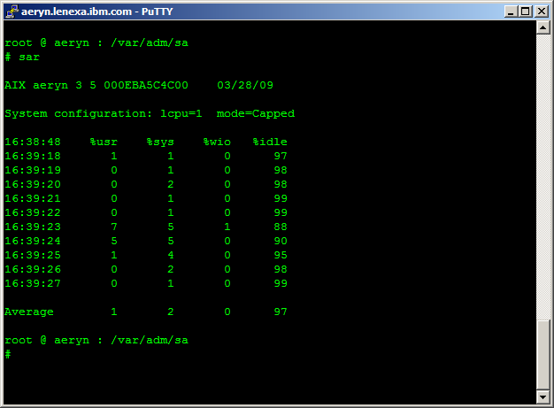
sar – cpu information

Slide 33
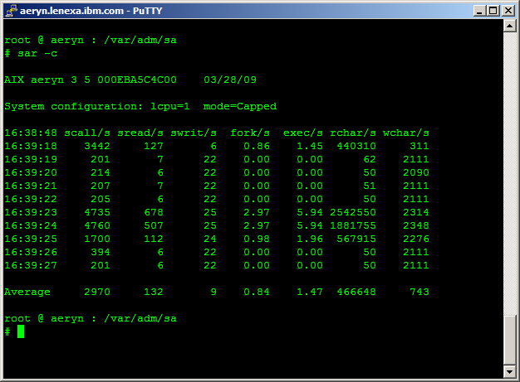
sar – system calls
Notes:
As you can see, sar does display a lot of the information that vmstat displays; however, it can break the data down into ever more granular items.

Slide 34
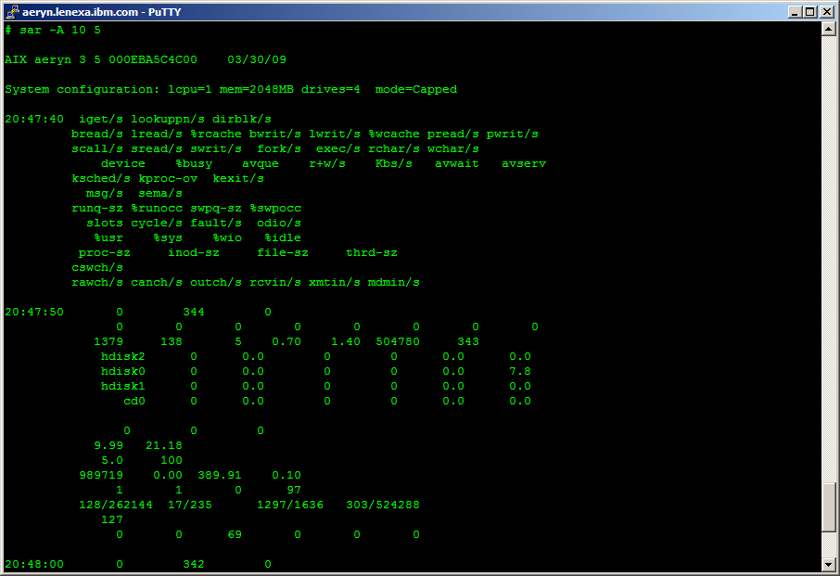
sar – all data
Notes:
You can see from this output there are many fields displayed in the output. While this output was sent to the screen, you could also save the data to a binary file and pull out the parts you want later. That can sometimes be better so that you are only looking at specific types of data at one point in time.
-a
Reports use of file access system routines specifying how many times per second several of the
system file access routines have been called. When used with the -P flag, the information is
provided for each specified processor; otherwise, it is provided only system-wide. The following
values are displayed:
dirblk/s
Number of 512-byte blocks read by the directory search routine to locate a directory
entry for a specific file.
iget/s
Calls to any of several i-node lookup routines that support multiple file system types.
The iget routines return a pointer to the i-node structure of a file or device.
lookuppn/s
Calls to the directory search routine that finds the address of a v-node given a path
name.
-b
Reports buffer activity for transfers, accesses, and cache (kernel block buffer cache) hit
ratios per second. Access to most files in Version 3 bypasses kernel block buffering and
therefore does not generate these statistics. However, if a program opens a block device or a
raw character device for I/O, traditional access mechanisms are used making the generated
statistics meaningful. The following values are displayed:
bread/s, bwrit/s
Reports the number of block I/O operations. These I/Os are generally performed by the
kernel to manage the block buffer cache area, as discussed in the description of the
lread/s value.
lread/s, lwrit/s
Reports the number of logical I/O requests. When a logical read or write to a block
device is performed, a logical transfer size of less than a full block size may be
requested. The system accesses the physical device units of complete blocks and buffers
these blocks in the kernel buffers that have been set aside for this purpose (the block
I/O cache area). This cache area is managed by the kernel, so that multiple logical reads
and writes to the block device can access previously buffered data from the cache and
require no real I/O to the device. Application read and write requests to the block
device are reported statistically as logical reads and writes. The block I/O performed by
the kernel to the block device in management of the cache area is reported as block reads
and block writes.
pread/s, pwrit/s
Reports the number of I/O operations on raw devices. Requested I/O to raw character
devices is not buffered as it is for block devices. The I/O is performed to the device
directly.
%rcache, %wcache
Reports caching effectiveness (cache hit percentage). This percentage is calculated as:
[(100)x(lreads - breads)/ (lreads)].
-c
Reports system calls. When used with the -P flag, the information is provided for each specified
processor; otherwise, it is provided only system-wide. The following values are displayed:
exec/s, fork/s
Reports the total number of fork and exec system calls.
sread/s, swrit/s
Reports the total number of read/write system calls.
rchar/s, wchar/s
Reports the total number of characters transferred by read/write system calls.
scall/s
Reports the total number of system calls.
Note: The sar command itself can generate a considerable number of reads and writes depending on
the interval at which it is run. Run the sar statistics without the workload to understand the
sar command's contribution to your total statistics.
-d
Reports activity for each block device with the exception of tape drives. The activity data
reported is:
%busy
Reports the portion of time the device was busy servicing a transfer request.
avque
Before AIX 5.3: Reports the instantaneous number of requests sent to disk but not
completed yet. AIX 5.3: Reports the average number of requests waiting to be sent to
disk.
read/s, write/s, blk/s
Reports the read-write transfers from or to a device in kilobytes/second.
avwait, avserv
Average wait time and service time per request in milliseconds.
-k
Reports kernel process activity. The following values are displayed:
kexit/s
Reports the number of kernel processes terminating per second.
kproc-ov/s
Reports the number of times kernel processes could not be created because of enforcement
of process threshold limit.
ksched/s
Reports the number of kernel processes assigned to tasks per second.
-m
Reports message (sending and receiving) and semaphore (creating, using, or destroying)
activities per second. When used with the -P flag, the information is provided for each
specified processor; otherwise, it is provided only system-wide. The following values are
displayed:
msg/s
Reports the number of IPC message primitives.
sema/s
Reports the number of IPC semaphore primitives.
-q
Reports queue statistics. The following values are displayed:
runq-sz
Reports the average number of kernel threads in the run queue.
%runocc
Reports the percentage of the time the run queue is occupied.
swpq-sz
Reports the average number of kernel threads waiting to be paged in.
%swpocc
Reports the percentage of the time the swap queue is occupied.
Note: A blank value in any column indicates that the associated queue is empty.
-r
Reports paging statistics. The following values are displayed:
cycle/s
Reports the number of page replacement cycles per second.
fault/s
Reports the number of page faults per second. This is not a count of page faults that
generate I/O, because some page faults can be resolved without I/O.
slots
Reports the number of free pages on the paging spaces.
odio/s
Reports the number of non paging disk I/Os per second.
-u
Reports per processor or system-wide statistics. When used with the -P flag, the information is
provided for each specified processor; otherwise, it is provided only system-wide. Because the
-u flag information is expressed as percentages, the system-wide information is simply the
average of each individual processor's statistics. Also, the I/O wait state is defined system-
wide and not per processor. The following values are displayed:
%idle
Reports the percentage of time the cpu or cpus were idle with no outstanding disk I/O
requests.
%sys
Reports the percentage of time the cpu or cpus spent in execution at the system (or
kernel) level.
%usr
Reports the percentage of time the cpu or cpus spent in execution at the user (or
application) level.
%wio
Reports the percentage of time the cpu(s) were idle during which the system had
outstanding disk/NFS I/O request(s). See detailed description above.
physc
Reports the number of physical processors consumed. This will be reported only if the
partition is running with shared processors or simultaneous multi-threading enabled.
%entc
Reports the percentage of entitled capacity consumed. This will be reported only if the
partition is running with shared processors. Because the time base over which this data
is computed can vary, the entitled capacity percentage can sometimes exceed 100%. This
excess is noticeable only with small sampling intervals.
Note: The sar command reports system unit activity if no other specific content options are
requested. If the -P flag is used and the partition is running with shared processors, and if
the partition capacity usage is what is allocated, then a CPU row with cpuid U will be reported
to show the system-wide unused capacity. If the partition is running with shared processors in
uncapped mode, then %entc will report the percentage of granted entitled capacity against each
CPU row and percentage of allocated entitled capacity in the system-wide CPU row.
-v
Reports status of the process, kernel-thread, i-node, and file tables. The following values are
displayed:
file-sz, inod-sz, proc-sz , thrd-sz
Reports the number of entries in use for each table.
-w
Reports system switching activity. When used with the -P flag, the information is provided for
each specified processor; otherwise, it is provided only system-wide. The following value is
displayed:
pswch/s
Reports the number of context switches per second.
-y
Reports tty device activity per second.
canch/s
Reports tty canonical input queue characters. This field is always 0 (zero) for AIX
Version 4 and later versions.
mdmin/s
Reports tty modem interrupts.
outch/s
Reports tty output queue characters.
rawch/s
Reports tty input queue characters.
revin/s
Reports tty receive interrupts.
xmtin/s
Reports tty transmit interrupts.

Slide 35
filemon
The filemon tool is used to help locate busy files on disk
Narrows down what on a hot volume is actually the problem
  Might be the jfs2 logs or user file
Can have a lot of output
Default level does not include logical file system
Once hot files are located, it may require plans to isolate the file(s) to their own disk or find other was to reduce the amount of access to the file(s)
Notes:
To provide a more complete understanding of file system performance for an application, the filemon command monitors file and I/O activity at four levels:
Logical file system
The filemon command monitors logical I/O operations on logical files. The monitored operations include all read, write, open, and lseek system calls, which may or may not result in actual physical I/O, depending on whether or not the files are already buffered in memory. I/O statistics are kept on a per-file basis. Calls to Asynchronous I/O system calls are not monitored by the filemon command, so the filemon logical file report does not include asynchronous I/O (AIO) requests.
Virtual memory system
The filemon command monitors physical I/O operations (that is, paging) between segments and their images on disk. I/O statistics are kept on a per-segment basis.
Logical volumes
The filemon command monitors I/O operations on logical volumes. I/O statistics are kept on a per-logical-volume basis.
Physical volumes
The filemon command monitors I/O operations on physical volumes. At this level, physical resource utilizations are obtained. I/O statistics are kept on a per-physical-volume basis.
This comand is available only on AIX.
The Solaris' equivalent is truss. Reference: http://www.idevelopment.info/data/Unix/Solaris/SOLARIS_UsingthetrussCommandinSolaris.shtml
The Linux's equivanteis is lsof. Reference: http://www.akadia.com/services/lsof_intro.html
The HP-UX's equivalent is fuser. Reference: http://docs.hp.com/en/B2355-60105/fuser.1M.html

Slide 36
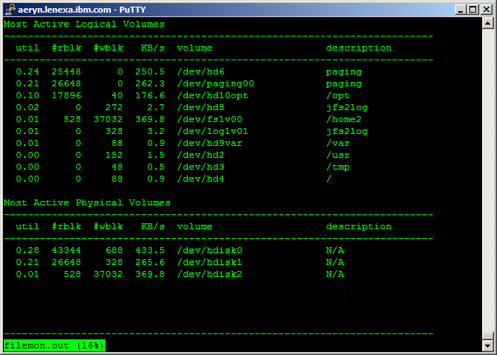
filemon – most active volumes
Notes:
This part of the output lists the most active logical and physical volumes in descending order.
In the above output, you can see the jfs2log and paging show up as well as regular mount points
Jfs2log space can be a significant problem if it is not placed well when dealing with writes

Slide 37
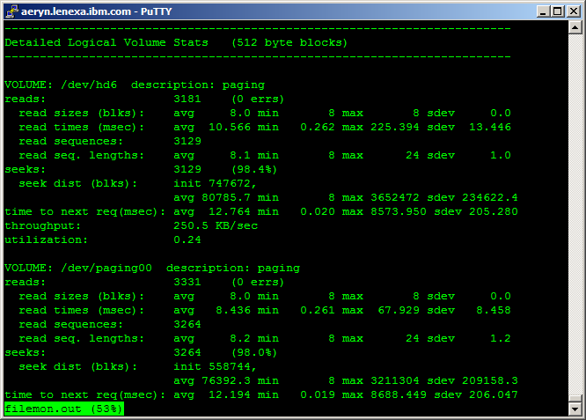
filemon – logical volumes
Notes:
Here you can see specific details on the logical volumes that were being accessed.

Slide 38
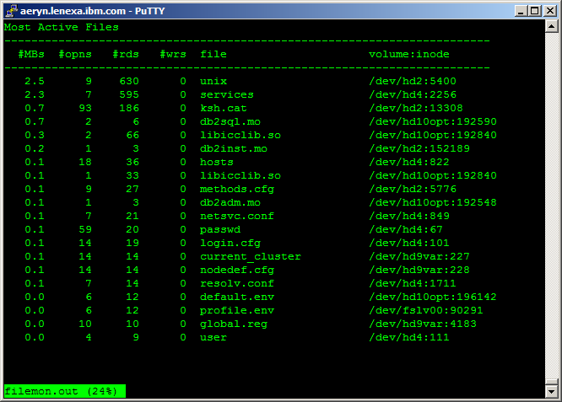
filemon – most active files
Notes:
From the above output, you can see what files are the most active. You get the file name, the volume name and the associated inode.
Many times, some of the most active files will be ones relating to the os that are referenced in the process of performing other functions. i.e. ps, ls, and other commands that display user names will reference /etc/passwd to translate the uid into the text label.

Slide 39
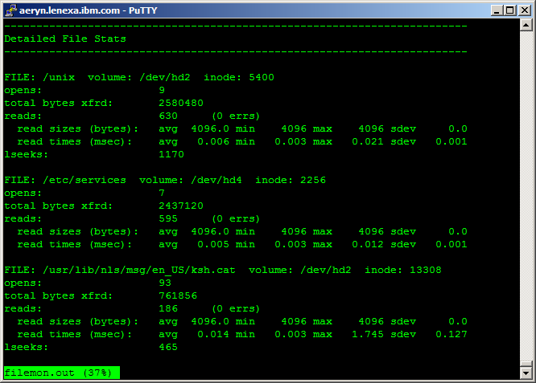
filemon – details of most active files
Notes:
Below the list of the most active files is the details about the file access.

Slide 40
svmon
While memory is not typically a memory problem when there is plenty of it, a shortage of memory can be a significant problem
The svmon tool is one of the best tools for analyzing memory usage
It has many options and can summarize the data at many levels
It does not take a lot of resources to collect
  But does require root authority to run
  Only available on AIX
Notes:
The svmon tool is one that is often desired on other platforms.
Also, in Solaris you can use pmap. Reference: http://www.cse.psu.edu/~dheller/cse411/notes/OSC/pmap.html

Slide 41
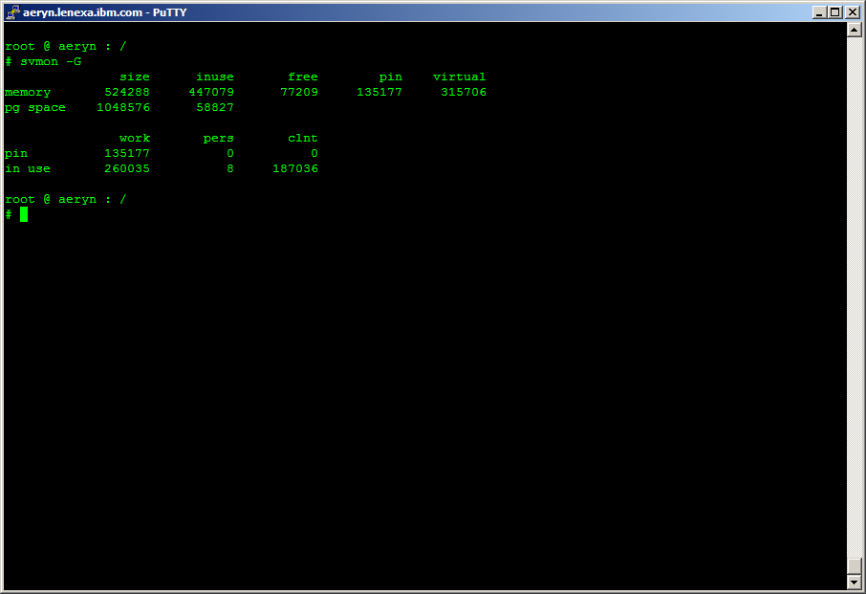
svmon - G
Notes:
The –G option lets you see how much memory is in use at the time, include the paging space.
It is an easy way to get a good breakdown of where the memory is divided; but does require root. The vmstat –v also provides a good understanding of where the real memory is, but does not show the paging space.

Slide 42
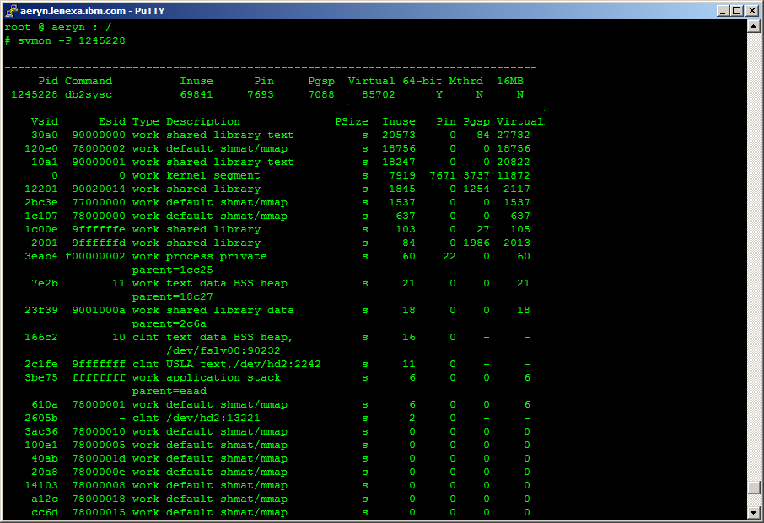
Svmon –P <pid>
Notes:
If you are wanting to look at the memory a single process is using, the –P <pid> option will do this.
From this output you can see the pid, the command, a summary of how much memory is in use and in what areas the memory is divided (pinned in memory, backed by paging space, and how much is being used in the address space of the process).
The Virtual memory may not (often not) add up to a sum of the Inuse, Pin, and Pgsp. That is because the memory that is not Pinned may be in both the paging space and active memory at the same time. Once a page is paged out, it remains in paging space, even if paged back into memory, until that memory is disclaimed.
The other entries list private memory, shared memory, and file system cache (clnt / perm pages).
The file system cache associated with the process as well as the shared memory may be associated with many processes. Therefore, you can not take a svmon –P for all the processes on the system and come up with a total amount of memory inuse / on the system. Instead, you would need to make sure all of the shared address space is only counted once and then add up all the private address space.
The breakdown is good so that you can see which parts of memory have been swapped out.
You can also look for the BSS heap (malloc memory goes here). If there is a private memory leak, this segment will be growing.

Slide 43
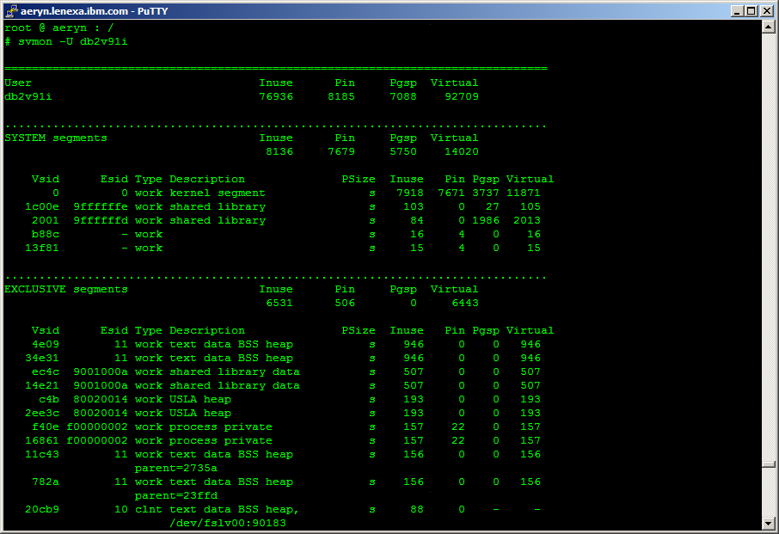
Svmon -U
Notes:
The svmon –U can be run specifying a user or without a userid. If run without a user id, it summarizes the memory for each user defined to the system.
This is useful, since it rolls up all processes under the user and only counts the shared memory once. As long as there are not a number of other significant processes running under the user id, this can very quickly tell you how much memory db2 has allocated and to which segments.

Slide 44
netstat
netstat has many options
The information is from the last reset of the adaptor / system
  Often requires a couple sets of output to compare the differences
  List errors and dropped packets most useful when looking for communication problems
The db2support collects netstat with the following options:
  /usr/bin/netstat –an (Network Socket Information)
  /usr/bin/netstat –in (Network Interface Information)
  /usr/bin/netstat –m (Network Stream Information)
  /usr/bin/netstat –rs (Network Routing Statistics)
  /usr/bin/netstat –v (Communication Adapter Statistics)
Notes:
Depending on what you are debugging the different options have different values.
For instance, if the something won’t start because a socket is in use, the –an option can be used to research this
The –v option summarizes the statistics and will contain the counts of errors as well as how much data has been sent and a breakdown of the activity

Slide 45
ping
ping is a simple and lightweight tool to test network connection latency
It sends and echo request (icmp) message to the target host
Does not always work as many times firewall rules block icmp request
Very useful if hadr WAN settings, as high latency will cause congestion
Notes:
Ping is a powerful little command.
If a server is hung, ping could possibly give some indication of how bad the hang is. As the network traffic will generate a hardware interrupt. If the server can respond to the hardware interrupt, the problem may be that os interrupts are blocked, unavailable do to runaway process(s).
Read up on the hadr perf wiki about tcp window size: https://w3.tap.ibm.com/w3ki/display/HADR/HADR_perf

Slide 46
Other Platforms
Most of this course applies to AIX and somewhat to Linux. For HP and Solaris, not all of the commands are the same.
Here are a couple of link to tool cross reference sites:
  http://bhami.com/rosetta.html
Here is a Redbook on moving from Solaris to AIX: http://www.redbooks.ibm.com/redpapers/pdfs/redp0104.pdf
Here is an article on monitoring Sun: http://www.ibm.com/developerworks/lotus/library/ls-Rules_SunSol/
Here is a series of articles on monitoring/tuning AIX:
  http://www.ibm.com/developerworks/aix/library/au-Keung_AIXPerf.html
  http://www.ibm.com/developerworks/eserver/articles/AIX5.2PerfTools.html
  http://www.ibm.com/developerworks/systems/articles/AIX5.2_performancetoolsupdatepart3.html

