Slide 1
Inside SQL Server In-Memory OLTP
Credits to Kalen Delaney, Jos de Bruijn, Sunil Agarwal, Cristian Diaconu, Craig Freedman, Alejandro Hernandez Saenz, Jack Li, Mike Zwilling and the entire Hekaton team
Latch free since 2007
Based on this whitepaper, internal docs, source code, and reverse engineering
Bob Ward, Principal Architect, Microsoft, Data Group, Tiger Team
deck and demos at http://aka.ms/bobwardms

Slide 2
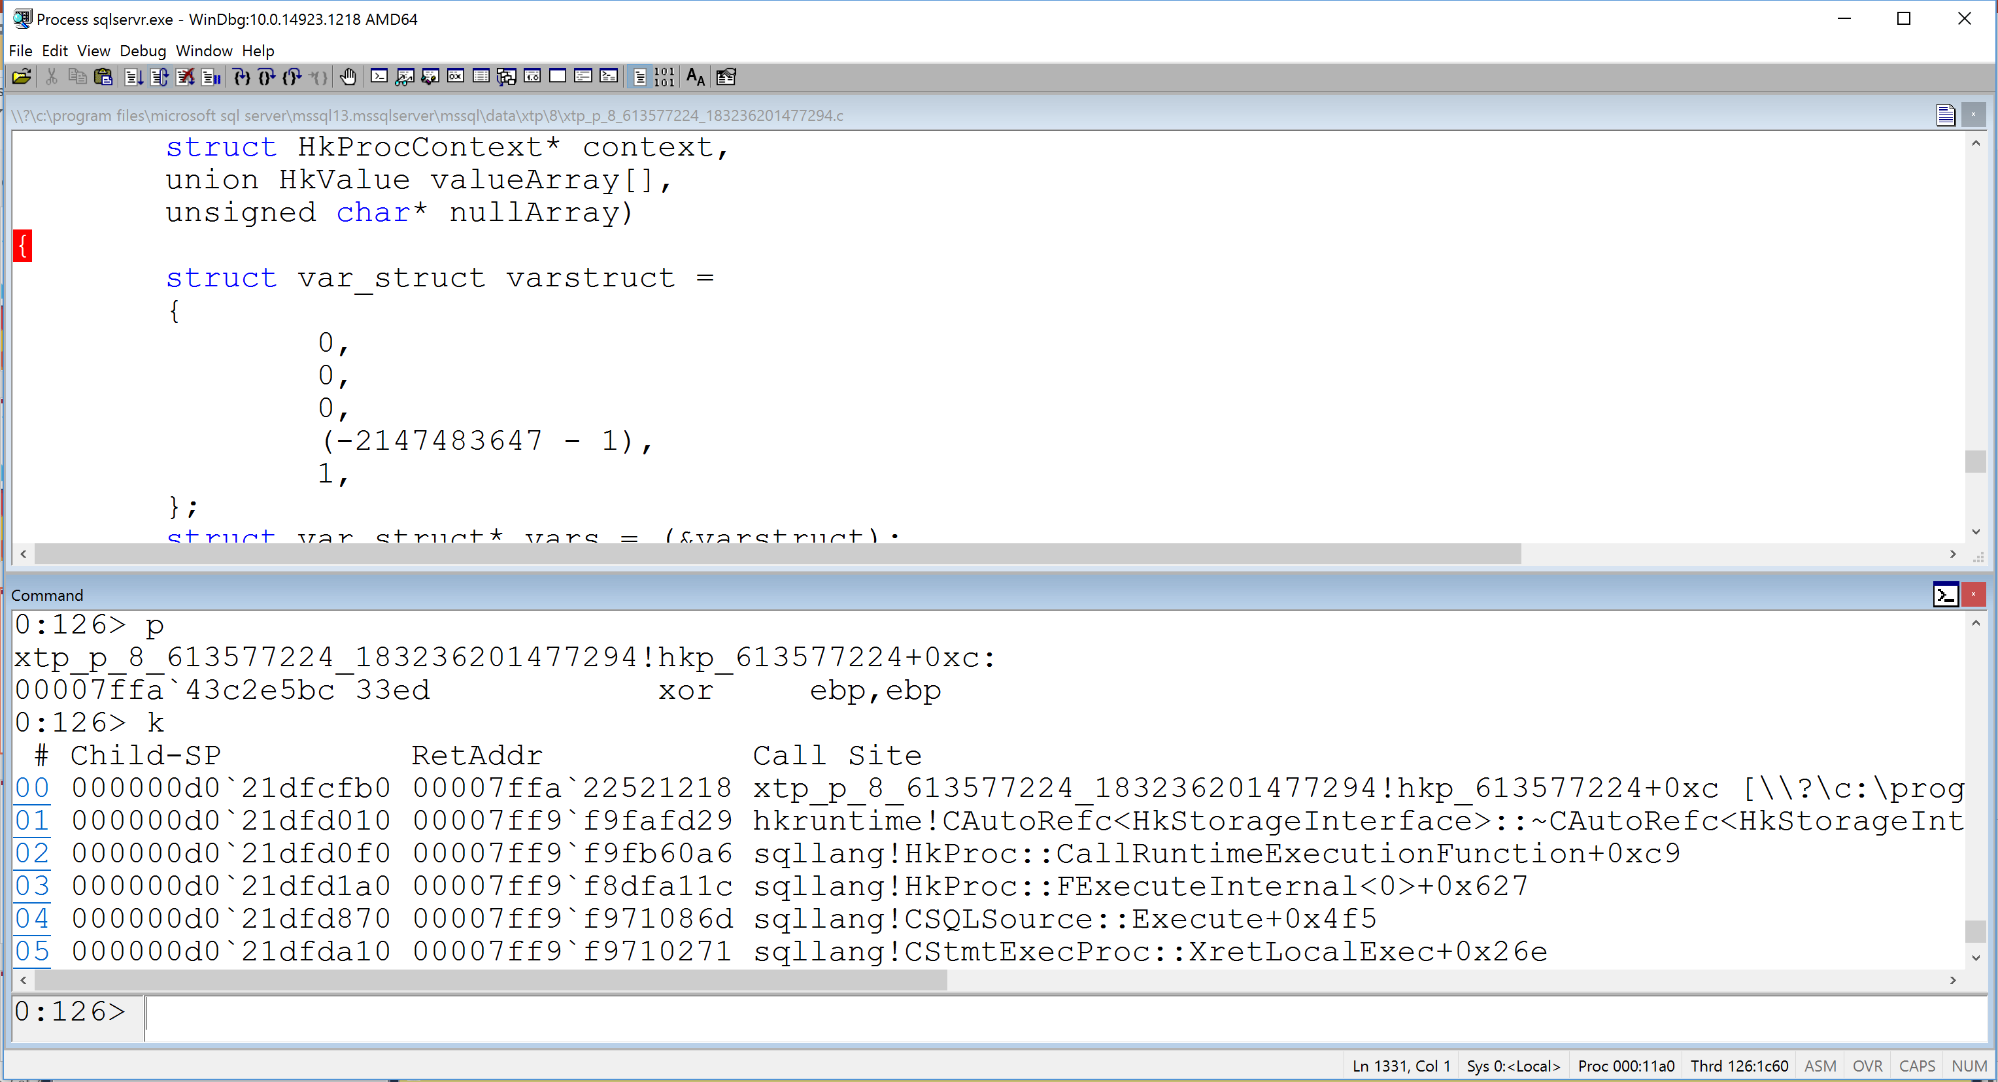

Slide 3

Great primer and customer stories by @jdebruijn
This is a 500 Level Presentation
It is ONE talk with a 15min break for 3 hours
=
Get and run the demo yourself from github

Slide 4
Let’s Do This
Based on SQL Server 2016
What, How, Why, and Architecture
Data and Indexes
Concurrency, Transactions, and Logging
Checkpoint and Recovery
Natively Compiled Procedures
Resource Management
Check out the Bonus Material Section
if time

Slide 5
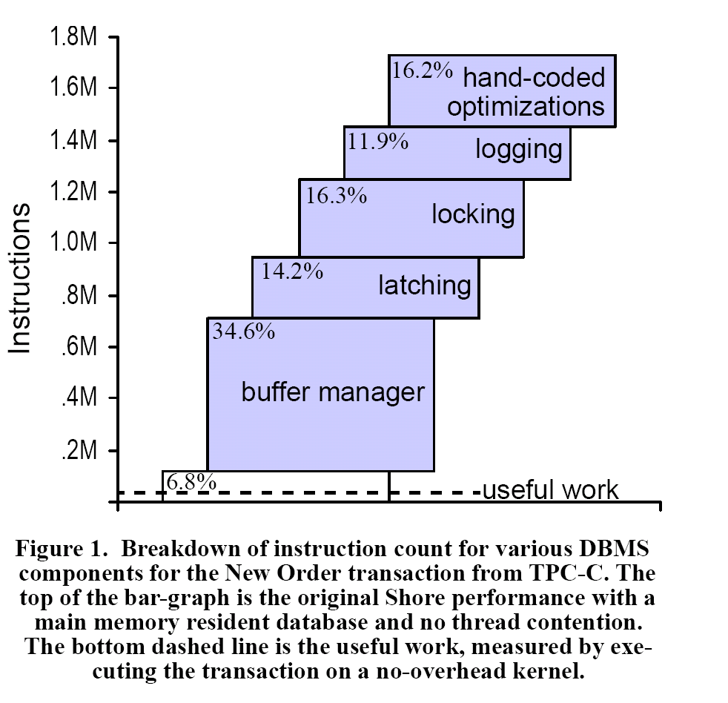
The Research behind the concept
OLTP Through the Looking Glass, and What We Found There by Stavros Harizopoulos, Daniel J. Abadi, Samuel Madden, Michael Stonebraker , SIGMOD 2008
TPC-C hand-coded on top of the SHORE storage engine
2/17/2008

Slide 6
The Path to In-Memory OLTP
Project Verde
2007
“Early” Hekaton
2009/2010
Hekaton becomes In-Memory OLTP
SQL Server 2014
In-Memory OLTP Unleashed
SQL Server 2016

Slide 7
What, Why, and How
Keep SQL Server relevant in a world of high-speed hardware with dense cores, fast I/O, and inexpensive massive memory
The need for high-speed OLTP transactions at microsecond speed
Reduce the number of instructions to execute a transaction
Find areas of latency for a transaction and reduce its footprint
Use multi-version optimistic concurrency and “lock free” algorithms
Use DLLs and native compiled procs
Minimal diagnostics in critical path
XTP = eXtreme Transaction Processing
HK = Hekaton

Slide 8
In-Memory OLTP Capabilities
Hear the case studies
Supported on Always On Availability Groups
Supports ColumnStore Indexes for HTAP applications
Supported in Azure SQL Database
Cross container transactions (disk and in-memory in one transaction)
Table variables supported
SQL surface area expanded in SQL Server 2016. Complete support here
LOB data types (ex. Varchar(max)) supported
BACKUP/RESTORE complete functionality
Use Transaction Performance Analysis Report for migration
Preview
Notes:
The point of this slide is talk about capabilities that this deck will not cover

Slide 9
The Path of In-Memory OLTP Transactions
“Normal” INSERT
In-Memory OLTP INSERT
INSERT LOG record
Obtain locks
Latch page
Modify page
Update index pages ( more locks and latch )
Release latches and locks
Insert ROW into memory
Maintain index in memory
Page Split
Spinlocks
Sys Tran = Log Flush
No latch
No spinlock
No index logging
SCHEMA_ONLY no logging
COMMIT Transaction = Log Record and Flush
COMMIT Transaction = Insert HK Log Record and Flush
Notes:
Notice that log records are not even created until COMMIT.

Slide 10
Just show it!
Demo
ἑκατόν
Notes:
That is the greek word for Hekaton which means 100 because our original goal was to achieve 100x performance with In-Memory OLTP
Follow the readme.txt file in the inmem_oltp_transaction_compare folder

Slide 11
Architecture and Engine Integration

Slide 12
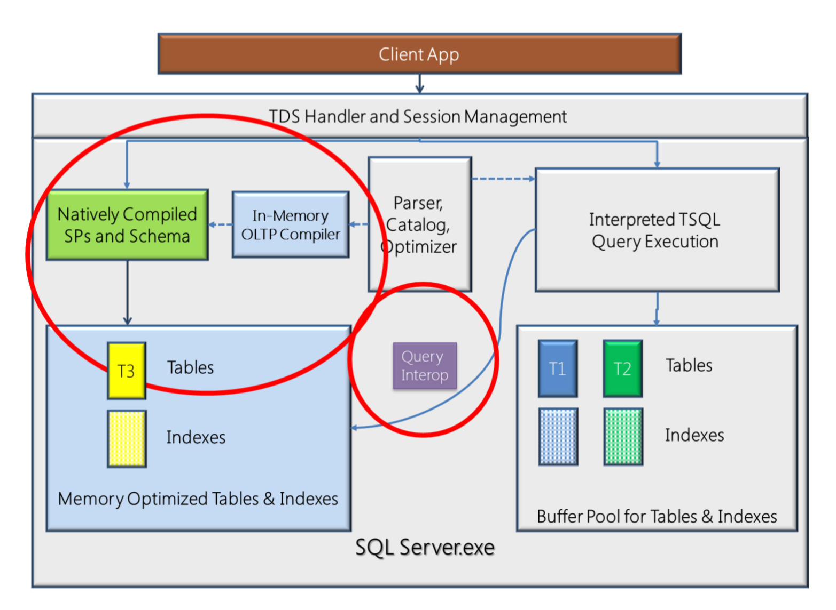
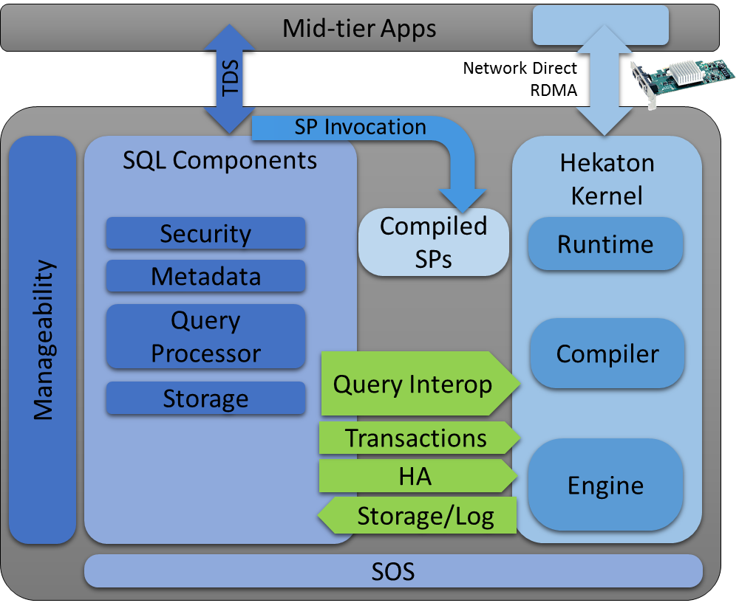
The In-Memory OLTP Architecture

Slide 13
In-Memory OLTP Engine Components
examples below
hkruntime.dll
hkcompile.dll
hkengine.dll
The Engine
SQL Engine
Allocate Memory
Checkpoint
Transaction Logging
Runtime
Call Native Procs
System Tables
Query Interop
Compile
Build Schema DLL
Build Native Proc DLL
Log Manager
Query Interop
HADR
SQL System Tables
Creating and executing procs
Hekaton Kernel
SCHEMA DLL and Native Proc DLL
“HOST”
SQLOS (sqldk.dll)

Slide 14
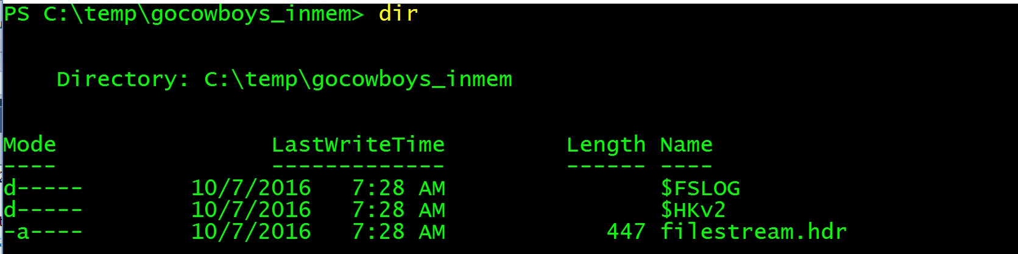
Creating the database for in-memory OLTP
filegroup <fg_name> contains memory_optimized_data
(name = <name>, filename = ‘<drive and path>\<folder name>’)
we create this
filestream container
Create multiple across drives
MEMORYCLERK_XTP
MEMOBJ_XTPDB
Name = DB_ID_<dbid>
Your data goes here so this gets big
Two of these for each db
Much smaller but can grow some over time
HK System Tables created
(hash index based tables)

Slide 15
In-memory OLTP Threads
U
user scheduler
H
hidden scheduler
database
P
preemptive
dm_xtp_threads
USER
XTP_OFFLINE_CKPT
USER
USER
CHECKPOINT
CONTROLLER
H
USER
LOG FLUSH
USER
P
USER
U
U
LOG FLUSH
CHECKPOINT
CLOSE
H
user transactions
P
CHECKPOINT I/O
You could see session_id > 50
In-Memory Thread Pools
Node 0
Node <n>
GC
GC
U
Data Serializer
Data Serializer
U
thread
P
H
thread
thread
Garbage collection one per node
P
Notes:
A request with command = XTP_CKPT_AGENT is used to keep FREE files replenished for CHECKPOINT files

Slide 16
Inside the HK architecture
Demo
Notes:
Follow the readme.txt file in the inmem_oltp_architecture folder

Slide 17
Data and Indexes
Hash Index = single row lookup with ‘=‘
Range Index = searching for multi-rows

Slide 18
Creating a Table
All tables require at least one index
create table starsoftheteam
(player_number int identity
primary key nonclustered hash with (bucket_count = 1048576),
player_name char(1000) not null)
with (memory_optimized = on, durability = schema_and_data)
Default = range
Schema stored in SQL system catalog
Hash index built in-memory
Hk system tables populated
Perform a checkpoint
Schema DLL built
Ex. “root” table
FS container files created and written

Slide 19
Inside Data and Rows
Compute your estimated row size here
How do you find data rows in a normal SQL table?
Heap = Use IAM pages
Clustered Index = Find root page and traverse index
What about an in-memory table?
Hash index table pointer known in HK metadata for a table. Hash the index key, go to bucket pointer, traverse chain to find row
Page Mapping Table used for range indexes and has a known pointer in HK metadata. Traverse the range index which points to data rows
All data rows have known header but data is opaque to HK engine
Schema DLL and/or Native Compiled Proc DLL knows the format of the row data
Schema DLL and/or Native Compiled Proc DLL knows how to find “key” inside the index
Data exists in memory as pointers to rows (aka a heap). No page structure
Hash index scan is possible
“bag of bytes”

Slide 20
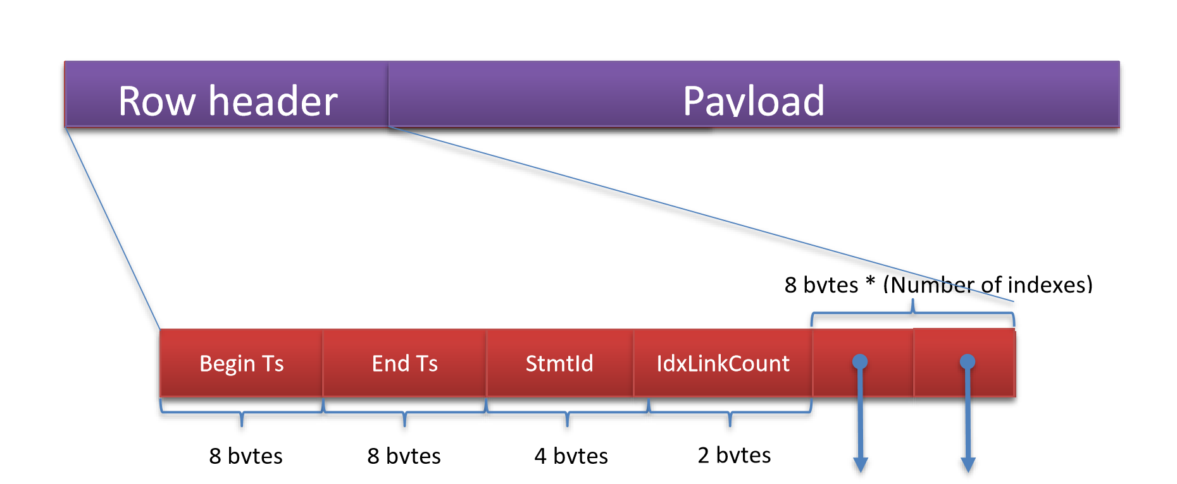
A In-Memory OLTP Data Row
Your data. “bytes” to HK engine
Rows don’t have to be contiguous in memory
Timestamp of DELETE. ∞ = “not deleted”
Timestamp of INSERT
Halloween protection
Points to another row in the “chain”. One pointer for each index on the table
Number of pointers = # indexes

Slide 21
Hash indexes
columns = name char(100), city char (100)
hash index on name bucket_count = 8
hash index on city bucket_count = 8
hash on name
hash on city
0
ts
chain count = 3
0
200,∞
Bob
Fort Worth
duplicate key != collision
100,∞
Bob
Dallas
3
90,∞
Ginger
Austin
4
Hash collision
4
5
5
50,∞
Ryan
Arlington
Begin ts reflects order of inserts
70,∞
Ginger
Houston
Notes:
Hash collision on name index with Ryan because it is a different value than Bob. The first two Bob rows are technically not a collision because they are the same key value

Slide 22
Hash Indexes
When should I use these?
Single row lookups by exact key value
Support multi-column indexes
Do I care about bucket counts and chain length?
The key is to keep the chains short
Key values with high cardinality the best and typically result in short chains
Larger number of buckets keep collisions low and chains shorter
Monitor and adjust with dm_db_xtp_hash_index_stats
SQL catalog view sys.hash_indexes also provided
Empty bucket % high ok except uses memory and can affect scans
Monitor average and max chain length (1 avg chain ideal; < 10 acceptable)
Rebuild with ALTER TABLE. Could take some time
REBUILD can block interop with SCH-S; Native proc rebuilt so blocked

Slide 23
Finding In- Memory Data Rows
Demo
Notes:
Follow the readme.txt file in the inmem_oltp_data_and_indexes folder

Slide 24
Range Indexes
When should I use these?
Frequent multi-row searches based on a “range” criteria (Ex. >, < )
ORDER BY on index key
First column of multi-column index searches
“I don’t know” or “I don’t want to maintain buckets” – Default for an index
You can always put pkey on hash and range on other columns for seeks
What is different about them?
Contains a tree of pages but not a fixed size like SQL btrees
Pointers are logical IDs that refer to Page Mapping Table
Updates are contained in “delta” records instead of modifying page

Slide 25
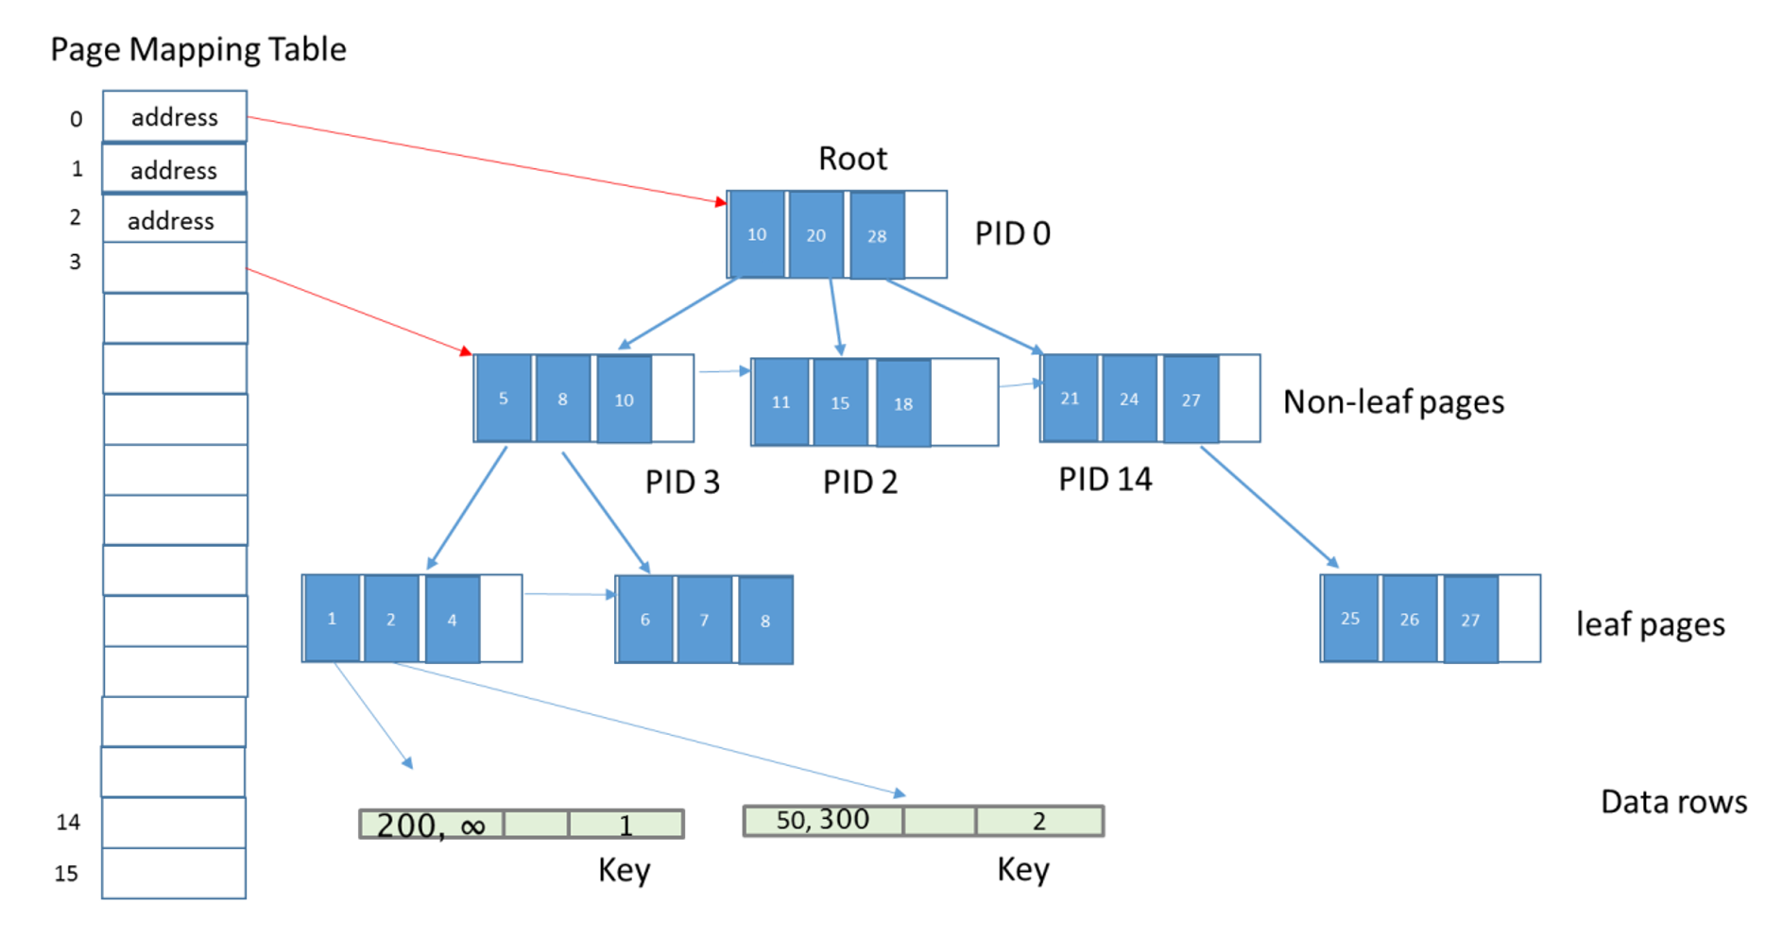
Range Indexes
A Bw-Tree. “Lock and Latch” free btree index

Slide 26
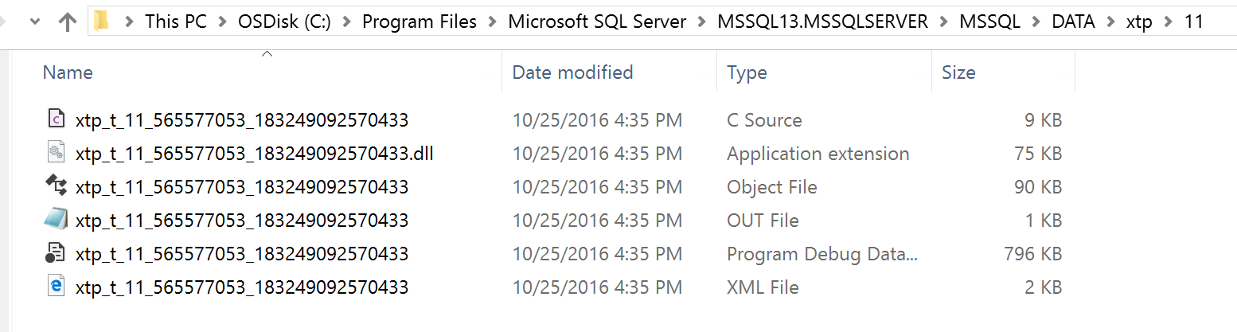
The SCHEMA DLL
The HK Engine doesn’t understand row formats or key value comparisons
So when a table is built or altered, we create, compile, and build a DLL bound to the table used for interop queries
dbid
Generated C source
Symbol file
object_id
Rebuilt when database comes online or table altered
cl.exe output
t = schema DLL
p =native proc
Notes:
We will discuss the compilation process when talking about natively complied DLLs

Slide 27
The Row Payload
create table letsgomavs
(col1 int not null identity primary key nonclustered hash with (bucket_count = 1000000),
col2 int not null,
col3 varchar(100)
)
with (memory_optimized = on, durability = schema_and_data)
struct NullBitsStruct_2147483654
{
unsigned char hkc_isnull_3:1;
};
struct hkt_2147483654
{
long hkc_1;
long hkc_2;
struct NullBitsStruct_2147483654 null_bits;
unsigned short hkvdo[2];
};
nullable
Header
hkc_1
hkc_2
Null bits
Offset array
col3
“your data”

Slide 28
Access data with the SCHEMA DLL
Interop Code to “crack” rows
Find Table metadata in Root Table
Get OpaqueData pointer
Get HkOffsetInfo pointer
Find columns and offsets
Use this to “crack” row values
schema DLL
Lookup a row in a hash index seek
Find hash index in metadata
Hash key and find bucket
Call CompareSKeyToRow routine
If row found, “crack” row

Slide 29
Cracking In-Memory OLTP Data Rows
Demo
Notes:
Follow the instructions in the readme.txt file in the inmem_oltp_schema_dll folder

Slide 30
Concurrency, Transactions, and Logging

Slide 31
Multi-Version Optimistic Concurrency (MVCC)
Immutable
Rows never change: UPDATE = DELETE + INSERT
Versions
UPDATE and DELETE create versions
Timestamps in rows for visibility and transactions correctness
Optimistic
Assume no conflicts
Snapshots + conflict detection
Guarantee correct transaction isolation at commit
NOT in tempdb
Pessimistic = locks
Errors may occur

Slide 32
In-memory OLTP versioning
1, ‘Row 1’
Disk based table
In-Mem Table
Time
T1
T2
Time
T1
T2
100
100
BEGIN TRAN
BEGIN TRAN
101
BEGIN TRAN
101
BEGIN TRAN
102
read committed and
SERIALIZABLE = blocked
2, ‘Row 2’
102
2, ‘Row 2’
X
103
SELECT
103
SELECT
104
RCSI = Row 1
Snapshot = Row 1
COMMIT
104
Snapshot always used = Row 1
COMMIT
105
SELECT
RCSI = Row 1 and 2
Snapshot = Row 1
105
SELECT
X
SERIALIZABLE = Msg 41325
106
COMMIT
106
COMMIT

Slide 33
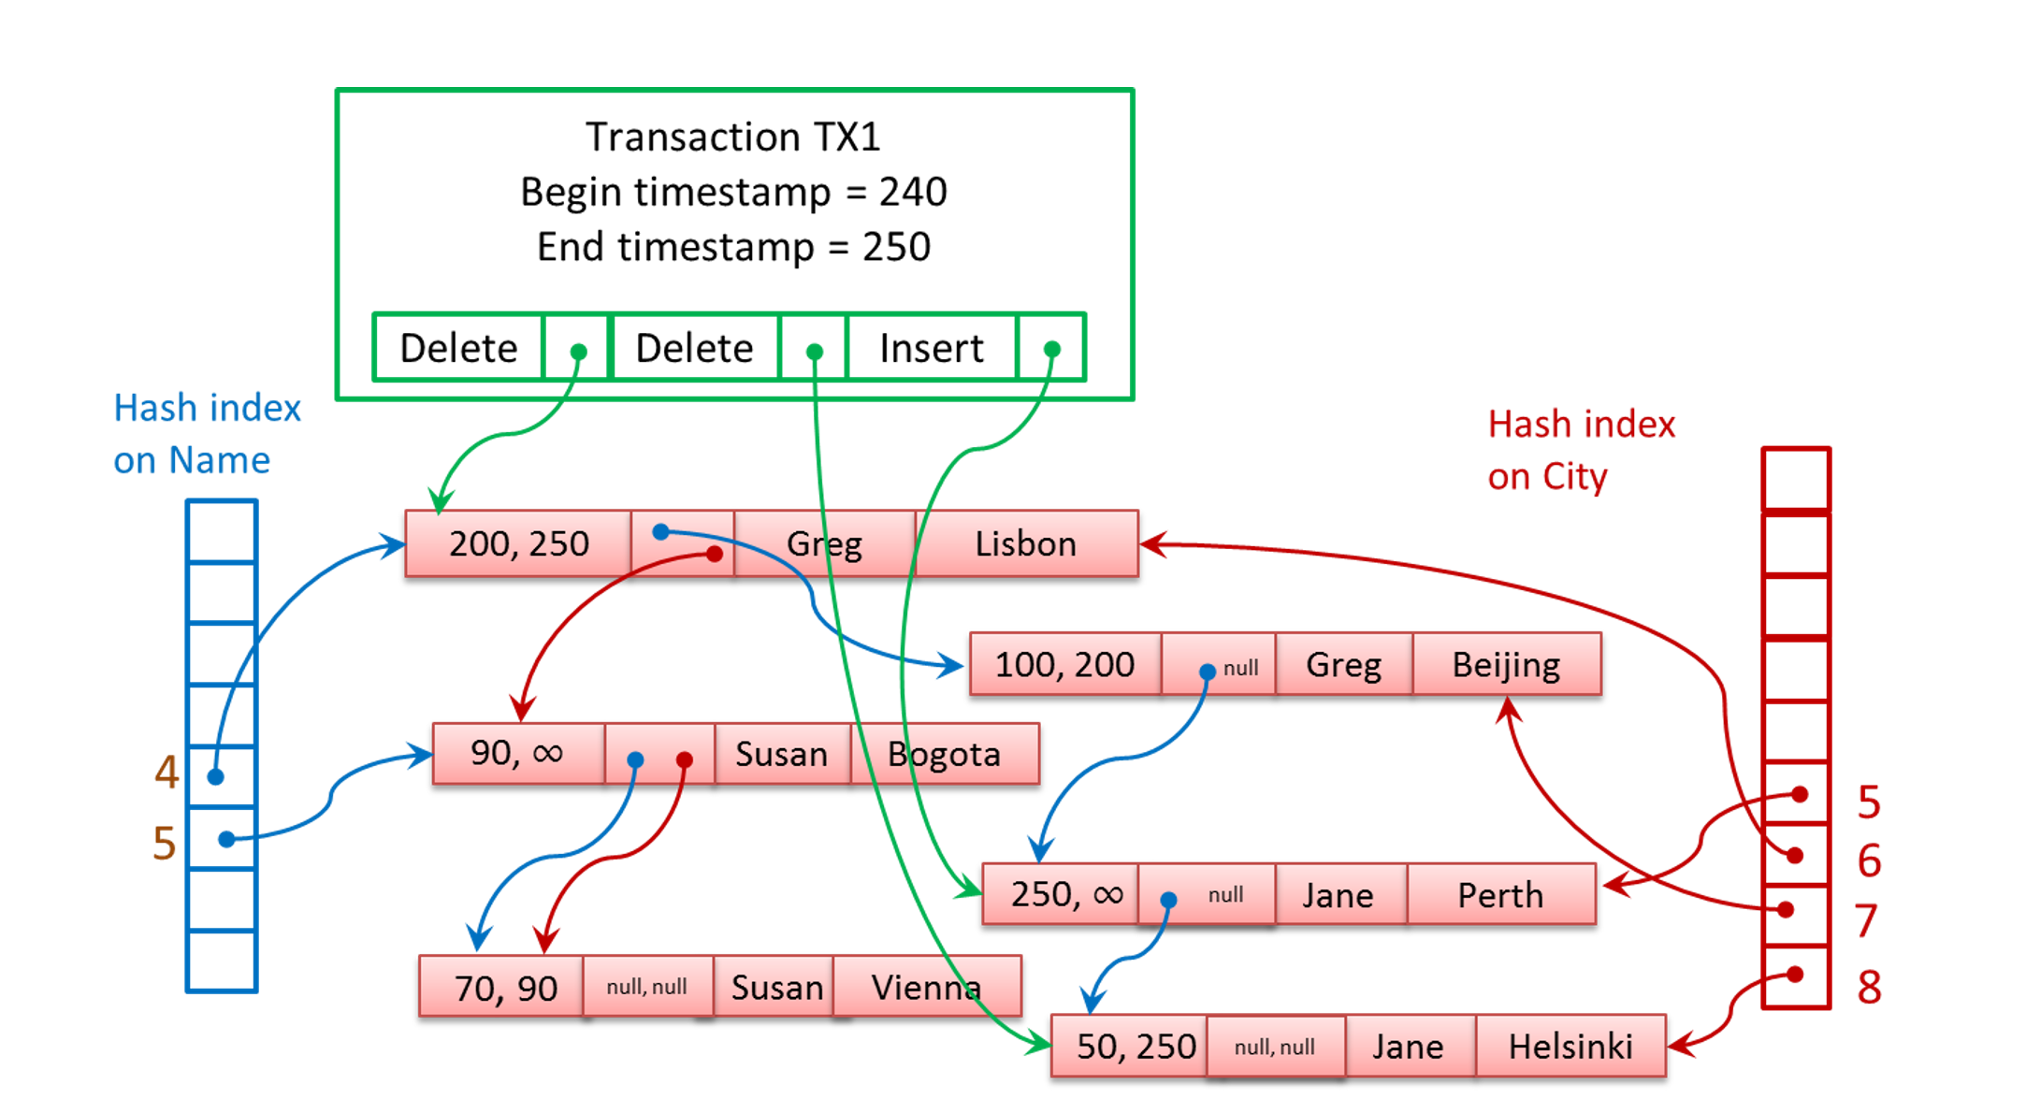
What were those timestamps for?
“read set”
TS = 243
SELECT Name, City FROM T1
Greg, Lisbon
Susan Bogata
Jane Helsinki
“write set” = logged records
BEGIN TRAN TX3 – TS 246
SELECT City FROM T1 WITH (REPEATABLEREAD) WHERE Name = 'Jane';
UPDATE T1 WITH (REPEATABLEREAD) SET City ‘Helinski’ WHERE Name = 'Susan';
COMMIT TRAN -- commits at timestamp 255
FAIL = ‘Jane’ changed after I started
but before I committed and I’m
REPEATABLEREAD. With SQL update to Jane would have been blocked
Commit dependency

Slide 34
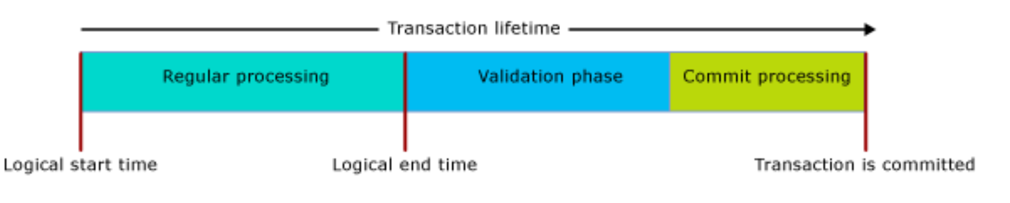
Transactions Phases and In-Memory OLTP
COMMIT
completed
Ensure isolation levels are accurate. Could result in failure
Update conflict can happen here
Wait for dependencies, flush log records, update timestamps
COMMIT started
Lookout for Fkeys
dm_db_xtp_transactions

Slide 35
It is really “lock free”
The “host” may wait – tLog, SQLOS
Code executing transactions in the Hekaton Kernel are lock, latch, and spinlock free
deadlock free
Locks
Only SCH-S needed for interop queries
Latches
No pages = No page latches
Latch XEvents don’t fire inside HK
Spinlocks
Spinlock class never used
Database locks
We use Thread Local Storage (TLS) to “guard” pointers
Atomic “Compare and Swap” (CAS) to modify
We can “walk” lists lock free. Retries may be needed
*XTP* wait types not in transaction code
Great blog post here
Spinlocks use CAS (‘cmpxchg’) to “acquire” and “release”
CMED_HASH_SET fix
IsXTPSupported() = cmpxchg16b
Notes:
T-SQL IsXTPSupported() = Windows API IsProcessorFeaturePresent(PF_COMPARE_EXCHANGE128)
= _InterlockedCompareExchange128() = Cmpxchg16b instruction

Slide 36
In-Memory OLTP Concurrency and Transactions
Demo
Notes:
Follow the instructions in the readme.txt file in the inmem_oltp_concurrency folder

Slide 37
Logging for a simple disk based INSERT
use dontgobluejays
create table starsoftheteam (player_no int primary key nonclustered, player_name char(100) not null)
One row already exists
begin tran
insert into starsoftheteam (1, 'I really don‘’t like the Blue Jays')
commit tran
LOP_BEGIN_XACT
LOP_INSERT_ROWS – heap page
LOP_INSERT_ROWS – ncl index
LOP_COMMIT_XACT
4 log records
528 bytes
124
204
116
84

Slide 38
Logging for a simple in-mem OLTP INSERT
use gorangers
create table starsoftheteam (player_no int primary key nonclustered, player_name char(100) not null)
with (memory_optimized = on, durability = schema_and_data)_
begin tran
insert into starsoftheteam values (1, 'Let'‘s go Rangers')
commit tran
fn_dblog_xtp()
3 log records
436 bytes
LOP_BEGIN_XACT
LOP_HK
LOP_COMMIT_XACT
144
HK_LOP_BEGIN_TX
HK_LOP_INSERT_ROW
HK_LOP_COMMIT_TX
208
84

Slide 39
Multi-row INSERT disk-based heap table
100 rows
LOP_BEGIN_XACT
LOP_INSERT_ROWS – heap page
LOP_INSERT_ROWS – ncl index
LOP_COMMIT_XACT
LOP_BEGIN_XACT
LOP_MODIFY_ROW – PFS
LOP_FORMAT_PAGE
LOP_COMMIT_XACT
LOP_HOBT_DELTA
LOP_SET_FREE_SPACE - PFS
1 pair for every row
Alloc new page twice
PFS latch
Metadata access
Log flush
PFS latch multiple times
213 log records @ 33Kb

Slide 40
Compared to In-Memory OLTP
Only inserted into log cache at commit.
LOP_BEGIN_XACT
LOP_HK
LOP_COMMIT_XACT
144
HK_LOP_BEGIN_TX
HK_LOP_INSERT_ROW
HK_LOP_COMMIT_TX
11988
100
84
ROLLBACK = more log records for SQL. 0 for HK
If LOP_HK too big we may need more than one
Log flush

Slide 41
Checkpoint and Recovery

Slide 42
In-Memory OLTP CHECKPOINT facts
Log truncation eligible at CHECKPOINT event
Why CHECKPOINT?
Speed up database startup. Otherwise we would have to keep around a huge tlog around.
We only write data based on committed log records
Independent of SQL recovery intervals or background tasks (1.5Gb log increase)
All data written in pairs of data and delta files
Preemptive tasks using WriteFile (async with FILE_FLAG_NO_BUFFERING)
Data is always appended
I/O is continuous but CHECKPOINT event is based on 1.5Gb log growth
Instant File Initialization matters for PRECREATED files
Data = INSERTs and UPDATEs
Delta = filter for what rows in Data are actually deleted
Periodically we will MERGE several Data/Delta pairs.
No WAL protocol
Typically 128Mb but can be 1Gb
Typically 8Mb but can be 128Mb
Notes:
We can switch to “large” files (1Gb) if checkpoint has determine it can read 200Mb/sec and the machine has 16 cores and 128Gb for SQL Server

Slide 43
CHECKPOINT FILE types and states
PRECREATED
ACTIVE
After first CREATE TABLE
INSERT data rows
UNDER CONSTRUCTION
Checkpoint File Pair (CFP) and are what is in tlog
WAITING..TRUNCATION
DATA
DATA
CHECKPOINT event
DELTA
ROOT
FREE
0 to 100 TS
DELTA
DATA
FREE
INSERT more
data rows
0 to 100 TS
FREE
ROOT
FREE
DELTA
ROOT
Any tran in this
range
DATA
These will be used to populate
table on startup and then apply log
ROOT
101 to 200 TS
DATA
DELTA
ROOT
101 to 200 TS
DELTA
This can be reused or deleted at log truncation
We constantly keep PRECREATED, FREE files available
ROOT

Slide 44
CHECKPOINT DATA file format
ROOT and DELTA files use 4Kb blocks
4Kb
256Kb
“CKPT”
Block Header
File Header
Block Header
Data Rows
PAD
Block Header
Data Rows
TYPE
……
Fixed
Length dependent
on TYPE
Fixed
Row headers and
payload
Every type starts with a FILE Header block of 4Kb
Find the list @ dm_db_xtp_checkpoint_files

Slide 45
In-Memory OLTP Recovery
Checksum failures = RECOVERY_PENDING on startup
Load ACTIVE DATA files filtered by DELTA streamed in parallel
Redo COMMITED transactions greater than last CHECKPOINT LSN
Load ROOT file for system tables and file metadata
Read details from database Boot Page (DBINFO)
We are a bit ERRORLOG “happy”
We can create a thread per CPU for this

Slide 46
CHECKPOINT and RECOVERY
Demo
Notes:
Follow the instructions in readme.txt in the inmem_oltp_checkpoint folder

Slide 47
Natively Compiled Procedures
Native = C code vs T-SQL
Built at CREATE PROC time or recompile
Rebuilt when database comes online
‘XTP Native DLL’ in dm_os_loaded_modules

Slide 48
The structure of a natively compiled proc
Required. No referenced
object/column
can be dropped or altered.
No SCH lock required
Compile this
Into a DLL
create procedure cowboys_proc_scan
with native_compilation, schemabinding as
begin atomic with
(transaction isolation level = snapshot, language = N'English')
select player_number, player_name from dbo.starsoftheteam
..
end
These are required. There are other options
Everything in
block a single tran
Iso levels still use MVCC
Your queries
No “*” allowed
Fully qualified names
Bigger surface area in SQL Server 2016
Restrictions and Best Practices are here

Slide 49
The lifecycle of compilation
Mixed Abstract Tree (MAT) built
Abstraction with flow and SQL specific info
XML file in the DLL dir
Converted to Pure Imperative Tree (PIT)
General nodes of a tree that are SQL agnostic. C like data structures
Easier to turn into final C code
Final C code built and written
C instead of C++ is simpler and faster compile.
Call cl.exe to compile, link, and generate DLL
Many of what is needed to execute in the DLL
Some calls into the HK Engine
No user defined strings or SQL identifiers to prevent injection
Query trees into MAT nodes
Done in memory
xtp_matgen XEvent
All files in BINN\XTP
Gen has HK header and libs
VC has compiler files, DLLs and libs
Call cl.exe to compile and link

Slide 50
Debugging a Natively Compiled Proc
Demo
Notes:
Show the XML representing the MAT TREE
Finding g_Bindings for a native proc DLL and set a breakpoint then step through it

Slide 51
Resource Management

Slide 52
Inside the Memory of In-Memory OLTP
Hekaton implements its own memory management system built on SQLOS
MEMORYCLERK_XTP (DB_ID_<dbid>) uses SQLOS Page allocator
Variable heaps created per table and range index
Details in dm_db_xtp_memory_consumers and dm_xtp_system_memory_consumers
In-Memory does recognize SQL Server Memory Pressure
Garbage collection is triggered
If OOM, no inserts allowed but you may be able to DELETE to free up space
“System” memory for database independent tasks
Hash indexes using partitioned memory objects for buckets
Memory only limited by the OS (24TB in Windows Server 2016)
Locked and Large apply
Allocated at create index time

Slide 53
Resource Governor and In-Memory OLTP
Remember this is ALL memory
SQL Server limits HK to ~70-90% of target depending on size
Freeing up memory = drop db (immediate) or delete data/drop table (deferred)
Binding to your own Resource Pool
Best way to control and monitor memory usage of HK tables
sp_xtp_bind_db_resource_pool required to bind db to RG pool
What about CPU and I/O?
RG I/O does not apply because we don’t use SQLOS for checkpoint I/O
RG CPU does apply for user tasks because we run under SQLOS host
no classifier function
Not the same as memory

Slide 54
Let’s Wrap It Up

Slide 55
Walk away with this
Want 30x faster for OLTP? Go In-Memory OLTP
Transactions are truly lock, latch, and spinlock free
Hash index for single row; Range for multi-row
Reduce transaction latency for super speed
SQL Server 2016 major step up from 2014

Slide 56
We are not done
Move to GA for Azure SQL Database
Increase surface area of features support for SQL Server
Push the limits of hardware
Speeding up recovery and HA with NVDIMM and RDMA
Explore further areas of code optimization
SQL 2016 CU2 fix for session state workloads Read more here
Range index performance enhancements

Slide 57
Resources
SQL Server In-Memory OLTP Internals for SQL Server 2016
In-Memory OLTP Videos: What it is and When/How to use it
Explore In-Memory OLTP architectures and customer case studies
Review In-Memory OLTP in SQL Server 2016 and Azure SQL Database
In-Memory OLTP (In-Memory Optimization) docs

Slide 58
Bonus Material

Slide 59
Troubleshooting
From the CSS team
Validation errors. Check out this blog
Upgrade from 2014 to 2016 can take time
Large checkpoint files for 2016 could take up more space and increase recovery times
Log growths, XTP_CHECKPOINT waits. Hotfix 6051103
Checkpoint file shut down and with no detailed info: https://support.microsoft.com/en-us/kb/3090141
Unable to rebuild log 6424109 (by design)
Set filegroup offline. NEVER do it because you can’t set it online again (filestream limitation)
You can’t remove HK filegroup after you add it 2016 LOB can cause memory issues
Other CSS Observations
Hash index doesn’t have a concept of “covered index”
Low memory can cause recovery to fail (because we need everything in memory)
No dbcc checkdb support (but checkpoint files and backup have checksum)

Slide 60
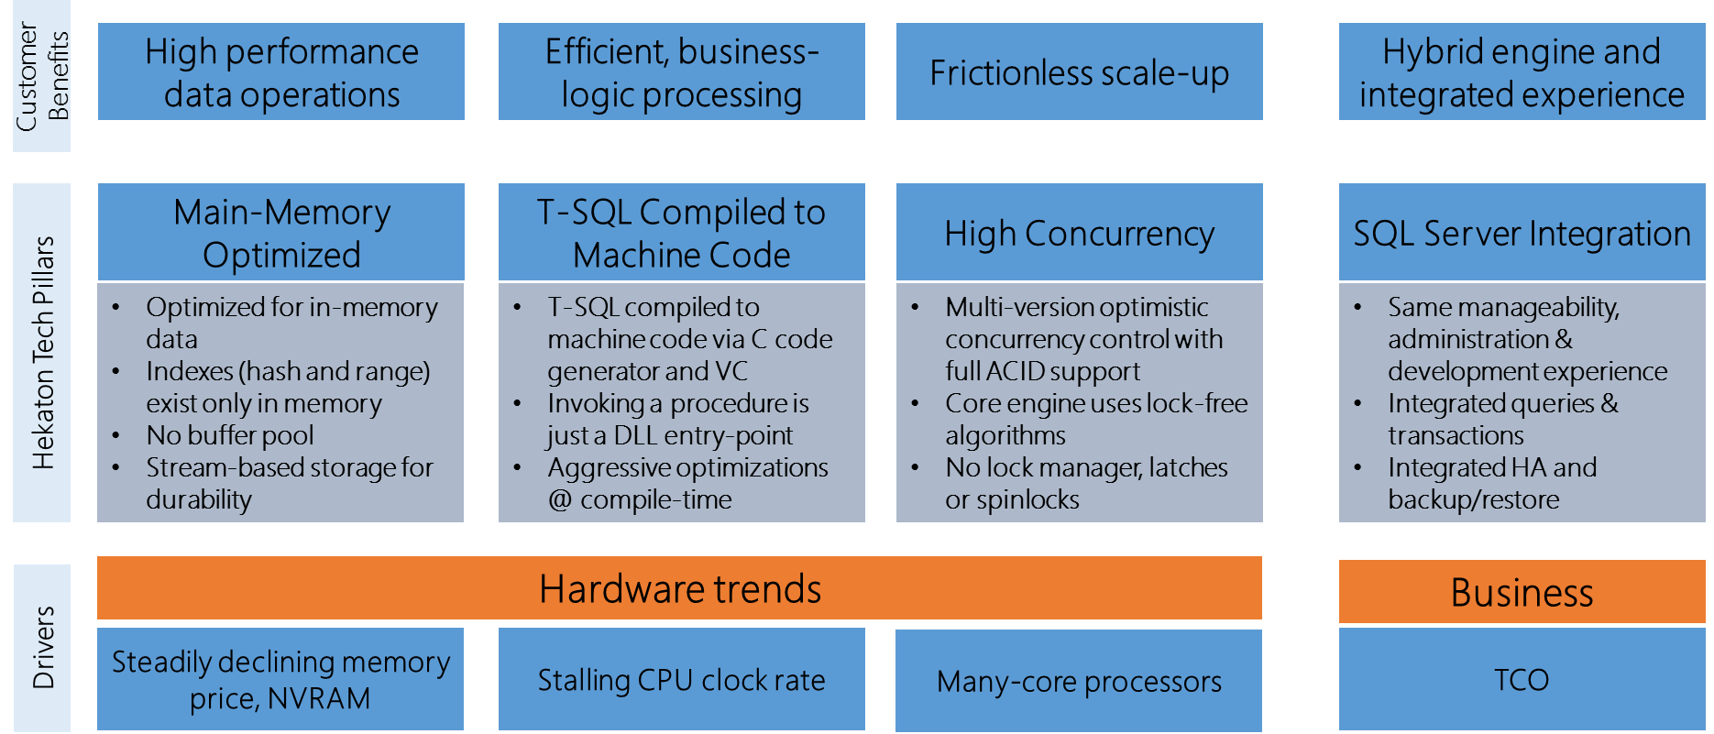
Architecture Pillars
Notes:
Probably cut slide

Slide 61
The Challenge
Network, TDS
10%
T-SQL interpreter
Query Execution
35%
Expressions
Access Methods
45%
Transaction, Lock, Log Managers
SOS, OS and I/O
10%

Slide 62
The In-Memory OLTP Thread Model
SQLOS task and worker threads are the foundation
“User” tasks to run transactions
Hidden schedulers used for critical background tasks
Some tasks dedicated while others use a “worker” pool
SQLOS workers dedicated to HK

Slide 63
In-Memory OLTP Thread Pool
H
hidden scheduler
U
user scheduler
NON-PREEMPTIVE POOL
Background workers needed for on-demand
Parallel ALTER TABLE
WORKERS POOL
Other workers needed for on-demand (non-preemptive)
Parallel MERGE operation of checkpoint files
PREEMPTIVE POOL
Background workers needed on-demand -preemptive
Serializers to write out checkpoint files
U
U
H
Command = XTP_THREAD_POOL wait_type = DISPATCHER_QUEUE_SEMAPHORE
Command = UNKNOWN TOKEN wait_type = XTP_PREEMPTIVE_TASK
Ideal count = < # schedulers> ; idle timeout = 10 secs
Notes:
Each pool is the size of number of schedulers after first item queued
Timeout after 10 secs of idle
NON-PREEMPTIVE and WORKERS POOL
Command = XTP_THREAD_POOL
Wait type = DISPATCHER_QUEUE_SEMAPHORE when idle
PREEMPTIVE POOL
Command = UNKNOWN TOKEN
Wait type = XTP_PREEMPTIVE_TASK

Slide 64
Data Modifications
Multi-version Optimistic Concurrency prevents all blocking
ALL UPDATEs are DELETE followed by INSERT
DELETED rows not automatically removed from memory
Deleted rows not visible to active transactions becomes stale
Garbage Collection process removes stale rows from memory
TRUNCATE TABLE not supported
Page deallocation in SQL Server

Slide 65
Garbage Collection
Stale rows to be removed queued and removed by multiple workers
User workers can clean up stale rows as part of normal transactions
Dedicated threads (GC) per NODE to cleanup stale rows (awoken based on # deletes)
SQL Server Memory pressure can accelerate
Dusty corner scan cleanup – ones no transaction ever reaches
This is the only way to reduce size of HK tables
Long running transactions may prevent removal of deleted rows (visible != stale)
Diagnostics
rows_expired = rows that are stale
rows_expired_removed = stale rows removed from memory
Perfmon - SQL Server 2016 XTP Garbage Collection
dm_db_xtp_gc_cycle_stats
dm_xtp_gc_queue_stats

Slide 66
Diagnostics for Native Procs
Read the docs
Query Plans and Stats
SHOWPLAN_XML is only option
Operator list can be found here
sp_xtp_control_query_exec_stats and sp_xtp_control_proc_exec_stats
Query Store
Plan store by default
Runtime stats store needs above stored procedures to enable (need recompile)
XEvent and SQLTrace
sp_statement_completed works for Xevent but more limited information
SQLTrace only picks up overall proc execution at batch level

Slide 67
Undo, tempdb, and BULK
Undo required 415 log records @46Kb
Hekaton required no logging
Tempdb has similar # log records as disk-based table but less per log record (aka minimal logging).
Multi-row insert test
Remember SCHEMA_ONLY has no logging or I/O
BULK INSERT for in-mem executes and logged just like INSERT
Minimally logged BULK INSERT took 271 log records @ 27Kb
Latches required for GAM, PFS, and system table pates

Slide 68
In-Memory OLTP pushes the log to the limit
Multiple Log Writers in SQL Server 2016
One per NODE up to four
We were able to increase log throughput from 600 to 900Mb/sec
You could go to delayed durability
Database is always consistent
You could lose transactions
Log at the speed of memory
Tail of the log is a “memcpy” to commit
Watch the video

Slide 69
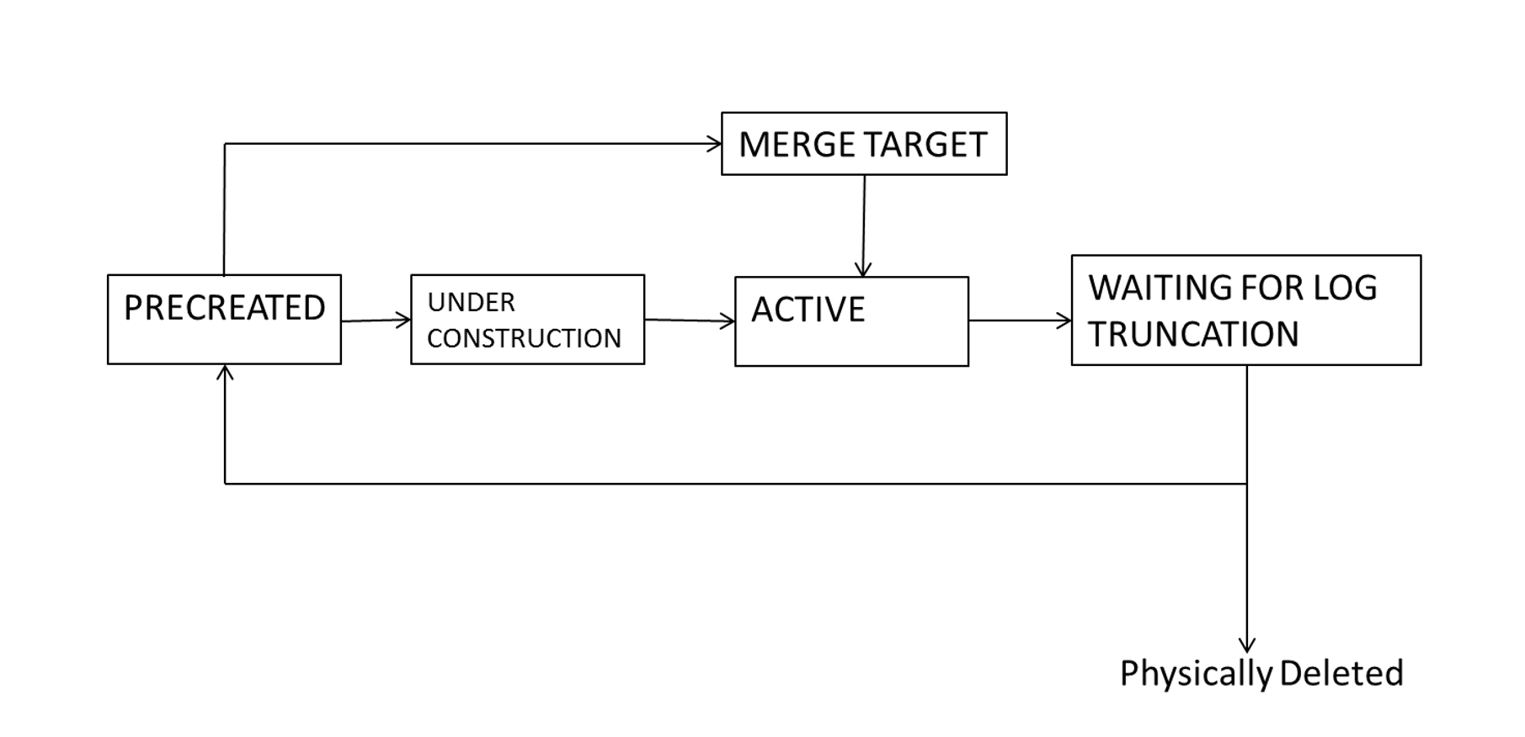
The Merge Process
Over time we could have many CFPs
Why not consolidate data and delta files into a smaller number of pairs?
MERGE TARGET type is target of the merge of files. Becomes ACTIVE
ACTIVE files that were source of merge become WAITING FOR LOG TRUNCATION

Slide 70

Bob Ward Principal Architect, Microsoft
Place your photo here
Bob Ward is a Principal Architect for the Microsoft Data Group (Tiger Team). Bob has worked for Microsoft for 23 years supporting and speaking on every version of SQL Server shipped from OS/2 1.1 to SQL Server 2016. He has worked in customer support as a principal escalation engineer and Chief Technology Officer (CTO) interacting with some of the largest SQL Server deployments in the world. Bob is a well-known speaker on SQL Server often presenting talks on internals and troubleshooting at events such as SQL PASS Summit, SQLBits, SQLIntersection, and Microsoft Ignite. You can find him on twitter at @bobwardms or read his blog at https://blogs.msdn.microsoft.com/bobsql..
/bobwardms
@bobwardms
Bob Ward

Slide 71










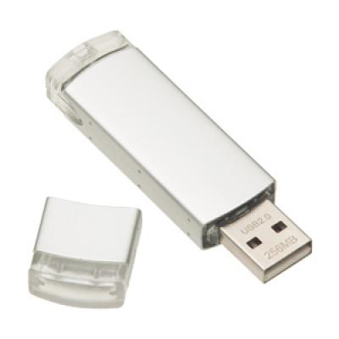

Explore Everything PASS Has to Offer
FREE ONLINE WEBINAR EVENTS
FREE 1-DAY LOCAL TRAINING EVENTS
VOLUNTEERING OPPORTUNITIES
LOCAL USER GROUPS AROUND THE WORLD
ONLINE SPECIAL INTEREST USER GROUPS
PASS COMMUNITY NEWSLETTER
FREE ONLINE RESOURCES
BUSINESS ANALYTICS TRAINING
BA INSIGHTS NEWSLETTER

Slide 72
Session Evaluations
ways to access
3
Your feedback is important and valuable.
Submit by 5pm
Friday November 6th to WIN prizes
Go to passSummit.com
Download the GuideBook App and search: PASS Summit 2016
Follow the QR code link displayed on session signage throughout the conference venue and in the program guide

Slide 73
Thank You
Learn more from
Bob Ward
bobward@company.com or follow @bobwardms

