Slide 1
10961B
Automating Administration with Windows PowerShell
Notes:
To help you teach this course a 10961A Train the Trainer video is available on the MCT Readiness site. There is also a change log that details the differences between the A and B versions.
10961B
00: Introduction

Slide 2

Welcome!
Thank you for joining us today.
We’ve worked together with Microsoft Learning Partners and Microsoft IT Academies to bring you a world-class learning experience, including:
Microsoft Certified Trainers + Instructors. Your instructor is a premier technical and instructional expert who meets ongoing certification requirements.
Customer Satisfaction Guarantee. Our Partners offer a satisfaction guarantee and we hold them accountable for it. At the end of class, please complete an evaluation of
today’s experience. We value your feedback!
Certification Benefits. After training, consider pursuing a Microsoft Certification, to help distinguish your technical expertise and experience. Ask your instructor about available exam promotions and discounts.
We wish you a great learning experience and ongoing career success!
Notes:
10961B
00: Introduction

Slide 3
Instructor Introduction
Instructor: <Instructor Name>
<Title or other credentials, e.g. Microsoft Certified Trainer>
<Affiliation/Company>
<A few words about my technical and professional experience>
Notes:
Welcome students to the course and introduce yourself. Provide a brief overview of your background to establish credibility. Use the next slide for students to introduce themselves.
10961B
00: Introduction

Slide 4
Student Introduction
Name
Company affiliation
Title/function
Job responsibility
Technical and professional experience
Product experience
Your expectations for the course
Notes:
Ask students to introduce themselves and provide their backgrounds, product experience, and expectations of the course.
Record student expectations on a whiteboard or flip chart that you can reference during class.
10961B
00: Introduction

Slide 5
Facilities
Class hours
Building hours
Parking
Restrooms
Meals
Phones
Messages
Smoking
Recycling
Notes:
Add any local information specific to your classroom, such as emergency situations.
10961B
00: Introduction

Slide 6
About This Course
Audience
Course Prerequisites
Course Objectives
What You Can Expect
Notes:
10961B
00: Introduction

Slide 7
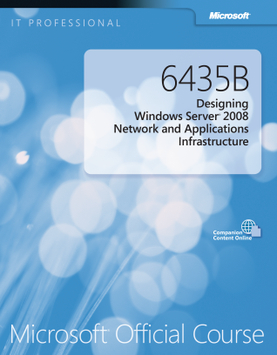

Your Course Materials
Microsoft Official Course Handbook
Organized by modules
Includes Labs and Lab Answer Keys
Module Reviews and Takeaways—great for on-the-job reference
Digital Companion Content
Supplemental content and helpful links
Download at: http://www.microsoft.com/learning/companionmoc
Notes:
10961B
00: Introduction

Slide 8
Course Outline
Module 1: Getting Started with Windows PowerShell
Module 2: Working with the Pipeline
Module 3: Understanding How the Pipeline Works
Module 4: Using PSProviders and PSDrives
Module 5: Formatting Output
Module 6: Using WMI and CIM
Module 7: Preparing for Scripting
Module 8: Moving From a Command to a Script to a Module
Notes:
Refer students to the online course syllabus for module objectives, lessons, and labs - http://www.microsoft.com/learning/en/us/Course.aspx?ID=10961B
10961B
00: Introduction

Slide 9
Course Outline (continued)
Module 9: Administering Remote Computers
Module 10: Putting it All Together
Module 11: Using Background Jobs and Scheduled Jobs
Module 12: Using Advanced PowerShell Techniques and Profiles
Notes:
10961B
00: Introduction

Slide 10
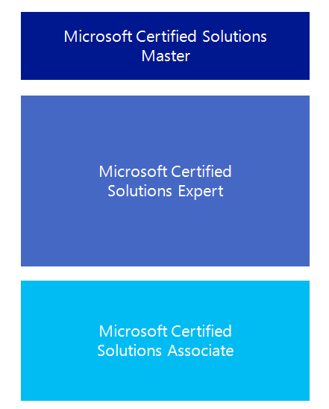

Microsoft Certification Program
Get trained. Get certified.
Get ahead.
Microsoft Certifications demonstrate you have the skills to design, deploy, and optimize the latest technology solutions.
Ask your Microsoft Learning Partner how you can prepare for certification.
Also see:
http://www.microsoft.com/learning/
certification
Notes:
This course does not have a direct mapping to any exam. However, while there is not a standalone Windows PowerShell exam the topics are covered across all the individual Microsoft Certified Solutions Associate (MCSA) and Microsoft Certified Certified Solutions Expert (MCSE) exams. This course will help prepare the student for Windows PowerShell related concepts and processes within those exams.
10961B
00: Introduction

Slide 11
Preparing for the Labs
Your lab activities will be centered around a fictitious company that we’ll call A. Datum Corporation.
Each lab is standalone and will emphasize a specific skill. You will be given an optional starting point or you can build on your previous work.
A major skill in Windows PowerShell is the ability to teach yourself, using the shell’s discovery tools. The lab answer key should only be used to verify your work.
To complete the labs, you will work in a virtual machine (VM) environment.
Notes:
10961B
00: Introduction

Slide 12
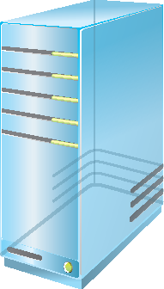
Virtual Machine Environment
Virtual Machine Name: | Use as:
10961B-LON-DC1 | Windows Server 2012 Server Core domain controller and DHCP server for the Adatum.com domain.
10961B-LON-CL1 | Windows 8 client computer and in the Adatum.com domain with Remote Server Administratin Tools (RSAT) installed.
10961B-LON-SVR1 | Newly installed Windows Server 2012 Server Core computer.
Notes:
10961B
00: Introduction

Slide 13
Demonstration: Using Hyper-V Manager
In this demonstration, you will learn how to:
Open Hyper-V Manager
Navigate the various sections/panes within Hyper-V Manager
Virtual Machines (VMs), Snapshots, and Actions: Server-specific and VM-specific
Identify the VMs used in the labs for this course
Take a Snapshot and Apply a Snapshot
Connect to a VM
Start and log on to a VM
Switch between full screen and window modes
Revert to the previous Snapshot
Shut down a VM
When to use Shut Down or Turn off
Close Hyper-V Manager
Notes:
Use this demonstration if students are not familiar with how to use Hyper-V. If students are not familiar with navigation in Windows Server 2012 provide this additional information:
Sign in and Sign out replace Log in and Log out.
Administrative tools are found in the Tools menu of Server Manager.
Move your mouse to the lower right corner of the desktop to open a menu with:
Settings: This includes Control Panel and Power
Start menu: This provides access to some applications
Search: This allows you to search applications, settings, and files
You may also find the following shortcut keys useful:
Windows: Opens the Start menu
Windows+C: Opens the same menu as moving the mouse to the lower right corner
Windows+I: Opens Settings
Windows+R: Opens the Run window
10961B
00: Introduction

