Slide 1
Module06
Querying Management Information by Using WMI and CIM
Notes:
Presentation: 45 minutes
Demonstrations: 45 minutes
Lab: 45 minutes
Required materials
To teach this module, you need the Microsoft® PowerPoint® file 10961B_06.pptx.
Important:
The use of PowerPoint 2013, PowerPoint 2010, or PowerPoint 2007 is recommended to display the slides for this course. If you use PowerPoint Viewer or a version of PowerPoint older than PowerPoint 2007, some of the features of the slides might not display correctly.
Preparation tasks
To prepare for this module:
Read all of the materials for this module.
Practice performing the demonstrations.
Practice performing the labs.
Work through the “Module Review and Takeaways” section, and determine how you will use this section to reinforce student learning and promote knowledge transfer to on-the-job performance.
As you prepare for this class, it is imperative that you complete the labs yourself so that you understand how they work and the concepts that are covered in each. This will help you provide meaningful hints to students who might experience difficulties in a lab; it will also help guide your lecture to ensure that you cover the concepts that the labs cover.
10961B
06: Querying Management Information by Using WMI and CIM

Slide 2
Module Overview
Understanding WMI and CIM Querying Data by Using WMI and CIM Making Changes by Using WMI and CIM
Notes:
Demonstration Preparation:
There are demonstrations in each Lesson in this module. To prepare for them, you need to do the following:
Start and sign in to the 10961B-LON-DC1 virtual machine with user name Adatum\Administrator and password Pa$$w0rd.
Start and sign in to the 10961B-LON-CL1 virtual machine with user name Adatum\Administrator and password Pa$$w0rd. (Start and log on to the 10961B-LON-DC1 before logging on to the 10961B-LON-CL1 virtual machine.)
The demonstration steps should be performed on the 10961B-LON-CL1 virtual machine in either the Windows PowerShell™ console or in the Windows PowerShell Integrated Scripting Environment (ISE). Aome demonstrations may explicitly call out which one to use.
Where commands are complex, or steps are numerous, .ps1 demonstration files are provided and can be opened and used in the ISE. They will be called out in the instructor notes in the demonstration where they are available. They are available on the 10961B-LON-CL1 at E:\Mod06\Democode.
Note: The “Finding Classes Documentation” and “Finding Methods and Documentation” in Lesson 1 and Lesson 3 in this module require access to the Internet. The course virtual machines do not have Internet access enabled. Thus, you should perform the demonstration on your host machine, and ensure that Internet access and overhead projection is available to the class from your host machine prior to starting the demonstration.
10961B
06: Querying Management Information by Using WMI and CIM

Slide 3
Lesson 1: Understanding WMI and CIM
Architecture and Technologies The Repository Finding Documentation Demonstration: Finding Classes Documentation
Notes:
Question
Can you think of any situations where you would have to use WMI instead of CIM?
Answer
The only situation is when you have to query a remote computer that does not have Windows PowerShell remoting enabled, and you do not want to create a CIM session that uses the DCOM protocol.
10961B
06: Querying Management Information by Using WMI and CIM

Slide 4
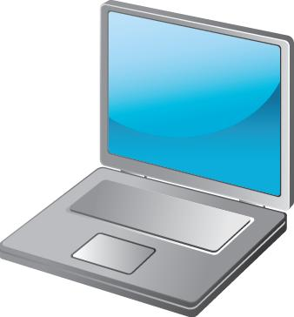
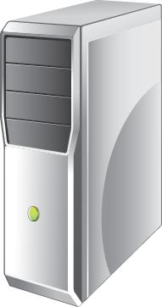
Architecture and Technologies
Earlier
(WMI)
New
(CIM)
DCOM
WS-MAN
WMI
WinRM
Repository
Notes:
The slide shows the two ways that a computer may communicate with the repository. The new way is to use Common Information Model (CIM) commands. These commands communicate by using the Web Services for Management (WS-MAN) protocol, and connect to the Windows® Remote Management (WinRM) service. The previous way was to use Windows Management Instrumentation (WMI) commands. Those commands communicate by using the DCOM protocol, and connect to the WMI service.
10961B
06: Querying Management Information by Using WMI and CIM

Slide 5
WMI or CIM?
 | CIM | WMI
Requires WMF 2.0 or later | Yes* | WMF Not required
Requires that Remoting be enabled | Yes* | No
Cross-platform compatibility i.e. Supports Non-Windows based systems | Yes | No
Requires Single firewall port exception | Yes | No
Supports session based connections | Yes | No
Supports ad-hoc based connections | Yes | Yes
Supports Microsoft Windows XP and later | Yes | Yes
Supports Microsoft Windows Server 2003 and later | Yes | Yes
Supports Microsoft Windows NT 4.0 and later | * | Yes
Requires Remote Administration firewall exception | * | Yes
*CIM has the same support as WMI when CIM commands use a CIMSession to create a DCOM connection.
Notes:
10961B
06: Querying Management Information by Using WMI and CIM

Slide 6
The Repository
Namespaces organize related classes
Classes represent manageable components
Instances are an actual occurrence of a class
Instances have
Properties that describe the instance’s attributes
Methods that make the instance perform an action
Notes:
10961B
06: Querying Management Information by Using WMI and CIM

Slide 7
Finding Documentation
Fastest way to find documentation is to enter a repository class name into an Internet search engine
Classes in the root\CIMv2 namespace are typically well-documented
Classes from other namespaces are typically not well-documented
Notes:
10961B
06: Querying Management Information by Using WMI and CIM

Slide 8
Demonstration: Finding Classes Documentation
In this demonstration, you will see how to locate online class documentation
Notes:
Preparation Steps
To complete this demonstration, you will require Internet access. The course virtual machines do not have Internet access. Thus, you need to perform this demonstration on the host machine and ensure Internet access is available.
Demonstration Steps
In a web browser, go to the Bing website (or use your preferred Internet search engine). In the search field, enter Win32_BIOS.
In the search results, click Win32_BIOS class (Windows).
Explain that this MSDN webpage is the documentation page for the class. Review some of the class properties.
10961B
06: Querying Management Information by Using WMI and CIM

Slide 9
Lesson 2: Querying Data by Using WMI and CIM
Listing Namespaces Demonstration: Listing Namespaces Listing Classes Demonstration: Listing Classes Querying Instances Demonstration: Querying Instances Remote Computers Using CIMSessions Demonstration: Using CIMSessions
Notes:
Although this lesson contains parallel coverage of WMI and CIM commands, you should focus students on CIM commands as much as you can.
Question
What are the advantages of creating and using CIM sessions instead of ad hoc connections?
Answer
If you are querying a computer one or more times in a short period of time, a CIM session offers much better performance than ad hoc connections.
10961B
06: Querying Management Information by Using WMI and CIM

Slide 10
Listing Namespaces
Listing namespaces helps you discover what the repository on your computer contains
Get-WMIObject –Namespace root –List -Recurse | Select -Unique __NAMESPACE
CIM commands offer tab-completion for the –Namespace parameter
Notes:
There is no easy, direct equivalent to this WMI command, GET-WMIObject, in the CIM command set. However, Get-WmiObject can be run locally on any computer to produce a list of its namespaces.
10961B
06: Querying Management Information by Using WMI and CIM

Slide 11
Demonstration: Listing Namespaces
In this demonstration, you will see how to list local repository namespaces by using WMI
Notes:
Preparation Steps
You should have completed the preparation steps in the Module Overview slide instructor notes and be logged on to the 10961B-LON-DC1 and 10961B-LON-CL1 virtual machines as Adatum\administrator with password Pa$$w0rd.
The demonstration steps should be performed on the 10961B-LON-CL1 virtual machine in the Windows PowerShell console application.
Demonstration Steps
Run Get-WMIObject –Namespace root –List -Recurse | Select -Unique __NAMESPACE
Note the ROOT\CIMV2 namespace and the ROOT\SecurityCenter2 namespace. You will use this in the next demonstration.
10961B
06: Querying Management Information by Using WMI and CIM

Slide 12
Listing Classes
Listing classes in alphabetical order can make it easier to decide whether the class you need exists
Get-WmiObject -Namespace root\cimv2 –List | Sort Name
Get-CimClass –Namespace root\CIMv2 | Sort CimClassName
Notes:
Acknowledge that the process of finding the class that you must have is difficult, time-consuming, and error-prone. Many newcomers to WMI and CIM become frustrated with the guesswork. Unfortunately, guessing is currently the only technique available.
Various third-party “WMI Explorer” tools are available that can make exploring the repository easier. These graphical tools enable you to validate guesses more quickly. An Internet search for WMI Explorer will frequently return several results.
The student notes reference a free WMI Explorer tool, written in Windows PowerShell script.
10961B
06: Querying Management Information by Using WMI and CIM

Slide 13
Demonstration: Listing Classes
In this demonstration, you will see how to list the classes in a namespace
Notes:
Preparation Steps
You should have completed the preparation steps in the Module Overview slide instructor notes and be logged on to the 10961B-LON-DC1 and 10961B-LON-CL1 virtual machines as Adatum\administrator with password Pa$$w0rd.
The demonstration steps should be performed on the 10961B-LON-CL1 virtual machine in the Windows PowerShell console application opened.
Demonstration Steps
Run:
Get-WmiObject -Namespace root\SecurityCenter2 –List
Explain that the class names starting with two underscore characters (__) are system classes. System classes can typically be ignored.
Run:
Get-CimClass –Namespace root\CIMv2 | Sort CimClassName
Explain that an alphabetical list can be useful when you have to validate a guess about a class name. For example, if you think a class named Win32_Network might be useful, you can more easily discover whether the class exists by using an alphabetical list.
10961B
06: Querying Management Information by Using WMI and CIM

Slide 14
Querying Instances
Query by specifying a class name
Include –Namespace if class is not in root\CIMv2
Include –Filter to restrict the instances that the command returns
Get-WmiObject –Class Win32_LogicalDisk –Filter "DriveType=3“
Get-CimInstance –ClassName Win32_LogicalDisk –Filter "DriveType=3"
Filter operators are different from Windows PowerShell comparison operators
Notes:
10961B
06: Querying Management Information by Using WMI and CIM

Slide 15
Using WQL
Use the –Query parameter to provide a WMI Query Language (WQL) query
Get-WmiObject –query "SELECT * FROM Win32_LogicalDisk WHERE DriveType = 3"
Get-CimInstance –query "SELECT * FROM Win32_LogicalDisk WHERE DriveType = 3"
WQL is not covered further in this course
Notes:
10961B
06: Querying Management Information by Using WMI and CIM

Slide 16
Demonstration: Querying Instances
In this demonstration, you will see several ways to query class instances from the repository
Notes:
You will find these commands on the 10961B-LON-CL1 virtual machine in E:\Mod06\Democode\Querying.ps1.
Preparation Steps
You should have completed the preparation steps in the Module Overview slide instructor notes and be logged on to the 10961B-LON-DC1 and 10961B-LON-CL1 virtual machines as Adatum\administrator with password Pa$$w0rd.
The demonstration steps should be performed on the 10961B-LON-CL1 virtual machine in the Windows PowerShell console application.
Demonstration Steps
Run:
Get-WmiObject –Class Win32_Service
Run:
Get-CimInstance –ClassName Win32_Process
Run:
Get-CimInstance –ClassName Win32_LogicalDisk –Filter "DriveType=3"
Run:
Get-CimInstance –Query “SELECT * FROM Win32_NetworkAdapter"
10961B
06: Querying Management Information by Using WMI and CIM

Slide 17
Remote Computers
Use –ComputerName to query from a remote computer.
Use –Credential to specify an alternate credential for remote connections.
Get-WmiObject –ComputerName LON-DC1 –Credential ADATUM\Administrator –Class Win32_BIOS
WMI uses DCOM. CIM uses WinRM for ad-hoc connections.
Notes:
10961B
06: Querying Management Information by Using WMI and CIM

Slide 18
Using CIMSessions
Reusable, persistent, authenticated connections to a remote computer
Create and store in a variable
Pass to –CimSession parameter instead of –ComputerName to target the computer in the specified session
Sessions time out after a period of inactivity
You can manually close sessions that are no longer needed
Notes:
10961B
06: Querying Management Information by Using WMI and CIM

Slide 19
Demonstration: Using CIMSessions
In this demonstration, you will see how to query repository classes from remote computers by using CIMSession objects
Notes:
You will find these commands on the 10961B-LON-CL1 virtual machine in E:\ Mod06\Democode\Sessions.ps1.
Preparation Steps
You should have completed the preparation steps in the Module Overview slide instructor notes and be logged on to the 10961B-LON-DC1 and 10961B-LON-CL1 virtual machines as Adatum\administrator with password Pa$$w0rd.
The demonstration steps should be performed on the 10961B-LON-CL1 virtual machine in the Windows PowerShell console application. The 10961B-LON-DC1 virtual machine must also be started, although you do not need to be logged on.
Demonstration Steps
Run:
$s = New-CimSession –ComputerName LON-DC1
Run:
Get-CimInstance –CimSession $s –ClassName Win32_OperatingSystem
Run:
$s | Remove-CimSession
10961B
06: Querying Management Information by Using WMI and CIM

Slide 20
Lesson 3: Making Changes by Using WMI and CIM
Discovering Methods Finding Method Documentation Demonstration: Finding Methods and Documentation Invoking Methods Demonstration: Invoking Methods
Notes:
Question
What are some disadvantages of using ForEach-Object instead of one of the Invoke commands to invoke a method?
Answer
ForEach-Object does not include –WhatIf or –Confirm parameters. When you use this command to invoke a method, the method will always run, and you will not have any way to test your command.
10961B
06: Querying Management Information by Using WMI and CIM

Slide 21
Discovering Methods
Many repository classes include methods
Methods tell an object to perform a task or action
Repository class methods typically reconfigure the manageable component that the class represents
Use Get-Member to discover the methods of a class
The output will not explain how to use a method; you will need documentation for that
Notes:
10961B
06: Querying Management Information by Using WMI and CIM

Slide 22
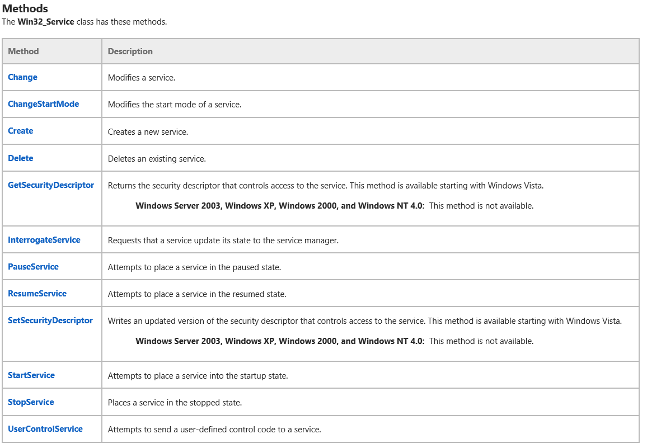
Finding Method Documentation
Notes:
In the demonstration you will access the Win32_Service class documentation page.
10961B
06: Querying Management Information by Using WMI and CIM

Slide 23
Demonstration: Finding Methods and Documentation
In this demonstration, you will see how to discover class methods and how to find their documentation
Notes:
You will find the Windows PowerShell commands on the 10961B-LON-CL1 virtual machine in E:\ Mod06\Democode\Methods.ps1.
Preparation Steps
To complete this demonstration, you will require Internet access. The course virtual machines do not have Internet access, so you need to perform this demonstration on the host machine and ensure Internet access is available.
Demonstration Steps
Run:
Get-WmiObject –ClassName Win32_Service | Get-Member
Explain that the Change() method is one member of the class.
Run:
Get-WmiObject -Class Win32_Service | Get-Member | Where Name -eq 'Change' | Format-List Name,Definition
In a web browser, go to the Bing website (or your preferred search engine).
Enter Win32_Service as the search term.
In the search results, click Win32_Service class (Windows).
You should be viewing the MSDN documentation page located here - http://msdn.microsoft.com/en-us/library/aa394418(VS.85).aspx.
On the webpage, scroll down to the Methods section list and then click Change.
Explain that this method has 11 parameters. Review the parameters with the class.
10961B
06: Querying Management Information by Using WMI and CIM

Slide 24
Invoking Methods
Three ways to invoke a method:
Invoke-WmiMethod
Invoke-CimMethod
ForEach-Object
Both Invoke techniques can be used by themselves or can accept a pipeline object from the corresponding Get command
Return object includes a ReturnValue parameter
0 typically means success
See documentation for other values
Notes:
10961B
06: Querying Management Information by Using WMI and CIM

Slide 25
Demonstration: Invoking Methods
In this demonstration, you will see how to invoke methods of repository objects
Notes:
You will find these commands on the 10961B-LON-CL1 virtual machine in E:\ Mod06\Democode\Invoke.ps1.
Preparation Steps
You should have completed the preparation steps in the Module Overview slide instructor notes and be logged on to the 10961B-LON-DC1 and 10961B-LON-CL1 virtual machines as Adatum\administrator with password Pa$$w0rd.
The demonstration steps should be performed on the 10961B-LON-CL1 virtual machine in the Windows PowerShell console application. The 10961B-LON-DC1 virtual machine must also be started, although you do not need to be logged on.
Demonstration Steps
Run:
Invoke-CimMethod –ComputerName LON-DC1 –ClassName Win32_OperatingSystem –MethodName Reboot
Right-click the lower-left corner of the screen, and then click Run.
Type MSPaint, click OK, and then verify that the MSPaint application opens.
In the Windows PowerShell console or ISE, run:
Get-WmiObject –Class Win32_Process –Filter "Name='mspaint.exe'" | Invoke-WmiMethod –Name Terminate
Ensure that MSPaint closes.
10961B
06: Querying Management Information by Using WMI and CIM

Slide 26
Lab: Working with WMI and CIM
Exercise 1: Querying Information by Using WMI Exercise 2: Querying Information by Using CIM Exercise 3: Invoking Methods
Logon Information
Virtual Machines: 10961B-LON-DC1, 10961B-LON-CL1
User Name: ADATUM\Administrator
Password: Pa$$w0rd
Estimated Time: 45 minutes
Notes:
Exercise 1: Querying Information by Using WMI
In this exercise, you will discover repository classes and then use WMI commands to query them.
Exercise 2: Querying Information by Using CIM
In this exercise, you will discover new repository classes and query them by using CIM commands.
Exercise 3: Invoking Methods
In this exercise, you will use WMI and CIM commands to invoke methods of repository objects.
10961B
06: Querying Management Information by Using WMI and CIM

Slide 27
Lab Scenario
You have to query management information from several computers. You start by querying the information from your local computer and from one test computer in your environment.
Notes:
10961B
06: Querying Management Information by Using WMI and CIM

Slide 28
Lab Review
One of your lab tasks directed you to query Win32_Product. Do you know of any disadvantages when you use this class? What are the main differences between WMI and CIM?
Notes:
Question
One of your lab tasks directed you to query Win32_Product. Do you know of any disadvantages when you use this class?
Answer
The class forces Windows Installer to revalidate all installed packages. On computers that have many installed packages, the validation process can take a long time to complete and can have a negative effect on performance.
Question
What are the main differences between WMI and CIM?
Answer
Both query the same repository, so both can return the same information and perform the same tasks. The only difference is the protocol they use to communicate with remote computers.
10961B
06: Querying Management Information by Using WMI and CIM

Slide 29
Module Review and Takeaways
Review Question Real-world Issues and Scenarios Tools Best Practice Common Issues and Troubleshooting Tips
Notes:
Review Question
Question
What do you think is the most difficult part about working with WMI and CIM?
Answer
Discovering the class that you want is the most difficult part about these technologies. Without a central directory and with inconsistent documentation, finding the class that will let you achieve a specific task can be very difficult and time-consuming. Many administrators rely on Internet search engines and Internet discussion forums to find classes.
Real-world Issues and Scenarios
Not all organizations have deployed Windows Management Framework 2.0 or newer versions and enabled Windows PowerShell remoting. That means the CIM commands cannot be used for ad hoc connections in those environments. Although you could create CIM sessions that use the DCOM protocol in those environments, doing this requires additional steps. Many environments will continue to use the WMI commands until remoting is enabled throughout their environment.
Tools
Another way to explore the repository is to use a graphical tool. One tool is the PowerShell Scriptomatic, available at http://go.microsoft.com/fwlink/?LinkID=306152.
Best Practice: Use CIM commands when possible. Unlike WMI commands, the CIM commands offer better performance and are the commands that Microsoft continues to develop and improve over time.
Common Issues and Troubleshooting Tips
Common Issue: “RPC server not found error” when you use WMI commands
Troubleshooting Tip: This error indicates that either the computer cannot be reached on the network or the computer has a local firewall that is preventing RPC connections.
10961B
06: Querying Management Information by Using WMI and CIM
(More notes on the next slide)

Slide 30
Notes Page Over-flow Slide. Do Not Print Slide.
Notes:
Common Issue: Errors when you use CIM to connect to a remote computer by using the WS-MAN protocol
Troubleshooting Tip: WS-MAN has specific requirements for connectivity that include a requirement for mutual authentication. Between trusted computers in a domain, mutual authentication is automatic. Outside a domain, additional configuration is required. Module 9, “Managing Remote Computers,” provides more details about the additional configuration steps.
Common Issue: “Access Denied” error when attempting to connect to a remote computer.
Troubleshooting Tip: Only members of a computer’s local Administrators group may remotely query information from that computer. You either need to open Windows PowerShell by using an appropriate administrator user account, or provide an alternative credential when querying.
10961B
06: Querying Management Information by Using WMI and CIM

