Slide 1
Module10
Putting it All Together
Notes:
Presentation: 30 minutes
Demonstrations: 0 minutes
Lab: 120 minutes
Required materials
To teach this module, you need the Microsoft® PowerPoint® file 10961B_10.pptx.
Important:
The use of PowerPoint 2013, PowerPoint 2010, or PowerPoint 2007 is recommended to display the slides for this course. If you use PowerPoint Viewer or a version of PowerPoint older than PowerPoint 2007, some of the features of the slides might not display correctly.
Preparation tasks
To prepare for this module:
Read all of the materials for this module.
Practice performing the demonstrations.
Practice performing the labs.
Work through the “Module Review and Takeaways” section, and determine how you will use this section to reinforce student learning and promote knowledge transfer to on-the-job performance.
As you prepare for this class, it is imperative that you complete the labs yourself so that you understand how they work and the concepts that are covered in each. This will help you provide meaningful hints to students who might experience difficulties in a lab; it will also help guide your lecture to ensure that you cover the concepts that the labs cover.
Each exercise in the lab should take approximately the same amount of time. Each exercise should take students no more than 15-20 minutes apiece. Tell your students to ask you for help if they have not completed an exercise after working on it for 15-20 minutes. This practice will help ensure that students do not become hopelessly stuck or lost.
10961B
10: Putting it All Together
(More notes on the next slide)

Slide 2
Module Overview
Provisioning a New Server Core Instance
Notes:
This module is primarily designed around its two-hour lab. The lecture must be kept to around 30 minutes or less. More material is provided that can usually be covered in that time; inform students that the lecture part of this module is mainly provided to them as a reference and reminder of what to do. Lab task instructions also provide clues and hints to help them along.
The lecture portion mainly outlines the tasks students will complete in the lab, and it provides some general direction on why they are performing each of these tasks. Remind students that this module does not introduce new material―everything they are asked to do is either something that they have done before or a variant of something that they have done before.
10961B
10: Putting it All Together

Slide 3
Lesson 1: Provisioning a New Server Core Instance
Overall Process Create a Parameterized Script Review Criteria and Tasks Lab Notes
Notes:
Before beginning, ensure that the students have a snapshot of each virtual machine in Hyper-V Manager. Having a snapshot may not be the default configuration. Students will need to revert to this snapshot in their lab, but the revert process will not work if no snapshot has been taken.
10961B
10: Putting it All Together

Slide 4
Overall Process
Provision a new Windows Server 2012 computer installed as Server Core
A local Administrator password has been set
You will need to write a script to perform the remainder of the provisioning process in accordance with your organization’s guidelines
Notes:
10961B
10: Putting it All Together

Slide 5
Create a Parameterized Script
Parameterize values that will change each time a new server is provisioned
Leave static any values that rarely or never change in the environment
What are some examples of each kind of value?
Notes:
10961B
10: Putting it All Together

Slide 6
Review Criteria and Tasks
Retrieve the current dynamic IP address
Add a reservation to the DHCP scope
Modify the local TrustedHosts list
Add the server to the domain
Add a role to the server
Restore the TrustedHosts list
Notes:
10961B
10: Putting it All Together

Slide 7
Retrieve the IP Address
You will need to discover the DHCP scopes available in your lab environment
You will need to find a way to retrieve IP address leases based upon a known MAC address
Your Windows 8 client computer has all of the necessary PowerShell commands to perform these tasks
You will hard-code the DHCP scope ID into your script after you discover it
Notes:
10961B
10: Putting it All Together

Slide 8
Create a DHCP Reservation
You will need to find a command that lets you create new DHCP reservations in the DHCP server
This technique, rather than a static IP address assignment, will be used to ensure the server has a consistent and unchanging IP address
Notes:
10961B
10: Putting it All Together

Slide 9
Modify the TrustedHosts List
WinRM is one of the few communication technologies enabled by default in Windows Server 2012
TrustedHosts disables the need for mutual authentication when remoting to a nondomain computer
You will need to automate the changing and later restoration of this list to facilitate initial communications with the new Server Core computer
Later restoration means you will need to save the current list value before altering it
Notes:
10961B
10: Putting it All Together

Slide 10
Add the Computer to the Domain
Change the computer’s name, add to the domain, and restart with one command.
The command will have to be transmitted using remoting to the Server Core computer, which will execute the command locally
You will need a way to pass data – such as the new name, the domain name, and credentials – to the Server Core computer
You will also need a way to wait while the computer restarts
Notes:
10961B
10: Putting it All Together

Slide 11
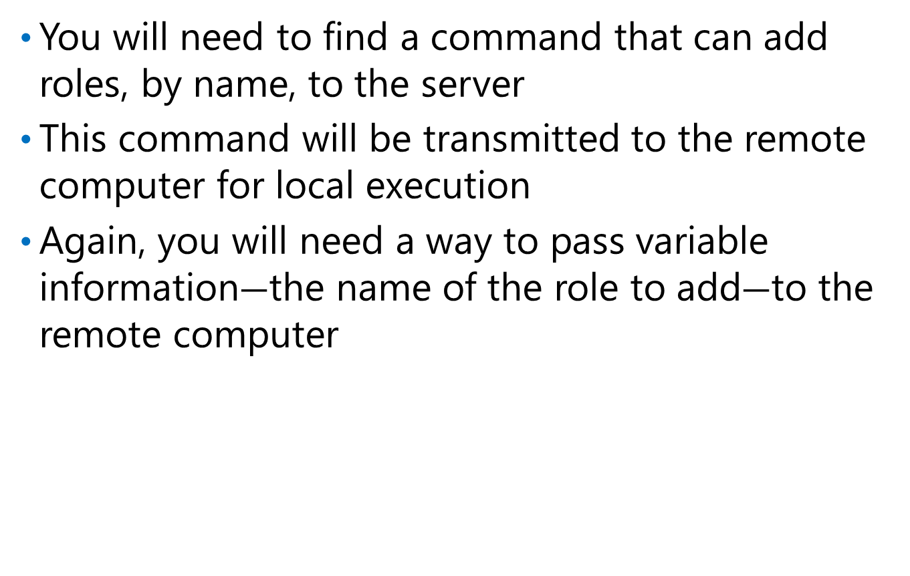
Add a Role to the Computer
You will need to find a command that can add roles, by name, to the server
This command will be transmitted to the remote computer for local execution
Again, you will need a way to pass variable information$―$the name of the role to add$―$to the remote computer
Notes:
10961B
10: Putting it All Together

Slide 12
Restore the TrustedHosts List
Restore the original value (even if blank) as a cleanup step
This helps preserve good security and prevent credential hijacking
Notes:
10961B
10: Putting it All Together

Slide 13
Lab Notes
Starting points are provided for each exercise in this lab.
If you get stuck and want to move on, carefully follow the instructions in your Lab Answer Key to copy the starting point into your Modules folder.
Notes:
10961B
10: Putting it All Together

Slide 14
Lab: Provisioning a New Server Core Instance
Exercise 1: Create a Parameterized Script Exercise 2: Get the Dynamic IP Address of the New Server Core Computer Exercise 3: Create a DHCP Reservation for the Server Core Exercise 4: Modify the local TrustedHosts list Exercise 5: Add a Role to the Server Core Instance Exercise 6: Add the Server Core Instance to the Domain Exercise 7: Test the Completed Script
Logon Information
Virtual Machines: 10961B-LON-DC1, 10961B-LON-CL1, 10961B-LON-SVR1
User Name: ADATUM\Administrator
Password: Pa$$w0rd
Estimated Time: 120 minutes
Notes:
This is a big lab, and students are deliberately not given a large amount of guidance. You should move through the lecture part of this module very quickly, spending fewer than 30 minutes total on lecture. Remind the students that the lecture part of their book should serve as guidance and reference/reminder material to them during the lab.
You should be aware that the lab task sequence explicitly enforces a philosophy of “try it in the Console pane, make sure that it works, and then add it to the script.” In other words, students should not have to test the script a lot, because they are already testing individual commands in the console before adding them to the script. When they add a command to their script, students will obviously have to make minor adjustments to things such as variable names and so on. The task steps outline these requirements.
Students are directed to create and populate variables in the Console pane. The variable names they are told to use will match those that they are told to use as script parameters. If students use different variable names, they may run into problems when adding commands to the script. Instruct students to follow the lab instructions exactly.
Be aware that each task includes an “answer script” in the students’ lab files. They can use this to check their results. Discourage them from copying the answer, and remind them that it is okay to have a slightly different answer from the example answer.
You should monitor students’ progress carefully and help them manage their time. The lab consists of seven exercises of approximately equal difficulty. This means that students should spend no more than 20 minutes per exercise. The first exercise is much simpler and should take only a few minutes. The final exercise tests only the completed script and should also take only a few moments. If students begin to exceed the allowed time, you can either decide to run class longer (this is the last scheduled module of the day), or you can direct students to use the appropriate Lab Answer Key sample script as a starting point, and to move on to the next exercise. Samples are provided at each major step along the way so that at any time, a student can abandon his or her own effort, and use the sample script to keep up with the rest of the class.
Exercise 1: Create a Parameterized Script
In this exercise, you will create the beginnings of a parameterized script. As you progress through the other exercises in this lab, you will add to this script, gradually building more and more functionality until the script is completed.
10961B
10: Putting it All Together
(More notes on the next slide)

Slide 15
Notes Page Over-flow Slide. Do Not Print Slide.
Notes:
Instructor Note: The goal of this lab is to have students use the skills and knowledge they have learned in this class to complete a new task. The Lab Answer Key for this lab refers students to provide files that each show the student what that task should look like. Students may create different commands on their own, and as long as their commands provide the same result, their solution is correct.
The Lab Answer Key does not explain why students are performing each task. Students should use the lab instructions to complete the lab, and refer to the Lab Answer Key only when lost or confused, or when they want to compare their solutions to the example solution provided.
Exercise 2: Get the Dynamic IP Address of the New Server Core Computer
In this exercise, you will use the MAC address of the new Server Core virtual machine to retrieve its IP address from the DHCP server. You will first perform this task interactively in the shell, and then add a command to your script to perform this same task.
Exercise 3: Create a DHCP Reservation for the Server Core Instance
In this exercise, you will create a DHCP reservation in the DHCP server for the Server Core instance’s MAC address. You will set it to use the IP address 10.0.0.10. This new address will not take effect immediately, but will instead take effect the next time that the virtual machine is restarted.
Instructor Note: Be aware that Add-DhcpServerv4Reservation does not correctly obey –ErrorAction, and if students try to add a reservation where one already exists (for example, they run their script multiple times), they’ll receive an “already exists” error. The error is expected in that situation, and should not be cause for worry.
Exercise 4: Modify the local TrustedHosts list
In this exercise, you will read your current TrustedHosts list into a variable for later use. You will then add the IP address of the Server Core computer to the TrustedHosts list, bypassing the need for mutual authentication when you connect to that IP address by using Windows PowerShell Remoting.
Exercise 5: Add a Role to the Server Core Instance
In this exercise, you will run a Windows PowerShell command that adds a designated role to the Server Core computer.
(More notes on the next slide)
10961B
10: Putting it All Together

Slide 16
Notes Page Over-flow Slide. Do Not Print Slide.
Notes:
Exercise 6: Add the Server Core Instance to the Domain
In this exercise, you will use Windows PowerShell Remoting to transmit a command to the Server Core computer. That command, when it is executed locally by the Server Core computer, will rename the computer, join it to the ADATUM domain, and restart it.
Instructor Note: Make sure that students revert the two server virtual machines, 10961B-LON-DC1 and 10961B-LON-SVR1, every time they have to re-test their command. Then, if the command does succeed in joining the domain or renaming the computer, they will start from scratch with each new test.
Exercise 7: Test the Completed Script
In this final exercise, you will run your complete script and verify its results.
Instructor Note: Students can skip this task if they have run out of time. You can also specify a role other than Telnet-Client, such as Web-Server, if you want a more realistic experience. Web-Server does take longer to install, so students will have to wait somewhat longer for their script to complete.
10961B
10: Putting it All Together

Slide 17
Lab Scenario
You are an administrator who is preparing a new Windows Server 2012 Server Core instance for use within the network. Windows Server 2012 was installed in a new virtual machine, and a local Administrator password was set. All other configuration settings on the new computer were left at their default settings. You must use Windows PowerShell to perform several basic provisioning tasks.
Notes:
10961B
10: Putting it All Together

Slide 18
Lab Review
Why was it necessary to modify TrustedHosts? Why was it necessary to use the param() block and –ArgumentList with Invoke-Command?
Notes:
Question
Why was it necessary to modify TrustedHosts?
Answer
Because the Server Core computer was not at first in the domain, and therefore had no context for the mutual authentication typically required by Remoting.
Question
Why was it necessary to use the param() block and –ArgumentList with Invoke-Command?
Answer
Because the information that we needed to pass to the remote computer was in variables, but we could not include those variables directly in the –ScriptBlock parameter value because the variables themselves would have no meaning on the remote computer.
10961B
10: Putting it All Together

Slide 19
Module Review and Takeaways
Best Practice Common Issues and Troubleshooting Tips
Notes:
Best Practice: Always try to test commands in the console before adding them to a script. In this manner, you have to write and debug only one command at a time. This makes it easier to assemble a working, bug-free script.
Common Issues and Troubleshooting Tips
Common Issue: One computer cannot connect to another.
Troubleshooting Tip: Find what communications protocol is being used. For example, Ping.exe uses the ICMP protocol that a firewall may be blocking. Windows PowerShell Remoting uses WS-MAN that is permitted by default in Windows Server 2012. Other commands might use remote procedure calls (RPCs), Windows Management Instrumentation (WMI), or other protocols, one or more of which might not be allowed by a firewall, or might not be enabled on the remote computer.
Common Issue: An extracted property value is not a string.
Troubleshooting Tip: Windows PowerShell does lots of behind the scenes manipulation to data to try to make it behave consistently, but sometimes it cannot do everything. In your lab, you were instructed to extract a computer’s IP address from a DHCP lease object. The resulting IP address is still seen by the shell as an array of objects (with each character in the IP address being a single object). Putting that into double quotation marks―$OldIPAddress = "$OldIPAddress"― forces the shell to parse out the whole address and to then store it as a single string.
10961B
10: Putting it All Together

