Slide 1
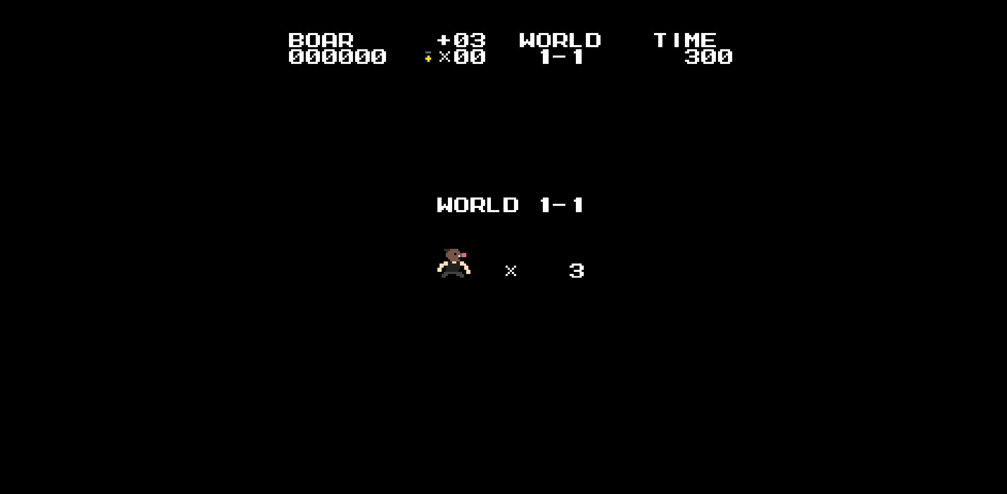
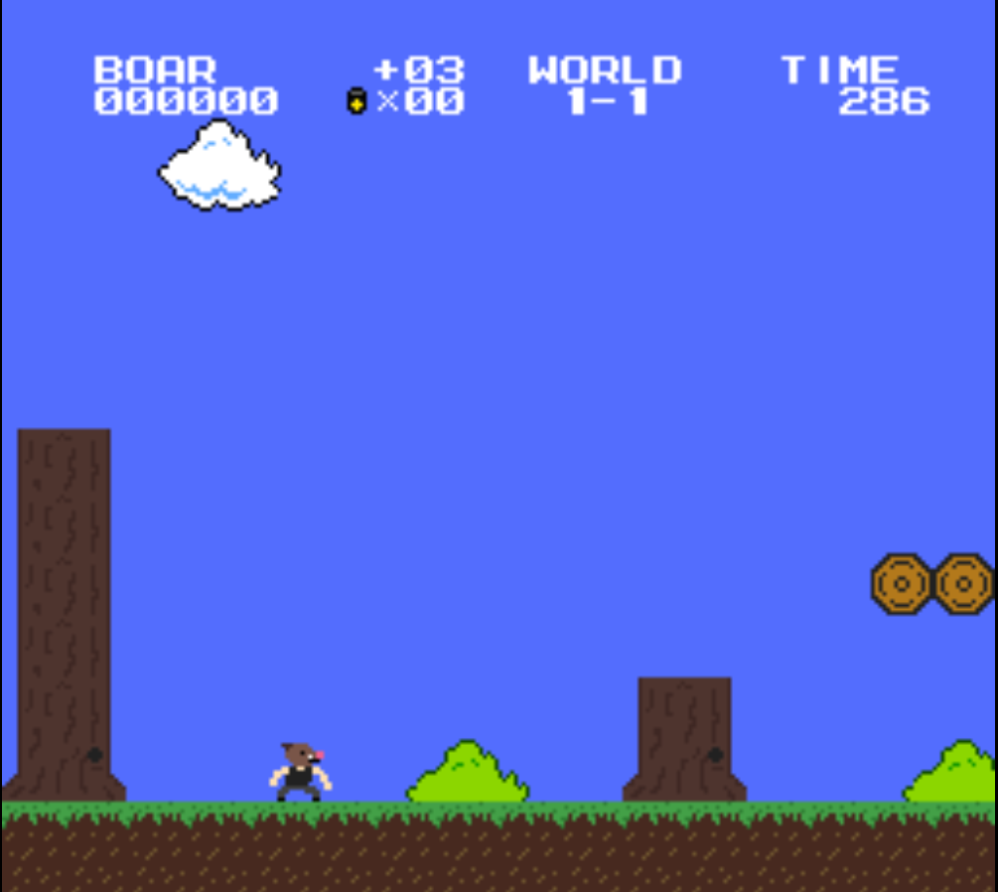
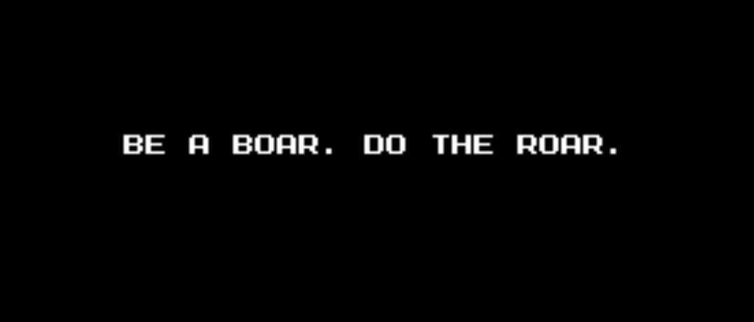
JavaScript based videogame ”The Boars Roar”
Dmitrii Tkachev, DIN19SP
Information Technology, Software Engineering
Introduction
Looking for a challenge, to improve my JavaScript programming skills I
Decided to create a platformer game fully on JS, that can be launched in browser, perform well and entertain its players.
The task appeared to be quite uneasy, but at the same time interesting for both : its developers and users.
It included usage of multiple canvases, asynchronous programming and many more
FIGURE 1. The title screen
Objectives
The main objective was to create a demo version of the game, that has
A playable charachter, some obsticles, enemies, collectibles and a logical end (so the player does not just fall through the level when it’s over). Some side tasks were drawing and implementing custom textures and tiles, adding more than one level
And just making the game more fun.
Methods
The game has in-build JSON reader and plenty if JSON files, that store information. They are used to define textures for objects, sounds and music, draw the layout of levels and create animations.
FIGURE 2. Svreenshot from the game
It also has a multy layered system that includes various canvases one on top of each other. One canvas draws the background sky, another – obsticles, enemies and clouds, third – text on the screen. Such complexity appeared to be necessary to make the picure look good
Results
As a result, I got a fully operational demo of the game with 2 levels filled
with enemies and collectibles, that you can swap between.
FIGURE 3. screen between levels
Conclusions
It was an uneasy, but interesting project to work on, I’ve learned plenty if useful things about not only about JavaScript and HTML, but also about the process of creating more complex builds.
It was also an interesting experience of creating a videogame
References
To complete this project I used a lot of information that I could find on StackOverflow or YouTube
Also I would like to notice the book
Eloquent JavaScript 3rd edition
Practical training
ECTS credits: 10-15
Date of publication: 2020, Summer
Instructor Lasse Haverinen

