Slide 1
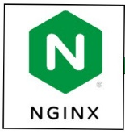
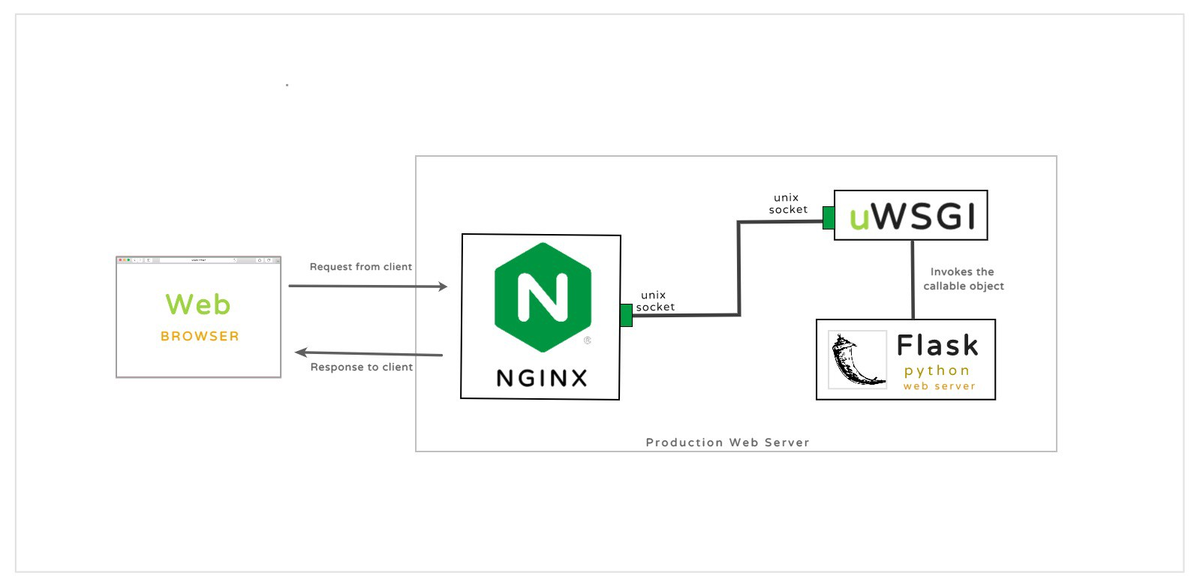
venv
r.GET
0.0.0.0:80
nginx
uwsgi
Flask
data=''' {
''position'': ''Супервайзер'',
''gender'': ''Мужчина'',
''city'': ''Воронеж'',
''age'': 40,
''experience'': 5
} '''
unix socket
# /etc/nginx/nginx.config
http {
include /etc/nginx/sites-enabled/*;
#include /etc/nginx/conf.d/*.conf;
}
# /etc/nginx/sites-available/jsp
server
{ listen 80;
server_name 0.0.0.0;
location / {
include uwsgi_params;
uwsgi_pass unix:/home/jsp/jsp.sock;
}
}
# wsgi.py
from jsp import app
if __name__ == "__main__": app.run()
# jsp.py
app = Flask(__name__)
@app.route('/jsp, methods=[‘GET']) def return_predict(): # Десериализация модели CatBoostRegressor with open(‘jsp_model.pkl', 'rb') as pkl_file: regressor = pickle.load(pkl_file) predict = regressor.predict([data]) return jsonify({'Predict': predict})
# jsp.ini
[uwsgi]
module = wsgi:app master = true
processes = 5 (cpu * 2 + 1)
socket = jsp.sock
chmod-socket = 666
vacuum = true
die-on-term = true
Production Server
# /etc/systemd/system/jsp.service
[Unit]
Description=uWSGI instance to serve jsp
After=network.target
[Service]
User=user
Group=www-data
WorkingDirectory=/home/jsp
Environment="PATH=/home/jsp/env/bin"
ExecStart=/home/jsp/env/bin/uwsgi --ini jsp.ini
[Install]
WantedBy=multi-user.target
systemd

