Slide 1
Calculation the best assets allocation using Modern Portfolio Theory
Using Modern Portfolio Theory you can reduce risk of your portfolio

Slide 2
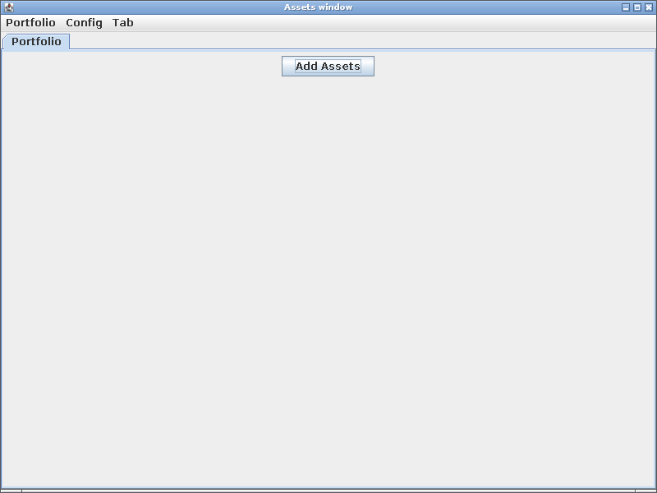
Main window
There is Main Window with the following menu items:
Portfolio-> Manage – manage your assets
Portfolio-> Update – get the latest data from Moscow Stock Exchange Market (http://moex.com)
Portfolio-> Sync with DB – Sync your assets with Database
Config-> Config DB – Configure the database connection
Tab → Add new Tab – Add new tab
Tab → Remove current Tab – Remove current tab
Add Assets – add assets to you portfolio

Slide 3
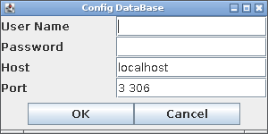
First please configure connection to the database
There you can configure the connection to MySQL database where your assets data is stored
You should have rights to create tables, add/remove values for the “User Name”
Default value of “User Name” is “dmitry” and Password is “123”, this values are hardcoded in src/Assets/DB/DBConnector.java

Slide 4
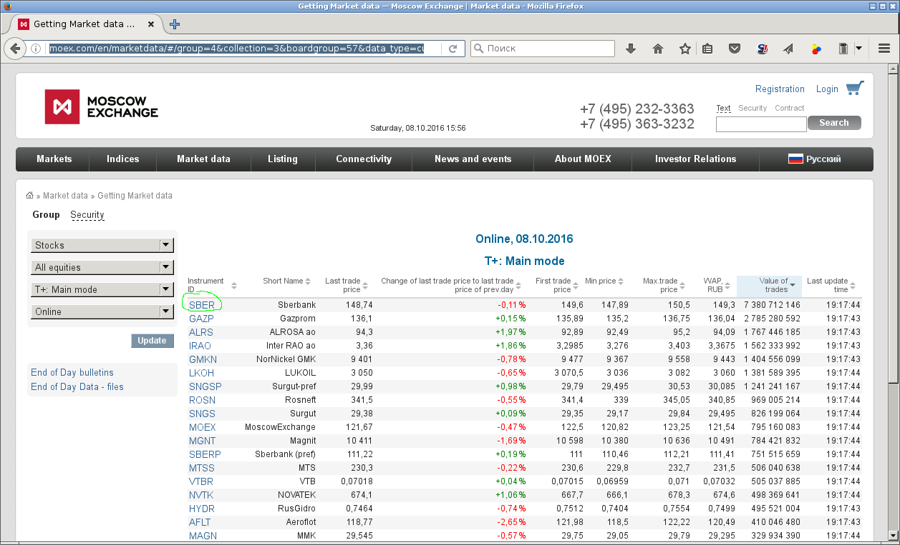
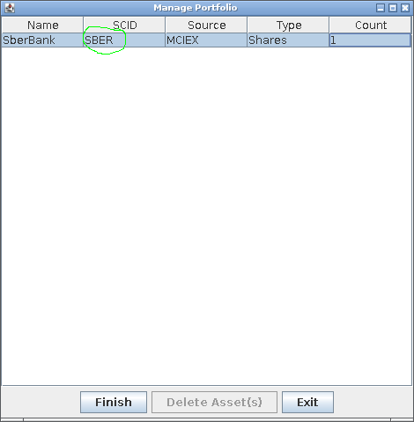
Add assets to calculate
Please add wanted assets from web site moex.com (http://moex.com/en/marketdata/#/group=4&collection=3&boardgroup=57&data_type=current&mode=groups&sort=VALTODAY&order=desc)
On example we choose Sberbank for the first assets: select Portfolio->Manage->Add Asset and enter SberBank as Name, SBER as SCID (SCID Must be the same as “Instrument ID” on moex.com), MCIEX as Source and Shares as Type (Type must be Shares for getting shares information), Count may be any positive number

Slide 5

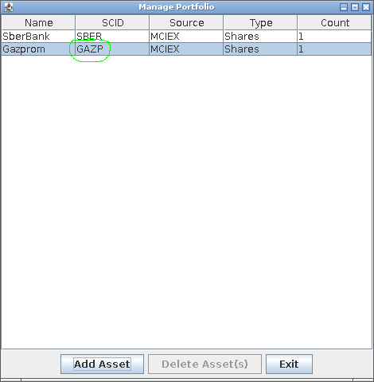
Add the second asset to calculate
To continue the example, add Gazprom to portfolio, using previously described methodology
Select Portfolio->Update main menu item to get stocks data from moex site

Slide 6
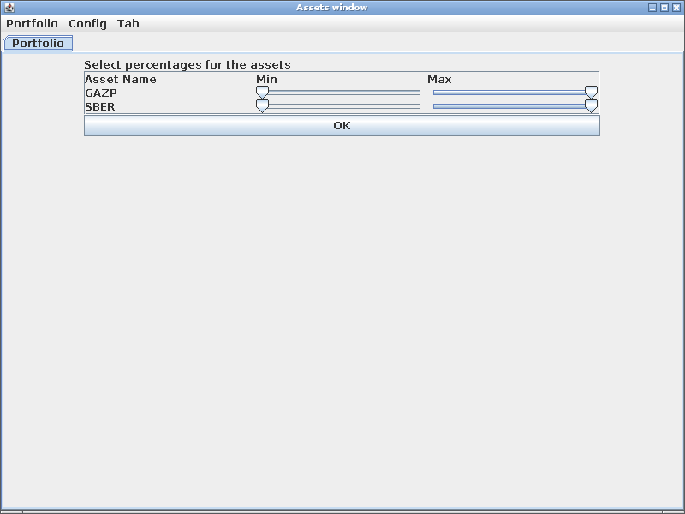
Now we can calculate the best allocation in portfolio
Press “Add Assets” on main window and choose GAZP and SBER assets in your portfolio.
Get stock data from moex by clicking on Portfolio->Update main menu item
After that you will get the window where you can change minimum and maximum percentages allowed for each asset. Just set it as default and press OK

Slide 7
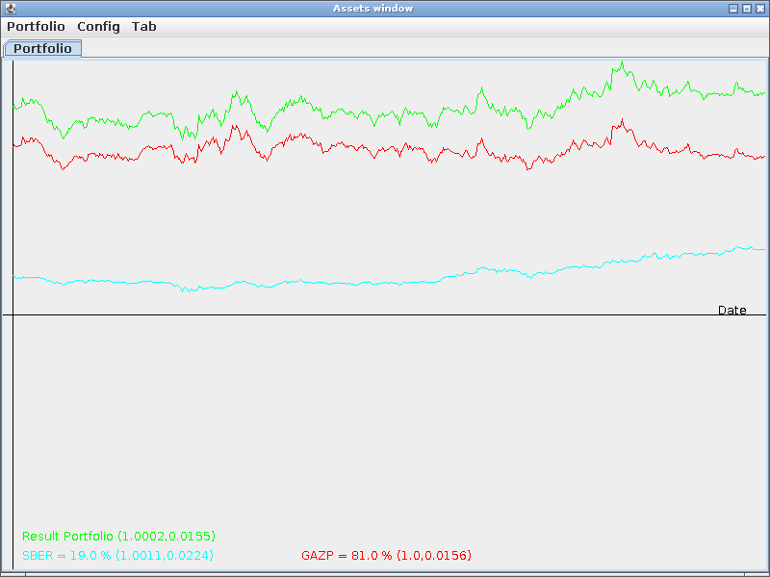
Check the allocation
Now we have our first portfolio containing SBER and GAZP stocks
Result Portfolio (1.0002, 0.0155) means the portfolio has 0.02% average return per day and 1.55% Standard Deviation (i.e. there is 66% of probability that portfolio stays between 0,9847 – 1.0157 times of the previous value)
SBER = 19% (1.0011, 0,0224) means that SBER has 0.11% Average return per day and 2.24% Standard Deviation and takes 19% in the portfolio
GAZP = 81% (1.0, 0,0156) means that GAZP has 0.0% Average return per day and 1,56% Standard Deviation and takes 81% in the portfolio

Slide 8
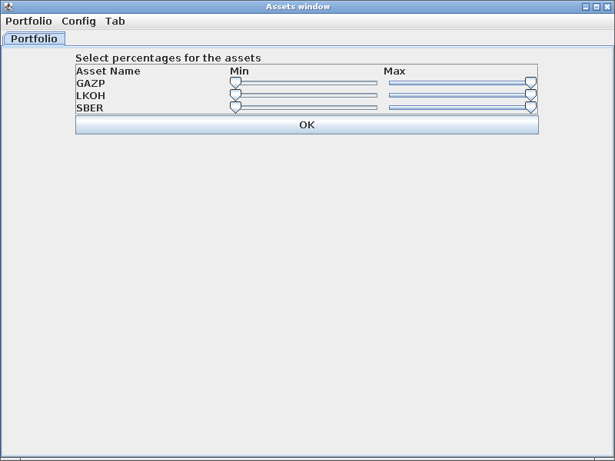
Create a portfolio with 3 assets
Click Tab → “Add new Tab” menu item to create new tab in the main window
Select 3 assets (GAZP, SBER, LKOH) and their percentages

Slide 9

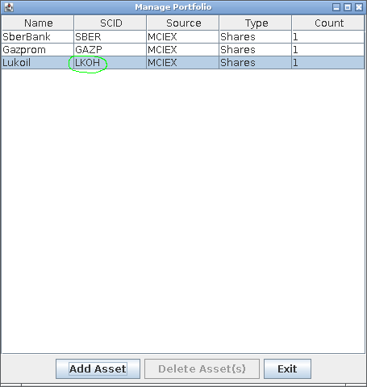
Add a new stock to the portfolio
Increasing the average return and decreasing the Standard Deviation (risk) is the main purpose of Portfolio Theory, thus add another stock to the portfolio.
Using described methodology to add Lukoil stock to the portfolio

Slide 10
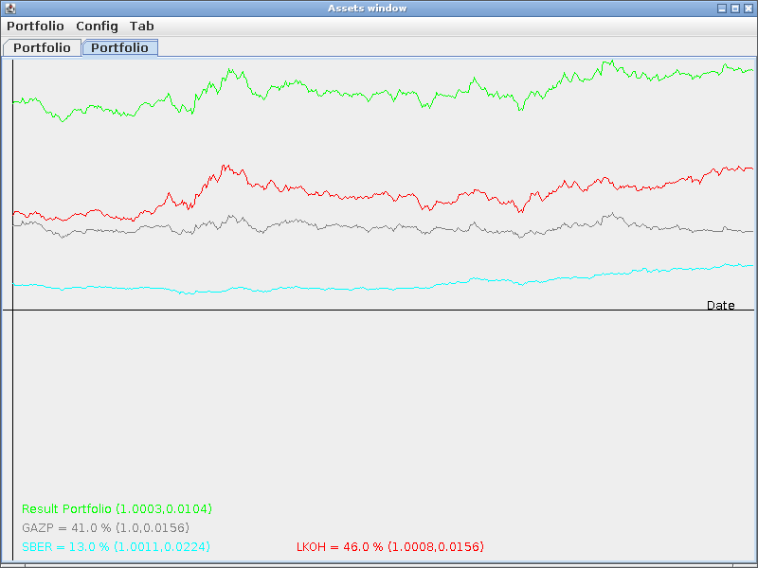
Check 3 assets portfolio
We have got the portfolio contains 3 assets:
Result Portfolio (1.0003, 0.0104) - means 0,03% Average return per day and 1,04% of risk
GAZP = 41.0% (1.0, 0.0156) – means 0.0% Average return per day, 1.56 % risk and takes 41% in the portfolio
SBER = 13.0% (1.0011, 0.0224) – means 0.11 Average return per day, 2.24% risk and takes 13% in the portfolio
LKOH= 46.0% (1.0008, 0.0156) – means 0,08% Average return per day, 1.56% risk and takes 46% in the portfolio

Slide 11
Happy creation of your own portfolio with low risk and high return!

Slide 12
Requirements
Java 7 or higher
MySQL database with properly access rights
Java Database Driver (JDBC) for MySQL libmysql-java package in Debian GNU/Linux added to your classpath environment (export CLASSPATH = $CLASSPATH:/usr/share/java/mysql-connector-java.jar on my Debian)
Internet connection to update asset's data

Slide 13
Roadmap:
V 0.9 – 1.0 Fixing bugs and usability issues
V 2.0 – Add correlation and sub-portfolio creation (i.e. creation of portfolio with high correlated assets and construct main portfolio based on sub-portfolios)
V 3.0 – Add support for bonds
V 4.0 – Add support for others stock markets, not only moex

Slide 14
Git repository and author
Repository of the project: https://github.com/DmitryZakurin/Assets
Author: Dmitry Zakurin zakurin@mail.ru

