Slide 1
Time Series Forecasting Using Hybrid Model
Nitin Tiwari (10CSS-43)
Tanzeer Zarar (10CSS-65)

Slide 2
Overview:
Time Series
Hybrid model ( ARIMA + ANN )
ARIMA Model
Integration
Identification
Parameter Estimation
Testing
Data Forecasting using Arima Model
Future work
References

Slide 3
Time Series:
Sequence of values of a random variable collected over time.
Discrete time series; Continuous time series
Discrete time scale: observations at specific times separated by ∆t. ( eg, average monthly stream flow, annual peak discharge, daily rainfall etc.)
Continuous time scale: data recorded continuously with time (eg, turbulence studies, pressure measurements)
X_{t} = d_{t} + ε_{t}

Slide 4
Required property of time series:
Time series should be stationary.
The time series is said to be stationary, if the properties of time series do not change with time.

Slide 5
What is Hybrid Model ?
It is a cascaded model of more than one independent models.
ARIMA(Auto Regressive Integrated Moving Average) Model
ANN (Artificial Neural Network) Model
Output 1
Output
Input
Input 2

Slide 6
ARIMA (Auto Regressive Integrated Moving Average) Model:
Integaration: to make time series stationary
Model Designing
Auto Regression(1-6) And Moving Average(0-2)
Parameter Estimation
Testing of designed models
Mean Square Error (for short time)
Maximum Likelihood Rule (for long time)
Forecasting of time series

Slide 7
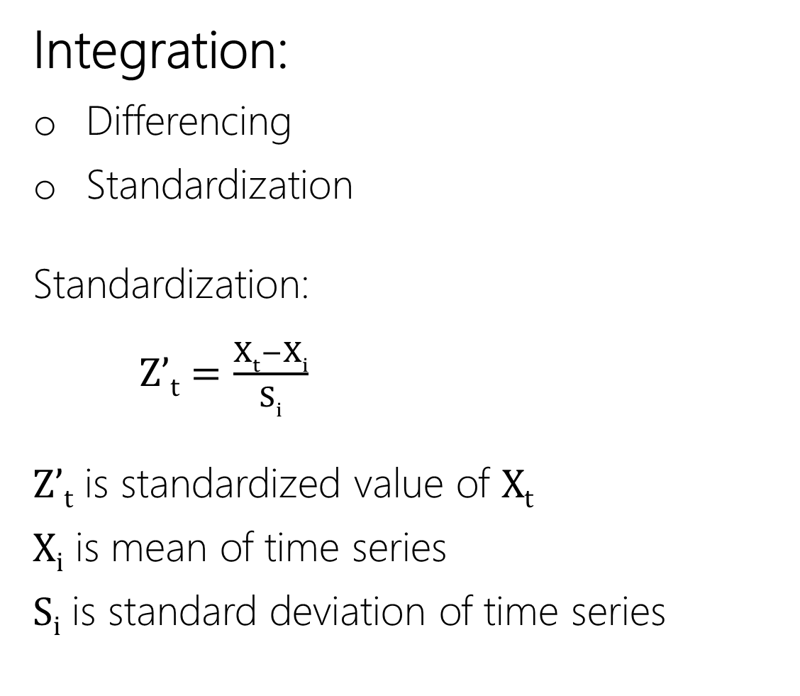
Integration:
Differencing
Standardization
Standardization:
Z’_{t} $=\frac{Xt−Xi}{Si}$
Z’_{t} is standardized value of X_{t}
X_{i} is mean of time series
S_{i} is standard deviation of time series

Slide 8
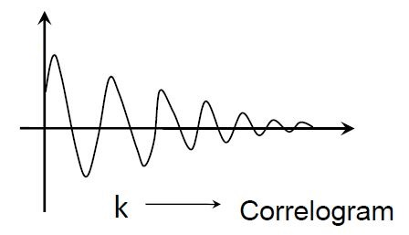
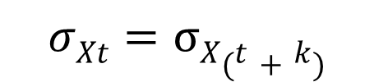
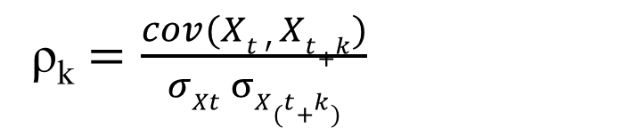
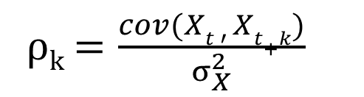
How to check whether time series is stationary or not:
Auto Correlation between X_{t} & X_{t+k}:
ρ_{k} $=\frac{cov(Xt ′ Xt+k)}{σXt σX(t+k)}$
If process is stationary, then
ρ_{k}
$$σXt=σX(t+k)$$
ρ_{k} $=\frac{cov(Xt ′ Xt+k)}{σ_{X}^{2}}$

Slide 9
ARMA (Auto Regression And Moving Average):
Regression:
Y = f(X₁, X₂, X₃, X₄,…)
Auto Regression:
X_{t} = f(X_{t-1}, X_{t-2}, X_{t-3},…)
e.g., AR(1), model
X_{t} = ϕ₁X_{t-1} + ε_{t}
Φ₁ is the AR parameter
ε_{t} is the Error term

Slide 10

AR(2), model
X_{t} = ϕ₁X_{t-1} + ϕ₂X_{t-2} + ε_{t}
AR(p) model
X_{t} = ϕ₁X_{t-1} + ϕ₂X_{t-2} +………….. +ϕ_{p}X_{t-p} + ε_{t}
X_{i} = $\sum_{i=1}^{p}{\text{ϕ}\text{i} \text{Xt}\text{−}\text{i}}$ + ε_{t}
{ ϕ_{i} } are AR Parameters

Slide 11
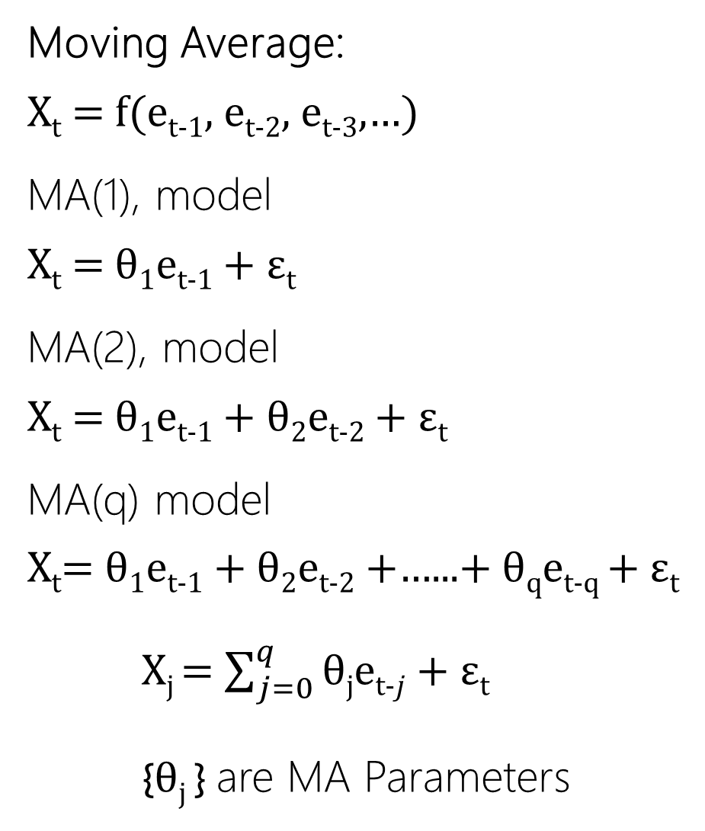
Moving Average:
X_{t} = f(e_{t-1}, e_{t-2}, e_{t-3},…)
MA(1), model
X_{t} = θ₁e_{t-1} + ε_{t}
MA(2), model
X_{t} = θ₁e_{t-1} + θ₂e_{t-2} + ε_{t}
MA(q) model
X_{t}= θ₁e_{t-1} + θ₂e_{t-2} +…...+ θ_{q}e_{t-q} + ε_{t}
X_{j} = $\sum_{j=0}^{q}{\text{θ}\text{j}\text{e}\text{t}\text{−}j}$ + ε_{t}
{$\text{θ}\text{j}$ } are MA Parameters

Slide 12
ARMA( p , q ) Model:
X_{t} = ϕ₁X_{t-1} + ϕ₂X_{t-2} +……+ ϕ_{p}X_{t-p} + θ₁e_{t-1} + θ₂e_{t-2} +……+ θ_{q}e_{t-q +} ε_{t}
Matlab function “armax” syntax:
m = armax(data, orders)
‘data’ : array of time series data
orders = [na, nc]
na = order of AR parameters
nc = order of MA parameters

Slide 13
Model selection:
Model selection is important in time series analysis as there are infinitely many possible models.
In general, AR parameters of order up to 6 and MA parameters of order up to 2 serve the purpose in most of the applications.
A model may be selected by using the following two criteria from among several candidate models:
Maximum likelihood rule (ML)
Mean square error (MSE)

Slide 14
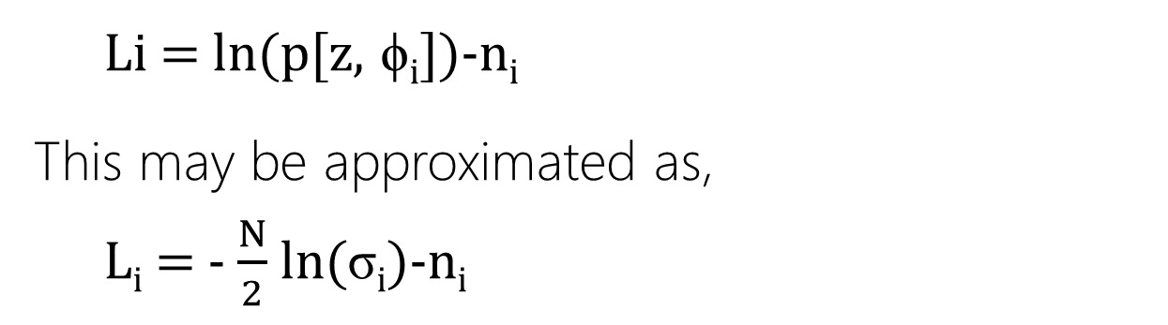
Maximum likelihood rule:
A likelihood value for each of the candidate models is evaluated.
The model with highest likelihood value is chosen.
The general form of log-likelihood function for the i^{th} model for a Gaussian process is
Li = ln(p[z, ϕ_{i}])-n_{i}
This may be approximated as,
L_{i} = - $\frac{N}{2}$ ln(σ_{i})-n_{i}

Slide 15
Where,
L_{i} is the likelihood value,
z is the vector of historical series
ϕ_{i} is the vector of parameters and residual variance
(θ₁, θ₂,……..; ϕ₁, ϕ₂, ……; σ_{i})
σ_{i} is the residual variance and
n_{i} is the number of parameters
As the number of parameters increase, the likelihood value decreases.
The ML rule selects the models with a small number of parameters (principle of parsimony)

Slide 16
Mean Square Error (MSE):
Using a portion of available data (N/2) estimate the
parameters of different models.
Forecast the series one step ahead by using the candidate models.
Estimate the MSE corresponding to each model.
The model with least value of MSE is selected for prediction.

Slide 17
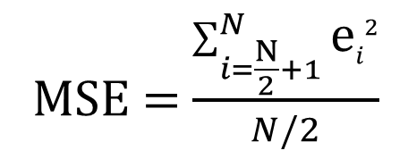
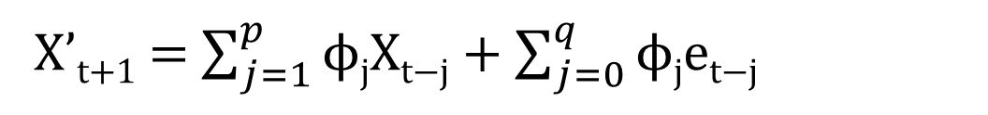
The one step ahead forecast for ARMA(p, q) is:
X’_{t+1} = $\sum_{j=1}^{p}{\text{ϕ}\text{j}\text{X}\text{t}\text{−}\text{j}}$ + $\sum_{j=0}^{q}{\text{ϕ}\text{j}\text{e}\text{t}\text{−}\text{j}}$
The error for one step ahead forecast is
e_{t+1} = X_{t+1} – X’_{t+1}
If the series consists on N observations, the first N/2
observations are used for parameter estimation and N/
2+1 to N are used for error series calculation.
MSE = $\frac{\sum_{i=\frac{N}{2}+1}^{N}{\text{e}i2}}{N/2}$

Slide 18
Data Forecasting:
Consider AR(1) model,
X_{t} = ϕ₁X_{t-1} + e_{t}
Expected value is considered:
E[X_{t}] = ϕ ₁E[X_{t-1}] + E[e_{t}]
(e_{t}: expected value of e_{t} is zero)
X’_{t} = ϕ₁X_{t-1}

Slide 19
Data Forecasting:
Consider AR(1,1) model,
X_{t} = ϕ₁X_{t-1} + θ₁e_{t-1} + e_{t}
E[X_{t}] = ϕ₁X_{t-1} + θ₁e_{t-1} + 0
ϕ₁ = 0.5, θ₁ = 0.4 therefore the model is
X_{t} = 0.5X_{t-1} + 0.4e_{t-1}
Say X₁ = 3.0,
X’₂ = 0.5x3.0+0.4x0 = 1.5 (Initial error assumed to be zero)
X₂ = 2.8
Error e₂ = 2.8-1.5 = 1.3

Slide 20
Similarly:
X’₃ = 0.5x2.8+0.4x1.3 = 1.92
X₃ = 1.8
Error e₃ = 1.8-1.92 = -0.12
Similarly:
X’₄ = 0.5x1.8+0.4x(-0.12) = 0.852
And so on…

Slide 21
Future Work
Designing of ANN:
time series is considered as nonlinear function of several past observations and random errors as follows:
y_{t}=f[(z_{t-1},z_{t-2},z_{t-3}……..,z_{t-n}),(e_{t-1},e_{t-2},e_{t-3},……..,e_{t-n})]
Where:
z_{t} is the standardized time series.
e_{t} is the residual calculated from Arima Model.
And f is then non linear function determined by neural network.

Slide 22
References:
Mehdi Khashei , Mehdi Bijari (2010). An artificial neural network (p, d,q) model for timeseries forecasting.
Lecture 10 to Lecture 21 of Online Course on Stochastic Hydrology by Prof. P.P. Mujumdar IISc Banglore
http://nptel.iitm.ac.in/courses/105108079

