Slide 1
Understanding Pairs Trading
Yuan Chen (Vincent)

Slide 2
Agenda
Intro: What is pairs trading?
Analysis: Performance & risks
Theory: Why pairs trading works?
Experiment: Real world experiment by R language
Summary: Conclusion & remarks

Slide 3
History
Pioneered by Gerry Bamberger and Nunzio Tartaglia
Quantitative group at Morgan Stanley in the 1980s
A notable pairs trader: Long-Term Capital Management

Slide 4
Pairs trading is…
Market neutral trading strategy

Slide 5
Pairs trading belongs to…
Statistical Arbitrage

Slide 6
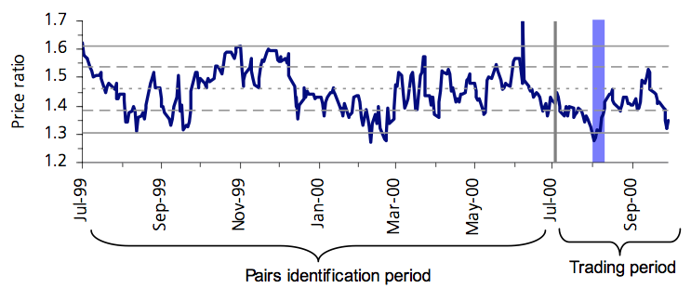
Basic idea

Slide 7
Basic idea: Step 1
Select 2 stocks which “move together”

Slide 8
Basic idea: Step 2
Sell high priced stock
Buy low priced stock
* Same size of each position (price * shares)

Slide 9
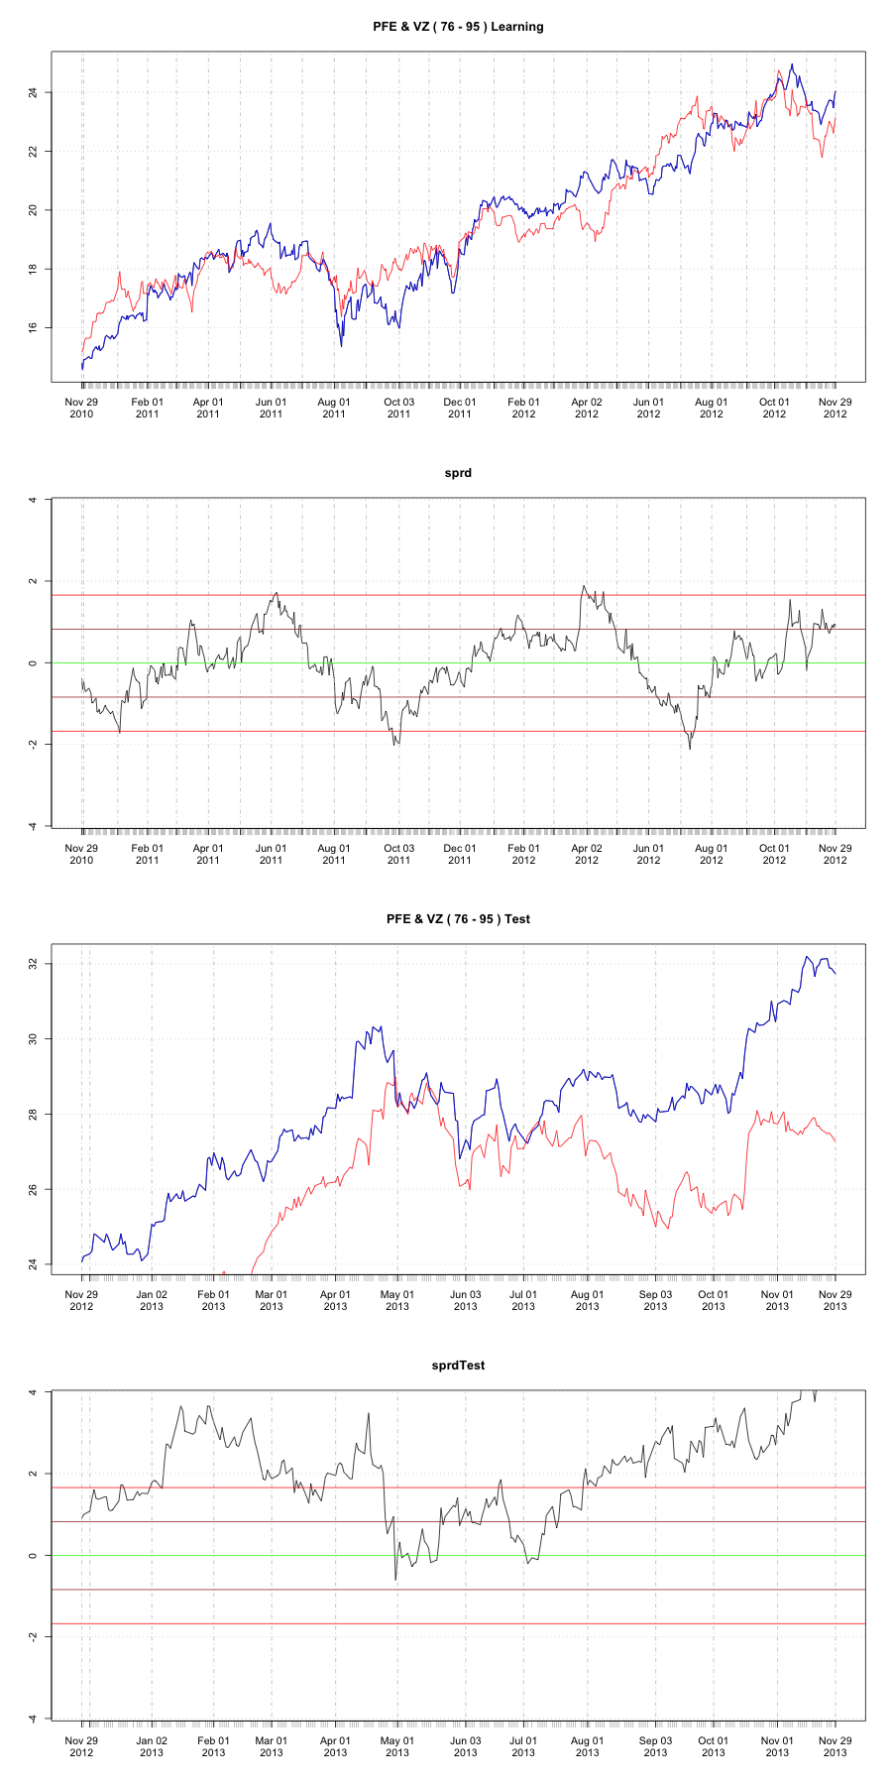
How to get profit…
2 Stock price “Move Together”: Diverge & Converge
* PFE: Pfizer Inc. (Pfizer) is a research-based, global biopharmaceutical company.
* VZ: Verizon Communications Inc.

Slide 10
* PFE: Pfizer Inc. (Pfizer) is a research-based, global biopharmaceutical company.
* VZ: Verizon Communications Inc.
PFE: Short
VZ: Long
PFE: Long
VZ: Short
: Hedge ratio

Slide 11
How to identify good pairs…
Factor
Price ratio:
Spread:
Relative return:
Behavior
“Stable” = “Good”

Slide 12
Measuring “Stable”
Stationary
&
Co-integrated
Notes:
A time series is stationary if it has constant mean, variance and autocorrelations.
In other words, if the price ratio is stationary, then it is not affected by structural
breaks or trends.
For our purposes two series are cointegrated (with cointegrating vector [1,-1])
when each series is nonstationary, but their difference is stationary. In practice
this means that a long term relation exists between the two stock prices, but
there can be a deviation from that relation in the short term. Alternatively, we
can say that the two prices share the same trend.

Slide 13
Co-integrated vs. Correlated
Co-integrated
Long term
Co-movement of price
Random walk each
Mean-reversion
Correlated
Short term
Co-movement of return
Both move in the same direction
Trend only, not sensitivity

Slide 14
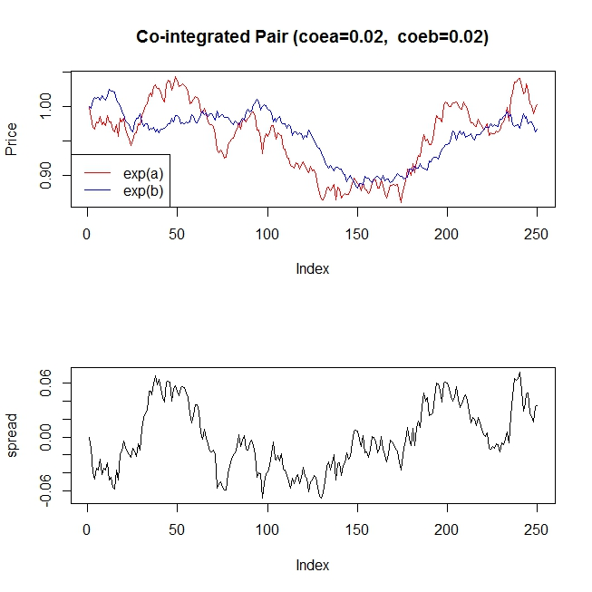
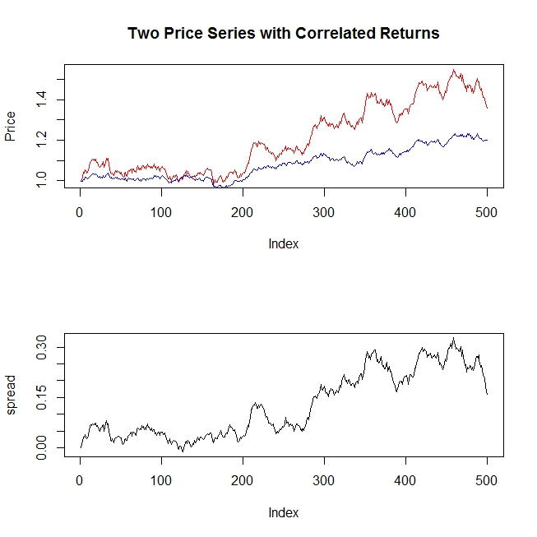
Co-integrated ≠ Correlated

Slide 15
Statistical test
* Price Ratio
Correlation of daily return
Run test: reject the null hypothesis of random walk
KPSS test: value change
IKPSS test: direction change
Sum of squares:
Adjusted Dickey-Fuller (ADF) test: unit root

Slide 16
Measure performance
Compare with indiscriminate pairs
Using same trading method
Notes:
In this paper we are particularly interested in the selection of the
pairs, so it is useful to compare the performance of our pairs trading strategies
with the performance of a strategy that used the same trading methodology, but
made no attempt to identify "good pairs". We call this strategy the
indiscriminate pairs trading strategy.

Slide 17
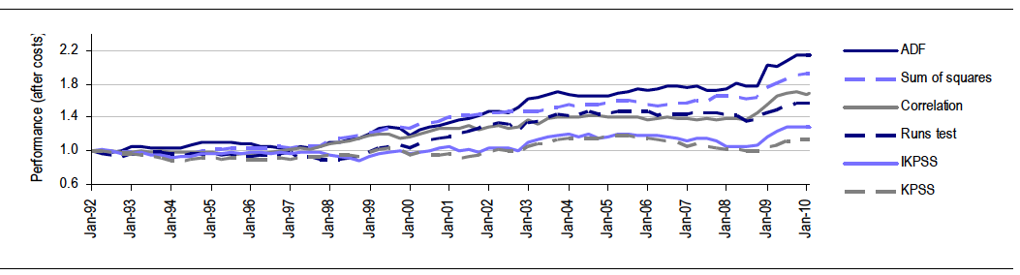
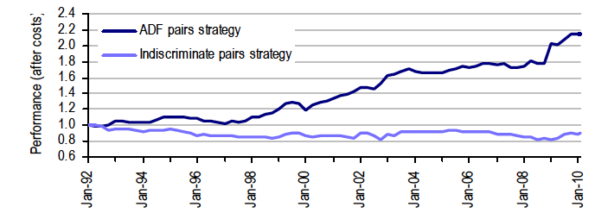
Performance (Jan-92 ~ Jan-10)

Slide 18
After selecting the good pairs
Market neutral ≠ Risk-free
Notes:
Nothing is free in this world, except the grace of god

Slide 19
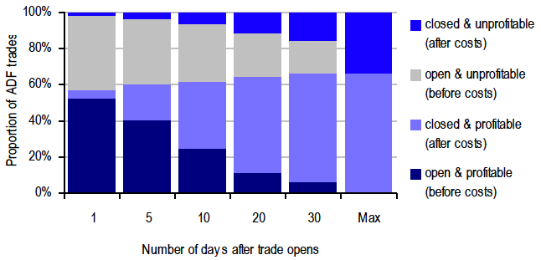
Timing is critical
25%+
6%
Notes:
more than a quarter of trades suggested by the ADF pairs strategies would have
opened and closed again within 5 days, while 6% would have been open for
only a day.

Slide 20
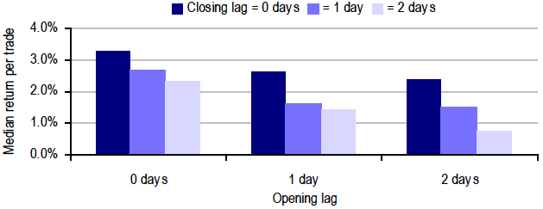
Timing is critical
3.3% decrease
0.73% decrease
Notes:
Median return to a trade with various lags in opening or closing the ADF strategy trades
Delays of a single day in opening a position have
heavy effects on the returns. Chart 11 shows the median return to a trade if we
delay entering it by 0, 1 or 2 days5 and if we delay closing it by 0, 1 or 2 days.
The effect of lagging the decision to open and close a trade by 2 days is
dramatic: the median return falls from 3.3% to just 0.73%.

Slide 21
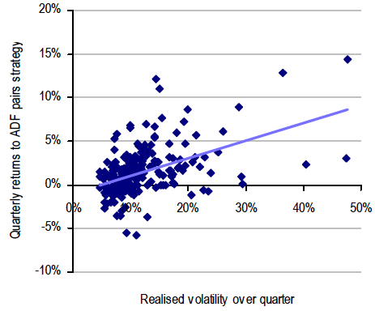
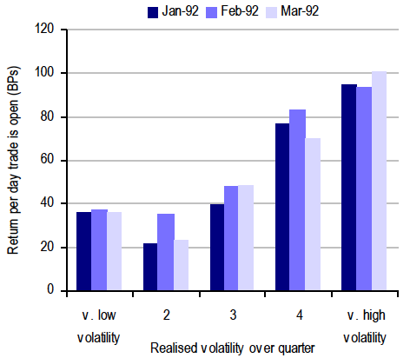
Volatility matters

Slide 22
Model fails
Precision & Recall
Notes:
Beautiful history doesn’t guarantee you a bright future!

Slide 23
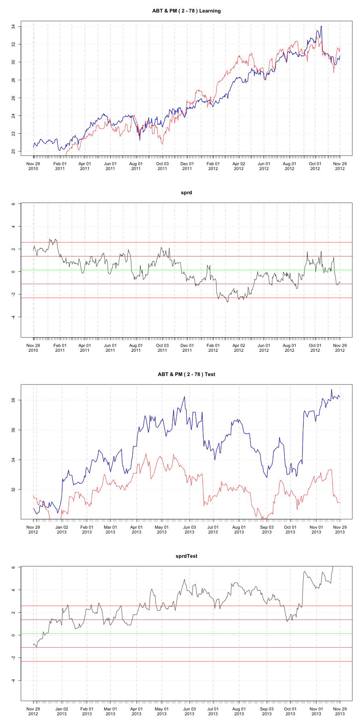
Trigger is important
One strategy doesn’t fit all!
Notes:
Open position when away 2*SD from mean and close position when spread revert, doesn’t always work

Slide 24
Other Impacts
Transaction cost
Trade execution
Time horizon
Risk free rate
Opportunity neutralized with too many arbitrageurs
etc…
Market neutral depends on moving in same direction
What if spread diverge and never converge again?

Slide 25



Theory
Linear model
Log of price
Log of price ratio
Idiosyncratic risk
Dynamic
Neutralized with same exposure to risk factors
Notes:
Beta neutralized with same exposure to risk factors, which make shocks due exclusively to idiosyncratic risk

Slide 26
Experiments with R language
Source Code:
https://github.com/artyyouth/r-quant
Stocks
S&P 100
4950 potential pairs
Identifying (Learning) period: 2010-11-30 / 2012-11-30
Trading (Test) period: 2012-11-30 / 2013-11-30
Algorithm
ADF
Factor
Price ratio
Spread

Slide 27
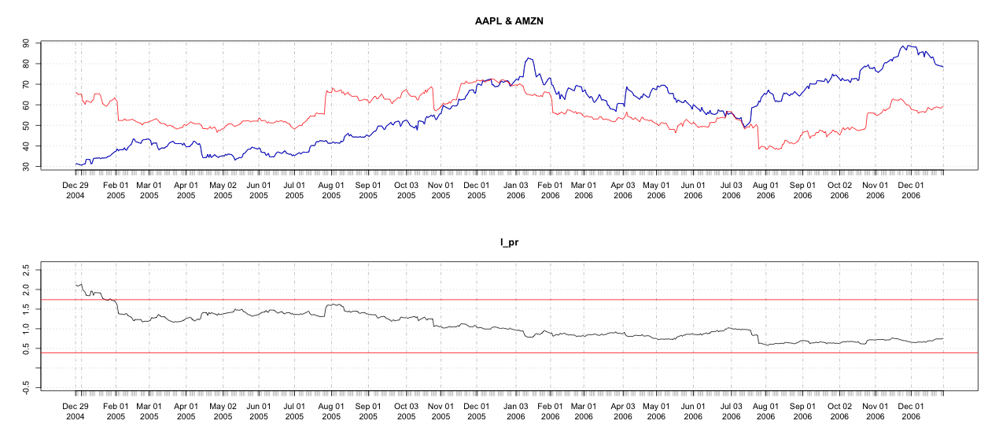
However…
Price ratio doesn’t work at all…

Slide 28
So…
Spread!
* Only accept potential pairs with p-value < 0.011 in ADF test
* Filter out with constrains:
1st quartile > -1
3rd quartile < 1

Slide 29
Bingo!
364 out of 4950 candidate pairs!
33 out of 364 good pairs!

Slide 30
33 Good pairs
Not all are as good as expected...
MDT & MMM
MO & WMT
CL & COST
C & GS
MDLZ & MON
BK & MET
MDLZ & UNH
ALL & DIS
ABT & WMT
ABT & COST
ABT & PM
PFE & RTN
ABT & PFE
MDLZ & UNP
PFE & WMT
ABT & CVS
MO & PM
F & FCX
MO & SPG
ABT & VZ
ABT & T
F & MET
F & GS
BMY & SO
ABT & CL
GE & WFC
ABT & MO
GE & MDT
PFE & VZ
GE & RTN
MDLZ & SO
PFE & UNP
F & GM

Slide 31
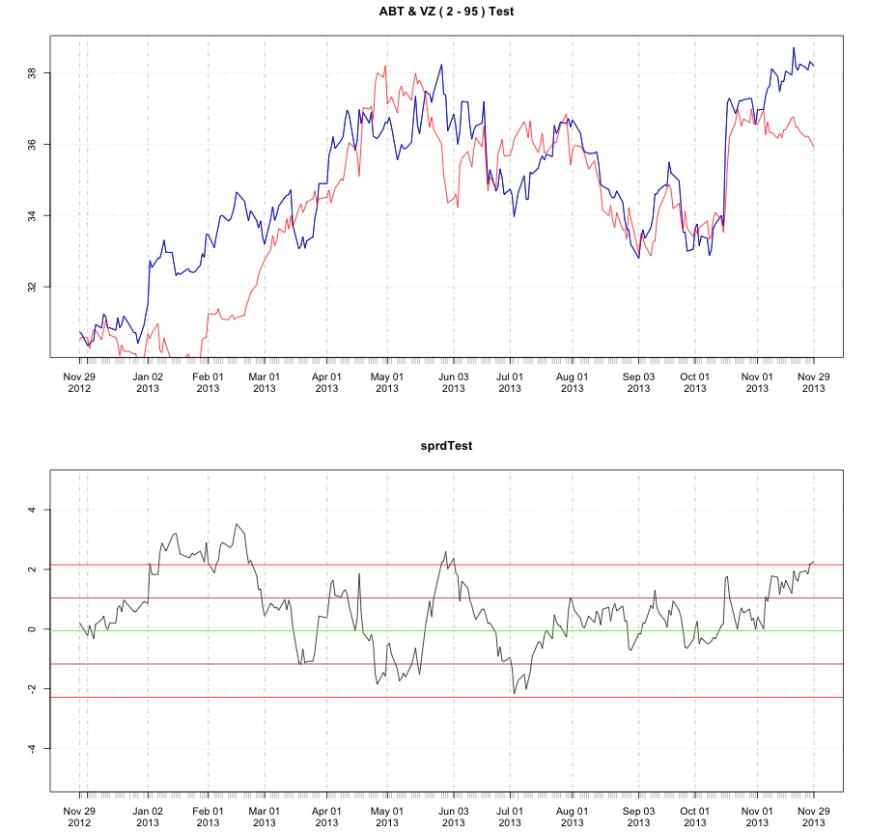
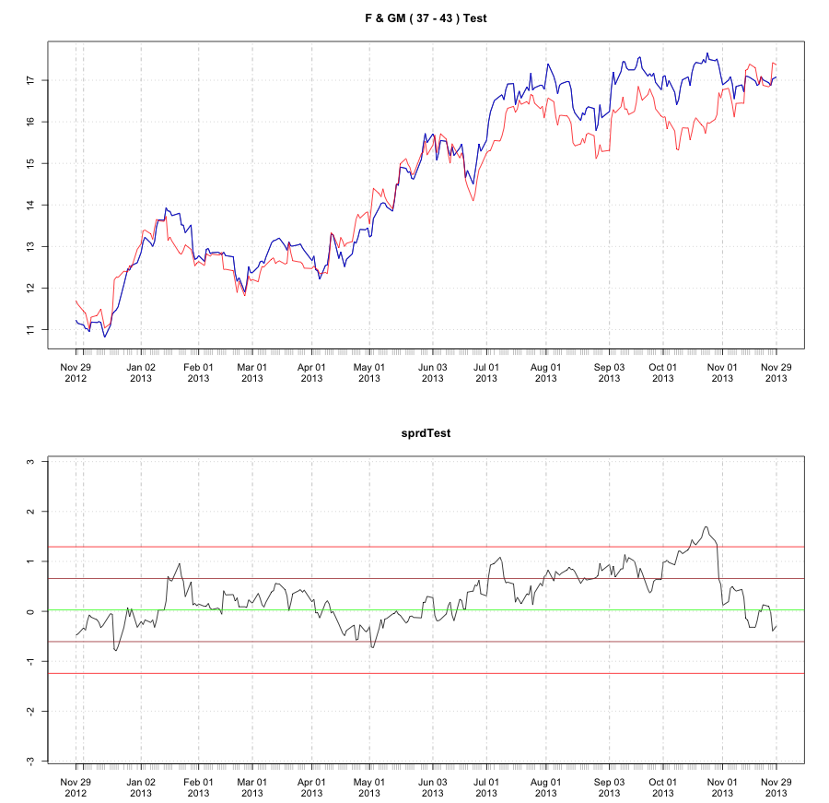
Good spreads

Slide 32
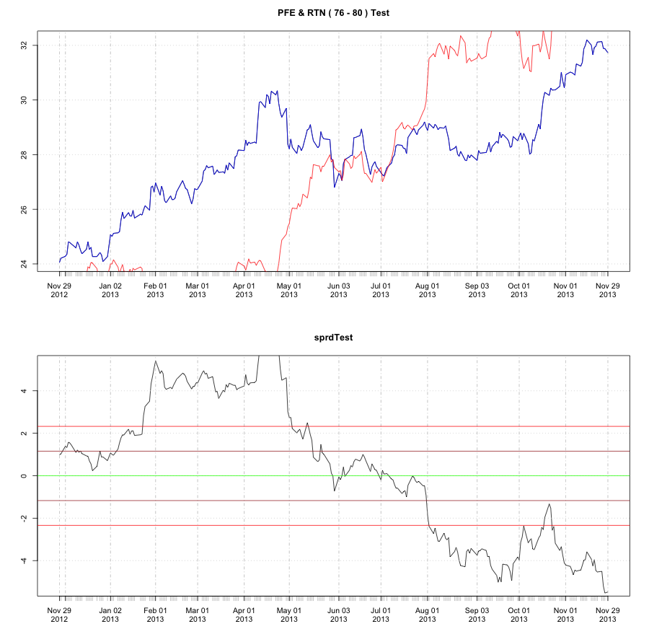
Bad spreads

Slide 33
Does model really fails?
Beta, Mean, Standard deviation are keep changing along the time!
Notes:
Traders should adapt the change and improve the model dynamically!

Slide 34
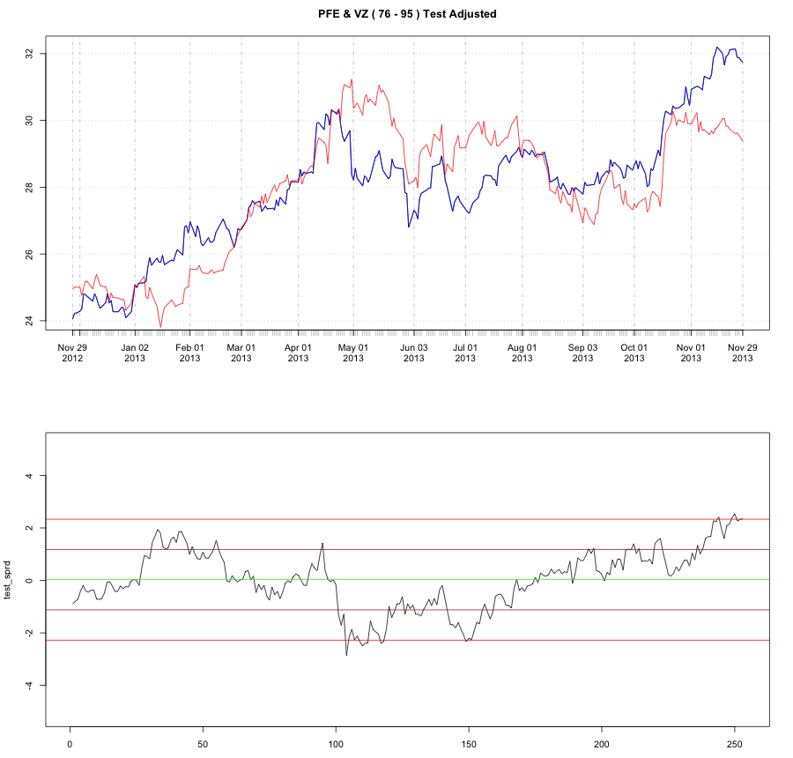
After adjust Beta, Mean, SD
Much better!

Slide 35
Summary
Stock pairs are viewed in the literature as pairs of securities which share common risk factors
Profit comes from spread swings
Volatility decides the speed of mean reversion
Market is very dynamic, strategy should adapt it to survive

Slide 36
Next…
Improve pairs selection with better factors and method
Integrate with fundamental model?
Dynamic & sophisticated trading rules by analyzing spread curve
…

Slide 37
Reference
Pairs trade: http://en.wikipedia.org/wiki/Pairs_trade
Null hypothesis: http://en.wikipedia.org/wiki/Null_hypothesis
Algorithmic trading: http://en.wikipedia.org/wiki/Algorithmic_trading
Execution management system: http://en.wikipedia.org/wiki/Execution_Management_System
Time series: http://en.wikipedia.org/wiki/Time_series_analysis
Market timing: http://en.wikipedia.org/wiki/Market_timing
Ornstein-Uhlenbeck process: http://en.wikipedia.org/wiki/Ornstein%E2%80%93Uhlenbeck_process
Autoregressive-moving-average model: http://en.wikipedia.org/wiki/Autoregressive_moving_average
Error correction model: http://en.wikipedia.org/wiki/Error_correction_models
Co-integration: http://en.wikipedia.org/wiki/Cointegration
Downside risk: http://en.wikipedia.org/wiki/Downside_risk
Statistical arbitrage: http://en.wikipedia.org/wiki/Statistical_arbitrage
Convergence trade: http://en.wikipedia.org/wiki/Convergence_trading
Fears more than death: http://www.psychologytoday.com/blog/the-real-story-risk/201211/the-thing-we-fear-more-death

Slide 38
Q & A
Thank You!

