Slide 1
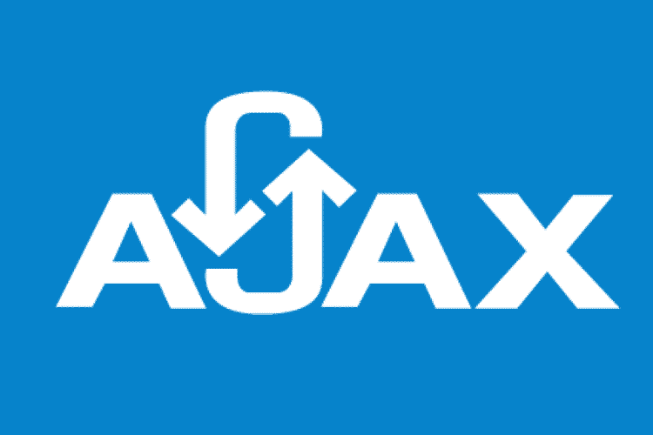

Slide 2
Presentation plan
What is AJAX?
Story AJAX
Technology
Synchronous data exchange model
Asynchronous data exchange model
AJAX application
AJAX work examples
Why would i recommend you to use AJAX

Slide 3
What is AJAX?
AJAX is a set of web technologies for creating asynchronous web applications.

Slide 4
Story AJAX
FRAME, IFRAME - IE 3, 1996
Remote Scripting (Microsoft) - IE 5.5 1998
AJAX - 2005
W3C XMLHttpRequest - 2006

Slide 5
Technology
XML
HTML
CSS
AJAX
AJAX
DOM
JavaScript
XmlHttpRequest

Slide 6
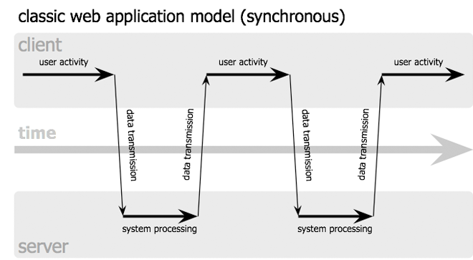
Classic Web Application (synchronous)

Slide 7
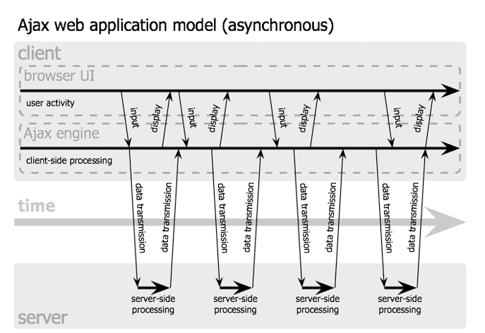
AJAX web application (asynchronous)

Slide 8
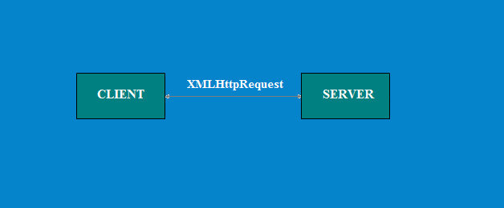
AJAX – application consists of two parts

Slide 9
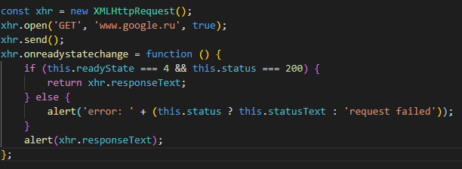
The structure of a simple request to the server

Slide 10
Advantages
Traffic saving
Reducing server load
Accelerate Interface Response
Increase interactivity
Notes:
not.

Slide 11
THANKS FOR ATTENTION!

