Slide 1
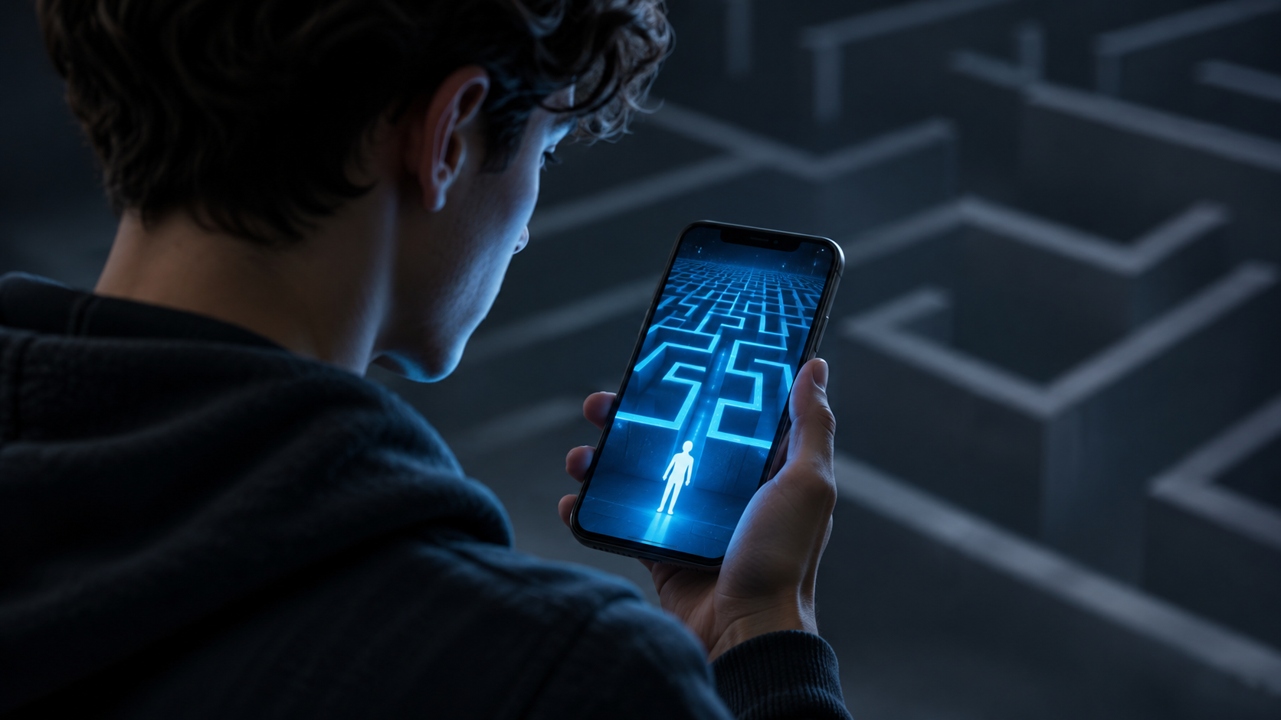
SOCIETY • TECHNOLOGY • HUMANITY
AI AND THE FUTURE
OF HUMAN VALUES
How intelligent systems are reshaping society — and what we can do about it
Prepared by Alekseenko Dmitry

Slide 2
JOURNEY
02
A ROADMAP FOR THE CONVERSATION
01
The big shift
AI changes the social rules around us
02
Connection
Algorithms, attention, and pluralism
03
Truth
Synthetic media and the crisis of trust
04
Work & dignity
Identity, dignity, and human control
05
Taking action
Shared responsibilities and practical safeguards

Slide 3
THE BIG SHIFT
03
AI DOES NOT JUST CHANGE TOOLS. IT CHANGES THE RULES.
FORCE 01
FORCE 02
ATTENTION
TRUST
Algorithms influence what becomes visible and important.
Synthetic media challenges how we decide what is real.
FORCE 03
FORCE 04
WORK
AGENCY
Automation reshapes the link between jobs, status, and identity.
Recommendation and decision systems can shift control away from people.
The question is not only what AI can do — but what its use encourages us to value.

Slide 4
01 / COMMUNICATION
04
CONNECTION OR FILTER BUBBLES?
POINT 01
POINT 02
POINT 03
THE OPPORTUNITY
THE RISK
THE VALUE AT STAKE
AI can translate, connect communities, and make knowledge easier to access.
We get more and more information through algorithms and recommendations.Because of this, we may hear fewer opinions that are different from our own.
Communication is becoming easier and faster, but sometimes less personal and sincere.It is important not to forget real conversations and to keep listening to each other.
Design for meaningful connection — not just maximum screen time.

Slide 5
02 / TRUTH & TRUST
05
WHEN SEEING IS NO LONGER BELIEVING
POINT 01
POINT 02
POINT 03
THE CHALLENGE
THE SOCIAL COST
THE RESPONSE
Deepfakes and synthetic content make images, audio, and video easier to manipulate.
Uncertainty can weaken trust in journalism, institutions, and one another.
Provenance, clear labeling, independent verification, and media literacy.
Trust must be earned through evidence, not appearance.

Slide 6
03 / WORK & DIGNITY
06
WORK, STATUS, AND HUMAN DIGNITY
POINT 01
POINT 02
POINT 03
WHAT MAY CHANGE
WHAT MUST NOT BE LOST
WHAT WE SHOULD VALUE
Routine tasks can be automated; roles and career paths may be redesigned.
Dignity cannot depend only on productivity, salary, or job title.
Care, judgment, creativity, responsibility, and lifelong learning.
A person's worth is greater than their economic output.

Slide 7
05 / SHARED RESPONSIBILITY
07
A FAIR AI FUTURE IS A SHARED RESPONSIBILITY
RESPONSIBILITY 01
RESPONSIBILITY 02
RESPONSIBILITY 03
DEVELOPERS
GOVERNMENTS
ALL OF US
Build AI systems that are safe, transparent, and tested for unfair bias. Make it clear when people are interacting with AI.
Set clear rules, protect people’s rights, and make sure powerful AI systems are properly monitored and accountable.
Think critically, check important information, protect our privacy, and speak up when AI causes harm.
A fair AI future depends on shared effort — not technology alone.

Slide 8
THE WAY FORWARD
08
THE GOAL: MORE HUMAN, NOT MORE AUTOMATED
POINT 01
POINT 02
POINT 03
PROTECT
STRENGTHEN
DEMAND
Human dignity, privacy, freedom, and equal opportunity.
Truth-seeking, empathy, pluralism, and meaningful relationships.
Transparent systems, accountability, and human oversight where it matters.
The future of AI is not only a technical question. It is a choice about who we want to be.

