Slide 1
Self-RAG: A Language Model That Retrieves, Generates and Criticises Its Own Answers
Dmitry Dolzhikov
Based on: A. Asai, Z. Wu, Y. Wang, A. Sil, H. Hajishirzi. "Self-RAG: Learning to Retrieve, Generate, and Critique through Self-Reflection". ICLR 2024
University of Washington, Allen Institute for AI, IBM Research AI

Slide 2
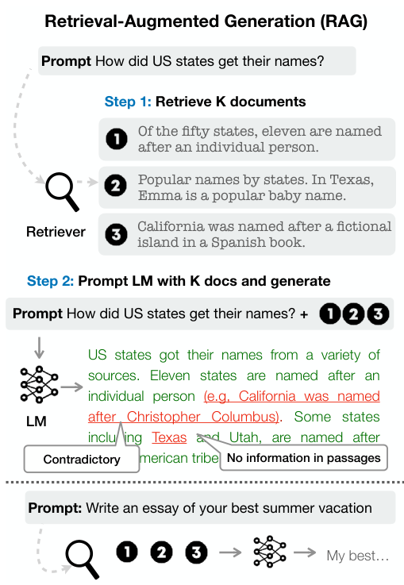
The Problem with Standard RAG
•
LLMs write fluent answers but make factual mistakes
•
RAG: find documents and add them to the model input
•
Standard RAG always retrieves K documents, even when they are not needed
•
It never checks whether the answer agrees with the documents
Conventional RAG: always retrieves K documents and generates without checking them. Source: Asai et al., ICLR 2024, Figure 1 (left).

Slide 3
Outline
1
The main idea of Self-RAG
2
Training the model
3
Experiments and results
4
What this means for reliable language models

Slide 4
Reflection Tokens
One model: retrieve when needed, generate, criticise its own output
Token Name | Values | Question
Retrieve | {yes, no, continue} | Should the model search?
IsRel | {relevant, irrelevant} | Is the passage relevant?
IsSup | {fully supported, partially supported, no support} | Is the output supported by the passage?
IsUse | {5, 4, 3, 2, 1} | How useful is the whole response?

Slide 5
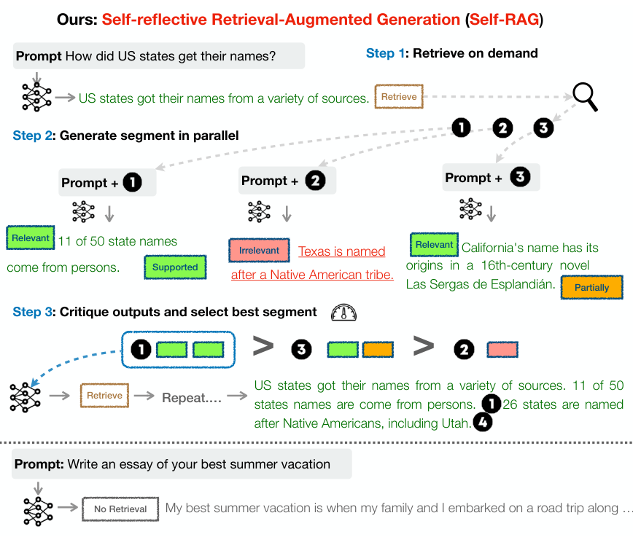
Self-RAG at Work
•
"How did US states get their names?": Retrieve, then 3 passages
•
A continuation for each passage, generated in parallel
•
Critique tokens select the relevant and fully supported segment
•
"Write an essay of your best summer vacation": no retrieval
Self-RAG retrieves on demand, generates segments in parallel and selects the best one. Source: Asai et al., ICLR 2024, Figure 1 (right).

Slide 6
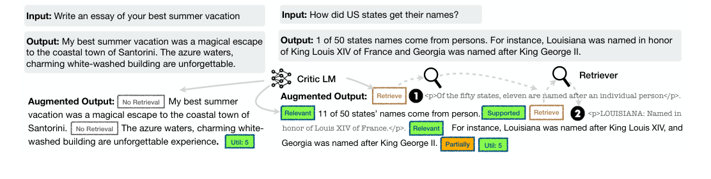
Training: Critic and Generator
1
GPT-4 labels: 4k–20k examples for each token type
2
Critic model trained on these labels: over 90% agreement with GPT-4 for most token types
3
The critic inserts reflection tokens into 150k training examples
4
Generator (Llama 2, 7B or 13B) learns text and tokens together; no critic at test time
Self-RAG training examples: without retrieval (left) and with retrieved passages (right). Source: Asai et al., ICLR 2024, Figure 2.

Slide 7
Control at Test Time
The model writes the reflection tokens itself — no retraining needed
Weights
Threshold
e.g. a higher weight on IsSup means more focus on support
Retrieve more or less often

Slide 8
Six Evaluation Tasks
Long-form
Short-form QA
Closed-set
•
Biography generation
•
PopQA
•
PubHealth (fact checking)
•
ASQA (answers with citations)
•
TriviaQA
•
ARC-Challenge (reasoning)

Slide 9
Main Results: Self-RAG 13B vs ChatGPT
Task and Metric | Self-RAG 13B | ChatGPT
PopQA (rare entities), accuracy | 55.8 | 29.3
PubHealth (health fact checking), accuracy | 74.5 | 70.1
ASQA citation precision | 70.3 | 65.1 (with retrieval)
Source: Asai et al., ICLR 2024, Table 2

Slide 10
Why Reflection Tokens Matter
PopQA accuracy — Llama2-FT 7B: same training data, no reflection tokens
48.7
54.9
Llama2-FT 7B
Self-RAG 7B
The gain comes from the method, not only from the data
Source: Asai et al., ICLR 2024, Table 2

Slide 11
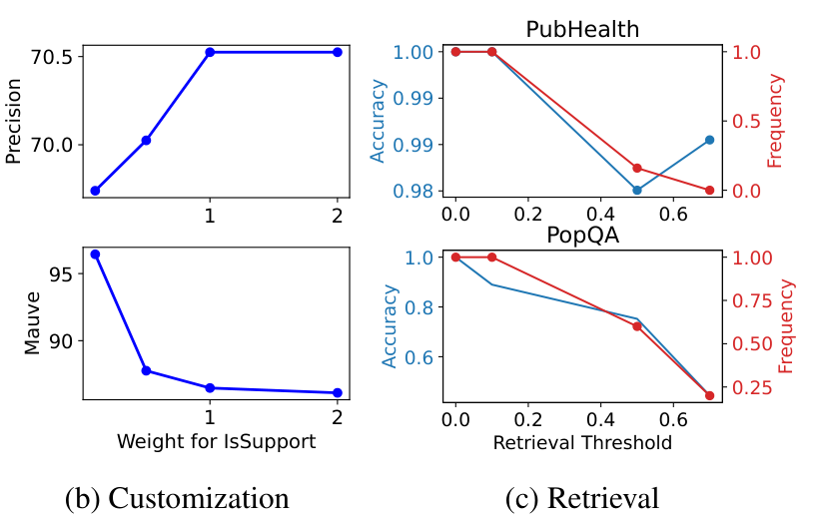
Trade-offs
Effect of the IsSup weight on ASQA (b) and of the retrieval threshold on PubHealth and PopQA (c). Source: Asai et al., ICLR 2024, Figure 3 (b, c).
•
Higher IsSup weight: higher citation precision, lower fluency (MAUVE) on ASQA
•
Higher retrieval threshold: fewer searches; accuracy drops on PopQA more than on PubHealth

Slide 12
Conclusions
1
One model decides when to search and checks its own answers with reflection tokens
2
Open 7B and 13B models outperform ChatGPT on several tasks and give more precise citations
3
Behaviour can be tuned at test time; claims are still not always fully supported

Slide 13
Key Message
"A language model becomes more reliable when it learns to check its own answers against its sources"
Thank you! Questions?

