Slide 1
Adaptive-RAG: Choosing a Retrieval Strategy by Question Complexity
Dmitry Dolzhikov
Based on: S. Jeong, J. Baek, S. Cho, S. J. Hwang, J. C. Park. "Adaptive-RAG: Learning to Adapt Retrieval-Augmented Large Language Models through Question Complexity". NAACL 2024, pp. 7036–7050

Slide 2
Why Retrieval?
LLM knowledge is stored in the model parameters
It can be incomplete or out of date, so models give wrong facts
Retrieval: search documents (e.g. Wikipedia) before answering
Every search step costs time and computation

Slide 3
Outline
1.
The problem
2.
The method
3.
Experiments and main results
4.
What the results mean

Slide 4
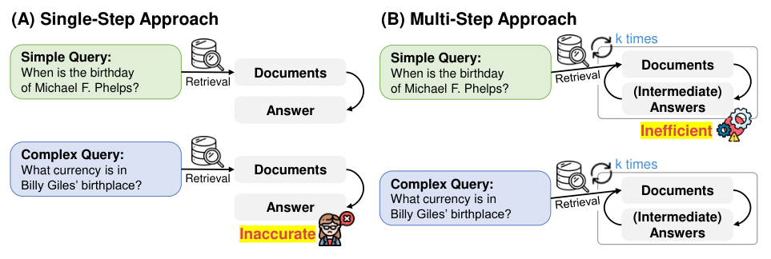
The Problem: Questions Differ in Complexity
Single-step (A) and multi-step (B) approaches. Source: Jeong et al., NAACL 2024, Figure 2.
•
Simple: "Paris is the capital of what?" (the model can answer alone)
•
Complex: "When did the people who captured Malakoff come to the region where Philipsburg is located?" (4 reasoning steps)
•
Single-step search is not enough for complex questions
•
Multi-step search wastes time on simple questions

Slide 5
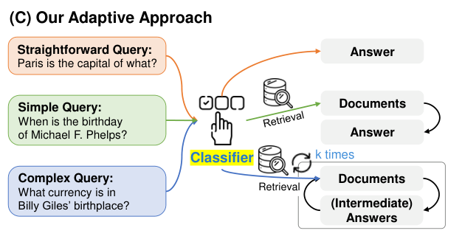
Adaptive-RAG: Match the Effort to the Question
A: answer without search
B: search once, then answer
C: search several times, reasoning between the steps
A small T5-Large classifier chooses A, B or C before any search
The adaptive approach with a query-complexity classifier. Source: Jeong et al., NAACL 2024, Figure 2 (C).

Slide 6
Training the Classifier without Manual Labels
FALLBACK
STEP 1
STEP 2
No strategy is correct: label by dataset type (single-hop → B, multi-hop → C)
EXAMPLE
Run all three strategies on training questions
Label = the simplest strategy that answers correctly
Example: an unlabelled HotpotQA question gets label C

Slide 7
Experimental Setup
6 open-domain QA datasets
3 LLMs
•
Single-hop: SQuAD, Natural Questions, TriviaQA
•
FLAN-T5-XL (3B)
•
FLAN-T5-XXL (11B)
•
Multi-hop: MuSiQue, HotpotQA, 2WikiMultiHopQA
•
GPT-3.5

Slide 8
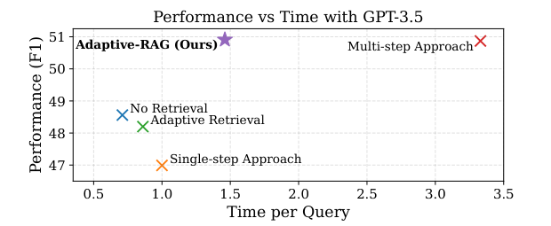
Results with GPT-3.5
Adaptive-RAG: F1 50.91, relative time 1.46
Multi-step approach: F1 50.87, relative time 3.33
The same accuracy in less than half of the time
QA performance (F1) against time per query with GPT-3.5. Source: Jeong et al., NAACL 2024, Figure 1.

Slide 9
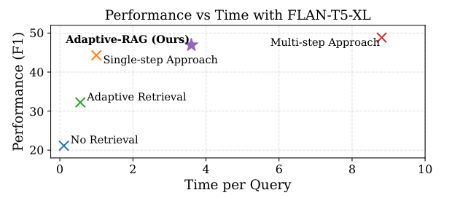
Results with FLAN-T5-XL (3B)
Adaptive-RAG: F1 46.94, relative time 3.60
Multi-step approach: F1 48.85, relative time 8.81
Adaptive Retrieval: F1 32.24, so Adaptive-RAG is 14.7 points higher
QA performance (F1) against time per query with FLAN-T5-XL. Source: Jeong et al., NAACL 2024, Figure 4.

Slide 10
Example: One Simple Question
Question: "Which famous corporate logo changed to a flat colour/color sans serif font in its first major change since 1999?"
Adaptive Retrieval | Adaptive-RAG
label B | label A
searched documents | no search
answer "Microsoft" (wrong) | answer "Google" (correct)

Slide 11
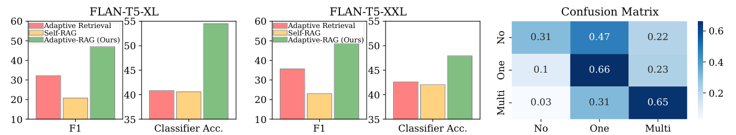
The Weak Point: The Classifier
Classifier performance with FLAN-T5-XL and XXL (left, centre) and the confusion matrix (right). Source: Jeong et al., NAACL 2024, Figure 3.
•
Correct label for 54.5% of questions
•
Easy questions are often sent to search
•
With an ideal (oracle) classifier: F1 62.80 with GPT-3.5

Slide 12
Conclusions
1
2
3
Questions differ in complexity: one fixed strategy wastes resources or fails
Choosing a strategy per question: accuracy close to multi-step search in less than half of the time
Next steps: better complexity labels and better classifiers

Slide 13
KEY MESSAGE
"Before spending resources on an answer, ask how difficult the question really is"
Thank you! Questions?

