Slide 1

Machine Learning with
A Machine learning framework from Microsoft
Praveen Raghuvanshi

Slide 2
Identify language
Bonjour
Guten Morgen
おはよ ございます
Good Morning

Slide 3
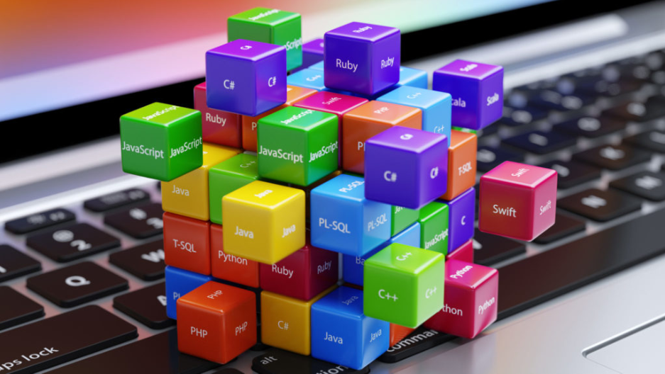
Programming Languages
Source: https://insights.dice.com/2019/10/24/tiobe-top-eight-top-ten-open/

Slide 4
Quiz : Type of ML
Is this A or B?
How much – or – How many?
How is this organized?
What should I do next?
Is number a Armstrong?

Slide 5
Machine learning
Machine learning is getting computers to program themselves.
If programming is automation, then machine learning is automating the process of automation
Traditional Programming
Machine learning
Data
Program
Output
Data
Output
Program
Computer
Computer

Slide 6
Pre-Requisites of ML
A Pattern should exist
Mathematical model / algorithm is unknown
Lots of data

Slide 7
Types of Machine Learning
Machine
Learning
Supervised
(Task based)
Unsupervised
(Data Driven)
Reinforcement
(Algorithms learns to react to an environment)
Classification
Regression
Clustering

Slide 8
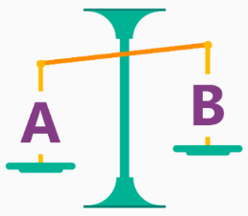
Is it A or B?
Classification Algorithm
Will this tire fail in the next 1,000 miles : Yes or No ?
Which brings in more customers: a $5 coupon or a 25% discount ?

Slide 9
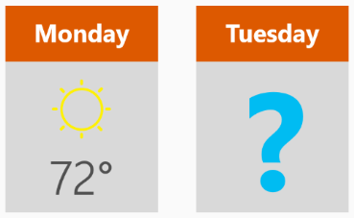
How much? How many?
Regression Algorithm
What will the temperature be next Tuesday?
What will my fourth quarter sales be?
They help answer any questions that asks for a number

Slide 10
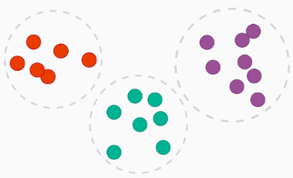
How is this organized?
Clustering Algorithm
Which viewers like the same type of movies?
Which printer model fail the same way?

Slide 11

What should I Do now?
Reinforcement learning Algorithm
If I'm a self-driving car: At a yellow light, brake or accelerate?
For a robot vacuum: Keep vacuuming, or go back to the charging station?

Slide 12

ML Frameworks

Slide 13
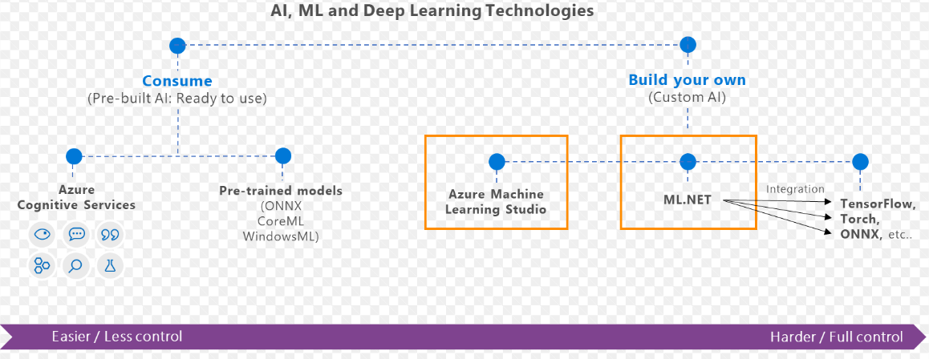
What is ML.Net?
ML framework from Microsoft for developing Custom AI/ML applications
Originated in 2002 as part of Microsoft Research project

Slide 14
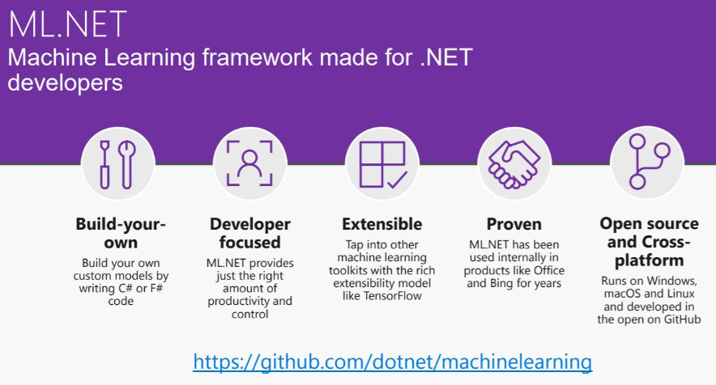

Slide 15
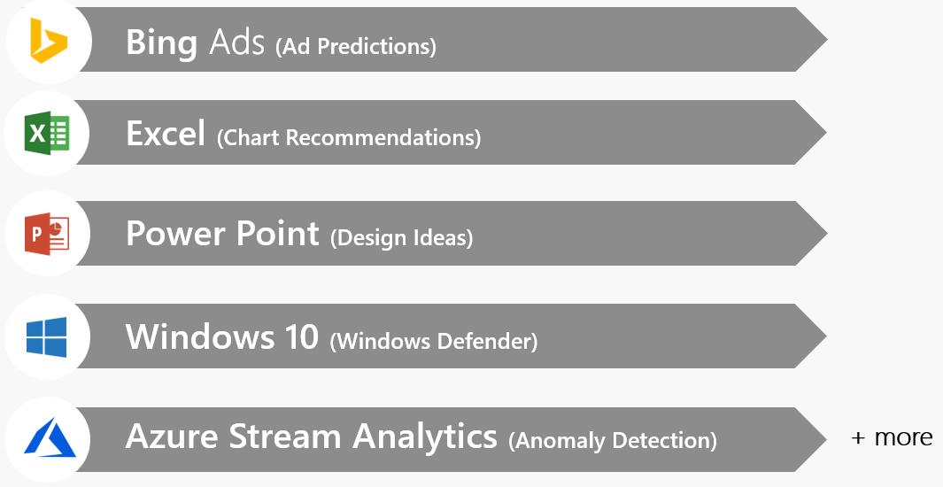
Proven at scale, Enterprise ready

Slide 16
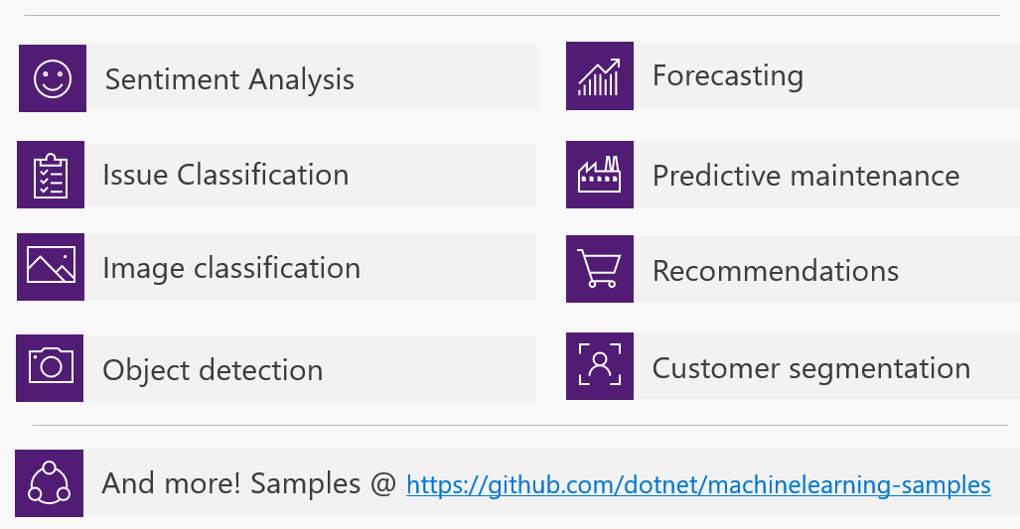
Possibilities

Slide 17
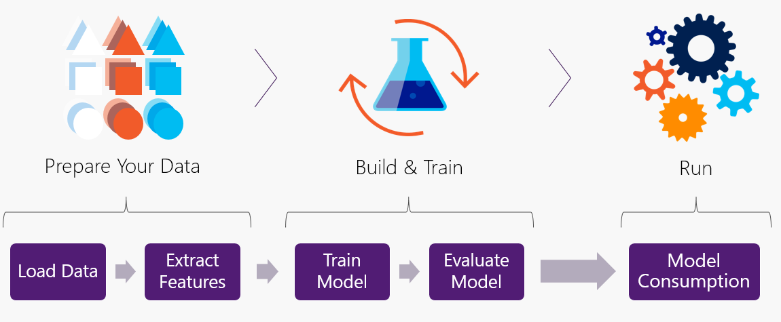
Workflow

Slide 18
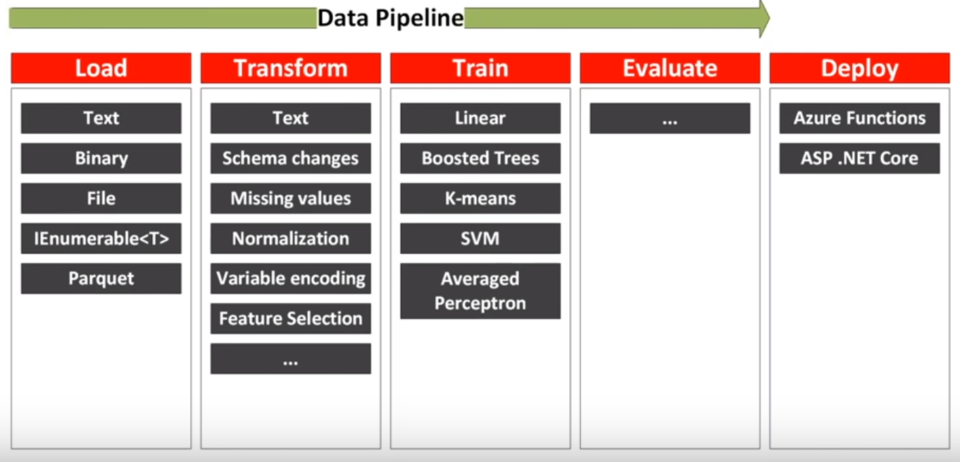
Data pipeline

Slide 19
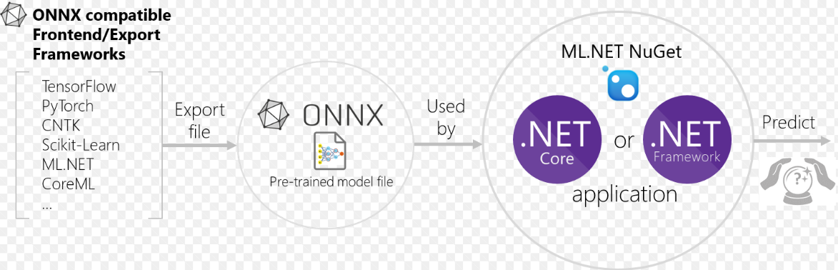
Interoperability: ONNX Open Neural Network Exchange Format
ONNX is developed and maintained by a community of partners such as Microsoft, Facebook.
ONNX files could be viewed using Netron

Slide 20
Code Demo(s)

Slide 21

Binary Classification
Titanic - Survival Prediction
Label and Features
Train model using ML.Net
Train using AutoML
Code generation
Accuracy improvement
Data: https://web.stanford.edu/class/archive/cs/cs109/cs109.1166/problem12.html

Slide 22
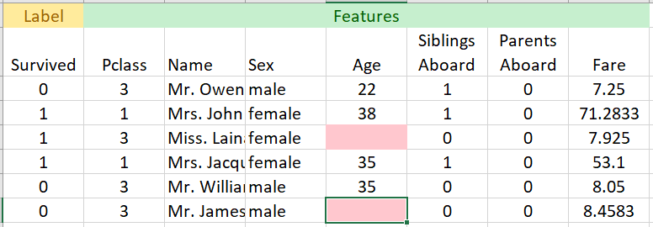
Titanic Data

Slide 23
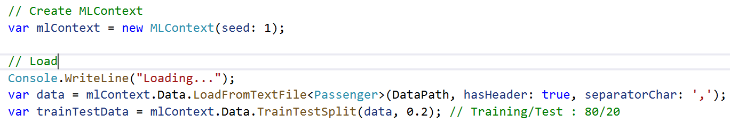
Load

Slide 24
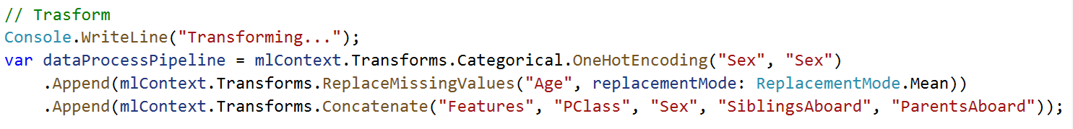
Load -> Transform

Slide 25
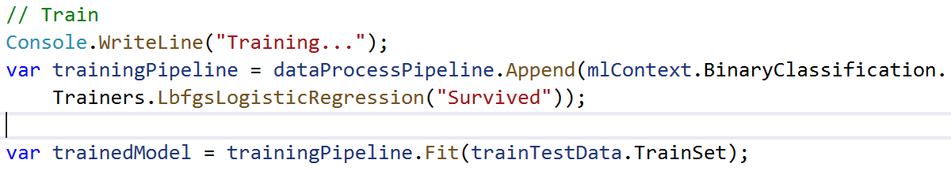
Load -> Transform -> Train

Slide 26
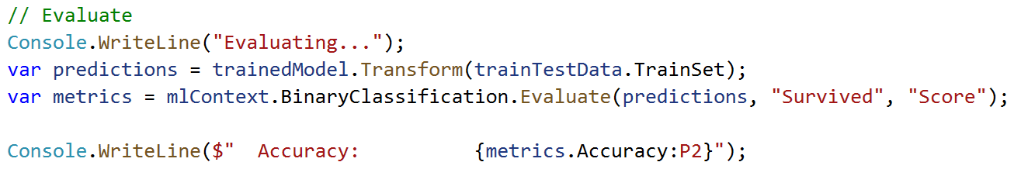
Load -> Transform -> Train -> Evaluate

Slide 27
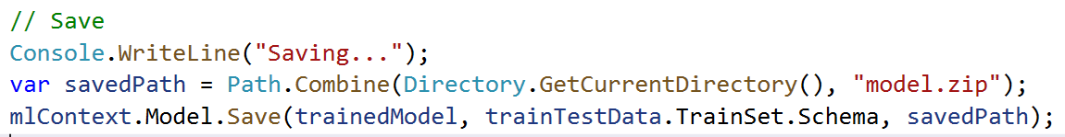
Load -> Transform -> Train -> Evaluate -> Save

Slide 28
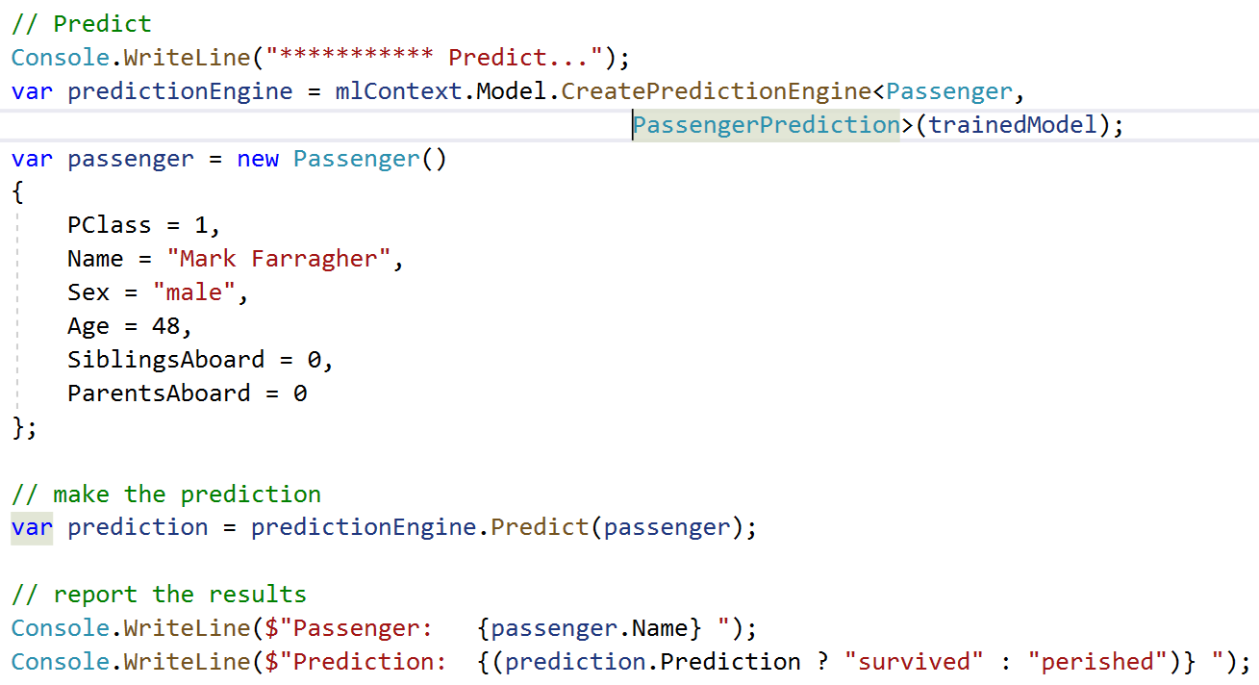
Load -> Transform -> Train -> Evaluate -> Save -> Predict

Slide 29
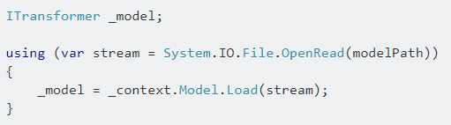
Load a model

Slide 30
AutoML – In Preview
S.No | Custom ML | AutoML
1. | Manually experiment with different algorithms | Runs different algorithms
2 | Time consuming in identifying best algorithm | Runs many algorithm without code changes
3 | Provides better control of algorithms | No control over algorithm selection
4 | Manually write code | Auto-generates code
mlnet auto-train --task binary-classification --dataset "titanic.csv" --label-column-index 0 --has-header true --max-exploration-time 30

Slide 31
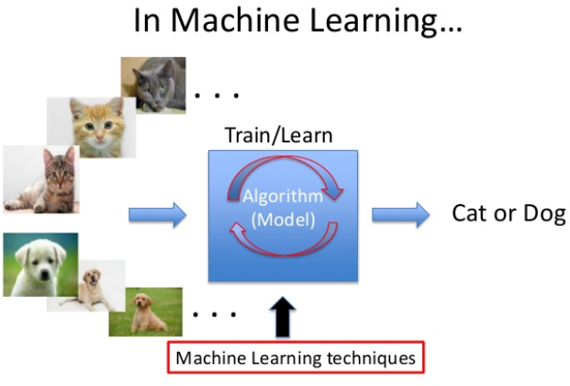
Interoperability
Photo-Search
ML.Net + ONNX
Keras CNN Model
No rewrite of algorithms/model
Save effort and time

Slide 32
References
ML.Net : https://dotnet.microsoft.com/apps/machinelearning-ai/ml-dotnet
ML.Net: https://devblogs.microsoft.com/cesardelatorre/what-is-ml-net-1-0-machine-learning-for-net/
ONNX : https://onnx.ai/
Photo-Search (ONNX) : https://github.com/Tak-Au/Photo-Search
Music Repair : https://www.youtube.com/watch?v=nnV-1q-z9uE
ML Cookbook : https://github.com/dotnet/machinelearning/blob/master/docs/code/MlNetCookBook.md
Deploy to Azure functions : http://luisquintanilla.me/2018/08/21/serverless-machine-learning-mlnet-azure-functions/
https://rubikscode.net/2019/02/18/ultimate-guide-to-machine-learning-with-ml-net/
https://www.youtube.com/watch?v=dojO4zEL9sg
https://www.youtube.com/watch?v=zy7Y9CHji2k

Slide 33




Thank you Q & A
praveenraghuvanshi@gmail.com
https://in.linkedin.com/in/praveenraghuvanshi
https://github.com/praveenraghuvanshi1512
@praveenraghuvan

