Slide 1


Final Project Mole Classifier
Dmitry Gavrilkoff
CSCI S-89 Introduction to Deep Learning
Summer 2022
Harvard Summer School

Slide 2
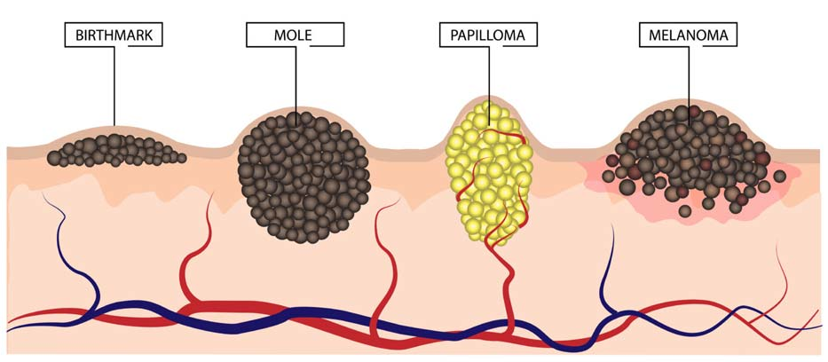
Introduction
Moles are a common type of skin growth. They often appear as small areas and are caused by clusters of dark brown pigment-forming cells. Most people have between 10 and 40 moles that appear during early childhood or adolescence and may change in appearance or fade over time. Most moles are harmless. However, occasionally they become cancerous. Being aware of changes on your skin is important to detecting cancerous moles.

Slide 3
Project
To build a neural network that can distinguish benign and malignant moles
OBJECTIVE
Multilayered Convolutional Network
APPROACH
"SIIM-ISIC Melanoma Classification Challenge" hosted on Kaggle during the Summer of 2020
DATASOURCE

Slide 4
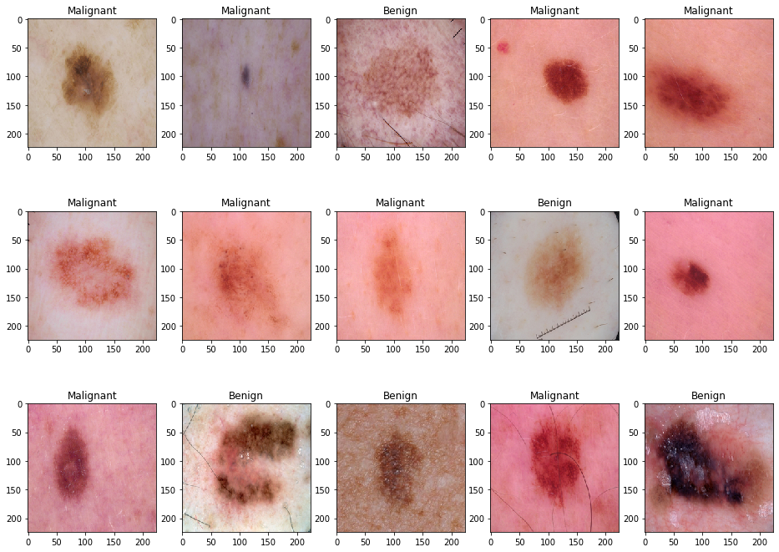
Glance at Training Data
Classifying skin lesions is challenging.
A small sample (15 images) displayed variations in colours, colour depths and shapes within each class.
OBSERVATION

Slide 5
Methodology – CNN Architecture
model = models.Sequential()
model.add(layers.Conv2D(64,
kernel_size = (3, 3),
padding = 'Same',
input_shape = x_train[0].shape,
activation = 'relu',
kernel_initializer ='glorot_uniform'
))
model.add(layers.MaxPool2D(pool_size = (2, 2)))
model.add(layers.Dropout(0.20))
model.add(layers.Conv2D(64,
kernel_size = (3, 3),
padding = 'Same',
activation = 'relu',
kernel_initializer = 'glorot_uniform'
))
model.add(layers.MaxPool2D(pool_size = (2, 2)))
model.add(layers.Dropout(0.20))
model.add(layers.Flatten())
model.add(layers.Dense(128, activation = 'relu'))
model.add(layers.Dense(2, activation = 'sigmoid'))
# check the model architecture
model.summary()
Model: "sequential_12"
_______________________________________________________________
Layer (type) Output Shape Param #
============================================================
conv2d_24 (Conv2D) (None, 224, 224, 64) 1,792
max_pooling2d_24 (MaxPooling2D) (None, 112, 112, 64) 0
dropout_24 (Dropout) (None, 112, 112, 64) 0
conv2d_25 (Conv2D) (None, 112, 112, 64) 36,928
max_pooling2d_25 (MaxPooling2D) (None, 56, 56, 64) 0
dropout_25 (Dropout) (None, 56, 56, 64) 0
flatten_12 (Flatten) (None, 200,704) 0
dense_24 (Dense) (None, 128) 25,690,240
dense_25 (Dense) (None, 2) 258
============================================================
Total params: 25,729,218
Trainable params: 25,729,218
Non-trainable params: 0
_______________________________________________________________

Slide 6
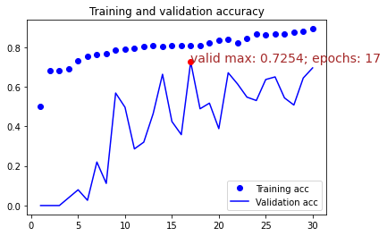
Training & Validation Accuracy
Training accuracy reached ~80% near the 10th epoch and slowly improved with extra training steps.
Validation accuracy reached its peak 17th epoch and continued at this level with some variations till the end of the model training.
OBSERVATION

Slide 7
Prediction Accuracy
The trained CNN model achieved 80.76% prediction accuracy on a never seen test set of images. Out of 660 images available, 533 were correctly classified as benign or malignant, while 127 (19.24%) pictures were allocated to the wrong group.
OBSERVATION
80.76%

Slide 8
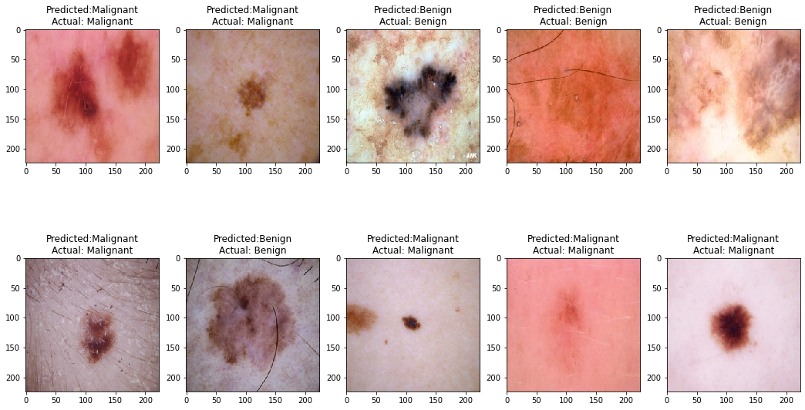
CORRECTLY Classified Moles

Slide 9
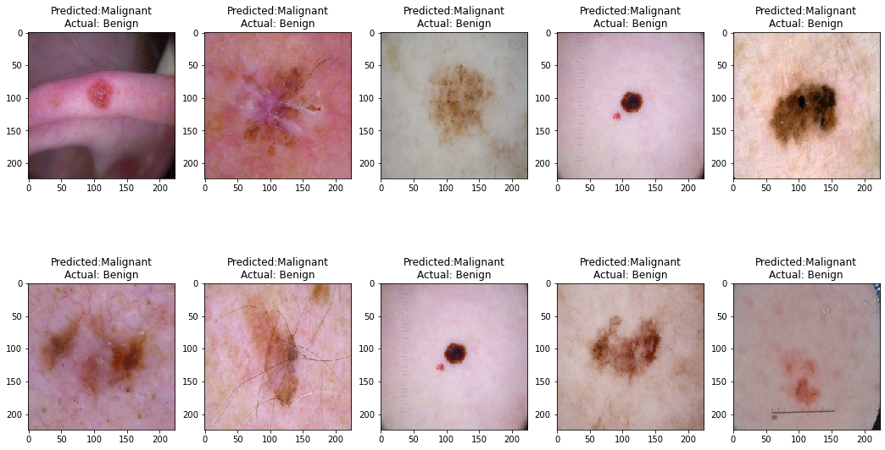
INCORRECTLY Classified Moles

Slide 10

Summary
The project successfully achieved the objective of building a convolutional neural network that can classify cancerous and non-cancerous moles. CNN trained on 2637 images and achieved 80.76% prediction accuracy on the test dataset. For the task, a 4-layered neural network with dropout layers was pretrained, which includes 25.7 million parameters. The project was done on a MacBook Pro 2.6 GHz 6-Core Intel Core i7 processor and 16GB of RAM. Hitting an 80% accuracy mark is a respectful result, which, however, could be improved by adding more layers or using pretrained CNN. More computing power has to be acquired to run experiments on more complex models.

Slide 11
Appendix
YouTube video presentation: https://youtu.be/vgukTx5mEi0
Data source: https://challenge2020.isic-archive.com/

