Slide 1


XPath, CSS selectors, RegEx
Introduction to elements searching
September 15, 2016

Slide 2
Terms
XPath is ...
a syntax
a pattern
a language
... for defining parts of an XML document.

Slide 3
What is it for?
How can we find a specific webelement on a page?
For example, you can easy find an element or Array List or Map - by index, value or key.
In GUI Test Automation we use Selenium WebDriver, and it uses locators to find web elements.

Slide 4
Little more terms
Selenium WebDriver is a tool for browser automation.
Selenium is a web application testing framework that allows you to write tests in many programming languages like Java, C#, Groovy, Perl, PHP, Python and Ruby. It deploys on Windows, Linux, and MAC OS.
Locator is a string that uniquely identifies an element of web page.

Slide 5
And some more terms
DOM (Document Object Model) is a platform and language-neutral interface that allows programs and scripts to dynamically access and update the content, structure, and style of a document.
It is declared by W3C (World Wide Web Consortium).

Slide 6

HTML DOM
HTML DOM is a standard object model for HTML. It defines:
The HTML elements as objects (nodes)
The properties of all HTML elements
The methods to access all HTML elements
The events for all HTML elements
In other words: HTML DOM is a standard for how to get, change, add, or delete HTML elements.

Slide 7
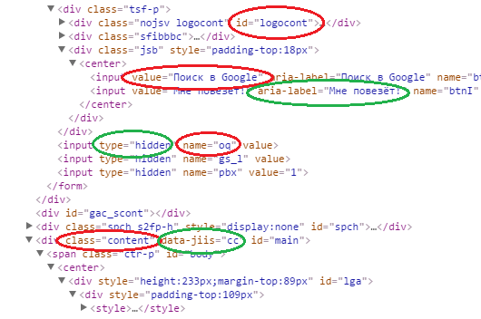
How does WebDriver locate
web elements in DOM?
It can find elements by:
Id
Name
Class
Value
XPath
CSS Selector
other ways

Slide 8
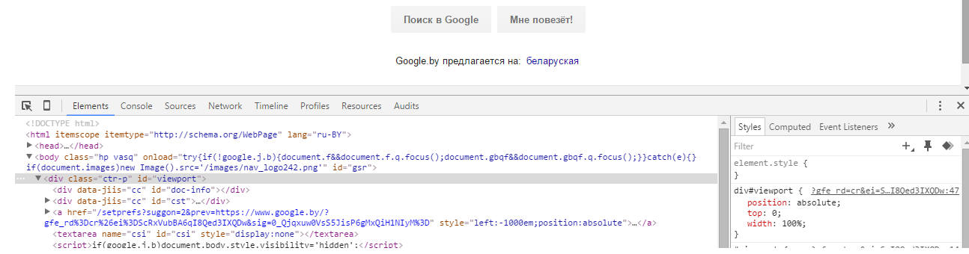
How can we create locators?
Using DevTools - web analyzing and debugging tools that are built into browser.
Here is how
chrome DevTools look

Slide 9
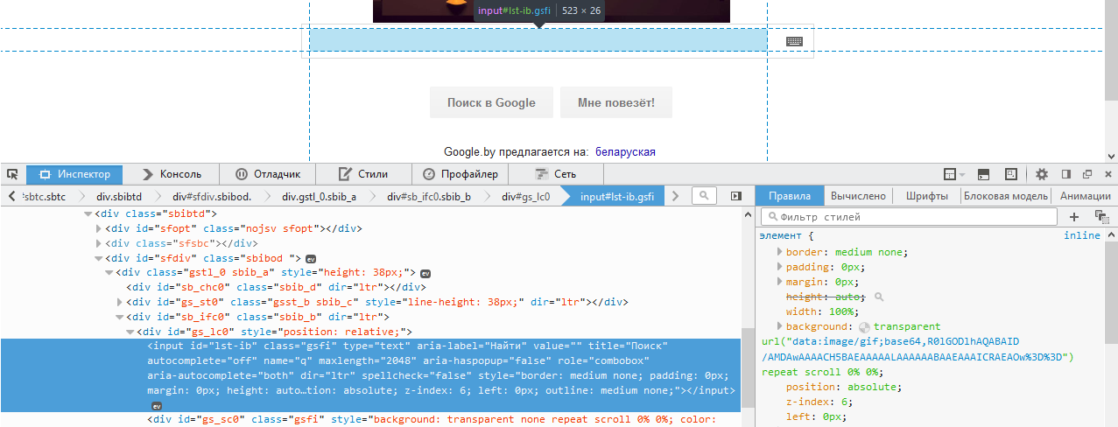
How can we create locators?
Here is how
FireFox DevTools look

Slide 10
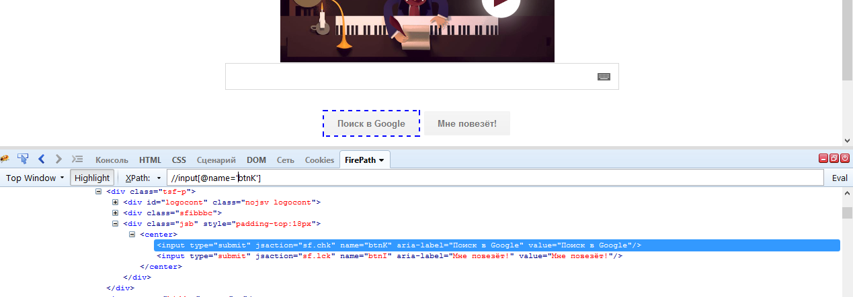
How can we create locators?
Here is how
FirePath looks

Slide 11
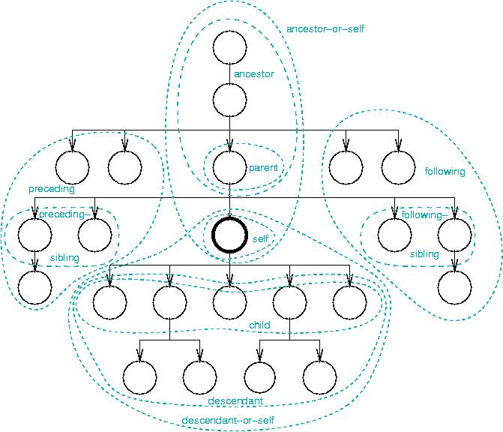

Slide 12
XPath axes
AxisName | Result
ancestor:: | Selects all ancestors (parent, grandparent, etc.) of the current node
ancestor-or-self:: | Selects all ancestors (parent, grandparent, etc.) of the current node and the current node itself
attribute:: | Selects all attributes of the current node
child:: | Selects all children of the current node
descendant:: | Selects all descendants (children, grandchildren, etc.) of the current node
descendant-or-self:: | Selects all descendants (children, grandchildren, etc.) of the current node and the current node itself
following:: | Selects everything in the document after the closing tag of the current node
following-sibling:: | Selects all siblings after the current node
namespace:: | Selects all namespace nodes of the current node
parent:: | Selects the parent of the current node
preceding:: | Selects all nodes that appear before the current node in the document, except ancestors
preceding-sibling:: | Selects all siblings before the current node
self:: | Selects the current node

Slide 13
XPath axes short syntax
attribute::
child::
descendant::
parent::
self::
@
/
//
..
.

Slide 14
XPath Operators
Operator | Description | Example
| | Computes two node-sets | //book | //cd
+ | Addition | 6 + 4
- | Subtraction | 6 - 4
* | Multiplication | 6 * 4
div | Division | 8 div 4
= | Equal | price=9.80
!= | Not equal | price!=9.80
< | Less than | price<9.80
<= | Less than or equal to | price<=9.80
> | Greater than | price>9.80
>= | Greater than or equal to | price>=9.80
or | or | price=9.80 or price=9.70
and | and | price>9.00 and price<9.90
mod | Modulus (division remainder) | 5 mod 2

Slide 15
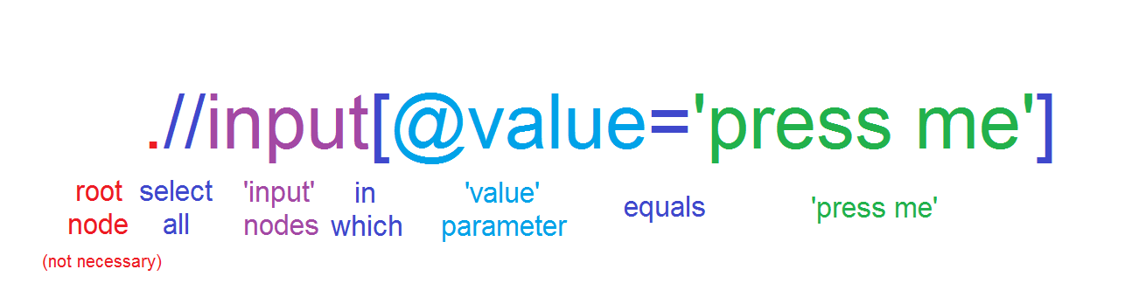
XPath locator - how does it look?

Slide 16
XPath predicates
Path Expression | Result
/bookstore/book[1] | Selects the first book element that is the child of the bookstore element
/bookstore/book[last()] | Selects the last book element that is the child of the bookstore element
/bookstore/book[last()-1] | Selects the last but one book element that is the child of the bookstore element
/bookstore/book[position()<3] | Selects the first two book elements that are children of the bookstore element
//title[@lang] | Selects all the title elements that have an attribute named lang
//title[@lang='en'] | Selects all the title elements that have a "lang" attribute with a value of "en"
/bookstore/book[price>35.00] | Selects all the book elements of the bookstore element that have a price element with a value greater than 35.00
/bookstore/book[price>35.00]/title | Selects all the title elements of the book elements of the bookstore element that have a price element with a value greater than 35.00

Slide 17
XPath locators examples
//button[@id=’submit’]
//div[not(@style=’display:none’)]/a
//*[text()='the visible text' and @class = ‘class1’]
//li[contains(@value, ’choice1’)]
//span[count(div)>=3]
//*[@class='search-result'])/descendant-or-self::*[@id=’banana’]
//a[ends-with(@href, ’.pdf’)]

Slide 18
XPath - useful links
XPath syntax
XPath axes
XPath operators
XPath functions

Slide 19
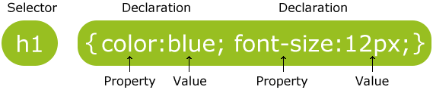
CSS Selectors
CSS Selectors work almost the same way, but use style attributes of elements.
They have more specific function and different syntax.

Slide 20
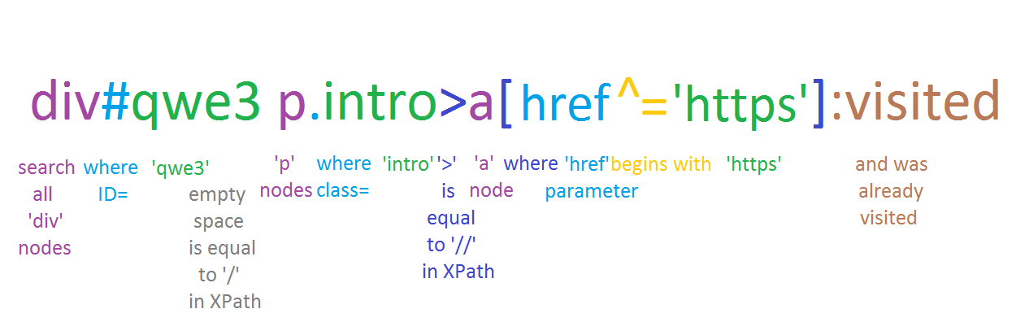
CSS Selector - how does it look?
it is pretty hard example :)

Slide 21
CSS Selector examples
h1
div.tagline
li#intro a
div.result > a
li ~ ul
a[href$=".pdf"]
span.qwe div#id > a:visited

Slide 22
CSS Selectors - useful links
CSS Selectors syntax
CSS Selectors examples
CSS Selectors online tester

Slide 23
What is better to use in test automation?
CSS Selector
works faster
looks laconic
has some unique features (like :visited)
harder to use, read and understand
can walk on DOM only down direction
can not search by text
XPath
the most frequently used
easier to use, read and understand
more powerful
can walk on DOM in any directions
has functions and operators
But it is better to know the both :)

Slide 24
Selectors: frequently made mistakes
using absolute, generated or too long path
using non-static properties
creating locators that return non-definite results
using double quotes in values
ignoring the frames
using difficult dependencies when simple location (id) could be used
being sure that locator will never change
//span[@id=’tsf’]/div[2]/div[3]/center/input[2]
//th[@class=’jfk-bubble chw-oc stv-enabled’]
//a[contains(text(),’hello’)]
//input[@id=’pass_input’]
//th[contains(@class, ‘jfk-bubble’)]
//popup[@id=’first_run_popup’]/a

Slide 25
Regular Expressions Basics
Regular Expressions are special string masks for describing a search pattern in text or content.
It is frequently used in programming for parsing some specified values, controlling some parameters format, filtering some data, etc.
In this lection we will consider just basic techniques of RegEx (or RegExp).

Slide 26
RegEx - Syntax
Ordinary characters - mean themselves.
Special characters (metacharacters): [ ] \ / ^ $ . | ? * + - ( ) { }
can have different meaning depends of context (position)
To use special symbol as itself, it should be escaped with \ .
Some ordinary characters become metacharacters when are escaped with \ :
d s w D S W
(not full list, but most frequently used chars)

Slide 27
RegEx - Syntax
.
*
+
?
[ ]
[^ ]
[a-z]
(a|x)
{m,n}
\d
\D
\w
\W
\s
\S
?
matches any character except a newline
matches the preceding element zero or more times
matches the preceding element one or more times
matches the preceding element zero or one times
denotes a set of possible character matches
matches every character except ones inside brackets
indicates a range - any between first and last chars
works like ‘or’ operator
matches the quantity of preceding element from m to n
matches any digit char
matches non-digit char
matches any alphanumeric, digits character and ‘_’ (word)
matches non-word char
matches any whitespace char
matches non-space char
turns preceding “greedy” matching to “lazy”
(watch examples)

Slide 28
RegEx - Examples
home.
h.*
a+
home4?
[qwerty]
[^123\s]+
[a-e]+
have (1|5) points?\?
cool!{1,3}
\d+
\D+
\w+@\w+\.\w{3}
I have \d+ apples?
web\s?element
Offer #\d+ was .*?changed
<.+>
<.+?>
home1, home2, homez
h, homez, homespace.txt
a, aa, aaaaaaaa
home4, home
q,e,t,w,y (just one char)
5, aqw45, wer789!#
abc, a, adeca
have 1 point? , have 5 points?
cool! , cool!! , cool!!!
1, 126, 156989479
Qwe , aaa#!$ , o__O
sanya_538@qwe.com
I have 1 apple, I have 3 apples
webelement, web element
Offer #123 was not changed
greedy and lazy matching:
<span> <div> <a> </a> </div> </span>
<span> <div> <a> </a> </div> </span>

Slide 29
RegEx - useful links
The most useful link

Slide 30
PRESENTER: SERGEY PORITSKIY
Thanks for attention

