Slide 1
Smart House
Engineering Adaptive Mobile Applications
Anastasia Lykhtar, Dmitriy Monakhov

Slide 2
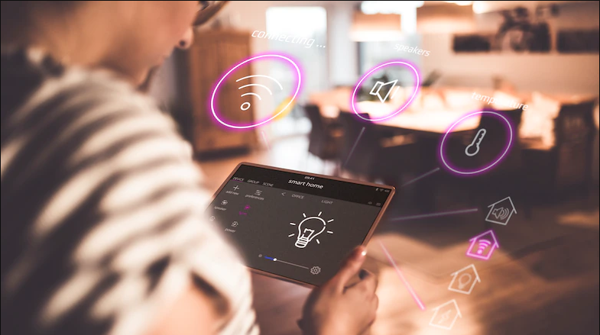
Problem of daily routines
Gunther has a big apartment and he needs to do housework. Gunter is a businessman, he is really busy! He has no time for such simple stuff.

Slide 3
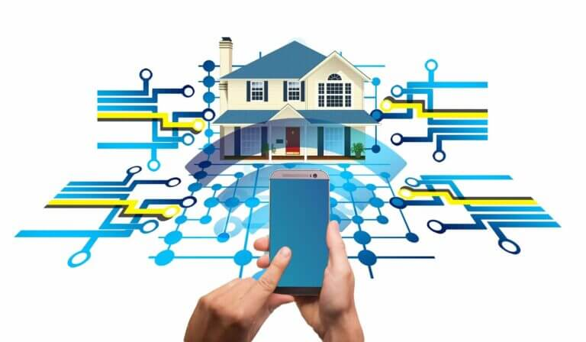
Approach
Modular structure: all parts interchangeable
Popular Hardware: cheap MCUs
Commodity user-devices: runs on any smartphone
Exploitation of standards: ease of expanding and maintenance
Android/Web: use smartphone or a browser with equal convenience to control the system.
Position tracking: focus on relevant locations

Slide 4
Benefits
Plug-and-play systems enables low-effort installation of new components
Low-cost hardware decreases your overall expenditures
With position tracking the application response time is about one second

Slide 5
Who is interested?
Any homeowner wants to make some action automatic.
Why is it so dark? Where is the switch?!
What is the current temperature here? I want A/C on!
What is the current humidity? I want dry air!
Nowadays we need to do all this manually.
Smart House will do your job!
Target user group: Owner of a big house/flat

Slide 6
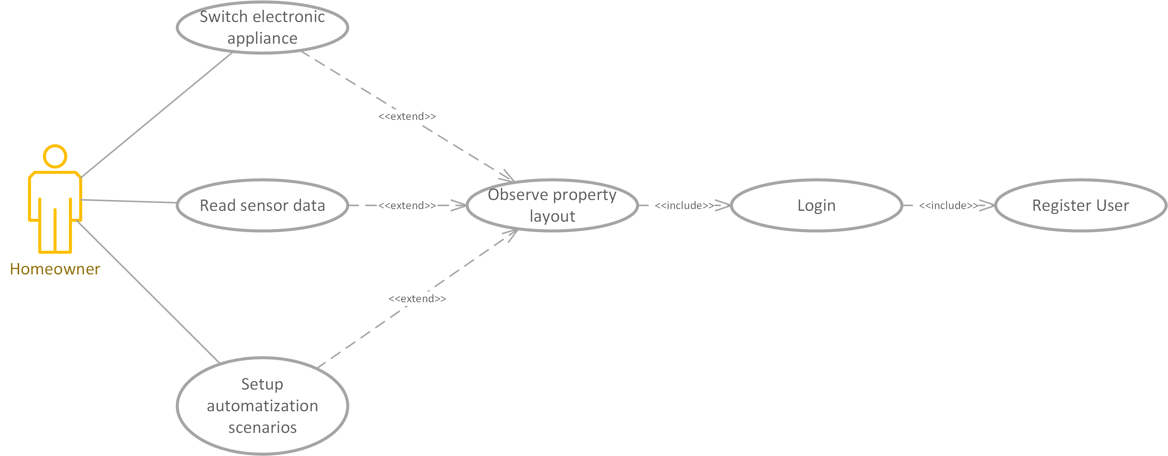
Use Cases

Slide 7
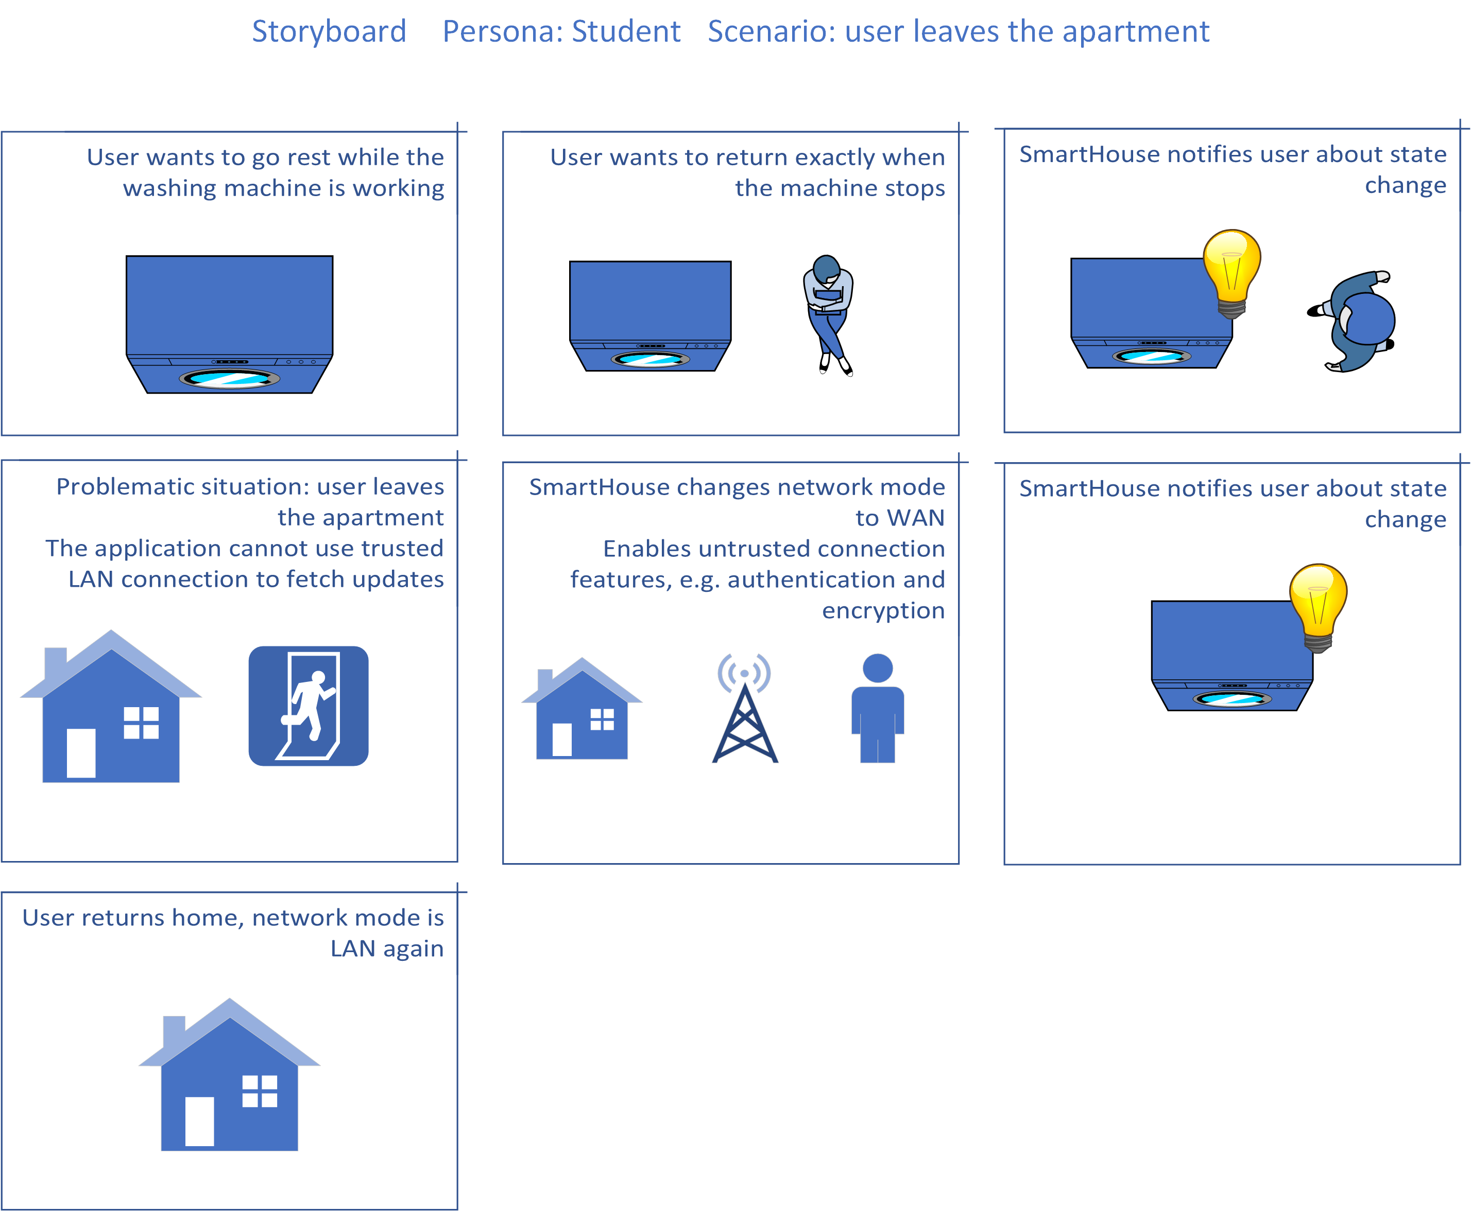
Challenge: User leaves the apartment

Slide 8
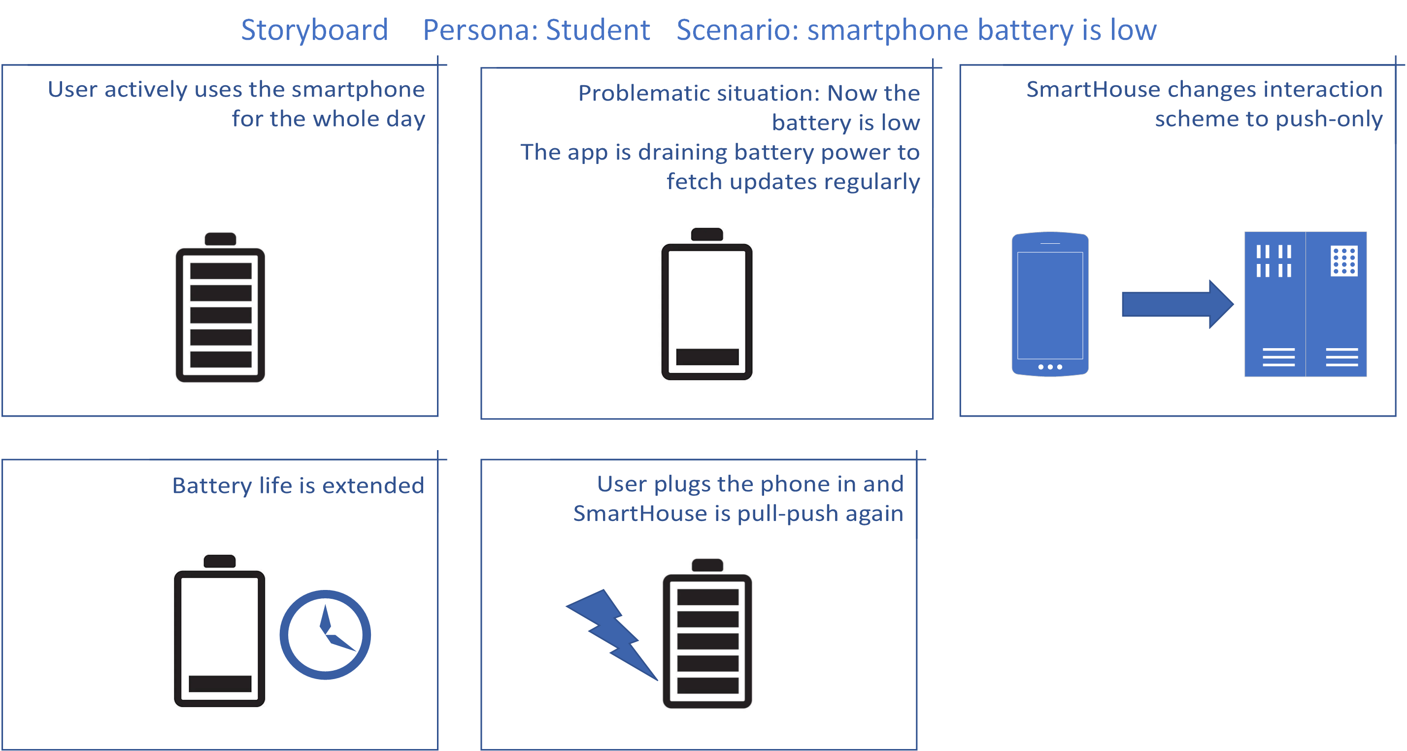
Challenge: Battery low

Slide 9
Key functions
Light control
Reading Appliance state
Remote control of appliance
Automation scenarios
Authorization. Separation of roles
Reading sensor data

Slide 10
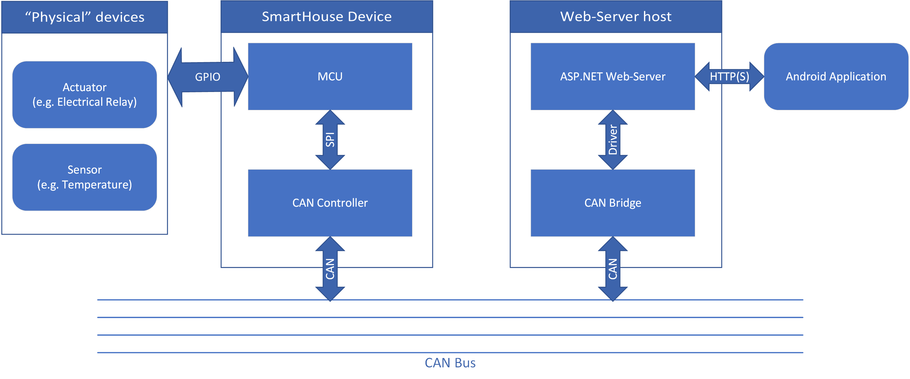
Hardware Structure diagram

Slide 11
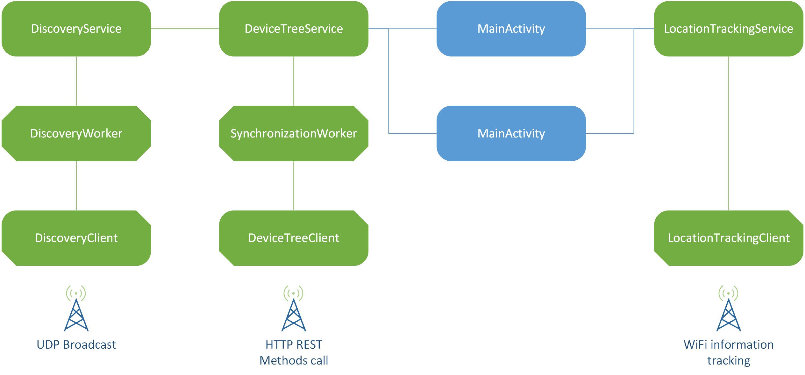
Software Component Structure diagram

Slide 12
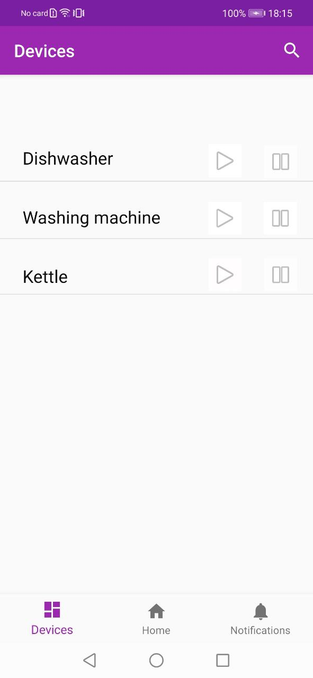
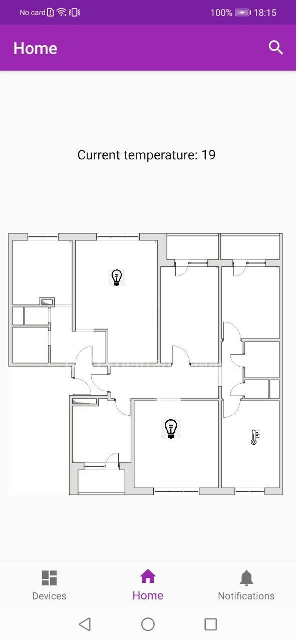
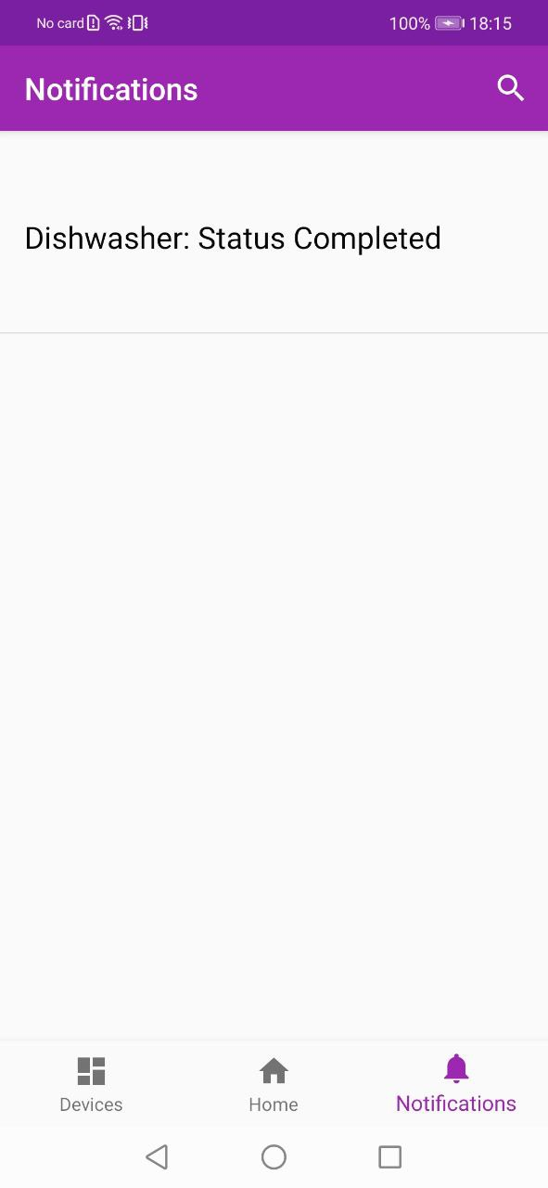
UI

Slide 13
Contributors
Dmitriy Monakhov: Backend developing
Anastasia Lykhtar: Frontend developing

