Slide 1
Improving Urban Traffic Flow with Drone Supported Vehicular Networks
final Talk by Dmitriy Monakhov

Slide 2
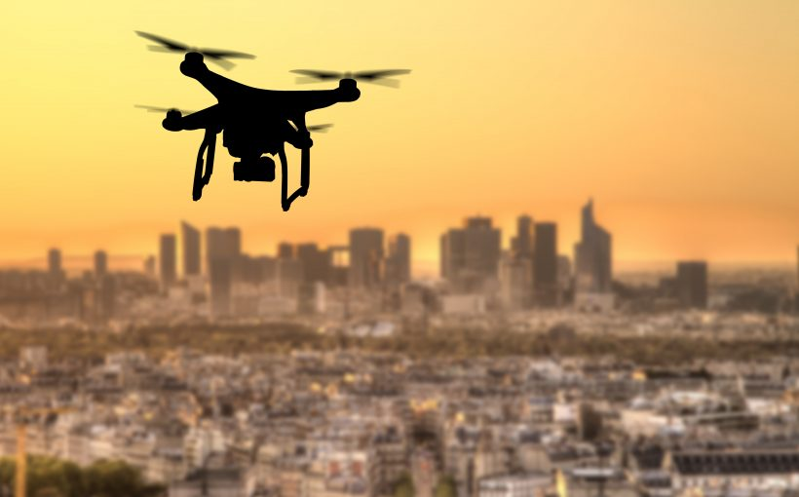
Motivation
Most recent works focus on different aspects
Very few works discuss urban environments
Source: https://www.unmannedairspace.info/uncategorized/39-cities-pioneering-urban-drone-operations/

Slide 3
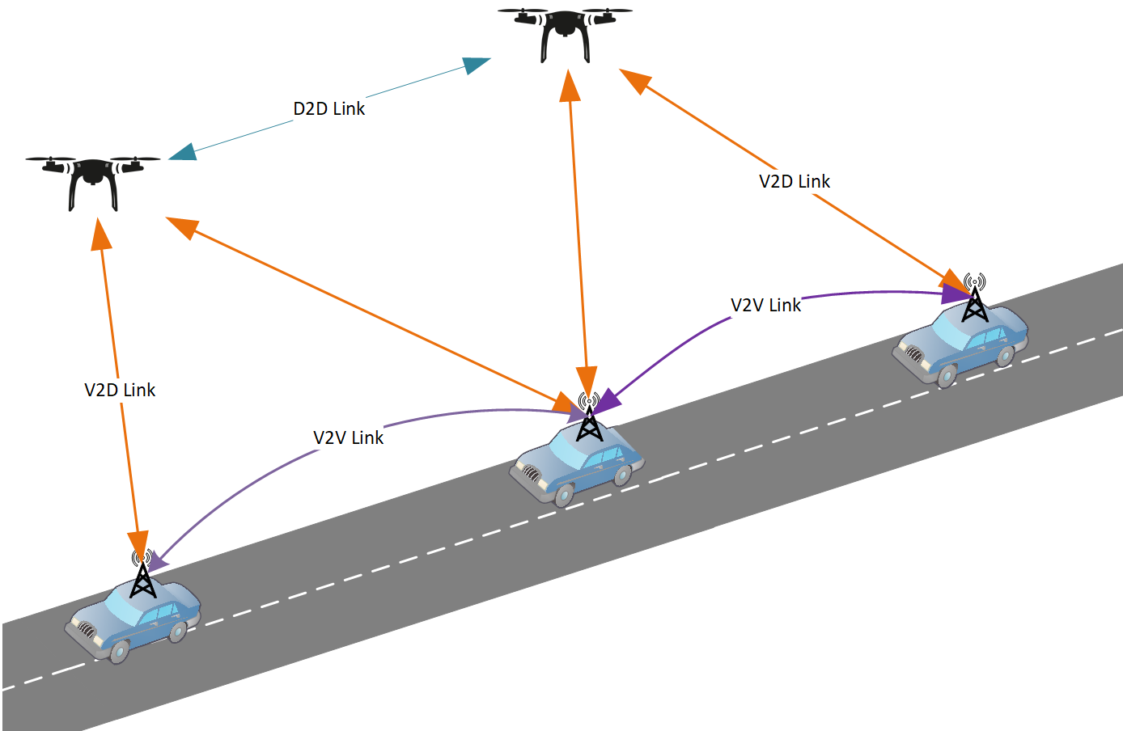
Goals
Simulate DAVN in a dense city region
Simulate traffic jams
Measure traffic flow with and without drones
Assess drone effects

Slide 4
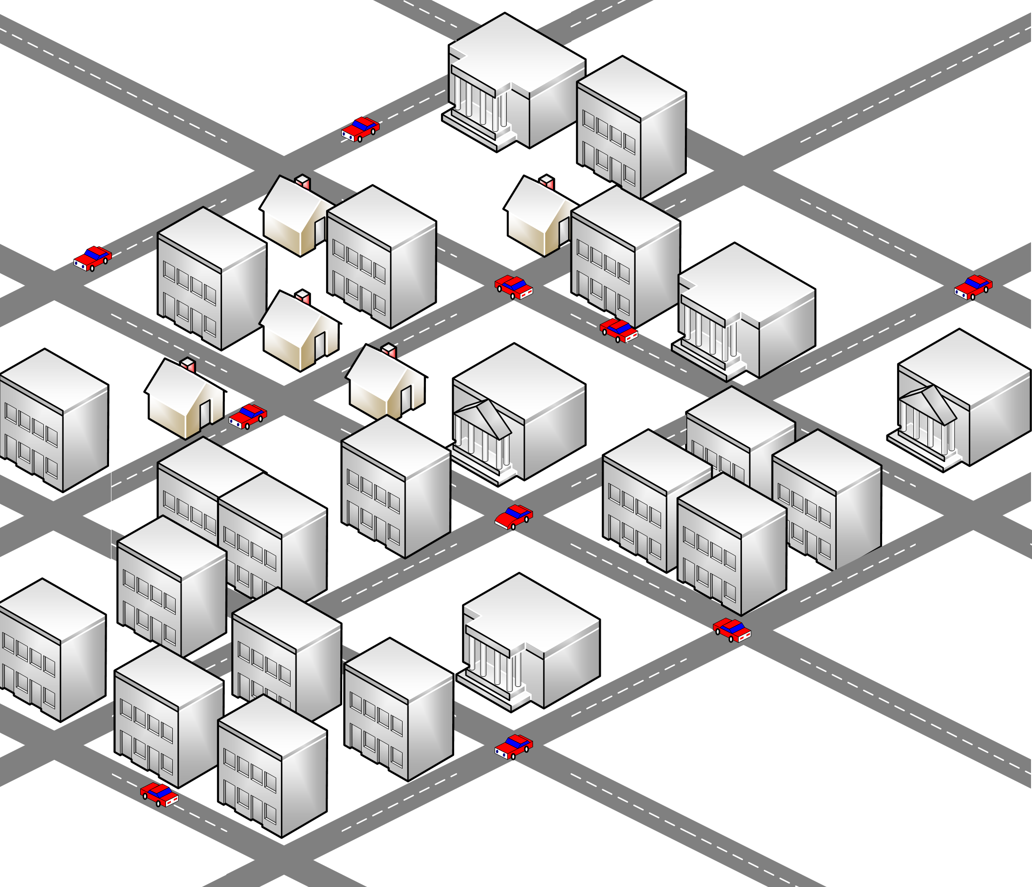
Implementation: setup
Manhattan Grid
Vehicles follow random routes
Some vehicles break down and block the road
Broken vehicles send broadcasts
Other vehicles change route and rebroadcast

Slide 5
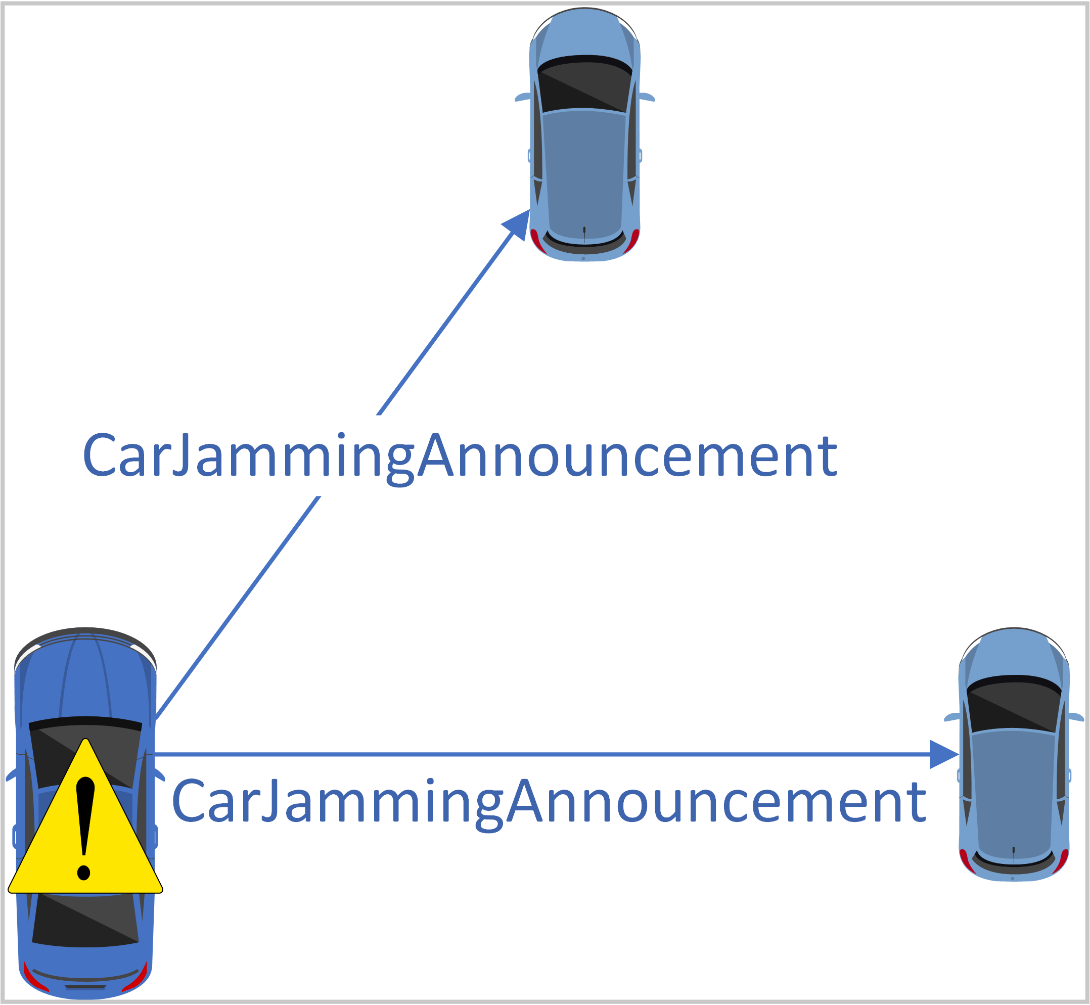
Implementation: protocol
Manhattan Grid
Vehicles follow random routes
Some vehicles break down and block the road
Broken vehicles send broadcasts
Other vehicles change route and rebroadcast

Slide 6
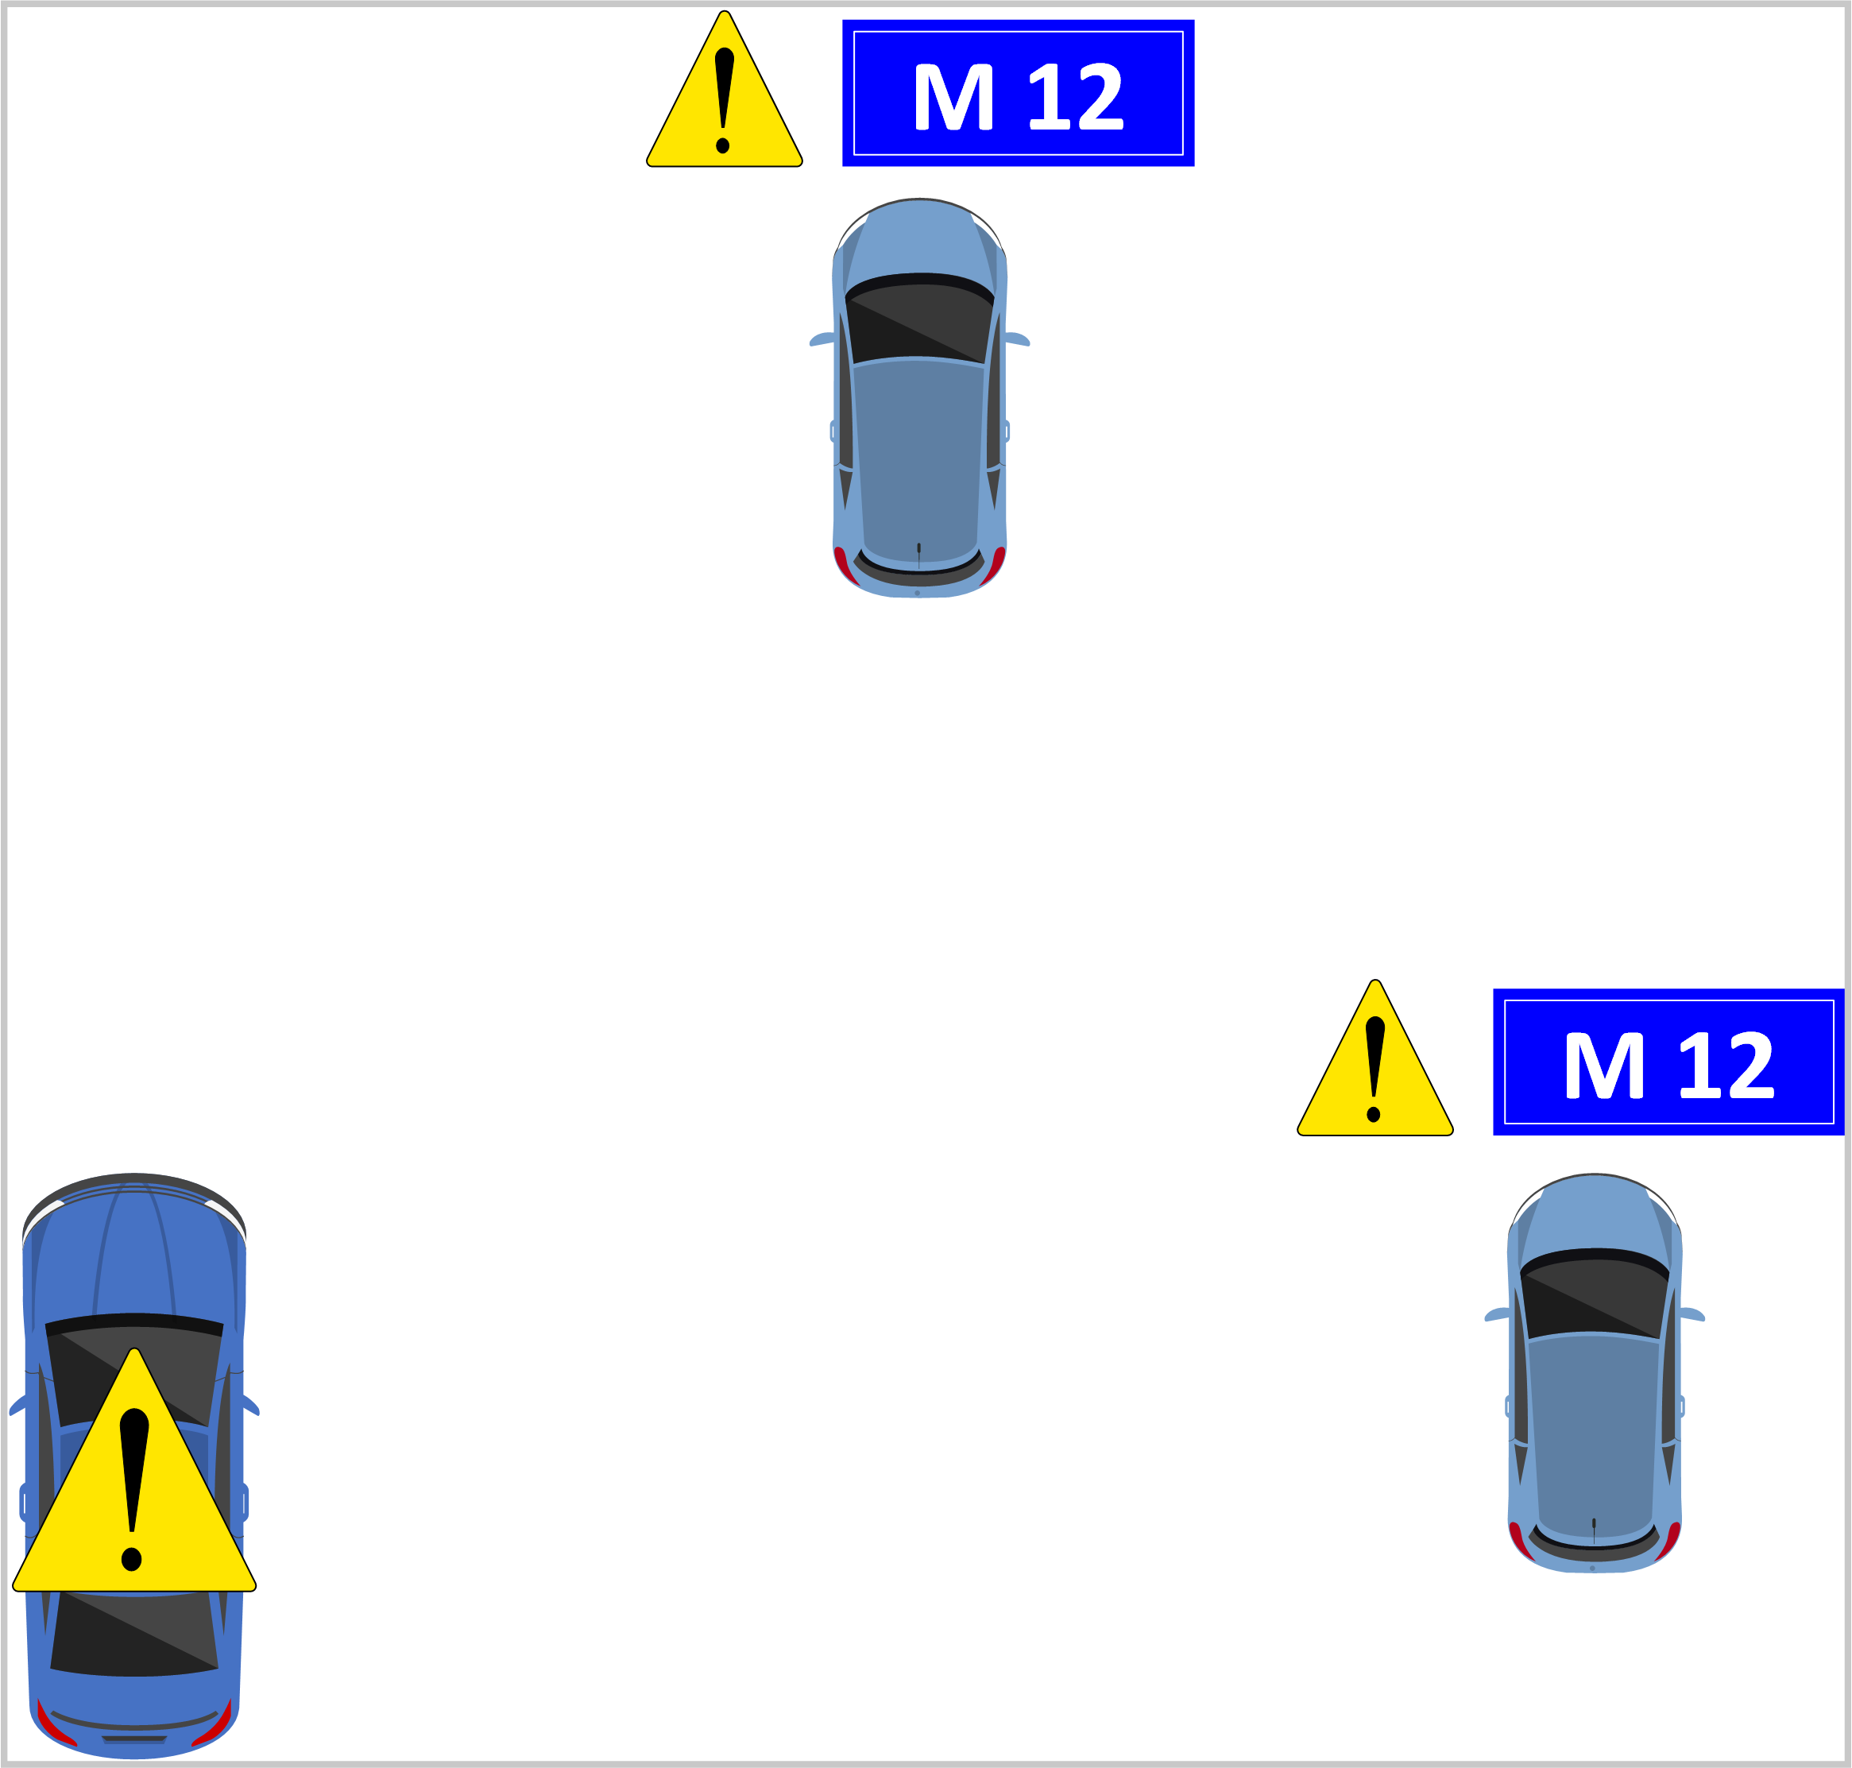
Implementation: protocol
Manhattan Grid
Vehicles follow random routes
Some vehicles break down and block the road
Broken vehicles send broadcasts
Other vehicles change route and rebroadcast

Slide 7
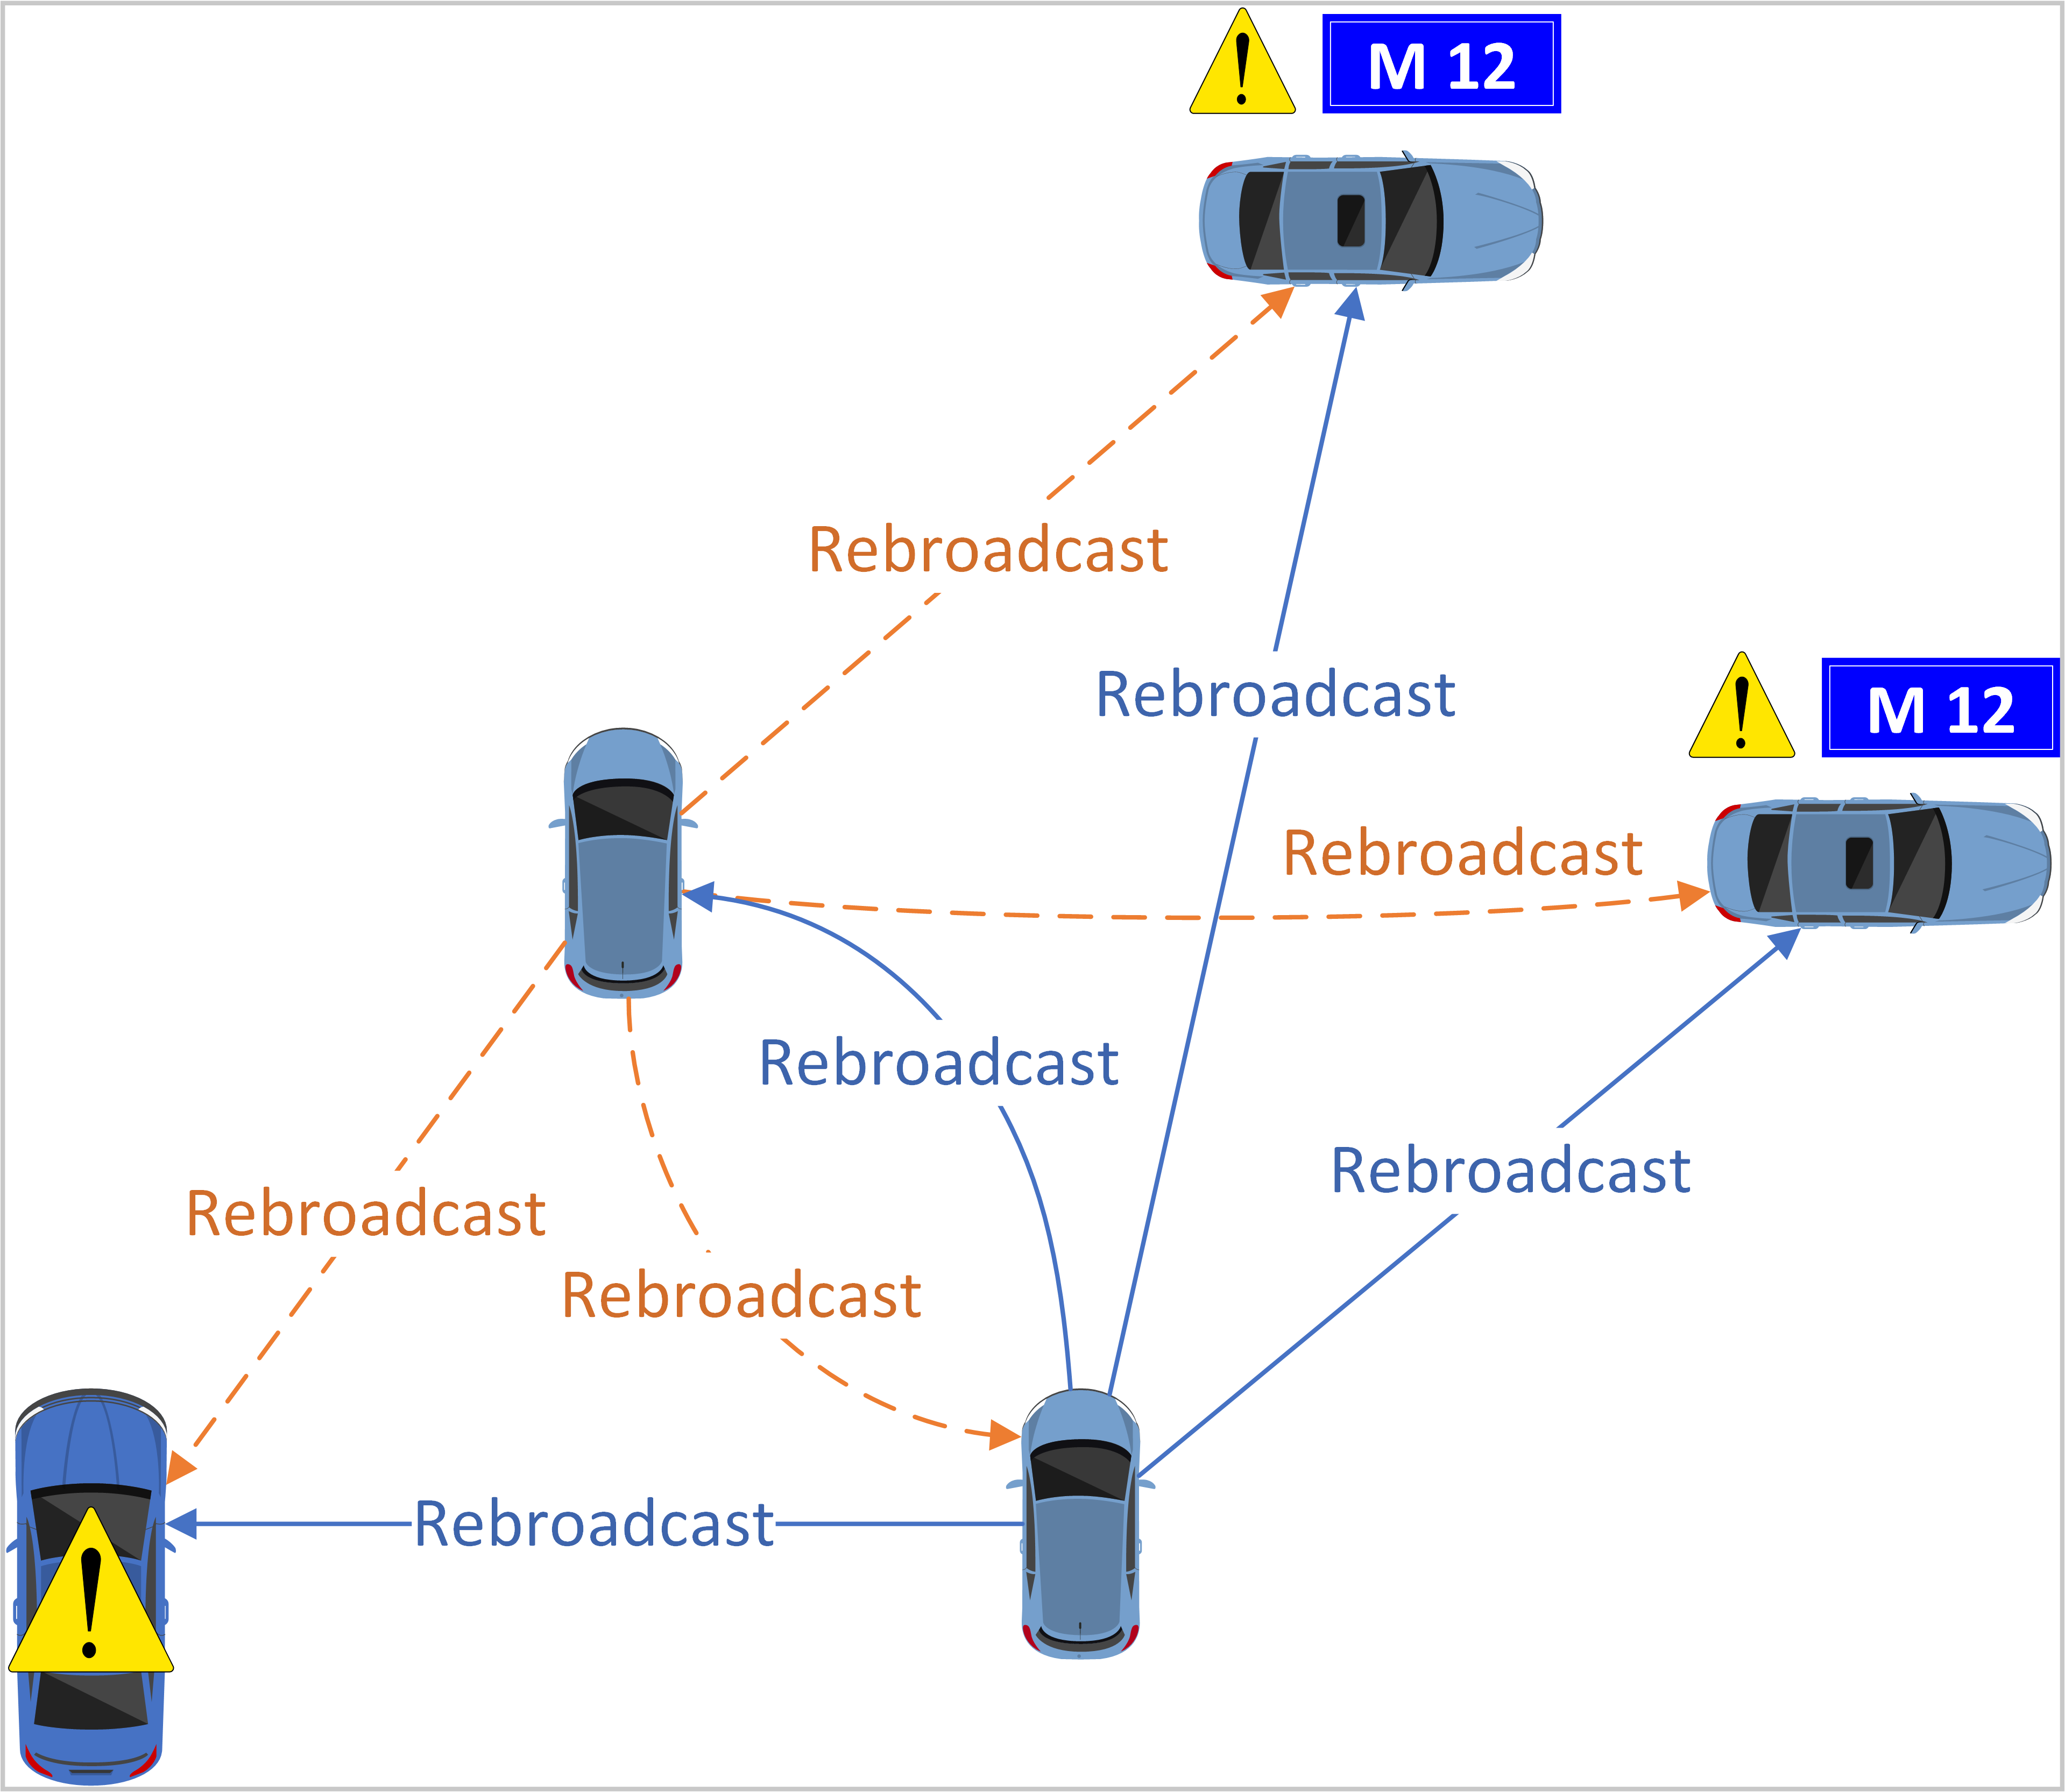
Implementation: protocol
Manhattan Grid
Vehicles follow random routes
Some vehicles break down and block the road
Broken vehicles send broadcasts
Other vehicles change route and rebroadcast

Slide 8
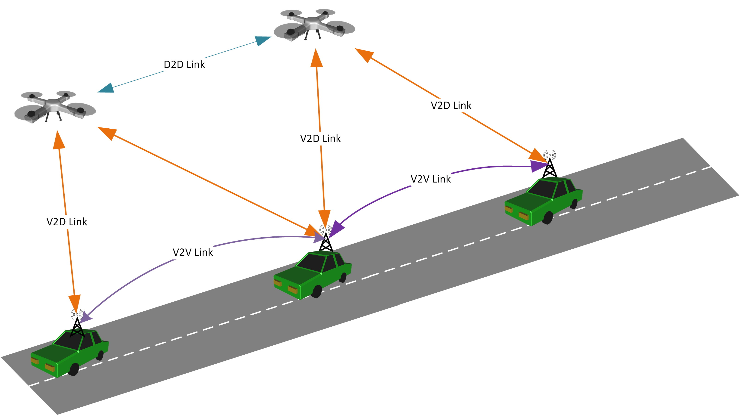
Implementation: drones
Drones reuse vehicles’ protocol
Drones fly opportunistically above buildings (average altitude: 175 m)
Drones rebroadcast messages from vehicles and other drones

Slide 9
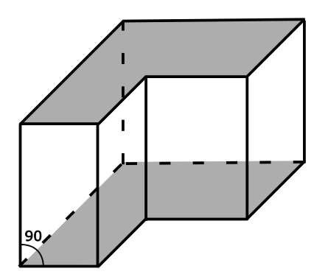
Implementation: 3D Shadowing
Buildings are approximated as right prisms
Calculates line-prism intersection points
Reuses existing Veins infrastructure

Slide 10
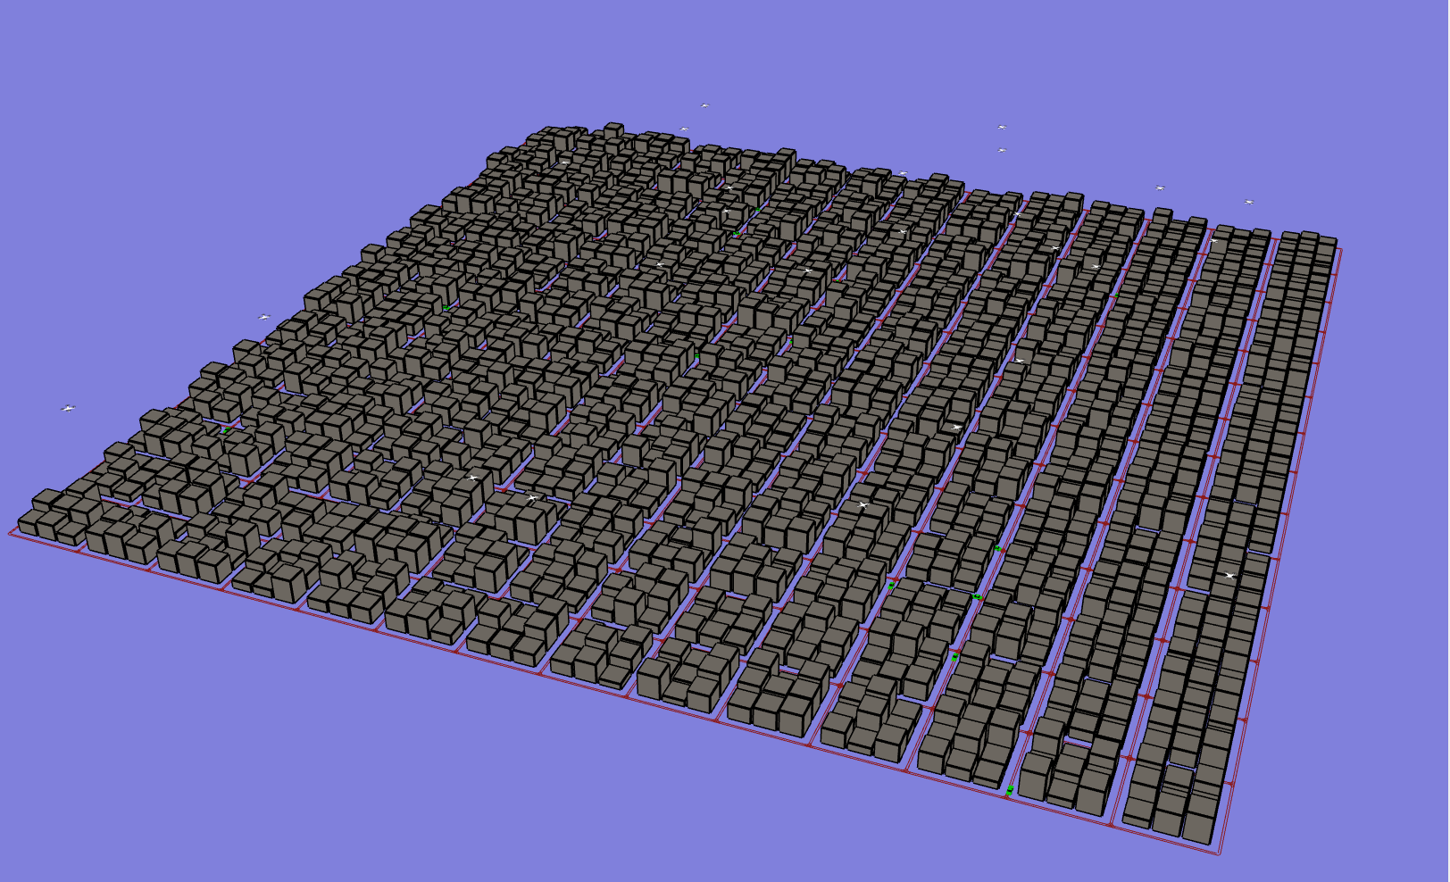
Implementation: visualization

Slide 11
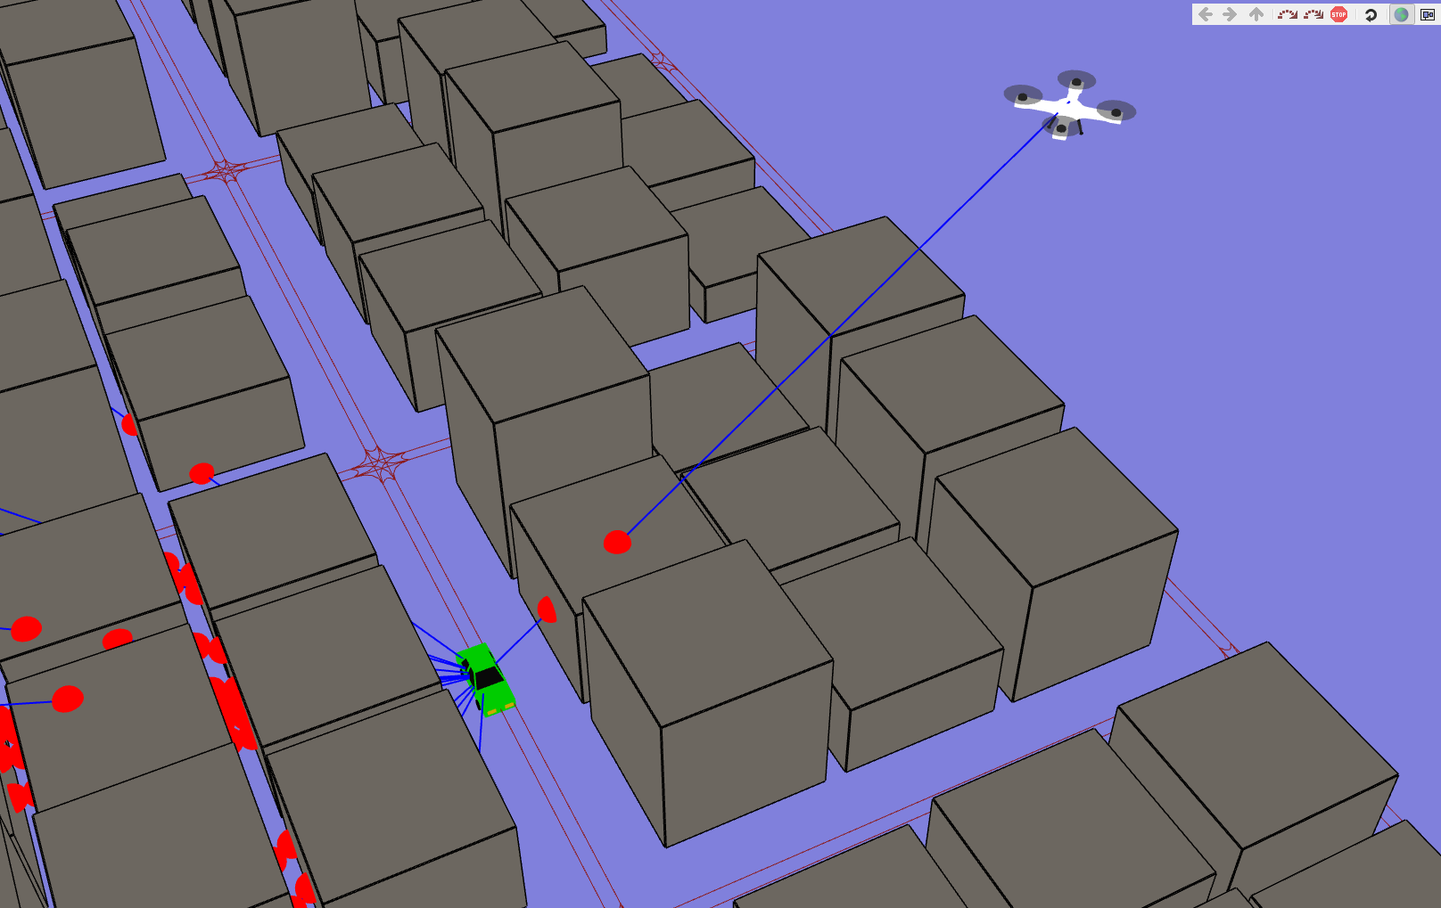
Implementation: visualization

Slide 12
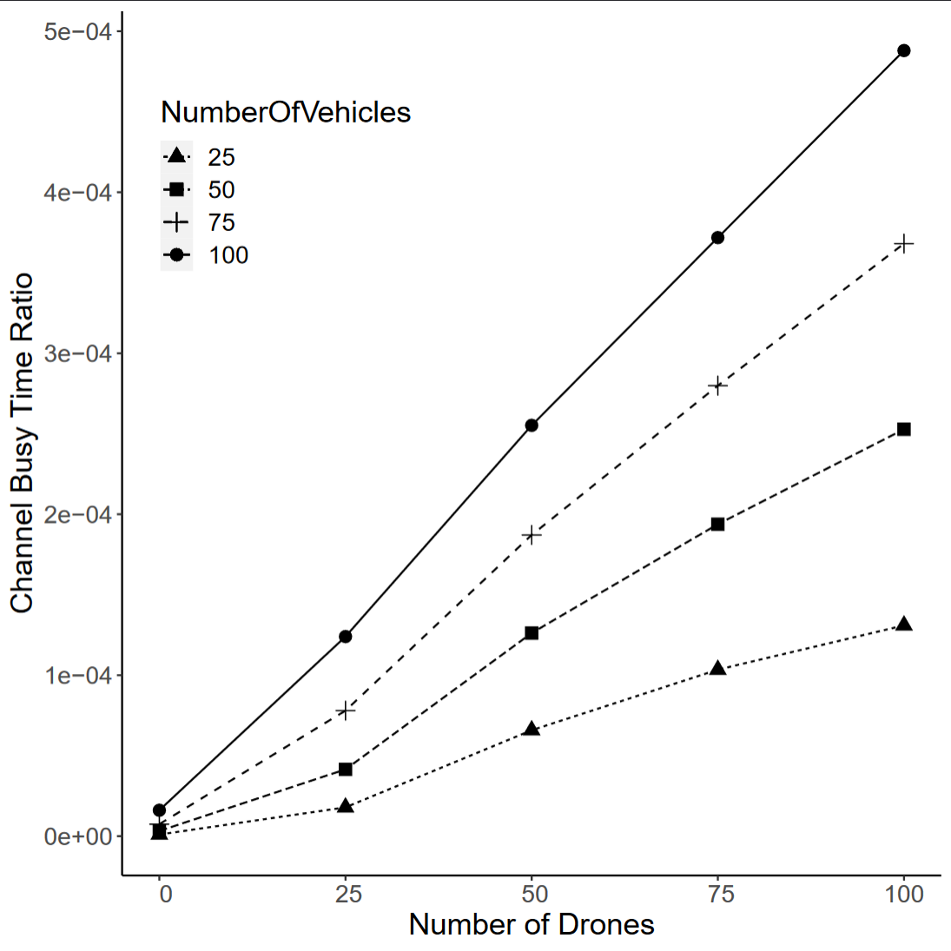
Broadcast storm suppression
Weighted p-persistence algorithm
Different parameters for drones and vehicles
Channel busy-time ratio low in all cases

Slide 13
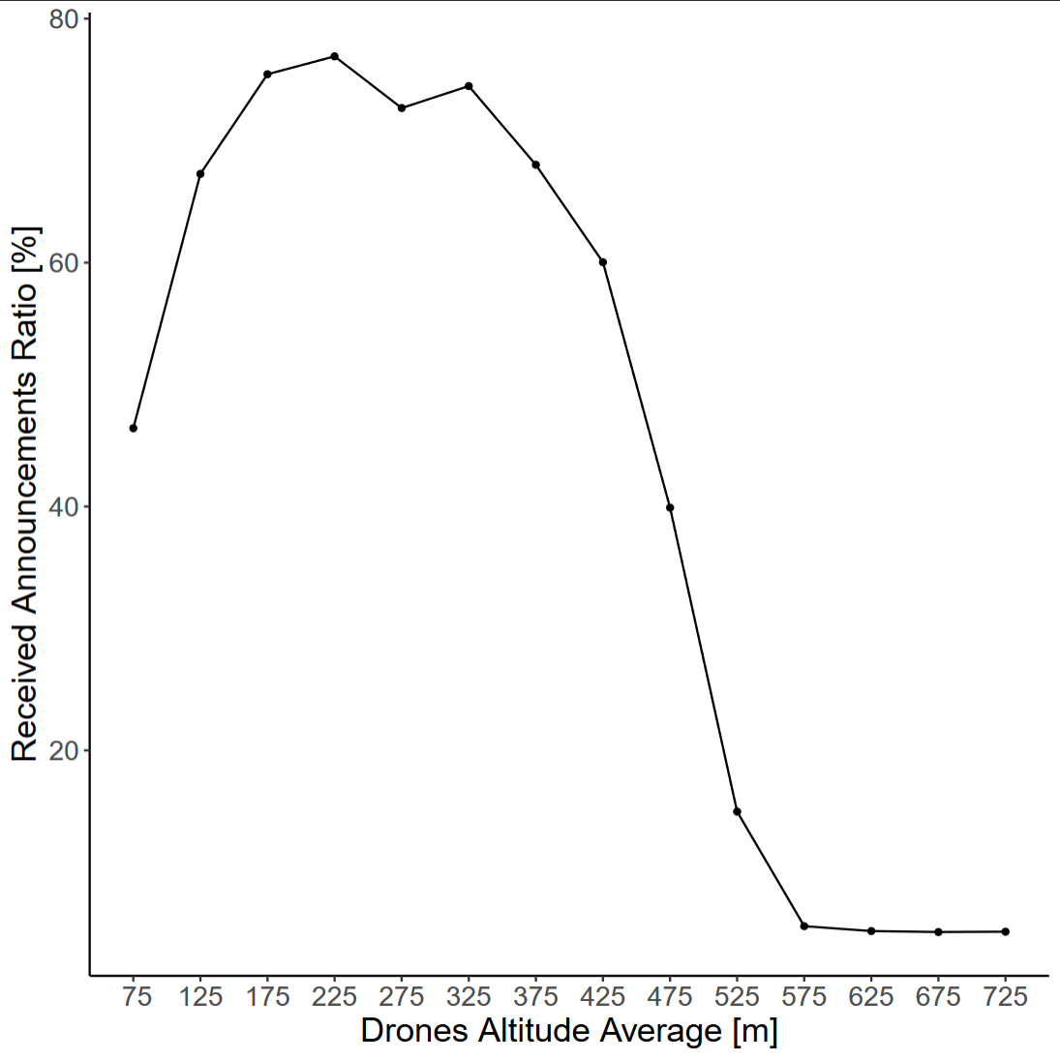
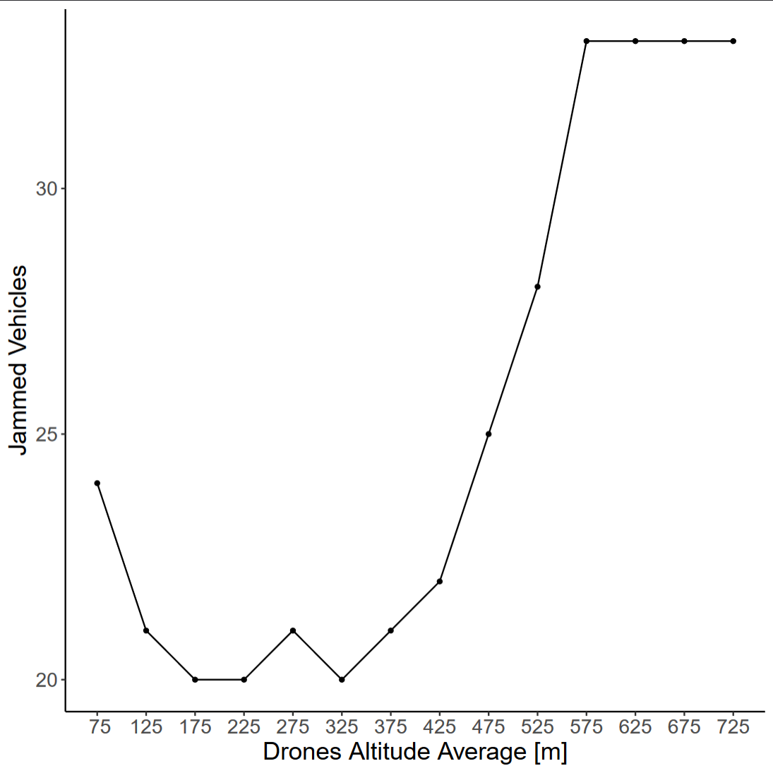
Drone flight altitude

Slide 14
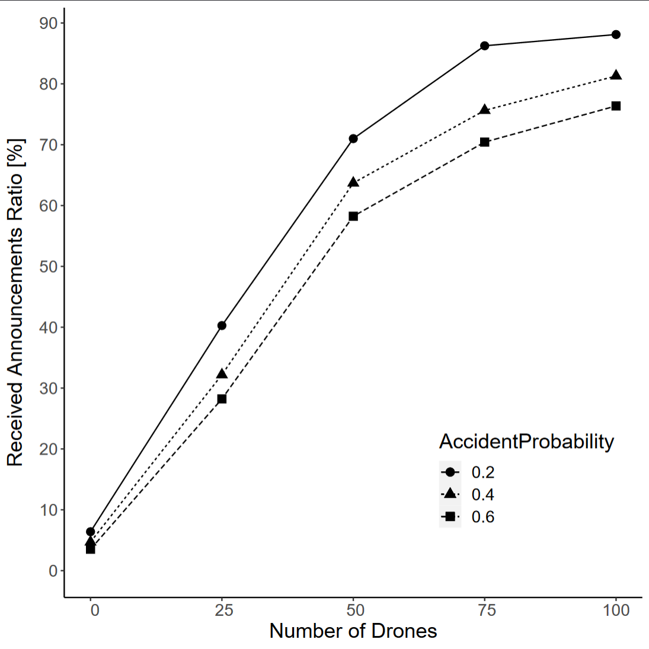
Evaluation
Can be used as connectivity metric
Connectivity increases when number of drones is rising
Accident probability has negative impact

Slide 15
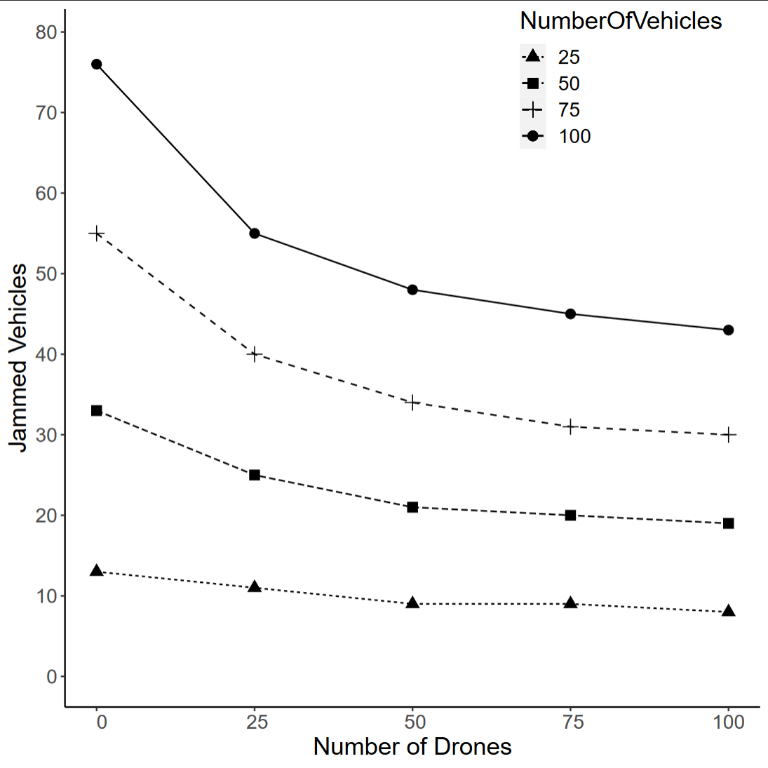
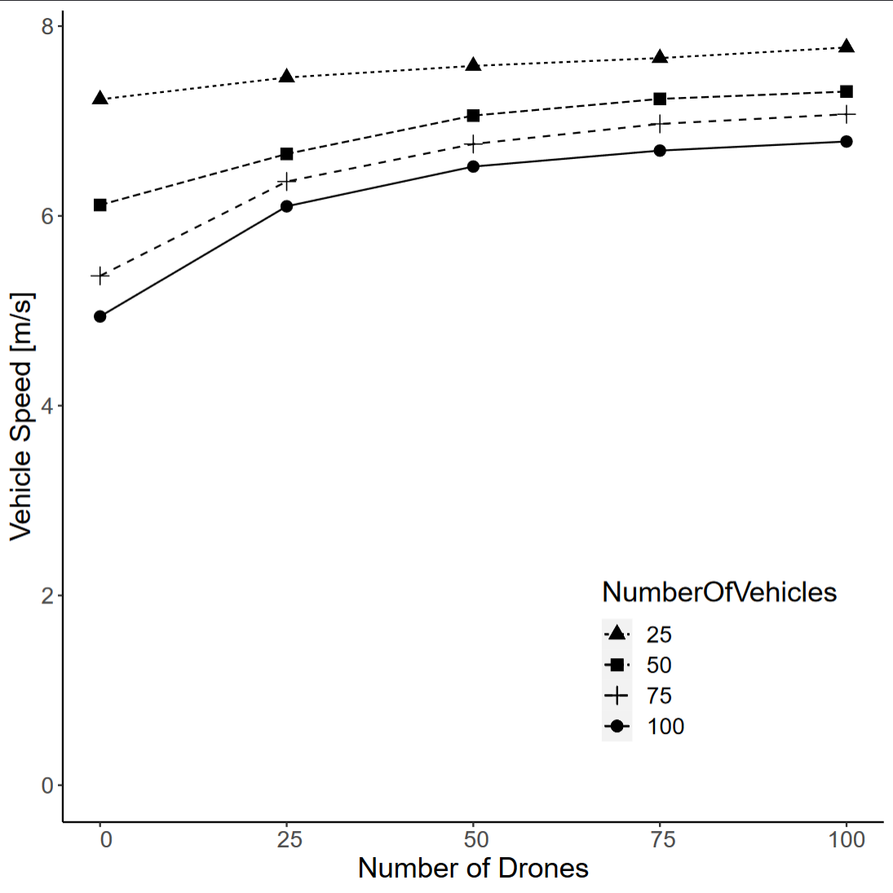
Evaluation: traffic flow improvement
Accident probability is fixed: 30%

