Slide 1
Improving Urban Traffic Flow with Drone Supported Vehicular Networks
final Talk by Dmitriy Monakhov

Slide 2
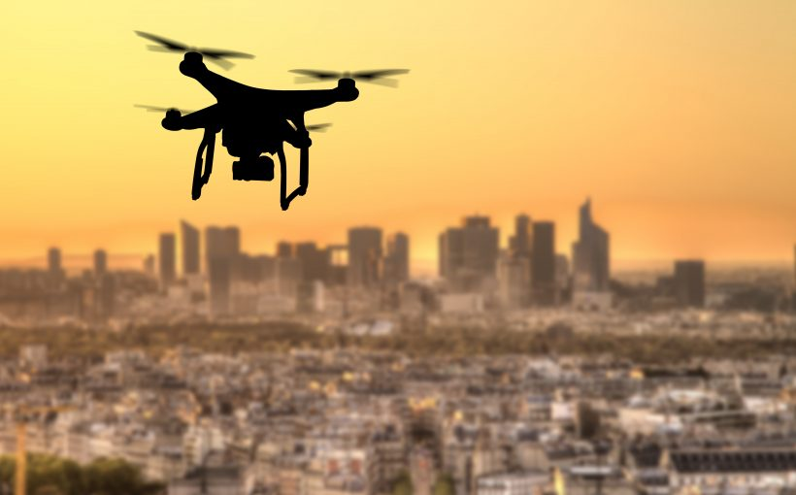
Motivation: why DAVNs?
Drones can improve communication in VANETs
Drones maintain line-of-sight easier
Drones avoid radio obstacles
Source: https://www.unmannedairspace.info/uncategorized/39-cities-pioneering-urban-drone-operations/

Slide 3
Motivation: related works
Most recent works focus on different aspects
Very few works discuss urban environments
Source: https://www.unmannedairspace.info/uncategorized/39-cities-pioneering-urban-drone-operations/

Slide 4
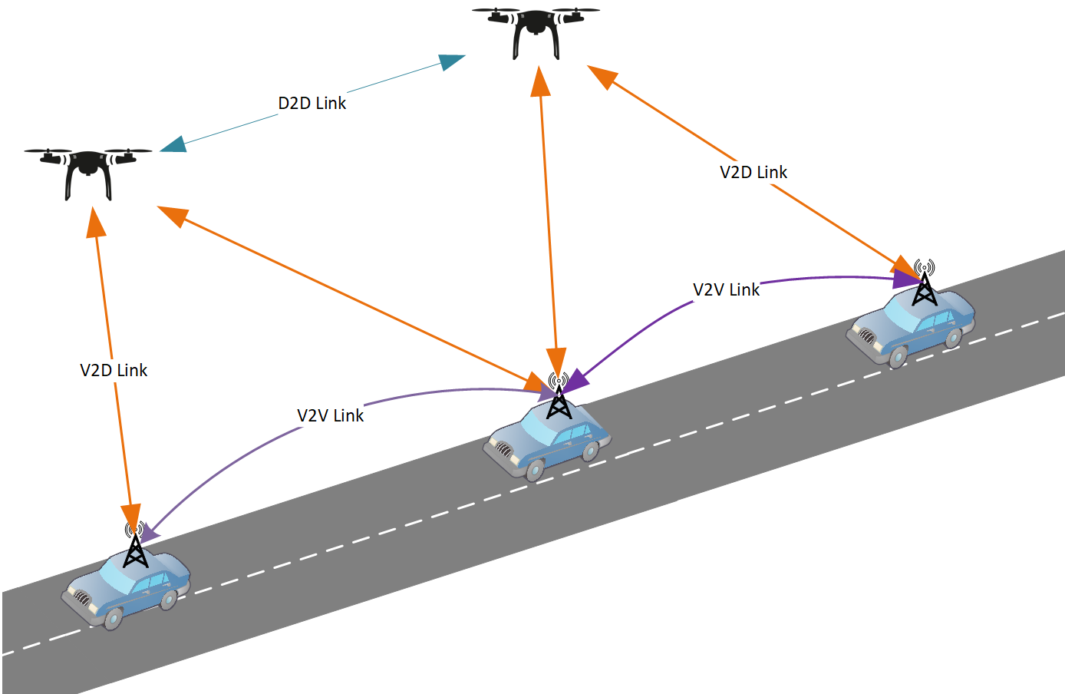
Goals
Simulate DAVN in a dense city region
Simulate traffic jams
Measure traffic flow with and without drones
Assess drone effects

Slide 5
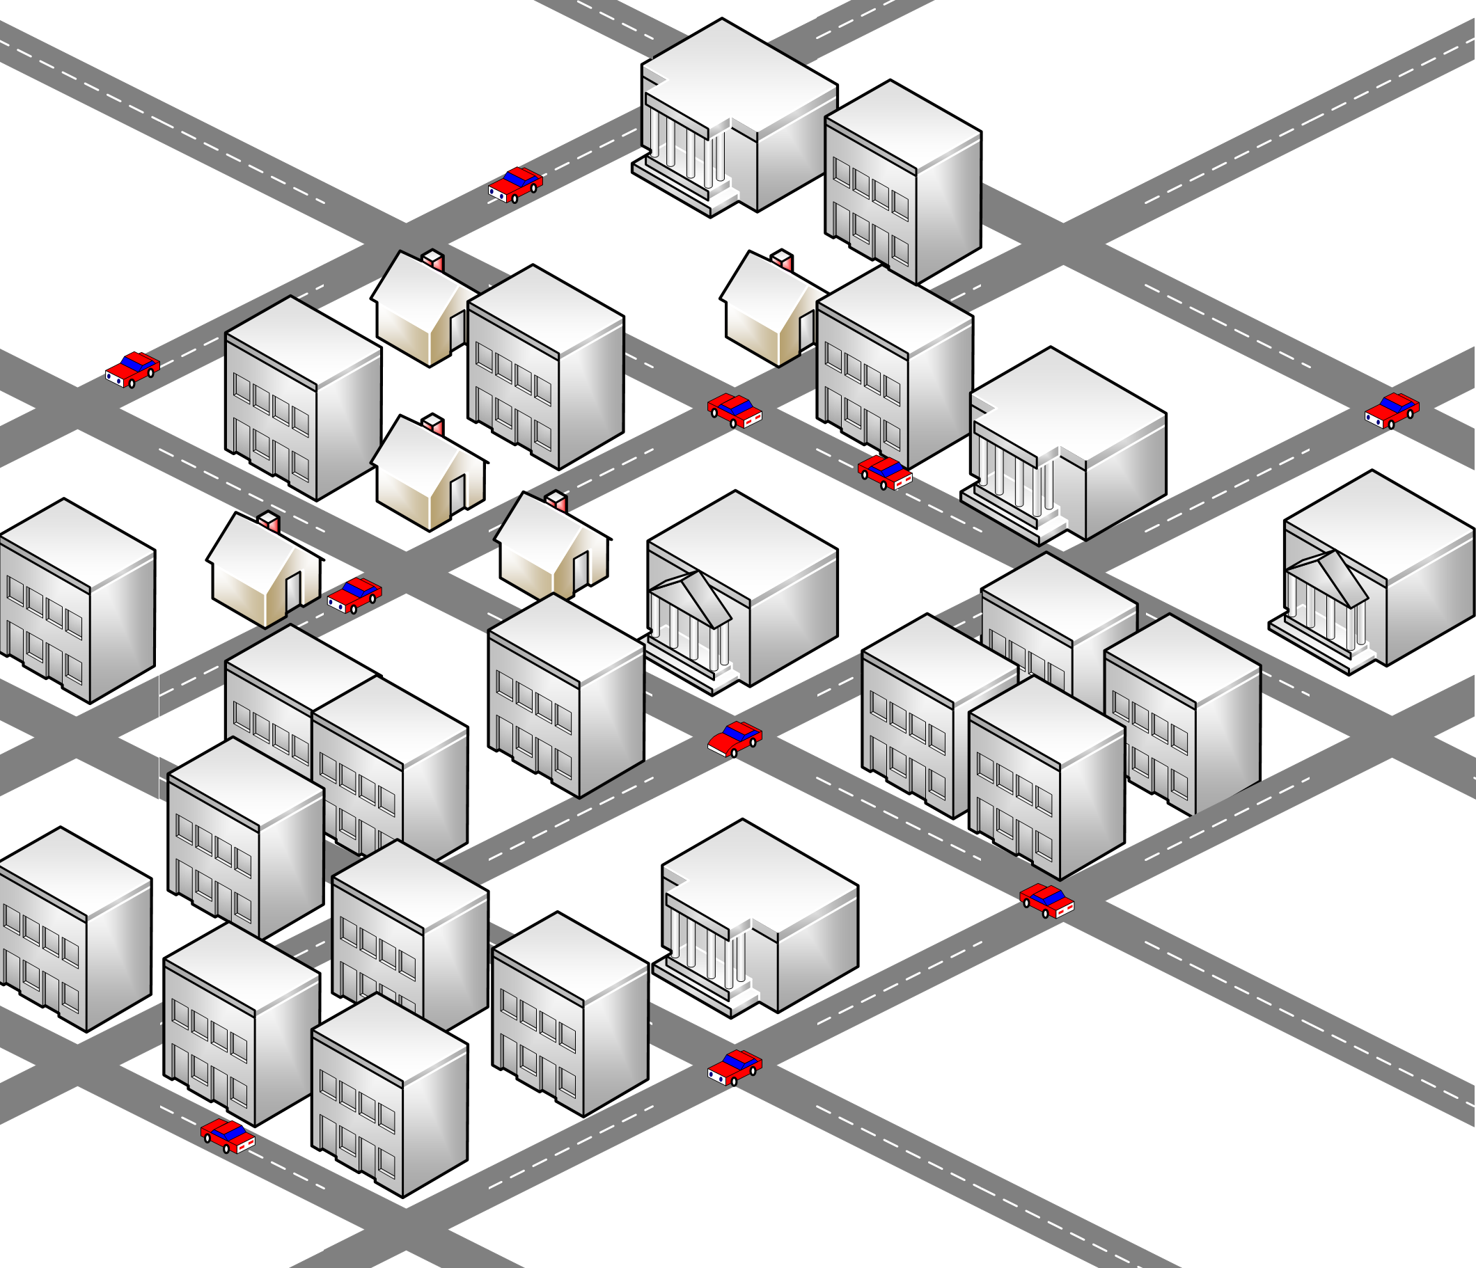
Implementation: setup
Manhattan Grid
Vehicles follow random routes
Some vehicles break down and block the road
Broken vehicles send broadcasts
Other vehicles change route and rebroadcast

Slide 6
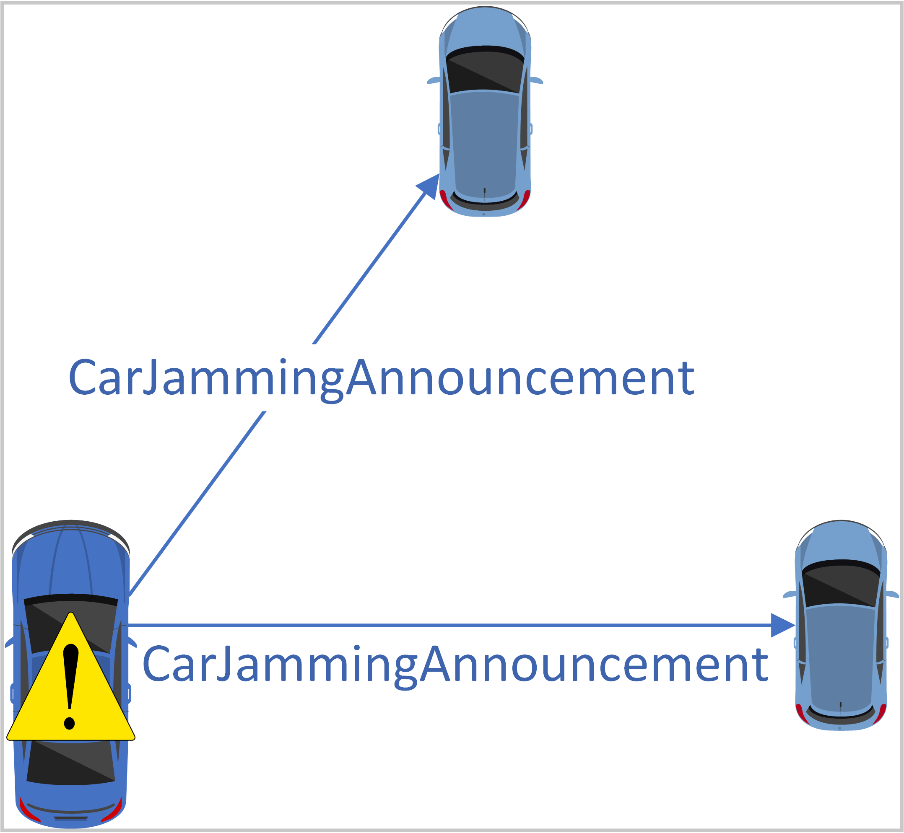
Implementation: protocol
Manhattan Grid
Vehicles follow random routes
Some vehicles break down and block the road
Broken vehicles send broadcasts
Other vehicles change route and rebroadcast

Slide 7
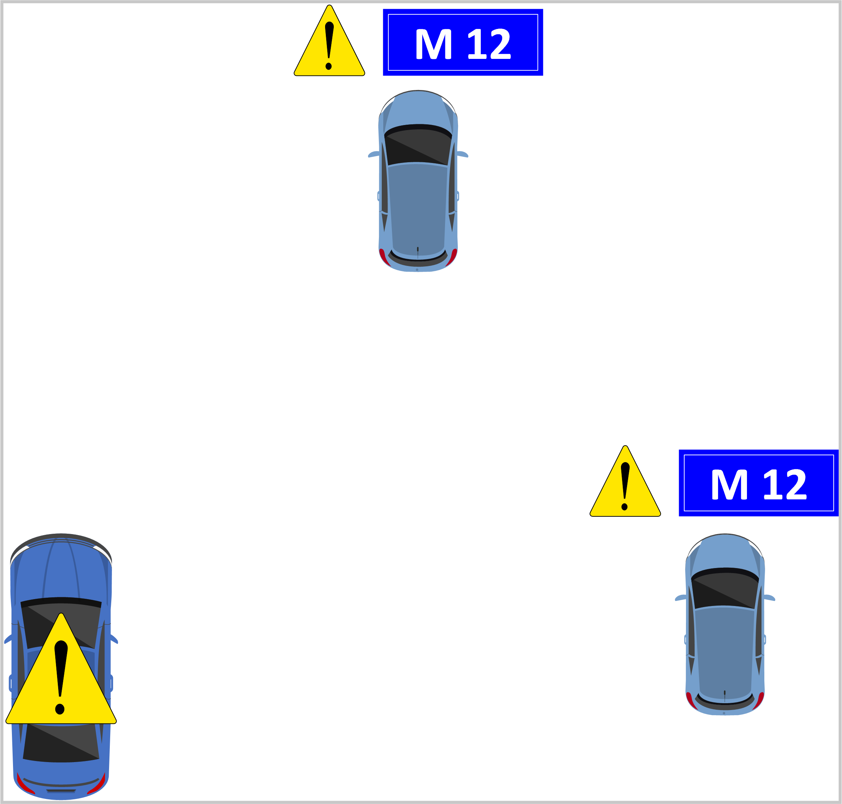
Implementation: protocol
Manhattan Grid
Vehicles follow random routes
Some vehicles break down and block the road
Broken vehicles send broadcasts
Other vehicles change route and rebroadcast

Slide 8
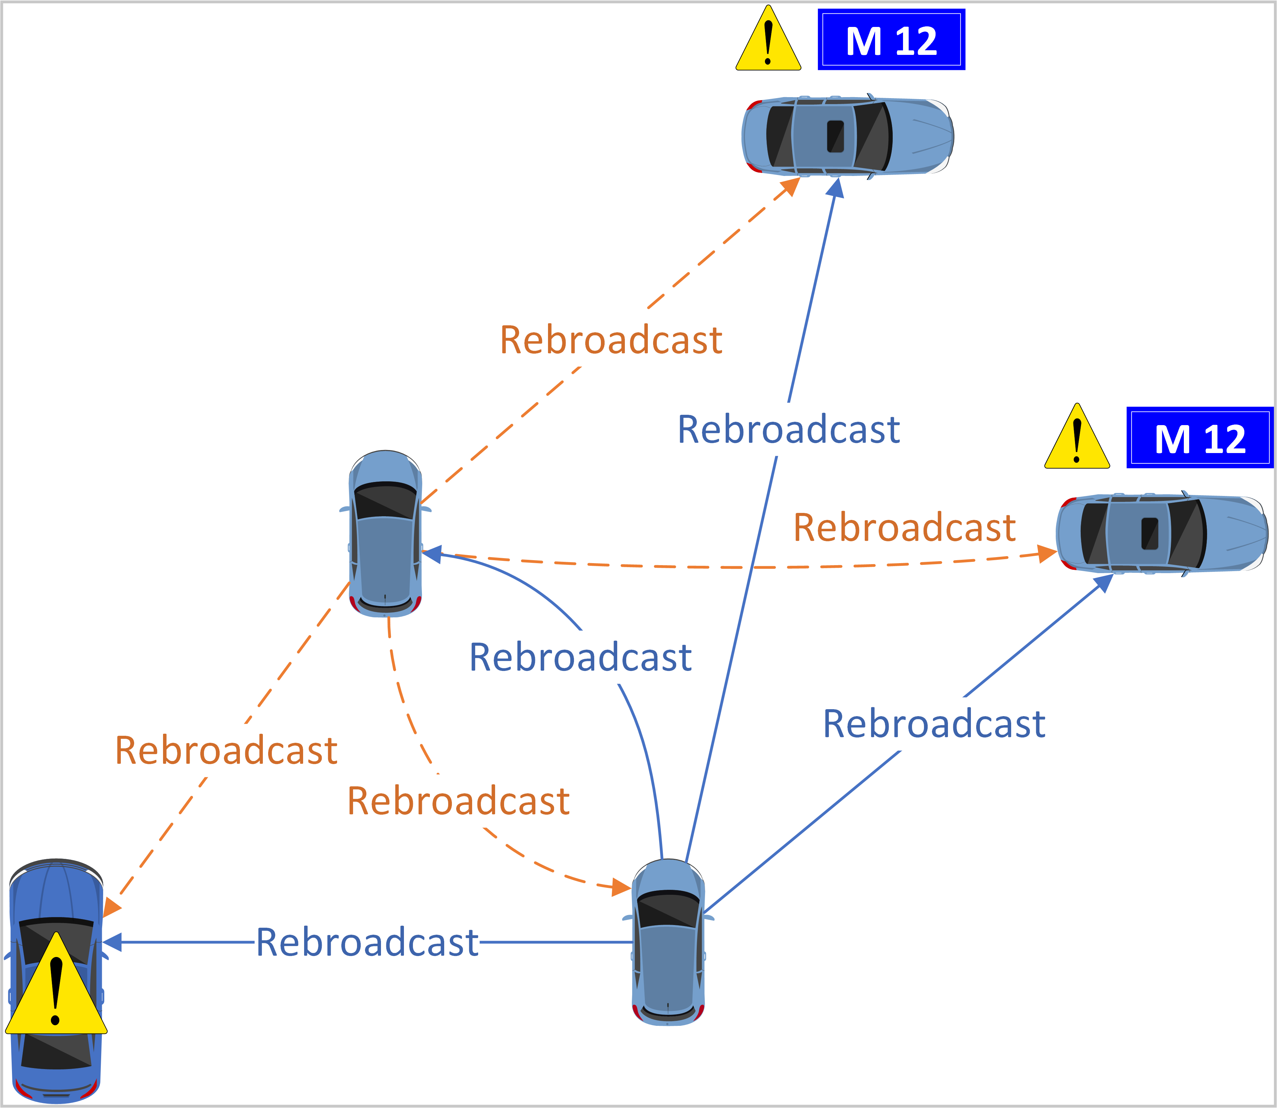
Implementation: protocol
Manhattan Grid
Vehicles follow random routes
Some vehicles break down and block the road
Broken vehicles send broadcasts
Other vehicles change route and rebroadcast

Slide 9
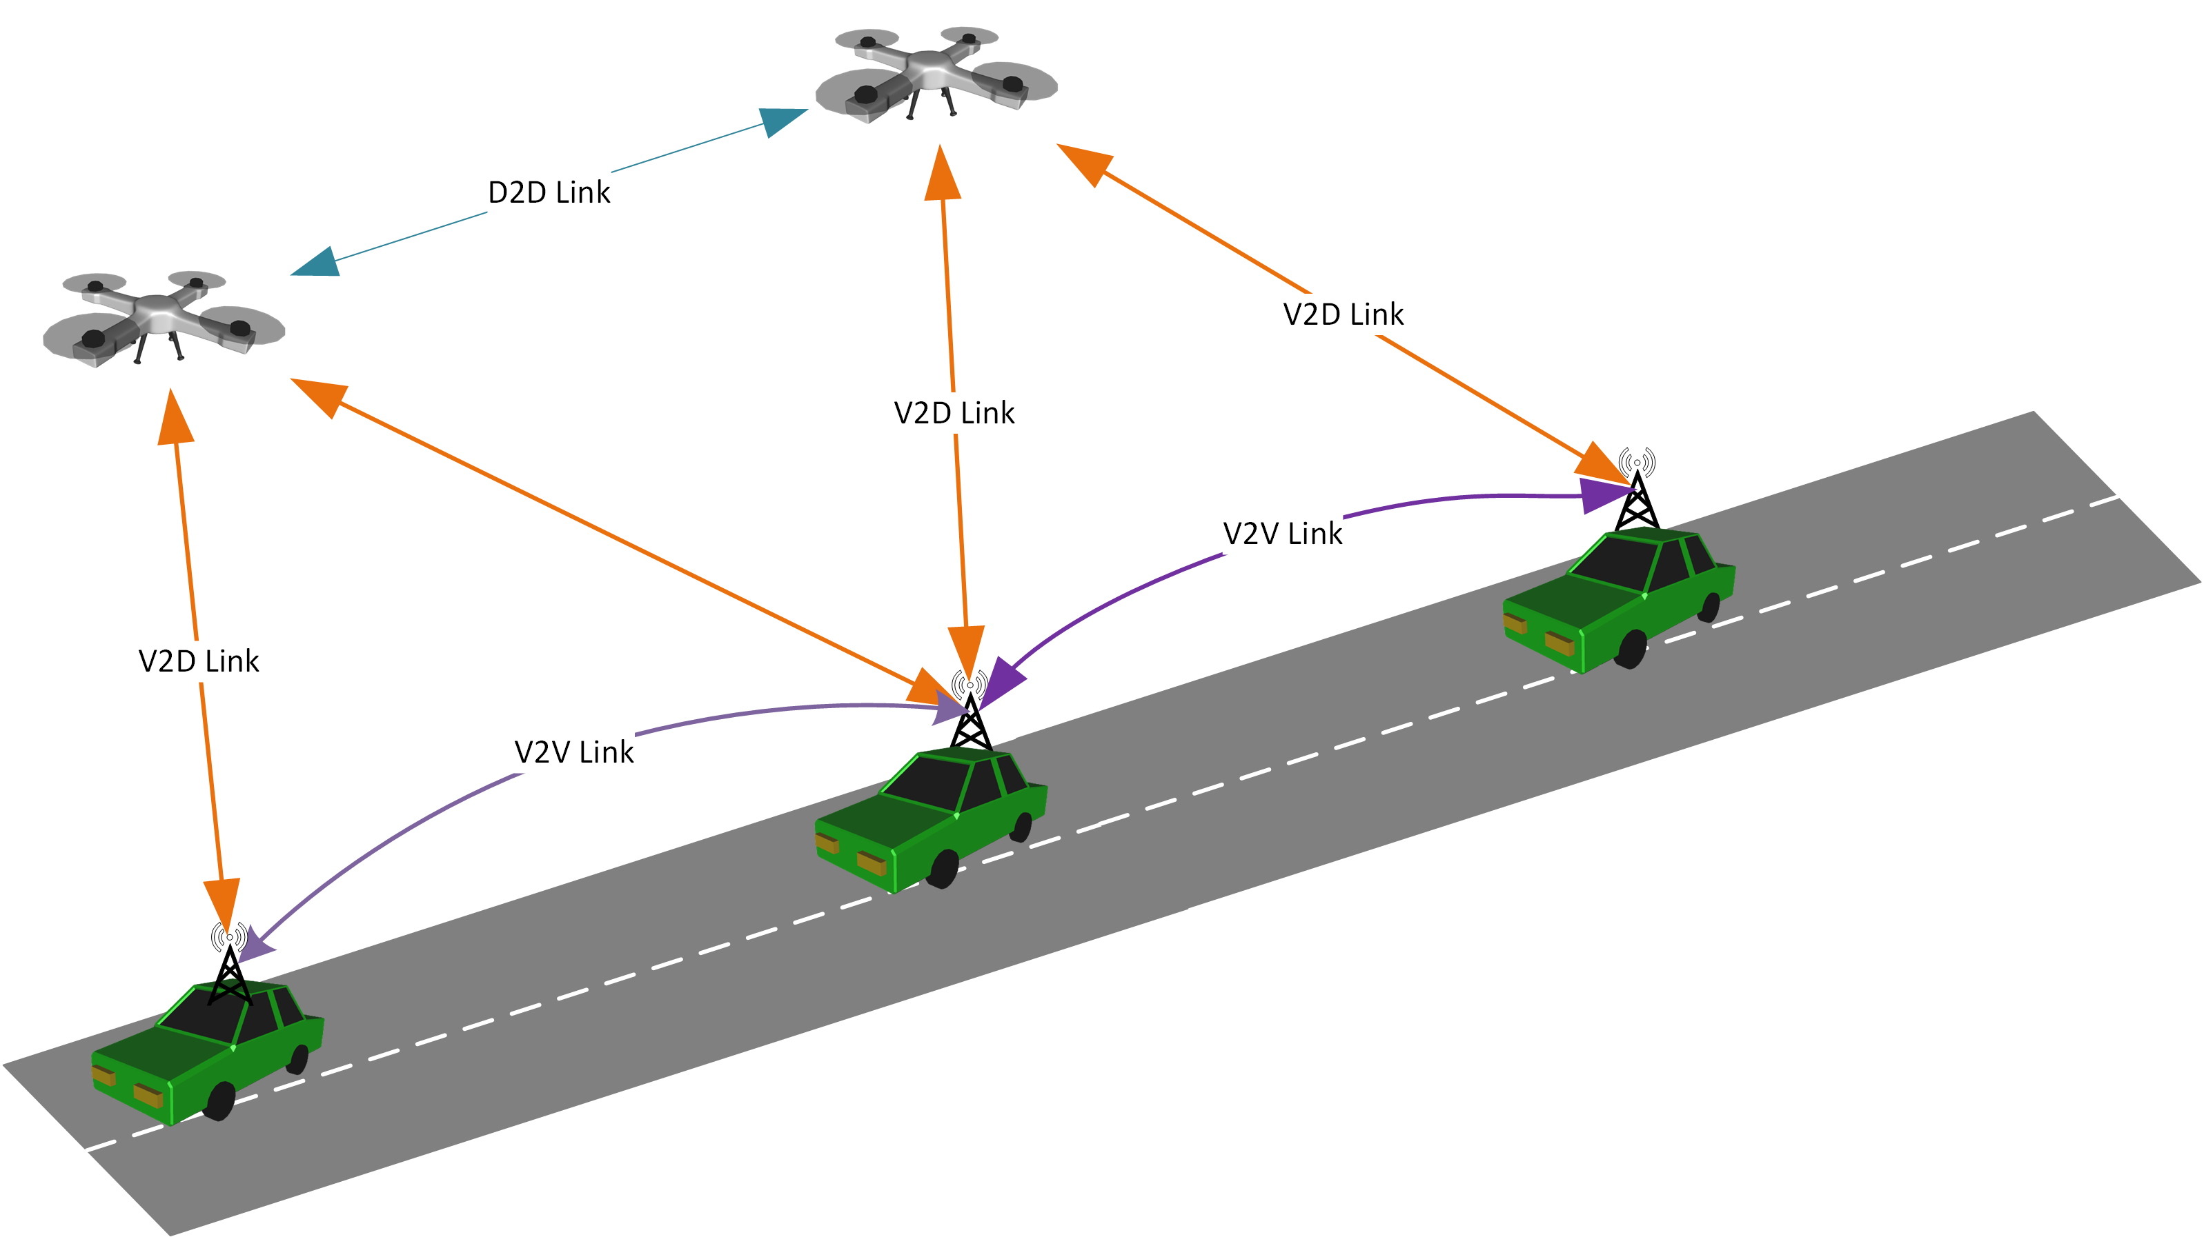
Implementation: drones
Drones reuse vehicles’ protocol
Drones fly opportunistically above buildings (average altitude: 175 m)
Drones rebroadcast messages from vehicles and other drones

Slide 10
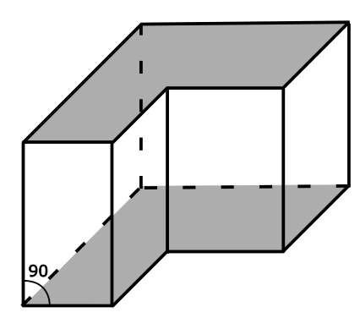
Implementation: 3D Shadowing
Buildings are approximated as right prisms
Calculates line-prism intersection points
Reuses existing Veins infrastructure

Slide 11
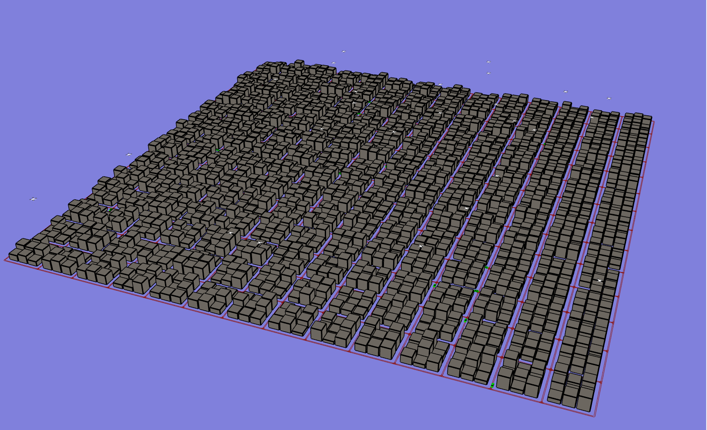
Implementation: visualization

Slide 12
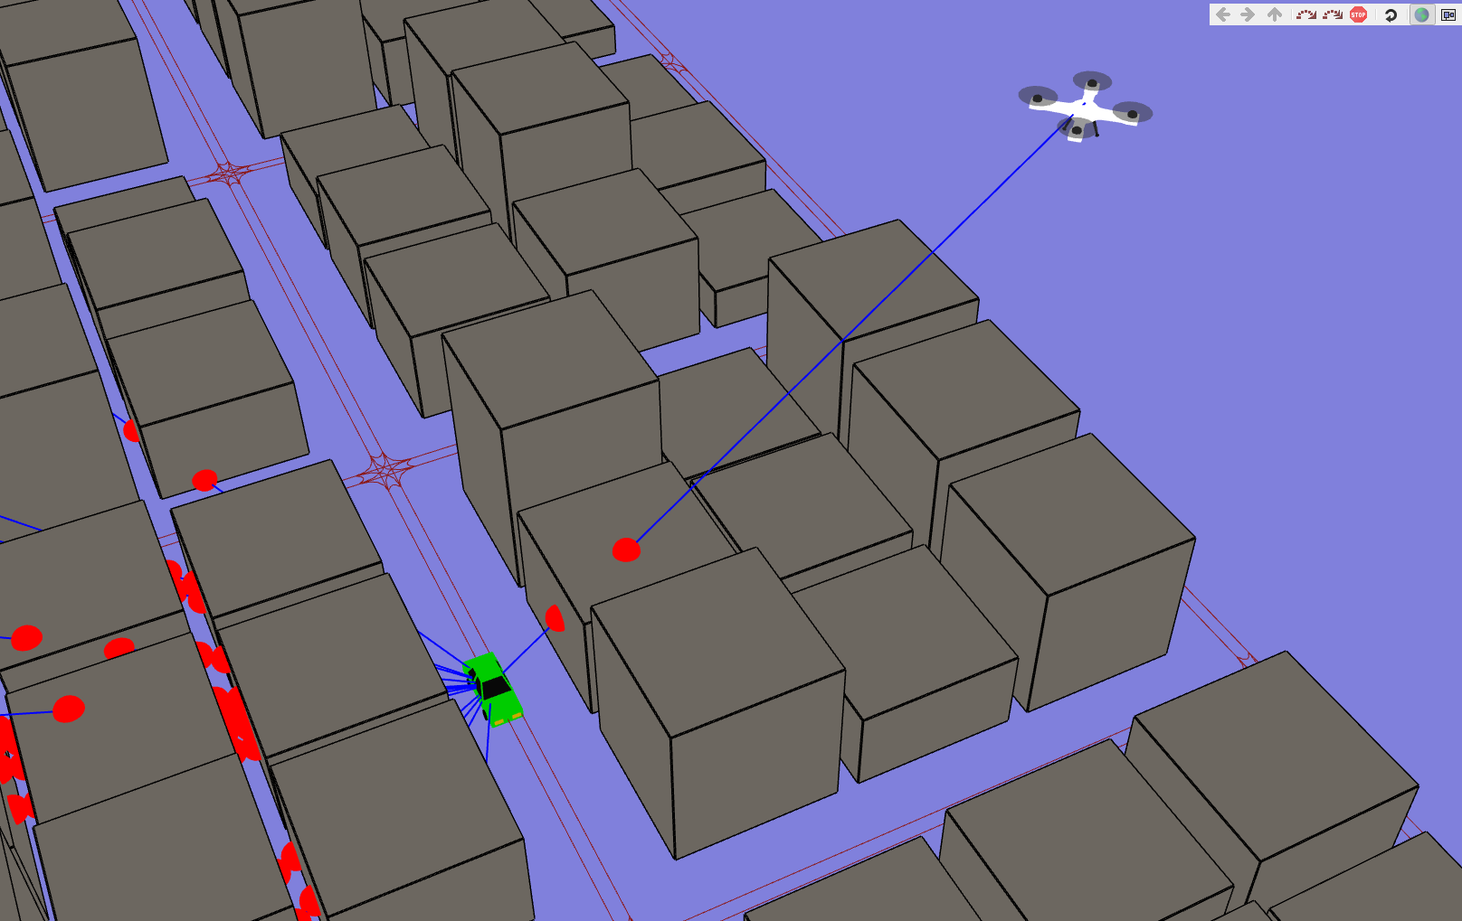
Implementation: verification

Slide 13
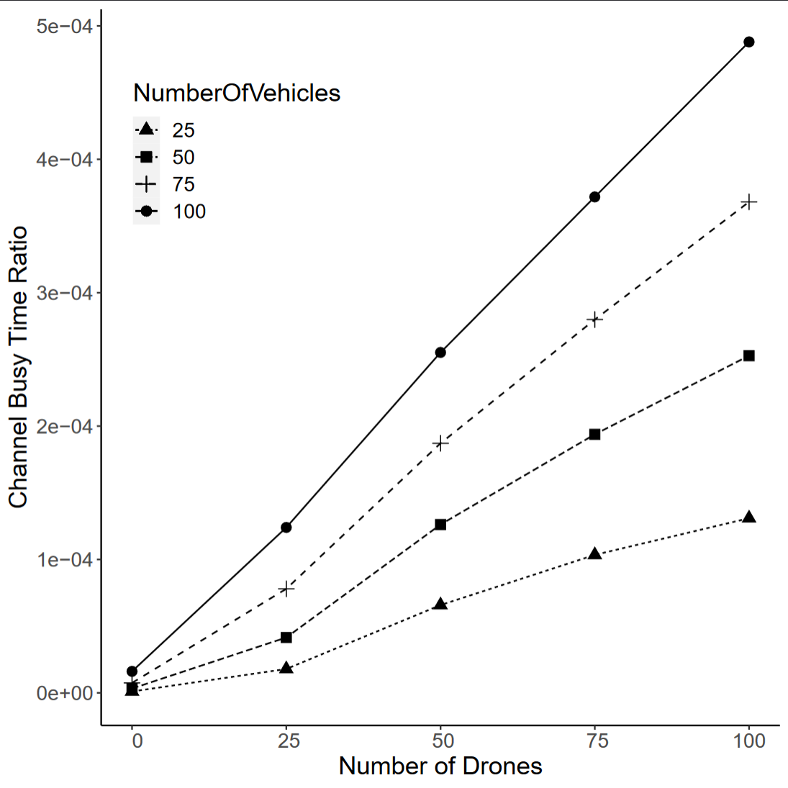
Broadcast storm suppression
Weighted p-persistence algorithm
Different parameters for drones and vehicles
Channel busy-time ratio low in all cases

Slide 14
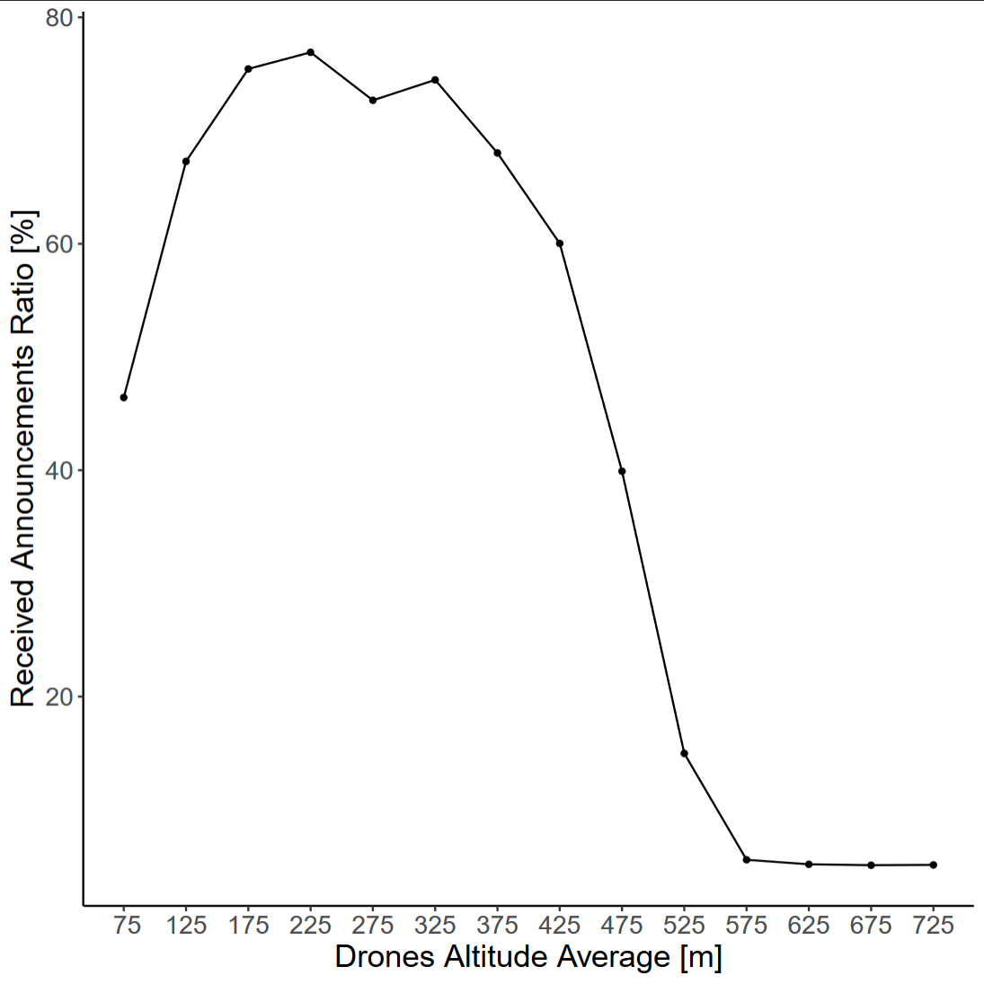
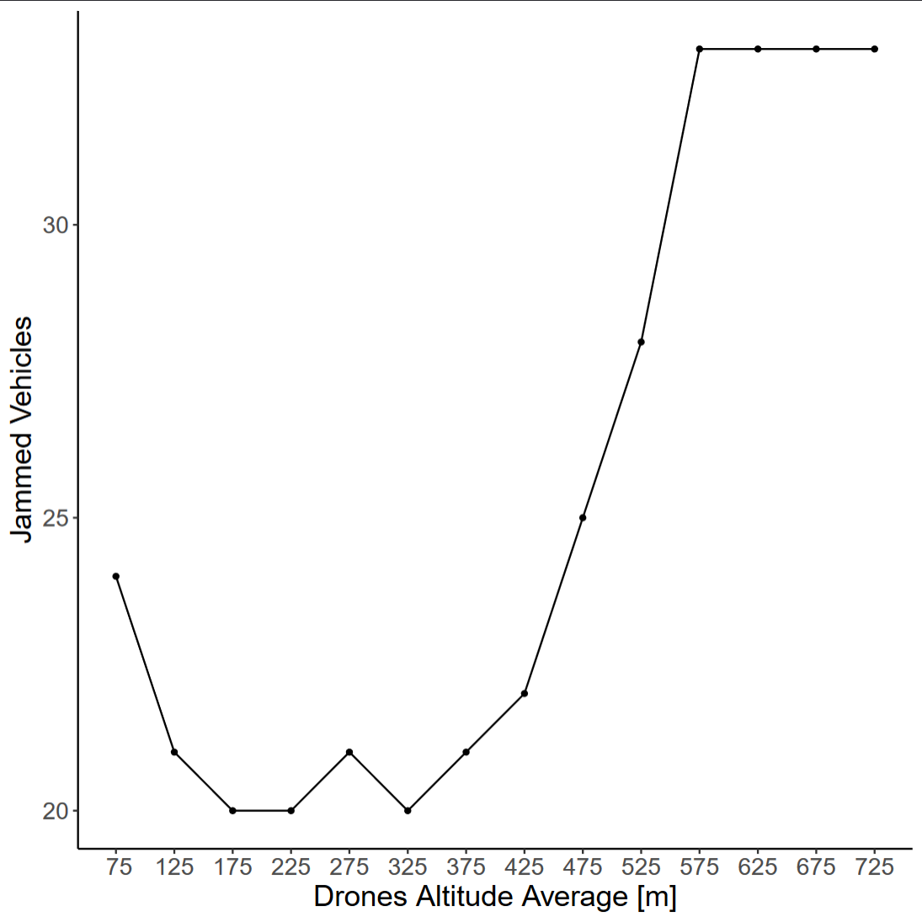
Drone flight altitude

Slide 15
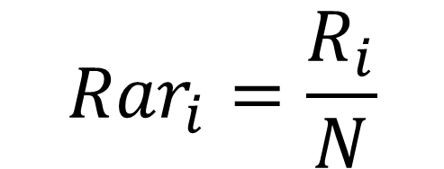
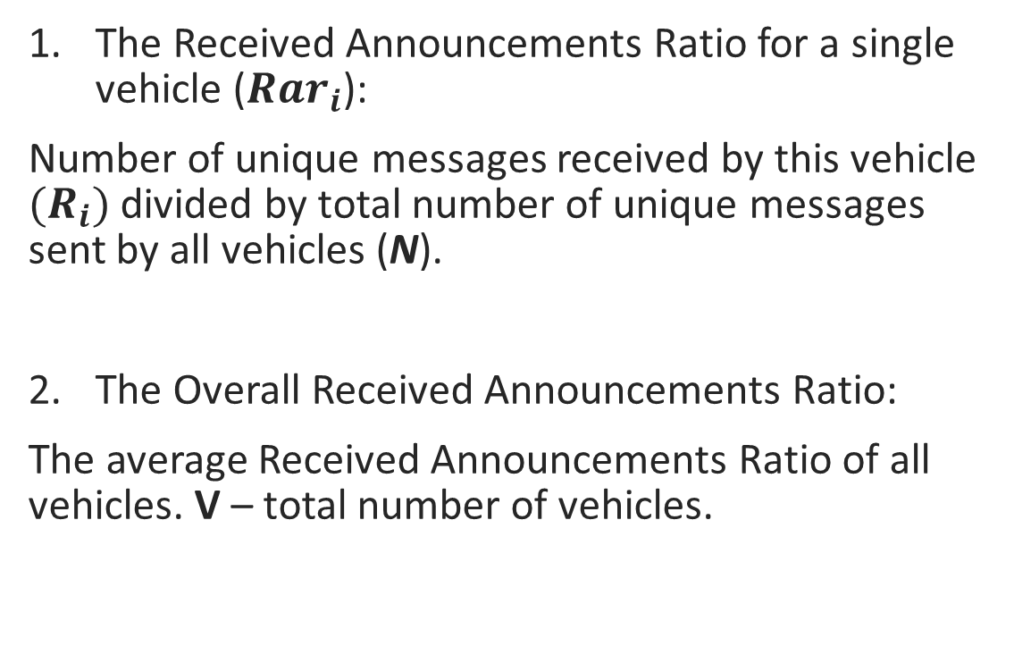
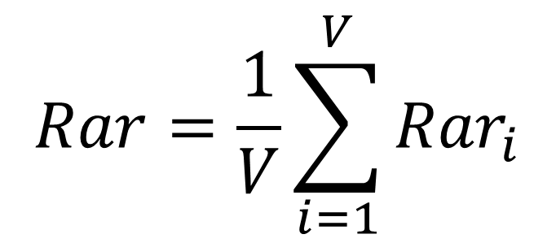
Evaluation: Received Announcements Ratio
The Received Announcements Ratio for a single vehicle (${Rar}_{i}$):
Number of unique messages received by this vehicle ${(R}_{i})$ divided by total number of unique messages sent by all vehicles (N).
The Overall Received Announcements Ratio:
The average Received Announcements Ratio of all vehicles. V – total number of vehicles.
$${Rar}_{i}=\frac{R_{i}}{N}$$
(1)
$$Rar=\frac{1}{V}\sum_{i=1}^{V}{{Rar}_{i}}$$
(2)

Slide 16
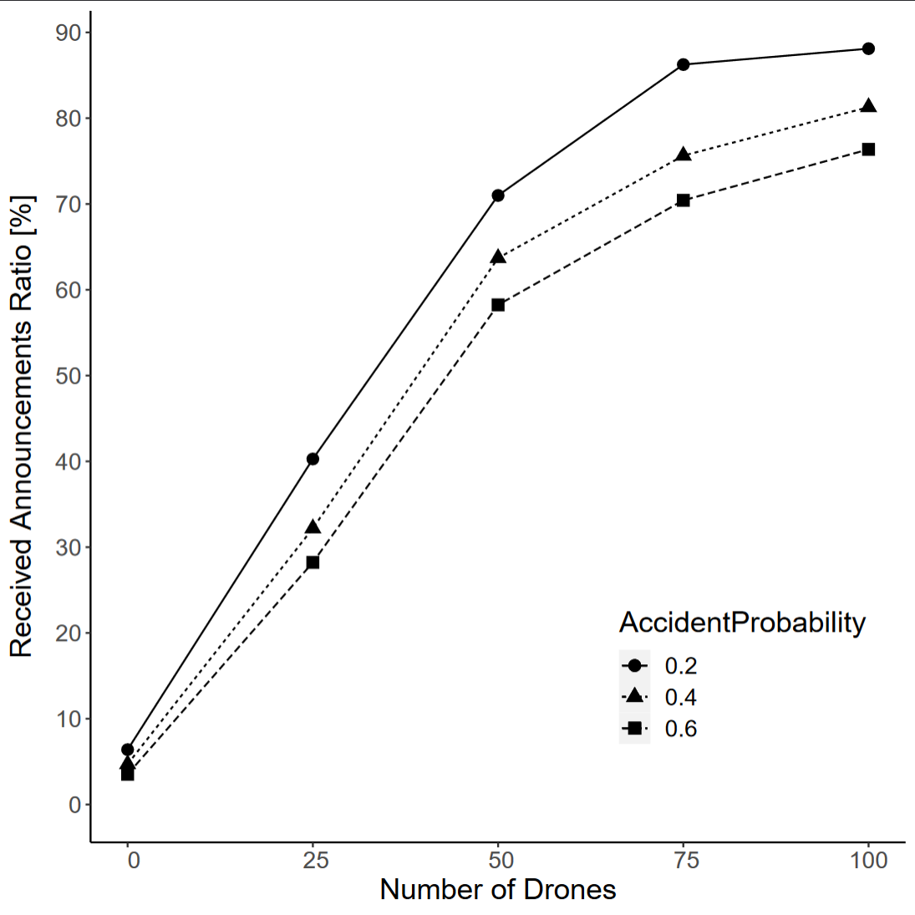
Evaluation: Received Announcements Ratio
Can be used as connectivity metric
Connectivity increases when number of drones is rising
Accident probability has negative impact

Slide 17
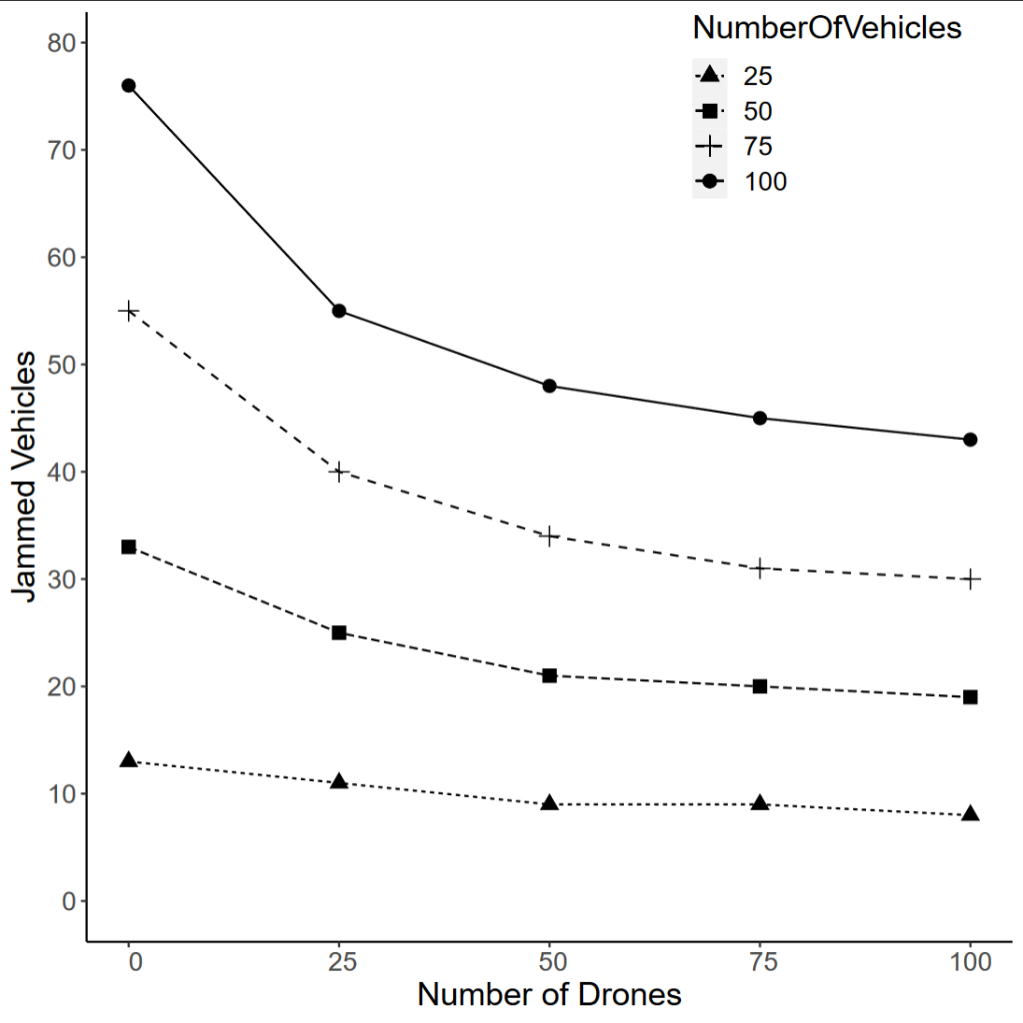
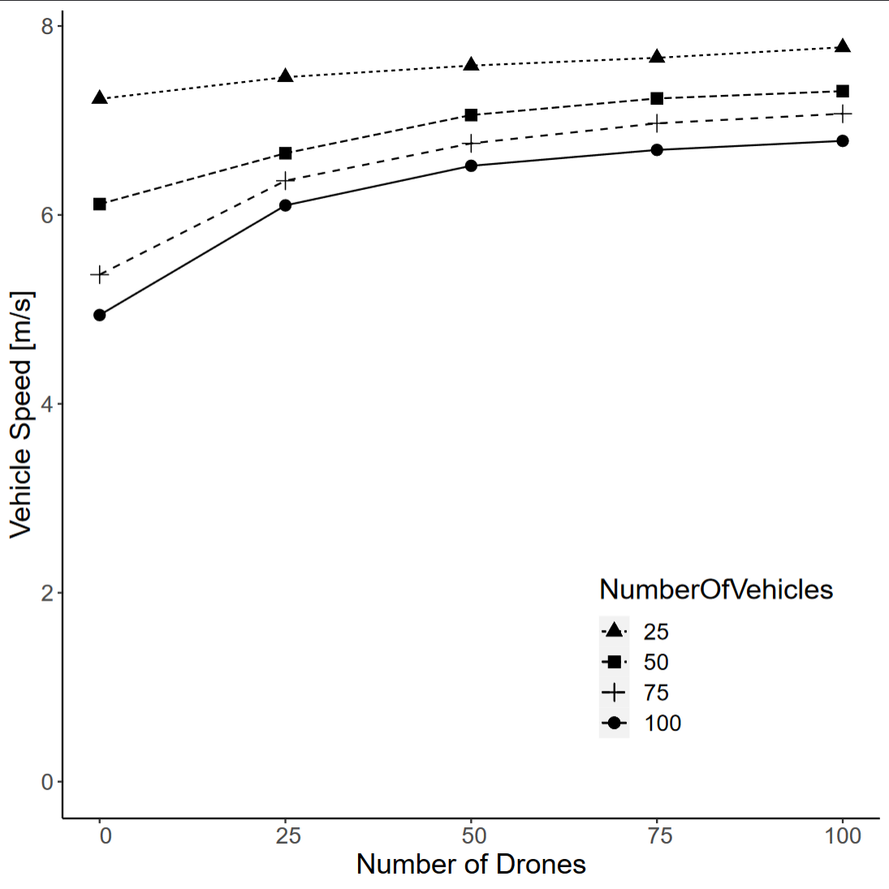
Evaluation: traffic flow improvement

Slide 18
Conclusion
Drones help to spread vehicles’ messages over the buildings
Drones improve VANET’s connectivity
Improved connectivity leads to better traffic message dissemination
Urban traffic improvement can be achieved!

Slide 19
Conclusion
Software simulation was implemented
Simulation results showed significant improvement in traffic flow (42% less jammed vehicles in the best case)
Project code can be easily integrated into Veins

