Slide 1

Responsible AI Agents in Transportation Research
Opportunities and Risks for Ethical and Impactful Innovation

Slide 2
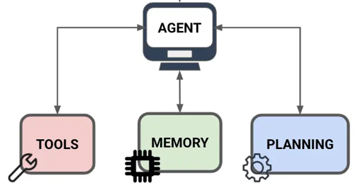
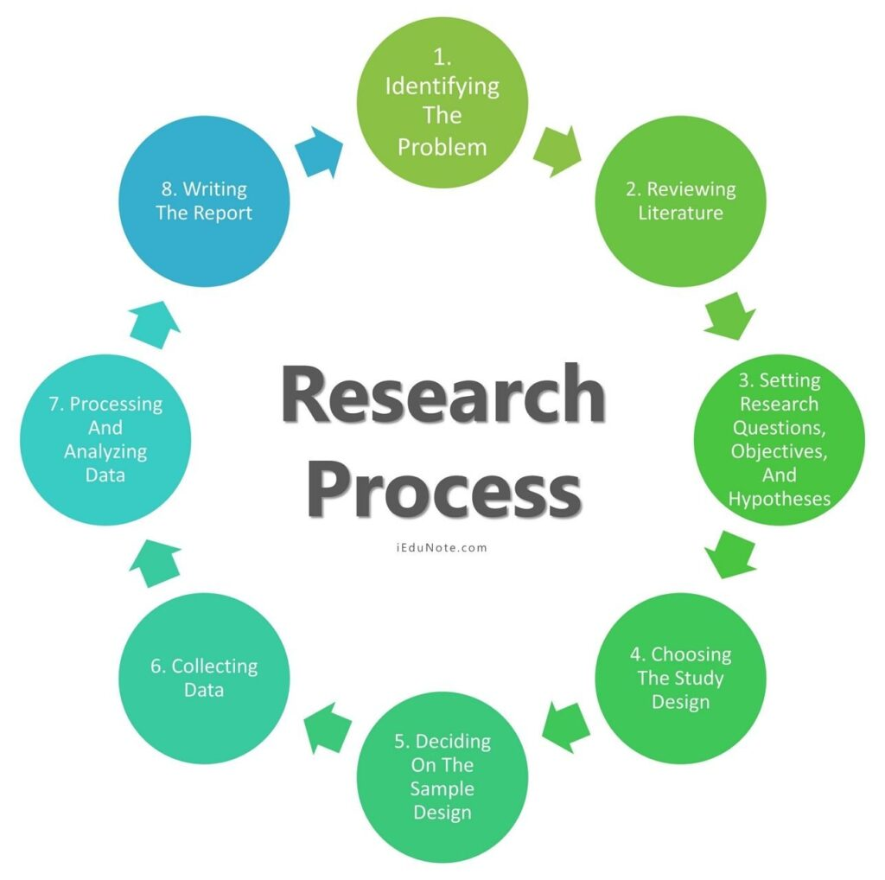

Presentation Framing
This presentation is about:
AI agents
not Artificial Intelligence
AI agent is an autonomous or semi-autonomous system that can plan, reason, and execute multi-step tasks to assist with or conduct scientific inquiry.
Transportation Research Process
not Research Outputs
Research Process is a systematic process for identifying transportation problems, collecting and analyzing relevant data, and translating findings into evidence-based conclusions and recommendations.

Slide 3

Presentation Outline
1 AI Agents in Research
Why transportation is the perfect domain?
2 Responsible AI
Principles, risks, and two-way oversight
3 Responsible AI Agent Examples
Compliance officer, bias auditor, and equitable optimization
4 Final remarks and Open Challenges
Entry points and directions
Presentation Repository

Slide 4
AI Agents
in Research

Slide 5


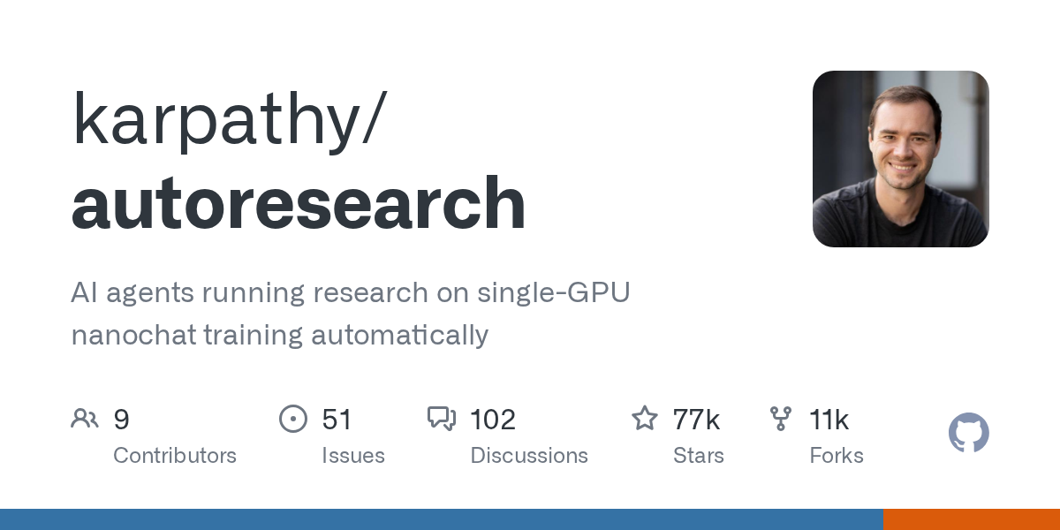
AI Agents in Research
The landscape of AI research agents is evolving rapidly:
SakanaAI AI-Scientist-v2
Introduced: Aug 2024
Success story: accepted at the ICLR workshop; ALE-Agent’s 1st place in optimization
Google Co-Scientist
Introduced: Feb 2025
Success story: antimicrobial resistance in ICL
Untapped frontier for transportation
Karpathy’s Autoresearch
Introduced: Mar 2026
Success story: Shopify model
Untapped frontier for transportation

Slide 6

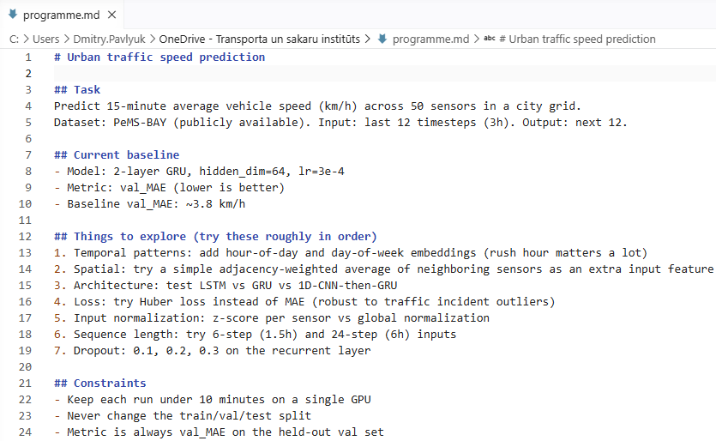
Opportunity: AI Agent in Research
AI agent to run machine learning experiments automatically: implement a model, train, evaluate.
Discover better architectures that outperform state-of-the-art models for network-wide traffic prediction.
Automate feature engineering – incorporating specific weather datasets or special event schedules
Example autoresearch programme for urban traffic forecasting
Research is shifting from writing training code to writing research directions
→ from marginal improvements to foundational research questions

Slide 7

AI Agents in the Research: Risks
Hallucination
AI agents may fabricate results or misinterpret data
Reproducibility level
AI pipelines make it hard to verify findings
Over-reliance and skill atrophy
Researchers may lose methodological skills
Bias amplification
AI pipelines can replicate historical biases in transport datasets
Authorship ambiguity
AI agent-generated discoveries raises ethical and legal issues
But aren't these problems already present in traditional research?

Slide 8
AI Agents in Transportation Research
Why transportation is the perfect domain for AI agents?
1 Transportation data is an ideal fuel for AI agents
sensor data, probe car data, crash records, emissions logs
2 Perfect match with AI advantages
AI agents are at the expert level of transportation research tools: optimization and ML training
3 Regulatory pressure
GDPR, EU AI Act, standards
4 Significant benefits
Research acceleration or automation, AI agent’s hours vs. human’s months

Slide 9
Responsible AI agents
in Transportation Research

Slide 10

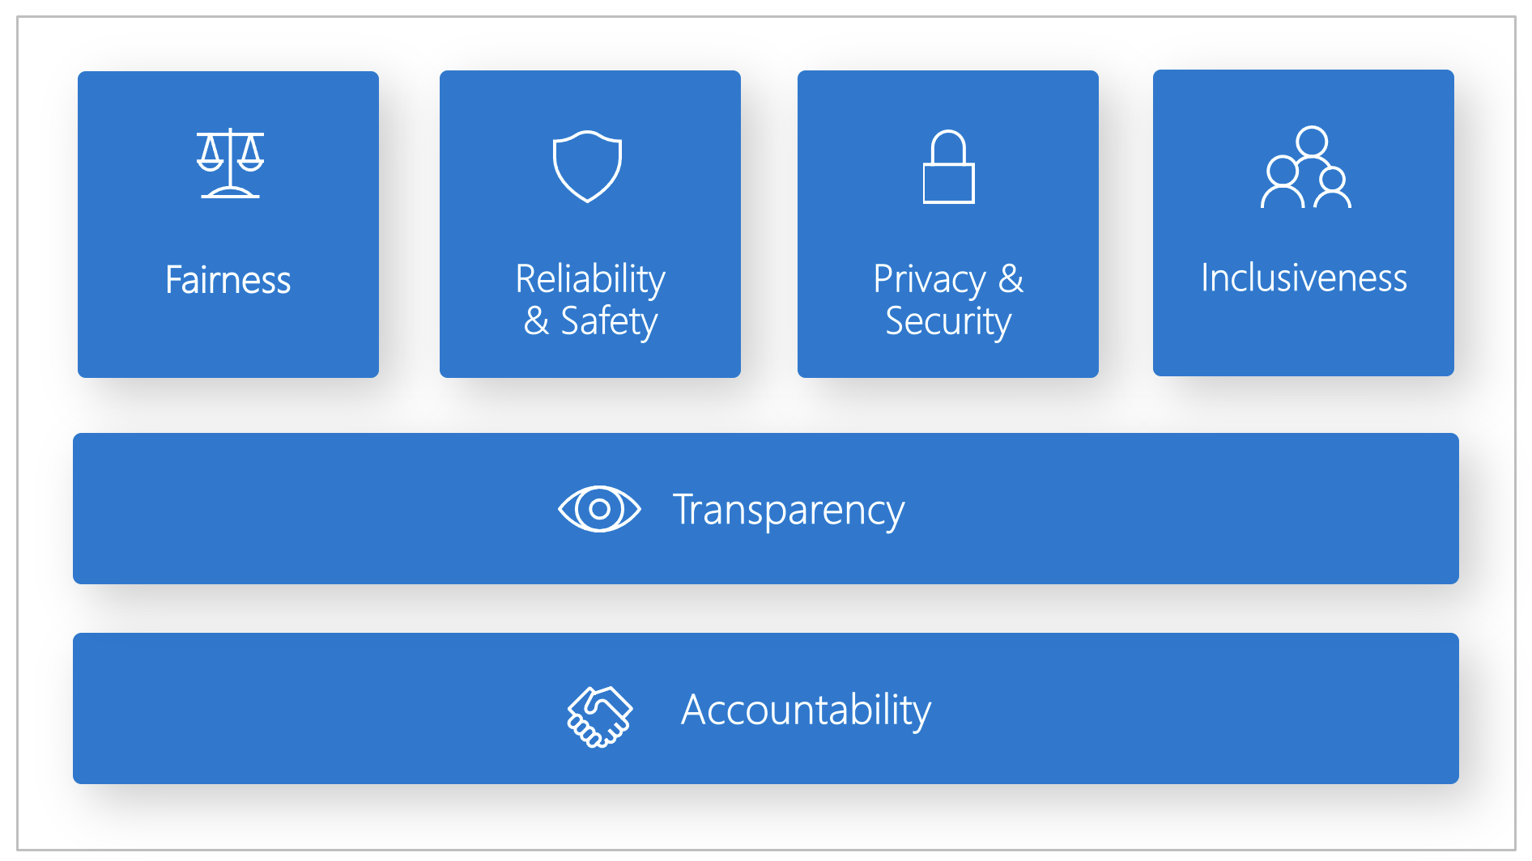


Responsible AI: Principles
Responsible AI is the practice of developing and using AI systems in a way that benefits society while minimizing the risk of negative consequences (ISO, 2023).
AI Risk Management Framework Jan 2023
ISO/IEC 42001: AI management
Dec 2023
EU AI Act
Aug 2024

Slide 11

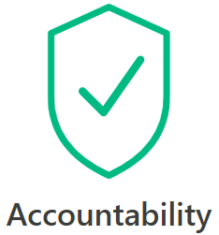
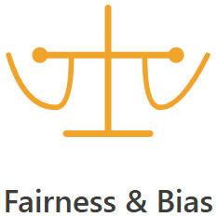



Responsible AI: Risks and Mitigation
Risk: black-box decisions
Mitigation: explainable methods (SHAP, LIME, attention, rule extraction, reasoning)
10 presentations at TRA-2026
Risk: direct harm from AI systems
Mitigation: logs, regulatory frameworks (e.g., AI sandbox), monitoring agents
6 presentations at TRA-2026
Risk: data inherit biased patterns
Mitigation: fairness constraints, synthetic data augmentation
5 presentations at TRA-2026
Risk: AI must fail safely
Mitigation: human-in-the-loop, simulation-based stress tests, constrained learning
10 presentations at TRA-2026
Risk: AI reveals sensitive information
Mitigation: federated learning, differential privacy, homomorphic encryption
5 presentations at TRA-2026
Risk: Groups are left out
Mitigation: inclusive datasets, community co-design
4 presentations at TRA-2026

Slide 12
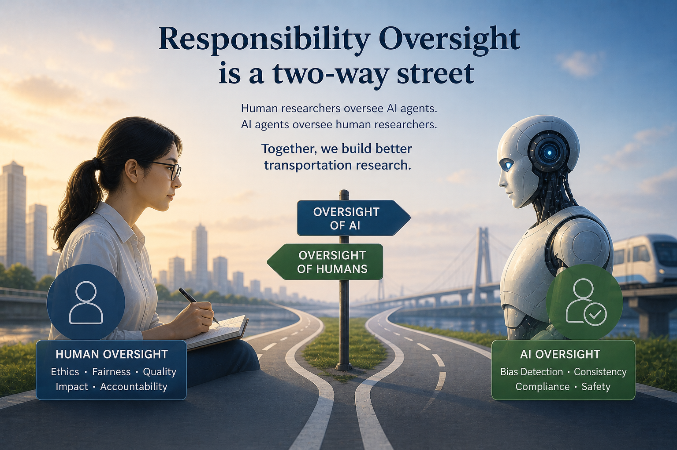
Responsibility Oversight is a Two-way Street
Researchers oversee AI agents
Transparency
Accountability
Fairness
Safety
Privacy
Inclusivity
AI agents oversee the Researchers
Compliance
Bias prevention
Consistency

Slide 13

Opportunity 1: AI Agent as a Responsible Compliance Officer
Challenge: compliance with legal and ethical rules in large-scale EU-level research projects
Large consortiums
Various data sources
Case: Bio-Intel-Mob project (Horizon Europe, 101239638)
32 partners across 13 countries
8 pilots
Hundreds (!) of data sources, including Interviews, surveys, sensors, cameras, etc.
3 roles per pilot: Local Ethics Responsible, Local Data Protection Officer, Local Data steward
Opportunity: AI as a Responsible Compliance Officer

Slide 14
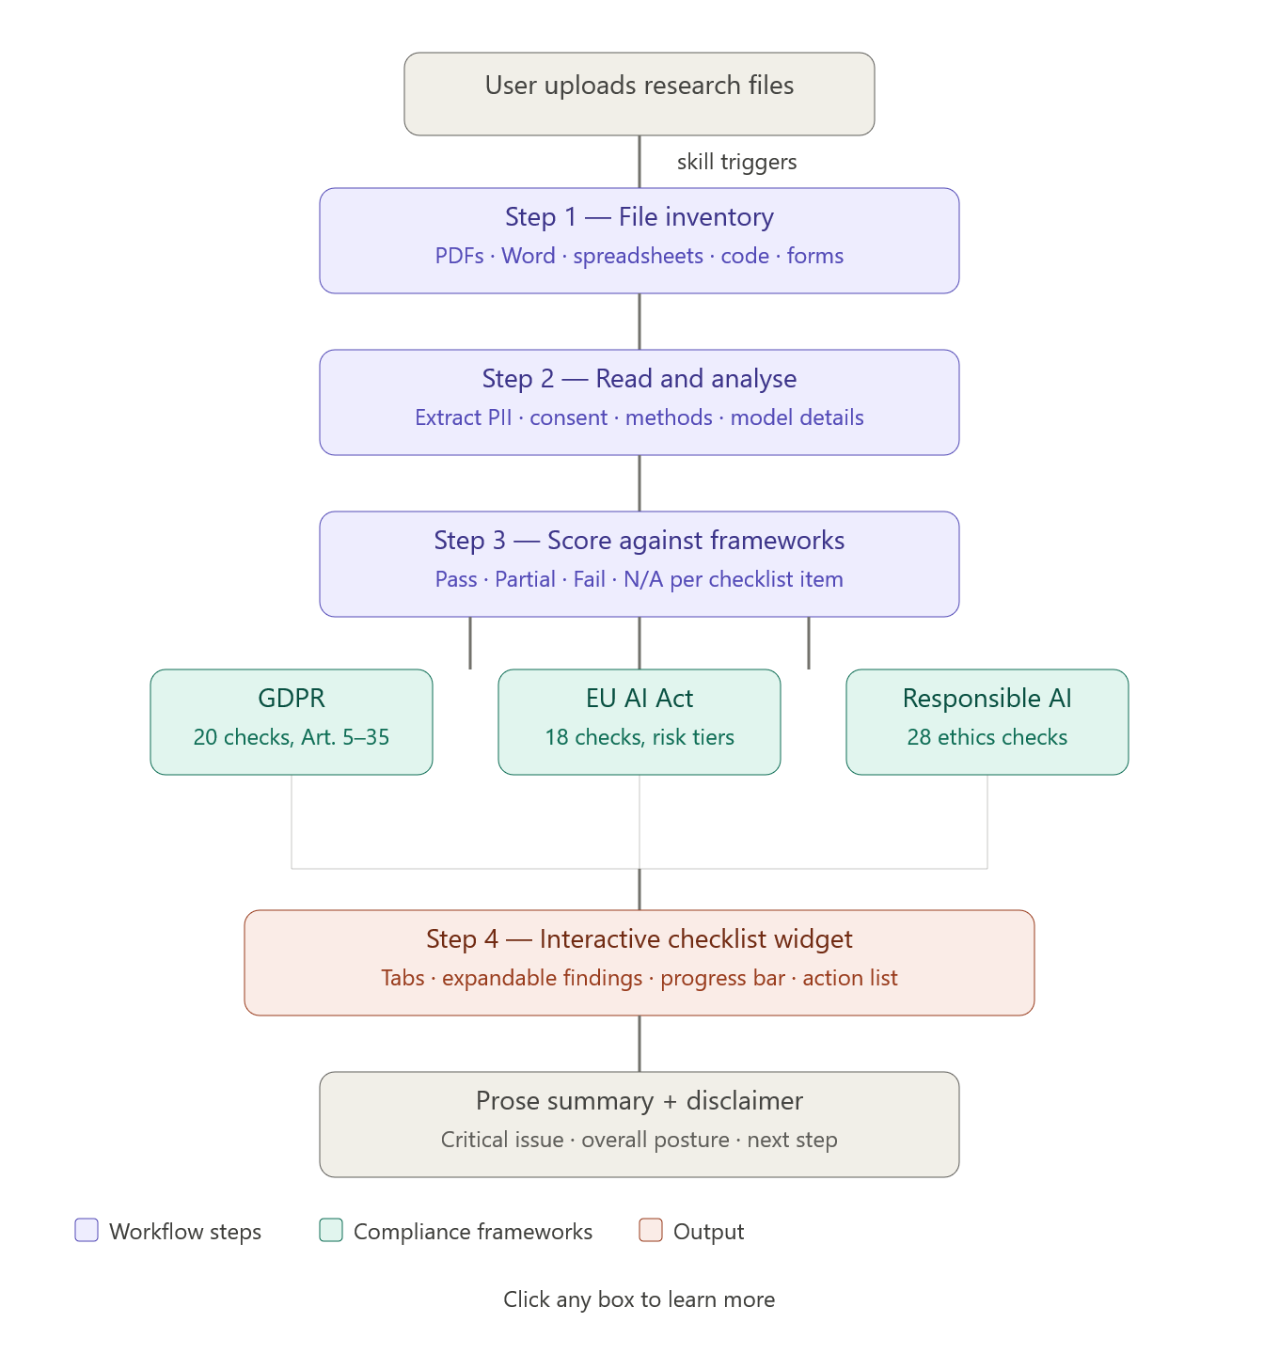
Opportunity 1: AI Agent as a Responsible Compliance Officer
AI Agent as a Responsible Compliance Officer:
Connected to the Project repository
Continuously monitors data and research protocols
Updated with recent standards and legislation
Flag potential issues
There are commercial solutions, but a simple skill is working – available at the presentation repo.

Slide 15
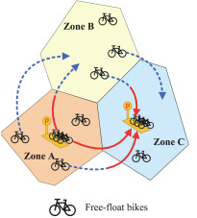
Opportunity 2: AI Agent for Penalization of Automated Decisions
Challenge: Decisions in automated/autonomous systems in are not always responsible
Example: Empty logistics (container, ride-hailing, e-bike rebalancing)
Focused on demand matching and operational efficiency
Low priority for peripheral, low-income, or minority zones
Non explainable decisions
Opportunity: an AI agent that contributes to the optimization objective
Fu et al. (2025)

Slide 16
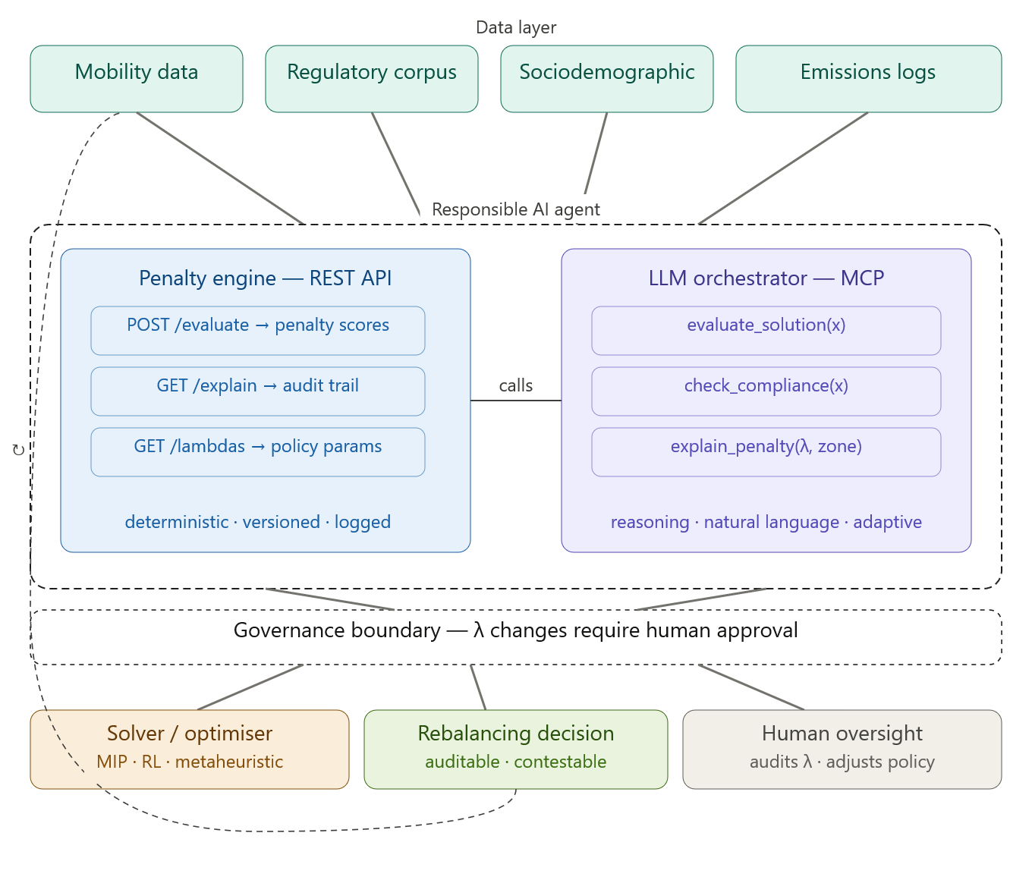
Opportunity 2: AI Agent for Penalization of Automated Decisions
Recent publications
Horton et al. (2024) A scalable optimization approach for equitable facility location: Methodology and transportation applications
Guo et al. (2024) Fairness-enhancing vehicle rebalancing in the ride-hailing system
The responsible restatement:
min RepositioningCost(x)
+ λ₁ · EquityPenalty(x) + λ₂ · CarbonPenalty(x) + λ₃ · DriverFairnessPenalty(x) + λ₄ · AccessibilityPenalty(x) where λ are a transparent, regulator-set policy parameter.

Slide 17
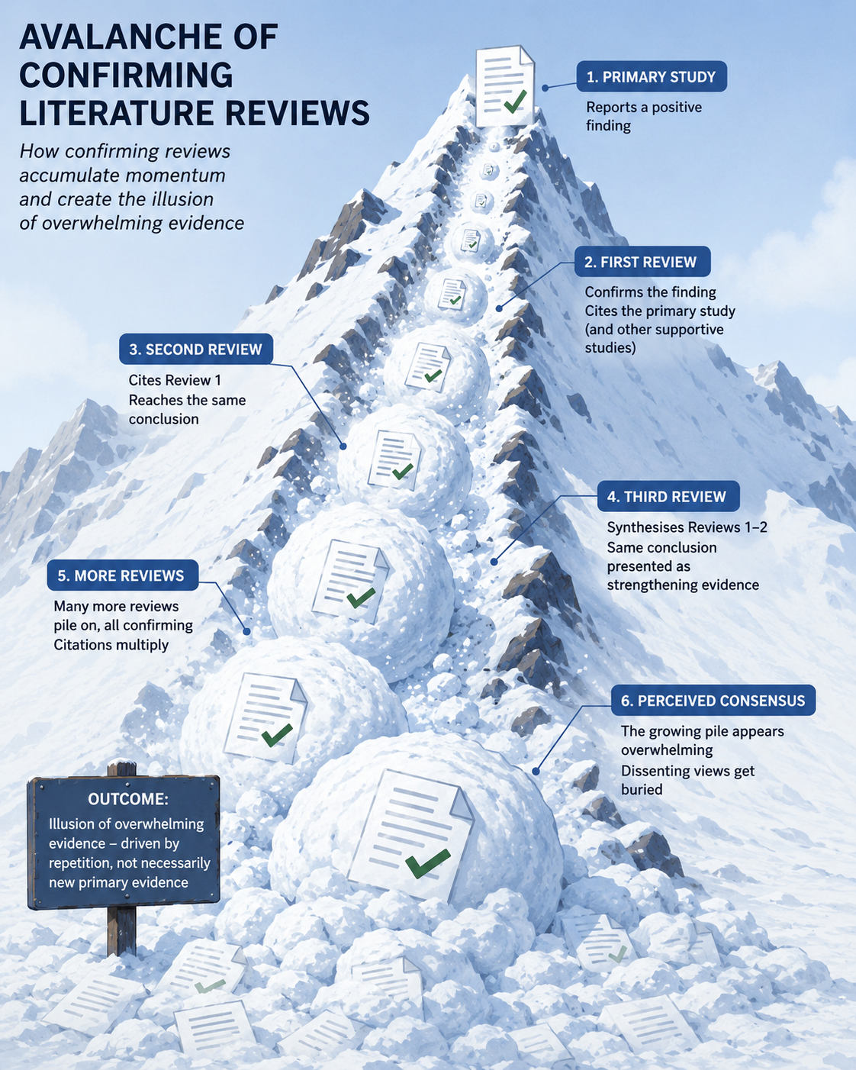
Opportunity 3: AI Agent as a Researcher's Bias Auditor
Challenge: traditional research suffers from cognitive biases
Confirmation bias, optimism bias, anchoring bias
Case: Cascade of confirming literature reviews
Flyvbjerg (2002) assumed optimism bias in rail infrastructure projects 9 of 10 projects overestimate demand, +106%
Flyvbjerg (2002) ⇨ cited by Flyvbjerg et al. (2003, 2004, 2005...) ⇨ cited by Cantarelli et al. (2010, 2012...) ⇨ cited by Country replication studies (Dutch, Italian, Norwegian...) ⇨ cited by Policy documents (UK Dept. for Transport, World Bank...) ⇨ cited by new researchers
Opportunity: AI as a Researcher’s Bias Auditor

Slide 18
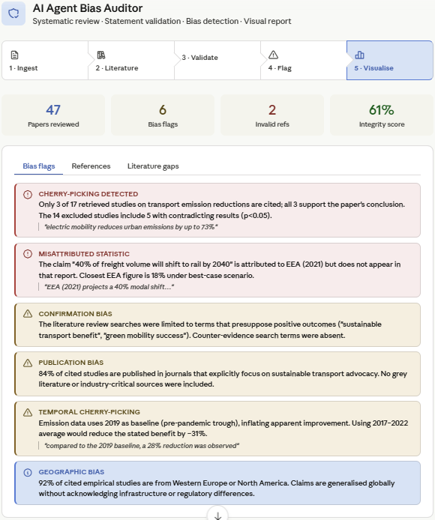
Opportunity 3: AI Agent as a Researcher's Bias Auditor
AI Agent as Researcher’s Bias Auditor:
Run a systematic literature review
Analyze research outputs (papers, report, deliverables)
Validate statements and references
Flag biases and cherry-picking
Example AI agent is available at the presentation repository.

Slide 19
Final Remark

Slide 20
Final Remark
What we showed
Transportation is an ideal yet still untapped domain for AI agents
Responsibility is not a constraint on AI agents – it is a two-way street
Perspective patterns: AI compliance officers, bias auditor, and AI-controlled optimization
Emerging steps
Acceptance and informal standards for AI agent use in transportation
Reproducible, peer-reviewed transportation research generated autonomously by AI agents

Slide 21
Thank you!
Presentation Repository
Contact details:
Dmitry Pavlyuk, Transport and Telecommunication Institute, Latvia
Dmitry.Pavlyuk@tsi.lv https://www.linkedin.com/in/dmitry-pavlyuk/

