Slide 1

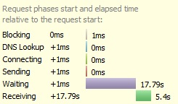
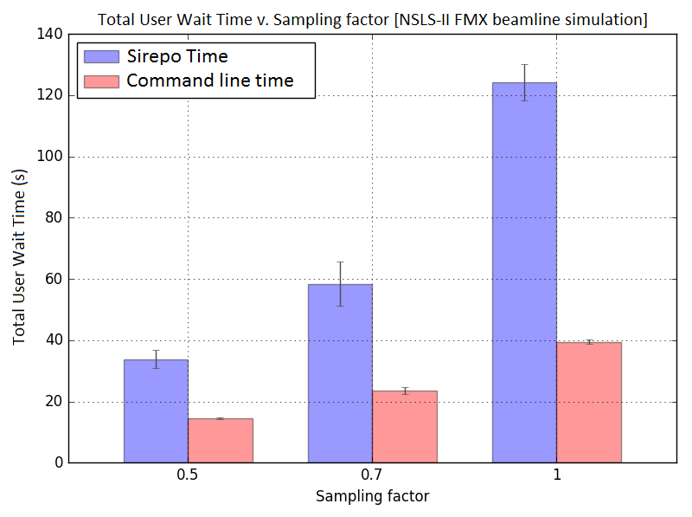
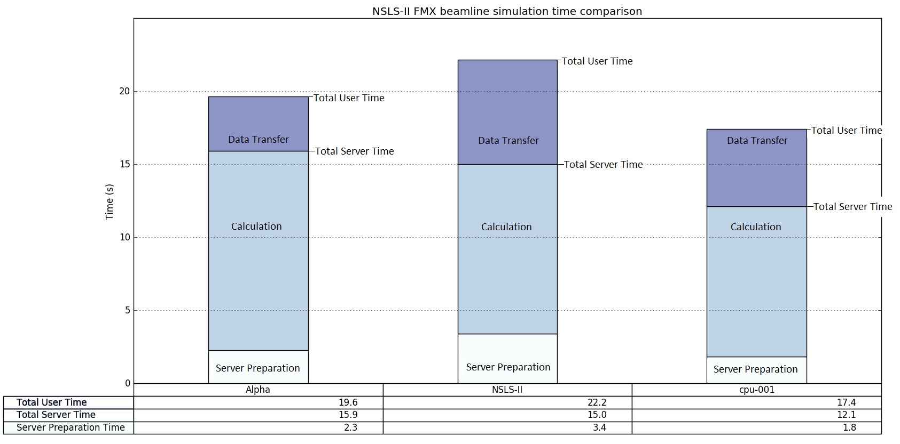
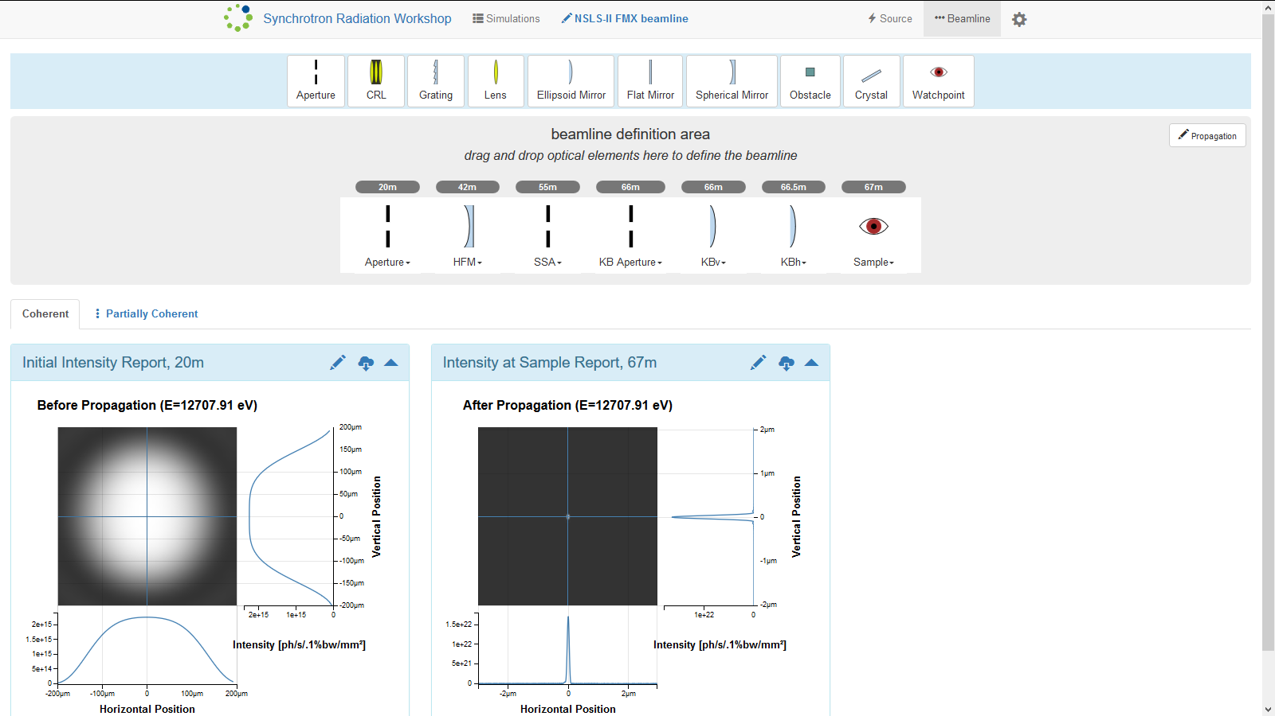
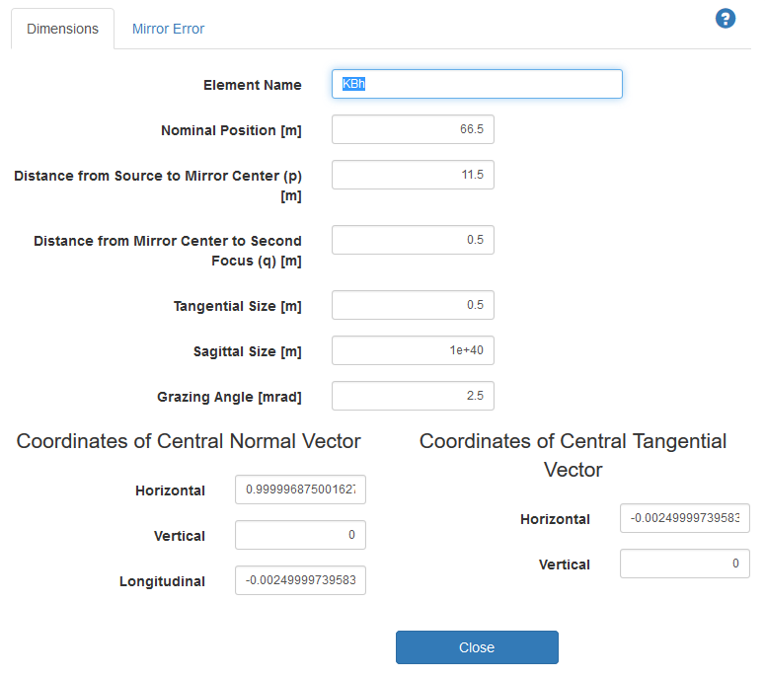



Using and Testing Synchrotron Radiation Simulation Software, SRW, and its Web-interface, Sirepo.
HSRP Student: Dmitry Smalyuk
Mentor: Oleg Tchoubar
Acknowledgements: Maksim Rakitin
Abstract
Investigating performance issues in sirepo - srw
Methods and Materials (cont’d.)
During the six weeks at HSRP, I worked with synchrotron radiation simulation software called Synchrotron Radiation Workshop, SRW, and its web-based graphic user interface, Sirepo.
SRW is a computer software package used to simulate synchrotron radiation (radiation produced by synchrotron particle accelerators, such as the NSLS-II) and its propagation though beamlines – systems of optical devices used to manipulate synchrotron radiation to, for example, focus or monochromatize it, making it applicable for a particular use [1]. Much of the useful radiation produced by synchrotron light sources is X-ray. Due to vast differences in optical properties between visible and X-ray radiation, optical systems designed for visible light are not applicable for X-rays. Instead, X-ray specific optical systems are designed. X-ray optics is more complex than visible light optics, both in the necessary calculations and the optical devices in use, and SRW can assist beamline design by taking on some of the calculations, to simulate the outcomes of propagation of X-rays through various configurations of virtual beamlines (computer models of beamlines.)
Sirepo is a web interface to SRW that allows users to set up, initiate, and access the results of, SRW simulations [2]. When using Sirepo, simulations are performed on remote servers, which send the results to the client (the web browser), where the results are rendered into graphic reports. Sirepo requires no familiarity with any programming language. Instead, it provides a means to create virtual beamlines and configure their simulations using a relatively simple graphic user interface. The beamlines can be set up by drag-and-dropping optical elements onto a virtual beamline and configuring them via their interactive pop-up menus. For many elements, the software calculates or otherwise obtains many of the necessary optical parameters based on few parameters provided by the user. For example, it can configure a focusing mirror based on the distance from source and the distance to the desired focal point that the user entered. Below are two screenshots of the Sirepo web interface: a whole beamline simulation page (Figure 1), and a focusing mirror configuration menu (Figure 2).
During my time at HSRP, I investigated performance issues in Sirepo to figure out why performing SRW simulations via Sirepo interface often took too much time, and was slower than performing identical simulation via a command line interface to SRW. I collected statistical data on the amounts of time spent by the software on various processes, visualized the data, and wrote a report; it was discovered that the main cause of the performance issues was lack of optimization in data transfer. In addition to the performance investigation, I used Sirepo and SRW to simulate actual beamlines, set up simple example simulations to illustrate Sirepo’s abilities, report various bugs in Sirepo, and learn about synchrotron radiation optics.
And finally, to determine the amount of time spent on data transfer, I subtracted both the amount of time spent on calculation and the amount of time spend on server preparation from the total user wait time.
Below is a screenshot (Figure 4) of part of the Firebug interface, showing the various time values for a simulation.
I performed tests on three servers running Sirepo – SRW, carrying out multiple trials for each test. I then organized the results of the tests in an excel document, calculated averages, and visualized the data using a python library called Matplotlib.
The time required by the command line interface to complete the same simulations under the same conditions and parameters was also recorder to compare the results later.
Introduction
SRW can be accessed via two interfaces – either a command line interface, or the web interface - Sirepo. Users often found that Sirepo took way too much time to perform SRW simulations that were executed much faster via the command line. To determine whether there was a significant difference between the speed of execution via Sirepo and speed of execution via command line interface, and, if there was such difference, to potentially find its cause, I performed a variety of testing on both the command line and Sirepo interfaces, running various SRW simulations and collecting statistics.
Figure 4.
Hypothesis
Firstly, I collected some preliminary data by recording the time of execution for a few simulations on the same server via both the command line and Sirepo interfaces, and comparing the results between the two interfaces. I performed the tests with multiple trials at varying resolution parameters, and found that, while at low resolutions the two interfaces performed nearly identically, as resolutions grew, the Sirepo interface lagged more and more behind the command line interface.
Results and Discussion
At higher resolution settings, the Sirepo interface was up to 6 times slower than command line. The plot below (Figure 3) illustrates some of the data that were collected. (Sampling factor is a resolution parameter. The values of time are averages of several trials.)
The next chart, Figure 5, summarizes the results of the investigation, presenting the most informative data that were collected. These data were collected from tests with multiple trials, performed on three servers running Sirepo – SRW, with identical simulations and constant simulation parameters.
Figure 5.
Each column represents results from one of the three servers.
From Figure 5 it is clear that the biggest time consumer in Sirepo is calculation. The same calculations, though, are performed in the same manner when one uses the command line interface. Calculation time, therefore, cannot be the cause of a speed difference between command line and Sirepo interfaces, unless the calculations for identical simulations take different amounts of time to complete depending on which interface is used to access SRW. To determine whether that was the case, I compared the amounts of time spent by the server exclusively on calculations (“duration” value) of identical simulation when accessed via the two interfaces. Below is a table of result averages (Figure 6.) (Sampling factor is a resolution parameter.)
Figure 1.
Figure 2.
Figure 3.
Error bars represent standard error.
It was clear that there was an issue within Sirepo. It was then necessary to determine what process within Sirepo was taking too much time. The processes performed by Sirepo are, briefly, such: waiting for server to prepare for calculation, waiting for server to perform calculation, transferring calculation results from server. I needed to find out which one contributed the most to the low performance of Sirepo. The correlation between resolution parameters and Sirepo’s lag behind command line (as illustrated by Figure 3) led my mentor to propose that the cause of Sirepo’s long wait times was the time spent on transferring results data from server to client. When the command line interface is used, the resulting simulation report image (a graph) is rendered on the server, and only the small image is sent to client; at the same time, Sirepo sends all of the results data to the user’s computer, because the report image is rendered on the client – in the web browser. Transferring all of the data to client allows the user to zoom in to the graphic report, but leads to longer wait times. At higher resolutions, more precise results are produced, and thus more results data are transferred. Thus, the hypothesis of this investigation was such:
The main cause of the difference in user wait times for SRW simulations between the Sirepo interface and the command line interface is the difference in the amounts of data transferred from server to client by the software when accessed through the two interfaces.
Sampling factor | Average [Sirepo]:[Command Line] Calculation Time Ratio
0.3 | 0.908
0.7 | 1.096
1.0 | 1.218
Figure 6.
It is evident from the table (Figure 6) that, even at sampling factor of 1, which is often the highest that is used, the difference in calculation time between Sirepo and command line interface is only around 20%, which is nowhere near the differences of over 300% in total user wait times observed at the same sampling factor. Thus, calculation time cannot account for the slow performance of Sirepo.
The next biggest contributor to total user wait time is data transfer. Since, as we’ve discussed in the second paragraph of the Hypothesis section, the command line interface does not perform as much data transfer as Sirepo, it is entirely possible that data transfer is the main cause of Sirepo’s slow performance.
The time spent on server preparation is the least significant time consumer, accounting for a maximum of 15% of total user wait time, and so it can hardly challenge data transfer as the cause of slow performance.
Using sirepo to build simulations of real beamlines and simple examples
I used Sirepo to create two simulations of real NSLS-II beamlines – CHX and FMX – using parameters provided by my mentor. The FMX simulation was then added to the set of example simulations in Sirepo. Building the beamline simulations involved altering a variety of parameters until a satisfying result was achieved; after working on the beamline simulations for a while, I got a good sense of what effects various optical and calculation parameters had on the simulation results – working on these simulations, I learned a lot about synchrotron radiation, as well as beamline optics and design. Among other things, I learned how to calculate the focal distance of a Compound Refractive Lens, and how focusing mirrors are used and set up. While building these simulations, I also discovered several bugs that existed within Sirepo, and have reported them via the project’s GitHub (https://github.com/radiasoft/sirepo) repository. After I created these simulations, my mentor took me on a tour to see what those very beamlines I simulated look like in real life.
I have also created a few simple single-element example simulations for Sirepo, such as examples illustrating the use of a Compound Refractive Lens, a crystal monochromator, and a fiber element. These example simulations are available to Sirepo users to help them familiarize themselves with the software and the optical elements. Building these examples also allowed me to learn more about several optical devices used in beamlines, as well as test the virtual optical elements newly implemented by my mentor.
After using Sirepo to do all of those things, I was asked by my mentor to investigate performance issues in Sirepo. The next sections presents the investigation.
Use this QR code to get to the GitHub repository of the Sirepo project
(https://github.com/radiasoft/sirepo)
Conclusion
Methods and Materials
Since calculation time cannot be the cause of performance issues (see paragraph 3 of Results and Discussion section), and pre-calculation preparation time is less significant than data transfer time (as a fraction of total user wait time), it is most reasonable to conclude that the difference in the amounts of data transfer in the two interfaces is indeed the main cause of performance issues in Sirepo.
My mentor is now considering optimizing data transfer to improve performance, by downloading the detailed data only when users zoom into reports, not by default.
To test the hypothesis, I needed to determine how significant were the effects of each of the three processes performed by Sirepo (waiting for server to prepare for calculation, waiting for server to perform calculation, transferring calculation results from server) on total user wait time.
To determine how much time was spent waiting for the server to perform calculations, my mentor implemented a feature in Sirepo that provided a value called “duration” for every simulations performed via Sirepo. The “duration” value represents the amount of time spent by the server exclusively on calculations. I employed a web browser extension called Firebug to access the duration value, and was able to record the time spent on waiting for the server to perform the calculation for any tested simulation.
To determine the amount of time spent on waiting for the server to prepare for calculation, I once again used Firebug. Firebug provides a value called “waiting”, which represents the total time spent waiting for the server to finish work, for every simulation; thus, in order to determine the time spent by the server on pre-calculation preparation, I only had to subtract the “duration” value from the “waiting” value.
Use the QR code on the right to get to the GitHub repository which contains all of the data and plots for this investigation, as well as a written report. (https://github.com/DmitrySmalyuk/sirepo_benchmark)
Use the QR code below to access Sirepo – SRW, to try it yourself.
(https://beta.sirepo.com/light#/home)
References:
[1] O. Chubar “Precise computation of electron beam radiation in non-uniform magnetic fields as a tool for the beam diagnostics,” Rev. Sci. Instrum., vol.66 (2), 1872-1874 (1995).
[2] D.L. Bruhwiler, O. Chubar, R. Nagler, J. Krzywinski, A. Boehnlein, “An open software framework for advancement of x-ray optics simulation and modeling”, Proc. of SPIE Vol. 9209, 92090Z (2014).

