Slide 1

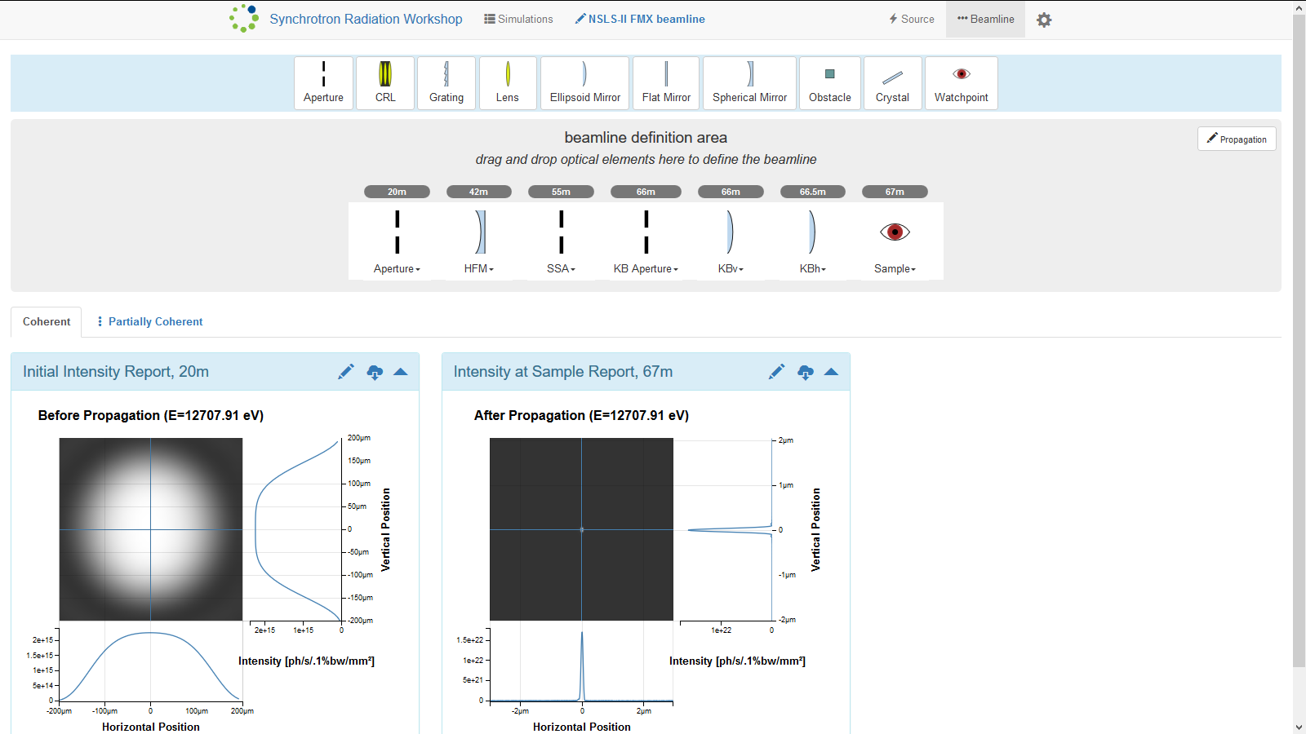
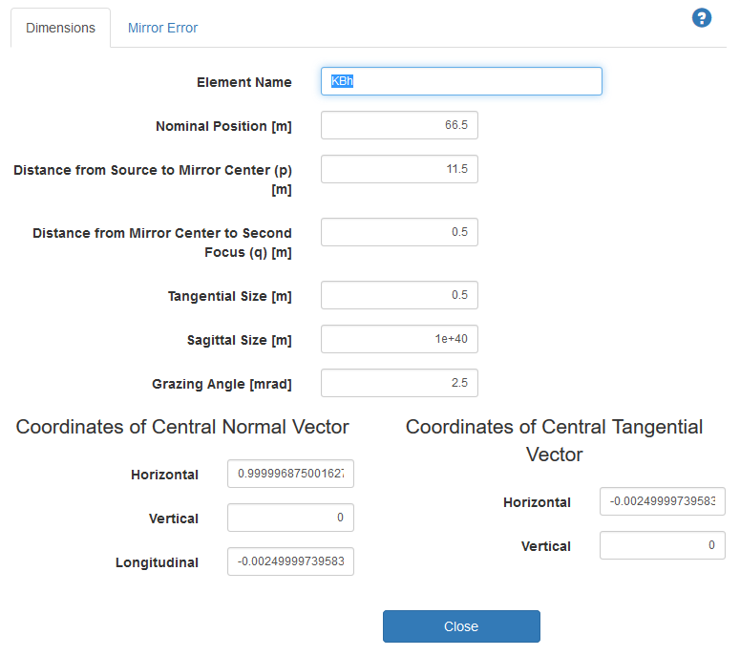
Dmitry Smalyuk, Oleg Tchoubar, Maksim Rakitin
Using and Testing Synchrotron Radiation Simulation Software, SRW, and its Web-interface, Sirepo.
Abstract
During the six weeks at HSRP, I worked with synchrotron radiation simulation software called Synchrotron Radiation Workshop, SRW, and its web-based graphic user interface, Sirepo.
SRW is a computer software solution used to simulate synchrotron radiation (radiation produced by synchrotron particle accelerators, such as the NSLS-II) and its propagation though beamlines – systems of optical devices used to manipulate synchrotron radiation to, for example, focus or monochromatize it, making it applicable for a particular use. Much of the useful radiation produced by synchrotron light sources is X-ray. Due to vast differences in optical properties between visible and X-ray radiation, optical systems designed for visible light are not applicable for X-rays. Instead, X-ray specific optical systems are designed. X-ray optics is more complex than visible light optics, both in the necessary calculations and the optical devices in use, and SRW can assist beamline design by taking on some of the calculations, to simulate the outcomes of propagation of X-rays through various configurations of virtual beamlines (computer models of beamlines.)
Sirepo is a web-based SRW interface that allows users to set up, initiate, and access the results of, SRW simulations running on remote servers. Sirepo requires no familiarity with any programming language. Instead, it provides a means to create virtual beamlines and configure their simulations using a relatively simple graphic user interface. The beamlines can be set up by drag-and-dropping optical elements and configuring them via their interactive pop-up menus. For many elements, the software calculates or otherwise obtains many of the necessary optical parameters based on few parameters provided by the user. For example, it can configure a focusing mirror based on the distance from source and the distance to the desired focal point that the user entered. Below are two screenshots of the Sirepo web interface: a whole beamline simulation page (top), and a focusing mirror configuration menu (bottom).
During my time at HSRP, I investigated performance issues in Sirepo to figure out why performing SRW simulations via Sirepo interface often took too much time, and was slower than performing identical simulation via a command line interface to SRW. I collected statistical data on the amounts of time spent by the software on various processes, visualized the data, and wrote a report; it was discovered that the main cause of the performance issues was lack of optimization in data transfer. In addition to the performance investigation, I used Sirepo and SRW to simulate actual beamlines, set up simple example simulations to illustrate Sirepo’s abilities, report various bugs in Sirepo, and learn about synchrotron radiation optics.
Investigating performance issues in sirepo - srw
Introduction
Users often found that Sirepo often took way too much time to perform simulations.

