Slide 1
Reflectometry in BornAgain: overview
Dmitry Yurov

Slide 2


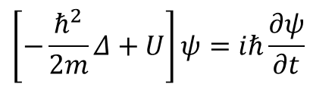

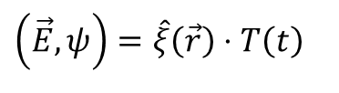
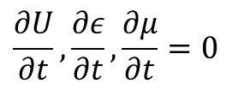
Helmholtz equation
Schrödinger equation:
Electromagnetic wave equation:
$$\left[−\frac{ℏ^{2}}{2m}Δ+U\right]ψ=iℏ\frac{∂ψ}{∂t}$$
$$\frac{∂U}{∂t},\frac{∂ε}{∂t},\frac{∂μ}{∂t}=0$$
Helmholtz equation:
$$\left[Δ+k_{0}^{2}n^{2}\right]\hat{ξ}=0$$
$$\left(\vec{E},ψ\right)=\hat{ξ}\left(\vec{r}\right)⋅T\left(t\right)$$
$$Δ\vec{E}=\frac{εμ}{c^{2}}\frac{∂^{2}\vec{E}}{∂t^{2}}$$
Contains all information about the media
Fundamental solution for homogeneous media
$$\hat{ξ}=\hat{A}exp\left(i\vec{k}⋅\vec{r}\right), {\left|\vec{k}\right|}^{2}=k_{0}^{2}n^{2}$$
20/12/18
2

Slide 3





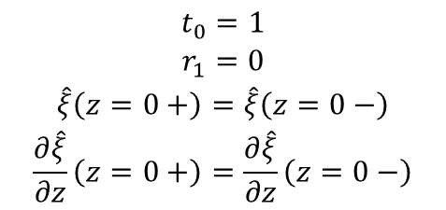
Plane wave in semi-infinite media
Helmholtz equation:
Doing separation of variables once again:
Generic solution:
Boundary conditions:
z
$$\left[Δ+k^{2}\right]\hat{ξ}=0$$
$$ξ_{zl}\left(z\right)=t_{l}e^{ik_{zl}z}+r_{l}e^{−ik_{zl}z}$$
t₀
r₀
$$\begin{aligned}t_{0}=1 \\ r_{1}=0 \\ \hat{ξ}\left(z=0+\right)=\hat{ξ}\left(z=0−\right) \\ \frac{∂\hat{ξ}}{∂z}\left(z=0+\right)=\frac{∂\hat{ξ}}{∂z}\left(z=0−\right)\end{aligned}$$
α_{i}
n₀
$$\begin{aligned}\hat{ξ}\left(\vec{r}\right)=\hat{A}e^{i\left(k_{x}⋅x+k_{y}⋅y\right)}ξ_{z}\left(z\right) \\ \frac{d^{2}ξ_{z}}{dz^{2}}+k_{z}^{2}\left(z\right)ξ_{z}=0\end{aligned}$$
0
α_{f}
n₁
t₁
Important implications
Fresnel’s formulas:
$R={\left|r_{0}\right|}^{2}={\left|\frac{k_{z0}−k_{z1}}{k_{z0}+k_{z1}}\right|}^{2}$, $T={\left|t_{1}\right|}^{2}={\left|\frac{{2k}_{z0}}{k_{z0}+k_{z1}}\right|}^{2}$
Snell’s law:
$\frac{\cos{α_{i}}}{\cos{α_{f}}}= \frac{n_{1}}{n_{0}}$, $\cos{α_{i,c}=}\frac{n_{1}}{n_{0}}$
20/12/18
3

Slide 4

Matrix formalism for multi-layer systems
Generic solution for z-component:
Boundary conditions:
z
$$ξ_{zl}\left(z\right)=t_{l}e^{ik_{zl}(z−p_{l−1}) }+r_{l}e^{−ik_{zl}(z−p_{l−1})}, l=1, …, i$$
p₀=0
n₀, d₀=0
$$ξ_{z0}\left(z\right)=t_{0}e^{ik_{z0}z }+r_{0}e^{−ik_{z0}z}$$
n₁, d₁
p₁
$$t_{0}=1, r_{i}=0$$
$$ξ_{zl−1}\left(p_{l}+\right)=ξ_{zl}\left(p_{l}−\right)$$
$$\frac{∂ξ_{zl−1}}{∂z}\left(p_{l}+\right)=\frac{∂ξ_{zl}}{∂z}\left(p_{l}−\right)$$
p₂
n₂, d₂
p_{i-1}
…
n_{i}, d_{i}
Backward matrix relation:
$$\left({t_{l−1} \atop r_{l−1}}\right)=\left(\begin{matrix}exp⁡(−ik_{zl−1}d_{l−1}) & 0 \\ 0 & exp⁡(ik_{zl−1}d_{l−1})\end{matrix}\right)\frac{1}{2k_{zl−1}}\left(\begin{matrix}k_{zl−1}+k_{zl} & k_{zl−1}−k_{zl} \\ k_{zl−1}−k_{zl} & k_{zl−1}+k_{zl}\end{matrix}\right)\left({t_{l} \atop r_{l}}\right)$$
Phase shift
“Sewing“ amplitudes together
20/12/18
4

Slide 5
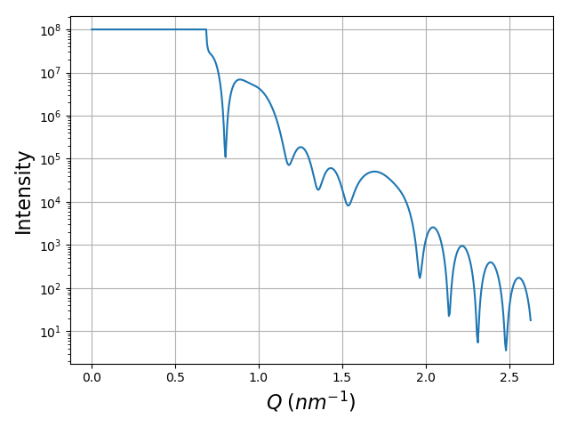



Typical reflectometry image
z
Interference maximum:
$$Δφ=2d\sin{α_{i}=λ}$$
Scattering wave vector:
Peak width:
$$Q=2k_{z0}=\frac{4π}{λ}\sin{α_{i}}$$
$$δQ≈\frac{2π}{d}$$
20/12/18
5

Slide 6
Task: sample thickness from reflectometry image
20/12/18
6

Slide 7


Task: sample thickness from reflectometry image
$$Δq≈0.16 nm^{−1}$$
$$Δd≈40 nm$$
20/12/18
7

Slide 8
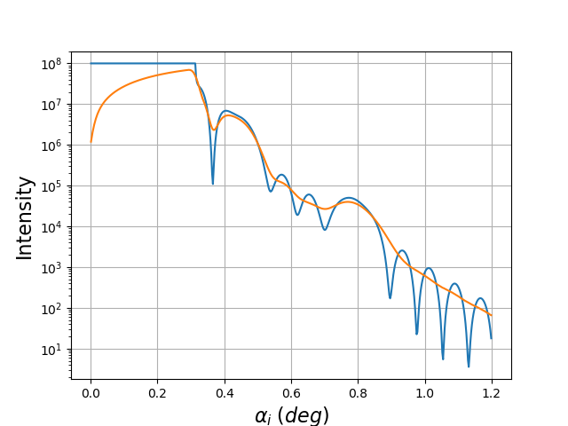
Beam effects: overview
Footprint correction
Beam divergence
Background noise
20/12/18
8

Slide 9
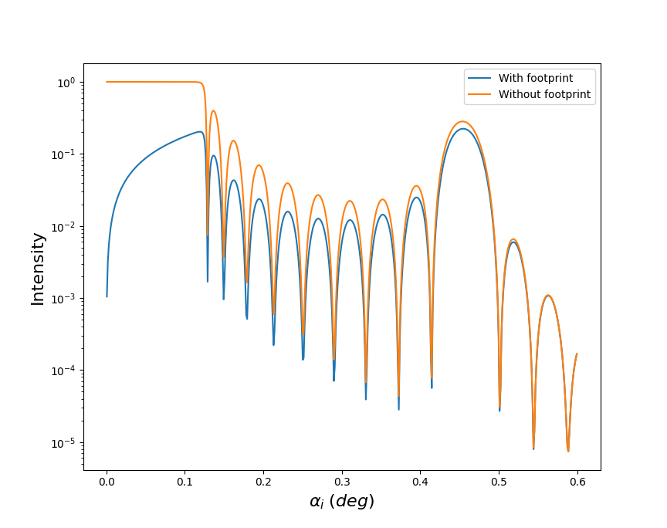

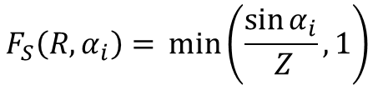
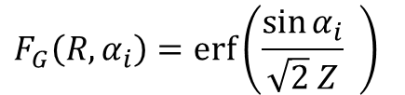
Beam effects: footprint correction
Depends on beam-to-sample width ratio
Gaussian beam
Square beam
$$Z=⁡\frac{w_{beam}}{w_{sample}}$$
$$F_{G}\left(R, α_{i}\right)=erf\left(\frac{sin⁡α_{i}}{\sqrt{2} Z} \right)⁡$$
$$F_{S}\left(R, α_{i}\right)=⁡min\left(\frac{sin⁡α_{i}}{ Z}, 1\right)⁡$$
20/12/18
9

Slide 10
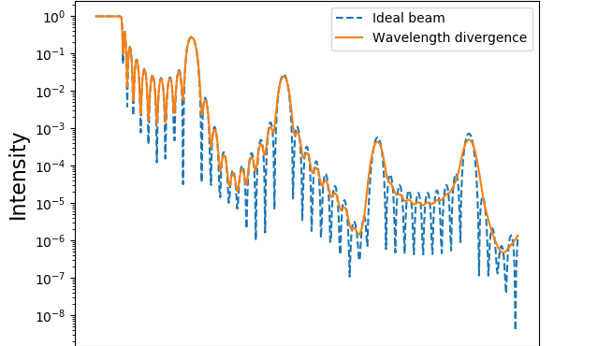
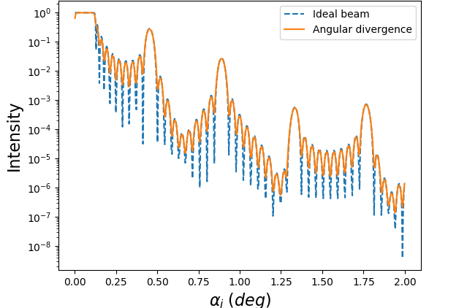


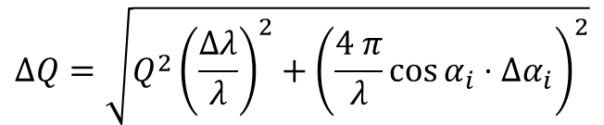
Beam effects: divergence
Total divergence impact on q:
Wavelength divergence at small angles:
Angular divergence at small angles:
$$ΔQ=\sqrt{Q^{2}{\left(\frac{Δλ}{λ}\right)}^{2}+{\left(\frac{4 π}{λ}\cos{α_{i}⋅Δα_{i}}\right)}^{2}}$$
$$ΔQ(Δλ=0, α_{i}≪1)≈\frac{4 π}{λ}Δα_{i}$$
$$ΔQ(Δα_{i}=0, α_{i}≪1)≈\frac{4 π}{λ}α_{i}\frac{Δλ}{λ}$$
20/12/18
10

Slide 11



Materials: index of refraction vs SLD
Index of refraction
Depends on wavelength
X-ray data at http://henke.lbl.gov/optical_constants/getdb2.html
$$n=1 − δ+iβ$$
Scattering length density (SLD)
Can be interpreted as normalized potential of interaction
Interaction with neutrons:
Neutron data at https://webapps.frm2.tum.de/intranet/neutroncalc/
$$n^{2}=1 − \frac{λ^{2}}{π}ρ, ρ= ρ_{r}−iρ_{i}$$
$$σ_{abs}≫ σ_{inc}$$
$$ρ ≈const$$
$$σ_{abs}∝ λ$$
20/12/18
11

Slide 12
Materials: index of refraction vs SLD
HomogeneousMaterial
Based on index of refraction
Suitable for any probe type
Provides correct values of refractive index for a monochromatic wave with predefined wavelength
Main use case: probes with negligible wavelength divergence
MaterialBySLD
Based on SLD
Provides correct values of refractive index in a range of wavelengths
Main use case: neutron probes and materials with small signal attenuation
20/12/18
12

Slide 13
Reflectometry in BornAgain: tutorials
Dmitry Yurov

Slide 14
GUI: Simulate and fit Ag nano-particles
Instrument:
Direct beam intensity: 10⁸
Wavelength: 0.1798 nm
Angle range: 0 – 3 deg
Gaussian angular divergence: σ = 0.01 deg
Square footprint: sample width – 10 cm, beam width – 0.1 mm
Sample:
Neutron data at https://webapps.frm2.tum.de/intranet/neutroncalc/
Material | Density, g/cm3 | ρ_{r}, 10⁻⁶ A⁻² | ρ_{i}, 10⁻⁶ A⁻² | thickness, nm
Vacuum | - | 0 | 0 | Inf
Ag | 4 |  |  | 20
SiO₂ | 2.33 |  |  | 5
Si | 2.33 |  |  | Inf
20/12/18
14

Slide 15
GUI: Simulate and fit Ag nano-particles
Instrument:
Direct beam intensity: 10⁸
Wavelength: 0.1798 nm
Angle range: 0 – 3 deg
Gaussian angular divergence: σ = 0.01 deg
Square footprint: sample width – 10 cm, beam width – 0.1 mm
Sample:
Neutron data at https://webapps.frm2.tum.de/intranet/neutroncalc/
Material | Density, g/cm3 | ρ_{r}, 10⁻⁶ A⁻² | ρ_{i}, 10⁻⁶ A⁻² | thickness, nm
Vacuum | - | 0 | 0 | Inf
Ag | 4 | 1.322 | 0.004 | 20
SiO₂ | 2.33 | 3.681 | 0 | 5
Si | 2.33 | 2.074 | 0 | Inf
20/12/18
15

Slide 16
GUI: Simulate and fit Ag nano-particles
Fitting parameters
Ag density
Ag layer thickness
SiO₂ density
SiO₂ layer thickness
Fit parameter | Start | Min | Max
Ag ρ_{r}, 10⁻⁶ A⁻² | 1.322 | 0.661 | 2.0
Ag thickness, nm | 20 | 10 | 30
SiO₂ ρ_{r}, 10⁻⁶ A⁻² | 3.681 | 3.5 | 4.0
SiO₂ thickness, nm | 5 | 3 | 8
20/12/18
16

Slide 17
GUI: Simulate and fit Ag nano-particles
Fitting parameters
Ag density
Ag layer thickness
SiO₂ density
SiO₂ layer thickness
Fit parameter | Target value
Ag ρ_{r}, 10⁻⁶ A⁻² | 1.984
Ag thickness, nm | 25
SiO₂ ρ_{r}, 10⁻⁶ A⁻² | 3.8
SiO₂ thickness, nm | 7
20/12/18
17

Slide 18
Thank you for your attention!

