Slide 1
Team: More Awesome
Members:
Designer 1:Shaoqing Yu
Designer 2:
Designer 3: Ruoyu Duan
Designer 4: Mingliang Duanmu
Designer 5: Xun Zhou
Notes:
Add or remove slides as needed

Slide 2
Step 1 Mission Digest

Slide 3
Designer 1 : Domain Cards that I created
Display the current productivity of two teams
Who’s the winner in productivity right now?
How’s the productivity changed over time?

Slide 4
Designer 2 : Domain Cards that I created
Whether the productivity is in the positive correlation with the the quantitative features of the robots
Is there any association between the nominal feature of the robots with their productivity
What is average productivity of each nominal feature?

Slide 5
Designer 3 : Domain Cards that I created
Who are the family members of a selected robot?
Who are the neighbors of a selected robot?
Which party does the family of a selected robot belong to?

Slide 6
Designer 4 : Domain Cards that I created
How many robots is won by each team?
What is the total productivity of robots owned by each team?
What is the position of a specific robot in the network and its family relationships?

Slide 7
Designer 5 : Domain Cards that I created
How much productivity do each team have at every XTU?
For a given robot, how many neighbors have already committed to each of the teams?
What’s the relationship between a robot’s productivity and its 10 features?

Slide 8
Step 2 Required Domain Tasks (for the group)

Slide 9
Team: Domain Cards that our team selected
What’s the relationship between a robot’s productivity and its 10 features?
What is the position of a specific robot in the network and its family relationships?
Who’s the winner in productivity right now?

Slide 10
Step 3 Individual Sketch 1

Slide 11
Designer 1

Slide 12
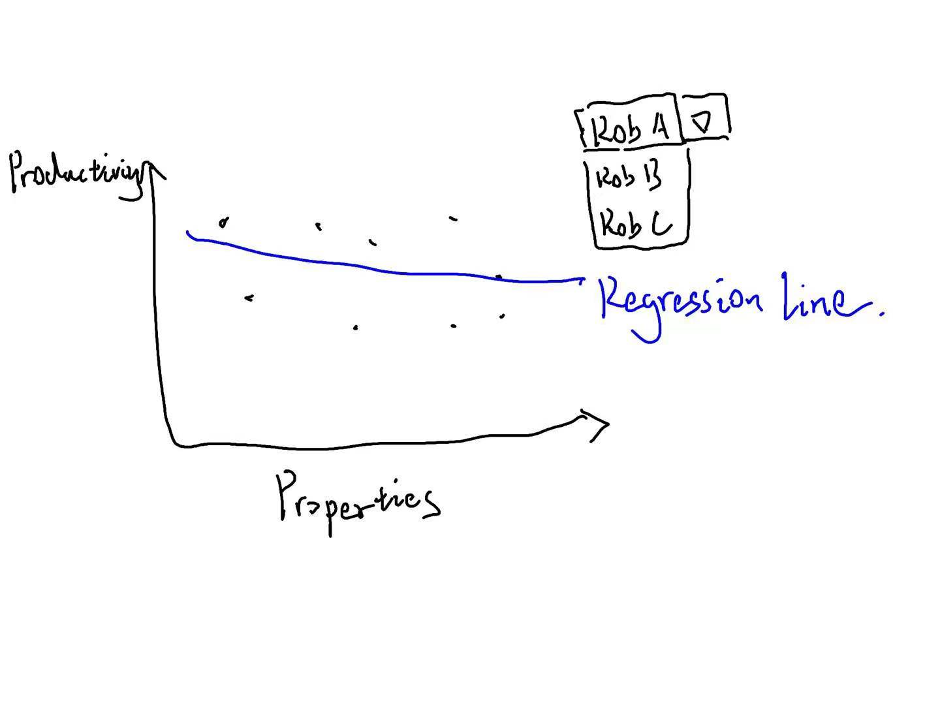
Designer 1 : My first sketch in round 1
Image
Comments

Slide 13
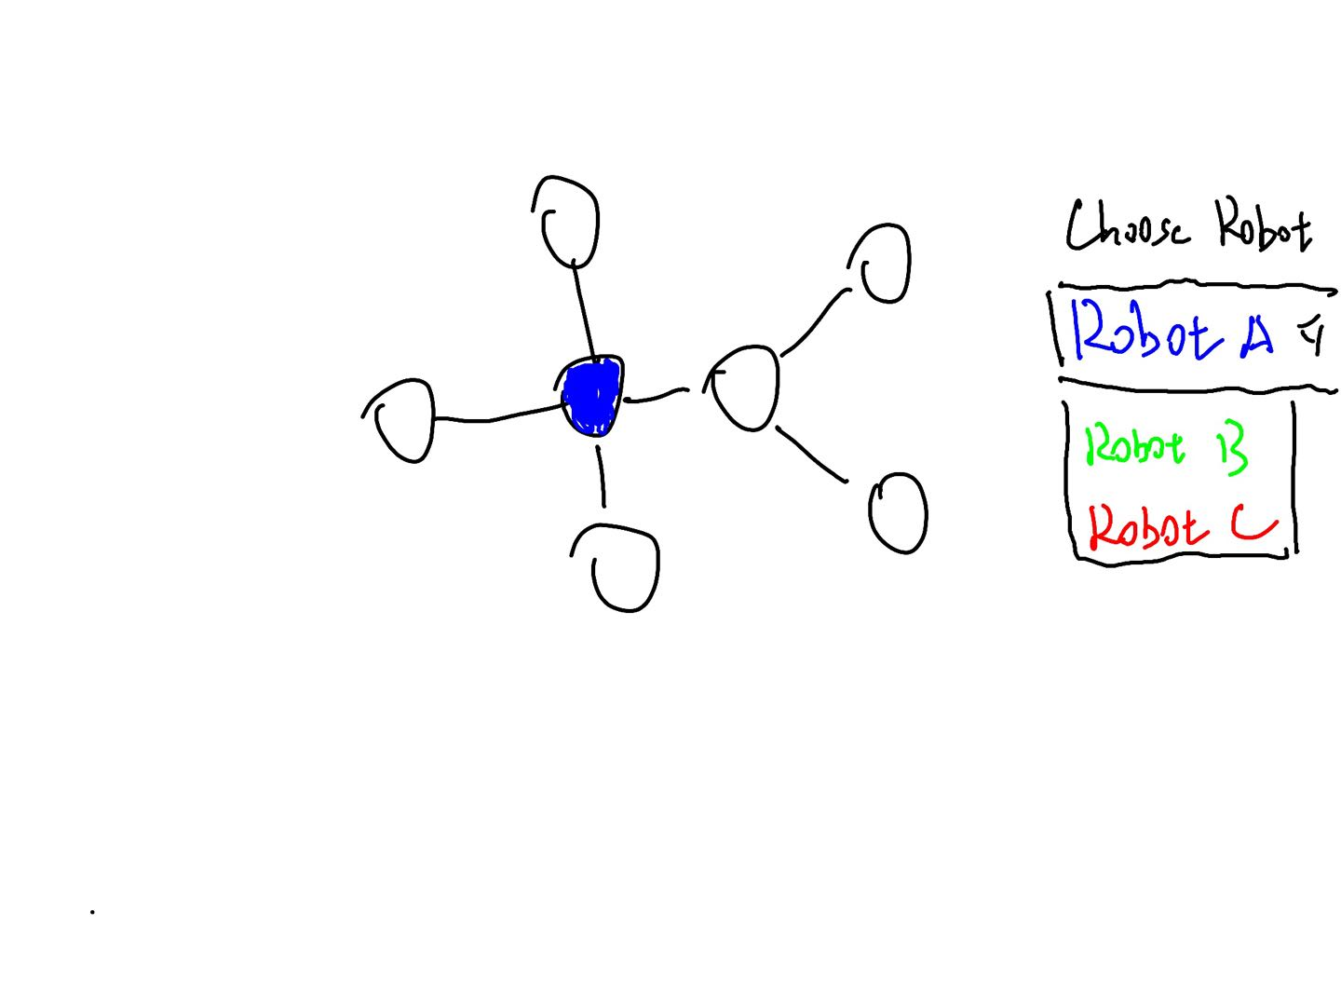
Designer 1 : My second sketch in round 1
Comments

Slide 14
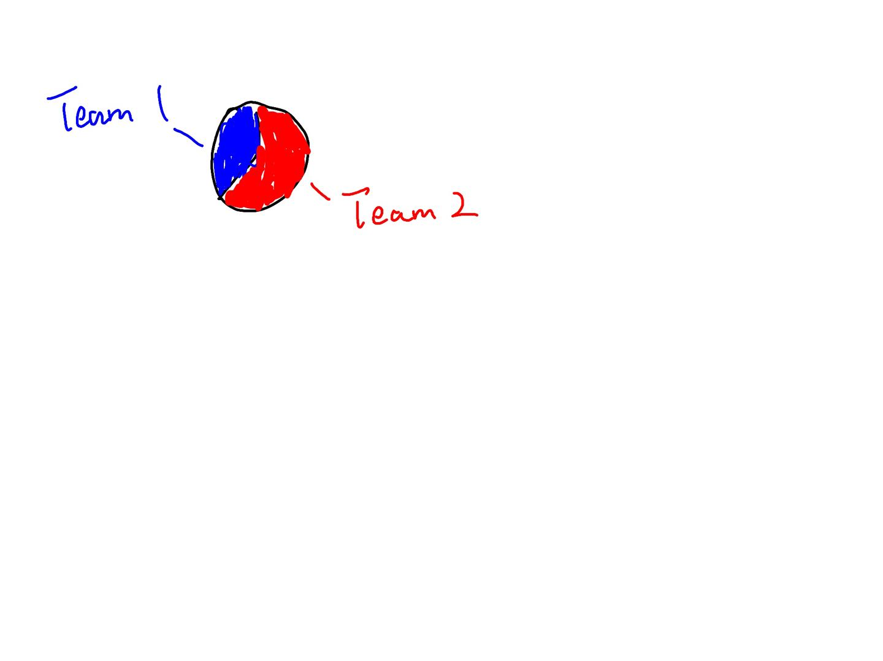
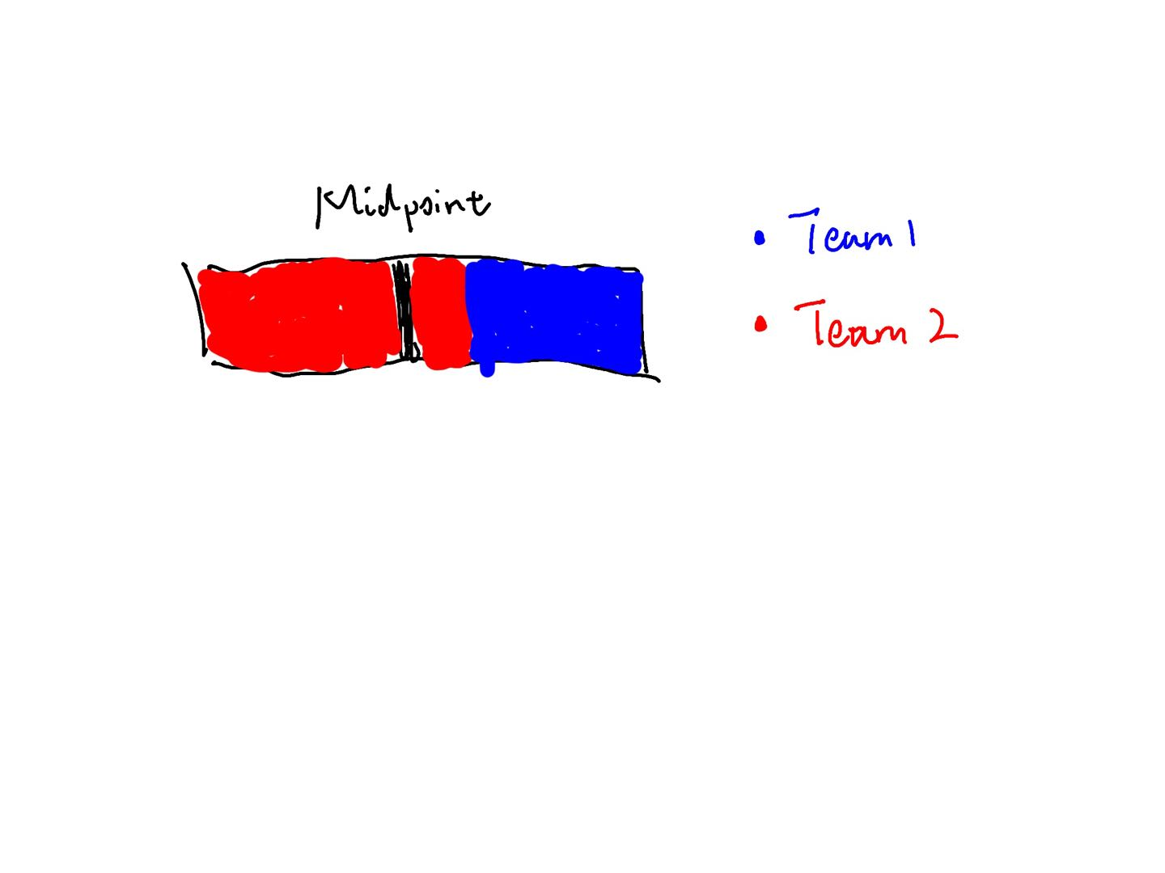
Designer 1 : My third sketch in round 1
Comments

Slide 15
Designer 2

Slide 16
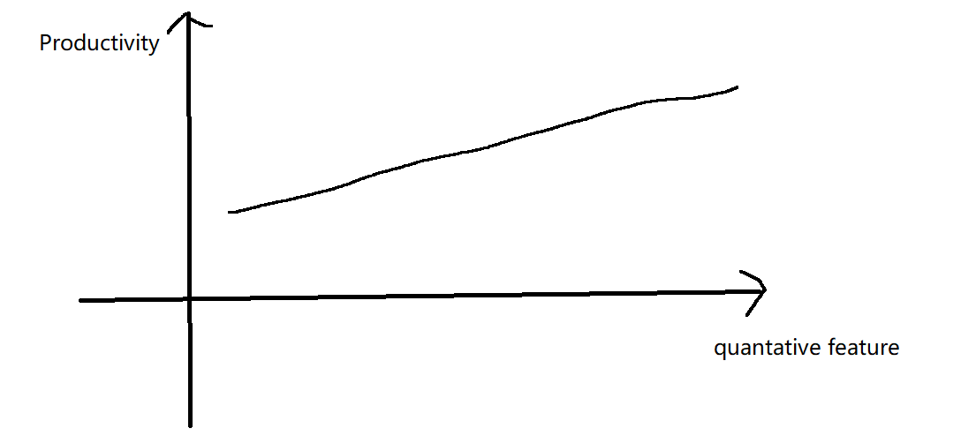
Designer 2 : My first sketch in round 1
Comments

Slide 17
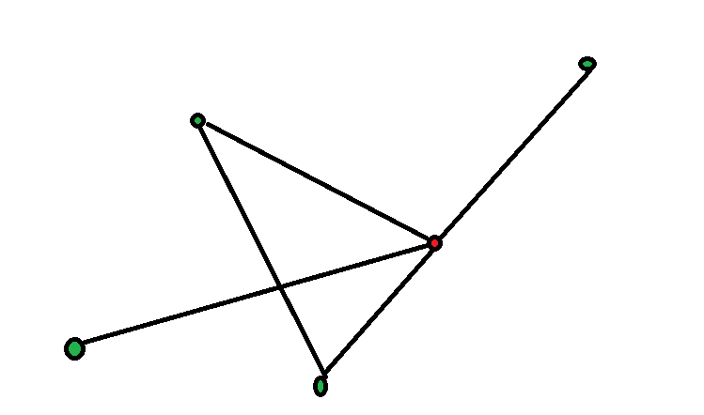
Designer 2 : My second sketch in round 1
Comments

Slide 18
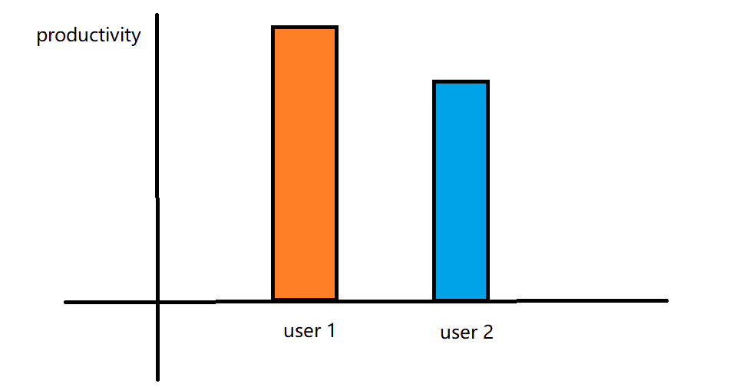
Designer 2 : My third sketch in round 1
Comments

Slide 19
Designer 3

Slide 20
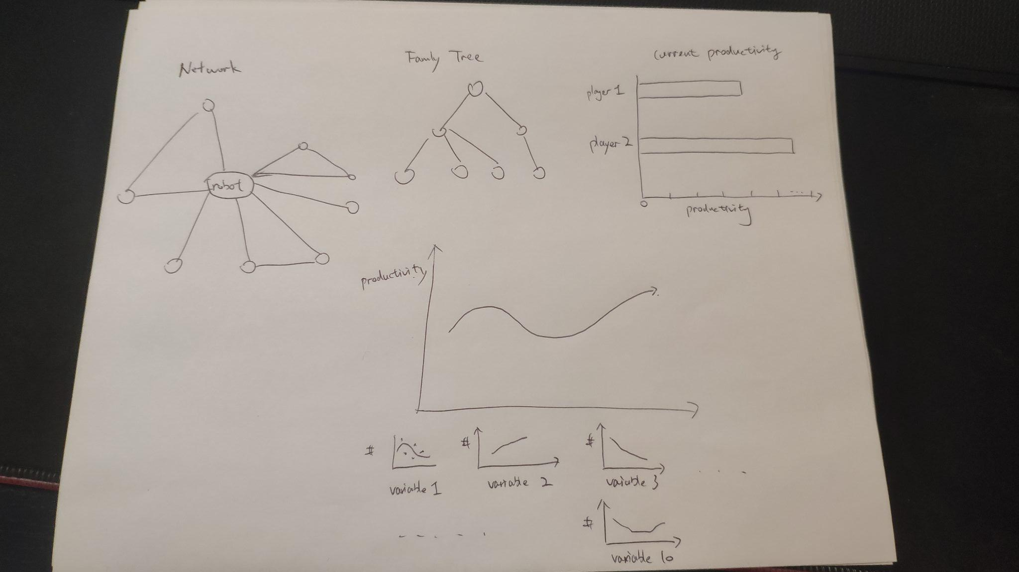
Designer 3 : My first sketch in round 1
Comments

Slide 21
Designer 3 : My second sketch in round 1
Comments

Slide 22
Designer 3 : My third sketch in round 1
Comments

Slide 23
Designer 4

Slide 24
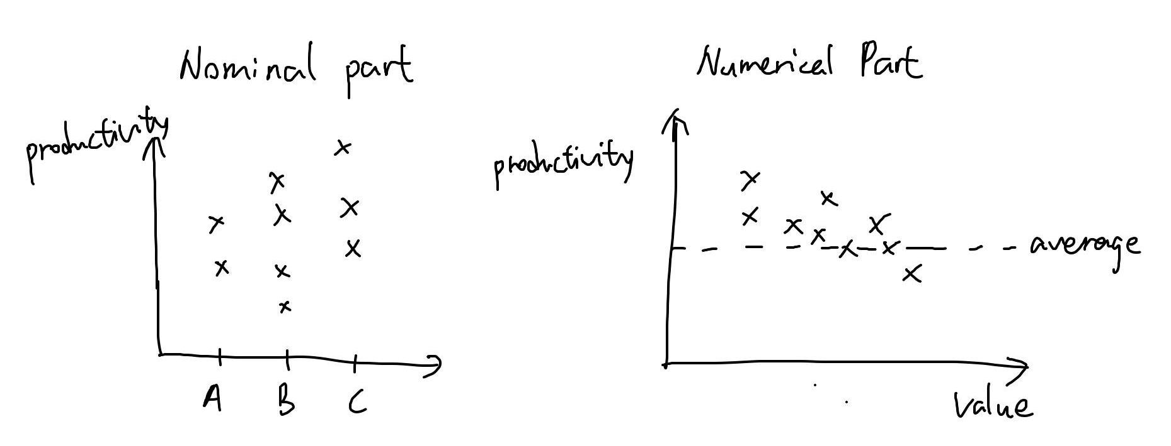
Designer 4 : My first sketch in round 1
Comments

Slide 25
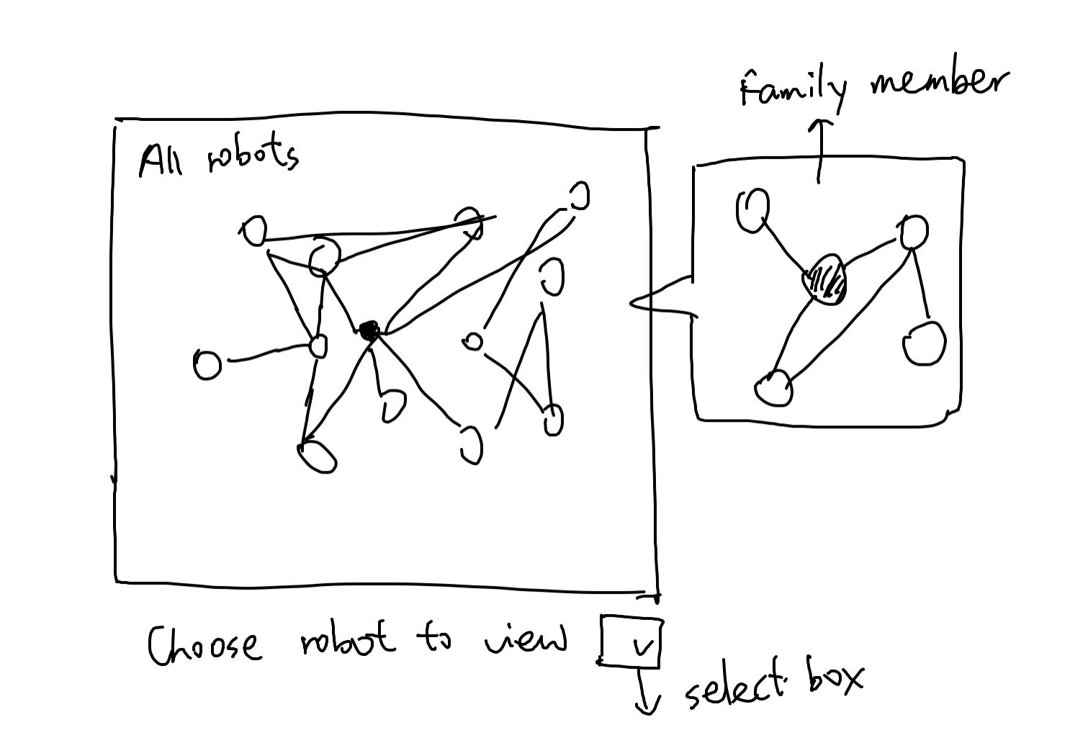
Designer 4 : My second sketch in round 1
Comments

Slide 26
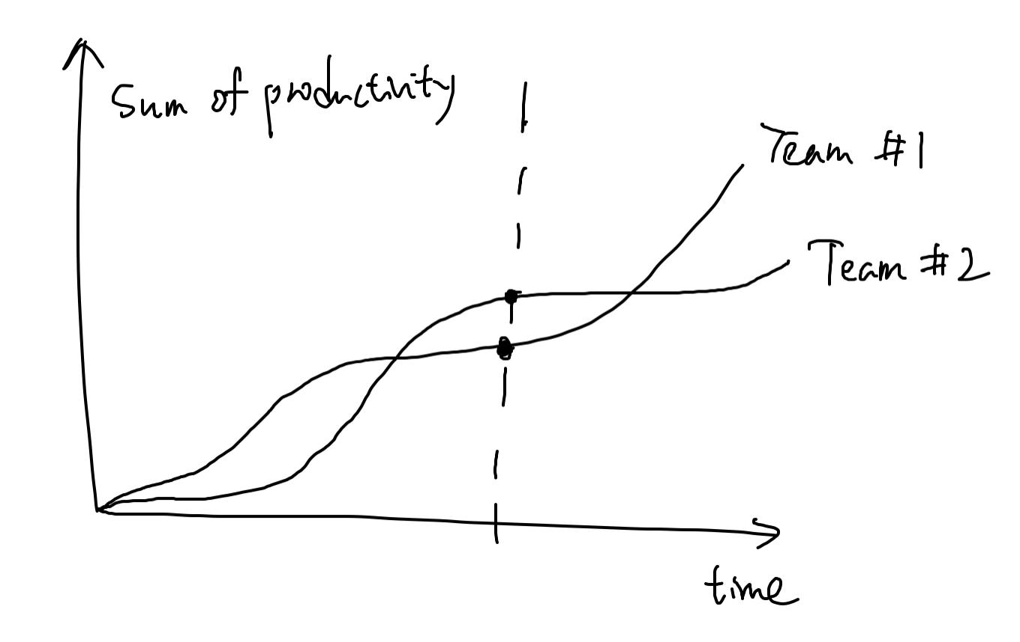
Designer 4 : My third sketch in round 1
Comments

Slide 27
Designer 5

Slide 28
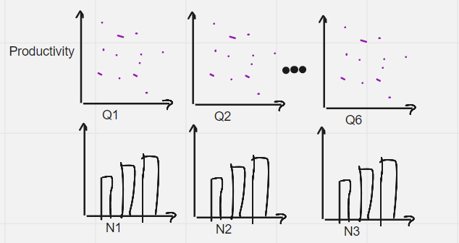
Designer 5 : My first sketch in round 1
Comments: The layer follows small multiples principles.
Scatter plot for Quantitative data, barplot for nominal data.

Slide 29
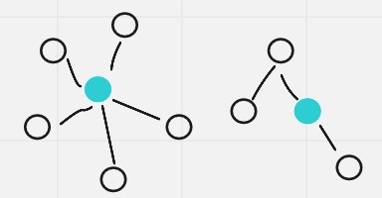
Designer 5 : My second sketch in round 1
Comments
Network graph and tree graph for social network and family tree.

Slide 30
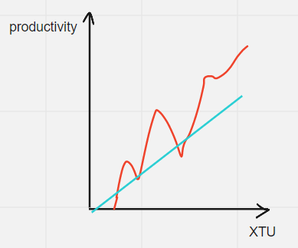
Designer 5: My third sketch in round 1
Comments
Two line plots representing the updating productivity of two teams.

Slide 31
Step 4 Individual Sketch 2

Slide 32
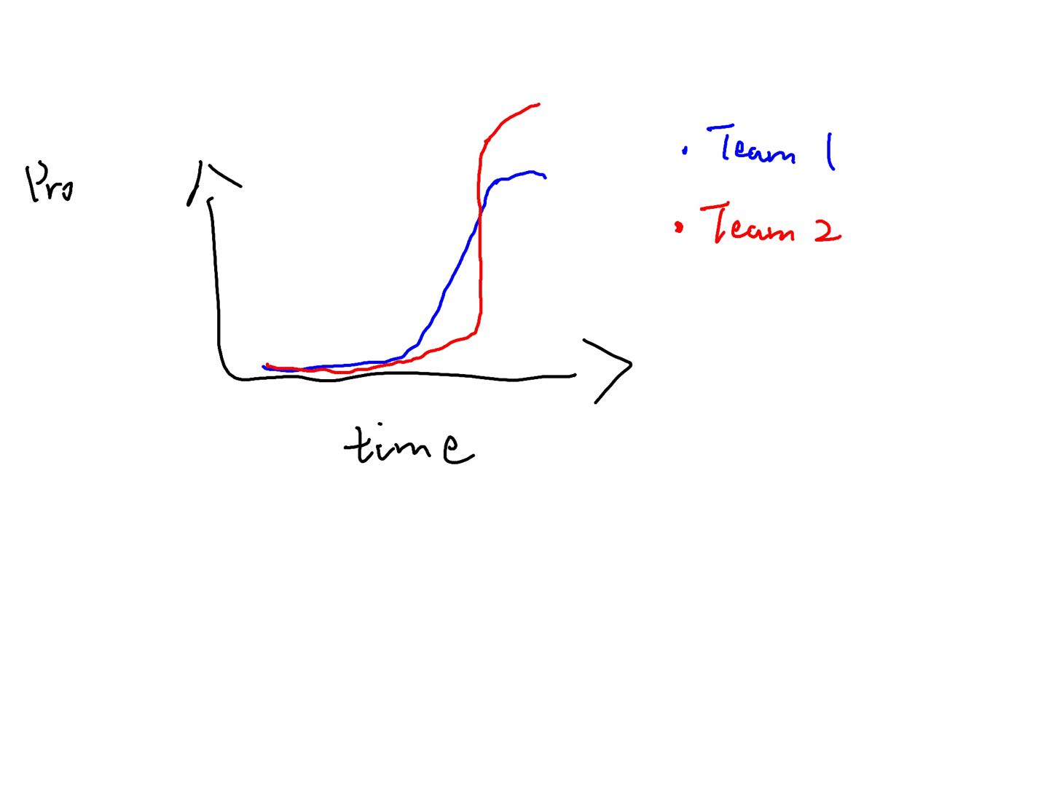
Designer 1 : My fourth sketch
Comments

Slide 33
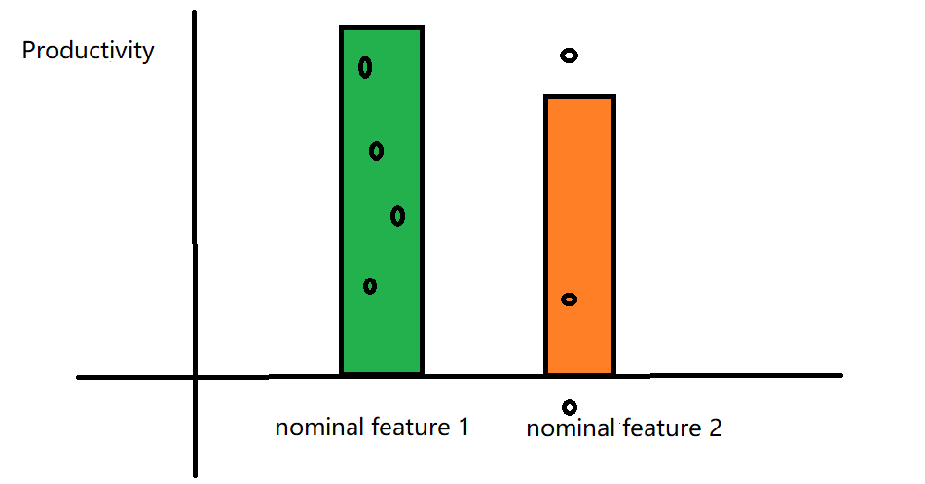
Designer 2: My fourth sketch
Comments

Slide 34
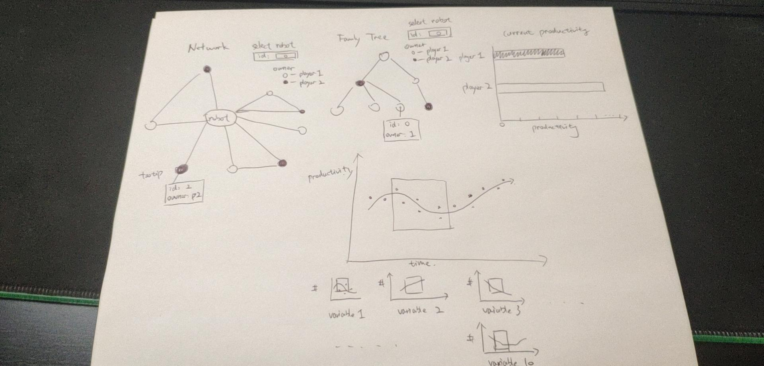
Designer 3 : My fourth sketch
Comments

Slide 35
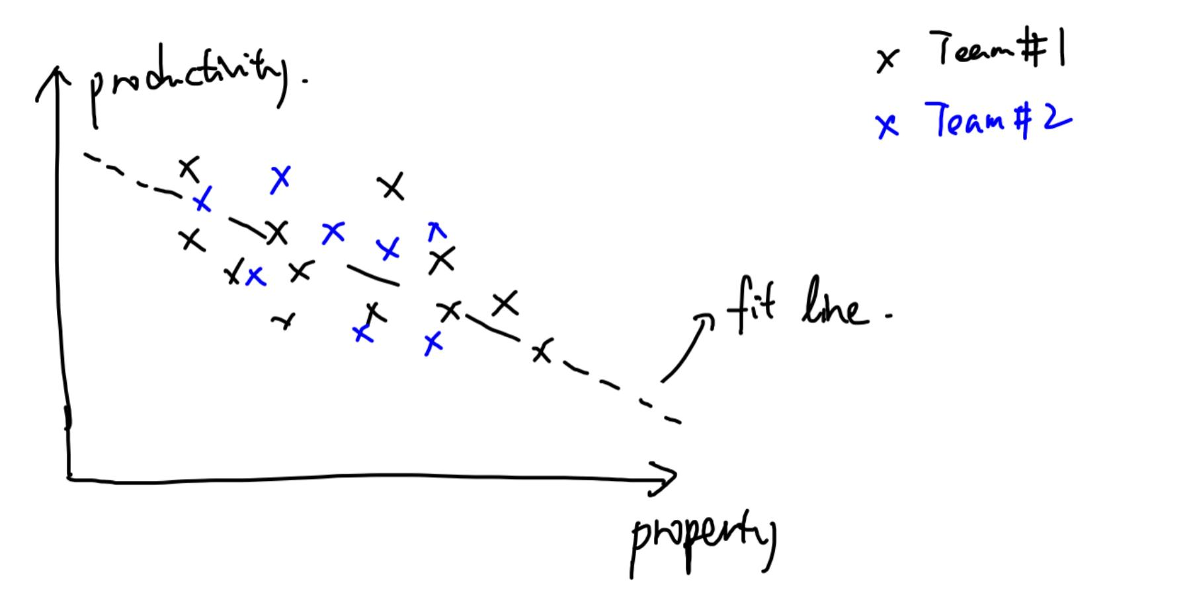
Designer 4 : My fourth sketch
Comments

Slide 36
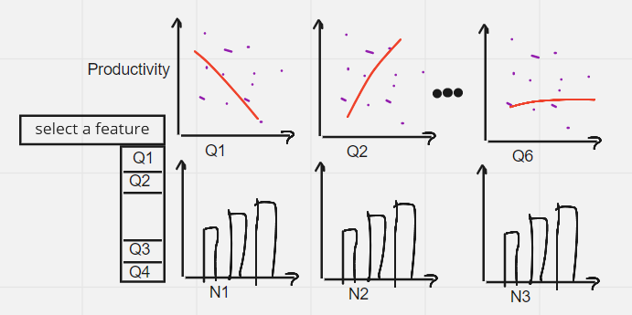
Designer 5 : My fourth sketch
Comments

Slide 37
Step 5 Consensus Sketch

Slide 38
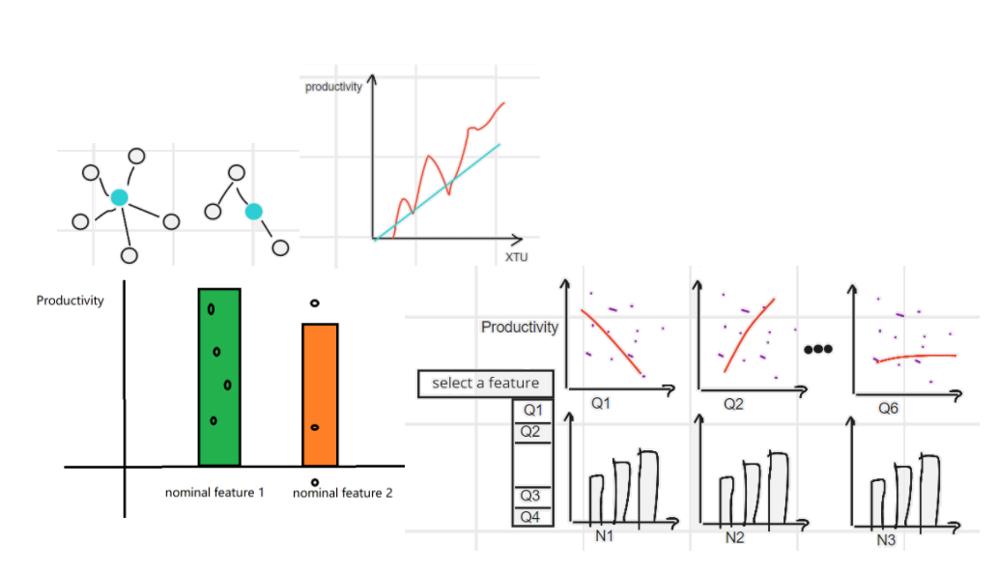
Team: Our Consensus Sketch

Slide 39
Team: Description of our design
Our design consists of three parts:
A line chart plotting the sum of productivity of robots for each team at each time point.
A network chart indicating the points in the social network of robots, where we can manually input the id of robot to display it as the center of the network. A tree graph showing the family for a specific robot we input.
Scatter plots for the relationship between quantitative parts of the robot and its productivity, with a linear regression line. Scatter plots for productivity and nominal parts, with a bar layer for the mean productivity of each category.

Slide 40
Notes

