Slide 1
Original Project Idea
For my final project, I will create a Spinning Globe using Three.js, a WebGL-based graphics library. The project will feature a 3D model of the Earth as a sphere, textured with a map of the globe. The globe will rotate continuously, simulating Earth’s rotation, and will include lighting to enhance realism.
Interactive Feature:
- Users can pause or resume the rotation using a button or keyboard input.
Demonstrates:
- Geometric objects
- Texture mapping
- Animation

Slide 2
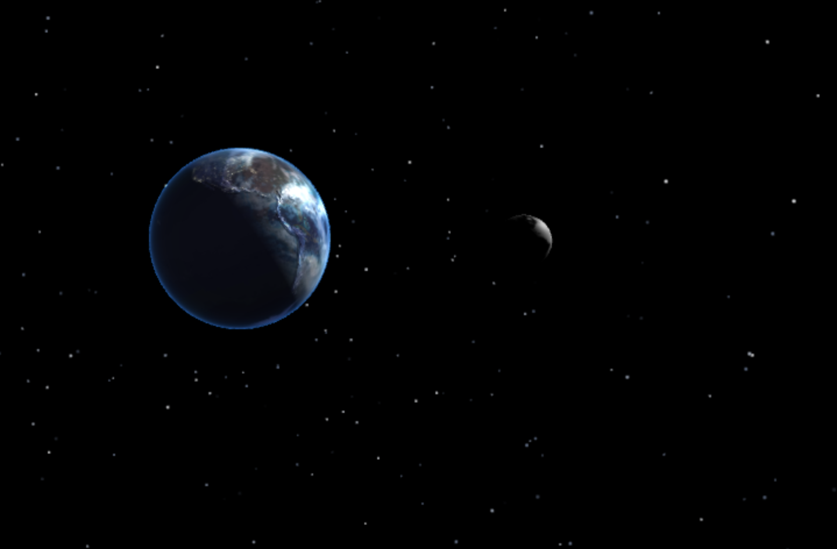
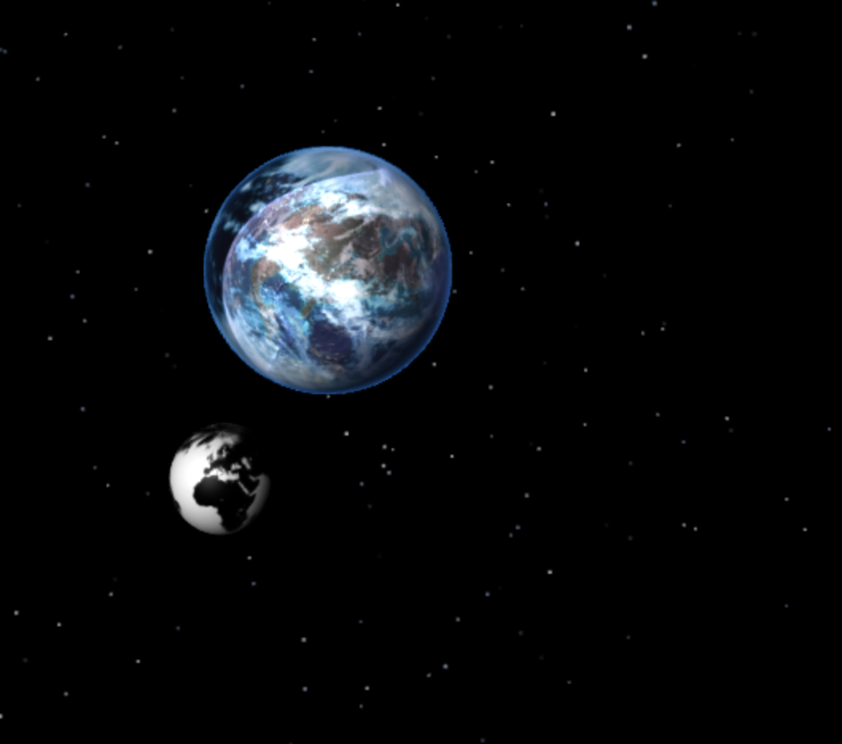
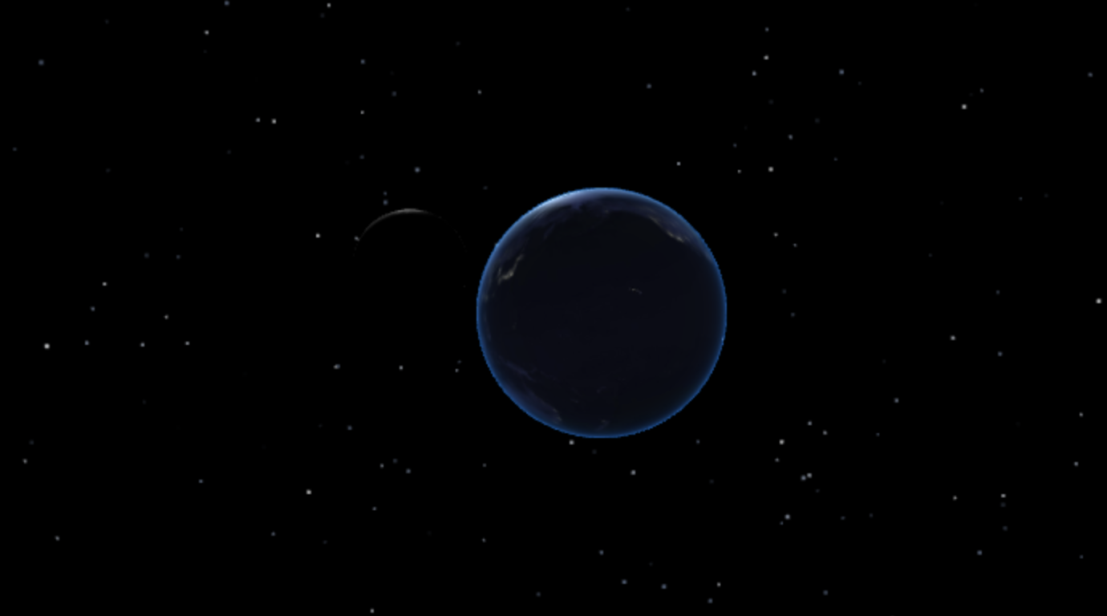
State of the Project
Features Implemented:
- Rotating Earth with realistic textures and lighting.
- Moon orbiting around the Earth.
- Random lightning flashes above the Earth.
- Starfield background simulating outer space.

Slide 3
Learning Challenges
Challenges Faced:
1. Understanding core Three.js concepts like texture mapping and materials.
2. Implementing animation for rotation and Moon's orbit.
3. Debugging missing textures, ensuring correct file paths, and variable scope issues.
4. Adding interactive features like lightning effects and Moon orbit.
Key Learnings:
- Experience with WebGL and Three.js for 3D graphics.
- Improved skills in animation and lighting in 3D environments.
- Importance of debugging and organized project structures.

