Slide 1
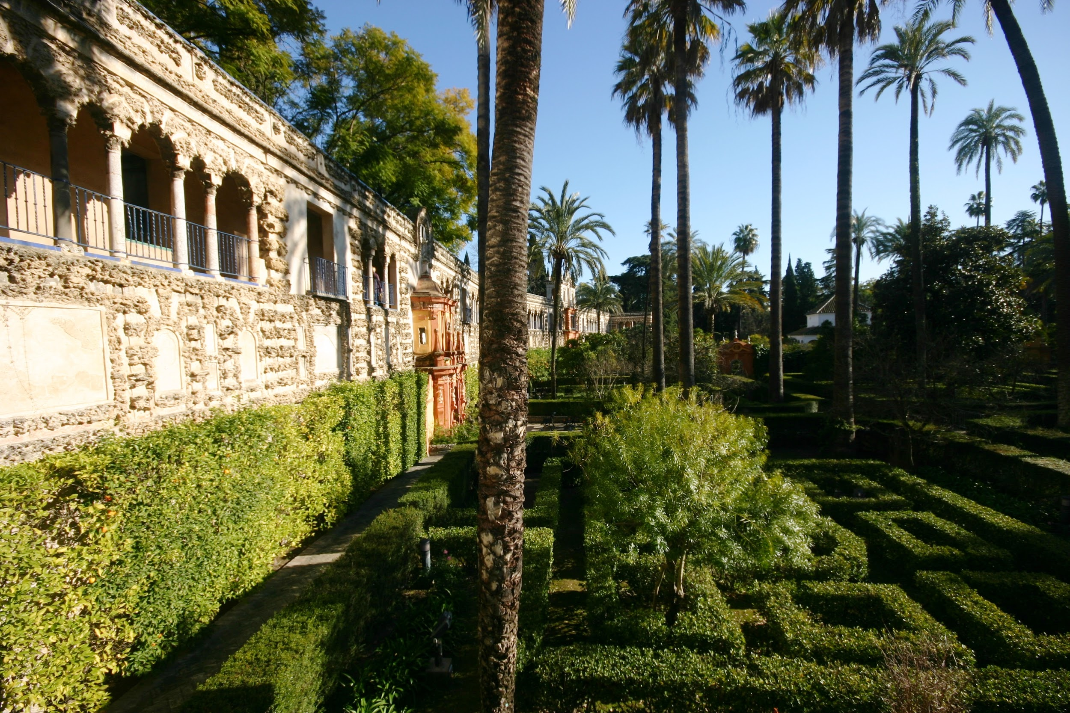
Seville Project

Slide 2
Summary
Projet presentation
Team presentation
Choices
Constraints
Second delivery
Changes made
Website presentation

Slide 3
Project presentation
Website
In the service of Seville’s culture
Discover the historical heritage

Slide 4
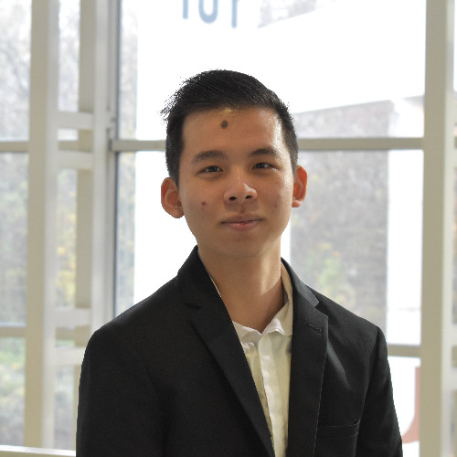
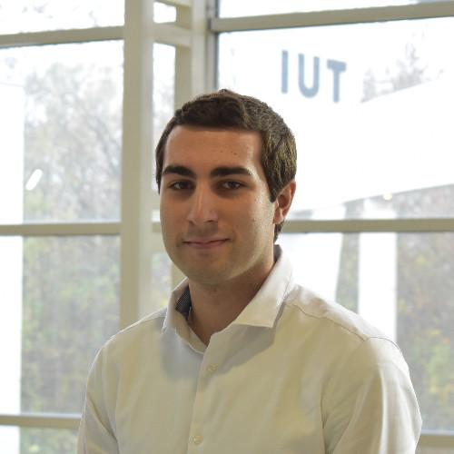
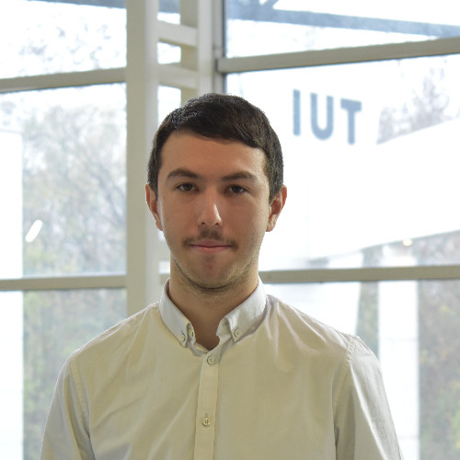
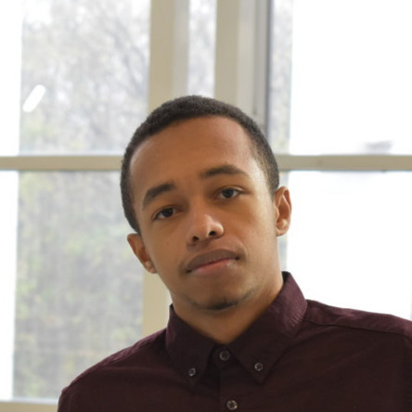
Team presentation
Davy Mu
Julien Quetin
Nathan Saucet
Teddy Ouazzani

Slide 5


Choices of content
Content
Available in English

Slide 6

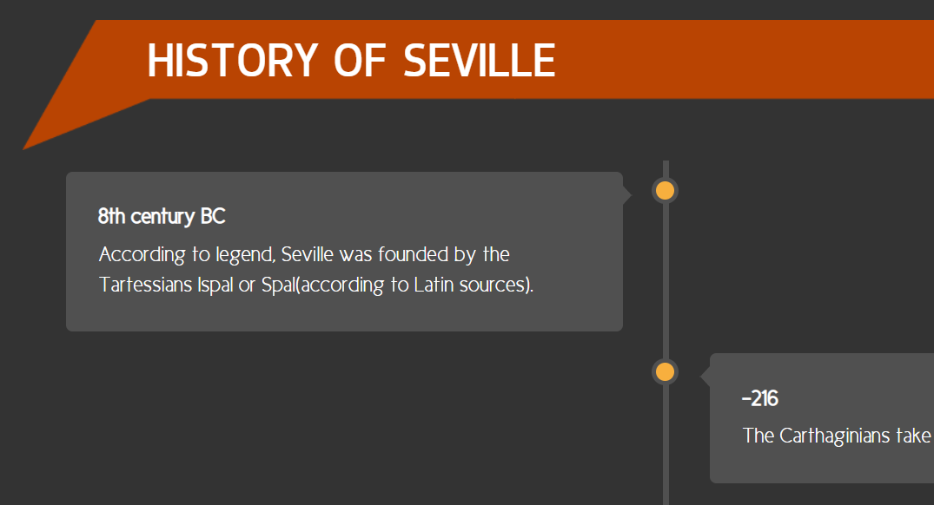
Graphical choices
Graphic charter

Slide 7
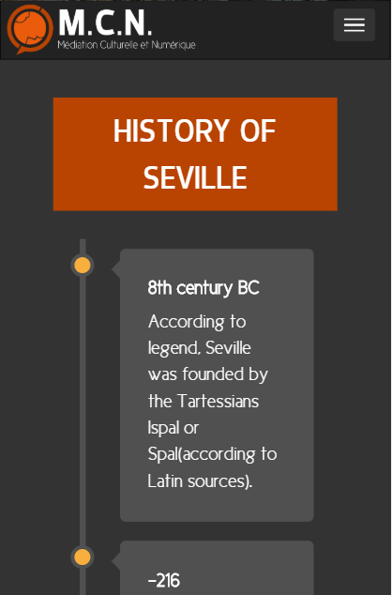



Technical choices
Responsive and dynamic
PHP
Framework

Slide 8
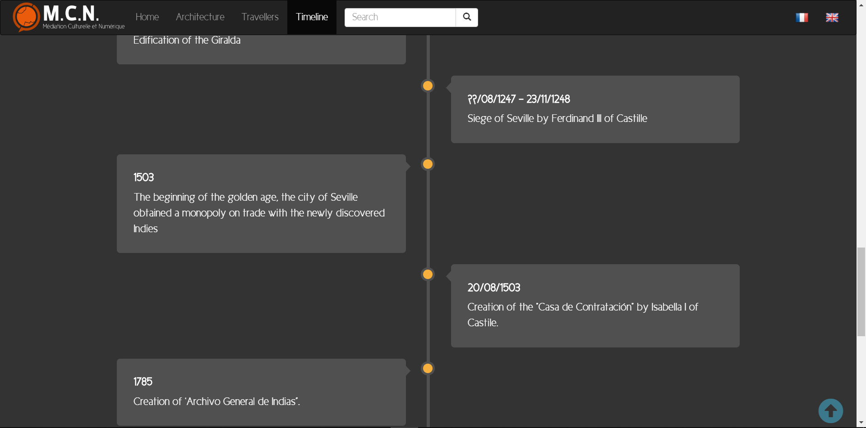
Ergonomic choices

Slide 9


Managerial choice
Content
Code

Slide 10
Constraints
Responsive website
Dynamic website
Time limit

Slide 11
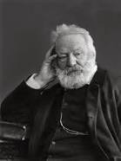

Second delivery
BootStrap
MySQL
Travellers writers

Slide 12
Changes made

Slide 13
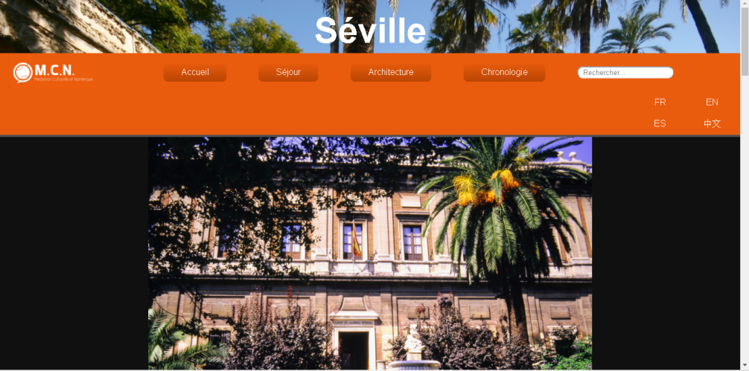
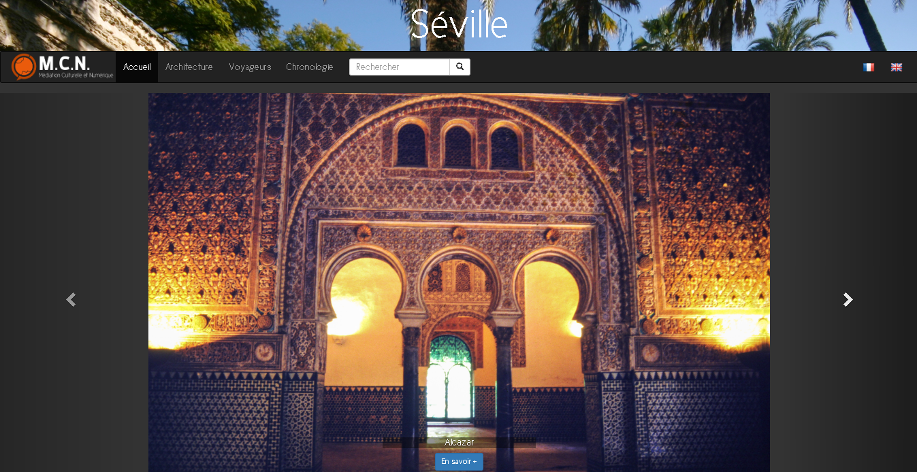

Slide 14
Website presentation
http://perso-etudiant.u-pem.fr/~nsaucet/en/

