Slide 1
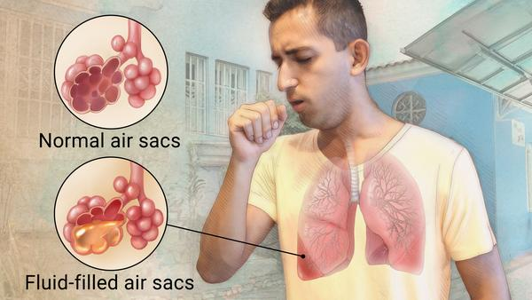
Hospital X-Ray
Predictions
Deztany Jackson
Phase 4 Project 4
March 30, 2023

Slide 2
Overview
Convolutional Neural Net models will be built to best predict if patient has a ”Normal or “Pneumonia” X-ray. The main stakeholder is for a local hospital to try out for potential staffing replacement.
Model: Convolutional Neural Net, Binary Classification
Classification Values: Normal, Pneumonia

Slide 3
Agenda
Business & Data Understanding
Modeling
Results
Limitations
Recommendations
Next Steps

Slide 4
Business and Data Understanding
Stakeholder: Local Hospital System
Use case: Predict “Pneumonia” cases
Dataset: 5856 Entries, T
Training Set: 3210 (Pneu), 1115 (Norm), .35 Ratio
Target Variable: Category[Pneumonia:1,Normal:0]
Primary Metrics: Recall, F1-Score, Loss

Slide 5
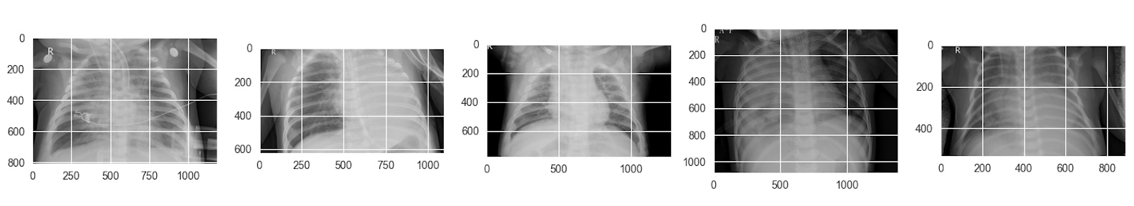
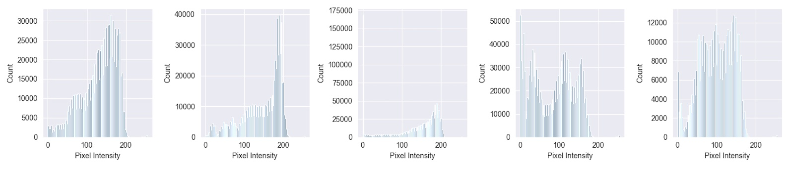
Pneumonia Pixel Distribution

Slide 6
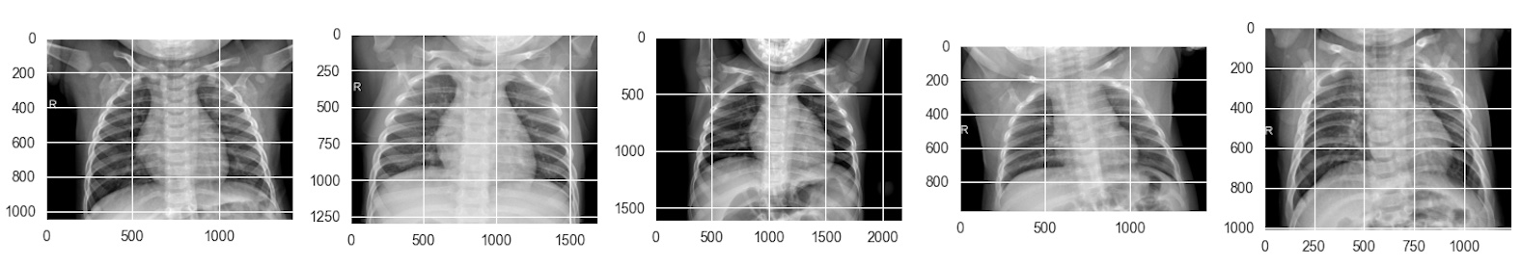
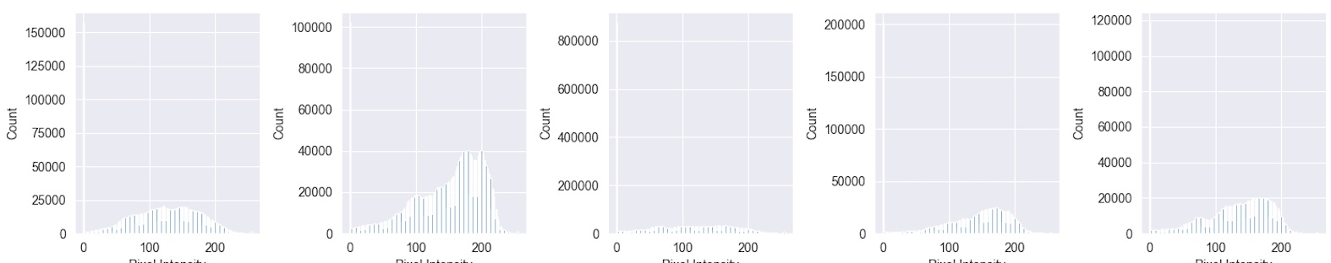
Normal Pixel Distribution

Slide 7
Modeling
Iteratively produce models. As new information was learned new models, parameters and transformation techniques were applied.
Model 1 Baseline
Model 2-3 Baseline Modification
Model 4-7 Hyperparameter optimization
Model 8-10 Transfer Learning
Final Model

Slide 8
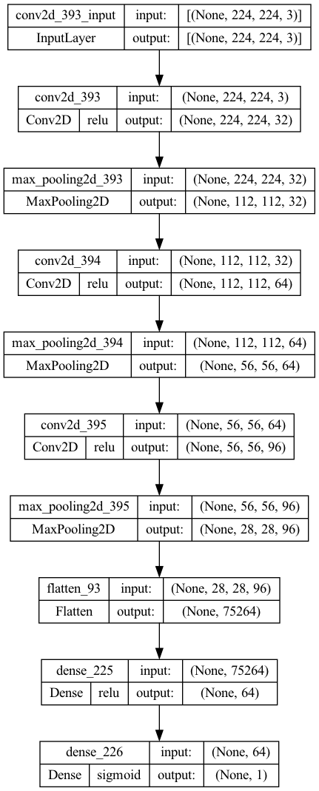
Evaluation
The Final Model metrics (Normal):
Recall Score (Lowest False Neg) : ~.04
F1 Score(Harmonic Mean): ~.07
The Final Model metrics (Pneumonia):
Recall Score (Lowest False Neg) : ~.94
F1 Score(Harmonic Mean): ~.75
Final Model Loss (Error Accuracy): ~.68
Final Model Architecture

Slide 9
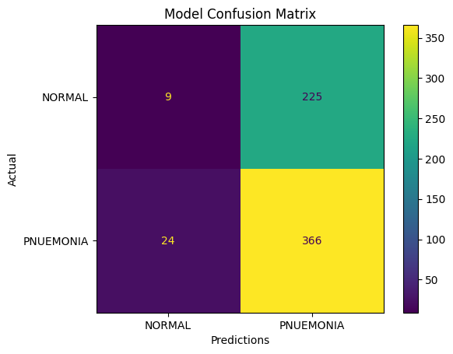
Final Model’s Prediction
Accurate “Normal” Prediction: 9
Incorrect “Normal” Prediction: 24
Accurate “Pneumonia” Prediction: 366
Incorrect “Pneumonia Prediction: 225

Slide 10
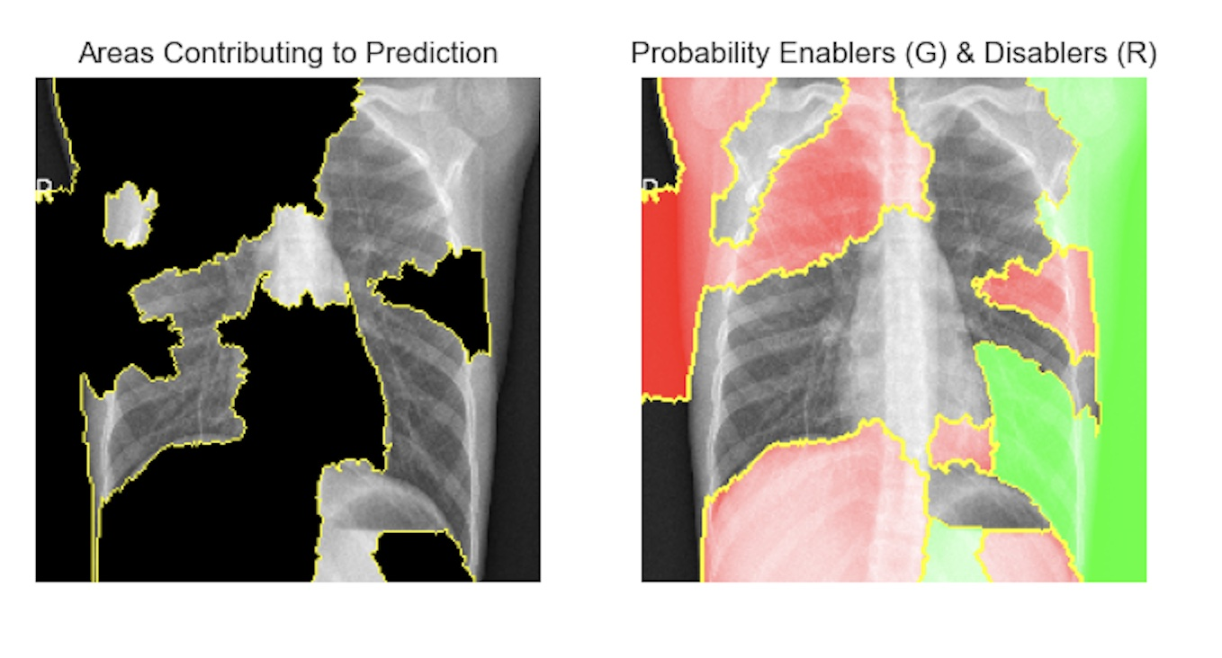
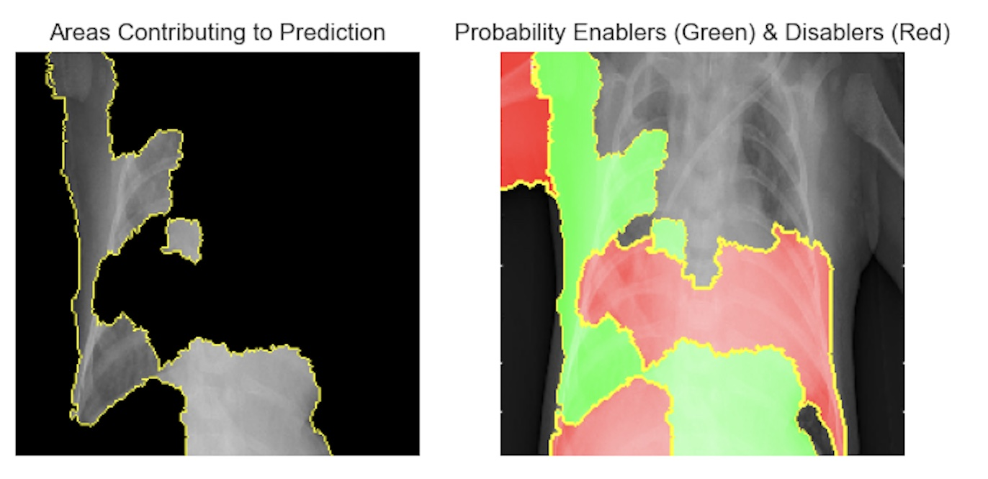
Final Model’s Prediction
Inaccurate Normal (FN)
Accurate Pneumonia (TP)

Slide 11
Conclusion: Limitations
Hospital:
Important image areas
Radiologist SME knowledge
Technical:
Hardware and Software Compatibility (Modeling on M2 GPU Laptop)
Hyperparameter optimization limits
Blackbox of Hidden Layers
Notes:
**Limited dataset:**
- The full dataset was filtered and scoped due to limited resources. There were attributes (features) in the dataset that would have supported a more accurate and model.
- Dataset does not take into account aesthietics. There are no features or pictures evaluating this aspect.
- **Unknown realistic "Condition" and "Grade" values:**
- Lack of knowledge on knowing whata realistic increase in "condition" and "grade" would be from the baseline. All chosen instances in the dataset were increased to the same values. It may be unrealistic to have a home in poor condition and below minimum building stards actually increase to "good" in both.
- **Unknown affects on other variables:**
- The "condition" and "grade" feeatures wree the only ones modified from the intial dataset. Home improvements would definitely affect those features. However, home improvements done on a home might also affect features like sqft_living, floors, bathrooms or bedrooms in some way.
- **Communal effects:**
- The predictions were based on the modication of specific features for an individual home. The predicitons did not take into account how the home improvements would affect the surrounding comparible homes. This is common task done in real estate.
- **Model approach fit for specific problem:**
- The model developed was for a specific problem. Understanding how home improvement how affect home values and the amount of the difference. Other usecases and problems were not taken into account. There may be insights to game from the model and predictions that
- **Time/Resources:**
- Because of limited time and skillset a "good enough" model was delivered. The datasets, techniquesm model robustness had to be scoped.
- **Actual market culture:**
- The dataset used wasn't the most current. These last two years have had major shifts in the supply and demand of homes. Therefore a shift in the home value estimates shift as well.
- **External effects:**
- The model and predictions did not account for external effects that were not attributes of the home and its property.
- **Data scientist skillset:**
- As a new data scientist the the model robustness is limited due to experience and skills.

Slide 12
Conclusion: Recommendations
Usage: The model is best as a learning tool and not an official diagnosis.
Strategy: Use the model as an initial reviewer of the images.
Staffing: The model is best used with a doctor, not standalone.
Notes:
**Limited dataset:**
- The full dataset was filtered and scoped due to limited resources. There were attributes (features) in the dataset that would have supported a more accurate and model.
- Dataset does not take into account aesthietics. There are no features or pictures evaluating this aspect.
- **Unknown realistic "Condition" and "Grade" values:**
- Lack of knowledge on knowing whata realistic increase in "condition" and "grade" would be from the baseline. All chosen instances in the dataset were increased to the same values. It may be unrealistic to have a home in poor condition and below minimum building stards actually increase to "good" in both.
- **Unknown affects on other variables:**
- The "condition" and "grade" feeatures wree the only ones modified from the intial dataset. Home improvements would definitely affect those features. However, home improvements done on a home might also affect features like sqft_living, floors, bathrooms or bedrooms in some way.
- **Communal effects:**
- The predictions were based on the modication of specific features for an individual home. The predicitons did not take into account how the home improvements would affect the surrounding comparible homes. This is common task done in real estate.
- **Model approach fit for specific problem:**
- The model developed was for a specific problem. Understanding how home improvement how affect home values and the amount of the difference. Other usecases and problems were not taken into account. There may be insights to game from the model and predictions that
- **Time/Resources:**
- Because of limited time and skillset a "good enough" model was delivered. The datasets, techniquesm model robustness had to be scoped.
- **Actual market culture:**
- The dataset used wasn't the most current. These last two years have had major shifts in the supply and demand of homes. Therefore a shift in the home value estimates shift as well.
- **External effects:**
- The model and predictions did not account for external effects that were not attributes of the home and its property.
- **Data scientist skillset:**
- As a new data scientist the the model robustness is limited due to experience and skills.

Slide 13
Conclusion: Next Steps
Iterate model improvement with with augmented data
Gather more images to train
Visually inspect the images that were inaccurate.
Increase consultation with the data scientist/analyst to improve our domain knowledge and more specific feature criteria

Slide 14
Thank You!
Email: dmvinedata@gmail.com
GitHub: @dmvinedata
LinkedIn: linkedin.com/in/deztanyjackson/

