Slide 1
Real Estate Home Improvement Price Predictions
Deztany Jackson
Data Science Flex
Phase 2 Project
January 6, 2023

Slide 2
Overview
Real Estate agents in King County, Seattle are evaluating the neighborhoods to encourage current home owners of he benefits of improving and upgrading their property value.
Model: Multi-Linear Regression
Top Attributes: Grade, Condition & Sqft Living

Slide 3
Agenda
Business & Data Understanding
Modeling
Regression Results
Limitations
Recommendations
Path Forward

Slide 4
Business and Data Understanding
Main Features | Description
Home Price | Price will be out target variable. Price is the amount of the house in context of the current attributes.
Sqft Living | The size of the livable space in the house
Condition | How good the overall condition of the house is. Related to maintenance of house.
Grade | Overall grade of the house. Related to the construction and design of the house.
Stakeholder: Real Estate Agency
Use case: Improvements Home Value Change
Dataset Filtered: 20 → 11 Features
Target Variable: Home Price
Main Coefficients: Sqft Living, Condition & Grade
Modified Prediction Variables: Condition & Grade
Feature | Description
Bedrooms | Number of bedrooms for the given home
Bathrooms | Number of bathrooms for the given home
Sqft Lot | The size of the lot
Floors | The Number of Floors.
Waterfront | Whether the house is on a waterfront
Yr Built | Year when house was built
Zipcode | ZIP Code used by the United States Postal Service

Slide 5
Modeling
A multi-linear regression model was created predicting housing prices . The model created to do this used an initial subset of data (from King County database) to process, train and test for this problem.
Developed using data science and python language
Developed over several iterations to refine accuracy
The final accuracy metrics:
Price Prediction Error (Root Mean Square Error [RMSE Score]): ~$197,000
Model Goodness( R2 Score ): 66%

Slide 6
Results
Grade Feature: For every one-unit increase in the Grade, the home value increases by about 26%.
Condition Feature: For every one-unit increase in the Condition, the home value increases by about 3%.
Sqft_living Feature: For every 1% increase in the sqft, the home value increases by about 4%.
Data Features Modified for New Predictions*:
Condition: 3-Average or less → 4-Good
Grade: 6-Low Average or less → 8-Good
*Used Zipcodes to group homes

Slide 7
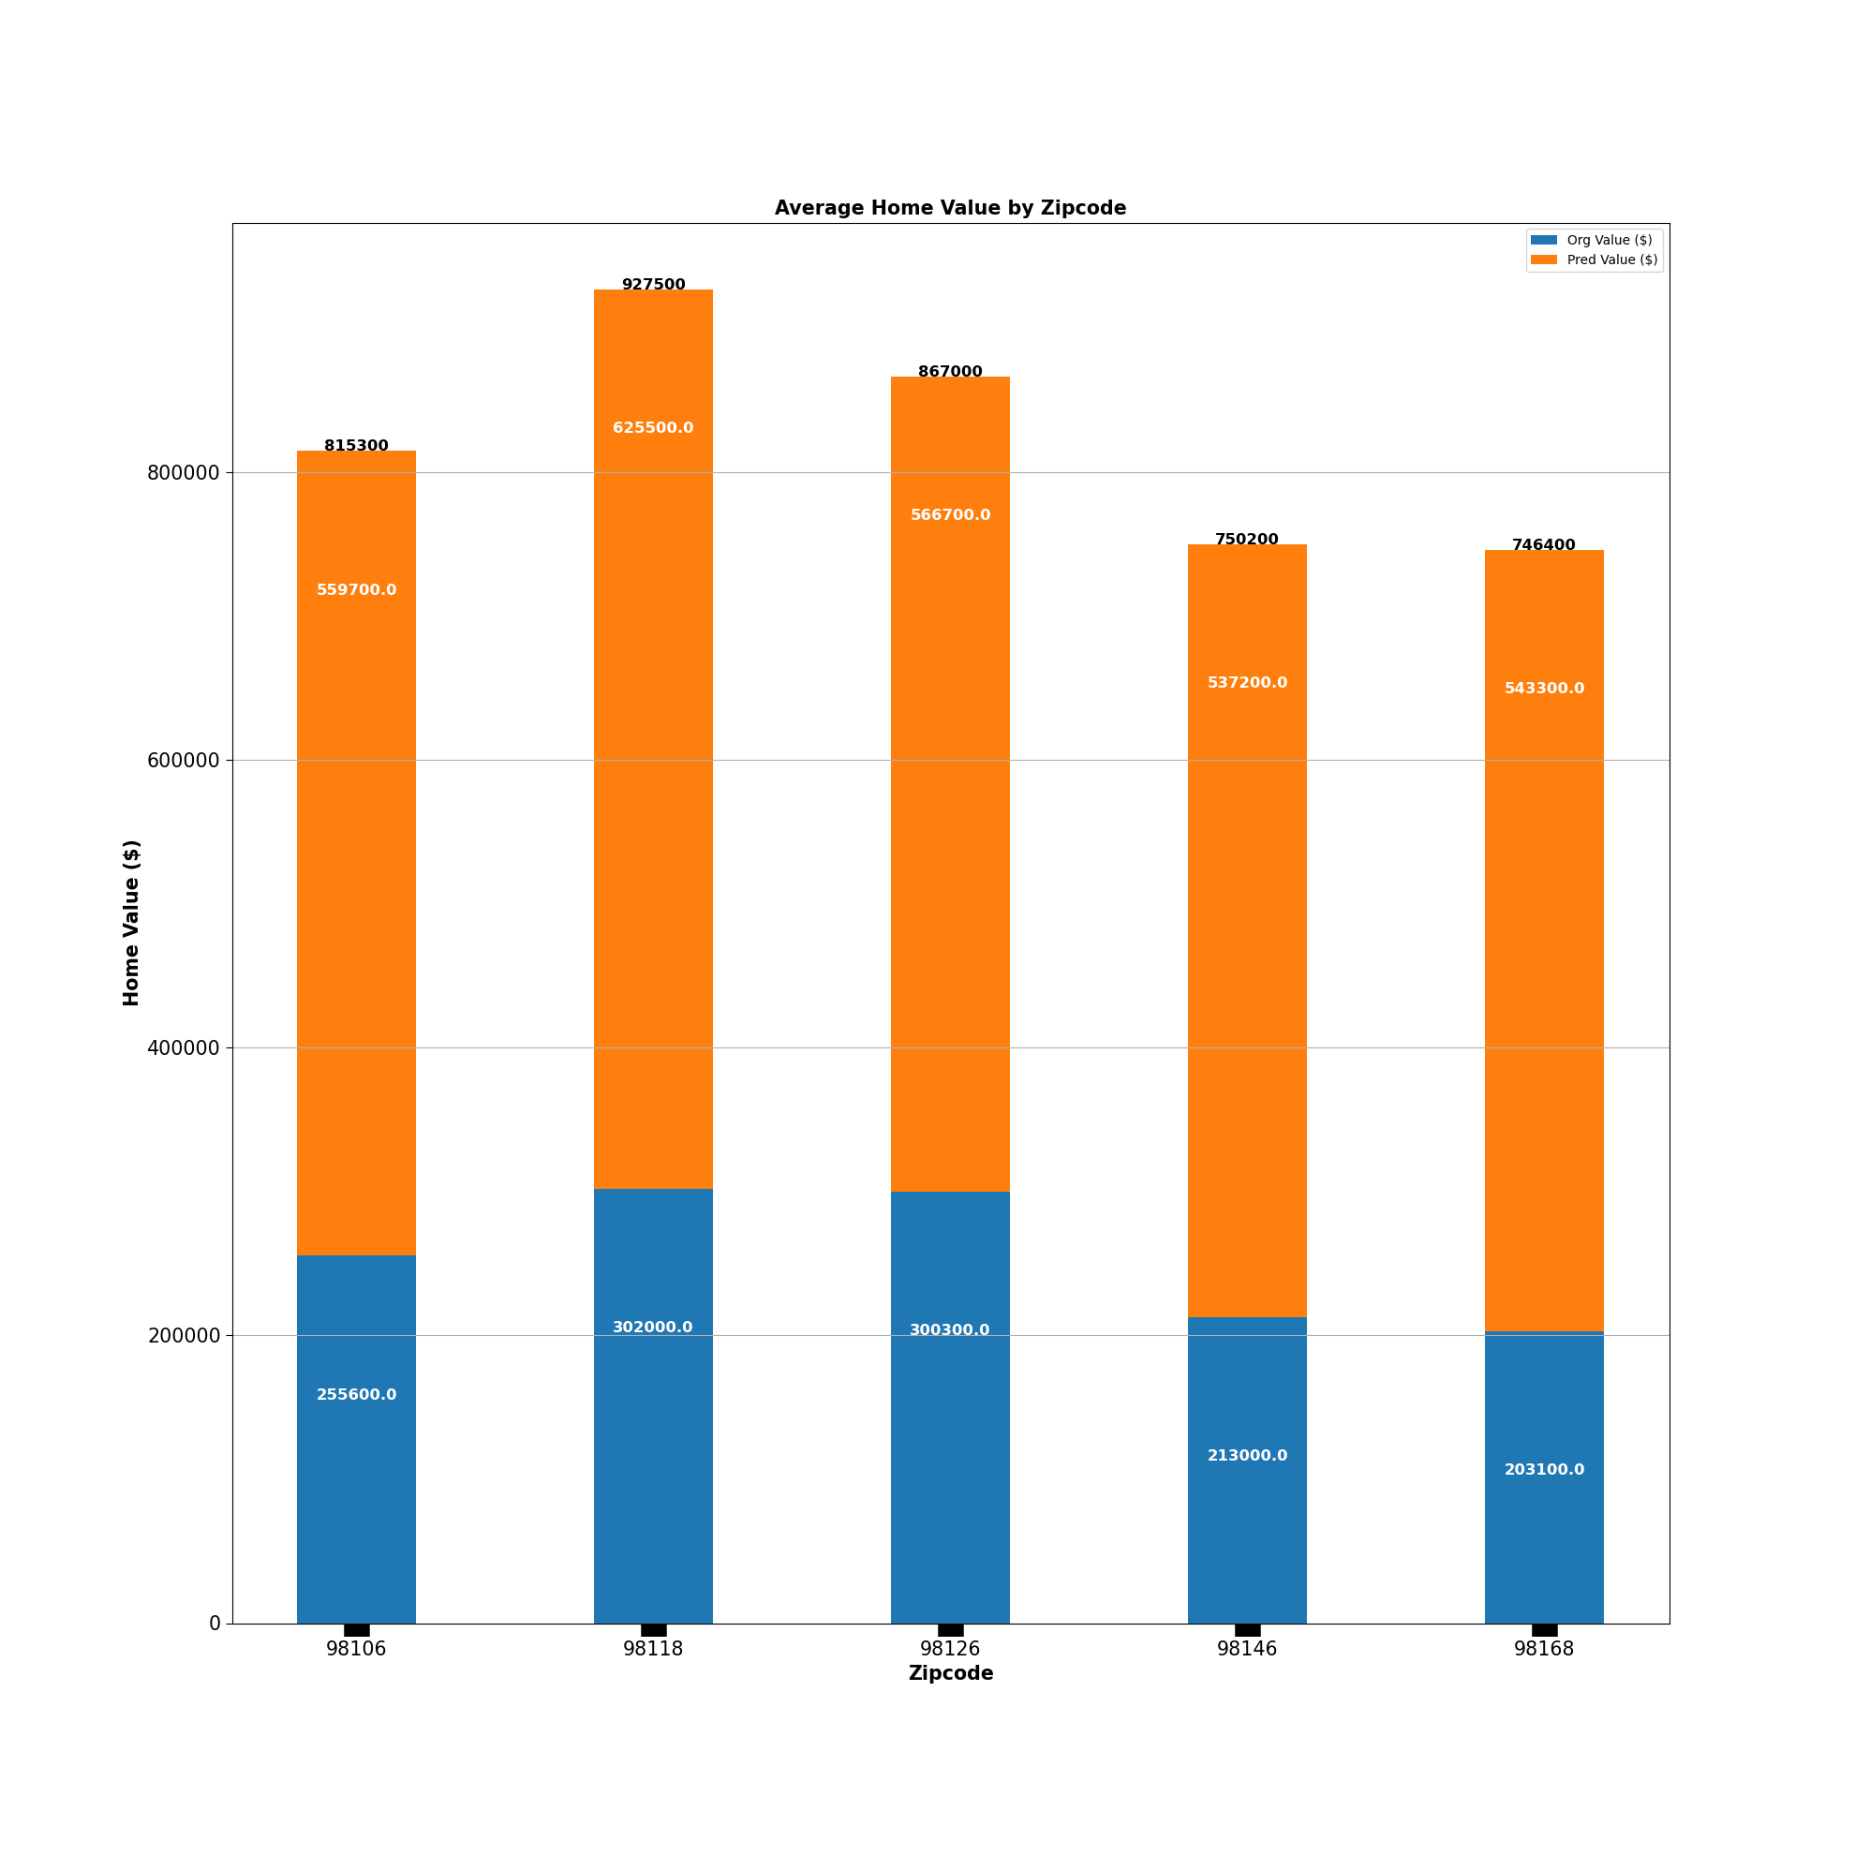
Top 5 Zipcode Averages
Average home value differences :
Zipcode 98118: $ 323,500, 100% Increase
Zipcode 98106: $ 304,100, 100% Increase
Zipcode 98126: $ 266,500, 100% Increase
Zipcode 98146: $ 324,300, 200% Increase
Zipcode 98168: $340,300, 200% Increase

Slide 8
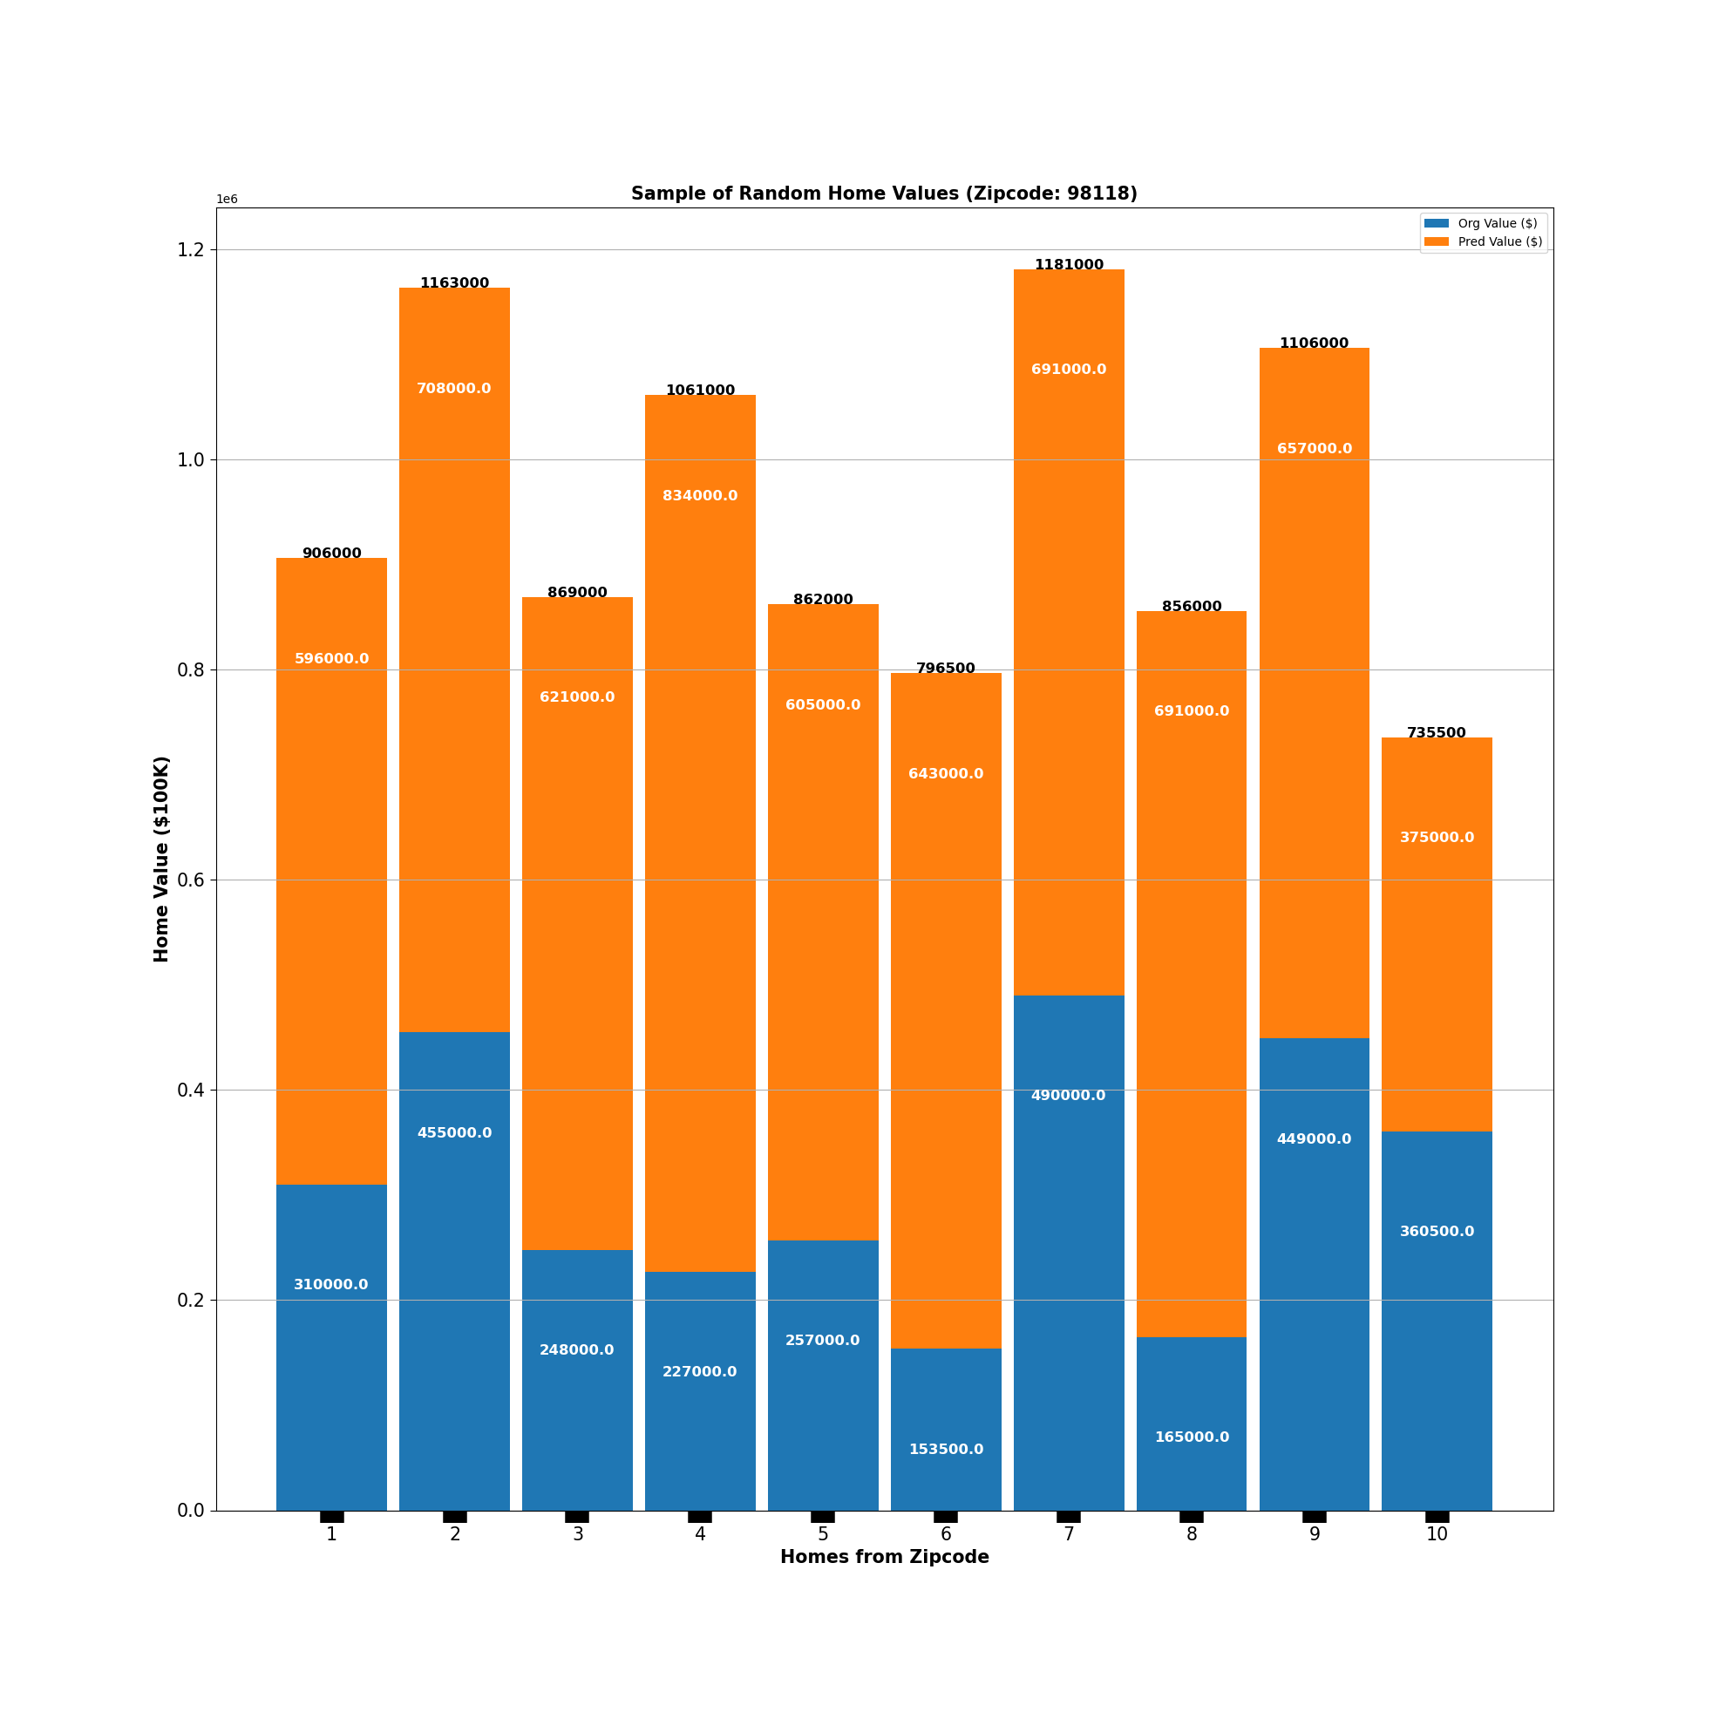
Zipcode 98118
Zipcode 98188 home value differences:
Lowest: $14,500 Increase
Highest: $624,000 Increase

Slide 9
Conclusion: Limitations
Limited dataset
Unknown realistic "Condition" and "Grade" values
Unknown affects on other variables
Communal effects
Model approach fit for specific problem
Actual market culture
External effects
Time/Resources
Data scientist skillset
Notes:
**Limited dataset:**
- The full dataset was filtered and scoped due to limited resources. There were attributes (features) in the dataset that would have supported a more accurate and model.
- Dataset does not take into account aesthietics. There are no features or pictures evaluating this aspect.
- **Unknown realistic "Condition" and "Grade" values:**
- Lack of knowledge on knowing whata realistic increase in "condition" and "grade" would be from the baseline. All chosen instances in the dataset were increased to the same values. It may be unrealistic to have a home in poor condition and below minimum building stards actually increase to "good" in both.
- **Unknown affects on other variables:**
- The "condition" and "grade" feeatures wree the only ones modified from the intial dataset. Home improvements would definitely affect those features. However, home improvements done on a home might also affect features like sqft_living, floors, bathrooms or bedrooms in some way.
- **Communal effects:**
- The predictions were based on the modication of specific features for an individual home. The predicitons did not take into account how the home improvements would affect the surrounding comparible homes. This is common task done in real estate.
- **Model approach fit for specific problem:**
- The model developed was for a specific problem. Understanding how home improvement how affect home values and the amount of the difference. Other usecases and problems were not taken into account. There may be insights to game from the model and predictions that
- **Time/Resources:**
- Because of limited time and skillset a "good enough" model was delivered. The datasets, techniquesm model robustness had to be scoped.
- **Actual market culture:**
- The dataset used wasn't the most current. These last two years have had major shifts in the supply and demand of homes. Therefore a shift in the home value estimates shift as well.
- **External effects:**
- The model and predictions did not account for external effects that were not attributes of the home and its property.
- **Data scientist skillset:**
- As a new data scientist the the model robustness is limited due to experience and skills.

Slide 10
Conclusion: Recommendations
Low Hanging Fruit: Focus on zipcodes with major improvement needs to bring up home values.
At a minimum promote increasing conditions (e.g. basic maintenance) in the homes.
Promote bring homes up to Average code (this increases the grade, which impacts home values the most).
Promote ,increasing sqft living area by adding a small room (e.g. bathroom, small bedroom).

Slide 11
Conclusion: Next Steps
Choose and present incentives and vision of home improvement within a community.
This incentivizes people and helps with accountability.
Market to potential homebuyers (individuals and investors) of the potential return on investment.
These homebuyers may potentially buy the homes before the improvements and then fix them up.
Increase consultation with the data scientist/analyst to improve our domain knowledge.
As both parties educate each other the model solution has a better chance at being more accurate and robust.

Slide 12
Thank You!
Email: dmvinedata@gmail.com
GitHub: @dmvinedata
LinkedIn: linkedin.com/in/deztanyjackson/

