Slide 1

Paris Real Estate Property
Predictions
Deztany Jackson
Data Science Flex
Phase 3 Project
February 24, 2023

Slide 2
Overview
Classification models will be built to best predict "Luxury" property for a Paris Real Estatee investment agency to support leasing to potential clients
Model: Binary Classification
Classification Values: Basic, Luxury

Slide 3
Agenda
Business & Data Understanding
Modeling
Results
Limitations
Recommendations
Next Steps

Slide 4
Business and Data Understanding
Target Attribute | Description
Category | Classification of Real Estate (Basic or Luxury)
Importance Level | Top Important Features
1 | Has_Yard
2 | Has_Pool
3 | Num_of_Guest_Rooms
4 | Num_of_Rooms
5 | Building_Size(m)
Stakeholder: Paris Real Estate Agency
Use case: Predict “Luxury” Property Data
Dataset: 10000 Entries;18 Features/Attributes
Target Variable: Category [“Basic”,”Luxury”]

Slide 5
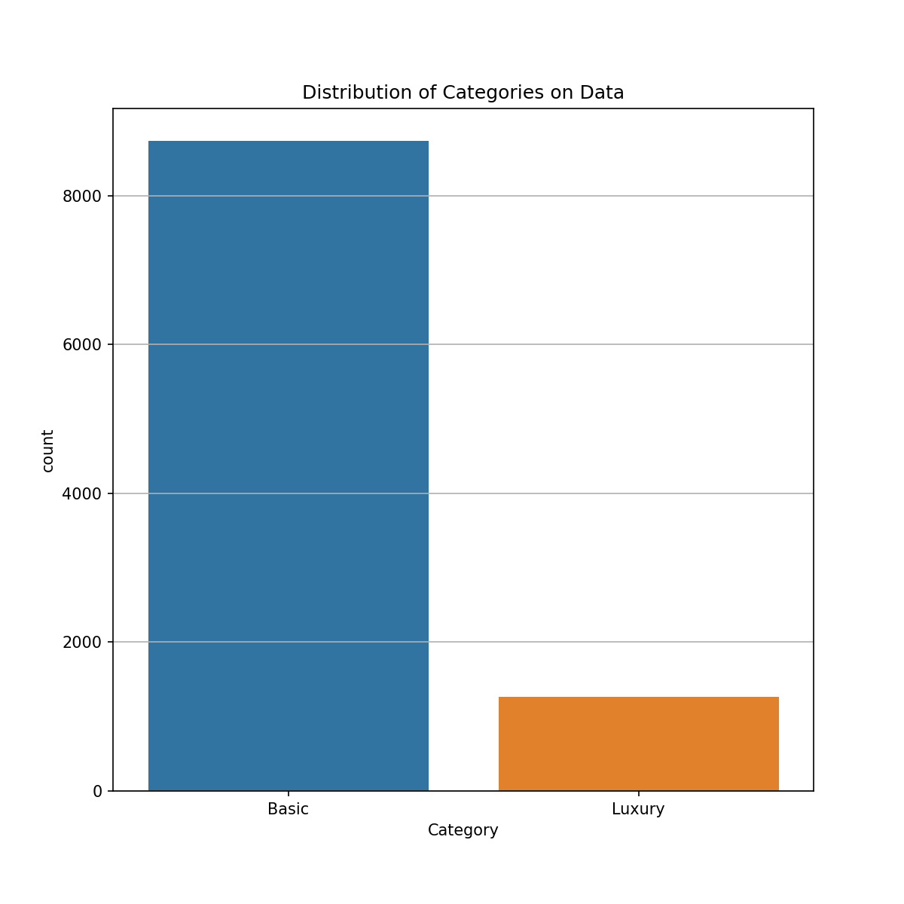
Distribution of Categorical Data
Basic Instances: 8735/10000 (87%)
Luxury Instances:1265/10000 (13%)

Slide 6
Modeling
Iteratively produce models. As new information was learned new models, parameters and transformation techniques were applied.
Dummy Model
Simple Model: Logistic Regression, Decision Tree and Random Forrest
Standardizations & Balancing Data
Best Model from optimization of Parameters

Slide 7
Evaluation
Best Model:
Standardize Data
Synthetic Data
Random Forest Classier ( w/ 10 Decision Trees)
The Final metrics:
Precision Score (Correct Predictions) : .52 (Better than Random Guessing)
F1 Score(Harmonic Mean): .13
Most Important Features (Ref Slide 4.):
Yard and Pool

Slide 8
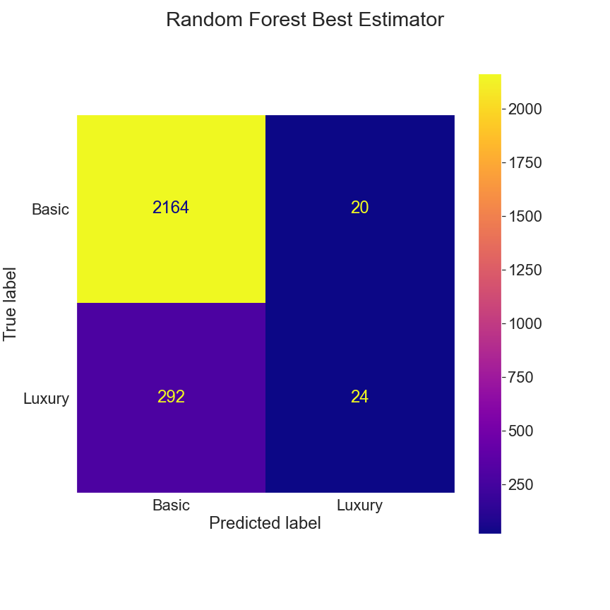
Best Model’s Prediction
Accurate “Luxury” Prediction: 24
Incorrect “Luxury” Prediction: 20
Accurate “Basic” Prediction: 2164
Incorrect “Basic” Prediction: 292

Slide 9
Conclusion: Limitations
Imbalanced data between "Basic" and “Luxury" properties
Used synthetic data
Limited computing resources
Limited knowledge of stakeholders requirements
No knowledge on the condition of property.
Notes:
**Limited dataset:**
- The full dataset was filtered and scoped due to limited resources. There were attributes (features) in the dataset that would have supported a more accurate and model.
- Dataset does not take into account aesthietics. There are no features or pictures evaluating this aspect.
- **Unknown realistic "Condition" and "Grade" values:**
- Lack of knowledge on knowing whata realistic increase in "condition" and "grade" would be from the baseline. All chosen instances in the dataset were increased to the same values. It may be unrealistic to have a home in poor condition and below minimum building stards actually increase to "good" in both.
- **Unknown affects on other variables:**
- The "condition" and "grade" feeatures wree the only ones modified from the intial dataset. Home improvements would definitely affect those features. However, home improvements done on a home might also affect features like sqft_living, floors, bathrooms or bedrooms in some way.
- **Communal effects:**
- The predictions were based on the modication of specific features for an individual home. The predicitons did not take into account how the home improvements would affect the surrounding comparible homes. This is common task done in real estate.
- **Model approach fit for specific problem:**
- The model developed was for a specific problem. Understanding how home improvement how affect home values and the amount of the difference. Other usecases and problems were not taken into account. There may be insights to game from the model and predictions that
- **Time/Resources:**
- Because of limited time and skillset a "good enough" model was delivered. The datasets, techniquesm model robustness had to be scoped.
- **Actual market culture:**
- The dataset used wasn't the most current. These last two years have had major shifts in the supply and demand of homes. Therefore a shift in the home value estimates shift as well.
- **External effects:**
- The model and predictions did not account for external effects that were not attributes of the home and its property.
- **Data scientist skillset:**
- As a new data scientist the the model robustness is limited due to experience and skills.

Slide 10
Conclusion: Recommendations
Recommend using the "best" model for a small list of "Luxury" property listings
Recommend looking any property that has a yard, pool and increased guess rooms.
Recommend not using "best" model for initial, not all searches
Recommend identifying criteria requirements for top features
Recommend new modeling with more than two classification values
Notes:
**Limited dataset:**
- The full dataset was filtered and scoped due to limited resources. There were attributes (features) in the dataset that would have supported a more accurate and model.
- Dataset does not take into account aesthietics. There are no features or pictures evaluating this aspect.
- **Unknown realistic "Condition" and "Grade" values:**
- Lack of knowledge on knowing whata realistic increase in "condition" and "grade" would be from the baseline. All chosen instances in the dataset were increased to the same values. It may be unrealistic to have a home in poor condition and below minimum building stards actually increase to "good" in both.
- **Unknown affects on other variables:**
- The "condition" and "grade" feeatures wree the only ones modified from the intial dataset. Home improvements would definitely affect those features. However, home improvements done on a home might also affect features like sqft_living, floors, bathrooms or bedrooms in some way.
- **Communal effects:**
- The predictions were based on the modication of specific features for an individual home. The predicitons did not take into account how the home improvements would affect the surrounding comparible homes. This is common task done in real estate.
- **Model approach fit for specific problem:**
- The model developed was for a specific problem. Understanding how home improvement how affect home values and the amount of the difference. Other usecases and problems were not taken into account. There may be insights to game from the model and predictions that
- **Time/Resources:**
- Because of limited time and skillset a "good enough" model was delivered. The datasets, techniquesm model robustness had to be scoped.
- **Actual market culture:**
- The dataset used wasn't the most current. These last two years have had major shifts in the supply and demand of homes. Therefore a shift in the home value estimates shift as well.
- **External effects:**
- The model and predictions did not account for external effects that were not attributes of the home and its property.
- **Data scientist skillset:**
- As a new data scientist the the model robustness is limited due to experience and skills.

Slide 11
Conclusion: Next Steps
Refine and Iterate more models for higher precision and accuracy scores
Gather more real data on “Luxury” property
Increase consultation with the data scientist/analyst to improve our domain knowledge and more specific feature criteria

Slide 12
Thank You!
Email: dmvinedata@gmail.com
GitHub: @dmvinedata
LinkedIn: linkedin.com/in/deztanyjackson/

