Slide 1
Real Estate Home Improvement Price Predictions
Deztany Jackson
Data Science Flex
Phase 2 Project
January 6, 2023

Slide 2
Overview
Real Estate agents in King County, Seattle are evaluating the neighborhoods to encourage current home owners of he benefits of improving and upgrading their property value.
Housing data from King County was used to develop linear regressions models to support future price predictions

Slide 3
Agenda
Business Problem
Data Understanding
Modeling
Regression Results
Recommendations
Path Forward

Slide 4
Business and Data Understanding
Feature | Description
Home Price | Price will be out target variable. Price is the amount of the house in context of the current attributes.
Bedrooms | Number of bedrooms for the given home
Bathrooms | Number of bathrooms for the given home
Sqft Living | The size of the livable space in the house
Sqft Lot | The size of the lot
Floors | The Number of Floors.
Waterfront | Whether the house is on a waterfront
Condition | How good the overall condition of the house is. Related to maintenance of house.
Grade | Overall grade of the house. Related to the construction and design of the house.
Yr Built | Year when house was built
Zipcode | ZIP Code used by the United States Postal Service
Primary Stakeholder: Real Estate Agency
Secondary Stakeholder : Homeowners,
Homebuyers & Businesses
Primary Use case: Price difference after home improvements
Dataset Filtered: 20 → 11 Features
Target Variable: Home Price
Modified Prediction Variables: Condition & Grade

Slide 5
Modeling
A multi-linear regression model was created predicting housing prices . The model created to do this used an initial subset of data (from King County database) to process, train and test for this problem.
Developed using data science and python language
Developed over several iterations to refine accuracy
The final accuracy metrics are “good enough” to use the model for basic home value predictions.
Model Error(Root Mean Square Error [RMSE Score]): .31
Prediction Accuracy( R2 Score ): .66

Slide 6
Results
Subset of homes were chosen which had space for improvement.
Dataset filtered by the top five zip codes that have the most homes with
Data Features Modified:
Condition 3-Good or less → 4-Good
Grade 6-Low Average or less → 8-Good
Average home value differences :
Zipcode 98118: $ 323,500, %100 Increase
Zipcode 98106: $ 304,100, %100 Increase
Zipcode 98126: $ 266,500, %100 Increase
Zipcode 98146: $ 324,300, %200 Increase
Zipcode 98168: $340,300, %200 Increase
Zipcode 98188 home value differences:
Lowest $14,500 Increase*
Highest $624,000 Increase
Notes:
The modified condition and grades were chosen as an objective goal. The thought was to give home owner incentives to improve upon their property, even if they do not reach the desired criteria. These predictions will serve as samples for the real estate agents to understand the benefit of real estate data analysis. Because home value can depend on the surrounding community, grouping the homes for predictions by zipcodes helps the agent target a specific community for an extra benefit.

Slide 7
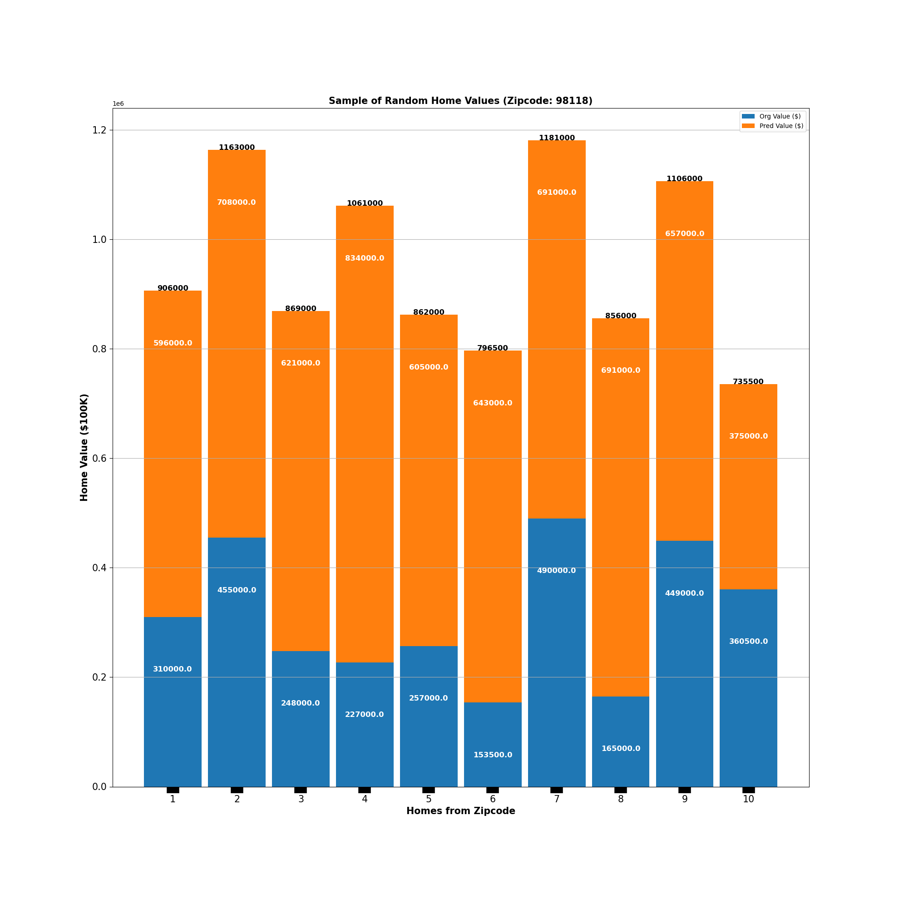
Zipcode 98118
Displaying 10 of 106 entries meeting criteria

Slide 8
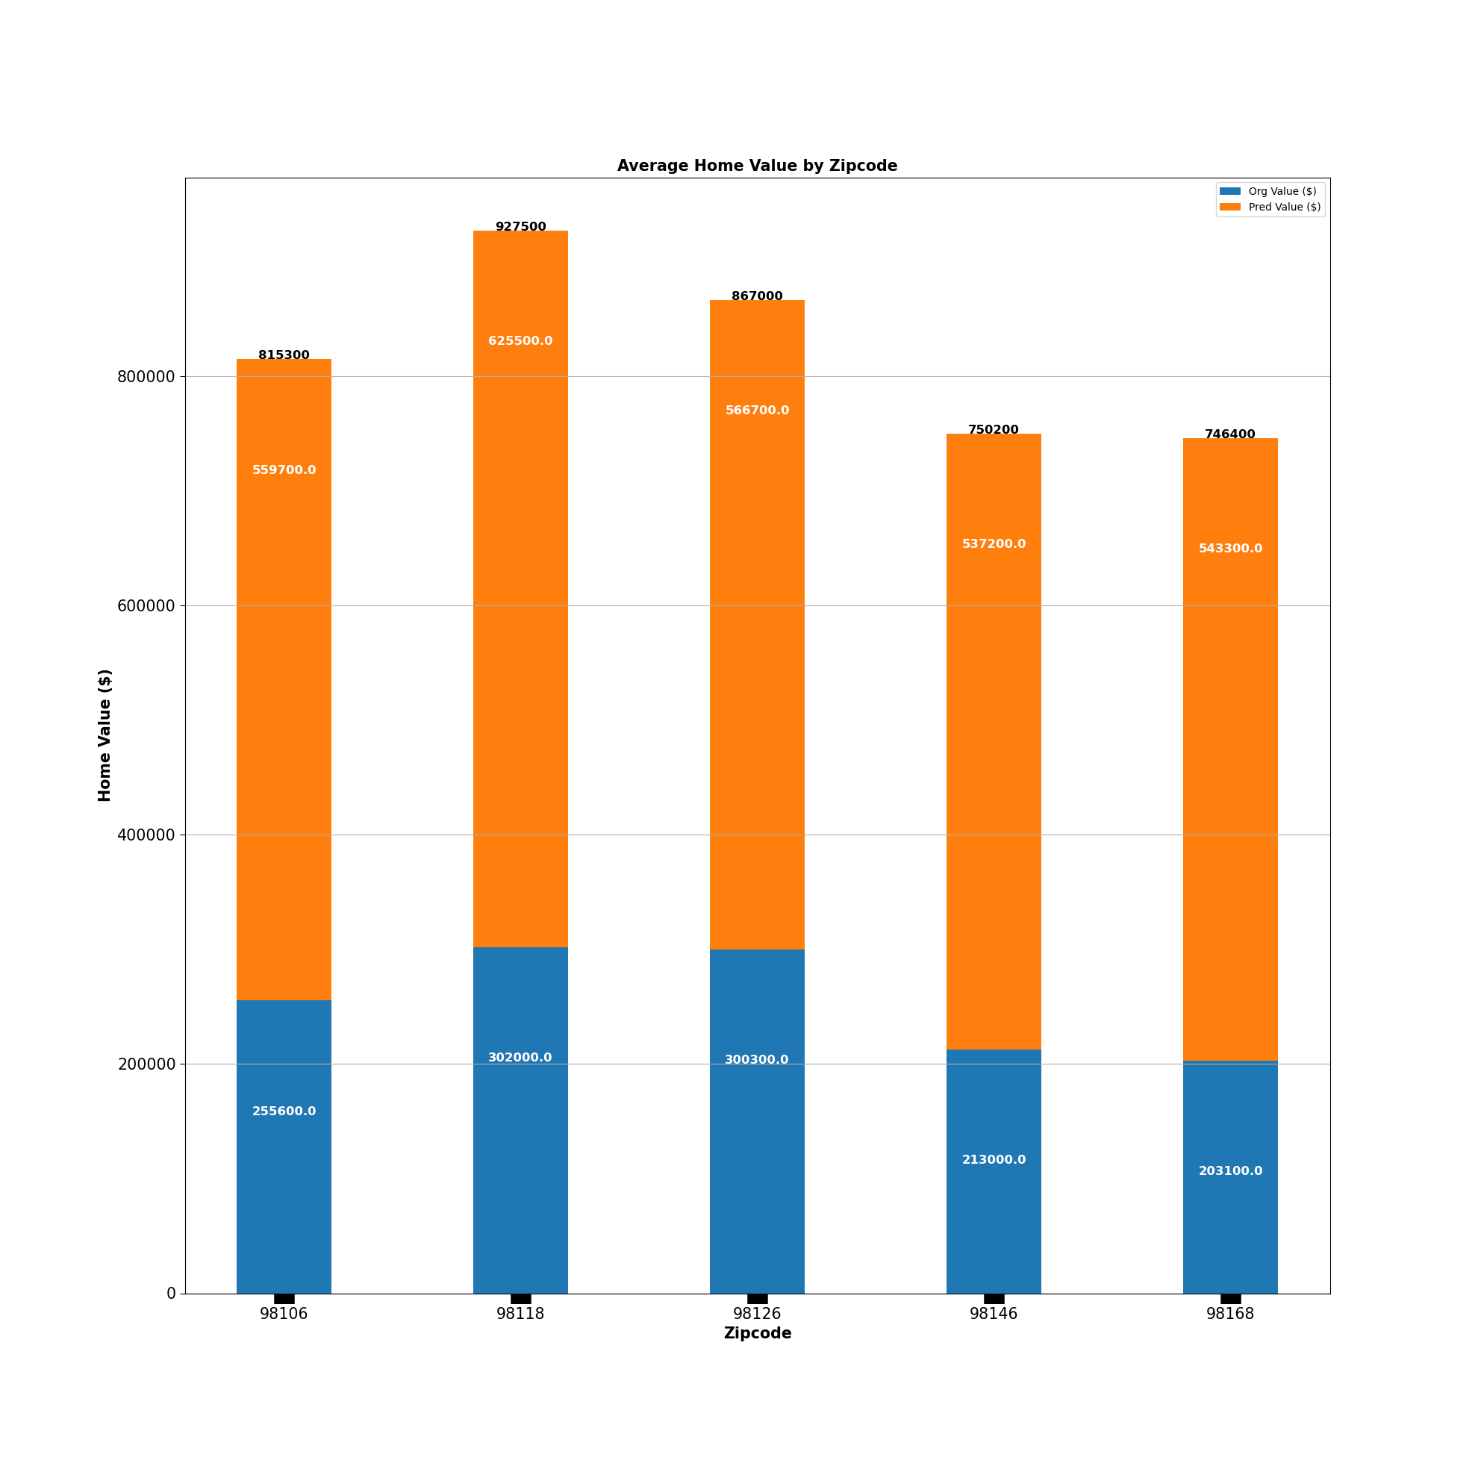
Top 5 Zipcode Averages

Slide 9
Conclusion: Limitations
Limited dataset
Unknown realistic "Condition" and "Grade" values
Unknown affects on other variables
Communal effects
Model approach fit for specific problem
Actual market culture
External effects
Time/Resources
Data scientist skillset
Notes:
**Limited dataset:**
- The full dataset was filtered and scoped due to limited resources. There were attributes (features) in the dataset that would have supported a more accurate and model.
- Dataset does not take into account aesthietics. There are no features or pictures evaluating this aspect.
- **Unknown realistic "Condition" and "Grade" values:**
- Lack of knowledge on knowing whata realistic increase in "condition" and "grade" would be from the baseline. All chosen instances in the dataset were increased to the same values. It may be unrealistic to have a home in poor condition and below minimum building stards actually increase to "good" in both.
- **Unknown affects on other variables:**
- The "condition" and "grade" feeatures wree the only ones modified from the intial dataset. Home improvements would definitely affect those features. However, home improvements done on a home might also affect features like sqft_living, floors, bathrooms or bedrooms in some way.
- **Communal effects:**
- The predictions were based on the modication of specific features for an individual home. The predicitons did not take into account how the home improvements would affect the surrounding comparible homes. This is common task done in real estate.
- **Model approach fit for specific problem:**
- The model developed was for a specific problem. Understanding how home improvement how affect home values and the amount of the difference. Other usecases and problems were not taken into account. There may be insights to game from the model and predictions that
- **Time/Resources:**
- Because of limited time and skillset a "good enough" model was delivered. The datasets, techniquesm model robustness had to be scoped.
- **Actual market culture:**
- The dataset used wasn't the most current. These last two years have had major shifts in the supply and demand of homes. Therefore a shift in the home value estimates shift as well.
- **External effects:**
- The model and predictions did not account for external effects that were not attributes of the home and its property.
- **Data scientist skillset:**
- As a new data scientist the the model robustness is limited due to experience and skills.

Slide 10
Conclusion: Recommendations & Next Steps
Choose and present incentives and vision of home improvement within a community. This incentivizes people and helps with accountability.
Choose a few zipcodes to try out and then offer feedback that would improve model accuracy or approach.
Focus on major areas with high needs to bring up. The communal effect will possibly increase prices even though the highest improvements may not have happened.
Present businesses(e.i. construction, remodeling) of the potential work to be done. Partnering with them and possibly offering discounts to the select communities would be a good incentive for communities to improve together
Market to potential homebuyers (individuals and investors) of the potential return on investment. These homebuyers may potentially buy the homes before the improvements and then fix them up.
Increase consultation with the data scientist/analyst to improve our domain knowledge. As both parties educate each other the model solution has a better chance at being more accurate and robust.
Feedback on realistic feature values after home improvement
Having examples and case studies of home improvements specifics would help give a realistic picture to all of the stakeholder supporting the predictions and work.
Notes:
**Limited dataset:**
- The full dataset was filtered and scoped due to limited resources. There were attributes (features) in the dataset that would have supported a more accurate and model.
- Dataset does not take into account aesthietics. There are no features or pictures evaluating this aspect.
- **Unknown realistic "Condition" and "Grade" values:**
- Lack of knowledge on knowing whata realistic increase in "condition" and "grade" would be from the baseline. All chosen instances in the dataset were increased to the same values. It may be unrealistic to have a home in poor condition and below minimum building stards actually increase to "good" in both.
- **Unknown affects on other variables:**
- The "condition" and "grade" feeatures wree the only ones modified from the intial dataset. Home improvements would definitely affect those features. However, home improvements done on a home might also affect features like sqft_living, floors, bathrooms or bedrooms in some way.
- **Communal effects:**
- The predictions were based on the modication of specific features for an individual home. The predicitons did not take into account how the home improvements would affect the surrounding comparible homes. This is common task done in real estate.
- **Model approach fit for specific problem:**
- The model developed was for a specific problem. Understanding how home improvement how affect home values and the amount of the difference. Other usecases and problems were not taken into account. There may be insights to game from the model and predictions that
- **Time/Resources:**
- Because of limited time and skillset a "good enough" model was delivered. The datasets, techniquesm model robustness had to be scoped.
- **Actual market culture:**
- The dataset used wasn't the most current. These last two years have had major shifts in the supply and demand of homes. Therefore a shift in the home value estimates shift as well.
- **External effects:**
- The model and predictions did not account for external effects that were not attributes of the home and its property.
- **Data scientist skillset:**
- As a new data scientist the the model robustness is limited due to experience and skills.

Slide 11
Thank You!
Email: dmvinedata@gmail.com
GitHub: @dmvinedata
LinkedIn: linkedin.com/in/deztanyjackson/

