Slide 1
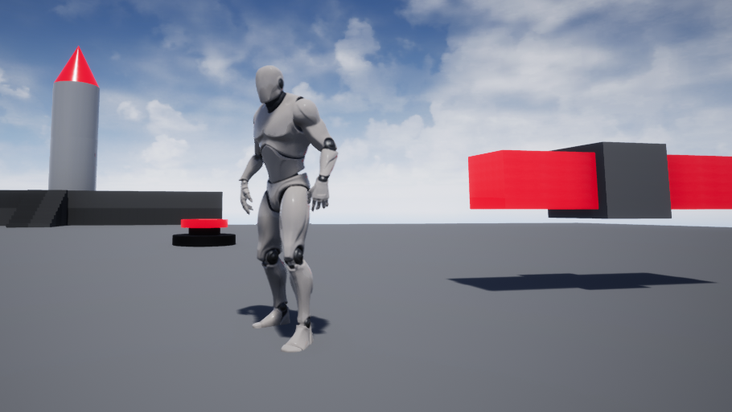
Physics Simulations in Unreal Engine 4
Dylan Whitehead

Slide 2

Unreal’s Physics Engine
Uses PhysX 3.3 as a framework
Still very much in development and frequently changing
Used in many different actors/components

Slide 3
Physics Actors and Components
Collision Detection / Computation
Physics Constraints
Physical Animation
Vehicle Physics
Material Physics

Slide 4
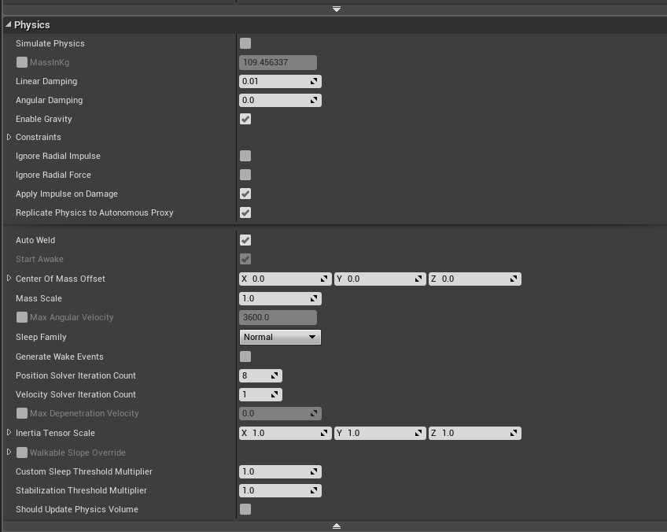
Enabling Physics in actors
Please note that enabling physics
behavior in an actor can hurt
performance speed and change how the object is lit in a scene regardless of if the actor is using any of the functionality.

Slide 5
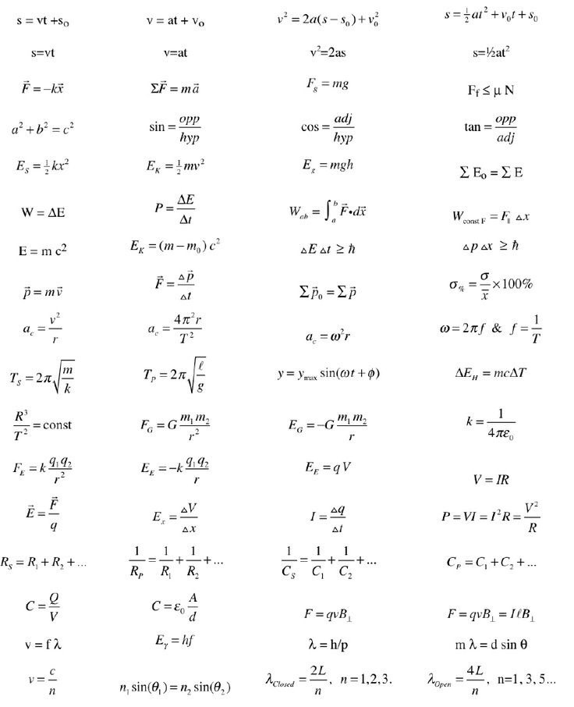
Applying force to physics-enabled actors

Slide 6
Physics Constraints
Used to “constrain” physical components/actors to act in a specific way to one another.
Think of it as a joint that you can attach to two components (usually meshes) that is also capable of generating and applying force.

Slide 7
Physical Animation Component
Allows for the implementation of dynamic animations
Still in development!

Slide 8

References
Unreal Documentation on Physics Simulations
Unreal Documentation on Physics Constraints
Video course on Physical Animation component
Video course on Physics Constraint component

