Slide 1
Lecture 2
Structures
Arrays
Methods

Slide 2
Structures
Structures
Value vs Reference types
Boking & Unboxing
Nullable Value types

Slide 3
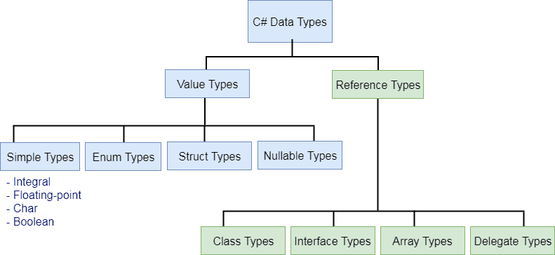
Value vs Reference types

Slide 4
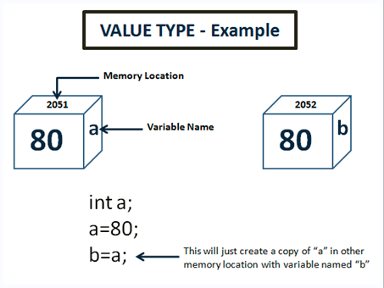
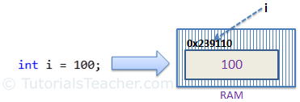
Understanding Value types
All types derived from System.ValueType
All stored in Stack
Does not support inheritence
Used only when you want small data structure
Does not take part in GC.
Does not require constructor

Slide 5
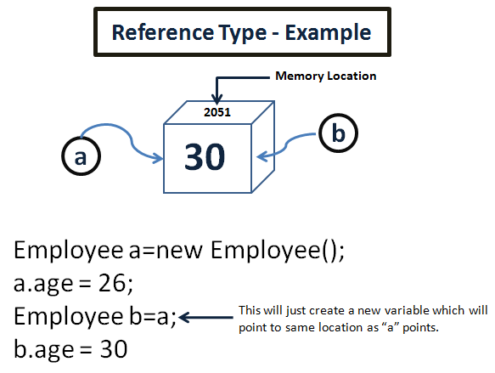
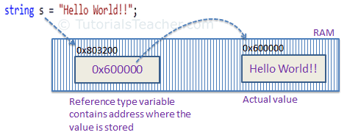
Understanding Reference types
Allocated on the managed heap.
Reference type variables are pointing to the memory occupied by the allocated instance.
Supports inheritance, is not sealed by default
Takes part in GC.
Assignment copies the reference

Slide 6
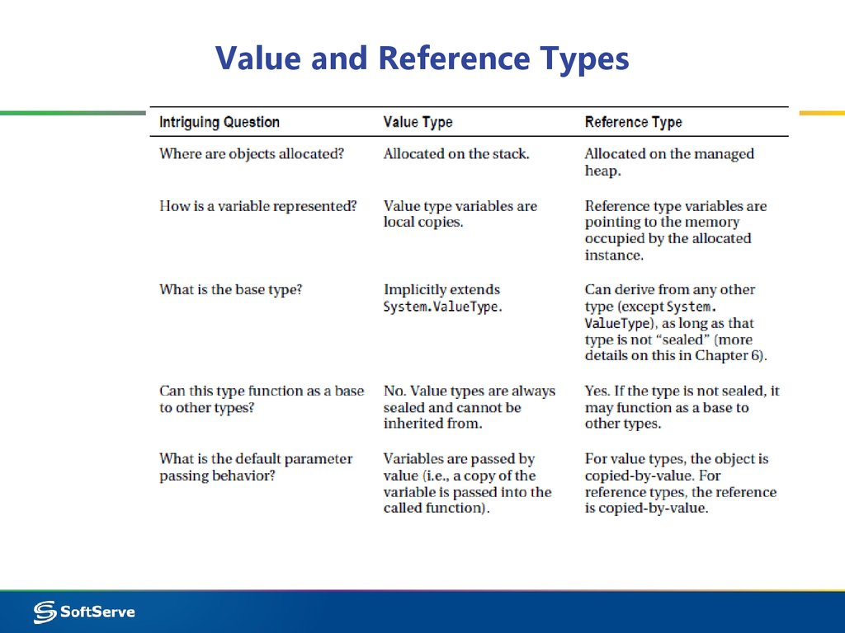
Value types vs Reference types

Slide 7
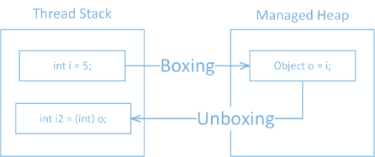
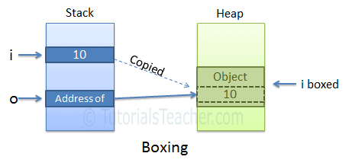
Boxing & Unboxing

Slide 8
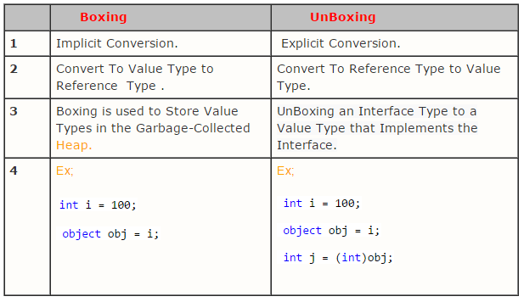
Boxing & Unboxing

Slide 9
Do not use Boxing & Unboxing
Boxed values take up more memory
Boxed values require an additional read
Boxed value stays in the heap
Boxing require allocating space in the heap and copying the value from the stack
You almost never need to do it. Mostly used in legacy code.

Slide 10
Live Demo

Slide 11
Structures
We can create our own value types using structures.
As value types they are created in Stack
Composite data type consisting of a number elements of other types
Can contain fields, methods, constants, constructors, properties, indexers and operators.
Have all the properties Value types have.

Slide 12
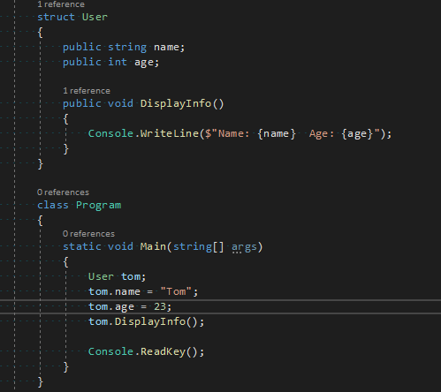
Structure declaration & instance creation

Slide 13
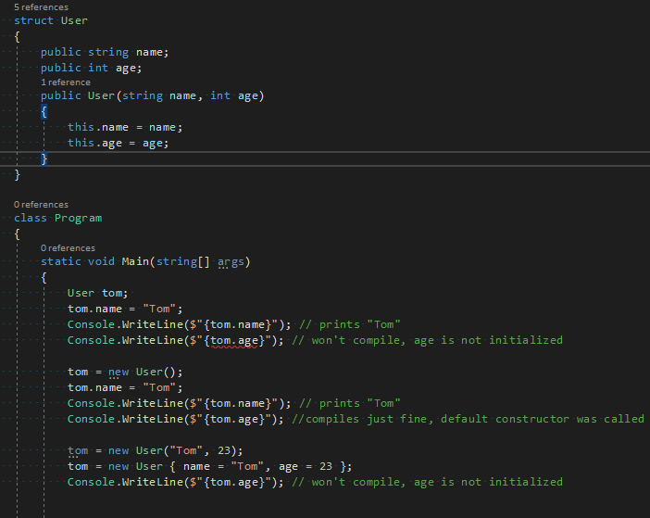
Structure Constructors
Every structure has a default constructor
You don’t have to call a constructor to create a struct
You can’t access structure members before initialization
You can create your own parameterized constructor
You can’t create your own default constructor (mb you can in c# 10)

Slide 14
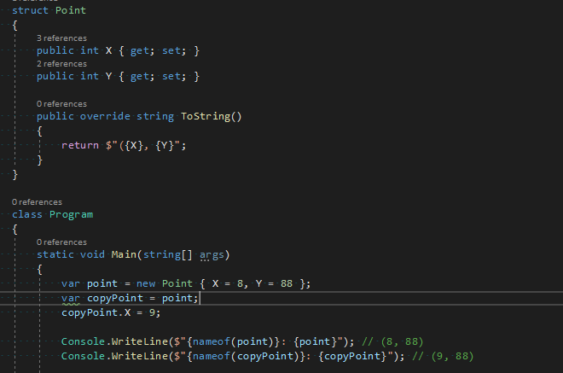
Structs copy by value example

Slide 15
Limitations of a structure type
You can’t declare a parameterless constructor. Every structure provides an implicit one which generated a default value of the type.
You can’t initialize an instance field or property at its declraration.
A custom constructor must initialize all instance fields of the type.
A structure can’t inherit form other class or structures and can’t be a base of a class. However, a structure type can implement interfaces.

Slide 16
Nullable types
null – default value for all reference types. Which indicates that there is no value(not initialized state), no memory allocated in the heap.
For Value types “nullable” types are used to specify not initialized state.
Example: `bool? test` will have `null` as default value, not `false`.
All Value types which can have “null” as a value are `Nullable<T>` value type. `int?` – is shorthand to create `Nullable<int>` instance.

Slide 17
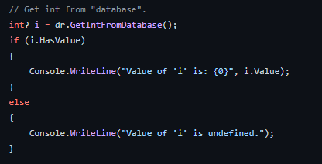
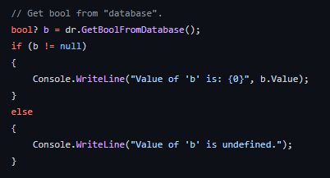
Nullable types in use

Slide 18
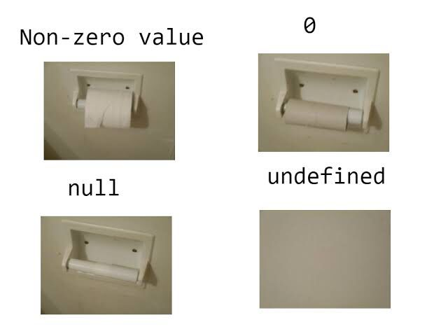
Concept of nullable in programming.

Slide 19

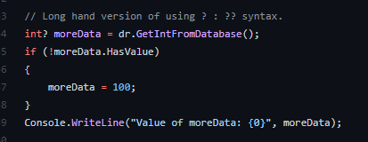
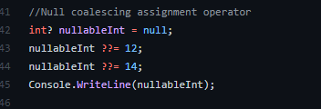
Null coalescing operator

Slide 20
Live demo

Slide 21
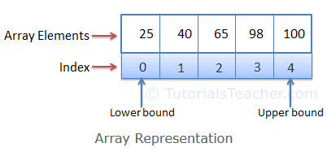
Arrays
Array is the data structure that stores a fixed number of literal values (elements) of the same data type.
Array elements are stored contiguously in the memory.
There are three types of arrays in c#: single-dimensional, multidimensional, and jagged array.

Slide 22
Array declaration and initialization
int[] nums = new int[3] { 8, 88, 888 }; // integer array
string[] cities = new string[2] { "Lviv", "Uzhgorod" }; // string array
// using var
var nums1 = new int[3] { 8, 88, 888 };
var cities1 = new string[2] { "Lviv", "Uzhgorod" };
// implicit declaration
int[] nums2 = { 8, 88, 888 };
string[] cities2 = { "Lviv", "Uzhgorod" };

Slide 23
Accessing Array Elements
int[] numbers = new int[5];
numbers[0] = 8;
numbers[3] = 88;
numbers[9] = 888; // throws IndexOutOfRangeException
Console.WriteLine(numbers[3]); // 88;
Console.WriteLine(numbers[4]); // ???

Slide 24
Accessing Array Elements using for/foreach
int[] numbers = { 8, 88, 888 };
for (var i = 0; i < numbers.Length; ++i)
numbers[i] += 10;
for (var i = 0; i < numbers.Length; i++)
Console.WriteLine(numbers[i]);
foreach (var i in numbers)
Console.WriteLine(i);
foreach (var i in numbers)
i = i + 10; // you can’t change the iterating variable

Slide 25
Array Methods
int[] nums = new int[5] { 10, 15, 16, 8, 6 };
Array.IndexOf(nums, 8); // returns index of element, if can’t find -1 is returned
Array.Sort(nums); // sorts array
Array.Reverse(nums); // reverses array elements
Array.ForEach(nums, n => Console.WriteLine(n)); // iterates array
Array.BinarySearch(nums, 6);// binary search, if can’t find -1 is returned

Slide 26
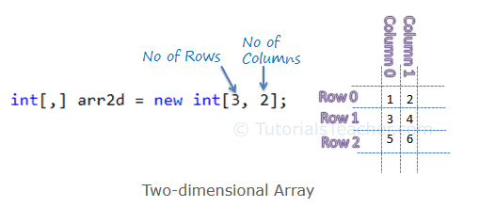
Multidimensional Arrays
int[,] arr2d; // two-dimensional array
int[,,] arr3d; // three-dimensional array
int[,,,] arr4d; // four-dimensional array

Slide 27
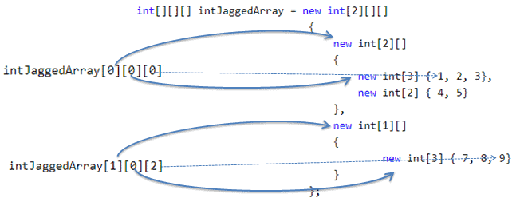
Jagged Arrays
int[][] jArray1 = new int[2][]; // can include two single-dimensional arrays
int[][,] jArray2 = new int[3][,]; // can include three two-dimensional arrays
int[][] jArray = new int[2][];
jArray[0] = new int[3] { 1, 2, 3 };
jArray[1] = new int[4] { 4, 5, 6, 7 };

Slide 28
Live Demo

Slide 29
Methods
Structure overview
Method parameter modifiers
Optional parameters
Named arguments
Methods overloading

Slide 30
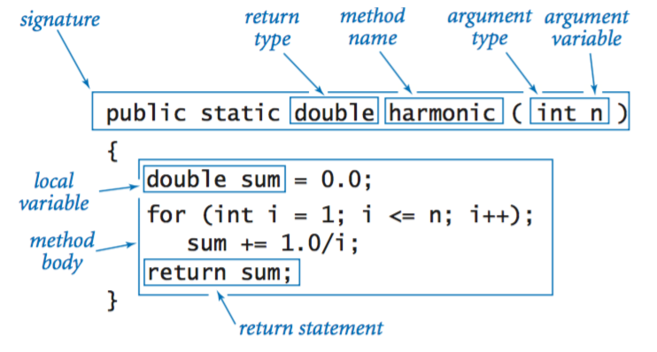
Method structure

Slide 31
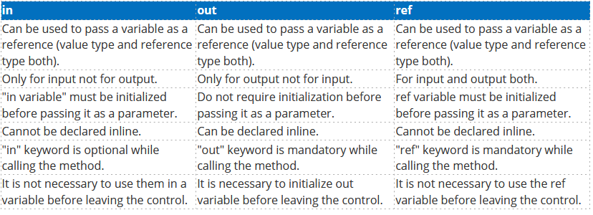
Parameter modifiers

Slide 32
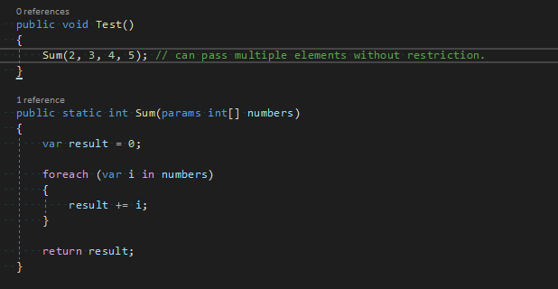
Params parameter modifier

Slide 33
Optional parameters
You can use optional parameters in Methods, Constructors, Indexers, and Delegates.
Each and every optional parameter contains a default value which is the part of its definition.
If we do not pass any parameter to the optional arguments, then it takes its default value.
The default value of an optional parameter is a constant expression.
The optional parameters are always defined at the end of the parameter list. Or in other words, the last parameter of the method, constructor, etc. is the optional parameter.

Slide 34
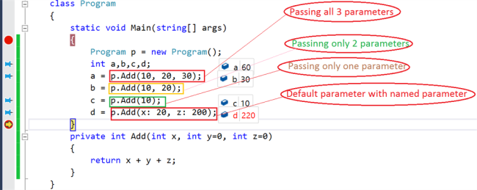
Named arguments
Main idea: pass arguments in any order you like.
Example:

Slide 35
Method overloading
Provides functionality to reuse method name for different arguments
Occurs within a single class may also occur in child class
Must have different argument list
May have different return types
May have different access modifiers

Slide 36
Live Demo

Slide 37
Questions?

