Slide 1
Lecture 3
Classes
OOP in C#

Slide 2
Classes
most fundamental construct
defined using class keyword
defining a class means defining a blueprint for a data type
can contain constructors, fields, methods, properties
is a reference type
instantiated with a new keyword
can have a base class unlike structures
default value of class instance is null

Slide 3
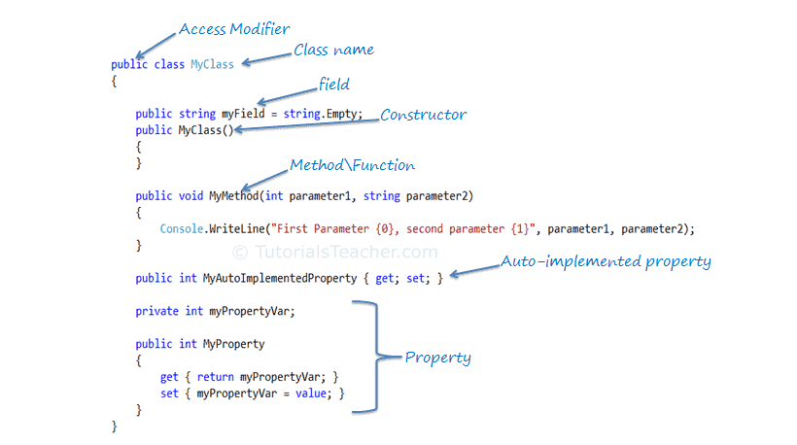
Class example
Notes:
SimpleClassExample

Slide 4
Constructors
Special type of method invoked when new instance of an object is created
Used to initialize the fields of the instance
Constructors have the same name as the class
Have not return type
Like methods can be private, protected, internal
Default constructor can be overridden unlike in structs
Can have parameters
Class can have any number of constructors

Slide 5
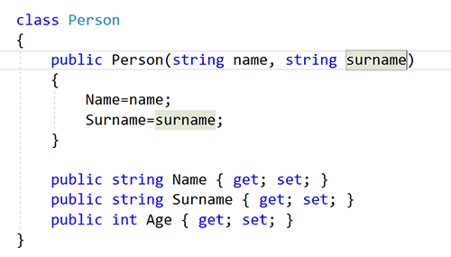
Constructors

Slide 6
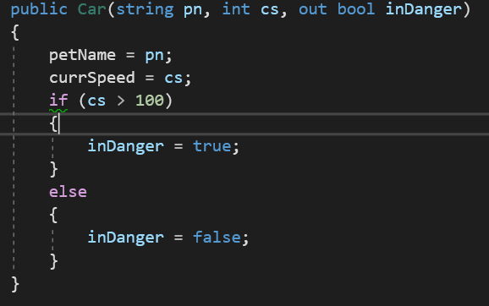
Constructors since C# 7.3
expression bodied
with out parameter

Slide 7
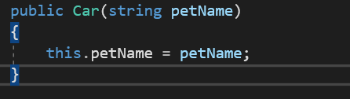
What is this?
this keyword provides access to the current class instance
is used to resolve ambiguity
using this for accessing instance members increases readability
can be used only in non-static methods
can be used in extension methods

Slide 8
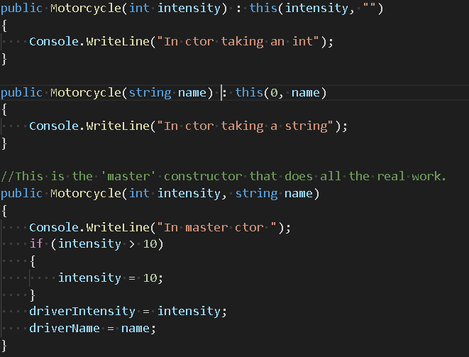
Constructor chaining
Notes:
What is the output???

Slide 9
Static
static implies that only one instance of the member exists for a class
static can be: field, property, method, constructor, class
static members can be retrieved by invoking the class without creating an instance of it
static methods can access only static variables of a class
there could be only one static constructor (parameterless and without access modifier)
Notes:
StaticDataAndMembers example !!!

Slide 10
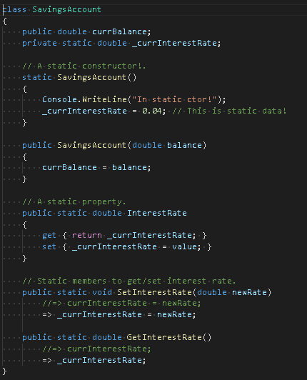
Static

Slide 11
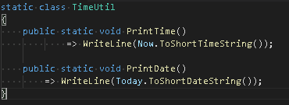
Static class
not creatable using new keyword
can contain only static members
mostly used for utils

Slide 12
Static test
How many static properties can class have?
Is it possible to derive from static class?

Slide 13
Pillars of OOP
OOP is a computer programming model that organizes software design around data, or objects, rather than functions and logic.
Object oriented language employ 3 core principles:
Encapsulation
Inheritance
Polymorphism

Slide 14
Building block in OOP
Classes are user-defined data types that act as the blueprint for individual objects, attributes and methods
Objects are instances of a class created with specifically defined data. Objects can correspond to real-world objects or an abstract entity. When class is defined initially, the description is the only object that is defined
Methods are functions that are defined inside a class that describe the behaviors of an object. Each method contained in class definitions starts with a reference to an instance object. Additionally, the subroutines contained in an object are called instance methods. Programmers use methods for reusability or keeping functionality encapsulated inside one object at a time
Attributes are defined in the class template and represent the state of an object. Objects will have data stored in the attributes field. Class attributes belong to the class itself.

Slide 15
Encapsulation
states that all important information is contained inside an object and only selected information is exposed
object data should not be directly accessible from an object instance
other object are only able to call a list of public functions or methods

Slide 16
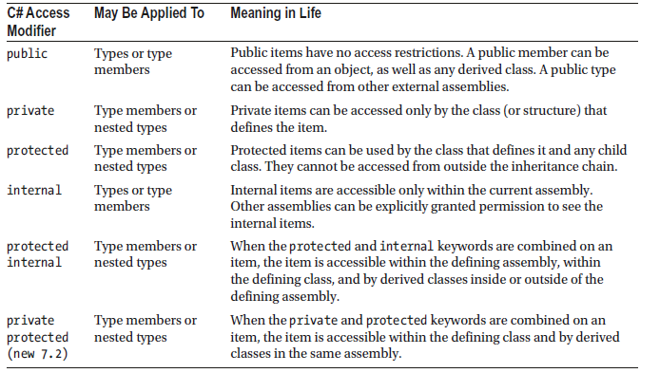
Access modifiers
define the accessibility of the class and its members
by default, members are private and types internal
nested types can be private

Slide 17
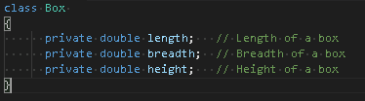
Field
class-level variable that holds a value
generally, field members should have a private access modifier and used with property

Slide 18
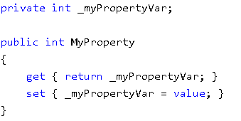
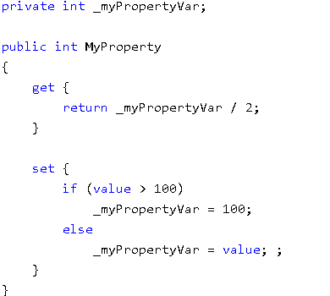
Properties
encapsulates a private field
controls how the data is manipulated

Slide 19
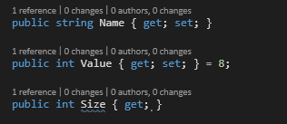
Auto properties
used when there is no manipulation with backing field
backing field will be created automatically by the compiler
Notes:
Read only property;
Property with default value;

Slide 20

Object initialization syntax
possibility to initialize the value or the fields or properties of a class at the time of creating an object:
with call of constructor
without call of constructor
Notes:
ObjectInitializerExample !!!

Slide 21
Immutable data
can be achieved with use of const or readonly
const
implicitly static
should be initialized on declaration
must be compile-time constant
can be a local variable
readonly
can be initialized on declaration or in constructor
helpful when value is unknown until runtime
Notes:
CONST EXAMPLES !!!

Slide 22
Test
What is difference between static readonly and const?

Slide 23
Inheritance
one class can include the feature of another class by using the concept of inheritance
idea of inheritance implements the IS-A relationship

Slide 24
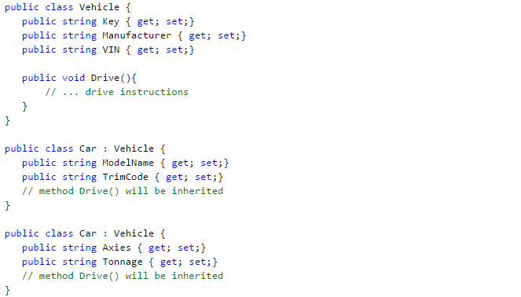
How to use inheritance
Notes:
BasicInheritance example !!!

Slide 25
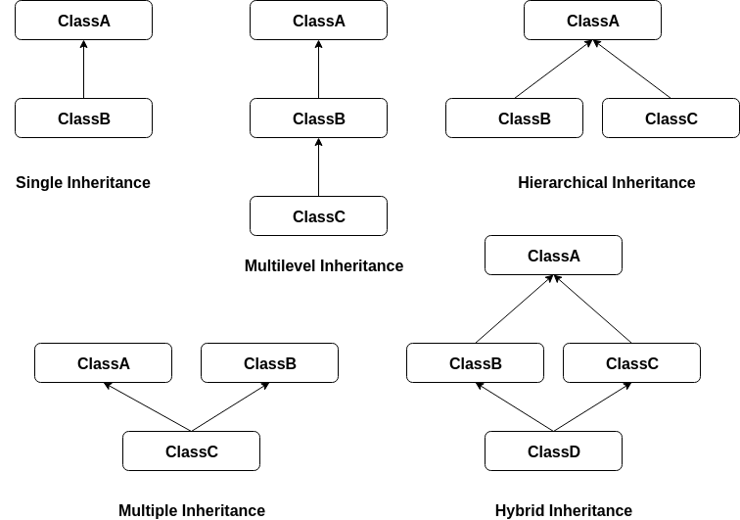
Types of inheritance
single inheritance
multilevel inheritance
hierarchical inheritance
multiple inheritance(not supported)
hybrid inheritance(not supported)

Slide 26
Inheritance in C#
Every class is implicitly subclass of Object class
Base call can only be one
Constructors are not inherited, but can be invoked
Subclass does not inherit private members
Subclass can be passed in any place where base class is expected

Slide 27
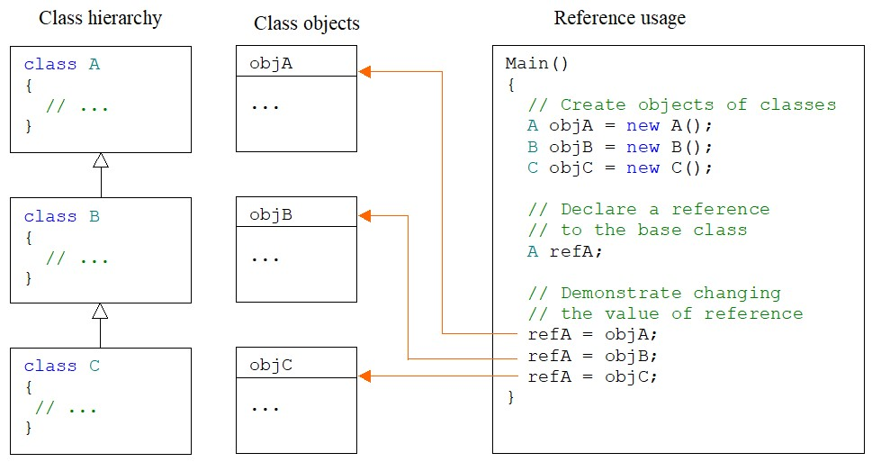
Understanding object reference

Slide 28
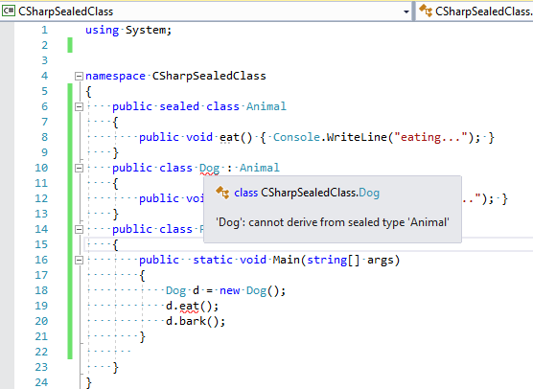
Sealed
prevents occurring of inheritance
structures are implicitly sealed
typically used when creating a framework

Slide 29
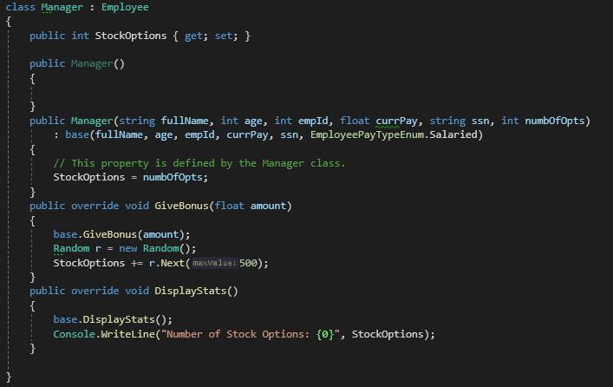
What is base?
base keyword is used to access parent class members within derived class

Slide 30
Polymorphism
means having many forms
expressed as 'one interface, multiple functions'

Slide 31
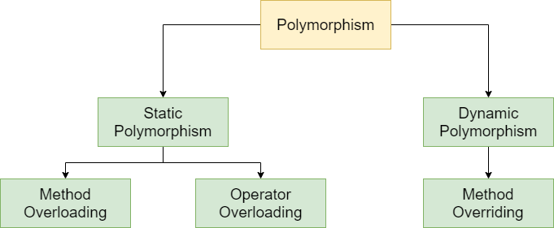
Types of polymorphism

Slide 32
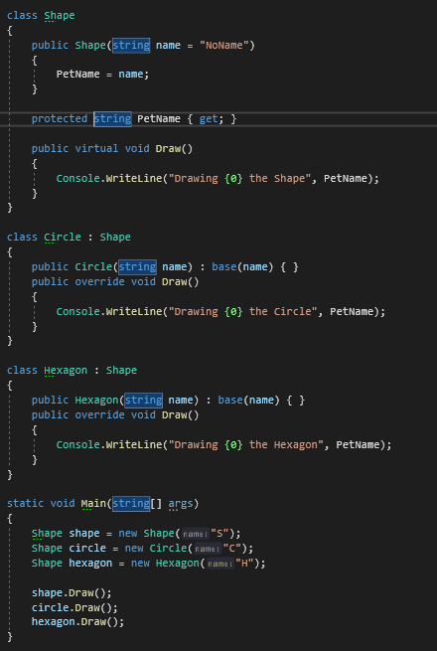
How to use dynamic polymorphism
implemented using virtual or abstract and override keyword

Slide 33
Live Demo

Slide 34
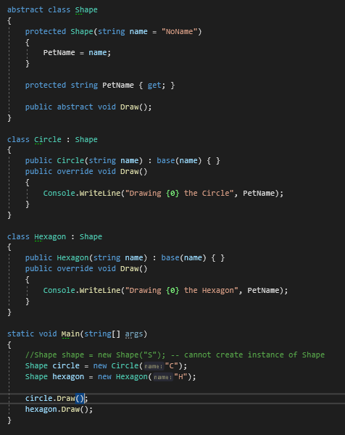
Abstract class

Slide 35
Abstract class
declared with the help of abstract keyword
used to declare common members
it’s not allowed to create objects of the abstract class
it’s not allowed to declare the abstract methods outside the abstract class
all abstract methods should be overridden in derived class
Notes:
OOP Example !!!

Slide 36
Abstract vs virtual
abstract
no implementation body
must be overridden using override
virtual
has implementation body
can be overridden using override

Slide 37
Test
Can abstract class be sealed?

Slide 38
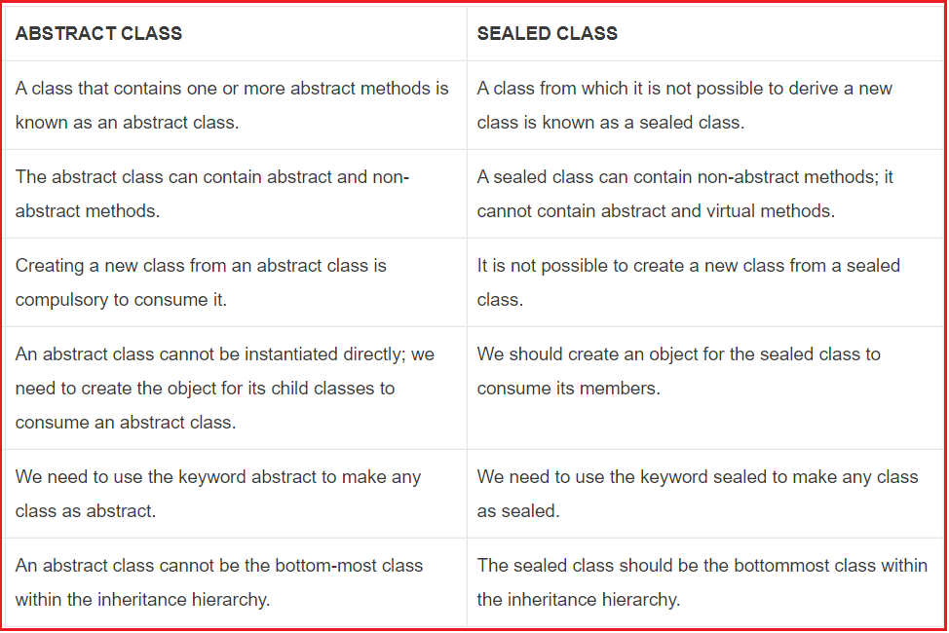
Abstract vs sealed

Slide 39
Base/derived class casting
it’s safe to store derived object with a base class reference
implicit cast
assigning derived object to a reference of base class
passing derived object as argument instead of base class
explicit cast
using explicit conversion operator
using as keyword

